Slide 1
Safely Supporting Probabilistic Data: PL Techniques as Part of the Story Dan Grossman University of Washington

Slide 2
Executive summary
Language design+implementation to help wrangle uncertainty
PL concepts+tools are a huge help
But also need to learn from statisticians
Validate these claims with UW’s approximate computing work
Acknowledgments: 9 co-authors [papers at end]
Especially Adrian Sampson, Luis Ceze
Including Kathryn and Todd

Slide 3
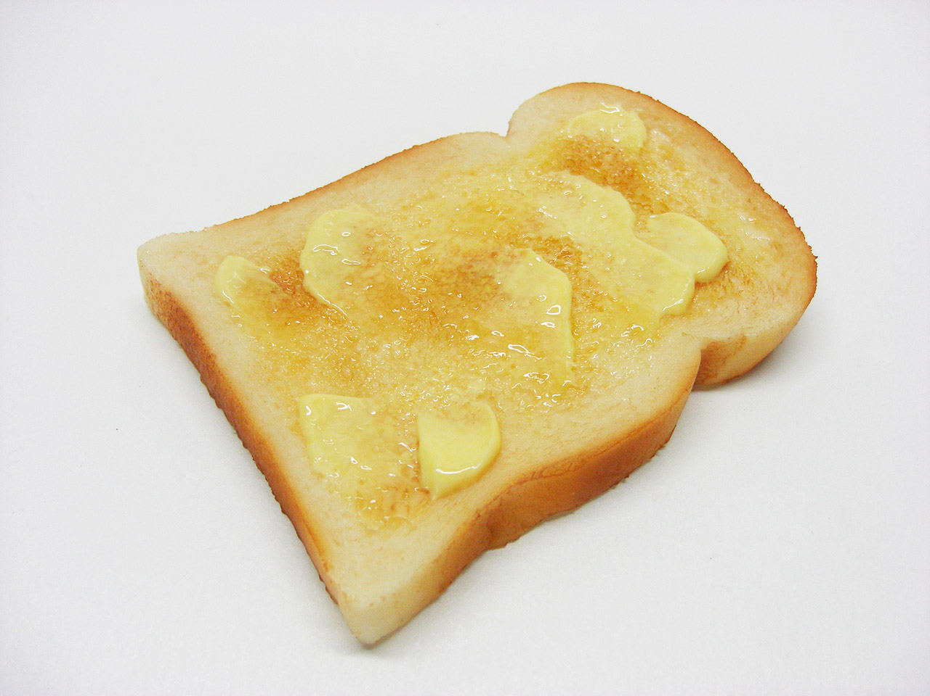
Background (1/2): PL bread-and-butter
Types for information flow
int<H> x;
int<L> y;
if(x)
y = 7;
Symbolic execution
z:
z = x;
if(x!=0)
z = x*y;
? :
✗
==
*
0
x
0
x
y
Type inference
let f = λ y. y+7
let z = f 9
let q = z && true
Function inlining/specialization
int f(int x, int y){
return x*y;
}
f(0,a) 0
f(3,b) f(3,b)
f(1,c) c
✗

Slide 4
Background (2/2): Approximation
Full bit-precision is unnecessary and wastes energy
Allowing probabilistic [in]correctness can work!
Let ALUs and memory produce garbage with low-nonzero probability
But most code/programmers want nothing to do with that…

Slide 5
EnerJ (and EnerC) a la 2011
Information flow is exactly the right high-level abstraction
Type qualifier for @approx
Explicit endorse as needed
Convenient:
Opt-in with precise default
Overloaded operations and methods
Strong guarantee: Approximate data has
no effect on precise data except via
endorse (classic non-interference theorem)
@approx int x = 12;
int y = 27;
y = x*2;
x = y*3;
@approx int z = f(x);
if(looks_okay(z))
int w = endorse(z);
…
✗

Slide 6
EnerJ limitations
Only “best effort” semantics for approximate computation
Encapsulated all the probability, and then ignored it!
No approximate control-flow (without endorse)
Stronger limitation to ensure non-interference, no crashes, no extra non-termination, …

Slide 7
Adding probabilities (2015)
Address limitation #1 directly:
@approx<p> int: static guarantee that at run-time value will be correct with at least probability p
Operator uses (e.g., +) also have correctness probability
EnerJ’s @approx is @approx<0.0>
Precise is @approx<1.0>
Natural subtyping: @approx<p> t <: @approx<q> t if p >= q
[See also Mike’s Rely and Chisel work (2014)]

Slide 8
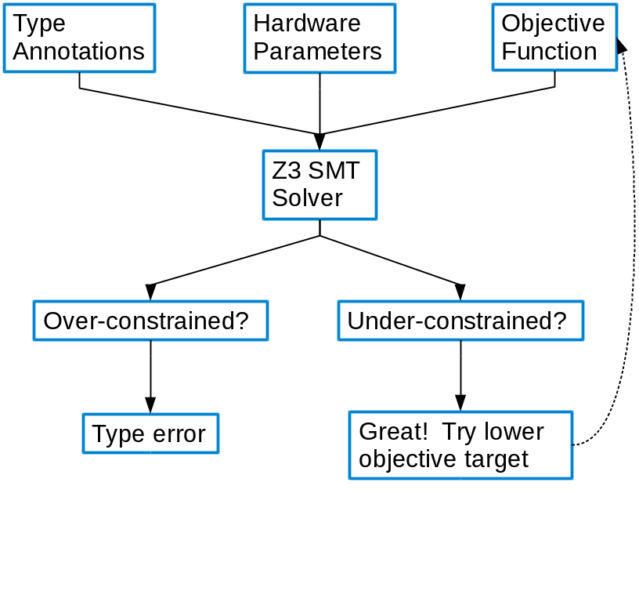
Essential additions
Type inference, part 1:
Programmer states probabilities at key points (inputs, outputs)
Automatic solver fills in the rest, and/or programmer can provide more annotations
Type inference, part 2:
Problem often under-constrained; goal is to save as much energy as possible within constraints
We use Microsoft’s Z3 solver with a custom objective function

Slide 9
Essential additions
Type inference, part 1:
Programmer states probabilities at key points (inputs, outputs)
Automatic solver fills in the rest, and/or programmer can provide more annotations
Type inference, part 2:
Problem often under-constrained; goal is to save as much energy as possible within constraints
We use Microsoft’s Z3 solver with a custom objective function
Method specialization
Up to k approximation settings for each method
Opt-in dynamic tracking for loop-carried dependencies

Slide 10
Still not much statistics
Additions are all “PL bread-and-butter”
Uses only one trivial statistical fact:
Result type is precise if x, y, (and addition) are independent
Result type is sound regardless of [in]dependence
Other panelists all make much better use of statistics, like in our probabilistic assertions work…
@approx<p1> int x = …;
@approx<p2> int y = …;
x +_{<p3>} y // @approx<p1*p2*p3>

Slide 11
Probabilistic assertions (2014)
Much richer setting:
Inputs/values can have arbitrary distributions, not just “Bernouilli failure”
Dependence tracked via symbolic execution, even through if-statements and some loops
Evaluate arbitrary probabilistic assertions:
passert(e,p,c)
Key insight:
Data-structure produced by symbolic execution is an “expression DAG” and a “Bayesian network”
So apply compiler and statistical optimizations to it
Followed by hypothesis testing

Slide 12
The limitation
EnerJ and follow-on work gave static guarantees regardless of input
Probabilistic assertions either revalidates for each input (testing) or needs probabilistic assumptions (distributions) of inputs
Need more research on:
Bridging this gap
Supporting unbounded loops by soundly trimming low-probability paths

Slide 13
The big context
“Early days”
Excited by the panel’s work, but many open questions…
Technical questions: (loops, modularity, scale, …)
Tools questions, also with some preliminary work
Debugging, profiling, monitoring
Error messages
Is “adding statistical properties” to modern language design The True Way Forward or a local optimum to avoid?

Slide 14
To learn more
EnerJ: Approximate Data Types for Safe and General Low-Power Computation. Adrian Sampson, Werner Dietl, Emily Fortuna, Danushen Gnanapragasam, Luis Ceze, Dan Grossman. PLDI2011
Expressing and Verifying Probabilistic Assertions. Adrian Sampson, Pavel Panchekha, Todd Mytkowicz, Kathryn S. McKinley, Dan Grossman, Luis Ceze. PLDI2014
Probability Type Inference for Flexible Approximate Programming. Brett Boston, Adrian Sampson, Dan Grossman, Luis Ceze. OOPSLA 2015

