Slide 1
Disciplined Approximate Computing: From Language to Hardware and Beyond
Adrian Sampson, Hadi Esmaelizadeh,¹ Michael Ringenburg, Reneé St. Amant,² Luis Ceze, Dan Grossman, Mark Oskin, Karin Strauss,³ and Doug Burger ³
University of Washington
¹ Now at Georgia Tech
² UT-Austin
³ Microsoft Research

Slide 2
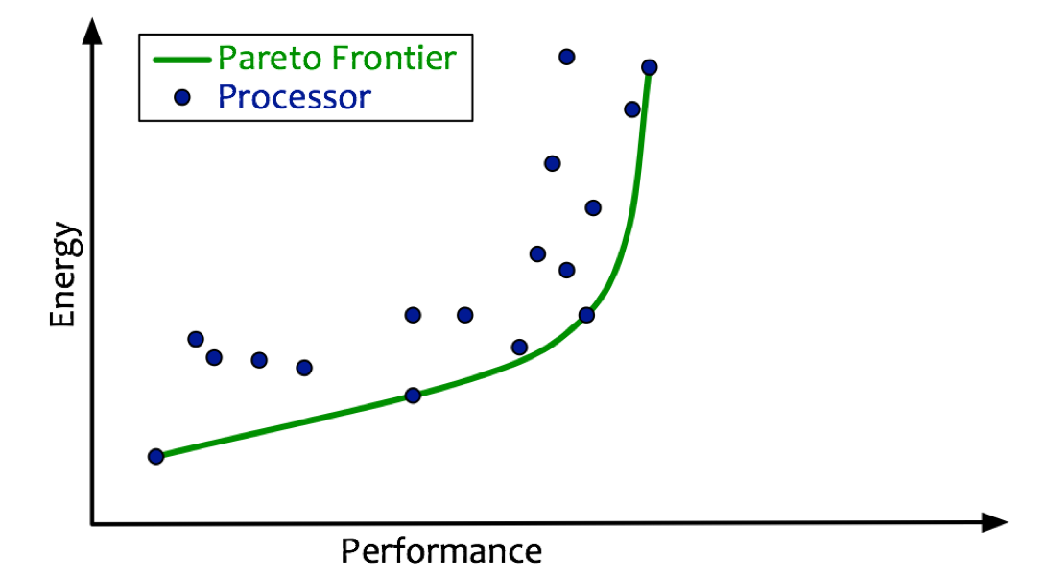
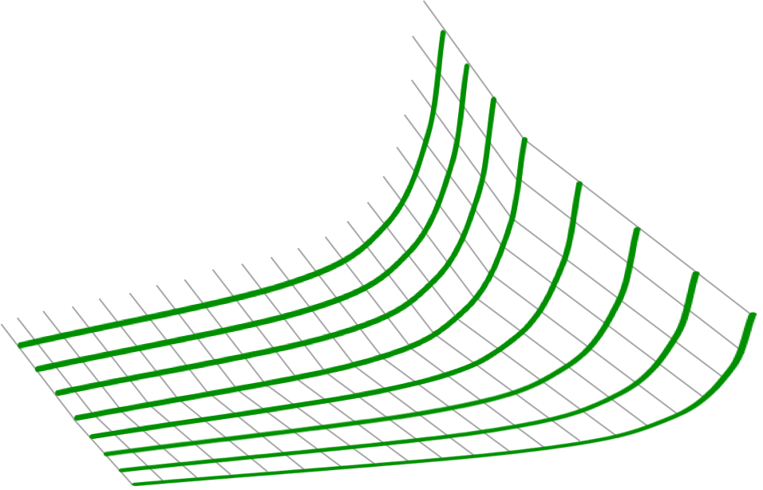
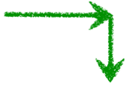
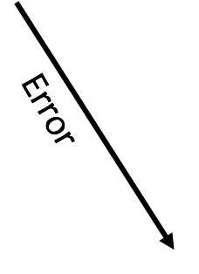
Approximation with HW eyes...

Slide 3
Approximation with SW eyes...
Approximation is yet another complexity
Most of a code base can’t handle it
But many expensive kernels are naturally error-tolerant
Multiple “good enough” results

Slide 4
Must work across the stack…
User
Application
Algorithm
Language
Compiler
Architecture
Circuits
Devices
From above: Where approximation acceptable
From below: More savings for less effort
Working at one level is inherently limiting

Slide 5
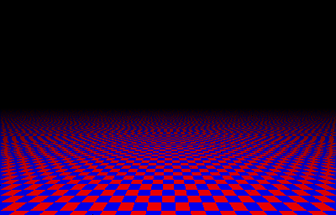
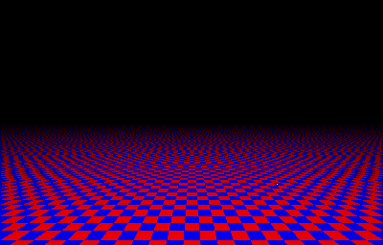
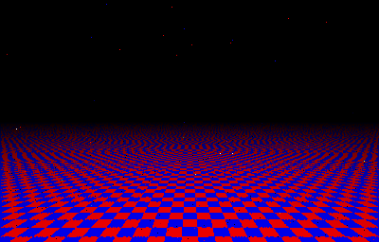
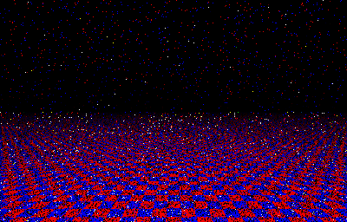

Slide 6
Errors
Energy
Errors
Energy
Errors
Energy
Errors
Energy
Notes:
Which one would you choose?

Slide 7
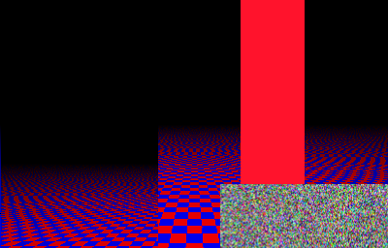
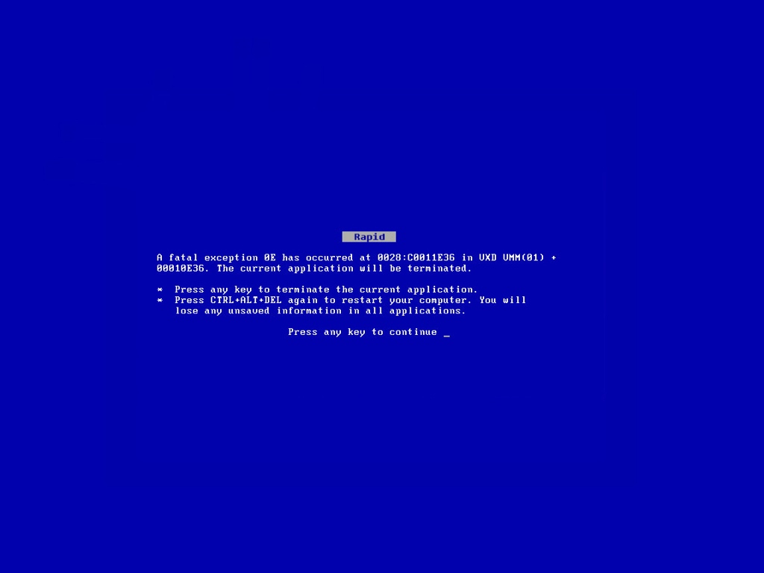
Notes:
JPEG HEADER: The hardware doesn’t know which bits are important and which are unimportant!
Without a good way to separate these things, this is a programmability nightmare.

Slide 8
Across the stack
Higher level knows pixel buffer vs. header bits and control flow
Lower level knows how to save energy for approximate pixel buffer
We are working on:
Expressing and monitoring disciplined approximation
Exploiting approximation in architectures and devices
Much, much more…

Slide 9
Plan for today
Application
language for where-to-approximate
EnerJ
Monitoring
dynamic quality evaluation
Compiler
neural
networks
as accelerators
Architecture
traditional
architecture
Truffle
NPU
Circuits
Approximate
Storage
Approximate
Wi-Fi
give high-level results
mention in passing

Slide 10
Application
language for where-to-approximate
EnerJ
EnerJ: Approximate Data Types for Safe and
General Low-Power Computation, PLDI 2011

Slide 11
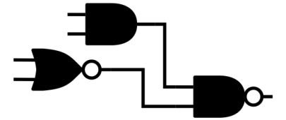
Safety
✓
✗
Statically separate critical and non-critical program components
Precise
Approximate
Generality
Various approximation strategies encapsulated
Disciplined Approximate Programming
Storage
Logic
Algorithms
Comunication
λ

Slide 12
Type qualifiers
@approx
int a = ...;
@precise
int p = ...;
✗
p = a;
✓
a = p;
Notes:
Precise-by-default: Java backward compatibility (every Java program is an EnerJ program; every EnerJ program is a Java program when the qualifiers are ignored)
***SEMANTICS***
Precise = normal, strong guarantees
Approx = no guarantees; pathological is legal, but expectation of best effort

Slide 13
Control flow: implicit flows
@approx
int a = ...;
@precise
int p = ...;
✗
if (
p = 2;
}
) {
a == 10
Notes:
This is information flow, so what about implicit flows? Lots of sophisticated ways to deal with them, but for our purposes something simple suffices: disallow approximate conditionals.
THE RESULT OF THIS EQUALITY : @APPROX BOOL

Slide 14
Endorsement: escape hatch
@approx
int a = expensive();
@precise
int p;
✓
p =
endorse(a);
quickChecksum(p);
output(p);
Notes:
Escape hatch. Terminology comes from info flow for security.
A common pattern: big approx computation followed by precise reduction/output.
**Explicit CONVERSION** (not “ignoring”)

Slide 15
Algorithmic approximation with Polymorphism
class FloatSet {
float mean() {
calculate mean
}
@context
float[] nums = ...;
Also in the PLDI’11 paper:
Formal semantics
Noninterference claim
Object-layout issues
Simulation results
…
@approx float mean_APPROX() {
calculate mean of half
}
}
@approx FloatSet someSet = ...;
someSet.mean();
Notes:
ALGORITHMIC APPROXIMATION as proposed in GREEN

Slide 16
Application
language for where-to-approximate
EnerJ
Monitoring
dynamic quality evaluation
[under submission]

Slide 17
Controlling approximation
EnerJ: approximate cannot interfere with precise
But semantically, approximate results are unspecified “best effort”
“Worst effort” of “skip; return 0” is “correct”
Only higher levels can measure quality: inherently app-specific
Lower levels can make monitoring convenient

Slide 18
Quality of Result (QoR) monitoring
Offline: Profile, auto-tune
Pluggable energy model
Online: Can react – recompute or decrease approximation-level
Handle situations not seen during testing
But needs to be cheap!
First design space of online monitors
Identify several common patterns
And apps where they work well

Slide 19
Online monitoring approaches
General Strawman: Rerun computations precisely; compare. More energy than no approximation.
Sampling: Rerun some computations precisely; compare.
Verification Functions: Run a cheap check after every computation (e.g., within expected bounds, solves equation, etc.)
Fuzzy Memoization: Record past inputs and outputs of computations. Check that “similar” inputs produce “similar” outputs.

Slide 20
Results
[See paper for energy model, benchmarks, etc.]
Application | Monitor Type
Ray Tracer | Sampling
Asteroids | Verifier
Triangle ∩ | Verifier
Sobel | Fuzzy Memo
FFT | Fuzzy Memo

Slide 21
Results
[See paper for energy model, benchmarks, etc.]
Application | Monitor Type | Precise | Approx No Monitor
Ray Tracer | Sampling | 100% | 67%
Asteroids | Verifier | 100% | 91%
Triangle ∩ | Verifier | 100% | 83%
Sobel | Fuzzy Memo | 100% | 86%
FFT | Fuzzy Memo | 100% | 73%

Slide 22
Results
[See paper for energy model, benchmarks, etc.]
Application | Monitor Type | Precise | Approx No Monitor | Approx Monitor | Retained Savings
Ray Tracer | Sampling | 100% | 67% | 85% | 44%
Asteroids | Verifier | 100% | 91% | 95% | 56%
Triangle ∩ | Verifier | 100% | 83% | 87% | 78%
Sobel | Fuzzy Memo | 100% | 86% | 93% | 49%
FFT | Fuzzy Memo | 100% | 73% | 82% | 70%

Slide 23
Application
language for where-to-approximate
EnerJ
Monitoring
dynamic quality evaluation
Compiler
traditional
architecture
Truffle
Architecture Support for Disciplined
Approximate Programming, ASPLOS 2012

Slide 24
Hardware support for disciplined approximate execution
Compiler
Truffle
Core
VDDH
int p = 5;
@approx int a = 7;
for (int x = 0..) {
a += func(2);
@approx int z;
z = p * 2;
p += 4;
}
a /= 9;
func2(p);
a += func(2);
@approx int y;
z = p * 22 + z;
p += 10;
VDDL

Slide 25
Approximation-aware ISA
ld 0x04 r1
ld 0x08 r2
add r1 r2 r3
st 0x0c r3

Slide 26
Approximation-aware ISA
ld 0x04 r1
ld 0x08 r2
add.a r1 r2 r3
st.a 0x0c r3
operations
storage
registers
ALU
caches
main memory

Slide 27
Approximate semantics
add.a r1 r2 r3:
some value
writes the sum of r1 and r2 to r3
Informally: r3 gets something approximating r1 + r2
Still guarantee:
No other register modified
No floating point trap raised
Program counter doesn’t jump
No missiles launched
…
Actual error pattern depends on approximation technique, microarchitecture, voltage, process, variation, …
Notes:
**FROM ENERJ: APPROXIMATE SEMANTICS ARE USEFUL**
ABSTRACTS the approximations performed by uarch
**TUNE VOLTAGE TO WORK FOR EACH APPLICATION**

Slide 28
Dual-voltage pipeline
replicated functional units
Fetch
Decode
Reg Read
Execute
Memory
Write Back
Branch Predictor
Integer FU
Data Cache
Register File
Register File
Instruction Cache
Decoder
FP FU
ITLB
DTLB
dual-voltage SRAM arrays
7–24% energy saved on average
(fft, game engines, raytracing, QR code readers, etc)
(scope: processor + memory)

Slide 29
Diminishing returns on data
Fetch
Decode
Reg Read
Execute
Memory
Write Back
Branch Predictor
Integer FU
Data Cache
Register File
Register File
Instruction Cache
Decoder
FP FU
ITLB
DTLB
Instruction control cannot be approximated
Can we eliminate instruction bookkeeping?

Slide 30
Application
language for where-to-approximate
EnerJ
Monitoring
dynamic quality evaluation
Compiler
neural
networks
as accelerators
Architecture
traditional
architecture
Truffle
NPU
Neural Acceleration for General-Purpose
Approximate Programs, MICRO 2012

Slide 31
Using Neural Networks as Approximate Accelerators
Very efficient hardware implementations!
Trainable to mimic many computations!
CPU
Recall is imprecise.
Fault tolerant
[Temam, ISCA 2012]
Map entire regions of code to an (approximate) accelerator:
Get rid of instruction processing (von Neumann bottleneck)
Notes:
hardware neural networks have been around for a long time -- approximate computing is a way we can use them in ordinary programs

Slide 32
Neural acceleration
Program
Notes:
HERE IS THE NEW CONTRIBUTION

Slide 33
Neural acceleration
Find an approximable
program component
Program

Slide 34
Neural acceleration
Find an approximable
program component
Compile the program
and train a neural network
Program
Notes:
THIS IS THE KEY: an algorithmic transformation
In the compilation step, we LEARN FROM THE IMPLEMENTATION provided by the programmer
the function can be COMPLEX, lots of CONTROL FLOW

Slide 35
Neural acceleration
Find an approximable
program component
Compile the program
and train a neural network
Program
Execute on a fast Neural Processing Unit (NPU)

Slide 36
Example: Sobel filter
@approx float grad(approx float[3][3] p) {
…
}
@approx float dst[][];
edgeDetection()
void edgeDetection(aImage &src,
aImage &dst) {
for (int y = …) {
for (int x = …) {
dst[x][y] = grad(window(src, x, y));
}
}
}
Notes:
good target: approximate outputs, well defined inputs

Slide 37
Code region criteria
√
small errors do not corrupt output
Approximable
Well-defined inputs and outputs
√
no side effects
Notes:
wouldn’t work on the whole edgeDetection() function because inputs & outputs are large & unbounded

Slide 38
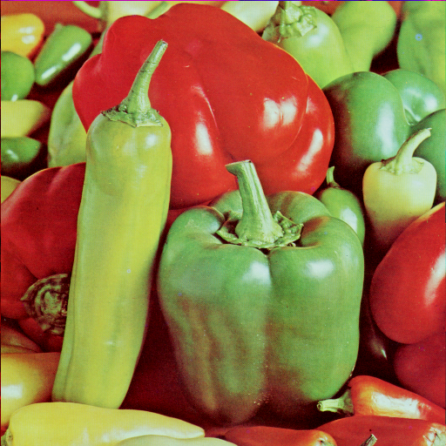
Code observation
record(p);
record(result);
p
grad(p)
[[NPU]]
float grad(float[3][3] p) {
…
}
void edgeDetection(Image &src,
Image &dst) {
for (int y = …) {
for (int x = …) {
dst[x][y] =
grad(window(src, x, y));
}
}
}
323, 231, 122, 93, 321, 49
➝
53.2
49, 423, 293, 293, 23, 2
➝
94.2
34, 129, 493, 49, 31, 11
➝
1.2
21, 85, 47, 62, 21, 577
+
=>
➝
64.2
7, 55, 28, 96, 552, 921
➝
18.1
5, 129, 493, 49, 31, 11
➝
92.2
49, 423, 293, 293, 23, 2
➝
6.5
34, 129, 72, 49, 5, 2
➝
120
323, 231, 122, 93, 321, 49
➝
53.2
6, 423, 293, 293, 23, 2
➝
49.7
test cases
instrumented program
sample
arguments & outputs
Notes:
one test input -> lots of data

Slide 39
Training
Training Inputs
Backpropagation
Training
Notes:
different shapes and sizes

Slide 40
Training
Training Inputs
Training Inputs
Training Inputs
70%
98%
99%
faster
less robust
slower
more accurate
Notes:
the smallest NN that meets an accuracy criterion
Different,code,regions,require,different, neural,networks
➙

Slide 41
Neural Processing Unit (NPU)
NPU
Core
Notes:
a neural network tightly coupled with the core -- more like a functional unit than a discrete GPU

Slide 42
Software interface: ISA extensions
input
enq.d
NPU
Core
output
deq.d
configuration
enq.c
deq.c
Notes:
deq.d: ONLY ISSUES when data is available

Slide 43
A digital NPU
scheduling
Bus
Scheduler
Processing Engines
input
output
Notes:
each processing engine represents one or more of the neurons in the NN topology
can implement many different sizes

Slide 44
A digital NPU
scheduling
multiply-add unit
Bus
Scheduler
input
neuron
weights
output
accumulator
Processing Engines
sigmoid LUT
Many other implementations
FPGAs
Analog
Hybrid HW/SW
SW only?
...
input
output
Notes:
each processing engine represents one or more of the neurons in the NN topology
can implement many different sizes

Slide 45
How does the NN look in practice?
88 static
instructions
18
neurons
edge detection
56% of dynamic
instructions
1,079
static x86-64
instructions
60 neurons
2 hidden layers
triangle intersection
97% of dynamic
instructions
Notes:
jmeint: 32 function calls, 23 IFs
sobel: 3 calls, 2 loops, 1 IF
LOGAL NEURAL TOPOLOGIES mapped on the PEs of the NPU

Slide 46
Results Summary
2.3x average speedup
Ranges from 0.8x to 11.1x
Also in the MICRO paper:
3.0x average energy reduction
All benchmarks benefit
Sensitivity to communication latency
Sensitivity to NN evaluation efficiency
Sensitivity to PE count
Benchmark statistics
All-software NN slowdown
Quality loss below 10% in all cases
As always, quality metrics application-specific
Notes:
Ranged from 11.1x (inverse kinematics) to 20% slowdown for kmeans
These results incorporate the communication & recall latency

Slide 47
Ongoing effort
Disciplined Approximate Programming
(EnerJ, EnerC,...)
Approximate Compiler
Approximate Wireless Networks and Storage
X86, ARM
off-the-shelf
Truffle:
dual-Vdd uArch
Approximate Accelerators
Approximate compiler (no special HW)
Analog components
Storage via PCM
Wireless communication
Approximate HDL

Slide 48
Conclusion
Goal: approximate computing across the system
Key: Co-design programming model with approximation techniques: disciplined approximate programming
Early results encouraging
Approximate computing can potentially save our bacon in a post-Dennard era and be in the survival kit for dark silicon

Slide 49
Disciplined Approximate Computing: From Language to Hardware and Beyond
University of Washington
Adrian Sampson, Hadi Esmaelizadeh, Michael Ringenburg, Reneé St. Amant, Luis Ceze, Dan Grossman, Mark Oskin, Karin Strauss, and Doug Burger
Thanks!
Notes:
hadi will be on the job market

