Slide 1
Building a MOOC: Some Practical Tidbits from a Do-It-Yourselfer Dan Grossman J. Ray Bowen Professor for Innovation in Engineering Education Department of Computer Science & Engineering University of Washington March 3, 2015

Slide 2
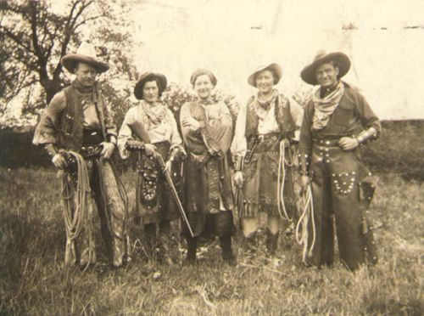
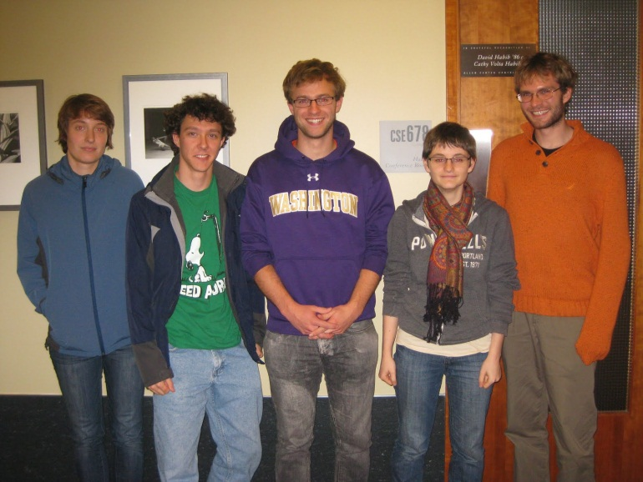
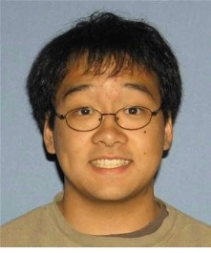
Context
Initially taught my MOOC Jan-Mar 2013
Reoffered Fall 2013, Fall 2014
Also helped 8 other faculty teach 4 other MOOCs
Done without videographers, instructional designers, or much $

Slide 3
My MOOC goals
Impact: textbook + social + direct-to-learners
“The real thing” – my challenging on-campus non-introductory course
Do-it-yourself-with-TAs fits well with these goals

Slide 4
This panel
Forget the long-term higher-ed philosophizing for an hour ☺
Tidbits that might save time or increase success

Slide 5
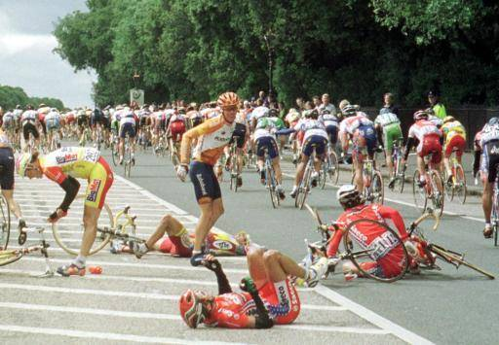
First-offering prime directive: Avoid disaster

Slide 6
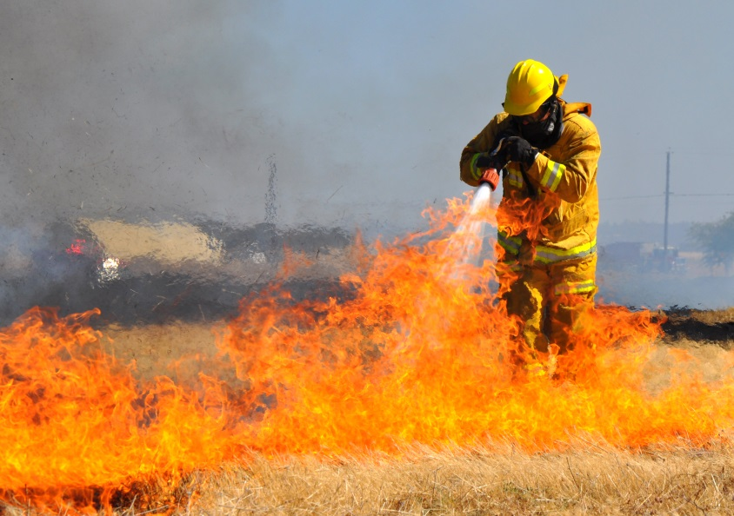
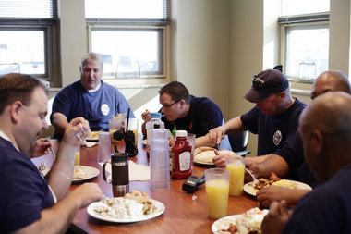
Repeat offerings: fight fires, polish apples

Slide 7
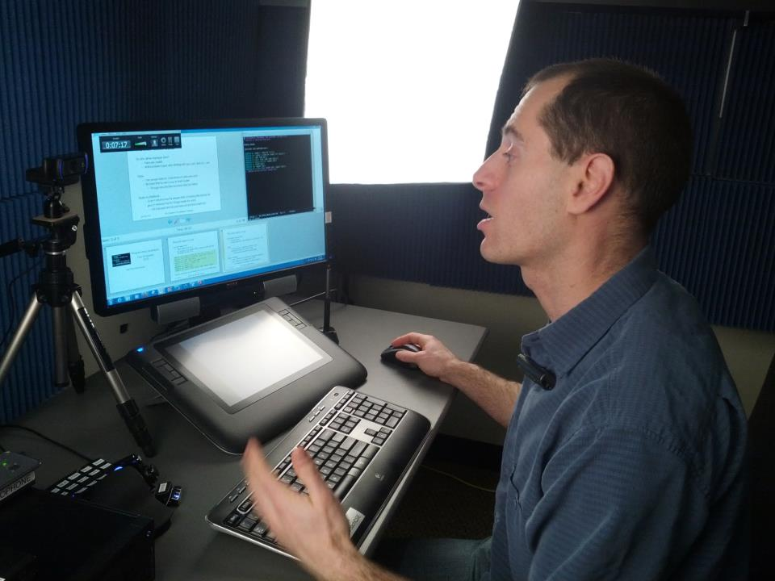
Tips on Videos

Slide 8
Keep it Simple
Show your passion
Don’t skip steps
Just teach with decent audio and video
You’re not going to compete with Hollywood, so don’t try!

Slide 9
Always do a mic-and-camera check
Videos take immense time and effort
I remember the one I had to redo because microphone was muted

Slide 10
Take A Full Breath At Beginning And End
Beginning: The “3-2-1-go” made me nervous
End: Don’t be talking while reaching for the stop button
Takes 30 seconds to edit out
Audio track shows where you start/end

Slide 11
If you screw up mid-take…
Deep breath, start “that idea” over
Pretty easy to edit, one “head jump” won’t matter
Or leave it in and explain: learners see you think
Or start over: It happens to everyone

Slide 12
When you find a mistake later…
I’m not perfect, but I am a perfectionist
But I have not dubbed or reshot a single video
Instead I edit the video
Either imperceptibly or with an “orange box”
Takes me ~10 minutes per edit

Slide 14
Tips on messaging
Keep it short and simple
Avoid slang, jargon, sarcasm, …
Less text means less proofreading
Treasure conciseness to disincentivize skimming
Keep it reusable
Avoid offering-specific details in the middle of announcements
Or keep a complete list
Beware timezones (“tomorrow” vs. “in about 24 hours”) …

Slide 15
Tips on scheduling
Regular, predictable schedule
Mine: Release Thursday, due Monday 10 days out
4 days of overlap falls on everybody’s weekend
Timezones are tricky (!)
What day is midnight on? Make deadlines 1 minute past
Daylight savings in the middle of the course, at different times on different continents, …

Slide 16
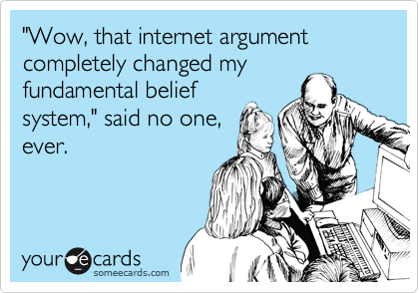
Tips on discussion forum
help forum
First 10 days: Avoid panic/disillusionment; be patient
“Instructor replied” is a reward most students will never get, so choose thoughtfully
If you do respond to complaints, be insanely polite even if you don’t want to
My #1 rule for CTAs too!
Short can come across as
dismissive. Exception:
“Thanks; fixed” for finding
errors in materials

Slide 17
A trick
I’ve never done this, but I had a TA do it well…
If you respond anonymously,
you can pretend to be a learner

Slide 18
Misc
Many learners won’t read basic course information ☹
So make a boring video and indicate “if you read everything, you can skip this”
You can have fun and reward learners in ways that work globally

Slide 19
Coda
Most stressful, fun, rewarding project of my professional career
Proud of our “old-school, do-it-yourself” approach
I made it up as I went along
You can [help others] do it too
Maybe something I said will help

