Slide 1
The CS Undergrad Curriculum of 2017: My Biased View from Academia
Dan Grossman
Paul G. Allen School of Computer Science & Engineering
University of Washington
April 21, 2017

Slide 2
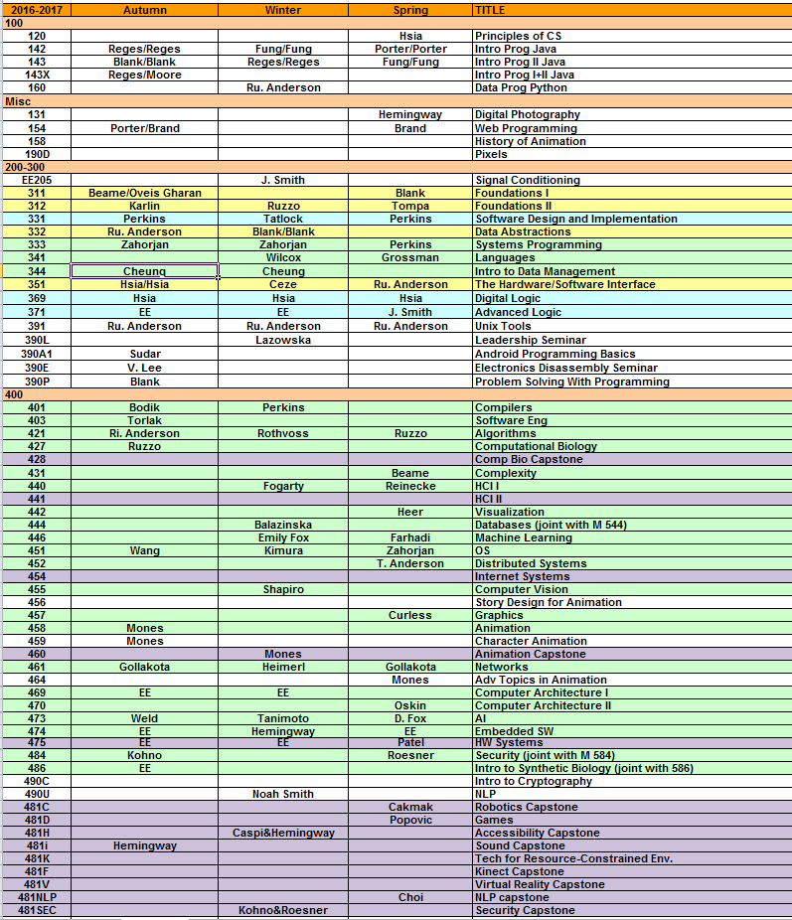
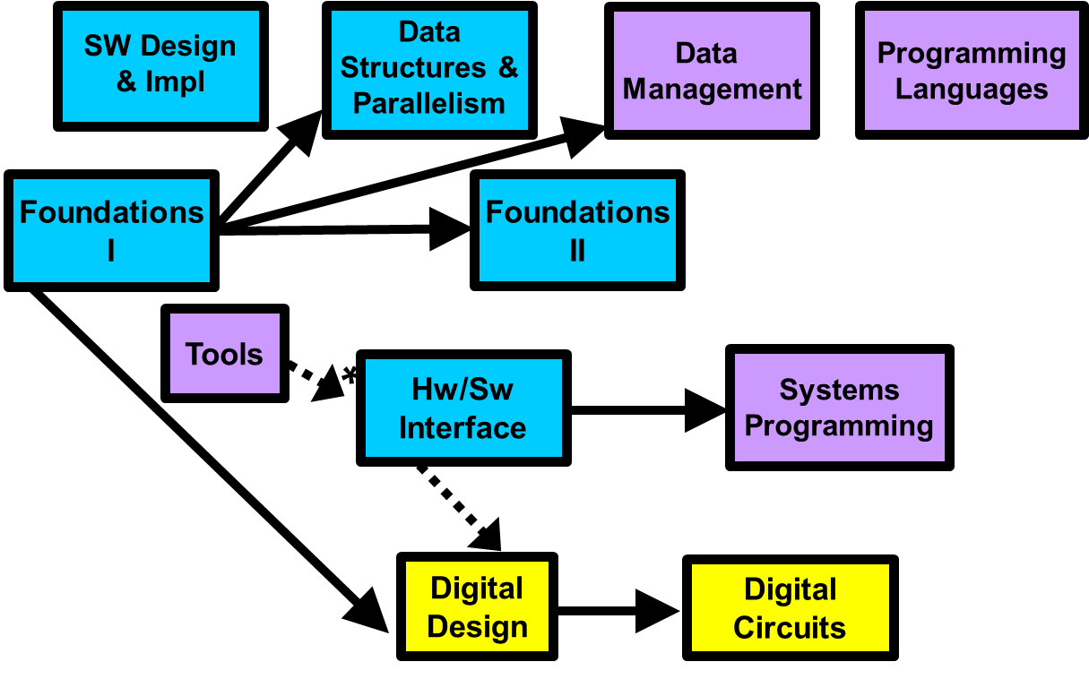
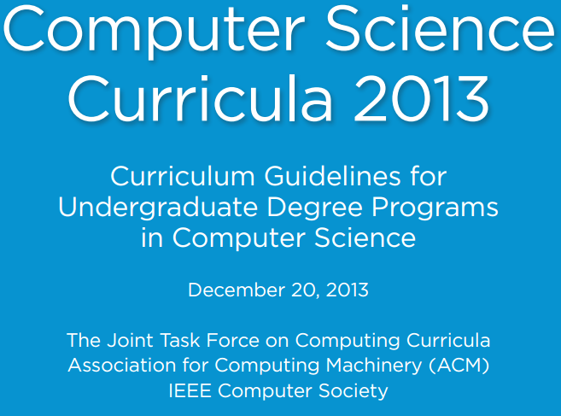
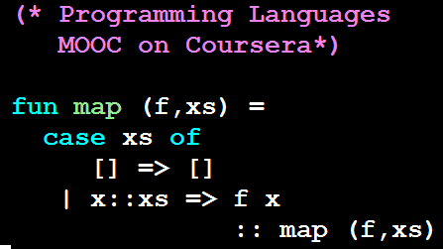
Who is this guy?
λx.x
2003-2050[?]
Notes:
UW faculty since 2003
Led undergrad curriculum revision 2009
ACM / IEEE-CS guidelines 2010-2013
MOOCs 2013 – present
Associate Chair for Eduction 2015 – present
Alumni relations, etc., etc.

Slide 3
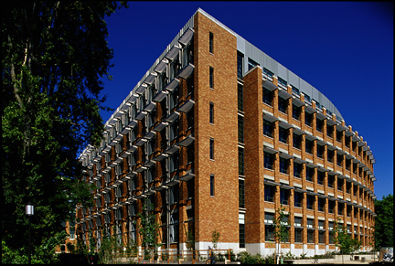
Simplified Model
Notes:
A snapshot of what CS education looks like in 2017
* Yes, we are booming [and turning away great students]
* Our students are succeeding
* Focus here on what we teach and what we don’t
-> and what’s different from 10, 20, years ago

Slide 4
Why you should care
You will hire these folks [now or later]
Recalibrate your pet peeves about undergrad CS
See how much undergrad CS has/hasn’t changed
Get global view from the “Switzerland” of the Seattle tech scene

Slide 5
Challenge 1 of 3
CS != SE

Slide 6
Some Justifications
Internships
Future-proofing / learning-how-to-learn
Antivocationalism / industry-is-broad
x
The best way to hire someone with 3-5 years of industry experience is to…
… look for people with 3-5 years of industry experience
David Notkin
1955-2013

Slide 7
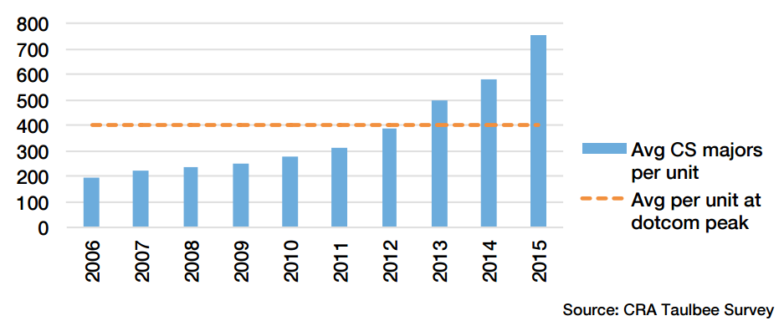
Challenge 2 of 3: Enrollment Boom

Slide 8
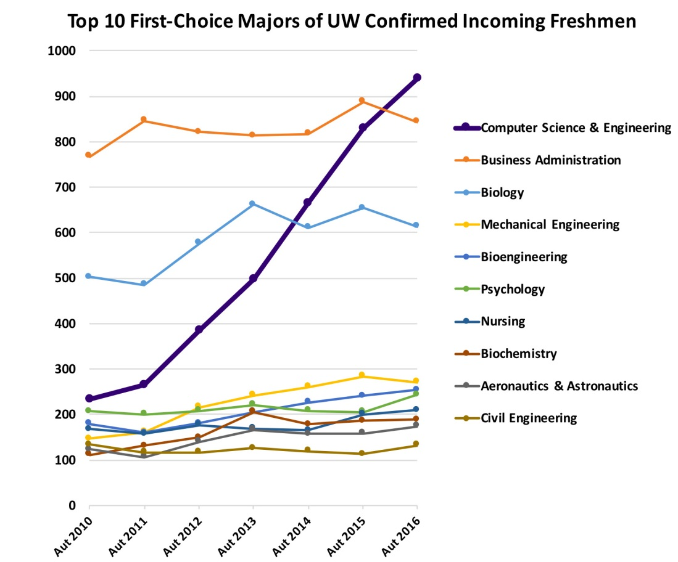
The Local News
Credit: Ed Lazowska

Slide 9
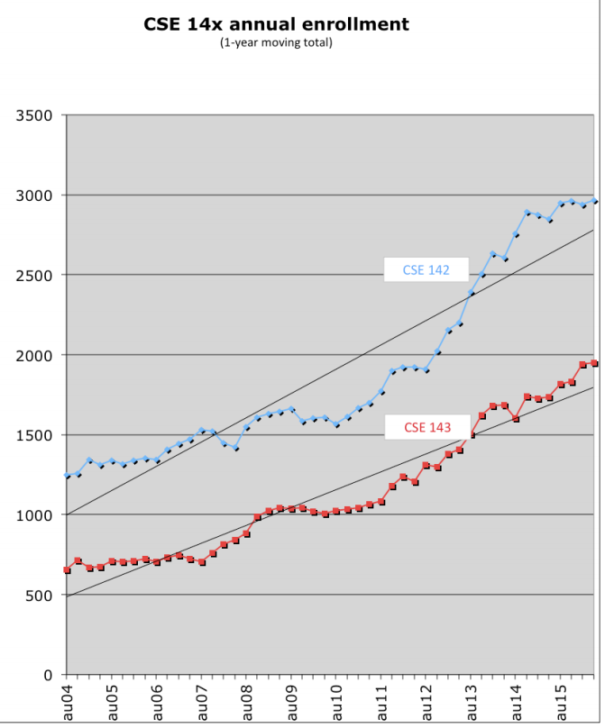
Credit: Stuart Reges

Slide 11
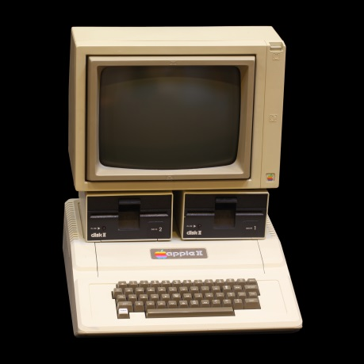
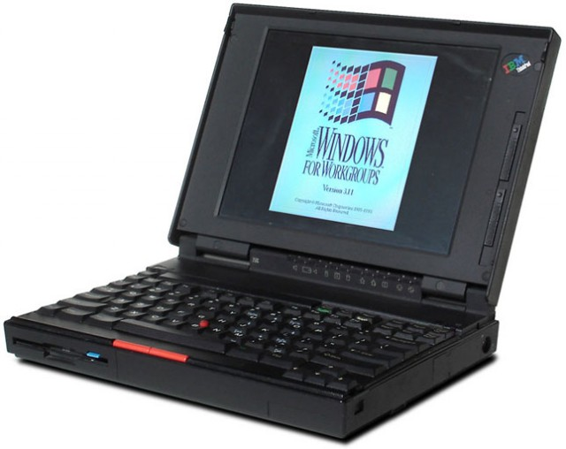
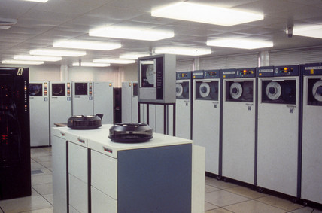
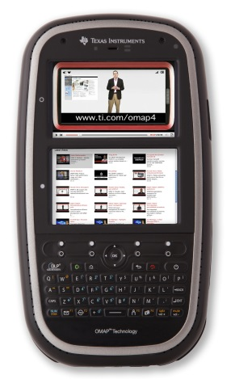
Challenge 3 of 3: “Fast-Moving Field”
?
Notes:
Cf Math Physics Chemistry etc.

Slide 12
Academia can do this…
Human-computer interaction [2007]
Machine learning [2009]
Parallelism [2010]
Distributed systems [2013]
Natural language processing [2016]
Robotics [2018]
… and more
Notes:
Security, developing world, hack-your-language, VR capstone, web programming, …

Slide 13
And/But: Timeless == Timeless
Abstraction
Decomposition
Invariants
Resource management
O(log n) vs. O(n) vs. O(n^2) vs. O(2^n)
Caching
…
… and little details like grep ☺

Slide 14
Curriculum Design:
An Exercise in Online System Evolution…

Slide 15
“300-level”
The core!
capstone
design
“100-level”
Intro. programming
“400-level”
Senior-level courses
Pertinent detail:
Quarter system = 10-week courses; 3 terms / year

Slide 16
Intro Programming
CSE142
CSE142:
Variables, conditionals, loops, arrays, methods, I/O, …
~3K students / year
~12% become majors
(Java with “objects late”)
CSE143

Slide 17
Intro Programming
CSE142
CSE143:
Recursion, linked lists, binary search trees, OOP, …
~2K students / year
~19% become majors
(Java)
CSE143

Slide 18
“300-level”
The core!
capstone
design
“100-level”
Intro. programming
“400-level”
Senior-level courses
Pertinent detail:
Quarter system = 10-week courses; 3 terms / year

Slide 19
SW Design
& Impl
Data
Structures &
Parallelism
Data
Management
Programming
Languages
Foundations
I
Foundations
II
Tools
*
Systems
Programming
Hw/Sw
Interface
required
recommended
optional
Digital
Design
Digital
Circuits
pre-req
co/pre-req
Grossman, DECONSTRUCT, 2017

Slide 20
SW Design
& Impl
Data
Structures &
Parallelism
Data
Management
Programming
Languages
logic, sets, circuits,
proofs, induction,
finite state machines,
undecidability, …
Foundations
I
Foundations
II
Tools
*
Systems
Programming
Hw/Sw
Interface
required
recommended
optional
Digital
Design
Digital
Circuits
pre-req
co/pre-req
Grossman, DECONSTRUCT, 2017

Slide 21
SW Design
& Impl
Data
Structures &
Parallelism
Data
Management
Programming
Languages
Foundations
I
Foundations
II
bits, binary numbers,
assembly, C,
pointers, caching,
connection to Java, …
Tools
*
Systems
Programming
Hw/Sw
Interface
required
recommended
optional
Digital
Design
Digital
Circuits
pre-req
co/pre-req
Grossman, DECONSTRUCT, 2017

Slide 22
SW Design
& Impl
Data
Structures &
Parallelism
Data
Management
Programming
Languages
Foundations
I
Foundations
II
Tools
*
Systems
Programming
Hw/Sw
Interface
required
recommended
linux, bash, make,
grep, git, …
(1-credit, pass/fail)
optional
Digital
Design
Digital
Circuits
pre-req
co/pre-req
Grossman, DECONSTRUCT, 2017

Slide 23
SW Design
& Impl
Data
Structures &
Parallelism
Data
Management
Programming
Languages
software design,
testing, ADTs, specs,
debugging, patterns, …
Foundations
I
Foundations
II
Tools
*
Systems
Programming
Hw/Sw
Interface
required
recommended
optional
Digital
Design
Digital
Circuits
pre-req
co/pre-req
Grossman, DECONSTRUCT, 2017

Slide 24
SW Design
& Impl
Data
Structures &
Parallelism
Data
Management
Programming
Languages
70% data structures:
big-O, trees, heaps,
hashing, sorting, graphs
25% threads, parallelism
5% P vs. NP
Foundations
I
Foundations
II
Tools
*
Systems
Programming
Hw/Sw
Interface
required
recommended
optional
Digital
Design
Digital
Circuits
pre-req
co/pre-req
Grossman, DECONSTRUCT, 2017

Slide 25
SW Design
& Impl
Data
Structures &
Parallelism
Data
Management
Programming
Languages
Foundations
I
Foundations
II
Tools
Probability & statistics in computing: Bayes, independence, …;
hash collisions, RAID, noisy channels, quicksort, network failure, …
*
Systems
Programming
Hw/Sw
Interface
required
recommended
optional
Digital
Design
Digital
Circuits
pre-req
co/pre-req
Grossman, DECONSTRUCT, 2017

Slide 26
SW Design
& Impl
Data
Structures &
Parallelism
Data
Management
Programming
Languages
non-trivial C/C++ programming,
asynchronous I/O, manual
memory management,
concurrency, …
Foundations
I
Foundations
II
Tools
~95%
*
Systems
Programming
Hw/Sw
Interface
required
recommended
optional
Digital
Design
Digital
Circuits
pre-req
co/pre-req
Grossman, DECONSTRUCT, 2017

Slide 27
~70%
SW Design
& Impl
Data
Structures &
Parallelism
Data
Management
Programming
Languages
Foundations
I
Foundations
II
Using a DBMS, SQL,
transactions,
MapReduce, …
Tools
~95%
*
Systems
Programming
Hw/Sw
Interface
required
recommended
optional
Digital
Design
Digital
Circuits
pre-req
co/pre-req
Grossman, DECONSTRUCT, 2017

Slide 28
~70%
~70%
SW Design
& Impl
Data
Structures &
Parallelism
Data
Management
Programming
Languages
Foundations
I
Foundations
II
functional programming,
static vs. dynamic typing,
modularity, macros, type
inference, …
[ML, Scheme, Ruby,]
Tools
~95%
*
Systems
Programming
Hw/Sw
Interface
required
recommended
optional
Digital
Design
Digital
Circuits
pre-req
co/pre-req
Grossman, DECONSTRUCT, 2017

Slide 29
~70%
~70%
SW Design
& Impl
Data
Structures &
Parallelism
Data
Management
Programming
Languages
Foundations
I
Foundations
II
Tools
~95%
*
Systems
Programming
Hw/Sw
Interface
required
recommended
optional
Digital
Design
Digital
Circuits
pre-req
co/pre-req
Grossman, DECONSTRUCT, 2017

Slide 30
My view of the core:
The stuff you [mostly] internalize so well…
… you forget you had to learn it

Slide 31
“300-level”
The core!
capstone
design
“100-level”
Intro. programming
“400-level”
Senior-level courses
Pertinent detail:
Quarter system = 10-week courses; 3 terms / year

Slide 32
Mostly independent courses taught by domain experts
Networks
Compilers
Security
Algorithms
HCI
OS
Complexity
AI
Mach Learning
Vision
OS
Databases
SE
Embedded sw
Graphics
etc…

Slide 33
Popularity contest?
Student interest
But also:
Faculty reputation
Course schedule
Course size
…

Slide 34
~% of 2012-2015 graduates
Not shown:
Newer courses
More tail

Slide 35
Trends
Choices, choices
ML + AI way up
Security remains bottle-necked
OS, networks a little down
SE, graphics down
…

Slide 36
Parting thoughts
Surprisingly happy alumni -- modulo key biases
My view on self-taught: Fine for the 1% but check-your-privilege
CS curriculum is ever-evolving and one of my passions
Notes:
Fun, important, my passion
If you don’t need this, great! Think about how you figured out what to study
Confirmation bias, survivorship bias, response bias

Slide 37
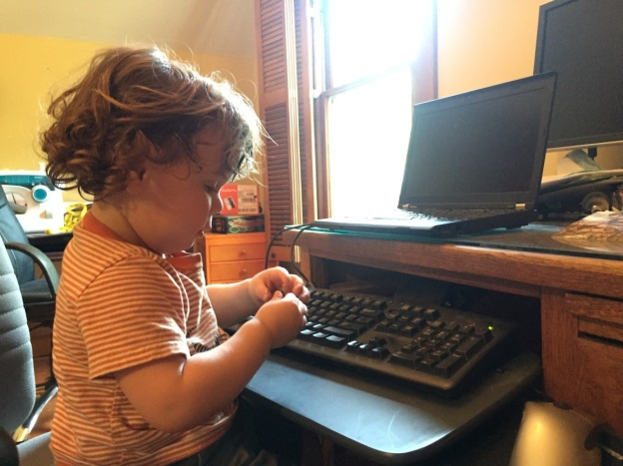
Dan Grossman
djg@cs.uw.edu
http://homes.cs.uw.edu/~djg

