Slide 1


Massive Open Online Courses (MOOCs):
How Do They Work?
(Reflections from Personal Experience)
Dan Grossman
Department of Computer Science & Engineering
University of Washington
ATLAS Speaker Series
Univ. Colorado Boulder
September 9, 2013

Slide 2
Plan
Background on MOOCs and my role
Why I did a MOOC
  Plus some university perspective
Course tour
First presentation of some course data
  Special focus for this audience: gender
Hopefully lots of Q&A
  There is much to say about MOOCs, pro or con
  Rather let you pick the subtopics!

Slide 3
What makes a MOOC a MOOC
Online
  Video, discussion board, etc.
Free
  Can talk monetization strategies if you want, but not my role
Semi-synchronous courses
  Social cohorts with modern lives
Scale
  Once a course is large, more students improve a course
  Very little can flow through the course staff

Slide 4
Recent history
2 years ago (!):
  3 CS MOOCs from Stanford go viral, hit mass media, etc.
  (Also Khan Academy, Code Academy, cMOOCs, …)
<1.5 years ago:
  Coursera, Udacity, EdX, …
  UW partners with Coursera (later, EdX too)
Coursera today: > 4M users, > 60 universities, > 400 courses
Everybody talking about it
  Academia, from presidents on down
  Much of the software industry
  Friends, strangers, my parents, …

Slide 5
My role
Instructor: Programming Languages, Jan-Mar 2013
  Sophomore-level majors-only class in a very competitive major
    A challenging course made available to all
Coordinated department effort: 5 courses in 2013
  Instructors plus cadre of nimble TAs
  Interactions with Coursera
Meeting with various UW entities about the path forward
  Department was first-mover, separate from other UW courses
  Now I know the Provost’s Office ☺

Slide 6

What a year!
15 months ago, I wasn’t a “MOOC expert,”
but it has been a fantastic passion
  Mostly brought energy, organization, and “common sense”
  It’s early days

Slide 7
Plan
Background on MOOCs and my role
Why I did a MOOC
  Plus a little on university perspective
Course tour
First presentation of some course data
  Special focus for this audience: gender

Slide 8

Why? Faculty View
I believe I have a great course and want to have impact
  5-10x more students in 1 term than in last decade combined
  More fun and effective than writing a textbook
  Have people learn instead of watching Real Housewives
  Influence other educators
  Fame (not fortune)
Be part of academic change
  Not read about it in the newspaper
  No substitute for first-hand experience

Slide 9
Why? Department View
Can have amazing impact
  Scalable, worldwide leaders in computing education
MOOCs might [not] change how universities work in N years
  Gain experience
Improve and leverage reputation
Feedback to improve conventional courses
  New modalities (e.g., video, peer assessment)
  Massive data
Yes, it costs money, but remarkably little
  Cost is time

Slide 10

Two Comparisons
Compared to conventional courses
  Same or better: Homeworks, lectures
  Unclear: Study groups
  Worse: Design projects, exams, mentoring, …
Compared to writing a textbook!!
  Attrition ≠ failure
  Rarely profitable for authors
  Worldwide impact of high-quality materials
  Influence other educators
  Assessment a secondary issue
  Better: videos, forums, graded homework
  “21st – century textbook plus social”

Slide 11
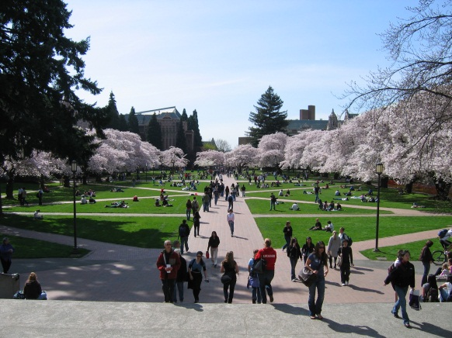
Does free mean doom?
“If these courses are free, why are people paying tuition?”
Coherent 4-year curriculum
Personal interaction with faculty/TAs
  Motivation, mentoring, …
Homeworks graded by humans
Open-ended design and free-response questions
Credit because we know you actually learned the material
Courses adapt to student needs
Plus other reasons to attend a university:
social support, job fairs, independent study/research, etc.
Focus on our higher-value “services”?

Slide 12


Perspective
It is plausible MOOCs will destroy universities as we know them (!)
  Big changes can happen quickly
But universities have survived before:
Plus: iTunes U, course web pages, …

Slide 13
Plan
Background on MOOCs and my role
Why I did a MOOC
  Plus a little on university perspective
Course tour
First presentation of some course data
  Special focus for this audience: gender

Slide 14
The course
My favorite teaching assignment
  Taught 5 times over 9 years before making a MOOC
  Already developed lecture materials, reading notes, homeworks, …
  A popular course
Comes after two programming courses
Majors only

Slide 15
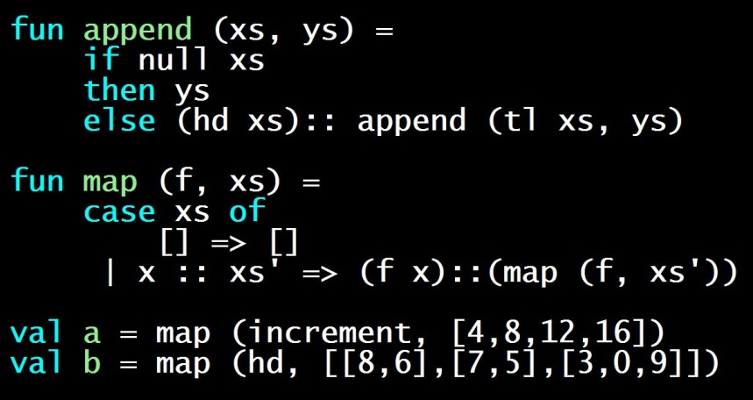
Some details
10 weeks
Topics: Syntax vs. semantics, recursive functions, benefits of no mutation, algebraic datatypes and pattern matching, tail recursion, higher-order function closures, lexical scope, currying, syntactic sugar, equivalence and effects, parametric polymorphism, type inference, modules and abstract types, static vs. dynamic typing, streams and memoization, macros, eval, pure OOP, implementing dynamic dispatch, multiple inheritance vs. mixins, OOP vs. functional decomposition, subtyping, bounded polymorphism
Languages: ML, Racket, Ruby
Seven homeworks, all programming
Midterm and final, including English and code

Slide 16
The Coursera course
10 weeks
Topics: Syntax vs. semantics, recursive functions, benefits of no mutation, algebraic datatypes and pattern matching, tail recursion, higher-order function closures, lexical scope, currying, syntactic sugar, equivalence and effects, parametric polymorphism, type inference, modules and abstract types, static vs. dynamic typing, streams and memoization, macros, eval, pure OOP, implementing dynamic dispatch, multiple inheritance vs. mixins, OOP vs. functional decomposition, subtyping, bounded polymorphism
Languages: ML, Racket, Ruby
Seven homeworks, all programming, average of 2 submissions
Midterm and final, including English and code

Slide 17
Key pieces
Videos:
  7-12 minutes, released weekly (3ish hours / week)
  Lots of writing code in Emacs; also Powerpoint
  TAs added “in-video questions” independently
Homeworks:
  From UW course, with “weapons-grade” auto-testing
  Peer assessment for 10% of grade
Exams: Open materials, multiple-choice-ish
Discussion Forum: Active and mostly self-sufficient

Slide 18
Video demo

Slide 19
How did we do it?
Compared to many institutions, we did it ad hoc
  With lots of advance preparation
  And lots of stress
A behind-the-scenes look in four pictures…

Slide 20
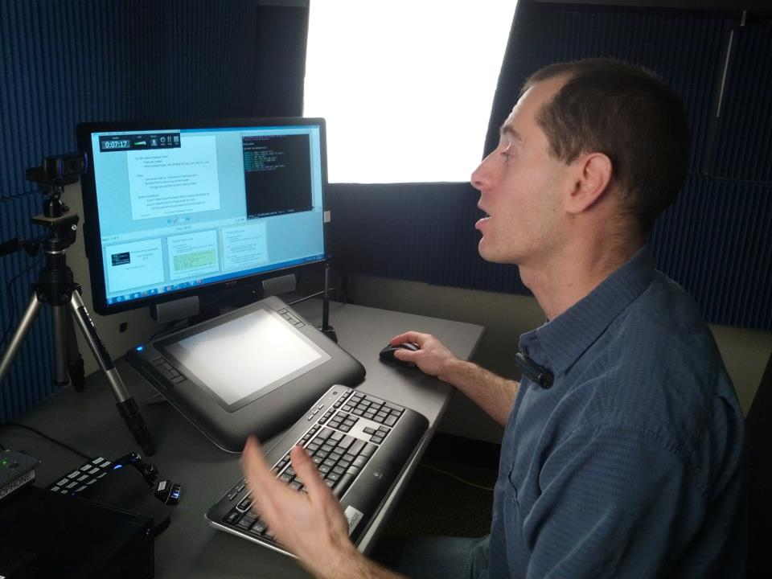
Four pictures

Slide 21
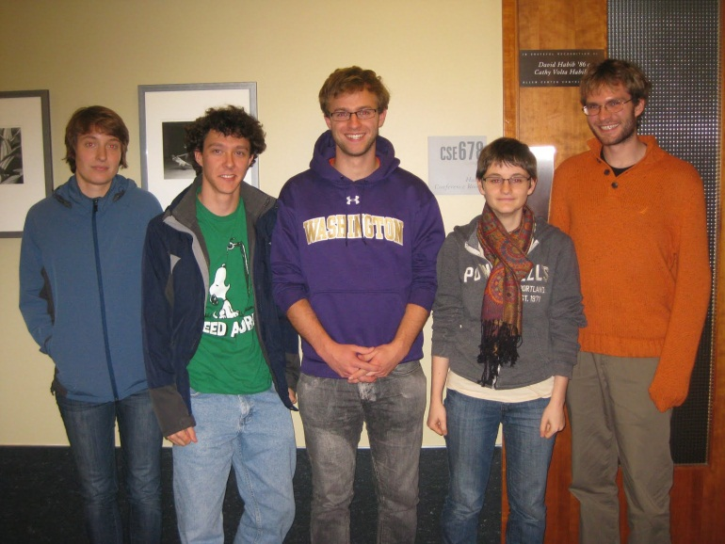
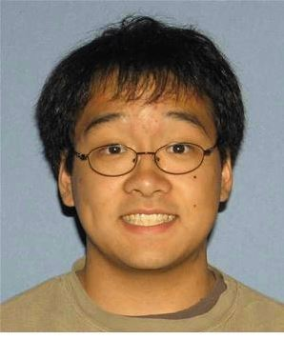
Four pictures

Slide 22
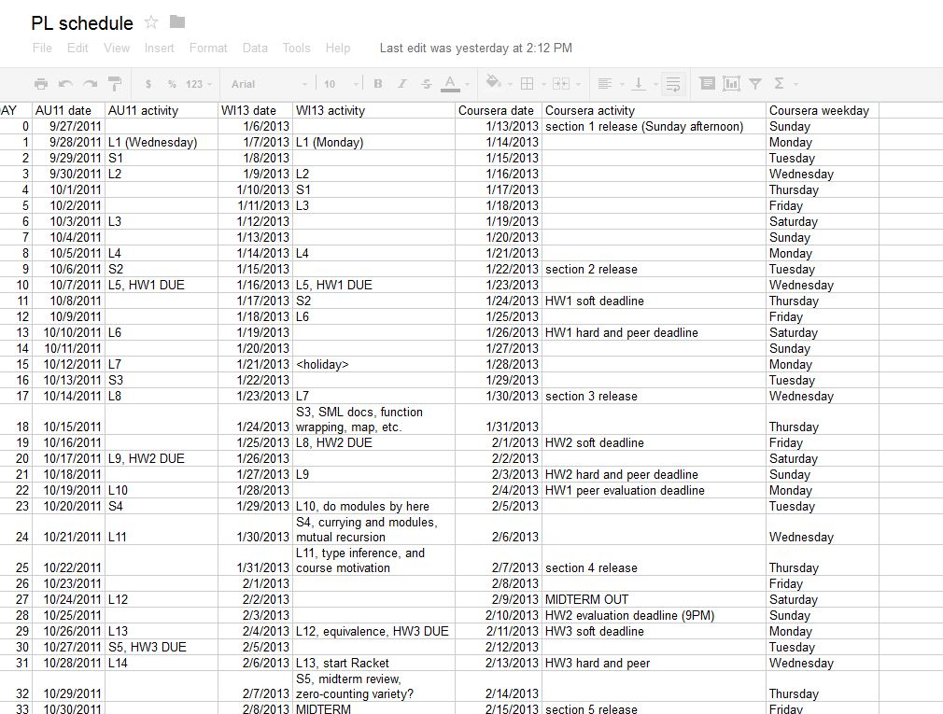


Four Pictures

Slide 23
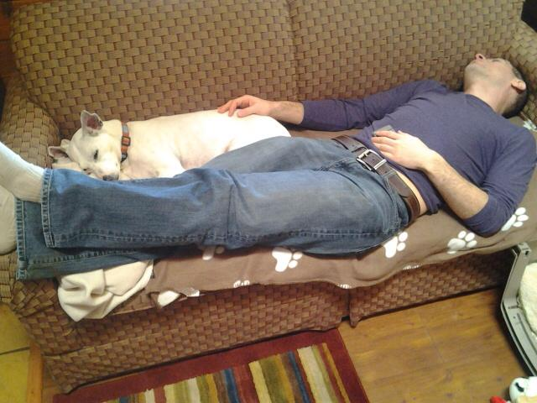
Four pictures

Slide 24
Where my time went
Caveat: Rough guesses; started 4 months early
Lectures: 30 hours of content, 250-300 hours total
  80ish% of this work requires domain expertise
Discussion forum: Several times / day, briefly (cf. Facebook)
Homeworks: Auto-grading and peer assessment 100 hours?
  Much more than multiple choice
Exams: 20-30 hours
Announcements, website, TA meetings, fixing typos, schedule spreadsheet, stress, etc. 50 hours?

Slide 25
Where TA time went
In-video questions
Grading scripts
Some things not requiring domain expertise
  File uploading, proof-reading, …
Note: TAs are much better than faculty/staff at learning new things!

Slide 26
Was it worth it?
Me:
  Extremely rewarding, exhausting, and hopefully influential
  Re-running will be much less work
TAs:
  Really proud and worked super hard
  I made a point of acknowledging the “sherpas,” but MOOCs still create “cult of personality”

Slide 27
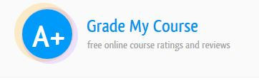
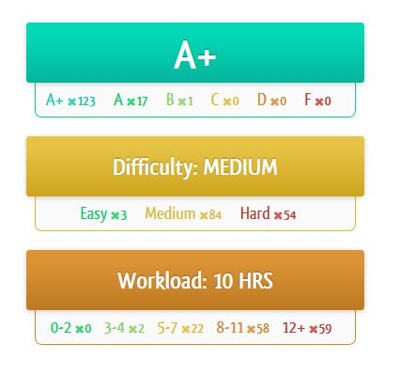
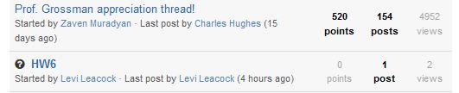
For participants
2000ish or more very happy
  In some sense, I get to pick
  which students are happy
Forum posts, online reviews, emails,
postcards, …
Post-course survey

Slide 28
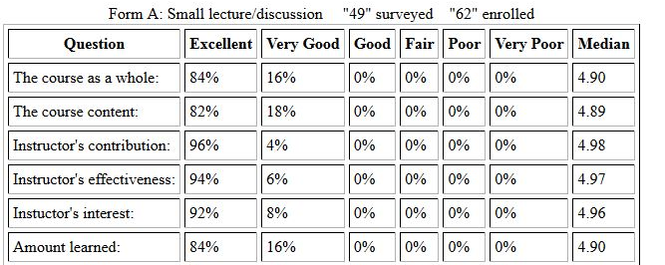
For UW students
Posted videos (not really flipped), more TAs, cachet
  Coursera rarely mentioned
My highest teaching evaluations ever…
  Great TAs the main reason

Slide 29
Plan
Background on MOOCs and my role
Why I did a MOOC
  Plus a little on university perspective
Course tour
First presentation of some course data
  Special focus for this audience: gender

Slide 30
Preliminary data
Recently completed first informal data analysis
  Things I wanted to know
  Caveats abound
Three parts:
Completion rates
Demographics: Country, Age, Background
Demographics: Gender

Slide 31
Participation numbers, take 1
“Registered”: 65,000 totally irrelevant
Clicked play in first 2 weeks: 27,000 many didn’t have pre-reqs?
Watched an hour of video: 12,000 like coming to first day?
Turned in 1st homework: 4,000
Turned in 5th homework: 2,100 attrition doesn’t stop
“Passed”: 1,716
Fan mail/posts: 300
Fairly consistent with Coursera data across “hard” courses
Define success however you want
  Many love it in parts, start late, don’t turn in homework, etc.
  Learning rather than watching television

Slide 32
Choose your denominator
I personally do not say, “65K took my course”!
We need to “choose” a more realistic “completion rate”
Registered: 65,000
Completers: 1716 2.6%
Took pre-survey: 16,587
Completers therein: 1479
8.9%
>70% (*) on Homework 1: 3170
Completers therein: 1552
49.0%
* UW median >95%

Slide 33
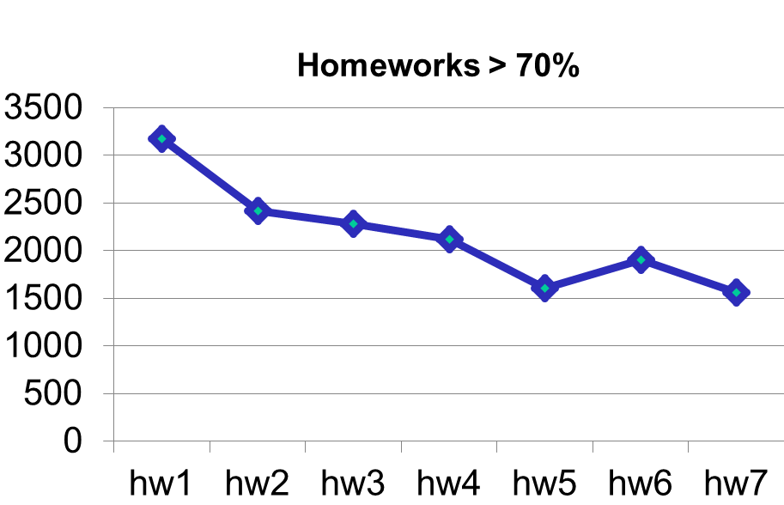
Attrition steady
“Life happens” to about 10% per week

Slide 34
Cynic’s view
The data clearly shows how to drive up completion rates:
  Make the course shorter
  Require less work
  Let them resubmit endlessly
  Set the bar for passing lower
  Make it harder to sign up (e.g., no sign-up until 2 weeks before)

Slide 35
Next time
Please take this survey after watching the introductory videos
I intend to complete ___ of the homework assignments. [none, < ½, > ½, all]
Do you intend to earn a Statement of Accomplishment? [yes, no, unsure]
How committed are you to earning a Statement of Accomplishment? [strongly, somewhat, barely, not]

Slide 36
Preliminary data
Recently completed first, informal data analysis
  Questions I personally had
  Caveats abound
Three parts:
Completion rates
Demographics: Country, Age, Background
Demographics: Gender

Slide 37
Caveats
No data for 48K / 65K (26% response rate)
  No clue how the sample is biased
No data for 237 / 1716 completers (86% response rate)
All data self-reported
Cheating is easy
Did not ask education level
  Other Coursera courses find 70+% of completers have a Bachelor’s degree
  Unclear “what we know about U.S. college students” applies

Slide 38
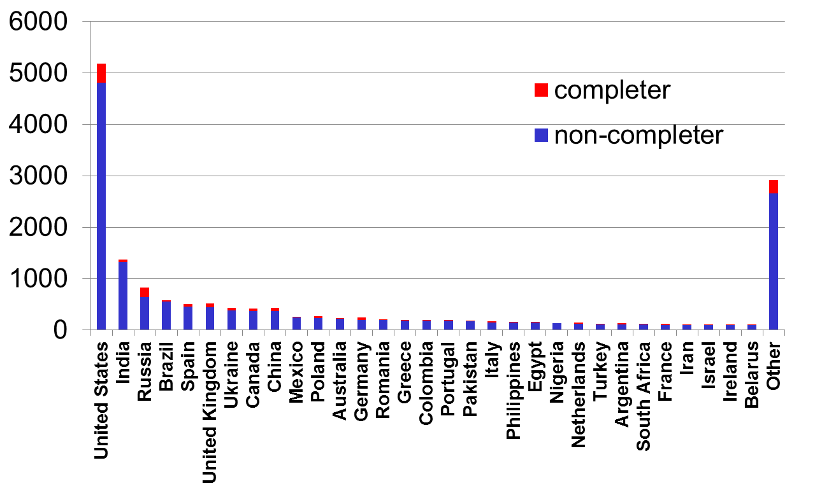
Country distribution
Others combined
69% outside the U.S. (76% of completers)

Slide 39
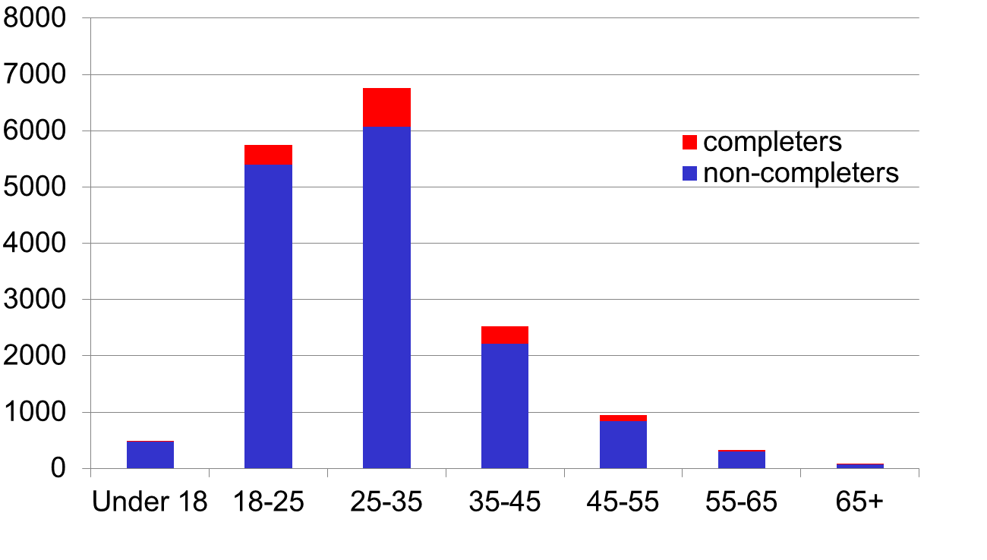
Age distribution
Completion % per age group
10%
6%
12%
11%
2%
9%
11%
Completion rate much lower for under-25

Slide 40
Recommended background
From the sign-up website:
Students should be comfortable with variables, conditionals, arrays, linked lists, stacks, and recursion (though recursion will be reviewed and expanded upon), and the difference between an interface and an implementation.
Most telling question I had the foresight to ask:
How would you describe your comfort level with recursion?
I have never heard of it.
It seems magical but I tried to learn it.
I think I have the hang of it.
Recursion is easy and natural.

Slide 41
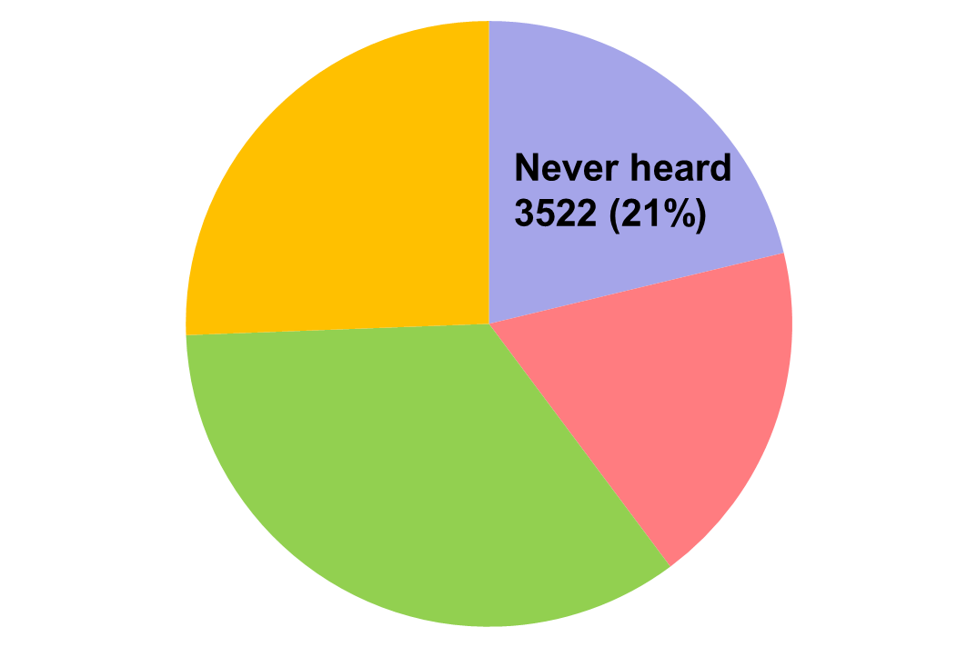
Recursion numbers
Easy, natural
4245 (26%)
Seems magical
3079 (19%)
Think I get it
5741 (35%)

Slide 42
Recursion / Completion
Background | Completers | Non- completers | % completers
Never heard | 26 | 3496 | 0.7%
Seems magical | 111 | 2968 | 3.6%
Think I get it | 602 | 5139 | 10.5%
Easy, natural | 740 | 3505 | 17.4%
Cannot compare my course to “Intro to X”?
Participants don’t read background or don’t heed it?

Slide 43
Preliminary data
Recently completed first, informal data analysis
  Questions I personally had
  Caveats abound
Three parts:
Completion rates
Demographics: Country, Age, Background
Demographics: Gender

Slide 44
Preparation
Numbers are worse than I thought ☹
  Silver linings follow: partial reasons and opportunities
I am less an expert on CS gender issues than many in audience
  But work hard on classroom environment, student interactions, department culture, …
“We are on the same team”
  I’m incredibly proud of UW’s NCWIT pace-setter status
  Though we, like everyone, have more work to do

Slide 45
Digression: some UW numbers
CS1: > 33% female
  Steady growth from 25% in 2004, while course largest ever
CS2: > 23% female
  Steady growth from 15% in 2004, while course largest ever
Percentage undergraduate CS degrees to women in 2011: 28%
  National average: 13%
My Winter+Spring course offerings:
  36 of 116 female (31%)
  6 of top 11 grades to women
  ...

Slide 46
Registration and completion numbers ☹
Of survey participants: 19% female
Of U.S. survey participants: 22% female
Of survey participants who completed: 9% female
Of U.S. survey participant who completed: 11% female
In isolation, any one of these numbers is disappointing but palatable
But combined, my heart sank:
Female completion rate: 4.2% (or 3.6% in U.S.)
Male completion rate: 9.9% (or 7.9% in U.S.)
Crucial to analyze the completion gap

Slide 47
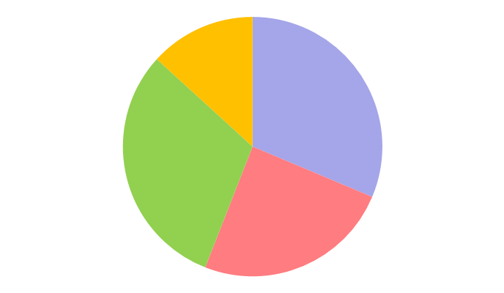
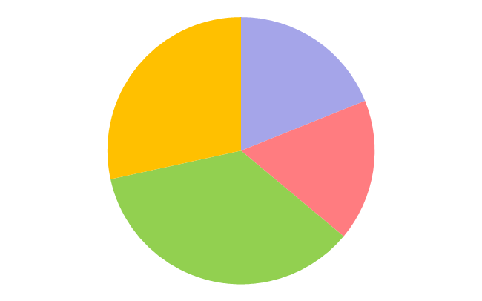
Partial reason #1
Does recursion background correlate with gender?
  Surprisingly: yes
  I don’t know why (among those who chose this course)
13%
Never heard
Seems magical
Think I get it
Easy, natural
19%
31%
28%
31%
17%
25%
36%
women
men

Slide 48
Partial reason #1
“Women report less recursion background” explains some of the overall completion gap (9.9% male, 4.2% female)
  But not most of it
Background | Men % Completer | Women % Completer
Never heard + seems magical | 2.1% | 2.1%
Think I get it + Easy, natural | 14.4% | 7.1%

Slide 49
Bigger reason
Whatever caused the gap happened almost entirely before Homework 1!
Background | Men % Completer | Women % Completer | No survey % Completer | Total % Completer
Everyone registered | 9.9% | 4.2% | < 0.1% | 2.6%
> 70% on Homework 1 | 52.0% | 44.9% | 41.5% | 49.0%
Focus on the first 7-10 days of the course – the rest is in pretty good shape!

Slide 50
Opportunities
Data was easy to collect for [almost] free
  Much more data we haven’t even looked at
MOOCs could provide distributed cohorts, mentors, on-ramps, your-idea-here, …
MOOCs are not entrenched in legacy decisions
MOOCs are an attractive target (more impact per course)
MOOCs are great for re-training
Remember the numerator too: > 134 women finished the course

Slide 51
Conclusions
Personal opinion: MOOCs are more fantastic than terrible…

Slide 52

For me…
One of the coolest things I have ever done
  Rewarding, influential, exhausting
  I got to teach thousands of students around the world!
  What is better than sharing your passion for free?
There is no “one right way” to teach a MOOC
(or write a textbook)
Demographics very different from my campus
It’s early days –
Nobody knows where MOOCs are heading:

Slide 53
Thanks
http://homes.cs.washington.edu/~djg/
https://www.coursera.org/course/proglang
[next offering begins early October]

