Slide 1
Teaching Programming Language Design and Implementation: Perspective From Two Roles
Dan Grossman
PLDI Panel 2011

Slide 2
My roles today
UW Faculty
PL Person
ACM/IEEE standard
SIGPLAN Board
My opinions
Push and provoke
Can’t do harm
Distill shared wisdom
Support diverse approaches
Convince non-PLDI crowd

Slide 3
Curriculum 2013: cs2013.org
ACM
1st major revision of ACM/IEEE CS Curriculum since 2001
3-year process
Large-if-indirect impact on new programs, curriculum revisions, textbook authors, etc.
Outline of topics and learning outcomes
Material labeled “core” or “elective”
Pretty big deal – comment publicly or put up with the result
FCRC-wide information session
6:00-7:00PM tonight! Room C2/C3
Please attend!
Learn about the overall effort
Share PLDI perspective

Slide 4
The PLDI piece
ACM
I’m on the steering committee and head the PL subcommittee
All of PL, compilers, and more
2001 is an, uhm, problematic starting point
With SIGPLAN Education Board help, have a working draft*
1st public draft in a few months, so now is the time to help!
Looking for a few compilers pedagogues to help with 1-2 pages of outline and learning outcomes
This is real work
Contact me
* More on this after my purple-hat bit

Slide 5
SIGPLAN
ACM
I currently chair the SIGPLAN Education Board
Created April 2009
Broad goals for improving PL education and represent SIGPLAN community
Currently focused on Curriculum 2013
Compilers experts currently under-represented
Blog/RSS:
Great place to hear about 2013 feedback opportunities
Enough with announcements, how about some content…
http://wp.acm.org/sigplaneducationboard

Slide 6
Compilers for all?
Faculty
Should every CS undergraduate take a compilers course?

Slide 7
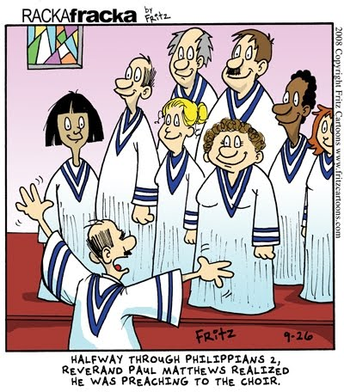
Compilers for all?
Faculty
Should every CS undergraduate take a compilers course?
Dear Choir,
Yes.
Amen.

Slide 8
Compilers for all?
Faculty
Should every CS undergraduate take a compilers course?
Honest answer:
No.
Maybe 75% should
and 40% will.

Slide 9
Growing field
Faculty
As the field grows, the courses a student takes does not
In 1996, I took compilers as part of a full curriculum
Since then, what about growth in:
security, networking, web programming, machine learning, parallel programming, human-computer interaction, embedded systems, massive data, …
Have to support undergraduates specializing and double-majoring
While justifying compilers as an important, vibrant area
(Our colleagues don’t think so!)

Slide 10
My advice
Faculty
Don’t:
Spend all your political capital making/keeping compilers required
Do:
Make compilers a more engaging, modern, relevant course by changing 15% of it
Help develop 2-3 weeks of core material for a required lower-level course

Slide 11
Compiler-course ideas
Faculty
More on modern run-time systems
Dynamic loading & recompilation, memory management, …
Static analysis for more than optimization
> 10 years of research papers and real-world tools rarely mentioned in curriculum
“Threads cannot be implemented as a library”
Not suggesting huge course changes
But 1-2 weeks connecting topics to modern challenges is worth dropping something else

Slide 12
What everyone should know
Faculty
Compilers: automatic meaning-preserving translation to lower levels of abstraction
Every student should have a sense of how to do it manually
YFHLL ⇒ C ⇒ assembly ⇒ binary
Example topics:
Low-level data representation (objects, arrays, …)
Call stacks
References as machine addresses
Rudiments of garbage collection
“Java and C are not magic”

Slide 13
Standard elective material
ACM
Faculty
Each “Knowledge Unit” has a topic list (omitted for space & time)
SyntaxAnalysis
CompilerSemanticAnalysis
CodeGeneration [really the whole back-end]
RunTimeSystems
DataflowAnalysis [really the whole middle-end & other uses]
[Plus other Knowledge Units more about “PL” than “compilers”]

Slide 14
Standard core material
ACM
Faculty
ProgramRepresentation [1 hour]
“Code is data”
Programs that process other programs
Abstract syntax trees
LanguageTranslationAndExecution [2-3 hours]
Interpretation / Compilation / Portable IRs
Standard static pipeline
Run-time data representation and memory layout
Role of memory manager
[Plus other Knowledge Units more about “PL” and “programming”]

Slide 15
ACM/IEE CS Curriculum
Information session tonight, 6-7PM
Room C2/C3
http://wp.acm.org/sigplaneducationboard

