Slide 1
Actual Needs and Opportunities Based on Teaching a Programming Languages MOOC Dan Grossman Department of Computer Science & Engineering University of Washington PLOOC Workshop June 21, 2013

Slide 2
Outline
Background
My course and what’s unique
How we did it
(Leverage that Scott went first: agree with > 80%)
Clarifying a MOOC’s goals
Things we do NOT need formal methods for
Longer-term opportunities FOR formal methods

Slide 3
My role
Instructor: Programming Languages on Coursera, Jan-Mar 2013
Sophomore-level majors-only class in a very competitive major
A challenging non-introductory course
1700 passed, 3000 watched through to the end, 5500 turned in first homework, …
Led department’s efforts to offer 5 courses this year
Instructors plus cadre of nimble TAs
Simple-ish “recording studio”
High-quality pedagogy and logistics
Meeting with administrators, companies, faculty committees, …

Slide 4
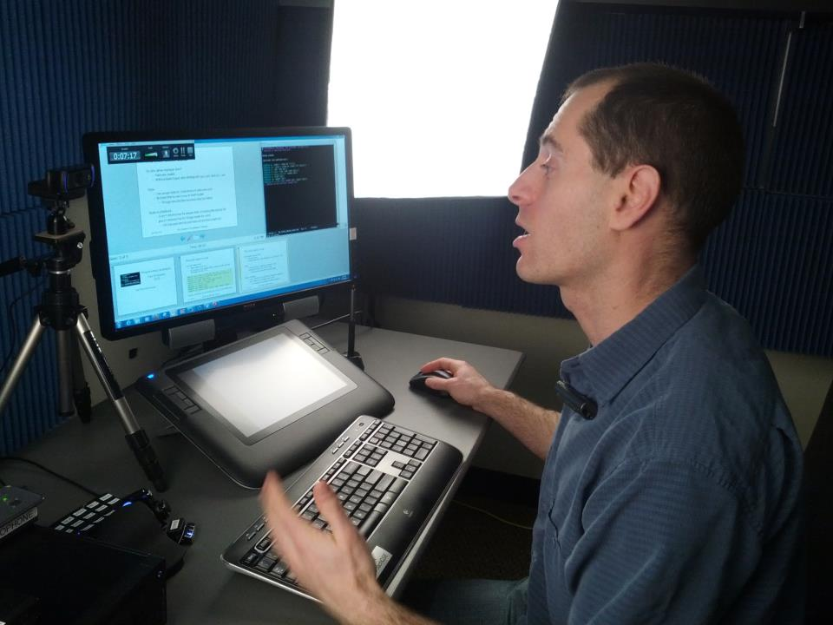
Four pictures

Slide 5
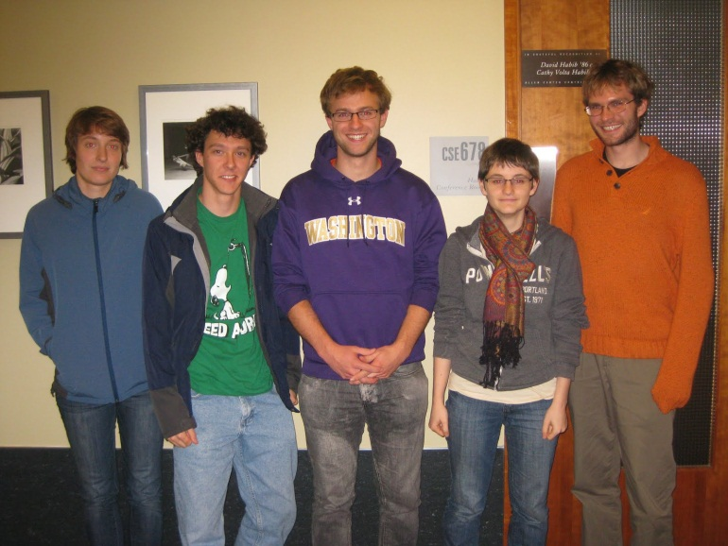
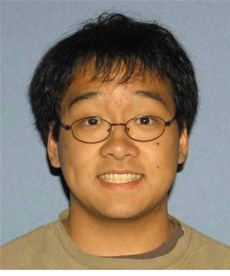
Four pictures

Slide 6
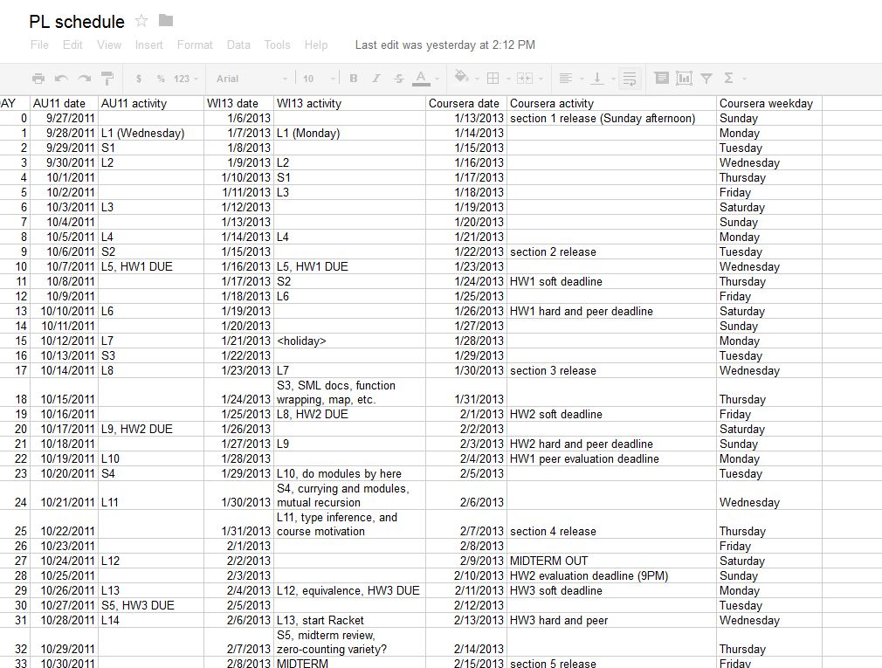
Four Pictures

Slide 7
Four pictures

Slide 8
The university PL course
Ten weeks
Topics: Syntax vs. semantics, recursive functions, benefits of no mutation, algebraic datatypes and pattern matching, tail recursion, higher-order function closures, lexical scope, currying, syntactic sugar, equivalence and effects, parametric polymorphism, type inference, modules and abstract types, static vs. dynamic typing, streams and memoization, macros, eval, pure OOP, implementing dynamic dispatch, multiple inheritance vs. mixins, OOP vs. functional decomposition, subtyping, bounded polymorphism
Languages: ML, Racket, Ruby
Seven homeworks, all programming
Midterm and final, including English and code

Slide 9
The Coursera course
Ten weeks
Topics: Syntax vs. semantics, recursive functions, benefits of no mutation, algebraic datatypes and pattern matching, tail recursion, higher-order function closures, lexical scope, currying, syntactic sugar, equivalence and effects, parametric polymorphism, type inference, modules and abstract types, static vs. dynamic typing, streams and memoization, macros, eval, pure OOP, implementing dynamic dispatch, multiple inheritance vs. mixins, OOP vs. functional decomposition, subtyping, bounded polymorphism
Languages: ML, Racket, Ruby
Seven homeworks, all programming, average of 2 submissions
Midterm and final, including English and code

Slide 10
Course materials
Roughly 30 hours of video in 6-14 minute blocks
In-video questions written by TAs
Reading notes covering the same material
Unorganized discussion forum
Practice exams
Announcements, calendars, instructions, etc.

Slide 11
Homework / Grading
Submit files containing code (tightly informally-specified behavior)
“Write a function that …”
“Complete the interpreter…”
“Port this function from ML to Ruby…”
90% of grade from home-grown auto-grader
Outer harness: Python, Makefile, chroot, timer, …
Per-problem unit tests
Some clever tricks (dynamic scoping, macros, grep-if-needed)
10% of grade from peer assessment
Detailed rubric
Exists for “style matters” and for pedagogy
Hope to back-port to conventional course

Slide 12
Exams
Unlike conventional course:
Multiple choice, check-boxes, etc.
Open course-materials, compiler, etc.
Trivial to cheat via two accounts
But still sophisticated and difficult (average about 80%)
“Which best describes why this program doesn’t terminate?”
“Can a client of this module cause ___ to happen?”
“Check all for which lexical/dynamic scope differ”

Slide 13
The numbers
“Registered”: 70,000 totally irrelevant
Clicked play in first 2 weeks: 30,000 many didn’t have pre-reqs?
Watched an hour of video: 11,000 like coming to first day?
Turned in first homework: 5,000
Took midterm: 3,000 this is a solid number
Turned in 5th homework: 2,000 attrition doesn’t stop
“Passed”: 1,700
Fan mail/posts: > 300
Define success however you want
Many love it in parts, start late, don’t turn in homework, etc.
Learning rather than watching television
Fairly consistent with Coursera data across “hard” courses

Slide 14
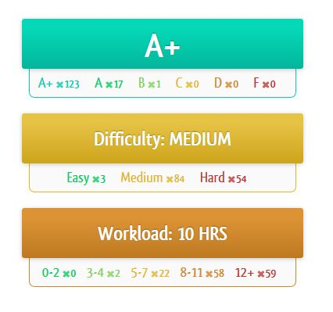
For the participants
2000+ very happy
Perhaps more
In some sense, I get to pick
which 2000+ are happy
Forum posts, online reviews, emails,
postcards, …
Spare you the gushing ☺

Slide 15
Outline
Background
My course and what’s unique
How we did it
(Leverage that Scott went first: agree with > 80%)
Clarifying a MOOC’s goals
Things we do NOT need formal methods for
Longer-term opportunities FOR formal methods

Slide 16
Why did I do this?
I believe I have a great course and want to have impact
5-10x more students in 1 term than in last decade combined
Influence other educators
More fun and effective than writing a textbook
Fame (not fortune)
Be part of academic change
Not read about it in the newspaper
No substitute for first-hand experience
Have people learn instead of watching Real Housewives

Slide 17
Two Comparisons
Compared to conventional courses
Same or better: Homeworks, lectures
Unclear: Study groups
Worse: Design projects, exams, mentoring, …
Compared to textbook writing!!
Attrition ≠ failure
Rarely profitable for authors
Worldwide impact of high-quality materials
Influence other educators
Better: videos, forums, graded homework
“21st - century textbook plus social”

Slide 18
Goals?
Teach millions of people something?
Teach thousands of students/professionals in a discipline?
Become rich and/or famous?
Assess learning?
Improve education (e.g., data analytics)
Give academic credit, degrees, certification, …
Detect cheating?
Lower cost of higher education?

Slide 19
It depends!
Just in computer science, there are hundreds (thousands?) of great courses each near its local optimum
Multiply by 500 to cover a large university
Why I’m “pro MOOC”:
Many courses I’m familiar with, especially mine, MOOC-ify
Can reach worldwide audience, full-time professionals, etc.
A better textbook
But every course on my campus uses different technology or same technology in different ways
And has different goals

Slide 20
Outline
Background
My course and what’s unique
How we did it
(Leverage that Scott went first: agree with > 80%)
Clarifying a MOOC’s goals
Thing we do NOT need formal methods for
Longer-term opportunities FOR formal methods

Slide 21
Skeptical view
[Assume my MOOC’s goals]
Some things I don’t think I need:
Problem generation: Have enough or humans could make more
Better grader testing/verification: Students aren’t adversarial
Plagiarism detection: Not my goal and diff/Moss is plenty
Human-quality feedback: Maybe, but peer assessment with incentives may be better for overall learning

Slide 22
Not my priority
Where I would spend time first:
Video examples error free (video is 60+% of total effort!)
Keeping installation instructions up-to-date
Better suggestions for students without assumed background
Native-language translation
Discussion-forum sanity, searching, especially at course-start
Better social interactions (group learning)

Slide 23
What about cheating?
[Assuming this goal]
Are current approaches enough?
Coursera Signature Track: biometrics, money
Udacity: Worldwide testing centers
DMV: Draw from a pool of multiple-choice questions
Is there an inherent trade-off between generating an infinite number of problems and pedagogically optimal problems?
May depend on domain and topic
May require human ingenuity

Slide 24
Outline
Background
My course and what’s unique
How we did it
(Leverage that Scott went first: agree with > 80%)
Clarifying a MOOC’s goals
Thing we do NOT need formal methods for
Longer-term opportunities FOR formal methods

Slide 25
Some ideas
Meta-idea: Aim 5-10 years out so not competing in the land grab
Focus on radically different learning experience
One-on-one intelligent tutors
Instant turn-around compared to peer assessment
Auto-graders that gave feedback based on nearest-correct-answer
Auto-graders with minimal, well-explained counter-examples
Also useful for interactive tutors
Automatic cross-references among homework, video, readings, …

Slide 26
Some more…
Deep code analysis for assigning study groups
Complementary concept deficiencies
Actual education research at scale
In ways that complement the machine-learning crowd
At-scale research on how informal specifications are misinterpreted
Grading on style while teaching the peer-assessors too
[Your idea here… a chance to run it by folks who have “been there”]

Slide 27
Conclusions
Nobody knows where MOOCs are heading
Really proud of my MOOC as-is, but big game-changers welcome
And like any course, shelf-life is probably < 10 years
Will be offered again in Fall 2013: feel free to lurk!
https://www.coursera.org/course/proglang

