Slide 1
Rice COMP Alum Spends 14 Years and Counting Posing as a PL Professor
Dan Grossman
Professor and Deputy Director
Paul G. Allen School of Computer Science & Engineering
University of Washington
November 8, 2017

Slide 2
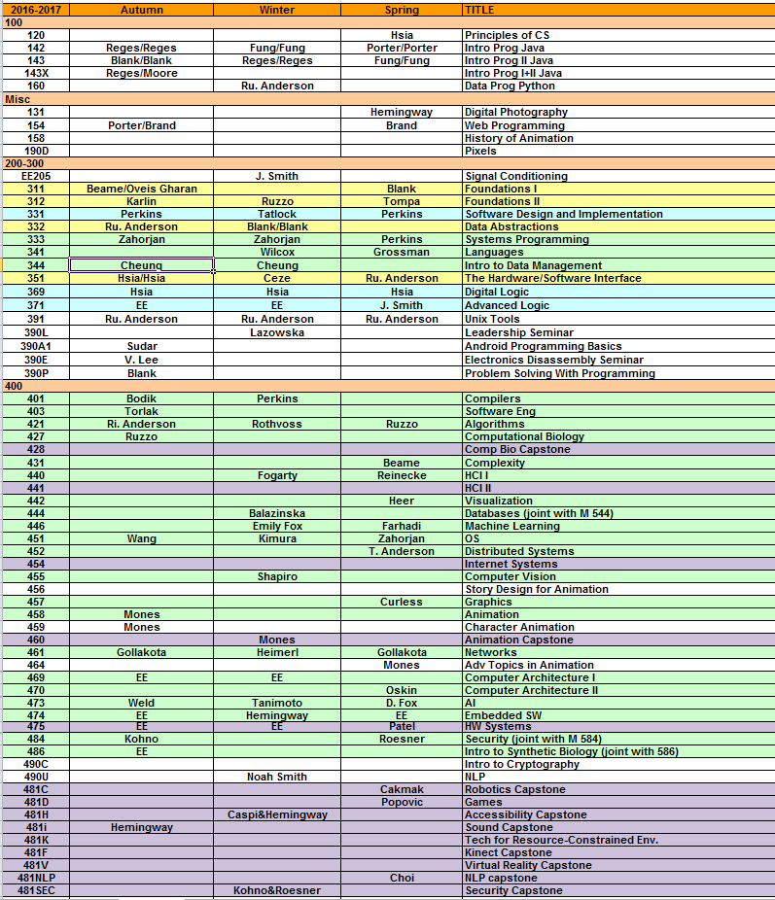
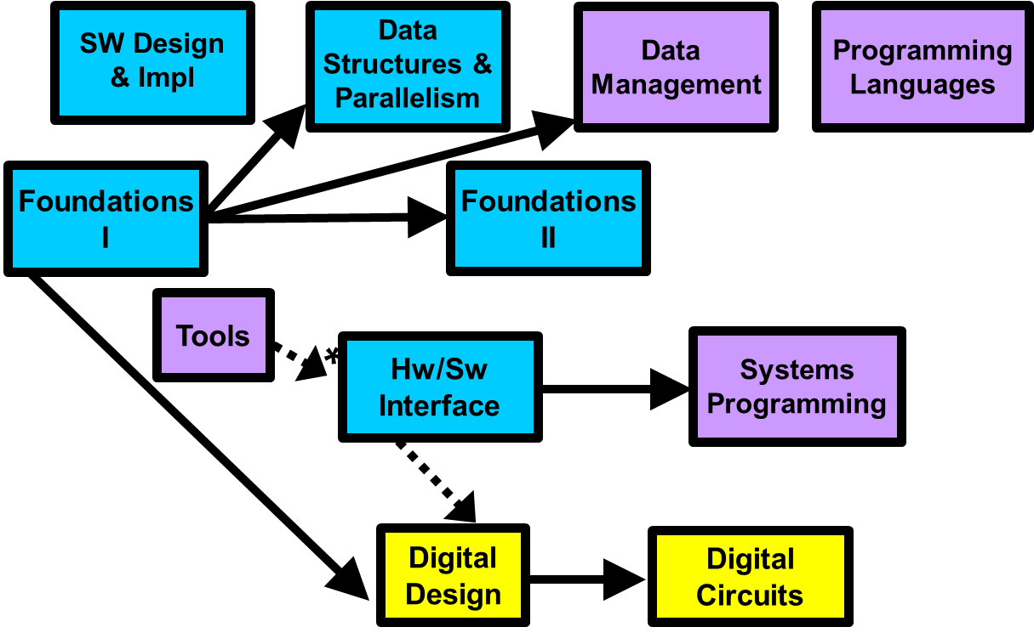
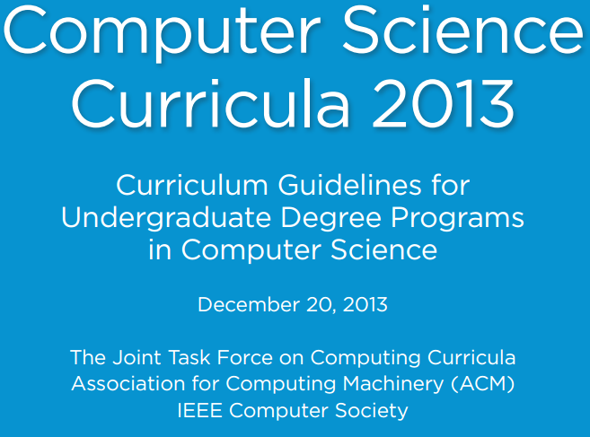
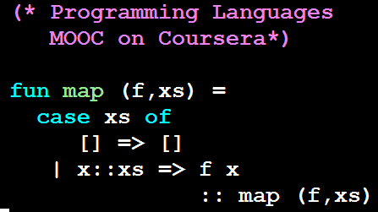
Who is this guy?
λx.x
2003-2050[?]
Notes:
UW faculty since 2003
Led undergrad curriculum revision 2009
ACM / IEEE-CS guidelines 2010-2013
MOOCs 2013 – present
Associate Chair for Eduction 2015 – present
Alumni relations, etc., etc.

Slide 3
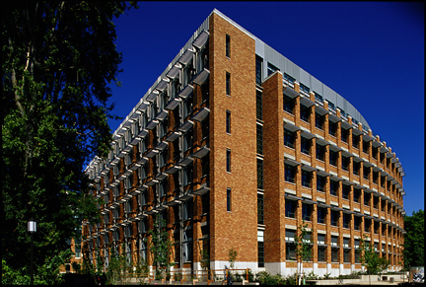
Life at the UW Allen School
345 CSE Bachelor’s degrees + second building in 2019
Out of a graduating class of ~6000 with much more demand
~70 faculty and growing

Slide 4
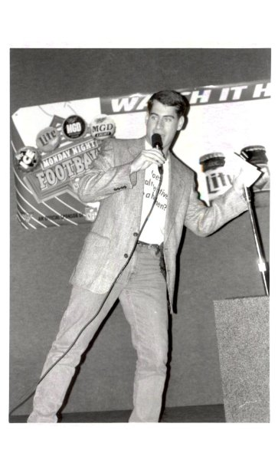
But before all that…
Rice 1993-1997
Sid
Chug captain (I wasn’t any good at it)
Honor Council
Flying to my 20th reunion tomorrow
Jesse and I were friends and lab partners in N COMP/EE courses
Somewhere I have a pre-digital photograph of him as Obi-Wan Kenobi

Slide 5
Life is a series of accidents
Impressionable freshman has friend say “take COMP 210”
Impressionable sophomore has professor connect him for summer research
Impressionable junior/senior gets reasonably good advice about applying to Ph.D. programs
… then at some unknown point I turned into an adult who has been doing PL research for 20 years

Slide 6
Life in PL Research
Publish research papers
Hope for impact in 5-20 years
Less theoretical of the two top conferences: PLDI
ACM SIGPLAN Conference on
Programming Language Design and Implementation
On my mind…

Slide 7
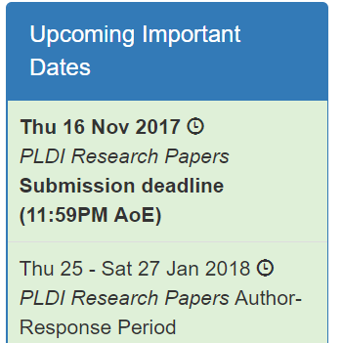

Slide 8
PLDI != PLDI
1980s and 1990s answer: compiler optimization and a little other stuff
Almost-never answer: design and implementation of a new language
I’m, like, in charge, but can’t give a one-tweet answer. Here’s a try:

Slide 9
Cutting-edge PL research leverages a worldview centered on:
Structured language with precise semantics
Interpreters, compilers, run-time systems
Static and/or dynamic code analysis
Automated creation, modification, and verification of programs
… to do anything useful to somebody
What changes most quickly

Slide 10
My PLDI history

Slide 11
2002

Slide 12
2007

Slide 13
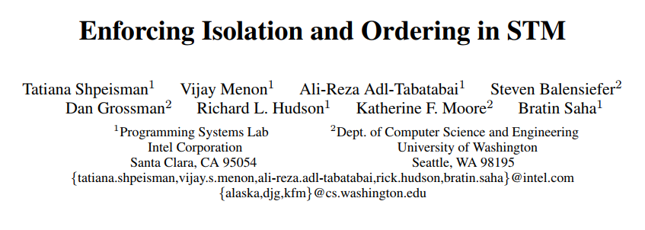
2007

Slide 14
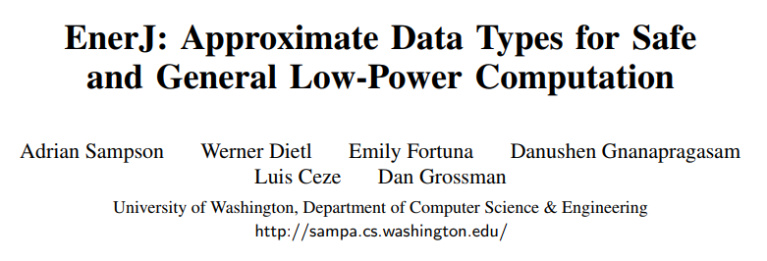
2011

Slide 15
2012

Slide 16
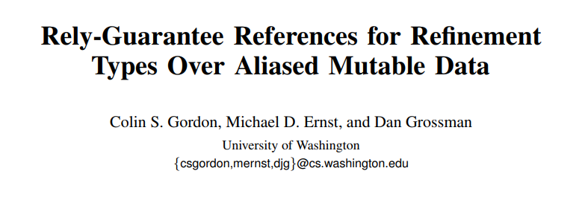
2013

Slide 17
2014

Slide 18
2014

Slide 19
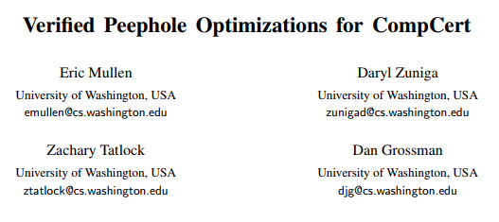
2016

Slide 20
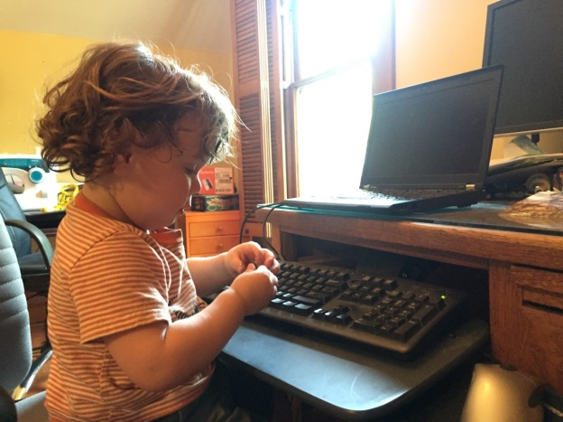
Dan Grossman
djg@cs.uw.edu
http://homes.cs.uw.edu/~djg

