Slide 1
My Programming Languages MOOC: Some Reflections After a First Offering Dan Grossman Department of Computer Science & Engineering University of Washington UWT/CTC May 10, 2013

Slide 2
Plan
Background on MOOCs
My role
Why I did a MOOC and why UW CSE is doing 6+
Quick course-tour
How it went
Lots of time for discussion
Everybody likes talking about MOOCs, pro or con
Rather let you pick the subtopics!

Slide 3
What makes a MOOC a MOOC
Online
Video, discussion board, etc.
Free
Can talk monetization strategies if you want, but not my role
Semi-synchronous courses
Social cohorts with modern lives
Scale
Past, say, 5,000 students, more students makes a class better
Nothing can flow through the course staff

Slide 4
Recent history [of “xMOOCs”]
2 years ago:
3 CS MOOCs from Stanford go viral, hit NYT, etc.
(Also Khan Academy, Code Academy, cMOOCs, …)
1 year ago:
Coursera, Udacity, EdX, Stanford, …
UW signs non-exclusive agreement with Coursera
Coursera: > 3M students, > 60 universities, > 350 courses
Everybody is talking about it
All of academia, from presidents on down
Much of the software industry
Friends I haven’t seen in 10 years, strangers, my parents, …

Slide 5
My role
Instructor: Programming Languages on Coursera, Jan-Mar 2013
Sophomore-level majors-only class in a very competitive major
A challenging course made available to all
1700 passed, 3000 watched through to the end, 5500 turned in first homework, …
Leading department’s efforts to offer 5 courses this year
Instructors plus cadre of nimble TAs
Simple-ish “recording studio”
High-quality pedagogy and logistics
Meeting with various UW entities about the path forward
UWEO has a different approach
Attended the Coursera partners conference, representing UW

Slide 6
What a year!
12 months ago, I wasn’t a “MOOC expert,”
but it has been a fantastic passion
It’s early days
Mostly brought energy, organization, and “common sense”

Slide 7
Plan
Background on MOOCs
My role
Why I did a MOOC and why UW CSE is doing 6+
Quick course-tour
How it went
Lots of time for discussion
Everybody likes talking about MOOCs, pro or con
Rather let you pick the subtopics!

Slide 8
Why? Faculty View
I believe I have a great course and want to have impact
5-10x more students in 1 term than in last decade combined
Influence other educators
More fun and effective than writing a textbook
Fame (not fortune)
Be part of academic change
Not read about it in the newspaper
No substitute for first-hand experience
Have people learn instead of watching Real Housewives

Slide 9
Why? Department View
Can have amazing impact
Scalable, worldwide leaders in computing education
MOOCs might [not] change how universities work in N years
We need experience
Improve and leverage CSE and UW reputation
Feedback to improve conventional courses
New modalities (e.g., video, peer assessment)
Massive data
Yes, this costs money, but remarkably little
Cost is time (cf. textbook)

Slide 10
Two Comparisons
Compared to conventional courses
Same or better: Homeworks, lectures
Unclear: Study groups
Worse: Design projects, exams, mentoring, …
Compared to writing a textbook!!
Attrition ≠ failure
Rarely profitable for authors
Worldwide impact of high-quality materials
Influence other educators
Better: videos, forums, graded homework
“21st – century textbook plus social”

Slide 11
Does free mean doom?
“If these courses are free, why are people paying tuition?”
Coherent 4-year curriculum
Personal interaction with faculty/TAs
Homeworks graded by humans
Open-ended design and free-response questions
Credit because we know you actually learned the material
Courses adapt to student needs
Plus other reasons to be at a university:
social support, job fairs, advisors,
independent study/research, etc.
Focus on our higher-value “products”?

Slide 12
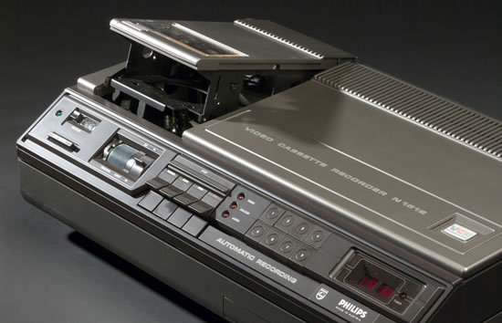
Perspective
It is plausible MOOCs will kill universities as we know them (!)
But none of these did:
Plus: iTunes U, UW TV, course web pages, books, …
And yet: Big changes can happen fast

Slide 13
Plan
Background on MOOCs
My role
Why I did a MOOC and why UW CSE is doing 6+
Quick course-tour
How it went
Lots of time for discussion
Everybody likes talking about MOOCs, pro or con
Rather let you pick the subtopics!

Slide 14
The UW course
10 weeks
Topics: Syntax vs. semantics, recursive functions, benefits of no mutation, algebraic datatypes and pattern matching, tail recursion, higher-order function closures, lexical scope, currying, syntactic sugar, equivalence and effects, parametric polymorphism, type inference, modules and abstract types, static vs. dynamic typing, streams and memoization, macros, eval, pure OOP, implementing dynamic dispatch, multiple inheritance vs. mixins, OOP vs. functional decomposition, subtyping, bounded polymorphism
Languages: ML, Racket, Ruby
Seven homeworks, all programming
Midterm and final, including English and code

Slide 15
The Coursera course
10 weeks
Topics: Syntax vs. semantics, recursive functions, benefits of no mutation, algebraic datatypes and pattern matching, tail recursion, higher-order function closures, lexical scope, currying, syntactic sugar, equivalence and effects, parametric polymorphism, type inference, modules and abstract types, static vs. dynamic typing, streams and memoization, macros, eval, pure OOP, implementing dynamic dispatch, multiple inheritance vs. mixins, OOP vs. functional decomposition, subtyping, bounded polymorphism
Languages: ML, Racket, Ruby
Seven homeworks, all programming, average of 2 submissions
Midterm and final, including English and code

Slide 16
Key pieces
Videos:
7-12 minutes, released roughly weekly (3ish hours / week)
Lots of writing code in Emacs, also Powerpoint
TAs added “in-video questions” independently
Homeworks:
From UW course, with “weapons-grade” auto-testing
Peer assessment for 10% of grade
Biggest complaint was lack of provided test cases
Exams: Open materials, multiple-choice-ish
Discussion Forum: Active and mostly self-sufficient

Slide 17
The numbers
“Registered”: 70,000 totally irrelevant
Clicked play in first 2 weeks: 30,000 many didn’t have pre-reqs?
Watched an hour of video: 11,000 like coming to first day?
Turned in first homework: 5,000
Took midterm: 3,000 this is a solid number
Turned in 5th homework: 2,000 attrition doesn’t stop
“Passed”: 1,700
Fan mail/posts: > 300
Define success however you want
Many love it in parts, start late, don’t turn in homework, etc.
Learning rather than watching television
Fairly consistent with Coursera data across “hard” courses

Slide 18
How did we do it?
Compared to most institutions, we did this all ad hoc
With lots of advance preparation
And lots of stress
A behind-the-scenes look in four pictures…

Slide 19
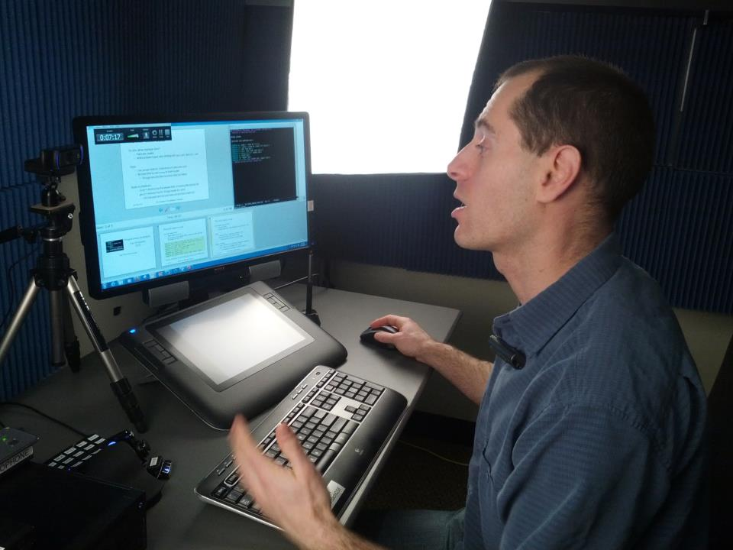
Four pictures

Slide 20
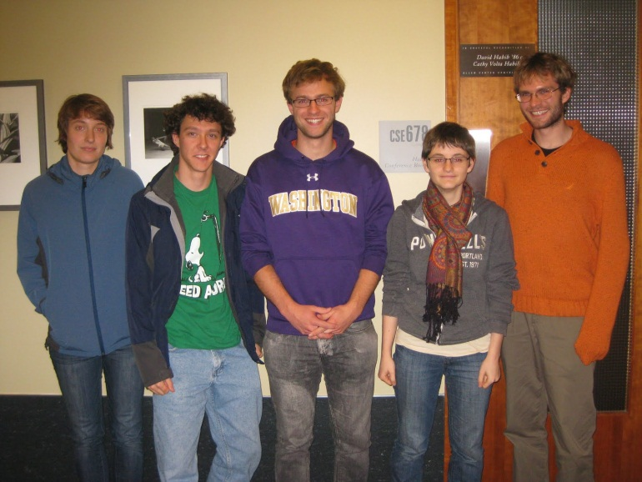
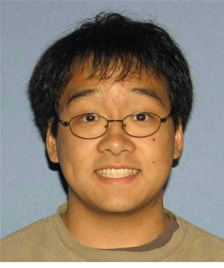
Four pictures

Slide 21
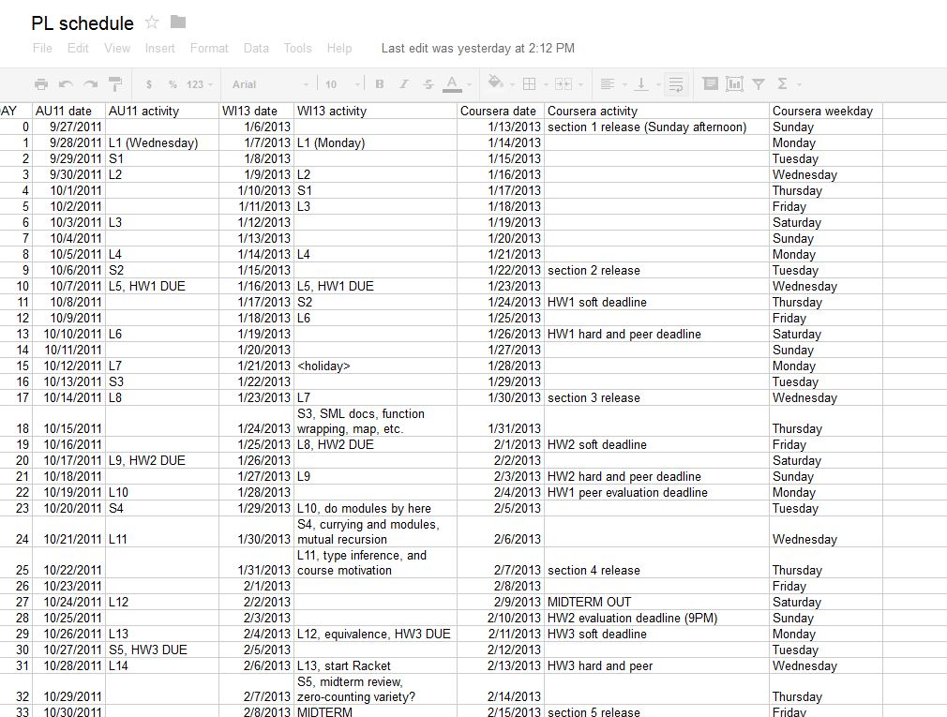
Four Pictures

Slide 22
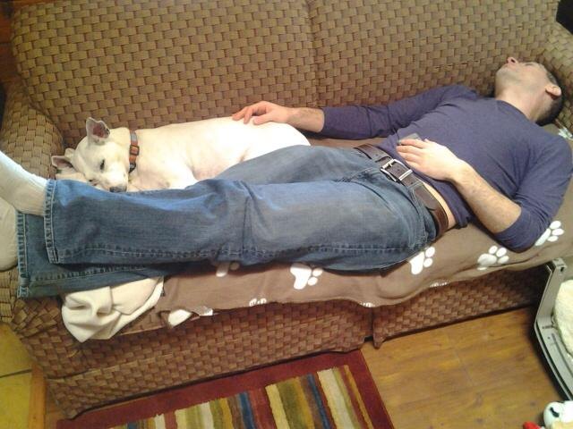
Four pictures

Slide 23
Where my time went (ignoring TAs)
Caveat: All very rough guesses; started 4 months early
Lectures: 30 hours of content, 250-300 hours total
Had taught course 5 times previously
80-90% of this work requires domain expertise
Discussion forum: Several times / day, briefly (cf. Facebook)
Homeworks: Auto-grading and peer assessment 100 hours?
Much more than multiple choice
Exams: 20-30 hours
Announcements, website, TA meetings, fixing typos, schedule spreadsheet, stress, … ???

Slide 24
What the TAs did
In-video questions
Grading scripts
Some things not requiring domain expertise
File uploading, proof-reading, …
Note: TAs are much better than faculty/staff at learning new things!

Slide 25
Plan
Background on MOOCs
My role
Why I did a MOOC and why UW CSE is doing 6+
Quick course-tour
How it went
Lots of time for discussion
Everybody likes talking about MOOCs, pro or con
Rather let you pick the subtopics!

Slide 26
For the staff
Me:
Extremely rewarding, exhausting, and hopefully influential
TAs:
Really proud and worked super hard
I made a point of acknowledging the “sherpas,” but MOOCs still create “cult of personality”

Slide 27
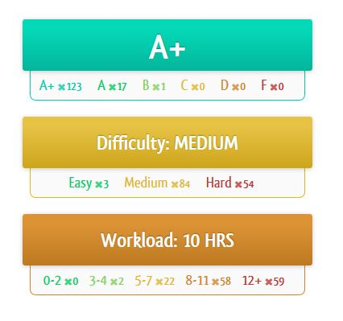
For the participants
2000+ very happy
Perhaps more
In some sense, I get to pick
which 2000+ are happy
Forum posts, online reviews, emails,
postcards, …
Spare you the gushing ☺

Slide 28
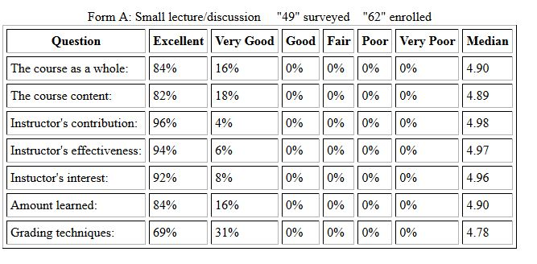
For the UW students
They got videos (not really flipped), more TAs, cachet
But otherwise Coursera rarely mentioned
My highest teaching evaluations ever…
Great TAs a big reason

Slide 29
So… do I advise teaching a MOOC?
Find your best, motivated faculty without arm-twisting
Very public
Share your unique passion with the world with high-quality material because you can’t pass it up
Focus on basic A/V quality and great homeworks
More is distracting
Understand (current) demographics: Most are non-U.S. and already have a Bachelor’s degree
How should you teach a MOOC? Two answers:
No more one-right-way than in a classroom
But it’s different: learn from others’ experience

Slide 30
For me…
One of the coolest things I have ever done
Rewarding, influential, exhausting
What I got for teaching thousands of students around the world?
I got to teach thousands of students around the world!
What I hope comes next:
Help “high-impact” UW teachers find their audience
Help UW become a leader with the highest-quality brand
It’s early days: everything will change in 5 years, but I couldn’t wait

Slide 31
[Things I predict you will ask about follow]

Slide 32
Thorny Issues
Yes, yes, many difficult questions ahead
If you wait for clear answers, you may remain a spectator
intellectual property
revenue models
faculty compensation
future of universities
credit-for-MOOCs
university quality control
Can talk about all this if you want, but less interesting?

Slide 33
Do they learn?
My MOOC participants probably learned less on average than my conventional 50-70 students
That’s not my goal: I want more impact than writing a book
The comparison is moot: We don’t have the capacity and students don’t have the flexibility to make that choice
About the impact, impact, impact!
Not the grading

Slide 34
Remember the numerator
Which has more impact?
95% completion rate with 200 students
3% completion rate with 50,000 students
We need to change the denominator to something realistic
I did not have 70,000 students
Nor did I have a 3% completion rate
“Did you intend to complete the coursework and did you watch at least 2 hours of video?”

