Slide 1
Advanced Memory Management

Slide 2
Main Points
Applications of memory management
What can we do with ability to trap on memory references to individual pages?
File systems and persistent storage
Goals
Abstractions
Interfaces

Slide 3
Address Translation Uses
Process isolation
Keep a process from touching anyone else’s memory, or the kernel’s
Efficient interprocess communication
Shared regions of memory between processes
Shared code segments
E.g., common libraries used by many different programs
Program initialization
Start running a program before it is entirely in memory
Dynamic memory allocation
Allocate and initialize stack/heap pages on demand

Slide 4
Address Translation (more)
Program debugging
Data breakpoints when address is accessed
Zero-copy I/O
Directly from I/O device into/out of user memory
Memory mapped files
Access file data using load/store instructions
Demand-paged virtual memory
Illusion of near-infinite memory, backed by disk or memory on other machines

Slide 5
Address Translation (even more)
Checkpoint/restart
Transparently save a copy of a process, without stopping the program while the save happens
Persistent data structures
Implement data structures that can survive system reboots
Process migration
Transparently move processes between machines
Information flow control
Track what data is being shared externally
Distributed shared memory
Illusion of memory that is shared between machines

Slide 6
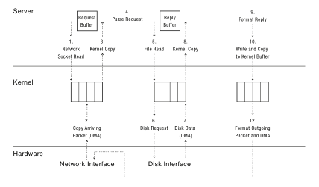
Web Server

Slide 7
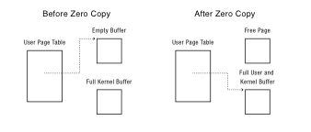
Zero Copy I/O Block Aligned Read/Write System Calls

Slide 8
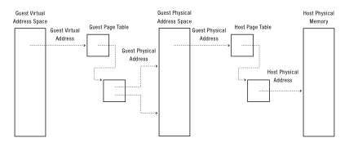
Virtual Machines and Virtual Memory

Slide 9
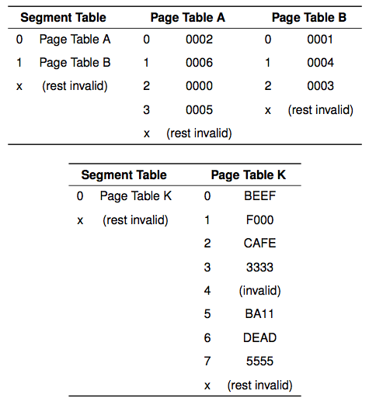

Slide 10
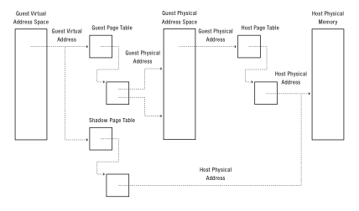
Shadow Page Tables

Slide 11
Hardware Support for Virtual Machines
x86 recently added hardware support for running virtual machines at user level
Operating system kernel initializes two sets of translation tables
One for the guest OS
One for the host OS
Hardware translates address in two steps
First using guest OS tables, then host OS tables
TLB holds composition

Slide 12
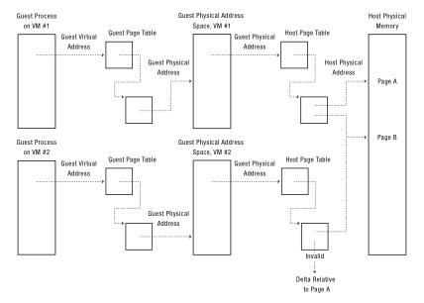
VMM Memory Compression

Slide 13
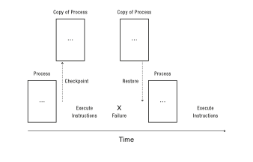
Transparent Checkpoint

Slide 14
Question
At what point can we resume the execution of a checkpointed program?
When the checkpoint starts?
When the checkpoint is entirely on disk?

Slide 15
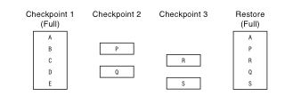
Incremental Checkpoint

Slide 16
Deterministic Debugging
Can we precisely replay the execution of a multi-threaded process?
If process does not have a memory race
From a checkpoint, record:
All inputs and return values from system calls
All scheduling decisions
All synchronization operations
Ex: which thread acquired lock in which order

Slide 17
Process Migration
What if we checkpoint a process and then restart it on a different machine?
Process migration: move a process from one machine to another
Special handling needed if any system calls are in progress
Where does the system call return to?

Slide 18
Cooperative Caching
Can we demand page to memory on a different machine?
Remote memory over LAN much faster than disk
On page fault, look in remote memory first before fetching from disk

Slide 19
Distributed Virtual Memory
Can we make a network of computers appear to be a shared-memory multiprocessor?
Read-write: if page is cached only on one machine
Read-only: if page is cached on several machines
Invalid: if page is cached read-write on a different machine
On read page fault:
Change remote copy to read-only
Copy remote version to local machine
On write page fault (if cached):
Change remote copy to invalid
Change local copy to read-write

Slide 20
Recoverable Virtual Memory
Data structures that survive failures
Want a consistent version of the data structure
User marks region of code as needing to be atomic
Begin transaction, end transaction
If crash, restore state before or after transaction

Slide 21
Recoverable Virtual Memory
On begin transaction:
Snapshot data structure to disk
Change page table permission to read-only
On page fault:
Mark page as modified by transaction
Change page table permission to read-write
On end transaction:
Log changed pages to disk
Commit transaction when all mods are on disk
Recovery:
Read last snapshot + logged changes, if committed

