Slide 1
Interactive Design Space Exploration and Optimization for CAD Models
Adriana Schulz¹
Jie Xu¹
Bo Zhu¹
Changxi Zheng²
Eitan Grinspun²
Wojciech Matusik¹
¹Massachusetts Institute of Technology
²Columbia University

Slide 2
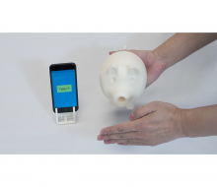
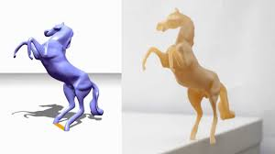
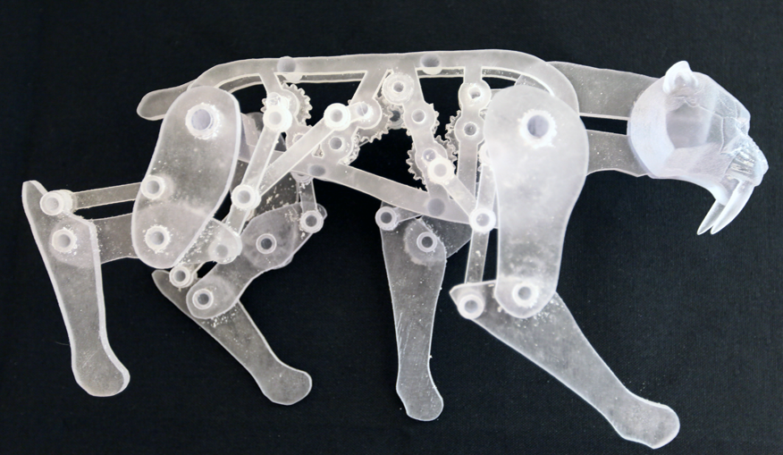
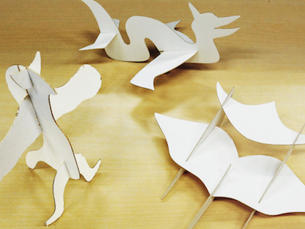
Computational Design
[Bächer et al. 2014]
[Prevost et al. 2014]
[Coros et al. 2013]
[Musialski et al. 2015]
[Umetani et al. 2014]

Slide 3
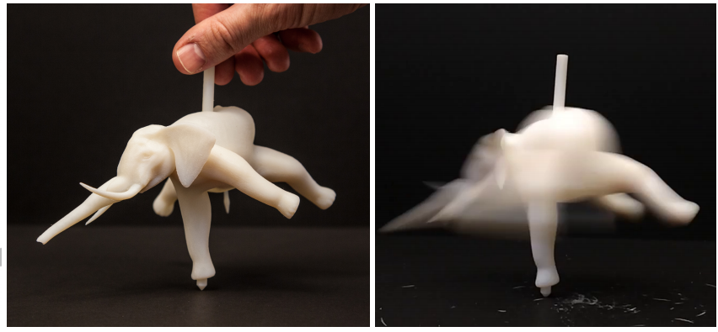
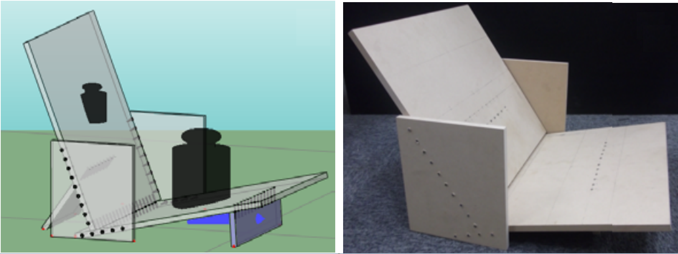
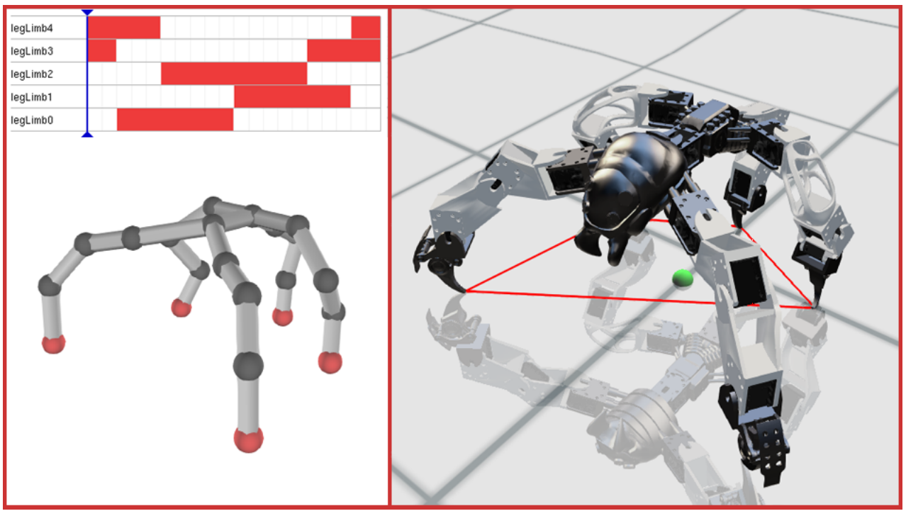
Typical Approaches
Parametrized
Design Space
[Umetani et al. 2012]
[Bächer et al. 2014]
[Bharaj et al. 2015]
[Megaro et al. 2015]
Optimization
Interactive Exploration
[Bharaj et al. 2015]
[Prevost et al. 2014]
[Musialski et al. 2015]

Slide 4
Parametrization
Parametric
Shape
parameters
Advantages:
constrains manipulations
reduces the search space

Slide 5
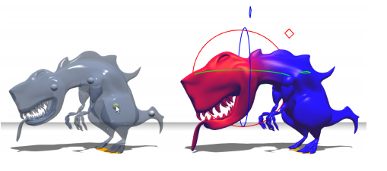
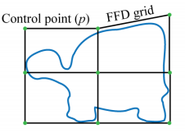
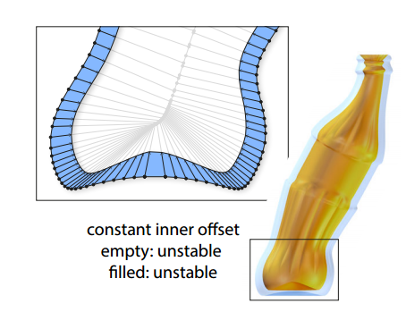
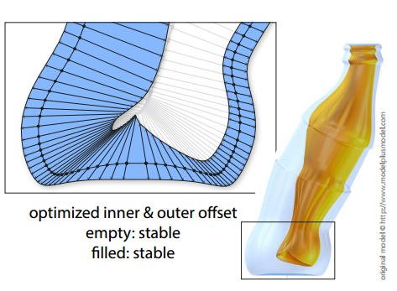
Parametrization Techniques
Cages
Linear Blend Skinning
[Prevost et al. 2014]
[Bharaj et al. 2015]
Offset Surfaces
[Musialski et al. 2015]

Slide 6
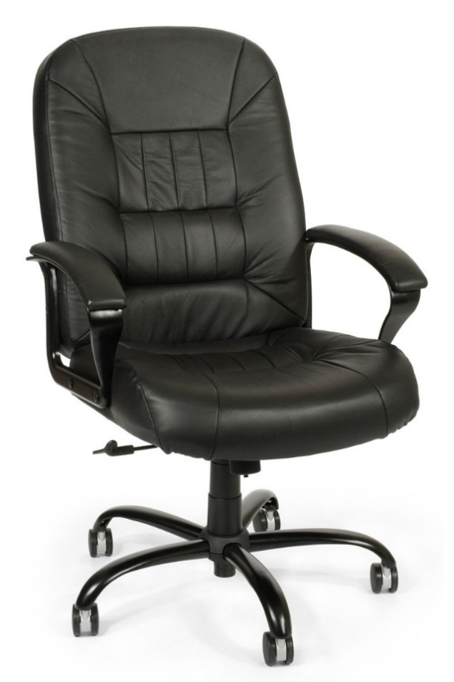
The World’s Preeminent Source of Parametric Data…

Slide 7
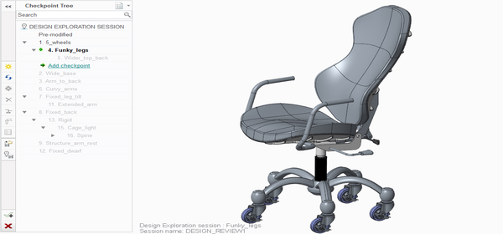
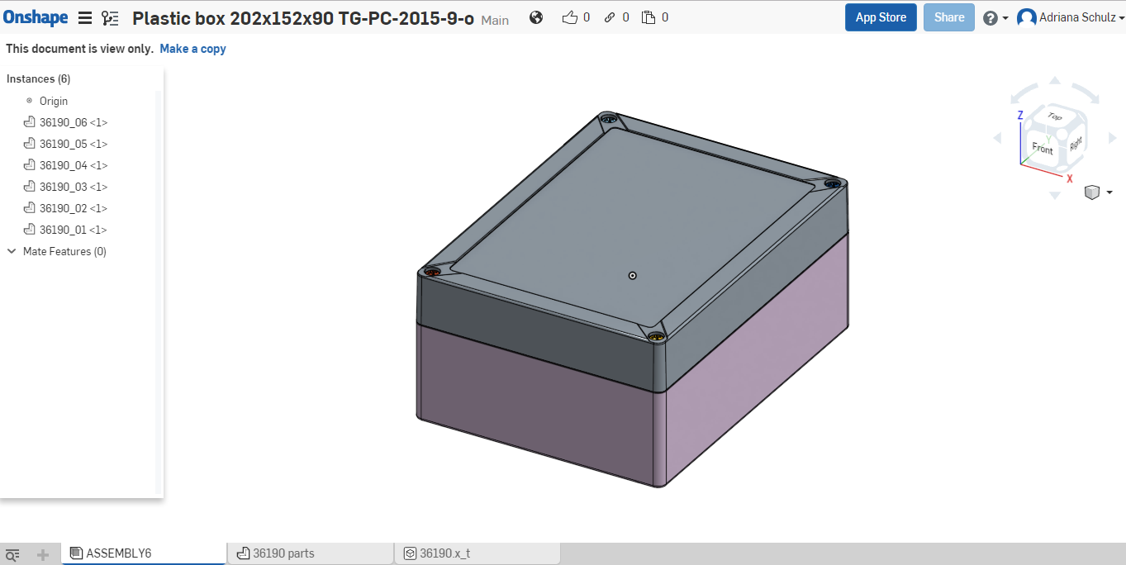
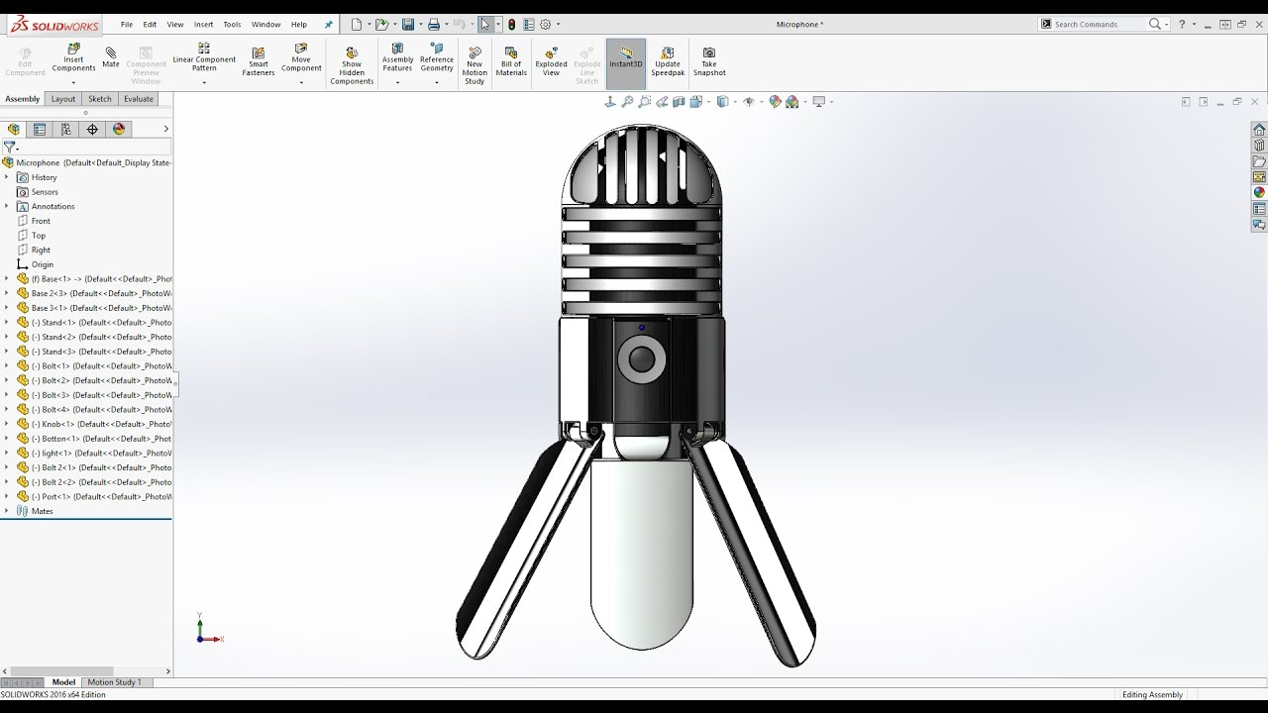
The World’s Preeminent Source of Parametric Data… CAD Systems

Slide 8
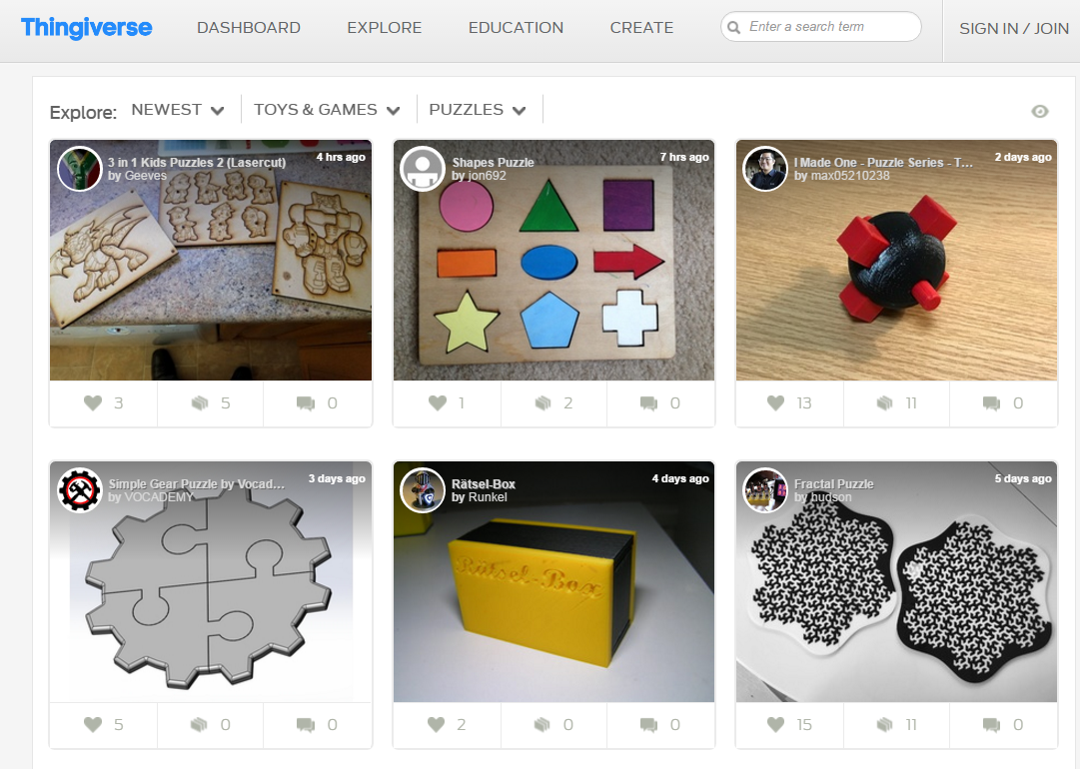
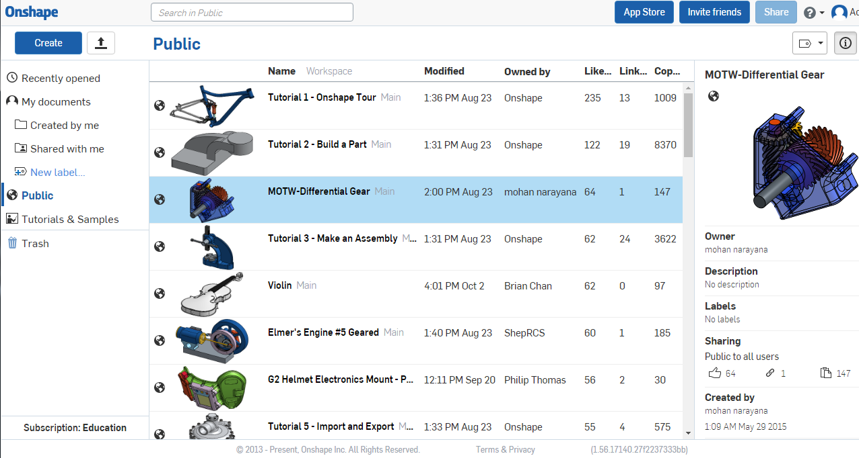
CAD Shape Collections
Thingiverse
GrabCAD
Onshape’s Public Repository

Slide 9
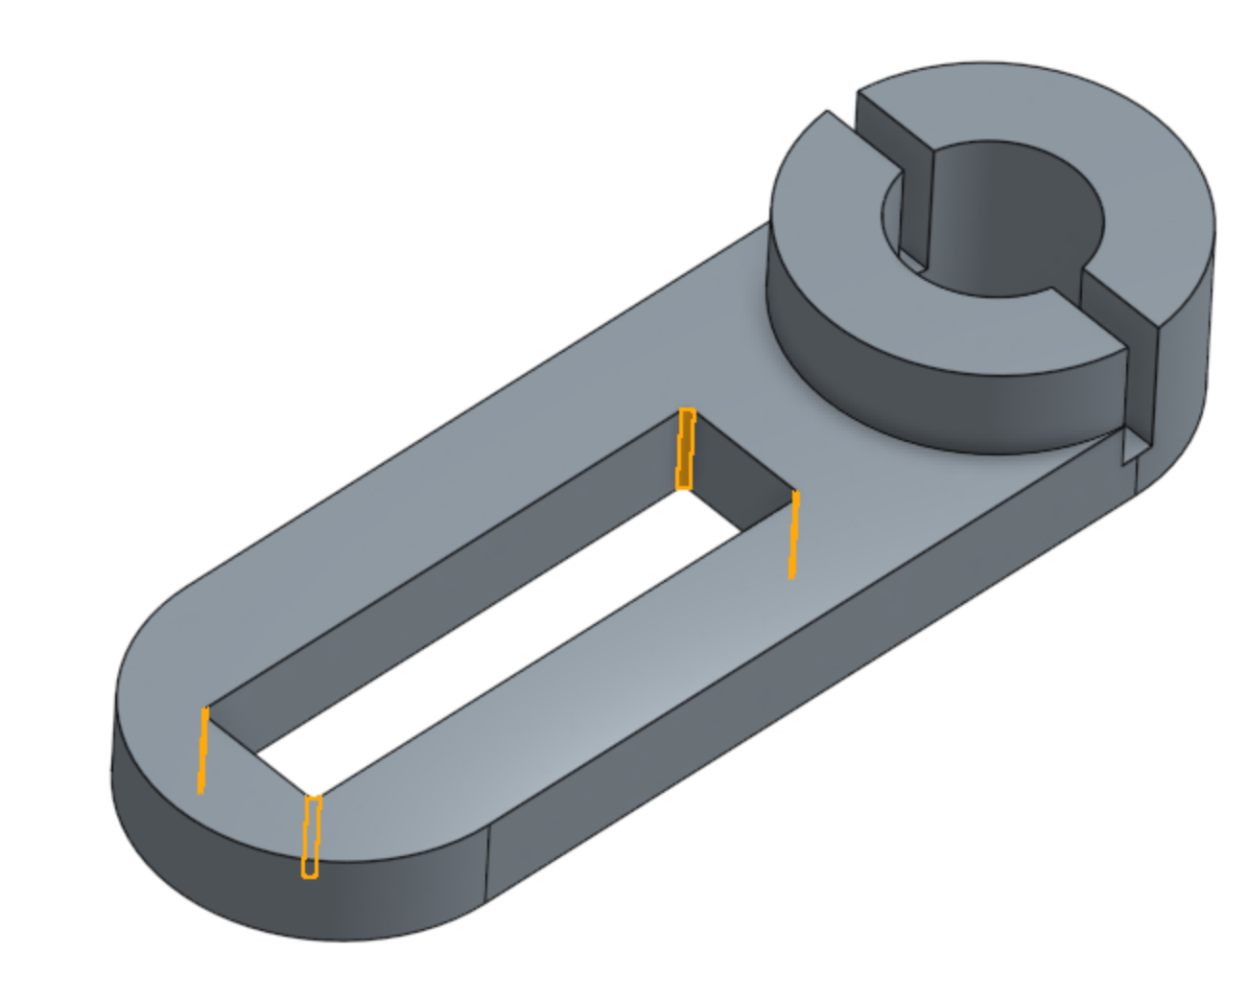
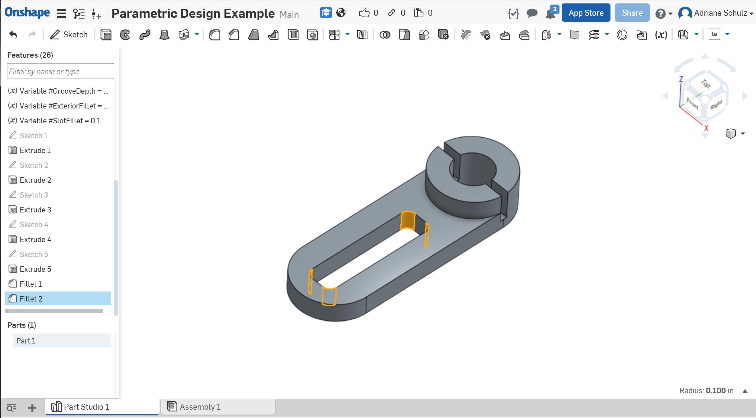
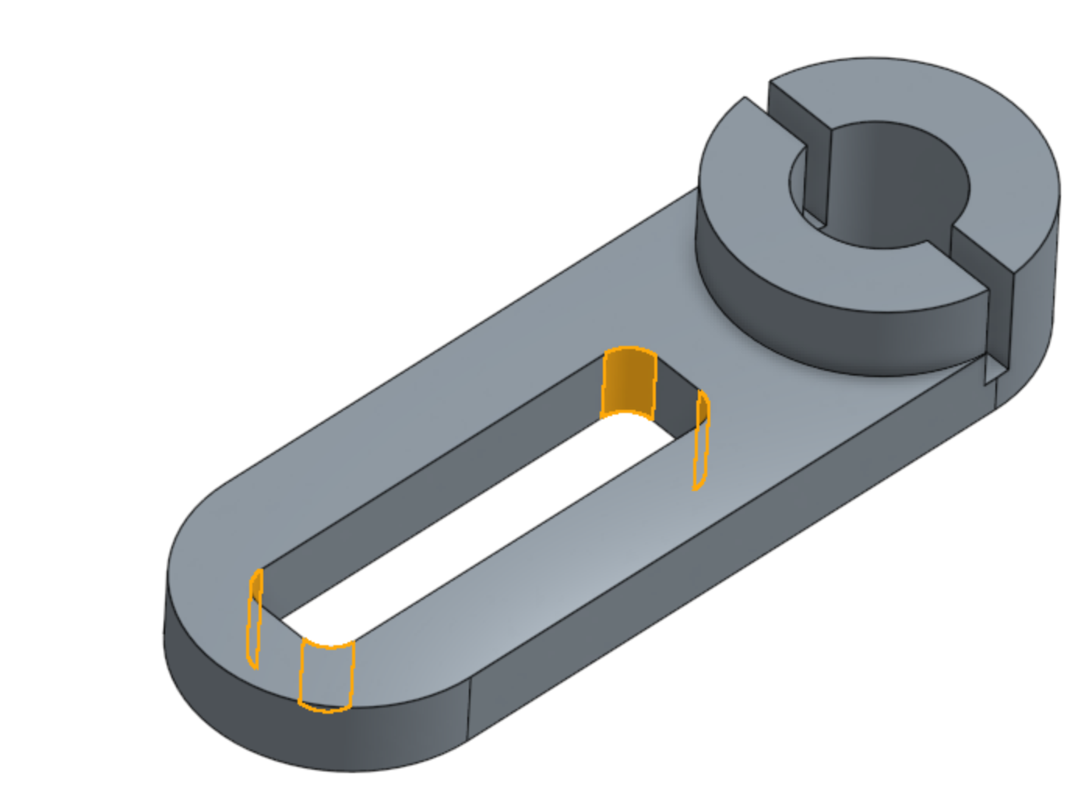
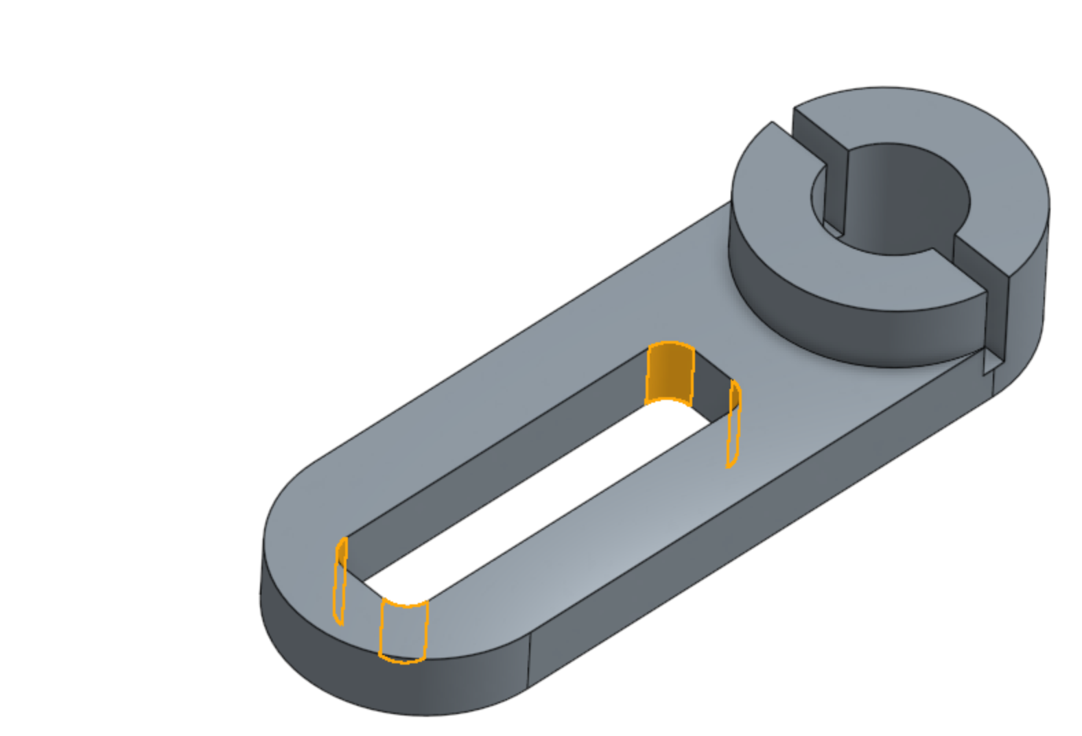
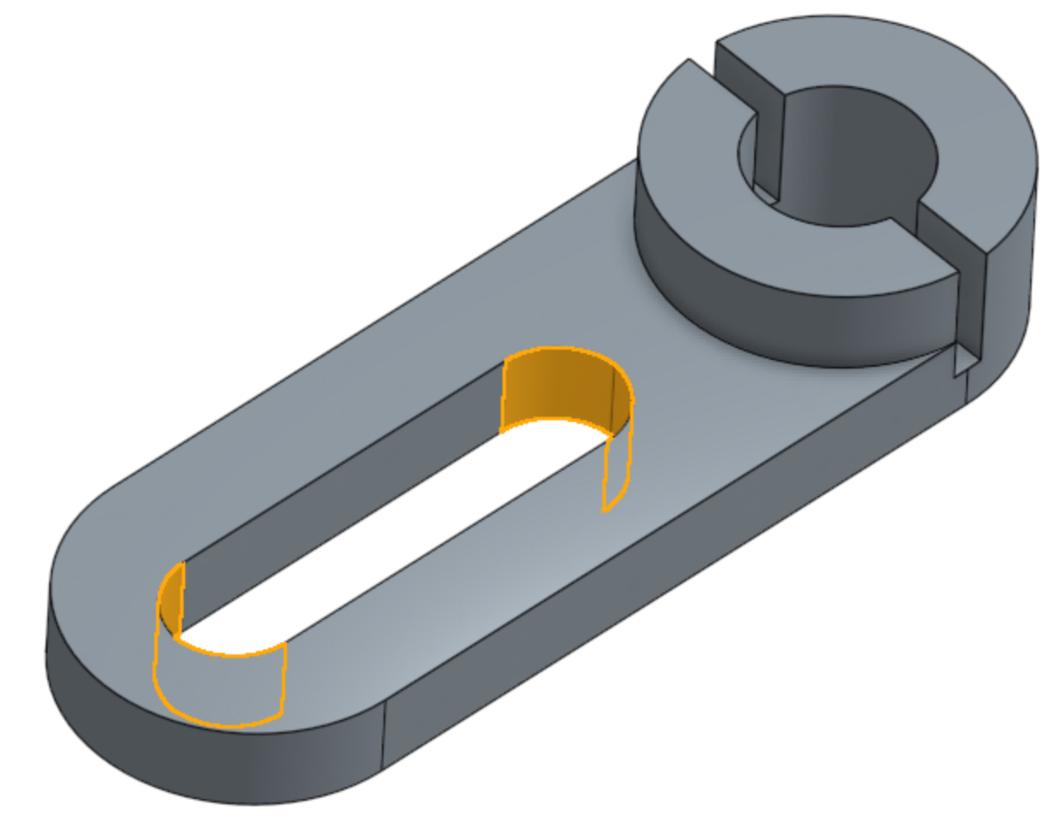
Expert Designed Parameters
exposed parameters

Slide 10
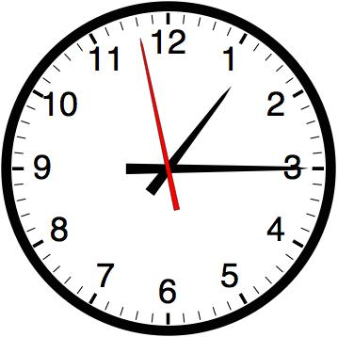
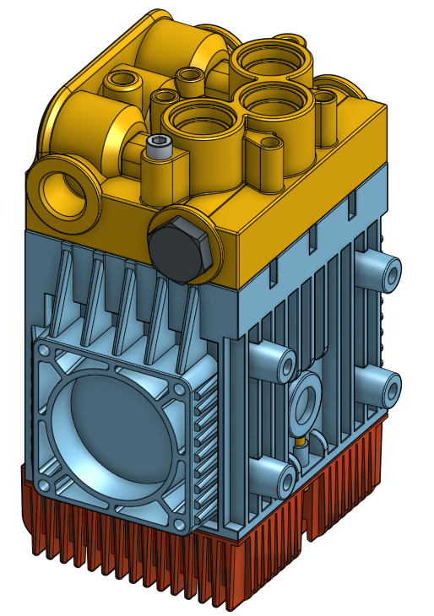
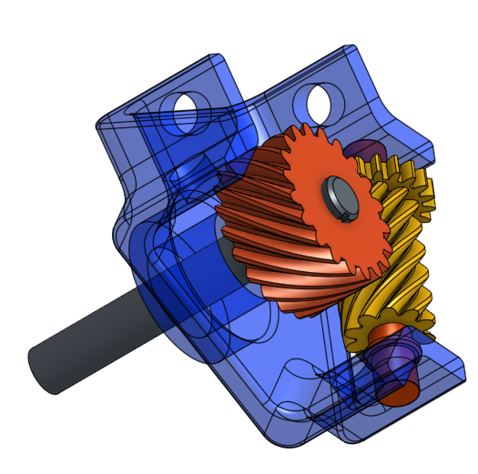
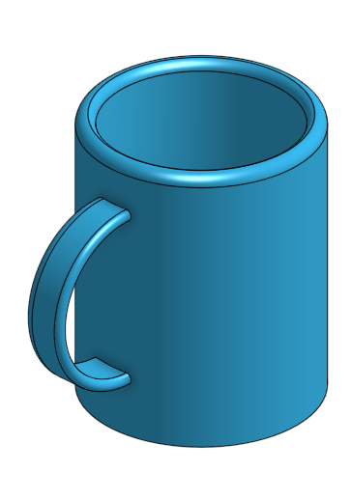
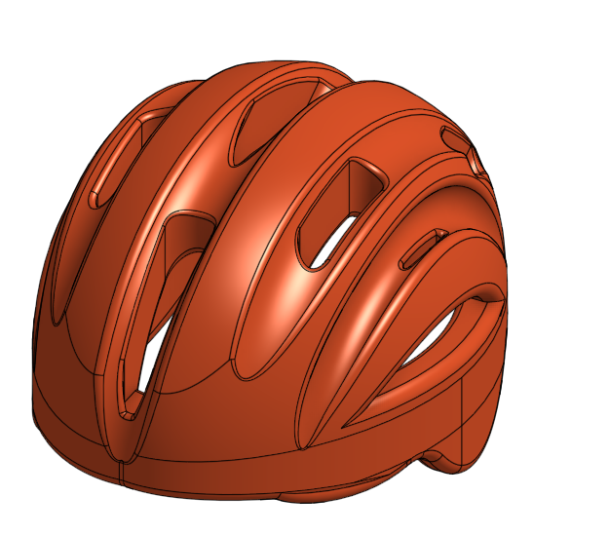
But no Real-time Exploration
parameters
CAD
sweeping
booleans
filleting
drafting
Regeneration Times (Onshape):
< 1 second
3 seconds
14 seconds
72 seconds

Slide 11
Typical Pipeline
parameters
CAD
simulation
re-iterate

Slide 12
Proposed Approach
exposed parameters
CAD model
Real-time Parametric Updates
+ Physical Properties

Slide 13
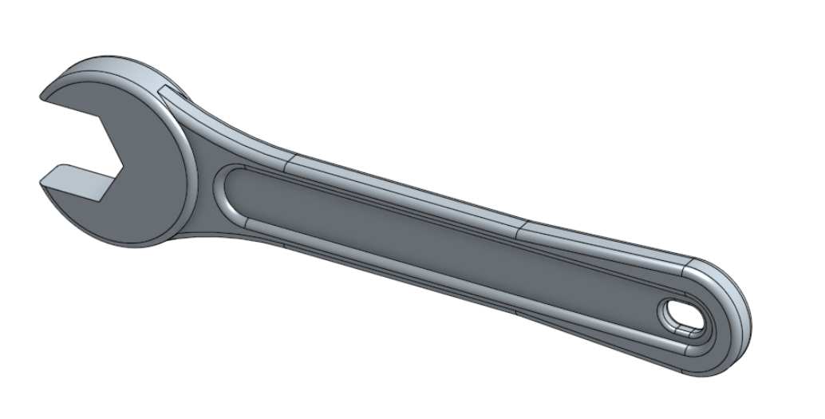
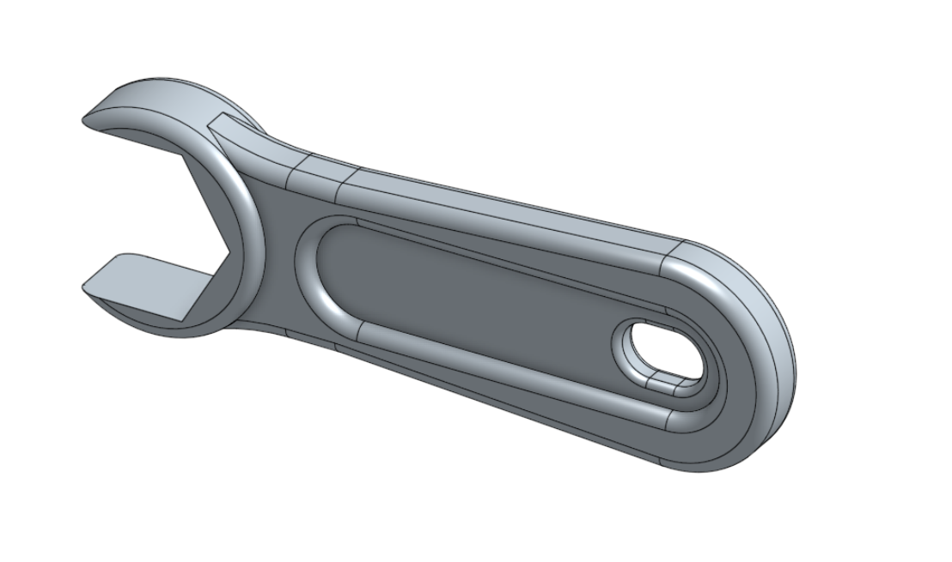
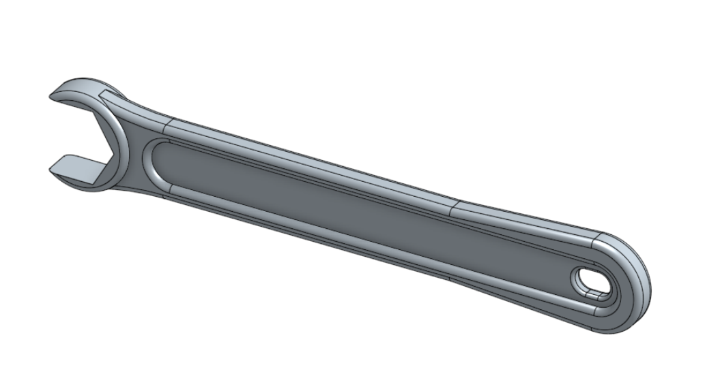
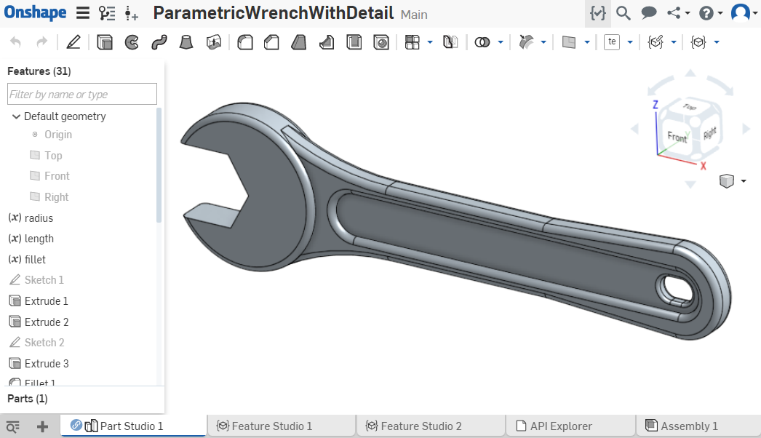
Our Method
Parametric
Space
input
precomputed data
output

Slide 14
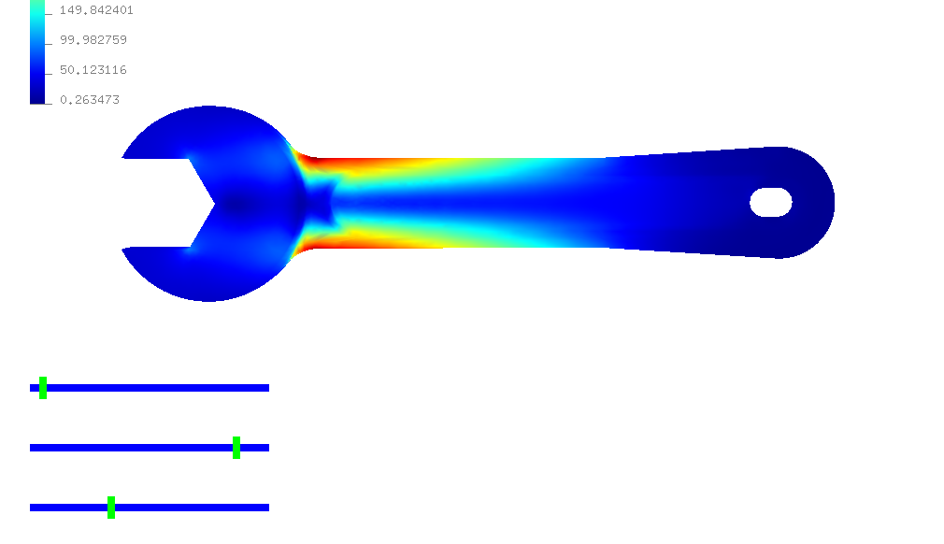
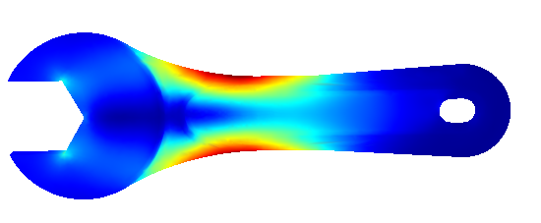
Our Method
Parametric
Space
input
precomputed data
output

Slide 15
Challenges: sampling and interpolation
Non-uniform
Different Combinatorics
Continuity
/Smoothness

Slide 16
Adaptive Sampling: K-d Trees
Error
Approximation
Ground Truth
Parametric
Space

Slide 17
Interpolation
$$P\left(x\right)= ∑ψ_{i}(x)p_{i}$$
$$ψ_{2}(x)$$
$$ψ_{3}(x)$$
$$ψ_{0}(x)$$
$$ψ_{1}(x)$$
$$p_{0}$$
$$p_{1}$$
$$p_{2}$$
$$p_{3}$$
$$x$$
$$ψ_{4}(x)$$
$$p_{4}$$
$$p^{A}$$
$$ψ_{7}(x)$$
$$ψ_{6}(x)$$
$$ψ_{5}(x)$$
$$p_{5}$$
$$p_{6}$$
$$p_{7}$$

Slide 18
Interpolation
$$P\left(x\right)= ∑ψ_{i}(x)p_{i}$$
$$ψ_{2}(x)$$
$$ψ_{3}(x)$$
$$ψ_{0}(x)$$
$$ψ_{1}(x)$$
$$p_{0}$$
$$p_{1}$$
$$p_{2}$$
$$p_{3}$$
$$x$$
$$ψ_{4}(x)$$
$$p_{4}$$
$$p^{A}$$
$$p_{7}$$
$$p_{7}^{A}$$
$$ψ_{7}(x)$$
$$ψ_{6}(x)$$
$$ψ_{5}(x)$$
$$p_{5}$$
$$p_{6}$$
$$p_{7}$$

Slide 19
Interpolation
$$P\left(x\right)= ∑ψ_{i}(x)p_{i}$$
$$ψ_{2}(x)$$
$$ψ_{3}(x)$$
$$ψ_{0}(x)$$
$$ψ_{1}(x)$$
$$p_{0}$$
$$p_{1}$$
$$p_{2}$$
$$p_{3}$$
$$x$$
$$ψ_{4}(x)$$
$$p_{4}$$
$$p^{A}$$
$$ψ_{7}(x)$$
$$ψ_{6}(x)$$
$$ψ_{5}(x)$$
$$p_{5}$$
$$p_{6}$$
$$p_{7}$$

Slide 20
Interpolation
$$P\left(x\right)=\sum_{\left\{ψ_{i}(x)≠0\right\}}{ψi\left(x\right)p_{i}}$$
$$P\left(x\right)= ∑ψ_{i}(x)p_{i}$$
$$ψ_{2}(x)$$
$$ψ_{3}(x)$$
$$ψ_{0}(x)$$
$$ψ_{1}(x)$$
$$p_{1}^{A}$$
$$p_{2}^{A}$$
$$p_{0}^{A}$$
$$p_{3}^{A}$$
$$x$$
$$ψ_{4}(x)$$
$$p^{A}$$
$$p_{4}^{A}$$
$$ψ_{7}(x)$$
$$ψ_{6}(x)$$
$$ψ_{5}(x)$$
$$p_{5}^{A}$$
$$p_{6}^{A}$$
$$p_{7}^{A}$$

Slide 21
Locality Property

Slide 22
Interpolation with Locality
$$ψ_{2}(x)$$
$$ψ_{3}(x)$$
$$ψ_{0}(x)$$
$$ψ_{1}(x)$$
$$p_{1}$$
$$p_{2}^{A}$$
$$p_{0}$$
$$p_{1}^{A}$$
$$p_{2}$$
$$p_{0}^{A}$$
$$p_{3}$$
$$x$$
$$ψ_{4}(x)$$
$$p_{4}$$
$$p^{A}$$
$$ψ_{7}(x)$$
$$ψ_{6}(x)$$
$$ψ_{5}(x)$$
$$p_{5}$$
$$p_{6}^{A}$$
$$p_{6}$$
$$p_{7}^{A}$$
$$p_{7}$$

Slide 23
Interpolation Steps
$$p_{1}$$
$$p_{1}^{A}$$
$$p_{1}^{B}$$
$$p_{1}^{C}$$
$$ψ_{1}(x)$$
$$ψ_{2}(x)$$
$$ψ_{3}(x)$$
$$ψ_{0}(x)$$
$$ψ_{4}(x)$$
$$p^{B}$$
$$p^{A}$$
$$p^{C}$$
$$ψ_{7}(x)$$
$$ψ_{6}(x)$$
$$ψ_{5}(x)$$

Slide 24
Interpolation Steps
Define the Basis Functions
(Locally) Consistent Mappings
$$P\left(x\right)= ∑ψ_{i}(x)p_{i}$$
sample
$$ψ_{2}(x)$$
$$ψ_{3}(x)$$
$$p_{1}$$
$$ψ_{0}(x)$$
$$ψ_{1}(x)$$
$$ψ_{4}(x)$$
element
mesh
$$p_{1}^{A}$$
$$p^{A}$$
mapping
$$ψ_{7}(x)$$
$$ψ_{6}(x)$$
$$ψ_{5}(x)$$

Slide 25
Interpolation Scheme
Locality
+
Continuity
(smoothness)
Challenge: K-d Trees

Slide 26
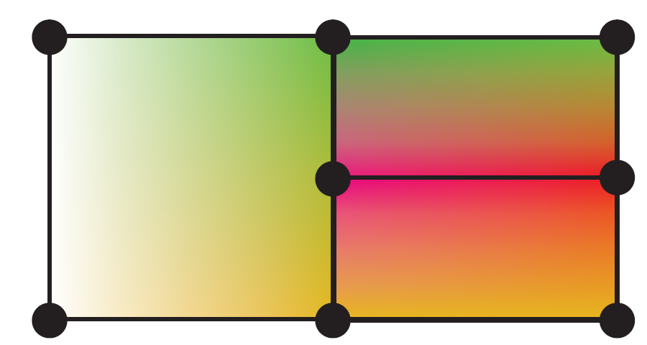
Challenge: Element Perspective
☺ locality
☹ continuity
T- junction

Slide 27
Challenge: Basis Perspective
☺ continuity
Basis Functions: $ψ$ (continuous)
Interpolation: $∑ψ_{i}p_{i}$ (continuous)
Hierarchical Refinement:
[Grinspun et al. 2002]

Slide 28
Challenge: Basis Perspective
☺ continuity
Basis Functions: $ψ$ (continuous)
Interpolation: $∑ψ_{i}p_{i}$ (continuous)
Hierarchical Refinement:
☹ locality
$$ψ_{A}$$
$$ψ_{B}$$
$$ψ_{A}$$
$$ψ_{C}$$
$$ψ_{B}$$
$$e_{0}$$
$$e_{3}$$
$$e_{4}$$
$$e_{1}$$
$$p_{A}$$
$$p_{B}$$
$$p_{A}$$
$$p_{C}$$
$$p_{B}$$
[Grinspun et al. 2002]

Slide 29
Challenge: Basis Perspective
☺ continuity
Basis Functions: $ψ$ (continuous)
Interpolation: $∑ψ_{i}p_{i}$ (continuous)
Hierarchical Refinement:
☹ locality
$$ψ_{A}$$
$$ψ_{B}$$
$$ψ_{A}$$
$$ψ_{C}$$
$$ψ_{B}$$
$$e_{0}$$
$$e_{3}$$
$$e_{4}$$
$$e_{1}$$
$$p_{A}$$
$$p_{B}$$
$$p_{A}$$
$$p_{C}$$
$$p_{B}$$
[Grinspun et al. 2002]

Slide 30
Challenge: Basis Perspective
☺ continuity
Basis Functions: $ψ$ (continuous)
Interpolation: $∑ψ_{i}p_{i}$ (continuous)
Hierarchical Refinement:
☹ locality
$$ψ_{A}$$
$$ψ_{B}$$
$$ψ_{A}$$
$$ψ_{C}$$
$$ψ_{B}$$
$$e_{0}$$
$$e_{3}$$
$$e_{4}$$
$$e_{1}$$
$$p_{A}$$
$$p_{B}$$
$$p_{A}$$
$$p_{C}$$
$$p_{B}$$
[Grinspun et al. 2002]

Slide 31
Solution
☺ continuity
☺ locality
Element Perspective + Basis Perspective

Slide 32
Refinement Relations
Coarser level ${(φ}_{i}^{0})$:
Finer level${(φ}_{i}^{1})$:
$$φ_{0}^{0}$$
$$φ_{1}^{0}$$
$$φ_{−1}^{1}$$
$$φ_{0}^{1}$$
$$φ_{1}^{1}$$
$$φ_{2}^{1}$$
$$φ_{3}^{1}$$
=
$$φ_{2}^{1}$$
$\frac{1}{2} φ_{1}^{1}$
$\frac{1}{2} φ_{3}^{1}$
$φ_{1}^{0}= \frac{1}{2} φ_{1}^{1}+φ_{2}^{1}$ + $\frac{1}{2} φ_{2}^{1}$
[Zorin and Schroder 2000]

Slide 33
Our Method – 1D example
level
Step1: Element Refinement
$$ψ_{A}$$
= $φ_{0}^{0}$
$$ψ_{B}$$
= $φ_{1}^{0}$
$$ψ_{C}$$
= $φ_{2}^{0}$
$$ψ_{D}$$
= $φ_{3}^{0}$
Step 2: Basis Refinement
position
$$e_{0}$$
$$e_{3}$$
$$e_{4}$$
$$e_{2}$$
$$e_{1}$$
$$p_{A}$$
$$p_{B}$$
$$p_{R}$$
$$p_{C}$$
$$p_{D}$$
$$P= p_{A}\underset{ψ_{A}}{\underbrace{φ_{0}^{0}}}+p_{B}\underset{ψ_{B}}{\underbrace{ φ_{1}^{0} }}+p_{C}\underset{ψ_{C}}{\underbrace{φ_{2}^{0} }}+p_{D}\underset{ψ_{D}}{\underbrace{φ_{3}^{0}}}$$
$$+ p_{R}\underset{ψ_{R}}{\underbrace{0}}$$
$$P = p_{A}ψ_{A}+{ p}_{B}ψ_{B}+{ p}_{C}ψ_{C} + p_{D}ψ_{D}$$

Slide 34
Our Method – 1D example
Step1: Element Refinement
$$ψ_{A}$$
= $φ_{0}^{0}$
$$ψ_{B}$$
= $φ_{1}^{0}$
$$ψ_{C}$$
= $φ_{2}^{0}$
$$ψ_{D}$$
= $φ_{3}^{0}$
Step 2: Basis Refinement
$$e_{0}$$
$$e_{3}$$
$$e_{4}$$
$$e_{2}$$
$$p_{A}$$
$$p_{B}$$
$$p_{R}$$
$$p_{C}$$
$$p_{D}$$
$$P= p_{A}\underset{ψ_{A}}{\underbrace{φ_{0}^{0}}}+p_{B}\underset{ψ_{B}}{\underbrace{ φ_{1}^{0} }}+p_{C}\underset{ψ_{C}}{\underbrace{φ_{2}^{0} }}+p_{D}\underset{ψ_{D}}{\underbrace{φ_{3}^{0}}}$$
$$+ p_{R}\underset{ψ_{R}}{\underbrace{0}}$$

Slide 35
Our Method – 1D example
$ψ_{B}$ =
Step1: Element Refinement
$$ψ_{A}$$
= $φ_{0}^{0}$
$$ψ_{C}$$
= $φ_{2}^{0}$
$$ψ_{D}$$
= $φ_{3}^{0}$
$$φ_{1}^{2}$$
Step 2: Basis Refinement
$$φ_{1}^{1}$$
$$φ_{3}^{1}$$
$$e_{0}$$
$$e_{3}$$
$$e_{4}$$
$$e_{2}$$
$$p_{A}$$
$$p_{B}$$
$$p_{R}$$
$$p_{C}$$
$$p_{D}$$
$$P= p_{A}\underset{ψ_{A}}{\underbrace{φ_{0}^{0}}}+p_{B}\underset{ψ_{B}}{\underbrace{\left(\frac{1}{2}φ_{1}^{1}+φ_{2}^{1}\text{ + }\frac{1}{2} φ_{3}^{1}\right)}}+p_{C}\underset{ψ_{C}}{\underbrace{φ_{2}^{0} }}+p_{D}\underset{ψ_{D}}{\underbrace{φ_{3}^{0}}}$$
$$+ p_{R}\underset{ψ_{R}}{\underbrace{0}}$$

Slide 36
Our Method – 1D example
$ψ_{B}$ =
Step1: Element Refinement
$$ψ_{A}$$
= $φ_{0}^{0}$
$$ψ_{C}$$
= $φ_{2}^{0}$
$$ψ_{D}$$
= $φ_{3}^{0}$
$$φ_{1}^{2}$$
Step 2: Basis Refinement
$$φ_{1}^{1}$$
$$φ_{3}^{1}$$
$$e_{0}$$
$$e_{3}$$
$$e_{4}$$
$$e_{2}$$
$$p_{A}$$
$$p_{B}$$
$$p_{R}$$
$$p_{C}$$
$$p_{D}$$
$$P= p_{A}\underset{ψ_{A}}{\underbrace{φ_{0}^{0}}}+p_{B}\underset{ψ_{B}}{\underbrace{\left(\frac{1}{2}φ_{1}^{1}+φ_{2}^{1}\text{ + }\frac{1}{2} φ_{3}^{1}\right)}}+p_{C}\underset{ψ_{C}}{\underbrace{φ_{2}^{0} }}+p_{D}\underset{ψ_{D}}{\underbrace{φ_{3}^{0}}}$$
$$+ p_{R}\underset{ψ_{R}}{\underbrace{0}}$$

Slide 37
Our Method – 1D example
$ψ_{B}$ =
$ψ_{C}$ =
Step1: Element Refinement
$$ψ_{A}$$
= $φ_{0}^{0}$
$$ψ_{D}$$
= $φ_{3}^{0}$
$$φ_{1}^{2}$$
$$φ_{4}^{1}$$
Step 2: Basis Refinement
$$φ_{1}^{1}$$
$$φ_{3}^{1}$$
$$φ_{3}^{1}$$
$$φ_{3}^{1}$$
$$e_{0}$$
$$e_{3}$$
$$e_{4}$$
$$e_{2}$$
$$p_{A}$$
$$p_{B}$$
$$p_{R}$$
$$p_{C}$$
$$p_{D}$$
$$P= p_{A}\underset{ψ_{A}}{\underbrace{φ_{0}^{0}}}+p_{B}\underset{ψ_{B}}{\underbrace{\left(\frac{1}{2}φ_{1}^{1}+φ_{2}^{1}\text{ + }\frac{1}{2} φ_{3}^{1}\right)}}+p_{C}\underset{ψ_{C}}{\underbrace{\left(\frac{1}{2} φ_{3}^{1}+φ_{4}^{1}\text{ + }\frac{1}{2} φ_{5}^{1}\right)}}+p_{D}\underset{ψ_{D}}{\underbrace{φ_{3}^{0}}}$$
$$+ p_{R}\underset{ψ_{R}}{\underbrace{0}}$$

Slide 38
Our Method – 1D example
$ψ_{B}$ =
$ψ_{C}$ =
Step1: Element Refinement
$$ψ_{A}$$
= $φ_{0}^{0}$
$$ψ_{D}$$
= $φ_{3}^{0}$
$$φ_{1}^{2}$$
$$φ_{4}^{1}$$
Step 2: Basis Refinement
$$φ_{1}^{1}$$
$$φ_{3}^{1}$$
$$φ_{3}^{1}$$
$$φ_{3}^{1}$$
$$e_{0}$$
$$e_{3}$$
$$e_{4}$$
$$e_{2}$$
$$p_{A}$$
$$p_{B}$$
$$p_{R}$$
$$p_{C}$$
$$p_{D}$$
$$P= p_{A}\underset{ψ_{A}}{\underbrace{φ_{0}^{0}}}+p_{B}\underset{ψ_{B}}{\underbrace{\left(\frac{1}{2}φ_{1}^{1}+φ_{2}^{1}\text{ + }\frac{1}{2} φ_{3}^{1}\right)}}+p_{C}\underset{ψ_{C}}{\underbrace{\left(\frac{1}{2} φ_{3}^{1}+φ_{4}^{1}\text{ + }\frac{1}{2} φ_{5}^{1}\right)}}+p_{D}\underset{ψ_{D}}{\underbrace{φ_{3}^{0}}}$$
$$+ p_{R}\underset{ψ_{R}}{\underbrace{0}}$$

Slide 39
Our Method – 1D example
$ψ_{B}$ =
$ψ_{C}$ =
Step1: Element Refinement
$$ψ_{A}$$
= $φ_{0}^{0}$
$$ψ_{D}$$
= $φ_{3}^{0}$
$$φ_{1}^{2}$$
$$φ_{4}^{1}$$
Step 2: Basis Refinement
$$φ_{1}^{1}$$
$$φ_{3}^{1}$$
$$φ_{3}^{1}$$
$$φ_{3}^{1}$$
$$e_{0}$$
$$e_{3}$$
$$e_{4}$$
$$e_{2}$$
$$p_{A}$$
$$p_{B}$$
$$p_{R}$$
$$p_{C}$$
$$p_{D}$$
$$P= p_{A}\underset{ψ_{A}}{\underbrace{φ_{0}^{0}}}+p_{B}\underset{ψ_{B}}{\underbrace{\left(\frac{1}{2}φ_{1}^{1}+φ_{2}^{1}\text{ + }\frac{1}{2} φ_{3}^{1}\right)}}+p_{C}\underset{ψ_{C}}{\underbrace{\left(\frac{1}{2} φ_{3}^{1}+φ_{4}^{1}\text{ + }\frac{1}{2} φ_{5}^{1}\right)}}+p_{D}\underset{ψ_{D}}{\underbrace{φ_{3}^{0}}}$$
$$+ p_{R}\underset{ψ_{R}}{\underbrace{0}}$$
Notes:
,

Slide 40
Our Method – 1D example
$ψ_{B}$ =
$ψ_{C}$ =
Step1: Element Refinement
$$ψ_{A}$$
= $φ_{0}^{0}$
$$ψ_{D}$$
= $φ_{3}^{0}$
$$φ_{1}^{2}$$
$$φ_{4}^{1}$$
Step 2: Basis Refinement
$$φ_{1}^{1}$$
$$φ_{3}^{1}$$
$$φ_{3}^{1}$$
$$φ_{3}^{1}$$
$$e_{0}$$
$$e_{3}$$
$$e_{4}$$
$$e_{2}$$
$$p_{A}$$
$$p_{B}$$
$$p_{R}$$
$$p_{C}$$
$$p_{D}$$
$$P= p_{A}\underset{ψ_{A}}{\underbrace{φ_{0}^{0}}}+p_{B}\underset{ψ_{B}}{\underbrace{\left(\frac{1}{2}φ_{1}^{1}+φ_{2}^{1}\text{ + }\frac{1}{2} φ_{3}^{1}\right)}}+p_{C}\underset{ψ_{C}}{\underbrace{\left(\frac{1}{2} φ_{3}^{1}+φ_{4}^{1}\text{ + }\frac{1}{2} φ_{5}^{1}\right)}}+p_{D}\underset{ψ_{D}}{\underbrace{φ_{3}^{0}}}$$
$$+ p_{R}\underset{ψ_{R}}{\underbrace{0}}$$

Slide 41
Our Method – 1D example
$ψ_{B}$ =
$ψ_{C}$ =
Step1: Element Refinement
$$ψ_{A}$$
= $φ_{0}^{0}$
$$ψ_{D}$$
= $φ_{3}^{0}$
$$φ_{1}^{2}$$
$$φ_{4}^{1}$$
Step 2: Basis Refinement
$$φ_{1}^{1}$$
$$φ_{3}^{1}$$
$$φ_{3}^{1}$$
$$φ_{3}^{1}$$
Step 3: Reallocation
$$e_{0}$$
$$e_{3}$$
$$e_{4}$$
$$e_{2}$$
$$p_{A}$$
$$p_{B}$$
$$p_{R}$$
$$p_{C}$$
$$p_{D}$$
$$P= p_{A}\underset{ψ_{A}}{\underbrace{φ_{0}^{0}}}+p_{B}\underset{ψ_{B}}{\underbrace{\left(\frac{1}{2}φ_{1}^{1}+φ_{2}^{1}\text{ + }\frac{1}{2} φ_{3}^{1}\right)}}+p_{C}\underset{ψ_{C}}{\underbrace{\left(\frac{1}{2} φ_{3}^{1}+φ_{4}^{1}\text{ + }\frac{1}{2} φ_{5}^{1}\right)}}+p_{D}\underset{ψ_{D}}{\underbrace{φ_{3}^{0}}}$$
$$+ p_{R}\underset{ψ_{R}}{\underbrace{0}}$$

Slide 42
Our Method – 1D example
$ψ_{B}$ =
$ψ_{C}$ =
Step1: Element Refinement
$$ψ_{A}$$
= $φ_{0}^{0}$
$$ψ_{D}$$
= $φ_{3}^{0}$
$$φ_{1}^{2}$$
$ψ_{R}$ =
$$φ_{4}^{1}$$
Step 2: Basis Refinement
$$φ_{1}^{1}$$
$$φ_{3}^{1}$$
$$φ_{3}^{1}$$
$$φ_{3}^{1}$$
Step 3: Reallocation
$$e_{0}$$
$$e_{3}$$
$$e_{4}$$
$$e_{2}$$
$$p_{A}$$
$$p_{B}$$
$$p_{R}$$
$$p_{C}$$
$$p_{D}$$
$$P= p_{A}\underset{ψ_{A}}{\underbrace{φ_{0}^{0}}}+p_{B}\underset{ψ_{B}}{\underbrace{\left(\frac{1}{2}φ_{1}^{1}+φ_{2}^{1}\text{ + }\frac{1}{2} φ_{3}^{1}\right)}}+p_{C}\underset{ψ_{C}}{\underbrace{\left(\frac{1}{2} φ_{3}^{1}+φ_{4}^{1}\text{ + }\frac{1}{2} φ_{5}^{1}\right)}}+p_{D}\underset{ψ_{D}}{\underbrace{φ_{3}^{0}}}$$
$$+ p_{R}\underset{ψ_{R}}{\underbrace{φ_{3}^{1}}}$$

Slide 43
Our Method – 1D example
$ψ_{B}$ = $\frac{1}{2}φ_{1}^{1}+φ_{2}^{1}$
$$ψ_{C}=φ_{4}^{1}\text{ + }\frac{1}{2} φ_{5}^{1}$$
Step1: Element Refinement
$ψ_{A}$ = $φ_{0}^{0}$
$$ψ_{R}=φ_{3}^{1}$$
$ψ_{D}$ = $φ_{3}^{0}$
Step 2: Basis Refinement
Step 3: Reallocation
$$e_{0}$$
$$e_{3}$$
$$e_{4}$$
$$e_{2}$$
$$p_{A}$$
$$p_{B}$$
$$p_{R}$$
$$p_{C}$$
$$p_{D}$$
$$P= p_{A}\underset{ψ_{A}}{\underbrace{φ_{0}^{0}}}+p_{B}\underset{ψ_{B}}{\underbrace{\left(\frac{1}{2}φ_{1}^{1}+φ_{2}^{1} \right)}}+p_{C}\underset{ψ_{C}}{\underbrace{\left(\frac{1}{2} φ_{3}^{1}+φ_{4}^{1} \right)}}+p_{D}\underset{ψ_{D}}{\underbrace{φ_{3}^{0}}}$$
$$+ p_{R}\underset{ψ_{R}}{\underbrace{φ_{3}^{1}}}$$

Slide 44
Reallocation Procedure
Any Dimension/Grading
Locality
Partition of Unity
Linear Precision
Continuity

Slide 45
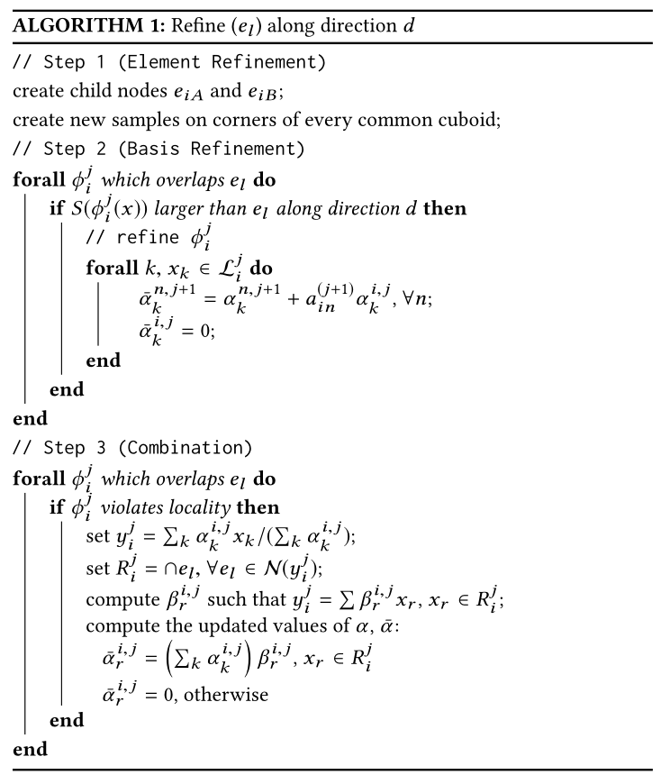
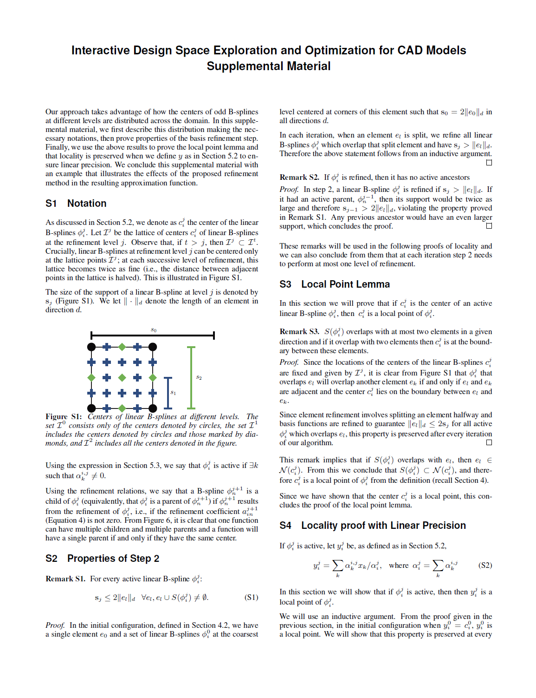
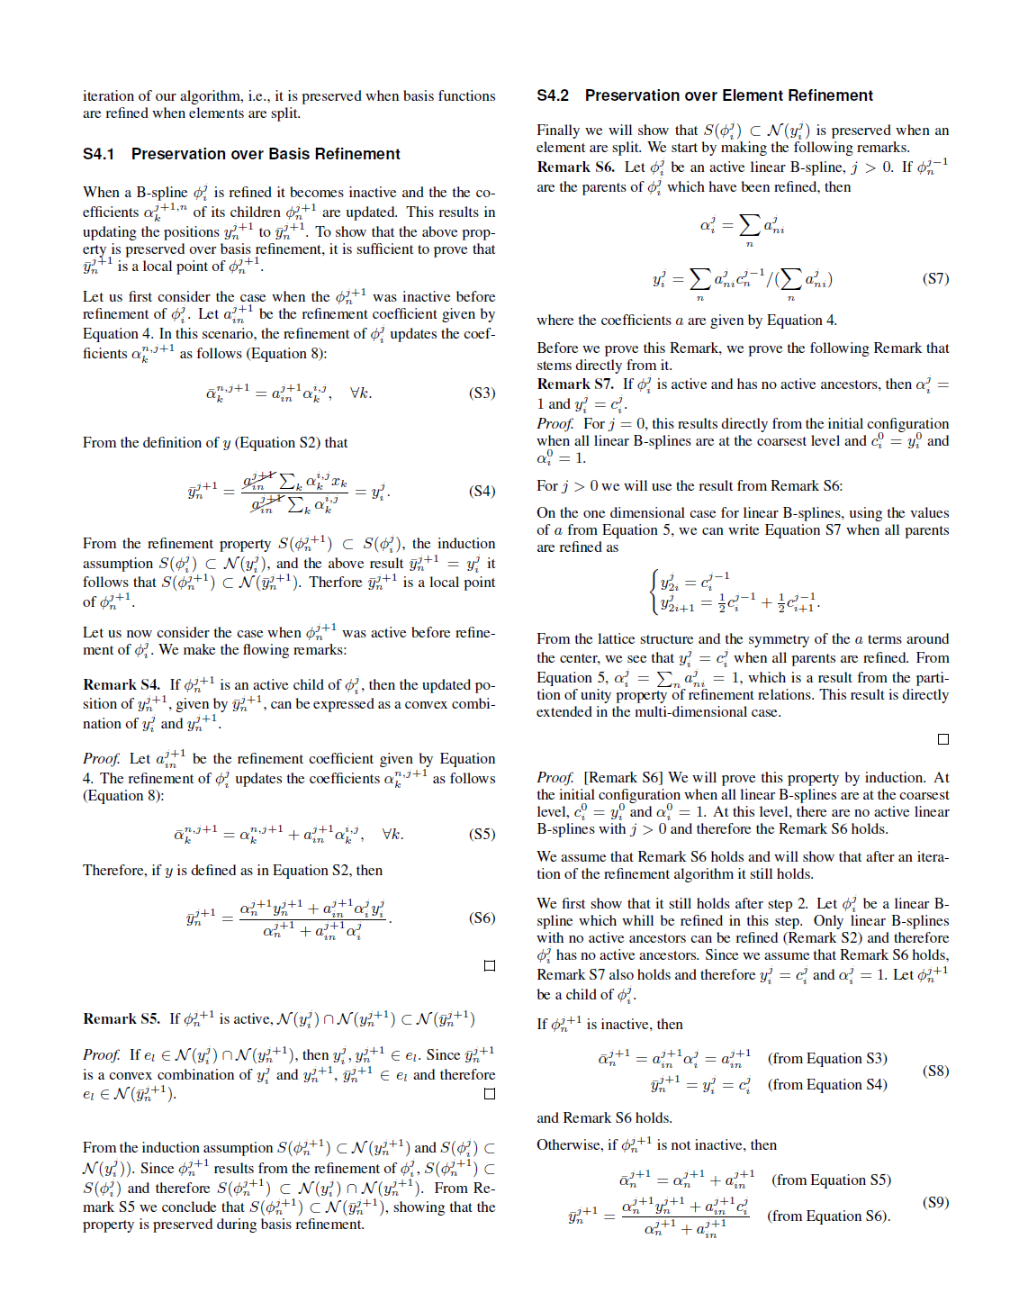
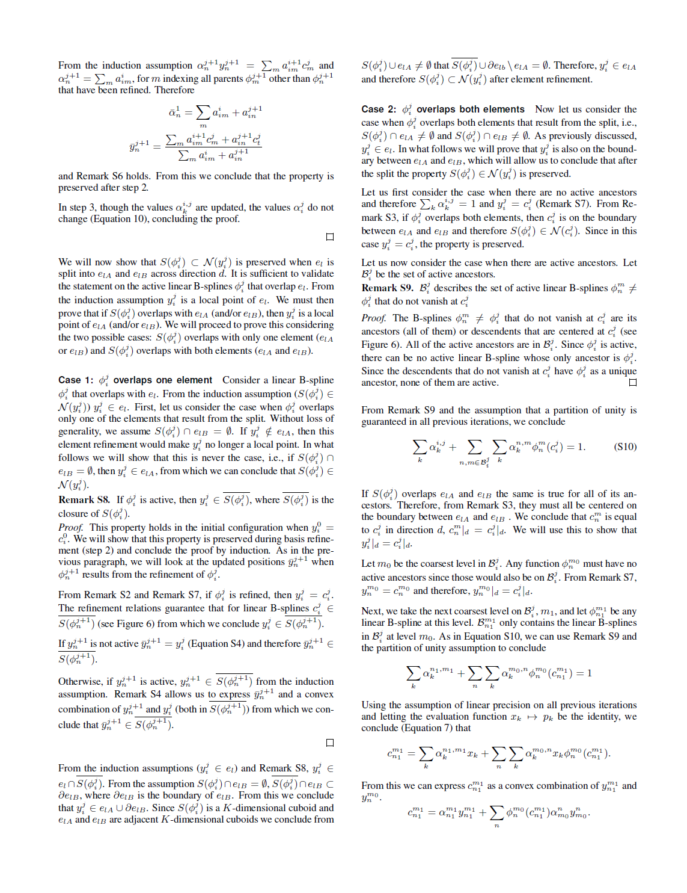
Algorithm in High Dimensions
(supplemental material)

Slide 46
Extension for Smoothness
Linear B-Splines
$$φ_{0}^{0}$$
$$φ_{1}^{0}$$
$$φ_{−1}^{1}$$
$$φ_{0}^{1}$$
$$φ_{1}^{1}$$
$$φ_{2}^{1}$$
$$φ_{3}^{1}$$
=
$$φ_{2}^{1}$$
$\frac{1}{2} φ_{1}^{1}$
$\frac{1}{2} φ_{3}^{1}$
$φ_{1}^{0}= \frac{1}{2} φ_{1}^{1}+φ_{2}^{1}$ + $\frac{1}{2} φ_{2}^{1}$

Slide 47
Extension for Smoothness
$$φ_{0}^{0}$$
$$φ_{1}^{0}$$
$$φ_{−2}^{1}$$
$$φ_{−1}^{1}$$
$$φ_{0}^{1}$$
$$φ_{1}^{1}$$
$$φ_{2}^{1}$$
$$φ_{3}^{1}$$
$$φ_{4}^{1}$$
=
$\frac{6}{8} φ_{2}^{1}$
$\frac{1}{2} φ_{1}^{1}$
$\frac{1}{2} φ_{3}^{1}$
$\frac{1}{8} φ_{0}^{1}$
$φ_{1}^{0}= \frac{1}{8} φ_{0}^{1}$ + $\frac{1}{2} φ_{1}^{1}\text{+ }\frac{6}{8} φ_{2}^{1}$ + $\frac{1}{2} φ_{3}^{1}$ + $\frac{1}{8} φ_{4}^{1}$
$\frac{1}{8} φ_{4}^{1}$

Slide 48
Interpolation Steps
Define the Basis Functions
(Locally) Consistent Mappings
$$P\left(x\right)= ∑ψ_{i}(x)p_{i}$$
sample
$$ψ_{2}(x)$$
$$ψ_{3}(x)$$
$$p_{1}$$
$$ψ_{0}(x)$$
$$ψ_{1}(x)$$
$$ψ_{4}(x)$$
element
mesh
$$p_{1}^{A}$$
$$p^{A}$$
mapping
$$ψ_{7}(x)$$
$$ψ_{6}(x)$$
$$ψ_{5}(x)$$

Slide 49
Mapping
Dense Correspondence Map
Mesh
Topology
Geometry
Source
Target
Mapping Result

Slide 50
Referencing in CAD
Boundary Representation (B-reps)

Slide 51
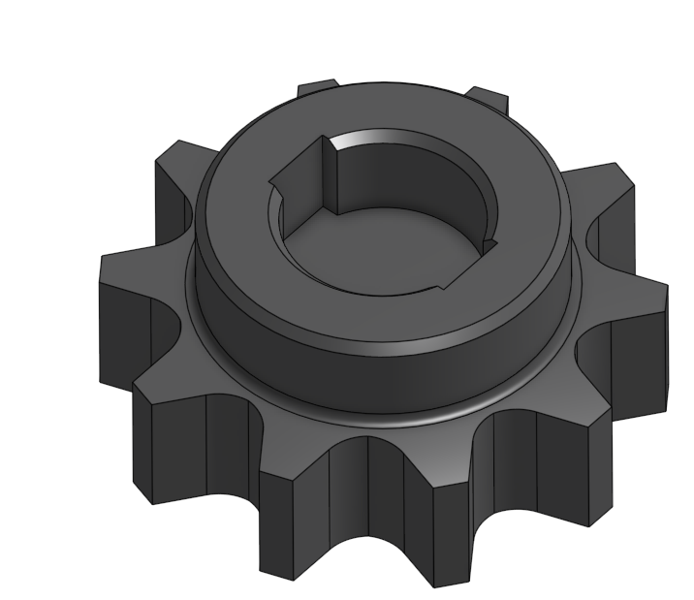
Topological Changes in B-reps

Slide 52
Our Mapping Approach
Patch Layout
Methods
e.g. [Kraevoy 2004]
CAD System
Sparse Correspondence
Dense Correspondence

Slide 53
Results
Notes:
Here are some results

Slide 54
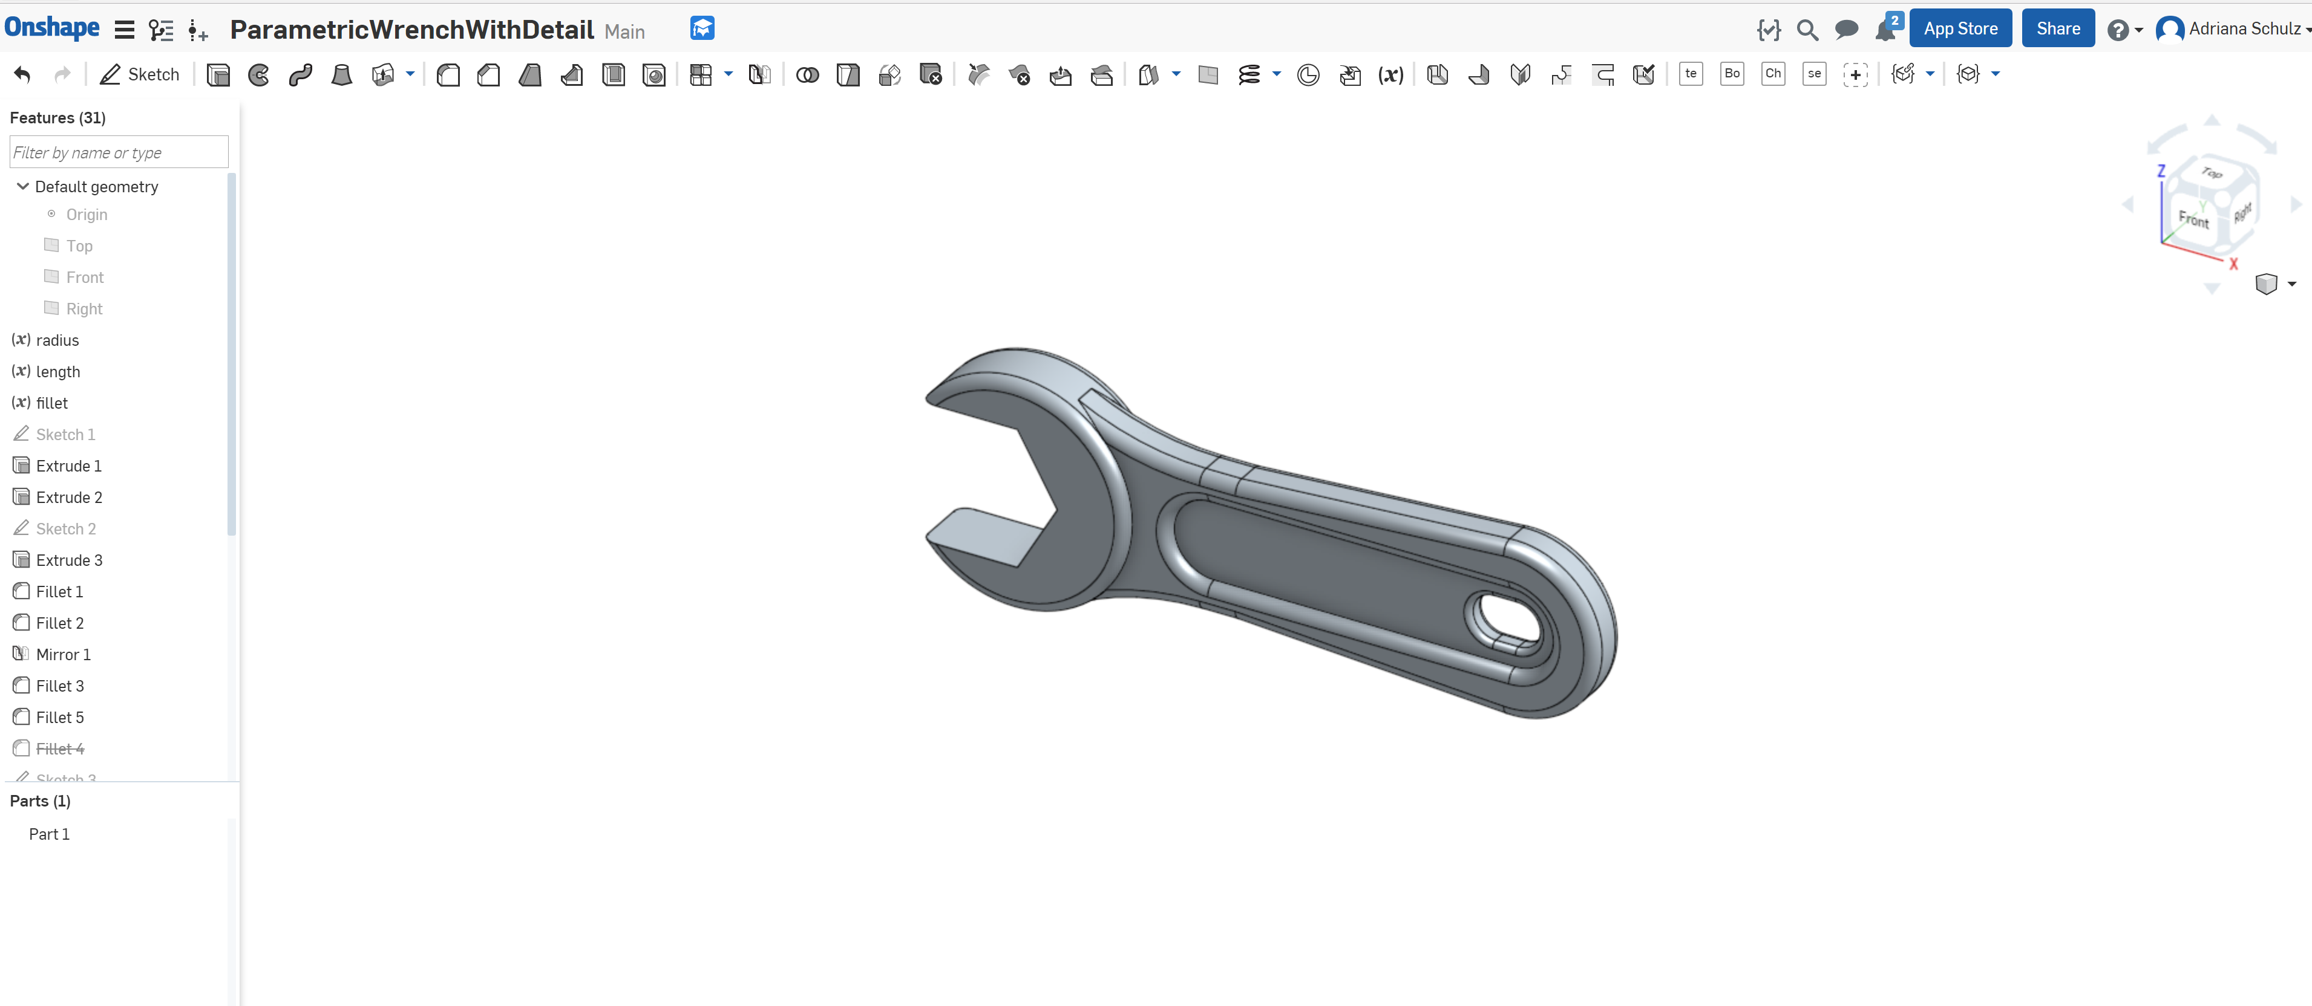
Live Demo

Slide 55
Notes:
The three different sliders allow me to change the length, head radius and fillet radius and see how the geometry updates in real time.
You can also see varying mass and the moments of inertia shown in this (red and green) axis. These properties are evaluated in real time from the interpolated geometry. And the stress shown by the color scheme is interpolated from pre-computed FEM simulation.

Slide 56
Stress Distribution

Slide 59
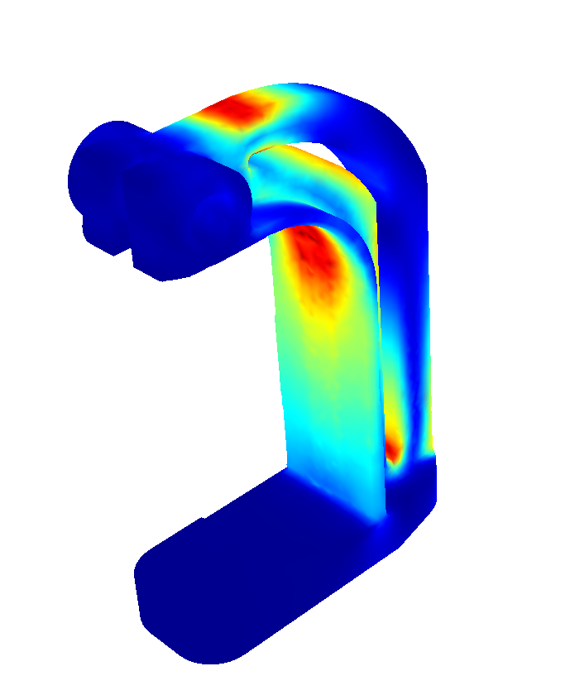
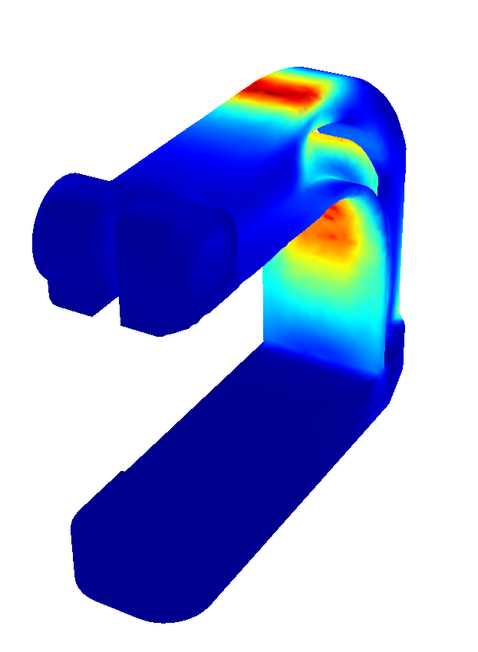
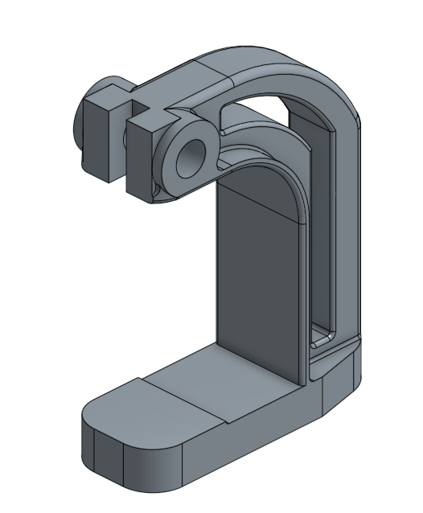
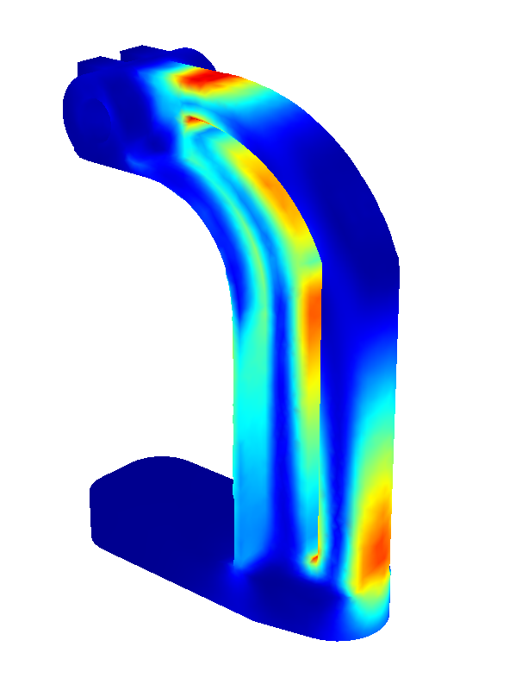
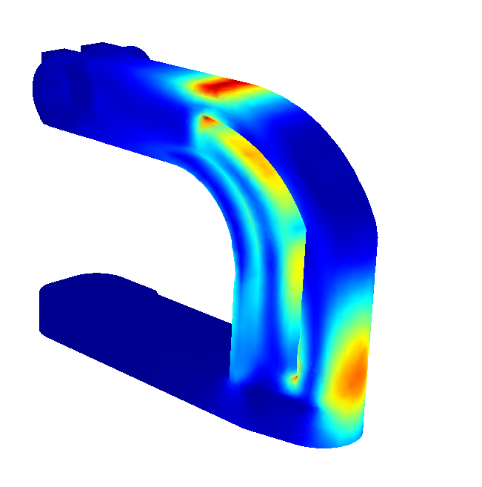
Results - Optimization
Use Case 1
Use Case 2

Slide 60
Future work
Discrete and topological changes
Dimensionality

Slide 61
Future work
Discrete and topological changes
Dimensionality
Applications

Slide 62
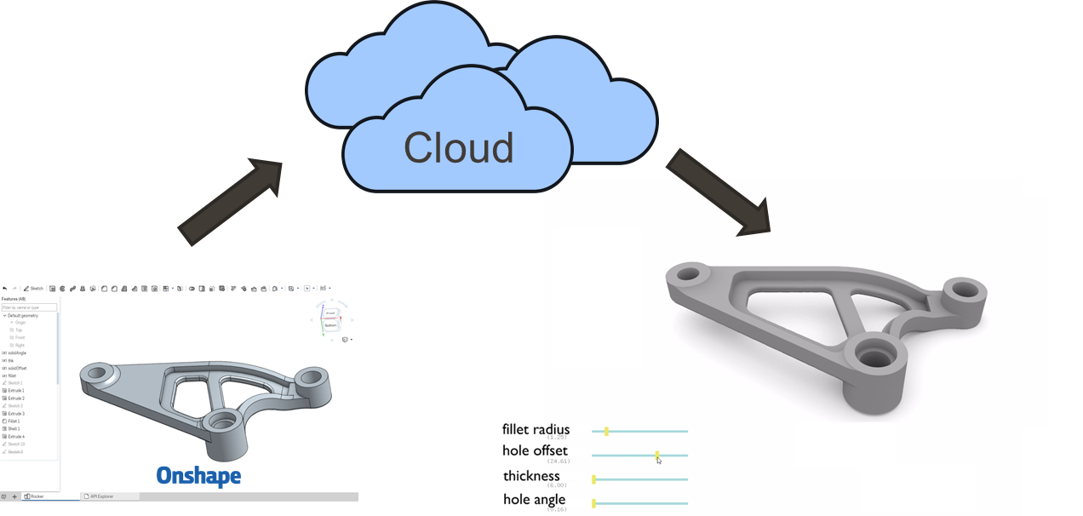
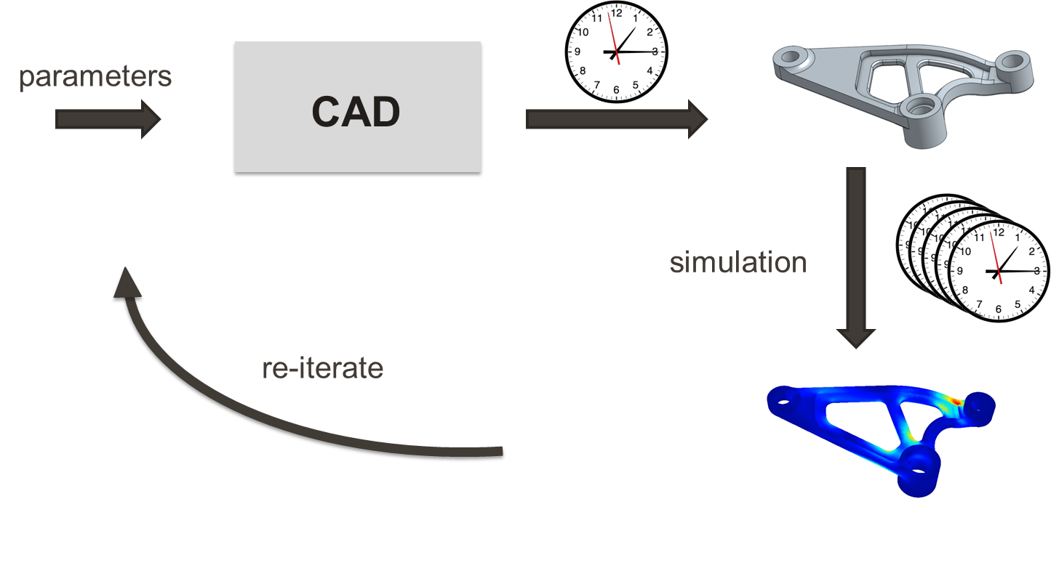
Conclusions
Reshape CAD Workflow

Slide 63
Conclusions
Reshape CAD Workflow

Slide 64
Conclusions
Reshape CAD Workflow
Novel Interpolation Scheme for K-d Trees

Slide 65
Acknowledgements
Ilya Baran
Michael Foshey
Nicholas Bandiera
Javier Ramos
Onshape Support Team
NSF CMMI-1547154
NSF CCF-1138967
NSF CMMI-1644558
NSF IIS-1409286

Slide 66
Thank you!
Code: http://people.csail.mit.edu/aschulz/instantCAD

Slide 67
Locality for Smoothness

Slide 68
Results – Parameters and Storage

Slide 69
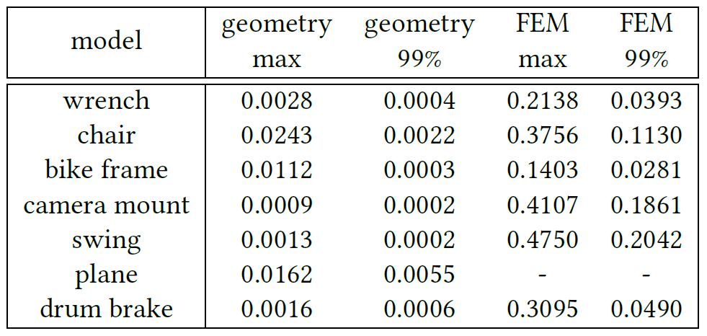
Results – Errors

Slide 70
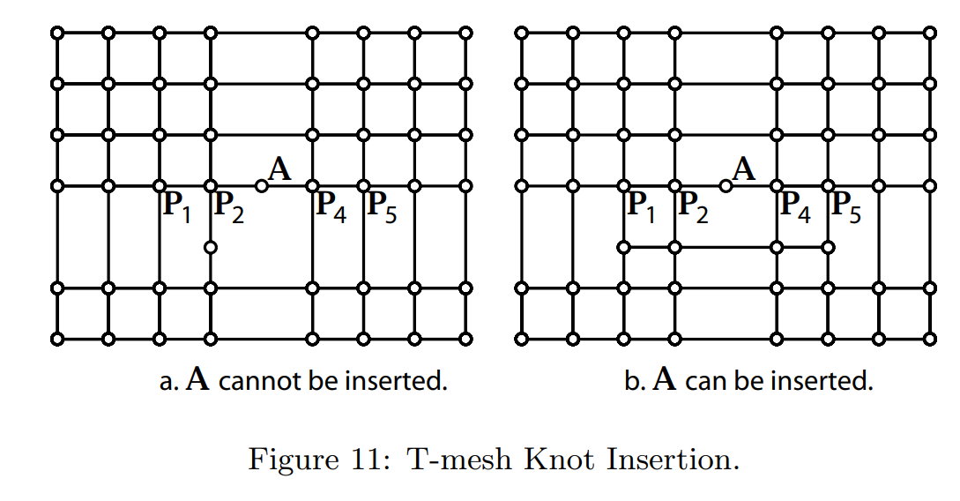
T-Splines
[Sederberg et atl. 2003]

