Slide 1
Retrieval on Parametric Shape Collections
Adriana Schulz¹
Ariel Shamir²
Ilya Baran³
David Levin^{1,4}
Pitchaya Sitthi-amorn^{1,5}
Wojciech Matusik¹
¹Massachusetts Institute of Technology
²The Interdisciplinary Center, Hertzliya
³Onshape Inc.
⁴University of Toronto
⁵Chulalongkorn University
Notes:
Thank you for the introduction. It’s a pleasure to be here.

Slide 2
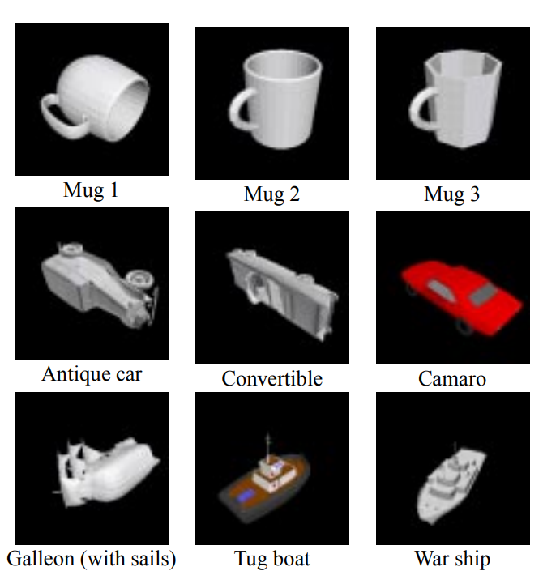
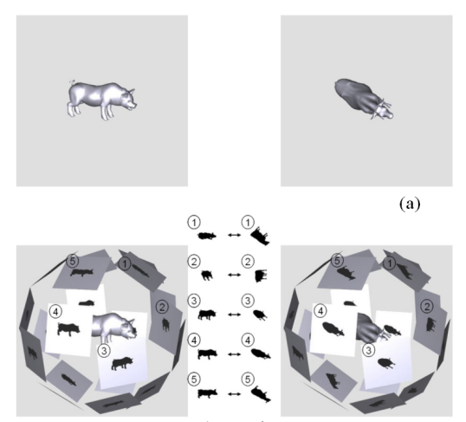
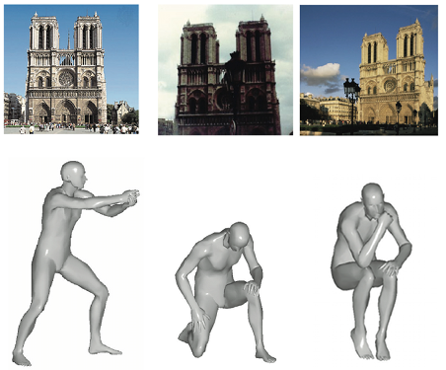
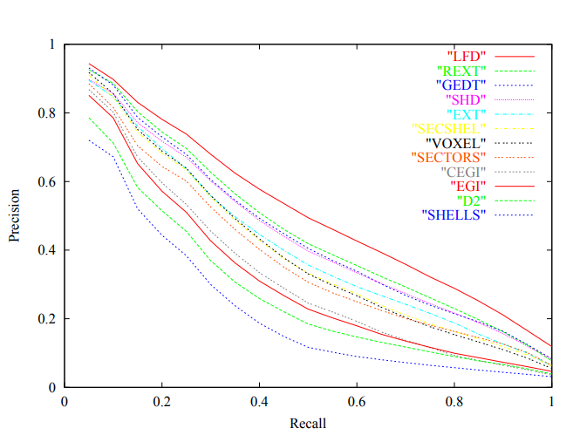
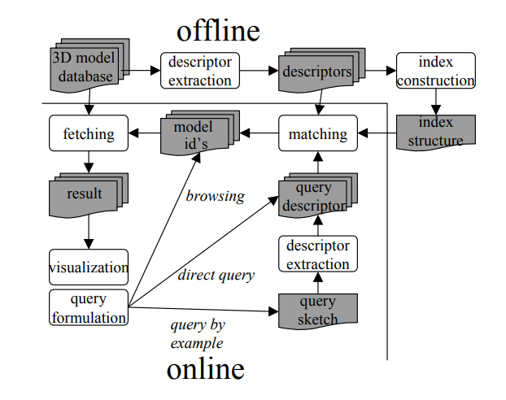

Shape Retrieval
[Osada et al. 2001]
[Chen et al. 2003]
[Brownstein et al 2011]
[Shilane et al. 2004]
[Veltkamp.et al 2008]
[SHREC 2013 - 2017]

Slide 3
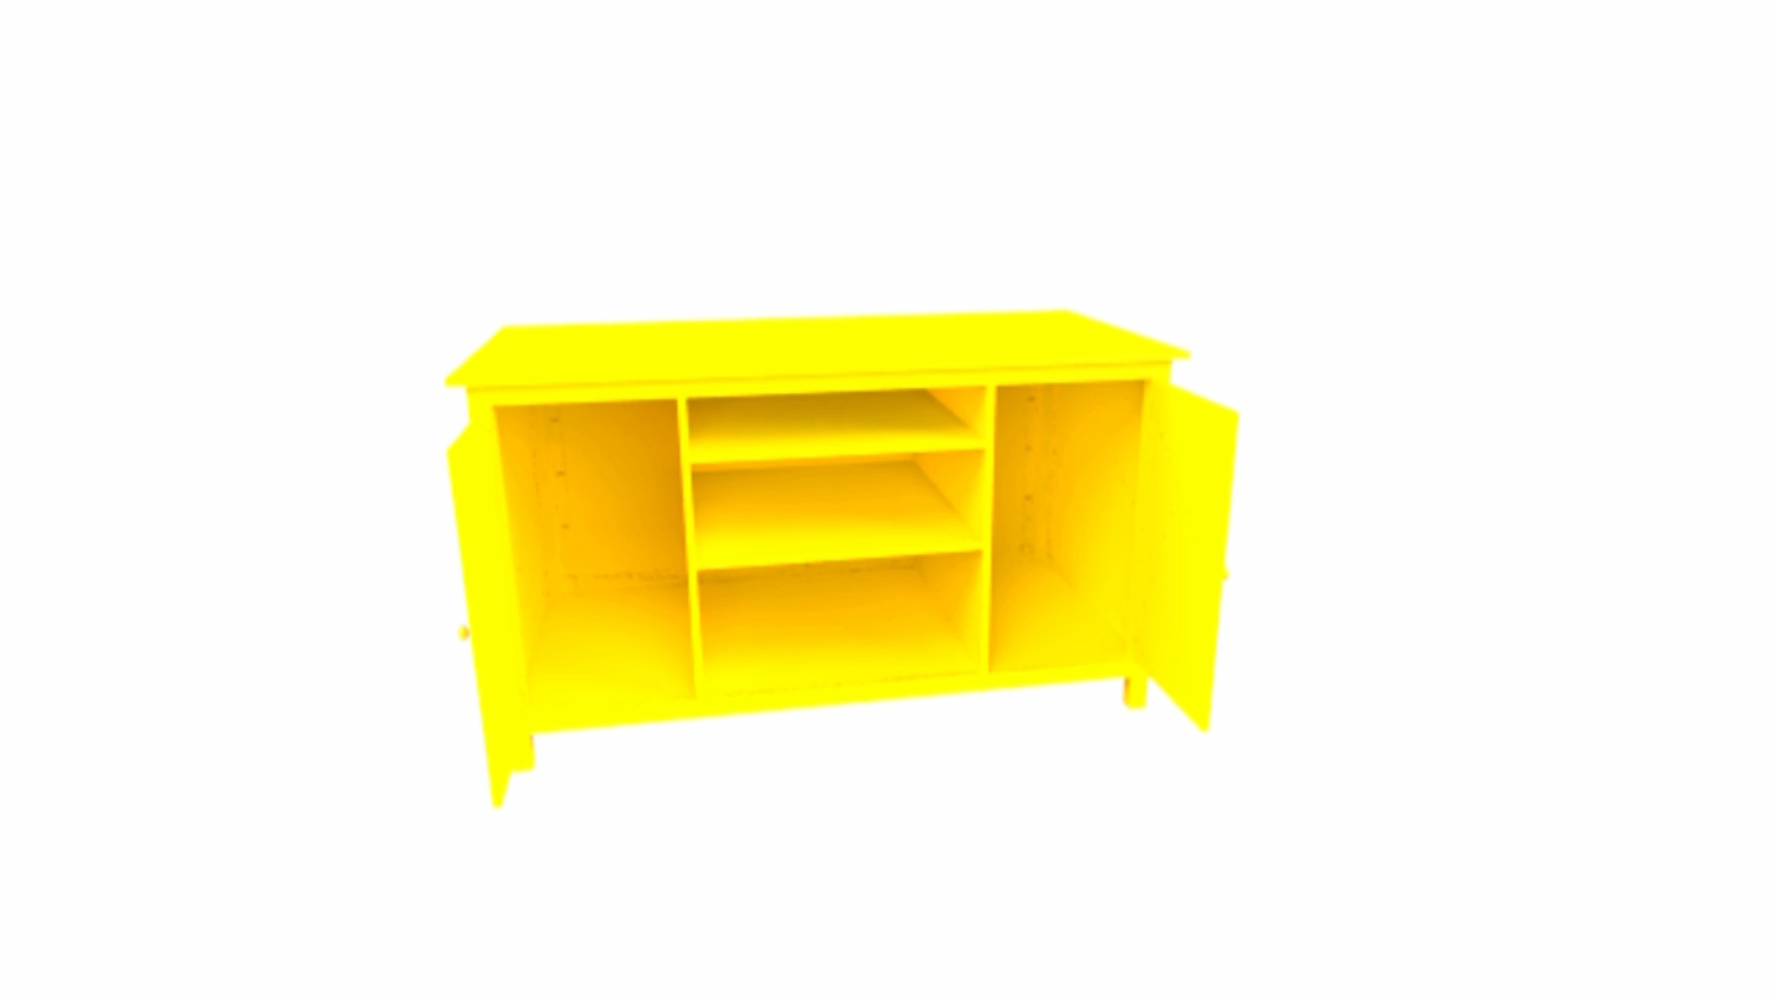
Parametrization
Parametric
Shape
parameters
Advantages:
constrains manipulations
  e.g., fabrication-oriented constraints
reduces the search space

Slide 4
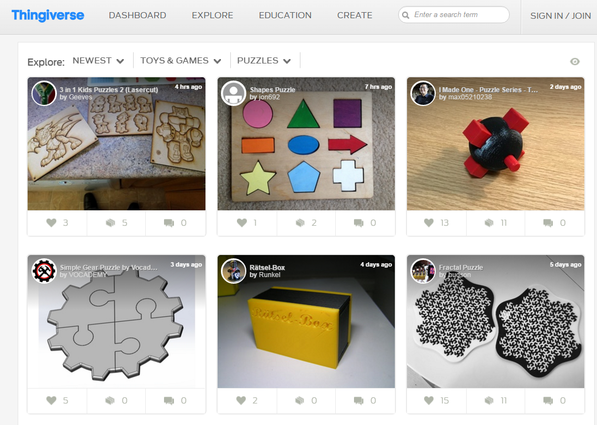

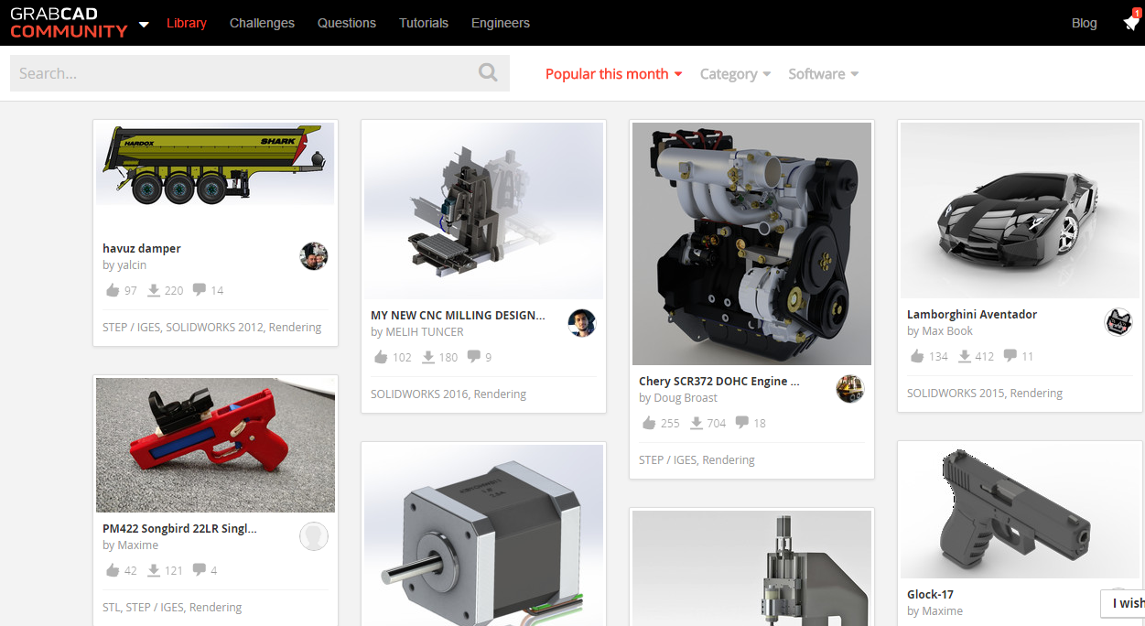

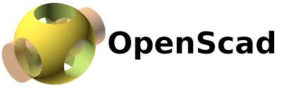
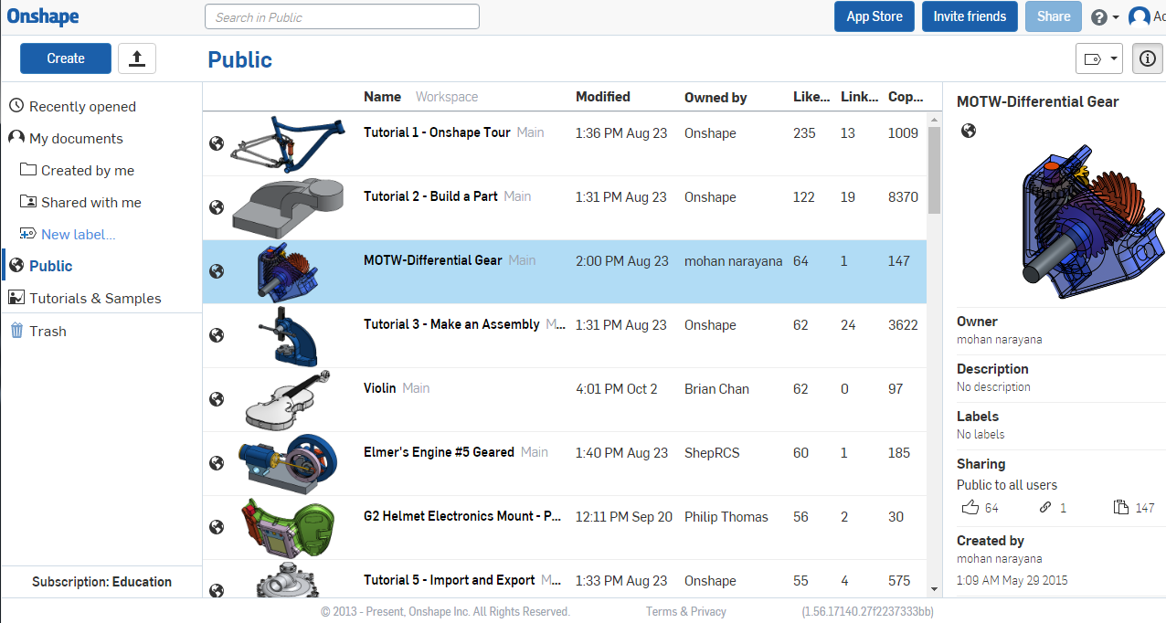

Available Collections
Thingiverse
GrabCAD
Onshape’s Repository

Slide 5
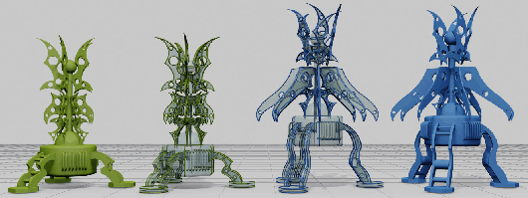
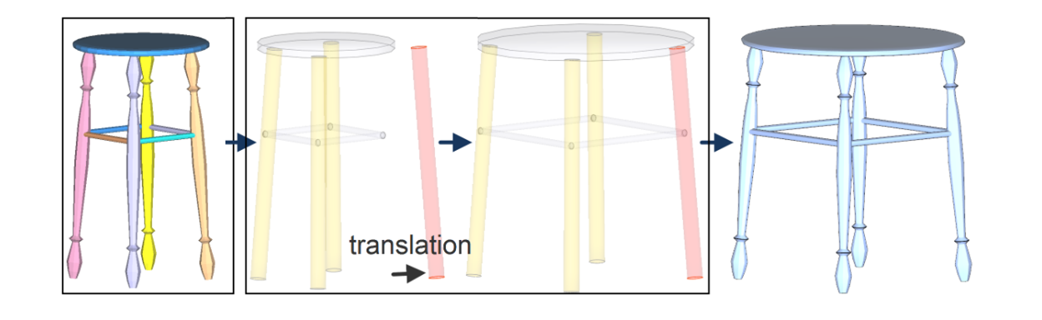
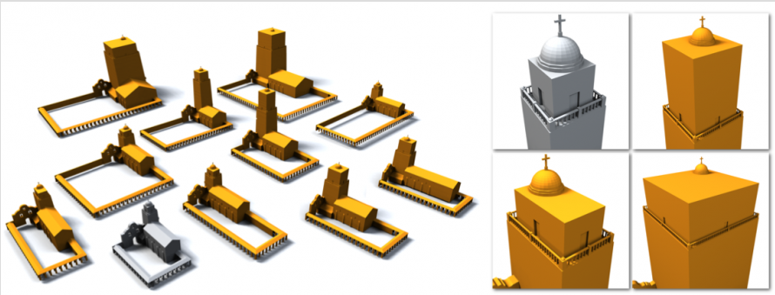
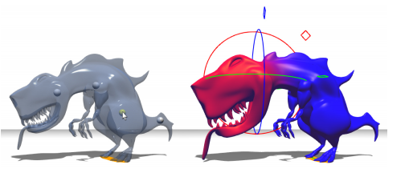
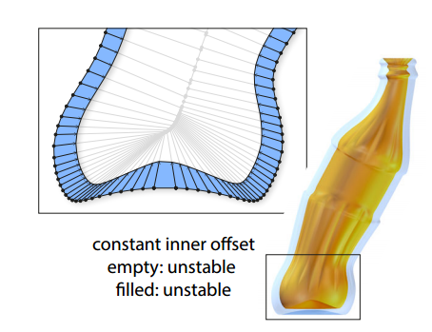
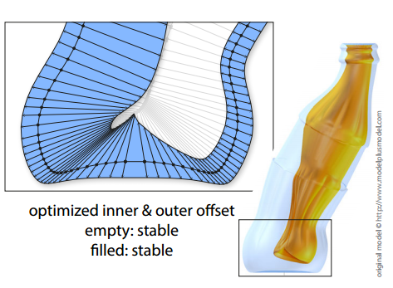
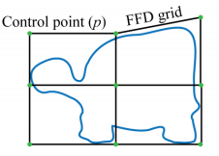
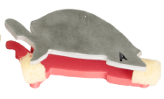
Parametrization Techniques
[Gal et al 2009]
[Zeng et al 2011]
[Bokeloh et al 2012]
Application Examples:
Linear Blend Skinning
Offset Surfaces
Cages
[Prevost et al. 2014]
[Musialski et al. 2015]
[Bharaj et al. 2015]

Slide 6
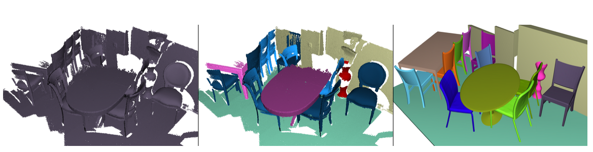
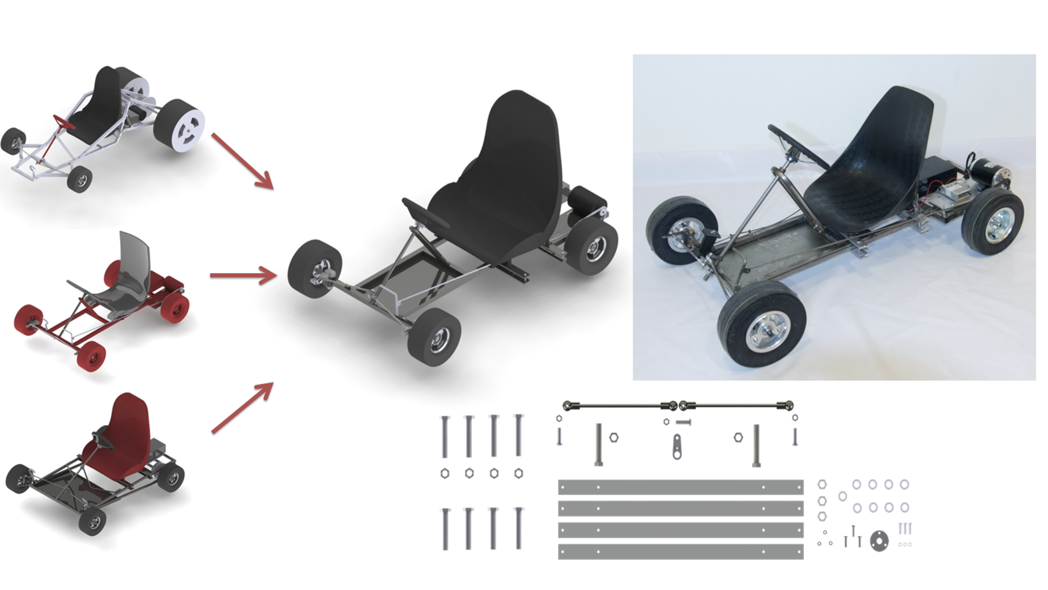
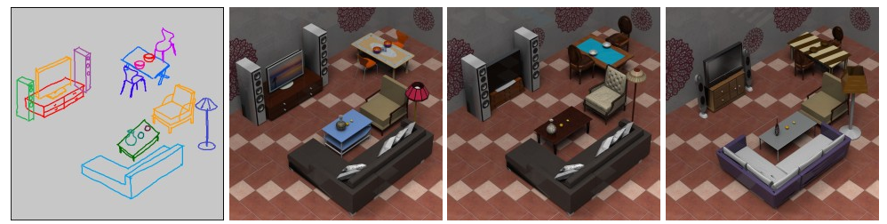
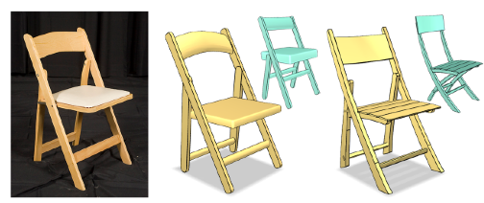
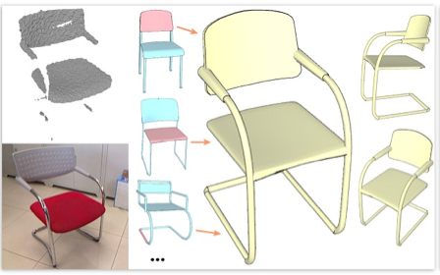
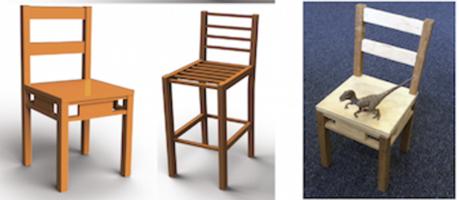
Data-Driven Modeling
[Nan et al 2012]
[Schulz et al. 2014]
[Xu et al 2013]
[Xu et al 2011]
[Shen et al 2012]
[Yang et al. 2015]

Slide 7
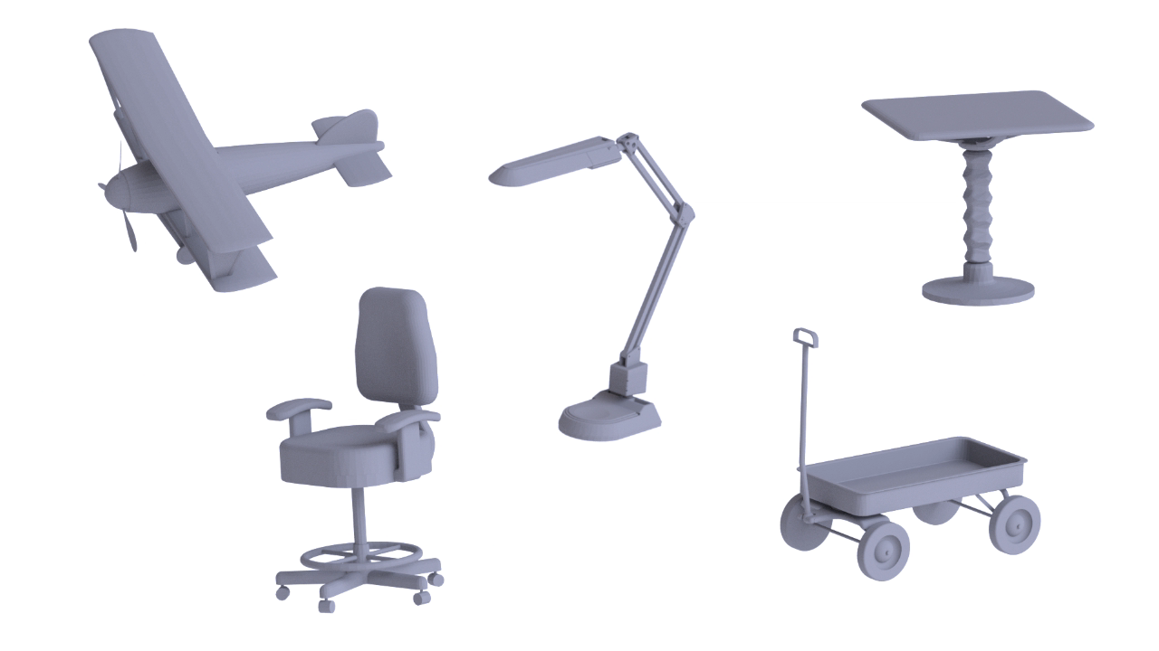
Parametric Shape Collections

Slide 8
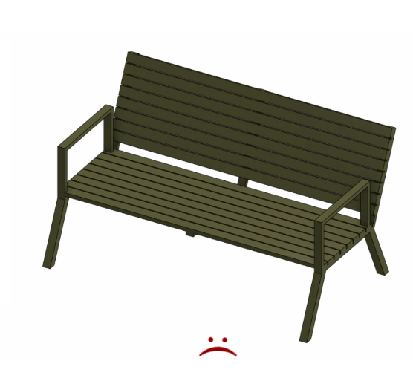
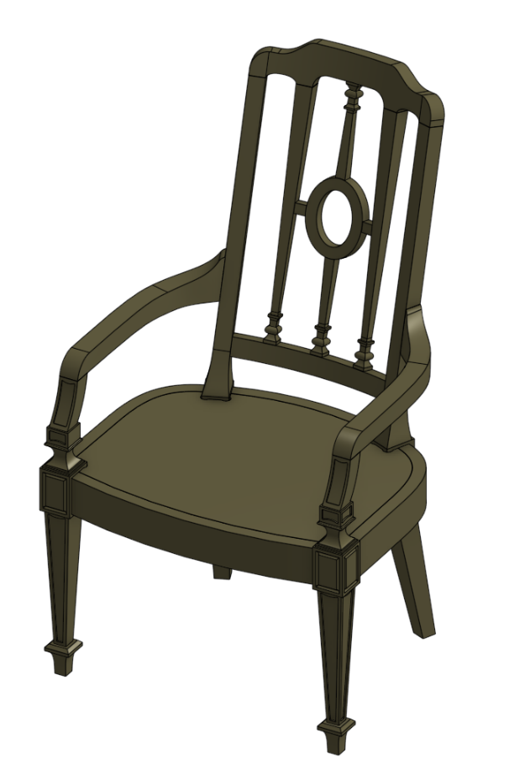
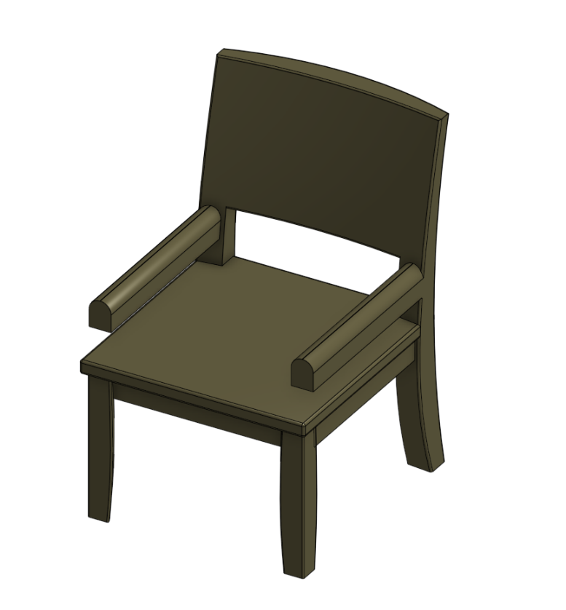
Retrieval in Parametric Shape Collections
Query
Parametric Shape Collection

Slide 9
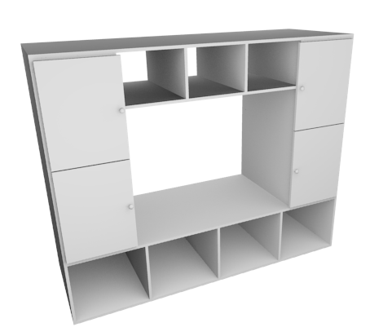

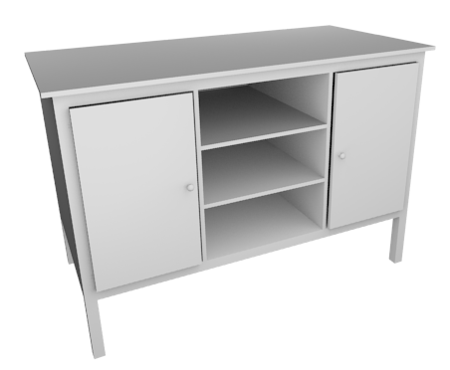
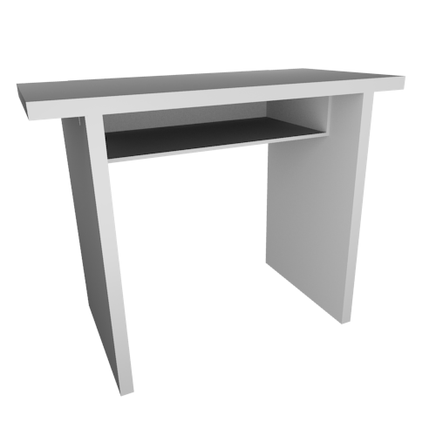
Typical Pipeline
?
Query Shape
Parametric Shape
Collection

Slide 10
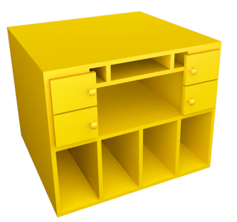
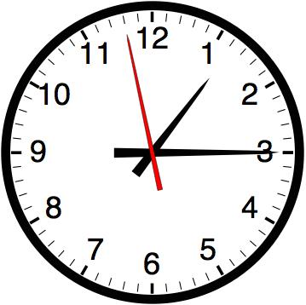
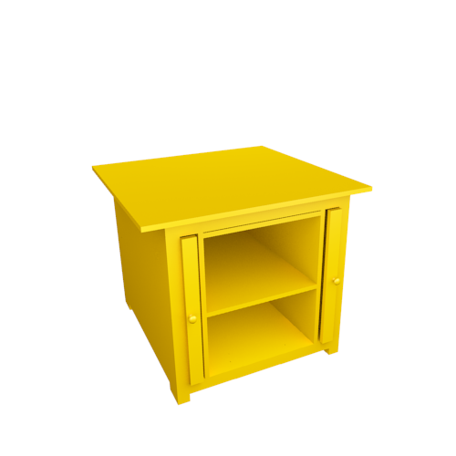
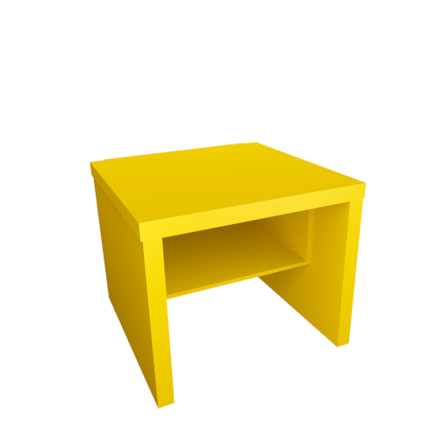
Typical Pipeline Fit-First
parameter
fitting
matching
Query Shape
Parametric Shape
Collection
Fitted Shapes
[Nan et al 2012]

Slide 11
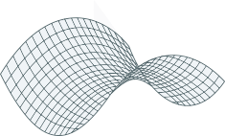
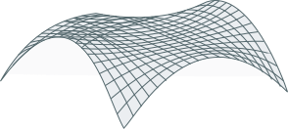
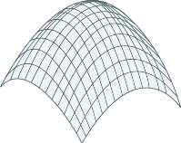
Our Approach
precomputed
descriptors
matching
Descriptor Space
Query Shape
Parametric Shape
Collection

Slide 12
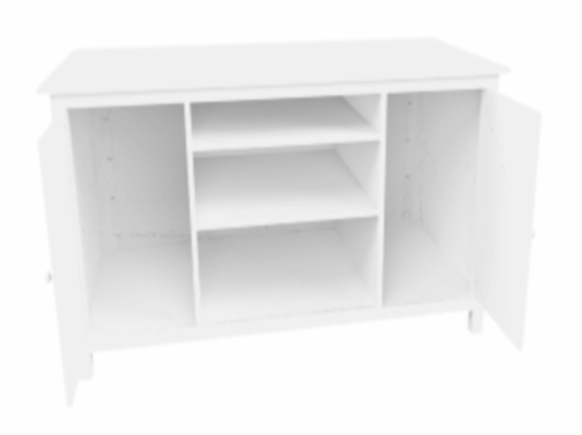





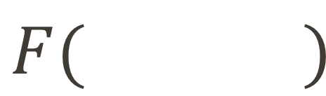

Retrieval Using Descriptors
$$F( )$$
$$x_{1}$$
$$n$$
$$1$$
$$2$$
$$x_{2}$$
.
.
.
Descriptor Space
$$x_{n}$$
Shape descriptor

Slide 13
Shape Retrieval with Descriptors
Descriptor Space
Parametric Shapes?

Slide 14
Parametric Shape Retrieval with Descriptors
Descriptor Space

Slide 15
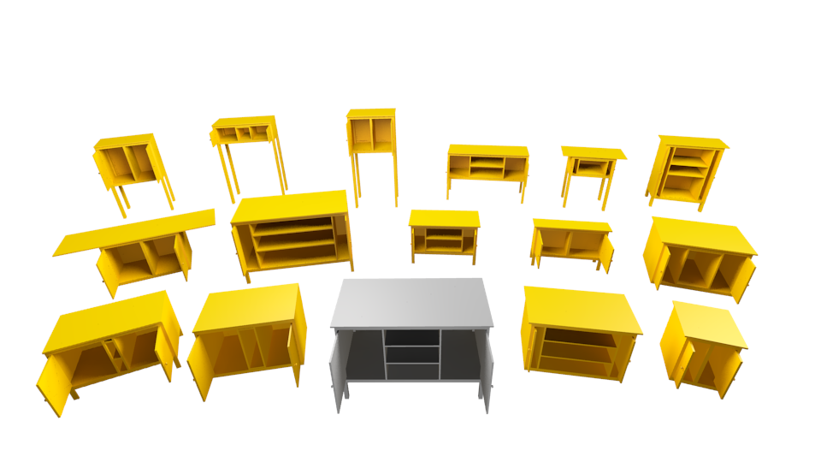
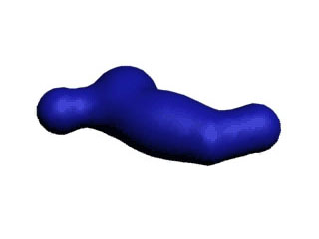
Parametric Shape Retrieval with Descriptors
Descriptor Space

Slide 16
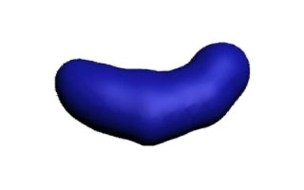
Parametric Shape Retrieval with Descriptors
Descriptor Space

Slide 17










Regions in Descriptor Space
$$ℳ$$
$$K≪N$$
$$ℝ^{N}$$
$$ℝ^{K}$$
$$ℳ(A)$$
$$ℳ(q)$$
$$ℱ$$
$$𝒟$$
$$q$$
$$A$$
Parameter Space
Descriptor Space
Descriptor Space

Slide 18




Parametric Shape Retrieval with Descriptors
$$ℝ^{K_{1}}$$
$$ℝ^{N}$$
$$ℝ^{K_{2}}$$
Descriptor Space
$$ℝ^{K_{3}}$$

Slide 19

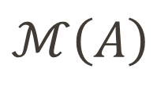
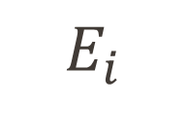


Approach
$$ℳ\left(A\right)$$
$\overline{ℳ\left(A\right)}=\{ P_{1}, …, P_{K}\}$
bounded
tangent space
point
$$E_{i}$$
$$P_{i}=T_{i}∩E_{i}$$
$$P_{i}=p_{i}$$
$$T_{i}$$

Slide 20
Technical Contribution
Algorithm for efficiently representing parametric shapes with these primitives to allow accurate retrieval.

Slide 21





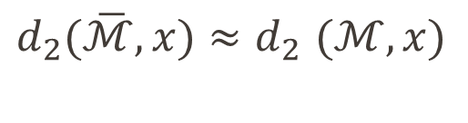


Accuracy Criteria
$$ℝ^{N}$$
$$x$$
$$d_{2}(\overline{ℳ}, x)$$
$$d_{2}(\overline{ℳ}, x){≈d}_{2}(ℳ, x)$$
$$\overline{ℳ}$$
$$d_{2}(ℳ, x)$$
${|d}_{2}\left(\overline{ℳ}, x\right){ − d}_{2}\left(ℳ, x\right)|≤ δ$
$$ℳ$$
user specified
Descriptor Space

Slide 22


Coverage and Tightness
$${|d}_{2}\left(\overline{ℳ}, x\right){ − d}_{2}\left(ℳ, x\right)|≤ δ ∀x∈ℝ^{N}$$
Coverage Property
$$d_{2}\left(\overline{ℳ}, y\right)≤ δ ∀y∈ℳ$$
Tightness Property
$$d_{2}\left(ℳ, y\right)≤ δ ∀y∈\overline{ℳ}$$

Slide 23








Algorithm
Initialize $\overline{ℳ}= ∅$
Sample $y∈ℳ$
if $d_{2}\left(\overline{ℳ}, y\right)≤ δ$
else $\overline{ℳ}⇐P_{i}(y)$
$⇒$ reject sample
$$ℝ^{N}$$
$$ℝ^{K}$$
$$ℳ$$
$$ℳ(q)$$
$$q$$
?
$$P_{i}=p_{i}$$
$$P_{i}=T_{i}∩E_{i}$$
$$A$$
Point Primitive
Tangent Primitive
Parameter Space
Descriptor Space

Slide 24



Choosing Between Primitives
bounded
tangent space
point
$$E_{i}$$
$$P_{i}=p_{i}$$
$$P_{i}=T_{i}∩E_{i}$$
$$T_{i}$$
K tangent vectors
+ center point
cost of tangent = $(K+1)$ cost of point
coverage of tangent > $\left(K+1\right)$ coverage of points

Slide 25


Coverage of Points and Tangents
$$\frac{d}{δ}=\sqrt{\frac{2}{δκ }}$$
curvature

Slide 26


Criteria for Primitive Selection
One-Dimensional Case
Multi-Dimensional Case
Use tangents if: $κ≤\frac{2}{δ{\left(K+1\right)}^{2}}$
Use tangents if: $κ^{max}≤\frac{2}{δ{\left(K+1\right)}^{\frac{2}{K}}}$

Slide 27





Bounding Tangent Primitives
$$P_{i}=T_{i}∩E_{i}$$
$$E_{i}$$
$$T_{i}$$
Hyperphere of radius $r$
$$r$$
Tightness
Bound

Slide 28





Handling the Feasible set $A$
$$ℝ^{K}$$
$$P_{i}=T_{i}∩E_{i}$$
$$ℳ$$
$$E_{i}$$
$$A$$
$$T_{i}$$
Ellipsoid
$$r$$
$$r_{b}$$
Tightness
Bound
Feasible set
Feasible set

Slide 29
Our Approach: Retrieval
$$ℝ^{N}$$
Descriptor Space

Slide 30




Retrieving the Parametric Shape
$$ℝ^{N}$$
Dist $(x, p_{i})$
Dist $(x, T_{i}∩E_{i})$
cost of tangent ~ $K$ cost of point

Slide 31

Parameter Fitting
Parameter fitting
$$ℝ^{N}$$

Slide 32
Evaluations

Slide 33











Experiments: Data
Number of parameters: 2-9

Slide 34

Experiments: Descriptors
D2 Shape Distribution
VOXEL Shape Histogram
Light Field Descriptors

Slide 35





Manifold Representation: Efficiency
(our method)
$$K=3$$
$$K=5$$
$$K=7$$

Slide 36

Manifold Representation: Efficiency
5X more efficient
$$K=3$$
$$K=5$$
$$K=7$$

Slide 37


Querying Parametric Variations
Parameter variations
“Mean” Shapes
Queries
Retrieval
Closest Mean shapes
$$ℝ^{N}$$
Descriptor Space
29% Accuracy

Slide 38





Querying Parametric Variations
$$ℝ^{N}$$
Our Method
Naïve Approach
Descriptor Space
same storage
$$ℝ^{K}$$
$$ℝ^{N}$$
$$ℳ$$
$$A$$
Parameter Space
Descriptor Space

Slide 39

Comparison with Naïve Method

Slide 40





Querying Shapes from Online Repositories
Query
D2 Descriptor
Voxel Descriptor
Light Field Descriptor
Error($δ)$
$0.05 0.1 0.2 0.4$
$0.075 0.1 0.2 0.4$
$0.6 0.8 1.0 2.0$

Slide 41
Classification

Slide 42



Classification
$\text{High} \text{Quality} \text{Descriptors}⇒$improves precision/recall
$\text{Low} \text{Quality} \text{Descriptors} ⇒$additional complexity cannot be captured (noise)

Slide 43

Beyond Classification
Query
Closest mean shape
Closest parametric
Shape(our Method)

Slide 44
Limitation and Future work
Scalability (number of parameters)

Slide 45
Limitation and Future work
Scalability (number of parameters)
Supporting Discrete Variations

Slide 46
Limitation and Future work
Scalability (number of parameters)
Supporting Discrete Variations
Retrieval Methods

Slide 47
Conclusion
First approach for efficient retrieval on a collection of parametric shapes

Slide 48
Acknowledgements
Charles K. Smart
Baker Logan
Marie P. E. Moudio
Jacob Haip
Megan C. Chao
NSF CCF-1138967
ISF grant 324/11

Slide 49
Thank you!
Data available at : http://people.csail.mit.edu/aschulz/paramShapeRetrieval

