Slide 1
Interactive Exploration of Design Trade-offs
Adriana Schulz, Harrison Wang, Eitan Grinspun,
Justin Solomon, and Wojciech Matusik

Slide 2
Performance-Driven Design
Performance metric:
flexibility
Performance metric:
weight
Performance metric: stability

Slide 3
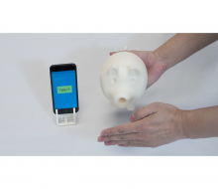
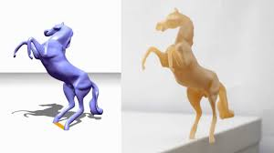
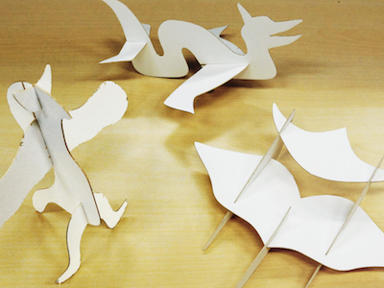
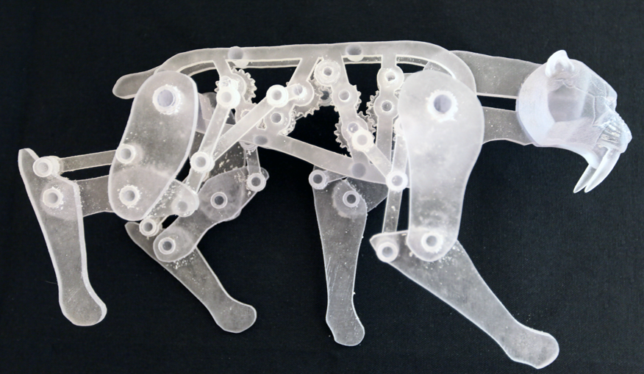
Previous Work
[Prevost et al. 2014]
[Bharaj et al. 2015]
[Li et al. 2016]
[Musialski et al. 2015]
[Coros et al. 2013]
[Umetani et al. 2014]
Single objective optimization!

Slide 4
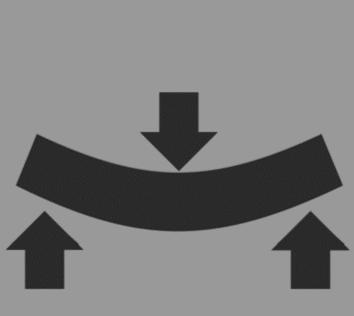
Multiple Design Objectives
$$ℝ^{D}$$
$$ℝ^{d}$$
$$F$$
weight
$$D≫d$$
BETTER
deformation
Design Space
Performance Space

Slide 5
Space of Optimal Solutions
Pareto Set
Pareto Front
$$ℝ^{D}$$
$$ℝ^{d}$$
Optimal?
$$F$$
“dominates”
$$F(𝒳)$$
$$𝒳$$
Design Space
Performance Space
Pareto Optimality:
Non-dominated Points

Slide 6
Exploration of Design Trade-Offs
Pareto Set
Pareto Front
$$ℝ^{D}$$
$$ℝ^{d}$$
Interactive Rates
efficiently discover and represent the Pareto Front
Design Space
Performance Space

Slide 7
Pareto Front Discovery: Challenges
Pareto Set
Pareto Front
$$ℝ^{D}$$
$$ℝ^{d}$$
Design Space
Performance Space

Slide 8
Pareto Front Discovery: Previous Work
Pareto Set
Pareto Front
$$ℝ^{D}$$
$$ℝ^{d}$$
Design Space
Performance Space
[Deb et al. 2017] (survey)

Slide 9
Pareto Front Discovery: Our Approach
Pareto Set
Pareto Front
$$ℝ^{D}$$
$$ℝ^{d}$$
$$f_{2}$$
Local expansion
$$f_{1}$$
Design Space
Performance Space

Slide 10
Set of Manifolds
Pareto Set
Pareto Front
$$ℝ^{D}$$
$$ℝ^{d}$$
Design Space
Performance Space
Affine Subspaces
(Bounded, $d−1$ dimensional)
Manifolds
(Bounded, $d−1$ dimensional)

Slide 11
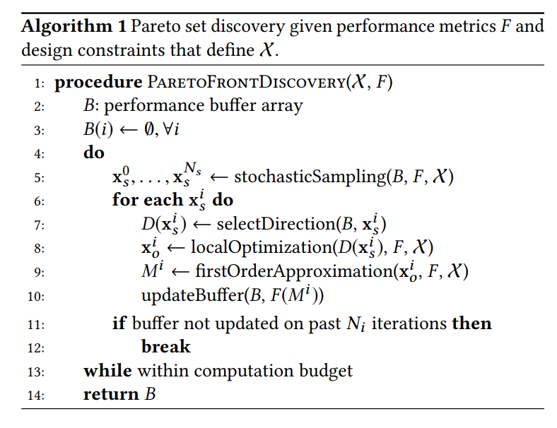
Method
Performance Space
Performance Space
Local Expansion
Discovery Algorithm
Data-Structure
Sparse Approximation

Slide 12
First Order Approximation
Affine Subspace
($d−1$ dimensional)
Manifold
($d−1$ dimensional)
$$ℝ^{d}$$
$$ℝ^{D}$$
Design Space
Performance Space
Optimality
Conditions
Sensitivity Analysis
Perturbation
Formula
(duality theory)

Slide 13
Pareto Front Discovery
Pareto Set
Pareto Front
$$ℝ^{D}$$
$$ℝ^{d}$$
$$f_{2}$$
$$f_{1}$$
Design Space
Performance Space

Slide 14
Method
Performance Space
Performance Space
Local Expansion
Discovery Algorithm
Data-Structure
Sparse Approximation

Slide 15
Algorithm Overview
Step 1: Stochastic Sampling
Step 2: Local Optimization
Step 3: Local Expansion
Design Space
Performance Space

Slide 16
Algorithm Overview
Step 1: Stochastic Sampling
Step 2: Local Optimization
Step 3: Local Expansion
Design Space
Performance Space

Slide 17
Algorithm Overview
Step 1: Stochastic Sampling
Step 2: Local Optimization
Step 3: Local Expansion
Design Space
Performance Space

Slide 18
Algorithm Overview
Step 1: Stochastic Sampling
Step 2: Local Optimization
Step 3: Local Expansion
Adaptive!
Direction Matters!
Design Space
Performance Space

Slide 19
Method
Performance Space
Performance Space
Local Expansion
Discovery Algorithm
Data-Structure
Sparse Approximation

Slide 20
Data Structure
Pareto Front
“Performance Buffer”
Performance Space
$$d$$
Not Pareto:
“dominates”
$$d$$
<
$$d$$
$$d$$

Slide 21
Data Structure
Performance Buffer
Design Space
Performance Space

Slide 22
Method
Performance Space
Performance Space
Local Expansion
Discovery Algorithm
Data-Structure
Sparse Approximation

Slide 23
Sparse Approximation
Performance Buffer
Design Space
Performance Space

Slide 24
Sparse Approximation
Performance Buffer
Solution to Labeling problem:
Design Space
Performance Space

Slide 25
Remove Non-Dominant Points
Pareto Set
Pareto Front
$$ℝ^{D}$$
$$ℝ^{d}$$
Design Space
Performance Space

Slide 26
Remove Non-Dominant Points
Pareto Set
Pareto Front
$$ℝ^{D}$$
$$ℝ^{d}$$
Design Space
Performance Space

Slide 27
Gaps in Performance Space

Slide 28
Interactive Exploration Results

Slide 29
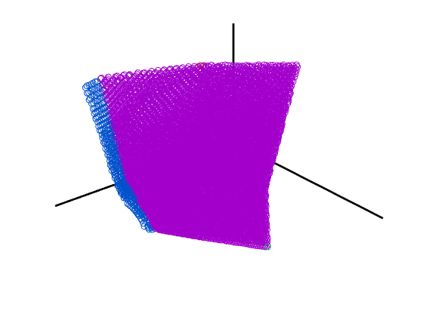
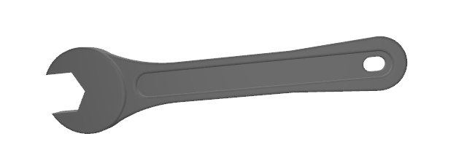
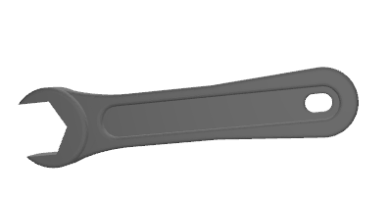
Wrench (3 design variables, 3 performance metrics)
force/torque
mass
stress
mass
stress
torque
Performance Space

Slide 30
Wrench (3 design variables, 3 performance metrics)

Slide 31
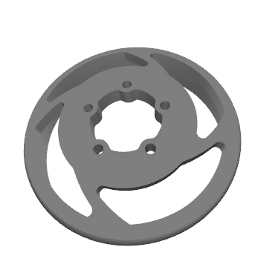
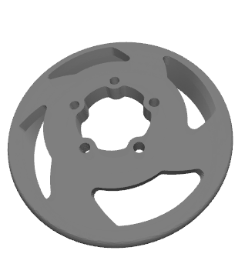
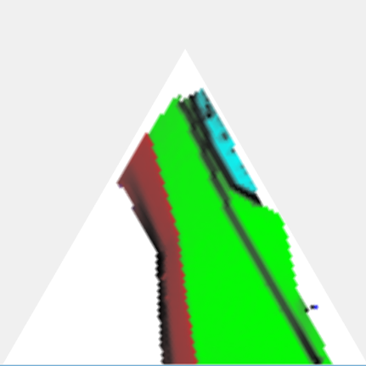
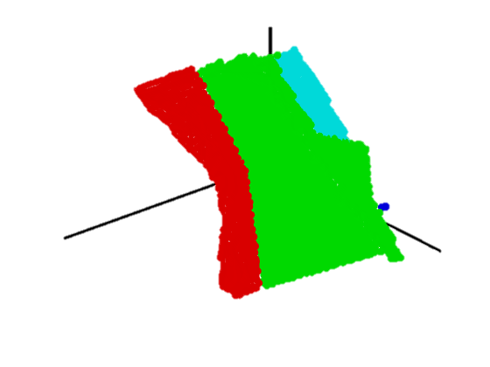
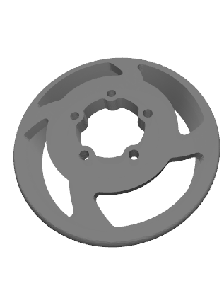
Brake Hub (4 design variables, 3 performance metrics)
$$ℝ^{P}$$
heat
stress
mass
mass
stress
heat
Performance Space

Slide 32
Brake Hub (4 design variables, 3 performance metrics)

Slide 33
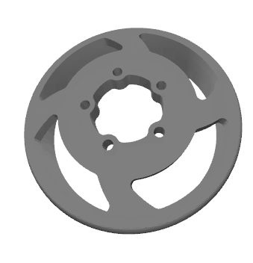
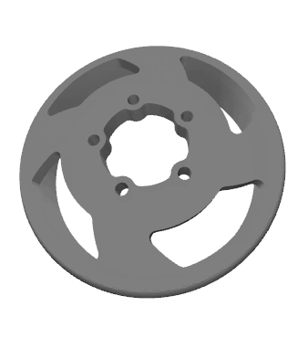
Transition Example
stress
mass
heat

Slide 34
Bike Frame (4 design variables, 3 performance metrics)

Slide 35
Bike Frame

Slide 36
Lamp (21 design parameters, 3 performance parameters)

Slide 37
Lamp (21 design parameters, 3 performance parameters)

Slide 38
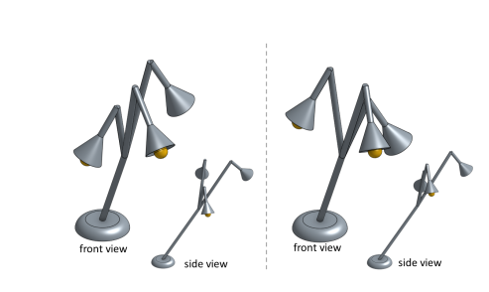
Different Solutions with Same Performance

Slide 39
Future Work
High-dimensional design and performance spaces
Siggraph 2017
$$ℝ^{D}$$
$$ℝ^{P}$$
$$F(𝒳)$$
$$𝒳$$
Design Space
Performance Space
small
large

Slide 40
Future Work
High-dimensional design and performance spaces
Siggraph 2017
$$ℝ^{D}$$
$$ℝ^{P}$$
$$F(𝒳)$$
$$𝒳$$
Design Space
Performance Space
large
small

Slide 41
Future Work
High-dimensional design and performance spaces
Siggraph 2017
$$ℝ^{D}$$
?
$$ℝ^{P}$$
$$F(𝒳)$$
$$𝒳$$
Design Space
Performance Space
large?
large?

Slide 42
Future Work
High-dimensional design and performance spaces
Mixture of continuous/discrete design variables
Visualization tool

Slide 43
Future Work
High-dimensional design and Performance Spaces
Mixture of continuous/discrete design variables
Visualization tool

Slide 44
Thank you!
Looking for students and postdocs!
adriana@cs.washington.edu

