Slide 1
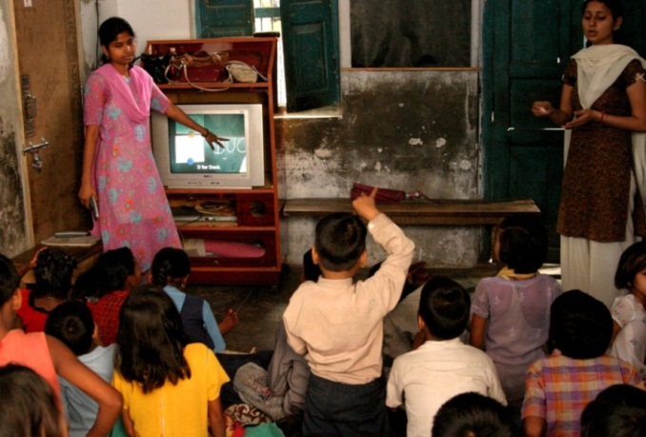
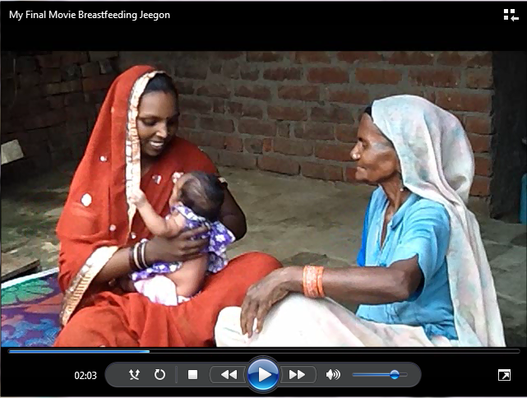
From Digital StudyHall to Digital PublicHealth
Richard Anderson
Department of Computer Science and Engineering
University of Washington, Seattle, USA

Slide 2
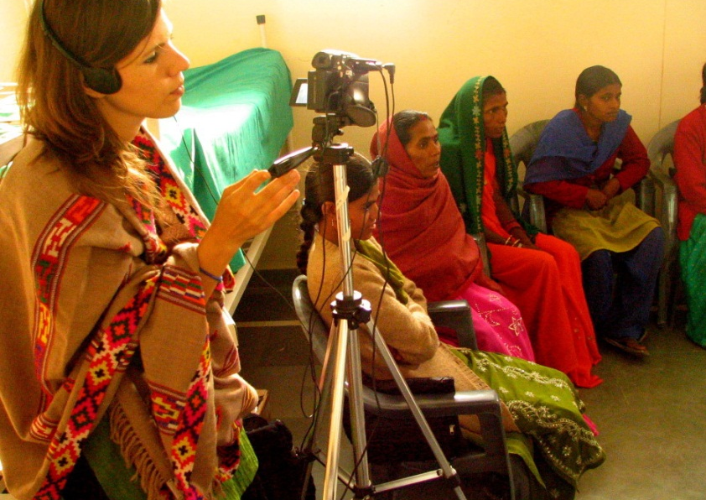
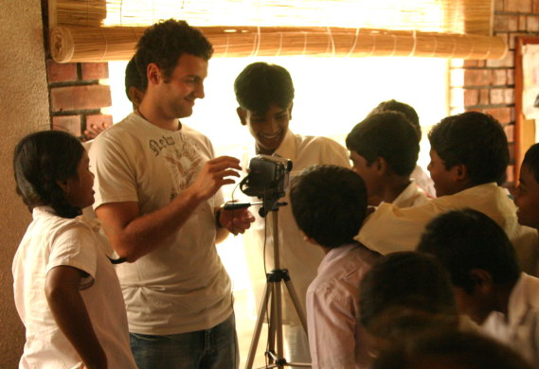
The History of D*
Digital StudyHall pioneered a technology and methodology for remote education with low cost digital video
D* designated the use of the DSH platform to multiple domains
Digital Green (DG) for agriculture
Rikin Gandhi
Digital PolyClinic (DPC) for health
Anna Spessard-Mulhair
Julia Lowe
Digital Self Employment (DSE) for livelihood
Paul Javid

Slide 3
Themes and distractions
Technologist led projects for global good
Relationship between academic ICTD community and the NGO world
Rapid technological and economic change
Sustainable and scalable interventions
How does an ICTD project succeed?
Technology is only one component of a successful program
Dominance of consumer/commercial technology

Slide 4
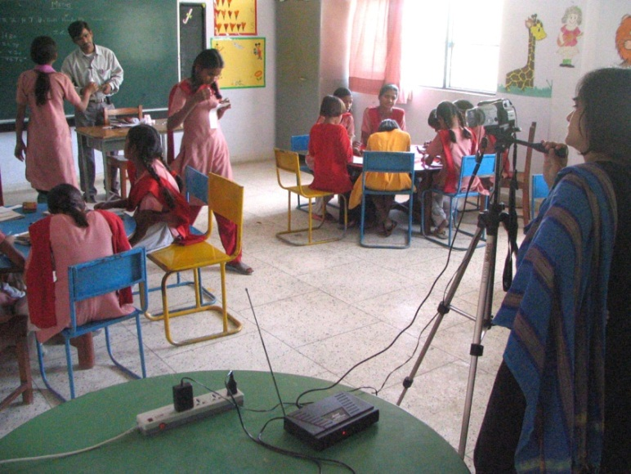
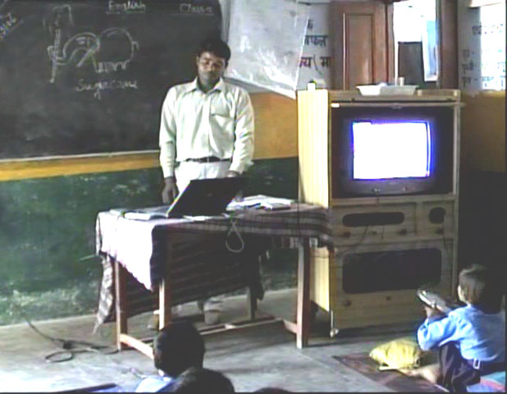
What is Digital StudyHall?
Support weak schools with video content from expert teachers
Local teacher mediates the video content
Based on the TVI model
Provide better content and support teacher development
Important to match content with target audience
Cost realism

Slide 5
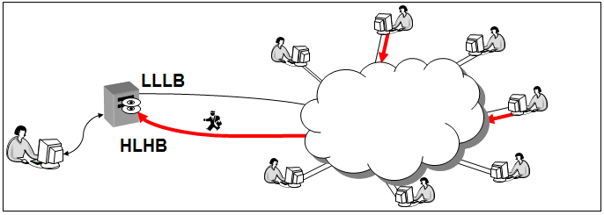
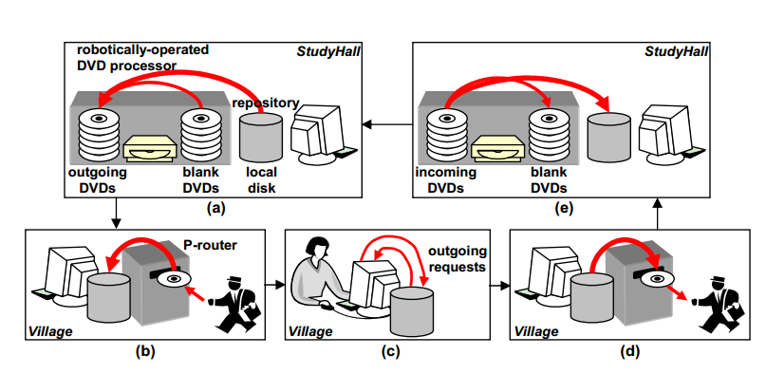
DSH History: The Idea
How can computing systems research be applied to help the very poor?
Solve the digital content distribution problem to make distance education possible
Concept paper, Randy Wang et al., Princeton, November 2003

Slide 6
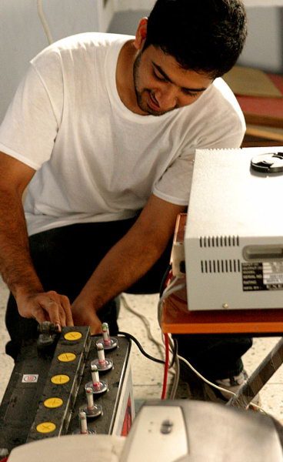
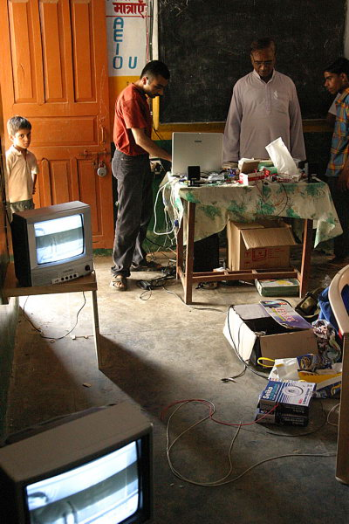
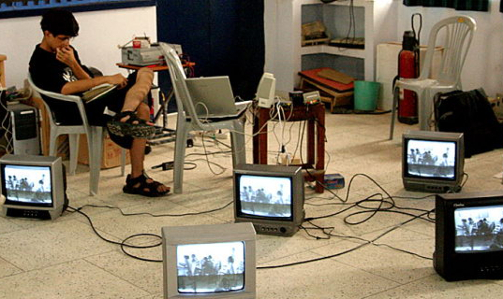
DSH History: Experimentation
Minimize cost of video playback in the classroom
Attempt to use low cost television sets
Target rural schools with irregular power
Low cost video and audio production
Develop video production tools based on open source software

Slide 7
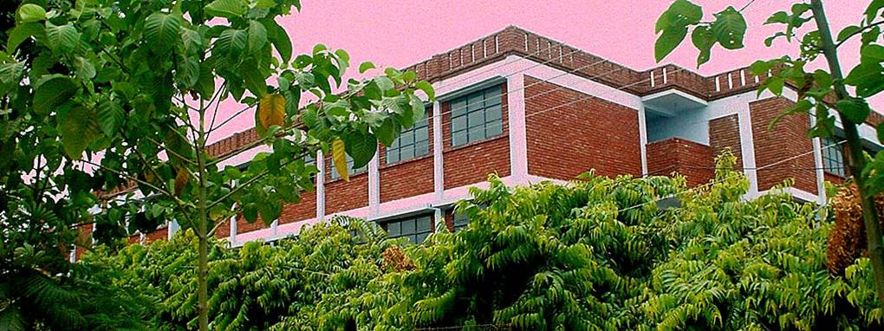
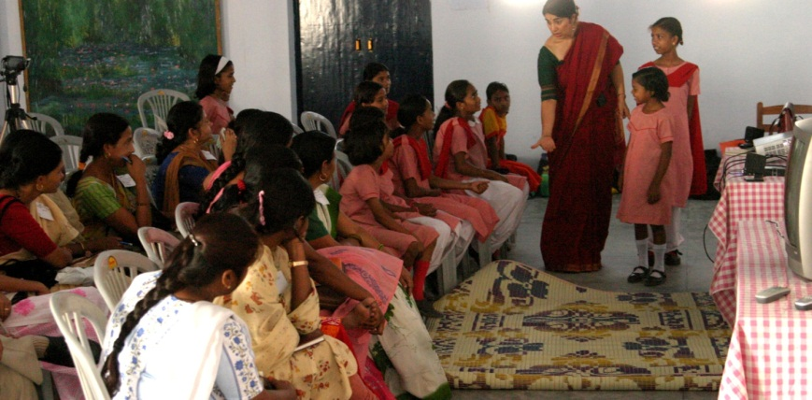
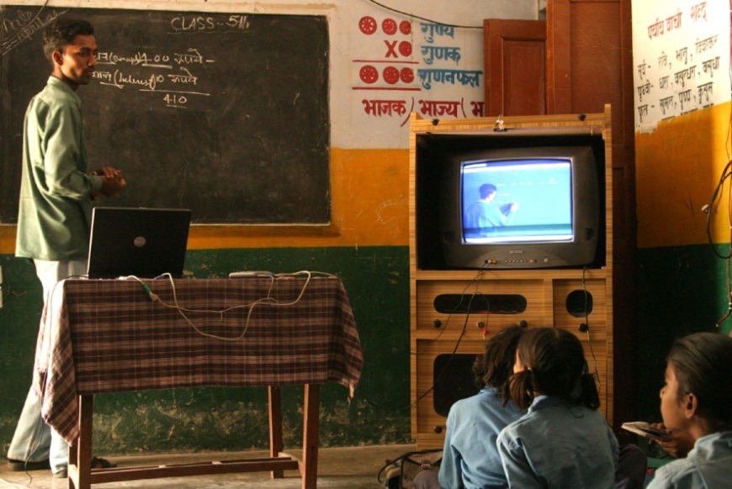
DSH History: Building the Lucknow hub
Developed content creation model with a strong school
Recorded core content for all grades
Teacher training workshops
Range of different types of schools
Government, private, informal
Simplification of the technology
DVD players instead of computers

Slide 8
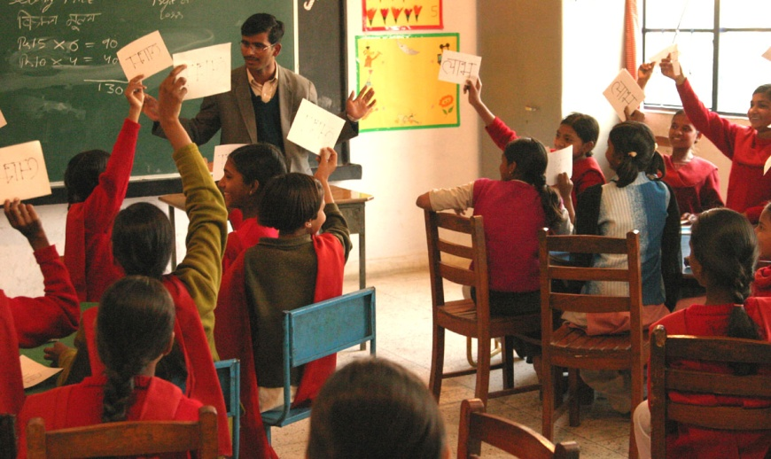
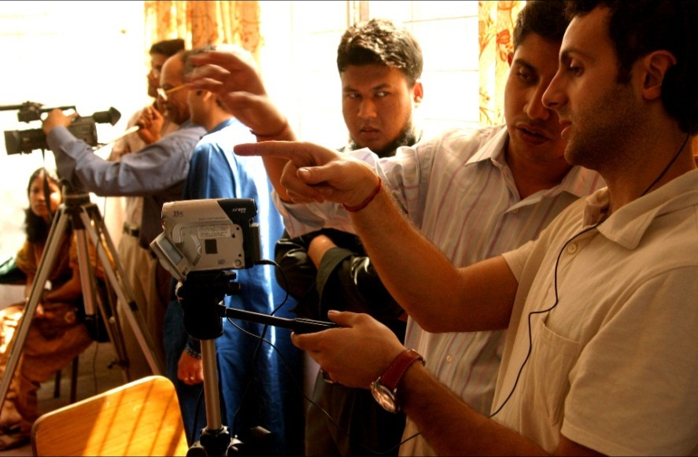
DSH History: Microsoft Research India
Randy Wang hired as a researcher at MSR India
Project remained based in Lucknow
Part of the Technology for Emerging Markets (TEM) group
Development of other HUBs
Bangalore, Pune, Dhaka, Calcutta

Slide 9
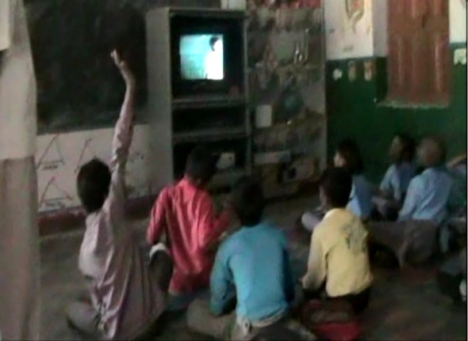
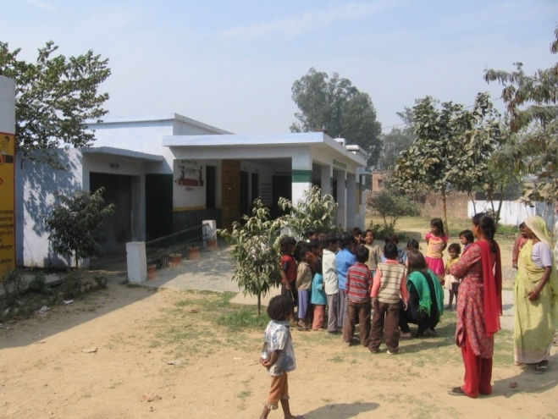
DSH History: Independence
Relationship with MSR ended in 2008
Activities in Lucknow continued, but many hubs stopped working
NSF sponsored study exposed challenges in working with government schools
Randy Wang moved to Intel, Shanghai in 2010
New set of projects developed by DSH Lucknow with a new manager

Slide 10
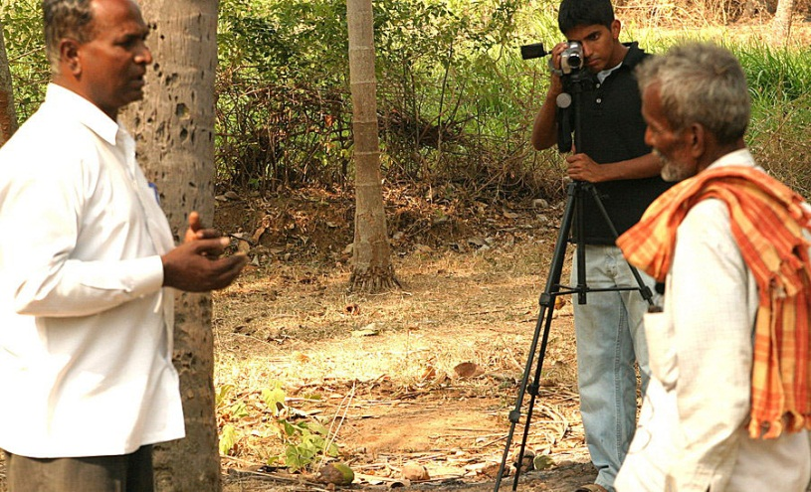
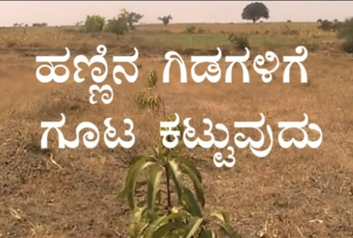
What is Digital Green?
Video based education for farmers
Community created videos demonstrating agricultural practices
Facilitated showings of videos in farmer groups
Digital Green (NGO) providing technology, training, content archive and advocacy

Slide 11
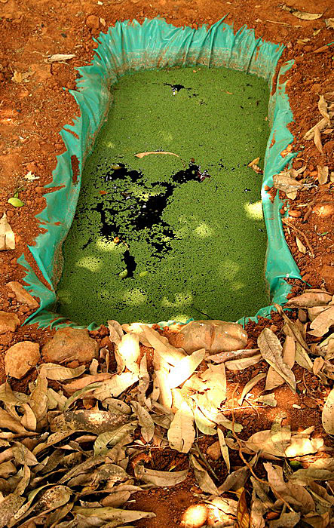
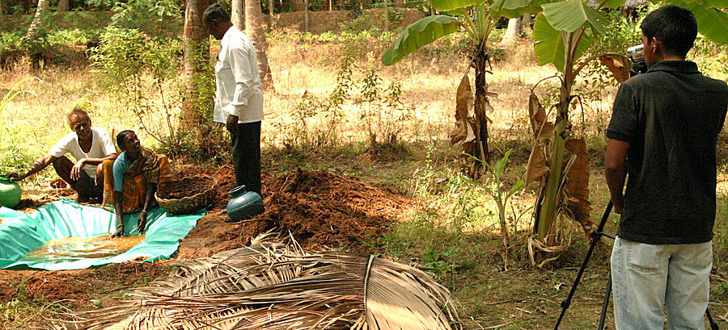
DG History: The Idea
Apply Digital StudyHall to agriculture
Formative research conducted with Bangalore based NGO (Green)
Promote organic farming practices
Film extension workers introducing practices
Public showings in evenings
Rikin Gandhi started work at MSRI as a volunteer

Slide 12
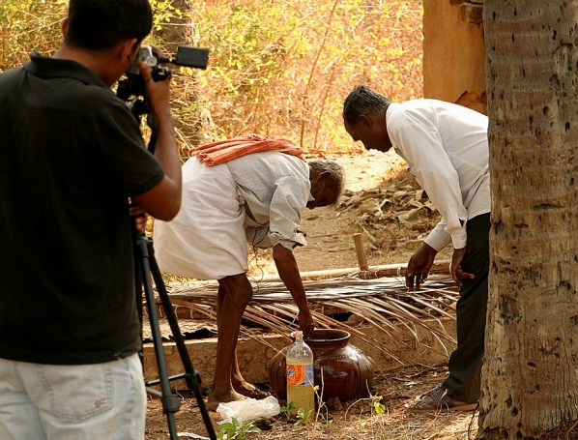
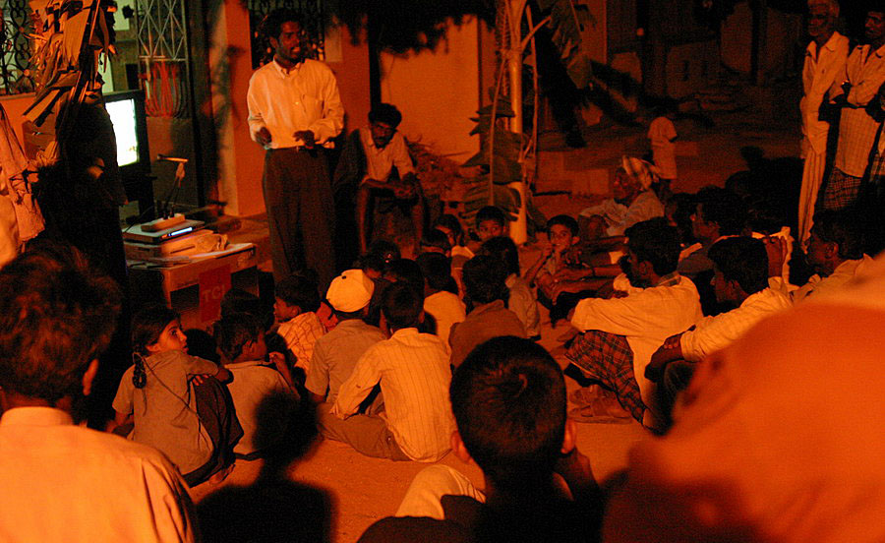
DG History: Experimentation
Video creation
Wide range of topics and video styles
Screening methodologies
In homes
In public square
Process
Hire ‘animators’ responsible for conducting showings and maintaining equipment
Follow up from meetings

Slide 13
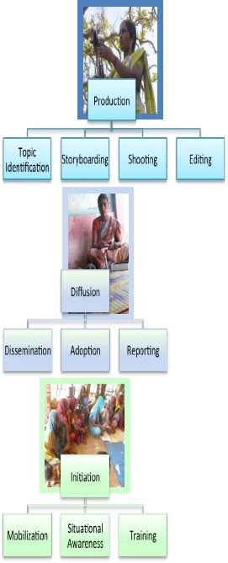
DG History: Spin Out
Studies measuring “cost per adoption”
Compare DG with extension agent
Emphasis on monitoring
Microsoft identified forming an NGO as a success criteria for the project
Support from BMGF to form NGO

Slide 14
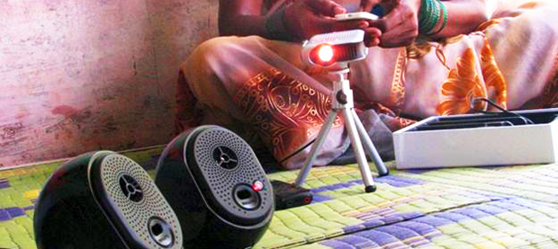
DG History: Building an NGO
Business model
Partner with NGOs implementing agricultural programs
Become trainers and managers of content and technology
Shift focus to low income states in India
Strengthen process model
Process innovation:
Shift video creation to the community
Technology innovation:
Pico-projector

Slide 15
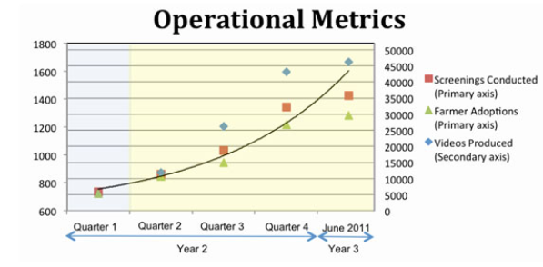
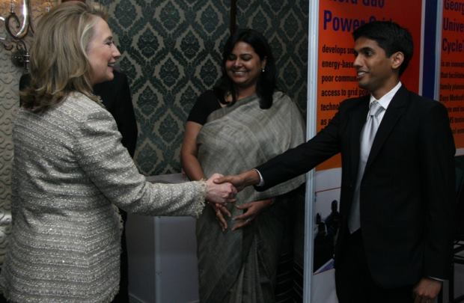
DG History: Expansion
Substantial growth
Partnership with NRLM in India
Exploratory projects in Africa
Identification of other domains
Health, Sanitation, Nutrition, Livelihood

Slide 16
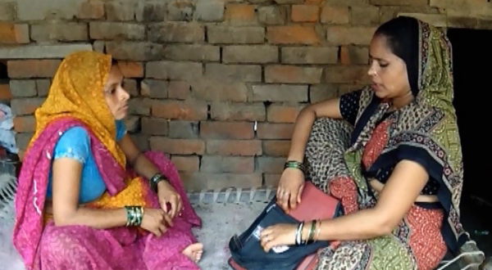
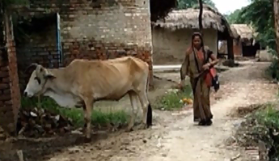
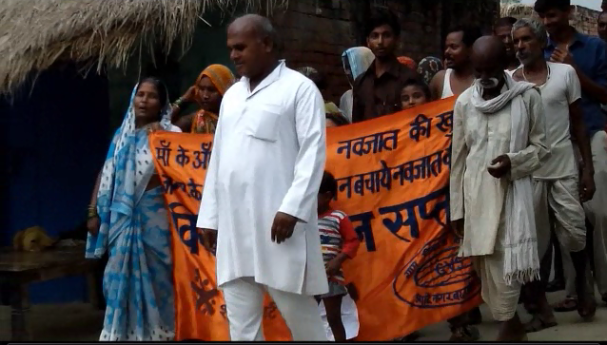
What is Digital Public Health?
Digital Green model applied to community health education
Community created video content for externally defined health messages
Video showings in community to promote behavior change

Slide 17
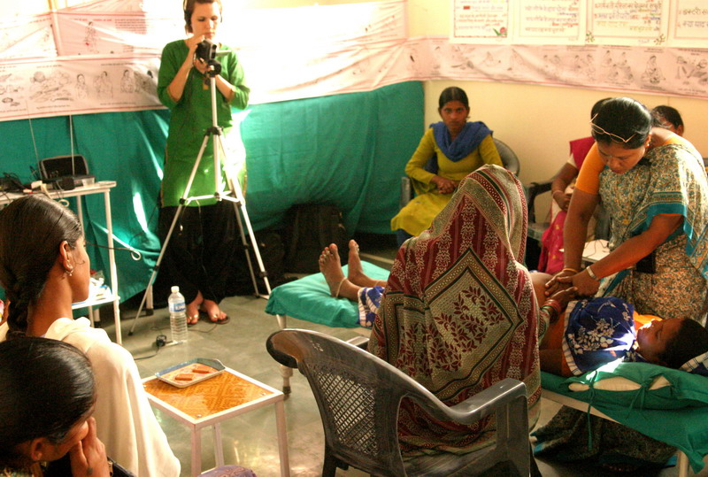
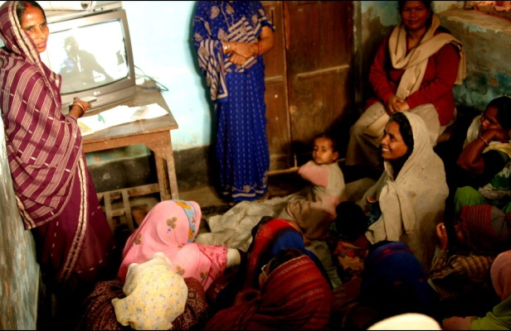
DPH History: The precursor – Digital PolyClinic
Digital StudyHall project conducted by interns
Anna Spessard-Mulhair
Julia Lowe
Recorded a women’s health workshop at a clinic
Trained facilitators
Videos shown in groups in village houses
Major effort to transport television and car batteries

Slide 18
DPH History: Building a Partnership
PATH/DG partnership established
DG Video Training workshop for PATH staff
Identification of possible differences between Health and Agriculture
Message review
Evaluation of impact
Dissemination models
Funding for pilot
Identification of implementation partner

Slide 19
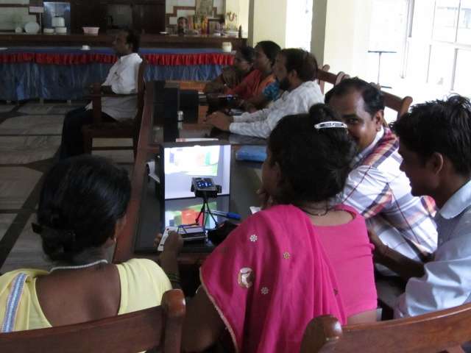
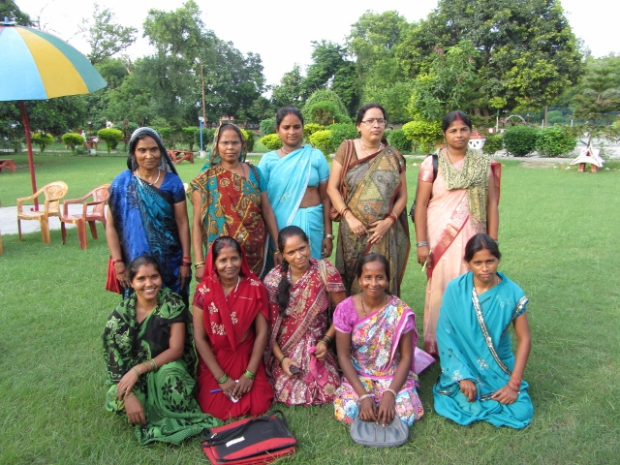
DPH History: Project Launch
Partnership agreement
Determine that DPH is consistent with partners goals and capabilities
Process definition
Plan M&E
Training
Video production
Dissemination
Data reporting
Video production
Dissemination starts October 1

Slide 20
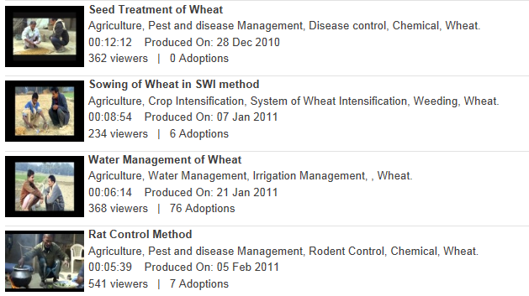
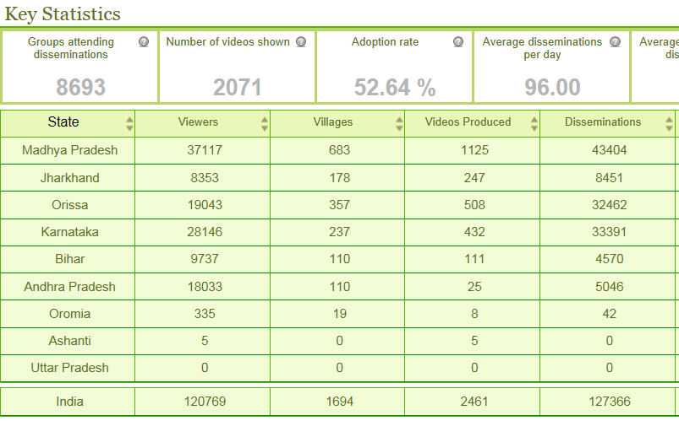
Applying the Digital Green model to health
Digital Green model
Participatory process for content production
Locally generated digital video database
Human-mediated instruction for dissemination and training
Regimented sequencing to initiate a new community
Integrated performance monitoring

Slide 21
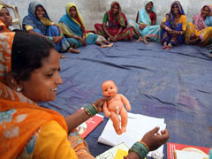
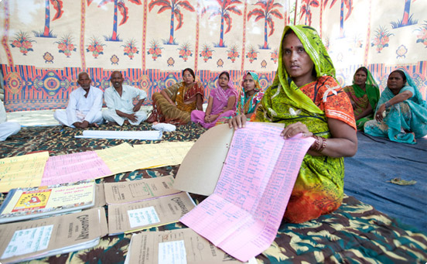
Surestart project
PATH led project in UP and Maharashtra
2006-2011, BMGF Funded
Community engagement to support maternal and newborn health
Governance and public health interventions
Mentoring ASHAs
Maternal health messaging
Danger signs
Birth preparedness
Thermal care
Breast feeding
Mothers’ group
ASHA led group of expecting mothers
Monthly meeting with activities

Slide 22
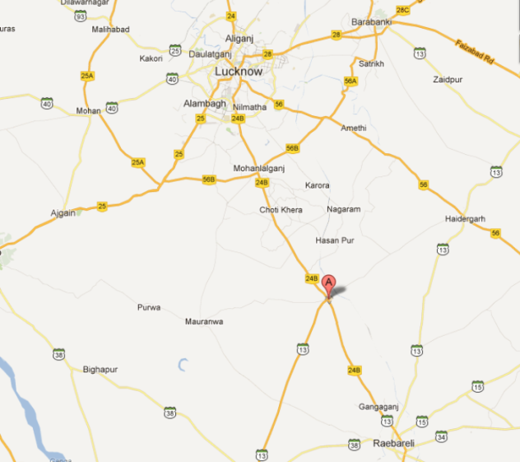
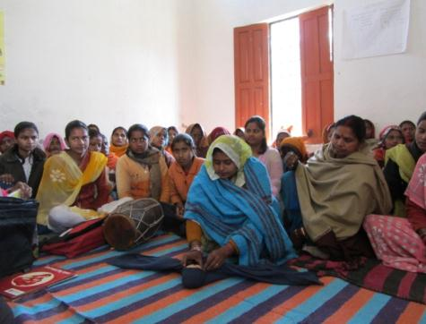
Bacchrawan, Raebareli, UP
Gran Vikas Sanstham
Well established local NGO
Active since 1977
Demonstration site for SureStart
High performing district
Project will cover 20 villages with 54 mothers’ groups
Direct continuation of Surestart
Supervisory structure already in place

Slide 23
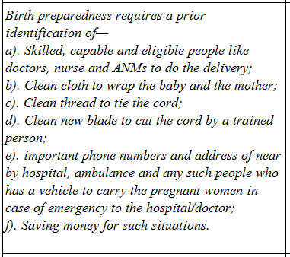
Message creation
Health messaging developed by experts
Standard messaging that has been adopted by health organizations
List of messages for a topic given to video team
Messages must appear in the video

Slide 24
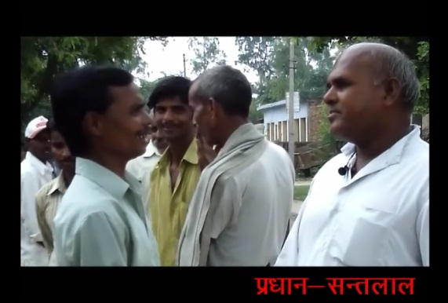
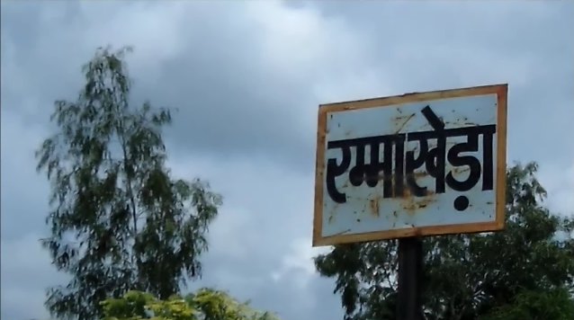
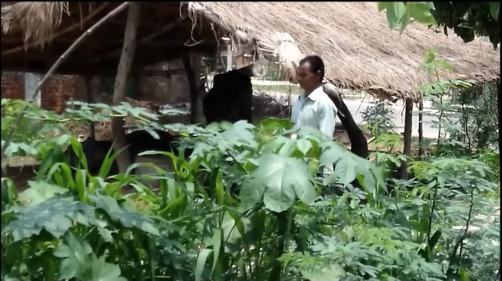
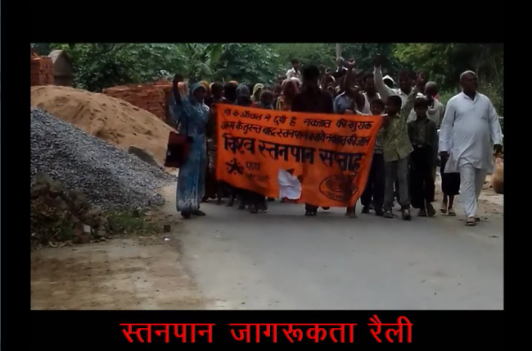
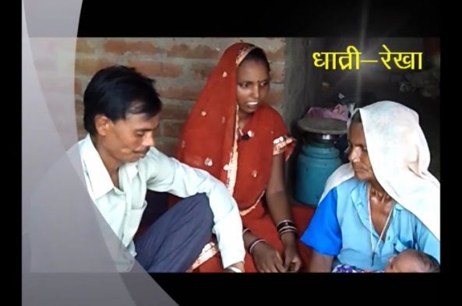
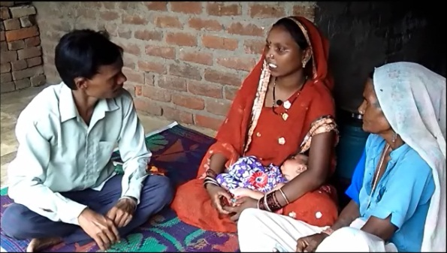
Video creation
GVS employees trained in video production and editing
No previous background
Training includes basics of film
Different types of shots
Video team had creative control on videos
Developed story lines for videos
Initial videos produced were of high quality

Slide 25
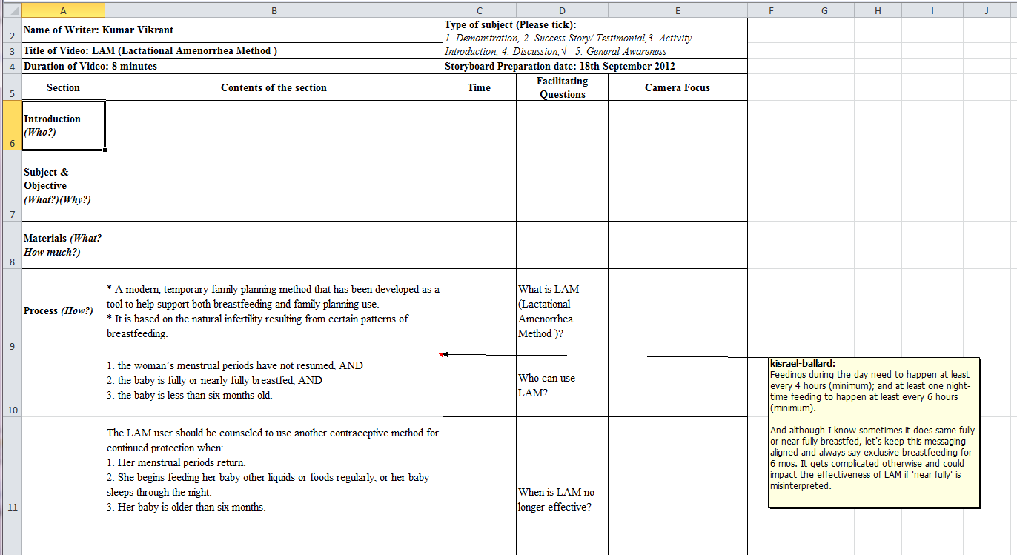
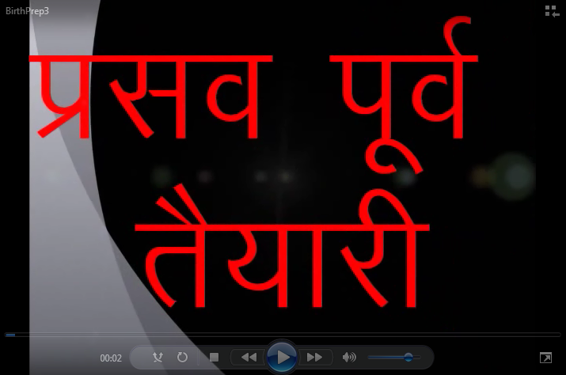
Review
Critical to ensure accuracy of messaging
Community advisory board created
Health system and community membership
Approvals
Storyboards
Final videos
Community and PATH review
Recommendations from CAB have been included in videos
Errors in videos have been detected

Slide 26
Dissemination
ASHAs trained to use videos
Technical training on Pico projector
Training in facilitation
Videos shown in existing mothers groups
Substitute videos for learning activities
Attempt to keep format the same

Slide 27
Technology
Video creation with Kodak playtouch camera
Edit with Microsoft Movie Maker
(sound problems)
Video sharing for review
Post to YouTube
Load on Pico projector for showings

Slide 28
Assessment
How do we know if practices are followed
DG Paradigm – practice demonstrated, follow up to see how many have adopted (with key adoption points)
Health – not clear
Will have ASHAs follow up on home visits

Slide 29
Monitoring and evaluation
Project goal: To generate evidence on Digital Public Health as a new model for community-driven behavior change communication for maternal/neonatal health issues in a targeted region in India
Feasibility study
Establish that the basic process works
Community acceptance
Focus on process indicators
Videos created
Number of screenings
Review of messages and videos
Attendance
Performance of ASHAs
Objective 1: Adapt the Digital Green model to Digital Public Health model
Objective 2: Strengthen capacity of community-based support through Digital Public Health messaging
Objective 3: Evaluate proof of concept of integrating the DPH model into a community support program

Slide 30
Behavior change communication
Promoting behavior change is much more than just making messages available
Different models of behavior change for different domains
Maternal health vs. lifestyle vs. agricultural practice
DPH model complementary to centralized initiatives

Slide 31
Extending DPH deployments
Groups available for health information disseminations
Mother’s groups
Self Help Groups
Village health and nutrition days
Requirements
Community mobilization
Facilitation structure
Reason for people to receive health content

Slide 32
Local versus centralized content
Why not create 20 videos that could cover all of Hindi speaking India?
Amortized cost will be lower
Arguments for local
Variation in practices
Tailor to local dialect and culture
Respond to local needs
Community identification, engagement and empowerment
Will the community prefer local content?
Need to do a rigorous evaluation

Slide 33
Handheld content delivery
Mobile devices for content dissemination
Household visits by nurses or community health workers often contain educational activities
Sensitive topics can be covered in one on one visits

Slide 34
Evaluating impact
Phase one: Feasibility
Phase two: Impact
Determine if DPH is cost effective for implementing BCC in community programs
What are the measured outcomes?

Slide 35
DSH to DPH: Technology vision
Central technical challenge for DSH was low cost digital video
Rapid changes in technology have simplified and lowered many costs
DG technology process adopted by DPH
MS MovieMaker
YouTube
Pico projectors
Digital backchannel unrealized

Slide 36
DSH to DPH: Deployment model
Organizational deployment model
DSH focusing on direct implementation of projects
Few external hubs
DPH starting with a model of field deployment partners
Differences in structure between schools and community groups
Training, video archive, technology management common to both

Slide 37
DSH to DPH: Content creation
DSH Model:
Centralized content creation (educational institution)
Common curriculum across deployment
DPH Model:
Community created content
Local content to allow message customization and increased engagement

Slide 38
Comments???
anderson@cs.washington.edu

Slide 39
Acknowledgment
Vikrant Kumar, Lysander Menezes, Noah Perin, Amit Saxena, Chad Robertson, Paul Javid, Natalie Linnell, Rahul Gupta, Anjana Arora, John Bransford, Tom Anderson, Pratyush Shukla, Sumeet Sobti, Randy Wang, Urvashi Sahni, Esha Nabi, Tanuja Setia, Kentaro Toyama, Kiersten Israel-Ballard, Sita Shankar, Shreya Agarwal, Rikin Gandhi, Vinay Kumar, Melody Kadenko, Julie Svendsen, Amjad Khan, Shivaji Choudhry, Peggy King, Jeff Bernson, Michelle Desmond, Trish Coffey, Anna Spessard-Mulhair, Julia Lowe

