Slide 1
Course Overview CS294: Program Synthesis for Everyone
Ras Bodik Emina Torlak
Division of Computer Science
University of California, Berkeley

Slide 2
The name of the course
this CS294 topics course has been listed as
CS294: Programming Language Design for Everyone
Since putting the course on the books, we realized we are ready teach a superset of intended material.
In addition to
design of domain-specific languages (DSLs) and
their lightweight implementation
you will learn
how to build a synthesizer in a semester
also a topic for everyone (PL students and others)

Slide 3
CAV tutorial
The course is based on our invited CAV 2012 tutorial
Synthesizing Programs with Constraint Solvers slides (ppt) slides (pdf) screencast
We will expand all topics into standalone segments
basics of modern verification (with solvers)
embedding your language in a host language (Racket)
synthesis algorithms (with solvers and without)
creative specifications and tests, etc

Slide 4
Motivation: Two quotes
Computers Programming Computers?
from the an interview with Moshe Vardi
Information technology has been praised as a labor saver and cursed as a destroyer of obsolete jobs. But the entire edifice of modern computing rests on a fundamental irony: the software that makes it all possible is, in a very real sense, handmade. Every miraculous thing computers can accomplish begins with a human programmer entering lines of code by hand, character by character.
http://www.thetexaseconomy.org/business-industry/business-development/articles/article.php?name=computersProgramming

Slide 5
Motivation: Two quotes
Automated programming revisited
Ras Bodik
Why is it that Moore’s Law hasn’t yet revolutionized the job of the programmer? Compute cycles have been harnessed in testing, model checking, and autotuning but programmers still code with bare hands. Can their cognitive load be shared with a computer assistant?

Slide 6
Discussion
Moore’s Law increased performance > 100x since the invention of C. Do you agree that this improvement has not conferred programmability benefits?

Slide 7
What is program synthesis
Find a program P that meets a spec $φ(\text{input}\text{,}\text{output}):$
$$∃P . ∀x . φ(x,P(x))$$
When to use synthesis:
productivity: when writing $φ$ is faster than writing $P$
correctness: when proving $φ$is easier than proving $P$

Slide 8
Is compiler a synthesizer
Can compilation be expressed with this formula?
$$∃P . ∀x . φ(x,P(x))$$
Assume we want to compile source program $S(x)$ into target program $P(x)$. Can $φ$ describe this?
Notes:
def $φ\left(x,y\right)≡y=S(x)$

Slide 9
Compilation vs. synthesis
So where’s the line between compilation & synthesis?
Compilation:
1) represent source program as abstract syntax tree (AST)
(i) parsing, (ii) name analysis, (iii) type checking
2) lower the AST from source to target language
eg, assign machine registers to variables, select instructions, …
Lowering performed with tree rewrite rules, sometimes based on analysis of the program
eg, a variable cannot be in a register if its address is in another variable

Slide 10
Synthesis, classical
Key mechanisms similar to compilation
start from a spec = src program, perhaps in AST form
rewrite rules lower the spec to desired program
But rewrite sequence can be non-deterministic
explore many programs (one for each sequence)
Rewrite rules are need not be arbitrarily composable
rewrite seq can get stuck (a program cannot be lowered)
hence must backtracking

Slide 11
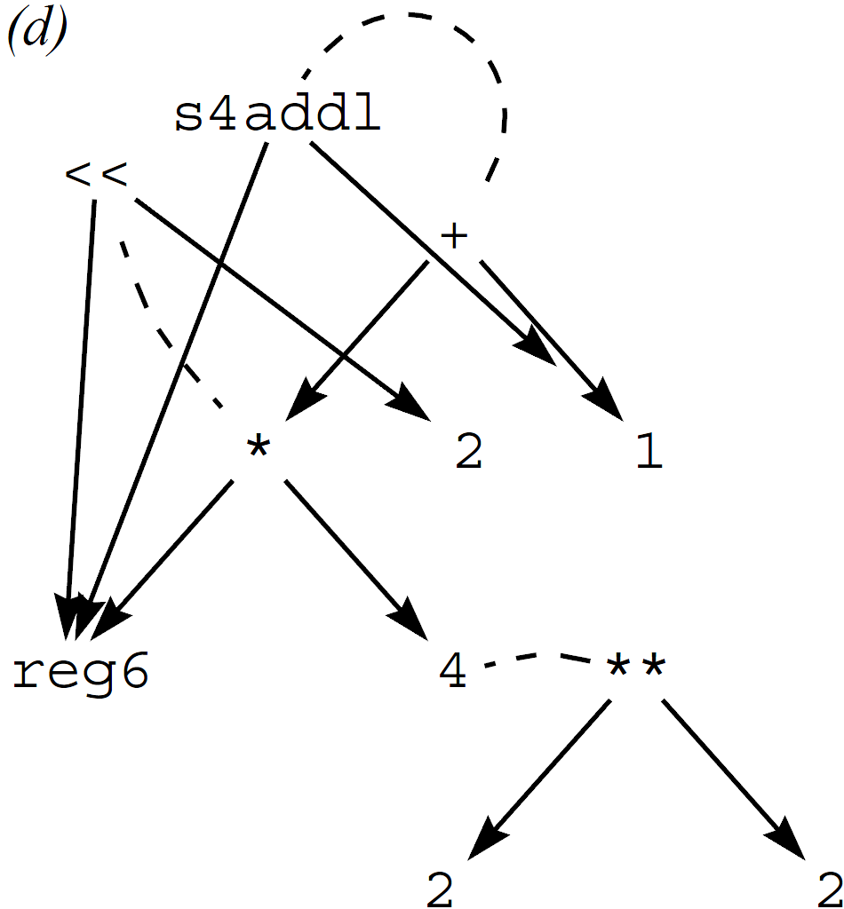
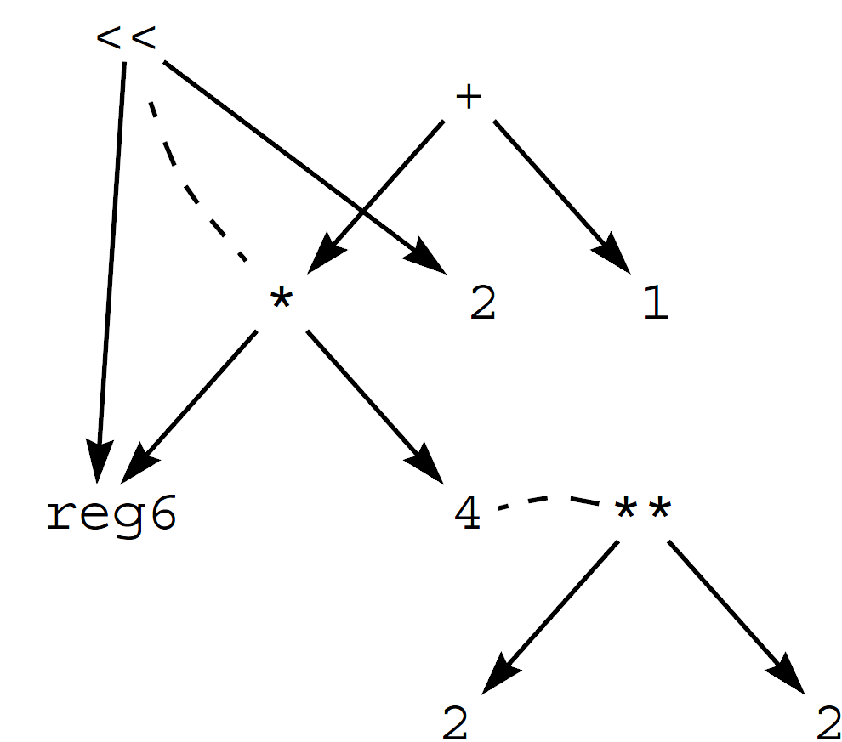
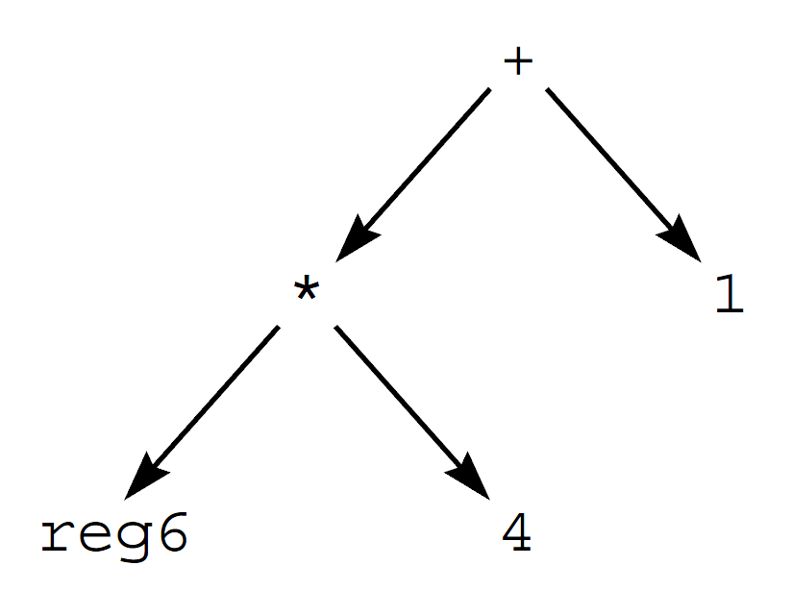
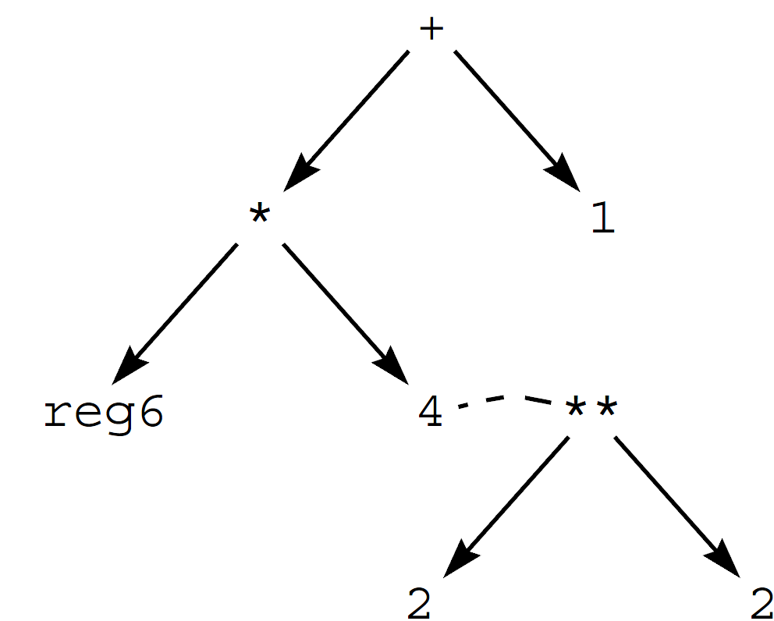
Denali: synthesis with axioms and E-graphs
[Joshi, Nelson, Randall PLDI’02]
$$∀ n . 2n=\text{2}\text{∗∗}n$$
$$∀ k, n . k∗2n=k\text{<<}n$$
$$∀k, n:: k∗4+n =\text{s}\text{4}\text{addl}(k, n)$$
$$\text{reg}\text{6}∗4+1$$ specification
$$\text{s}\text{4}\text{addl}\left(\text{reg}\text{6},1\right)$$ synthesized program

Slide 12
Two kinds of axioms
Instruction semantics: defines (an interpreter for) the language
$$∀ n . 2n=\text{2}\text{∗∗}n$$
$$∀ k, n . k∗2n=k\text{<<}n$$
Algebraic properties: associativity of add64, memory modeling, …
$$∀k, n:: k∗4+n =\text{s}\text{4}\text{addl}(k, n)$$

Slide 13
Compilation vs. classical synthesis
Where to draw the line?*
If it searches for a good (or semantically correct) rewrite sequence, it’s a synthesizer.
*We don’t really need this definition but people always ask.

Slide 14
Modern synthesis
Interactive: it’s computer-aided programming
a lot of our course will be on obtaining diagnostics about (incomplete or incorrect) programs under development
Solver-based: no (less) need for sem-preserving rules
instead, search a large space of programs that are mostly incorrect but otherwise posses programmer-specified characteristics, eg, run in log(n) steps.
how to find a correct program in this space? conceptually, we use a verifier that checks the $φ$ condition.

Slide 15
Preparing your language for synthesis
Extend the language with two constructs
spec: int foo (int x) {
return x + x;
}
$$φ\left(x,y\right):y=\text{foo}(x)$$
sketch: int bar (int x) implements foo {
return x << ??;
}
?? substituted with an int constant meeting $φ$
result: int bar (int x) implements foo {
return x << 1;
}
instead of implements, assertions over safety properties can be used
15
Notes:
Works probably for any language. This is a C/Fortan like language
Why constants suffice will become clearer in Part II

Slide 16
Synthesis as search over candidate programs
Partial program (sketch) defines a candidate space
we search this space for a program that meets $φ$
Usually can’t search this space by enumeration
space too large ($≫1010$)
Describe the space symbolically
solution to constraints encoded in a logical formula gives values of holes, indirectly identifying a correct program
What constraints? We’ll cover this shortly.

Slide 17
Synthesis from partial programs
spec
sketch
program-to-formula translator
$$φ$$
solver
“synthesis engine”
$$h↦1$$
sketch $P[h]$
code generator
$$P[1]$$
Notes:
TODO: Use this slide to reinforce the notion of partial programs, called henceforth sketches
Visually show the space of programs (as in Evan’s talk)
Divide the synthesizer into formula compiler, solver, and code generator.
Say that the spec need not be translated to formulas (more in Part II)
Do we need this slide or does it destroy min path to building a synthesizer?
Deleted text: No need for a rewrite-rule domain theory.
No rules needed to rewrite x+x into 2*x into x<<1.
If we need it, do we keep the reference to the rewrite-based domain theory or leave it completely to Part II?

Slide 18
What to do with a program as a formula?
Assume a formula S_{P}(x,y) which holds iff program P(x) outputs value y
program: f(x) { return x + x }
formula: $Sf\left(x,y\right): y=x+x$
This formula is created as in program verification with concrete semantics [CMBC, Java Pathfinder, …]

Slide 19
With program as a formula, solver is versatile
Solver as an interpreter: given x, evaluate f(x)
$$S\left(x,y\right)∧x=3 \text{solve} \text{for} y y↦6$$
Solver as a program inverter: given f(x), find x
$$S\left(x,y\right)∧y=6 \text{solve} \text{for} x x↦3$$
This solver “bidirectionality” enables synthesis

Slide 20
Search of candidates as constraint solving
$SP(x,h,y)$holds iff sketch $P[h](x)$outputs$y$.
spec(x) { return x + x }
sketch(x) { return x << ?? } $Ssketch\left(x,y,h\right): y=x∗2h$
The solver computes h, thus synthesizing a program correct for the given x (here, x=2)
$$Ssketch\left(x,y,h\right)∧x=2∧y=4 \text{solve} \text{for} h h ↦1$$
Sometimes h must be constrained on several inputs
$$S\left(x1,y1,h\right)∧x1=0∧y1=0∧$$
$$S\left(x2,y2,h\right)∧x2=3∧y2=6 \text{solve} \text{for} h h↦1$$
Notes:
TODO:
add solve for h
?? is represented with h
y values are computed using the spec function

Slide 21
Inductive synthesis
Our constraints encode inductive synthesis:
We ask for a program $P$ correct on a few inputs.
We hope (or test, verify) that $P$ is correct on rest of inputs.
Segment on Synthesis Algorithm will describe how to select suitable inputs

Slide 22
Why synthesis now?
Three trends in computing (during last 10-15 years)
parallelism
multi-level machines (SIMD to cluster), concurrency
the Web
distributed computation, lost messages, security
programming by non-programmers
scientists, designers, end users
Lessons:
We need to write programs that are more complex.
Programming must me more accessible.

Slide 23
Example real-world synthesizers: Spiral
Derives efficient linear filter codes (FFT, …)
exploits divide-and-conquer nature of these problems
A rewrite rule for Cooley/Tukey FFT:
DFT₄ = (DFT₂ ⊗ I₂) T⁴₂ (I₂ ⊗ DFT₂) L⁴₂
Similar rules are used to describe parallelization and locality
So, rewrite rules nicely serve three purposes: algo, para, local
http://www.spiral.net/

Slide 24
Example real-world synthesizer (FlashFill)
Demo
For video demos, see Sumit Gulwani’s page: http://research.microsoft.com/en-us/um/people/sumitg/flashfill.html
John | Smith | 12/1/1956 | 1956 | 12 | JS | 12-1-JS
Jamie | Allen | 1/1/1972
Howard | O'Neil | 2/28/2012
Bruce | Willis | 12/24/2000

Slide 25
What artifacts might be synthesizable?
Anything that can be viewed as a program:
reads input, produces output, could be non-terminating
Exercise: what such “programs” run in your laptop?

Slide 26
A liberal view of a program
networking stack
==> TCP protocol is a program ==> synthesize protocols
interpreter
==> embeds language semantics ==> languages may be synthesizable
spam filter
==> classifiers ==> learning of classifiers is synthesis
image gallery
==> compression algorithms or implementations

Slide 27
A liberal view of a program (cont)
file system
==> "inode" data structure
OS scheduler
==> scheduling policy
multicore processor
==> cache coherence protocol
UI
==> ???

Slide 28
What do we need to synthesize these?
Notes:
spec
domain knowledge
algorithms

Slide 29
Your project
Seven milestones (each a short presentation)
problem selection (what you want to synthesize)
what’s your DSL (design language for your programs)
what’s your specification (how to describe behavior)
how to translate your DSL into logic formulas
your synthesis algorithm
scaling up with domain knowledge (how to sketch it)
final posters and demos

Slide 30
Your project
language and programming
DIY translator
synthesis engines
spec
sketch
program-to-formula translator
$$φ$$
2QBF solver
“synthesis engine”
$$h↦1$$
sketch $P[h]$
code generator
$$P[1]$$

Slide 31
Example of projects
Synthesis of cache-coherence protocols
Incrementalizer of document layout engines
Web scraping scripts from user demonstrations
Models of biological cells from wet-lab experiments
…

Slide 32
Some open synthesis problems
how should synthesizer interact with programmers
in both directions; it’s psychology and language design
how to do modular synthesis?
we cannot synthesize 1M LOC at once; how to break it up?
constructing a synthesizer quickly
we’ll show you how to do it in a semester; but faster would be even better. Also, how to test, maintain the synthesizer?

Slide 33
Homework (due in a week, Aug 30 11am)
Suggest an application for synthesis
ideally from your domain of expertise.
1) Background: Teach us about your problem.
Eg, I want to implement X but failed to debug it in 3 months
2) Problem statement:
What specific code artifact would be interesting to synthesize? Why is it hard to write the artifact by hand?
3) What are you willing to reveal to the synthesizer
That is, what’s your spec? Is this spec easy to write precisely? What other info would you like to give to the synthesizer?

Slide 34
Next lecture
Constraint solvers can help you write programs:
Four programming problems solvable when a program is translated into a logical constraint: verification, fault-localization, angelic programming, and synthesis.
Example of a program encoding with an SMT formula (Experimenting with Z3).

