Slide 1


Knowledge-Based Weak Supervision for Information Extraction of Overlapping Relations
Raphael Hoffmann, Congle Zhang,
Xiao Ling, Luke Zettlemoyer, Daniel S. Weld
University of Washington
06/20/11

Slide 2
Relation Extraction
Citigroup has taken over EMI, the British music label of the Beatles and Radiohead, under a restructuring of its debt, EMI announced on Tuesday.
The bank’s takeover of the record company had been widely expected, reports Ben Sisario on Media Decoder, as EMI has been struggling under a heavy debt load as a result of its $6.7 billion buyout in 2007 and amid a decline in music sales.
The buyout, by the British financier Guy Hands’s private equity firm Terra Firm, came at the height of the buyout boom. Citigroup provided some $4.3 billion in loans to finance the deal.
CompanyAcquired(Citigroup, EMI)
CompanyOrigin(EMI, British)
CompanyIndustry(EMI, music label)
MusicPerformerLabel(Beatles, EMI)
MusicPerformerLabel(Radiohead, EMI)
CompanyIndustry(Citigroup, bank)
CompanyIndustry(EMI, record company)
CompanyIndustry(Terra Firm, private equity)
OwnedBy(Terra Firm, Guy Hands)
Nationality(Guy Hands, British)
Profession(Guy Hands, financier)

Slide 3
Knowledge-Based Weak Supervision
Use heuristic alignment to learn relational extractor
Relation
Acquisitions Database
Citigroup has taken over EMI, the British music label of the Beatles and Radiohead, under a restructuring of its debt, EMI announced on Tuesday.
Google | YouTube
Citigroup | EMI
Oracle | Sun
Facts
RelationMention
Citigroup has taken over EMI, the British …
Citigroup’s acquisition of EMI comes just ahead of …
Google’s Adwords system has long included ways to connect to Youtube.
Citigroup has seized control of EMI Group Ltd from …
Google acquires Fflick to boost Youtube’s social features.
Citigroup and EMI are in negotiations.
Oracle is paying out $46 million over kickback allegiations that got Sun in trouble.
In the wake of Oracle’s $5.6bn acquisition of Sun a year ago, …

Slide 4


Goal: Accurate extraction from sentences, that meets following challenges
Noise
True
Mentions
Aligned
Mentions
5.5%
1.9%
* percentages wrt. all
mentions of entity pairs
in our data
2.7%
Overlapping relations
18.3% of Freebase facts
match multiple relations
Founded(Jobs, Apple)
CEO-of(Jobs, Apple)
Large corpora
55 million sentences
27 million entities

Slide 5
Outline
Motivation
Our Approach
Related Work
Experiments
Conclusions

Slide 6
Previous Work: Supervised Extraction
Learn extractor
1
Steve Jobs is
CEO of Apple, …
E
2
CEO-of(1,2)
Given training data:
1
2
Steve Jobs presents Apple’s HQ.
Apple CEO Steve Jobs …
Steve Jobs holds Apple stock.
Steve Jobs, CEO of Apple, …
Google’s takeover of Youtube …
Youtube, now part of Google, …
Apple and IBM are public.
… Microsoft’s purchase of Skype.
N/A(1,2)
CEO-of(1,2)
N/A(1,2)
N/A(1,2)
Acquired(1,2)
Acquired(1,2)
N/A(1,2)
Acquired(1,2)
2
1
1
2
2
1
1
2
2
1
2
1
1
2

Slide 7
In this Work: Weak Supervision
Learn extractor
1
Steve Jobs is
CEO of Apple, …
E
2
CEO-of(1,2)
Given training data:
1
2
Steve Jobs presents Apple’s HQ.
Apple CEO Steve Jobs …
Steve Jobs holds Apple stock.
Steve Jobs, CEO of Apple, …
Google’s takeover of Youtube …
Youtube, now part of Google, …
Apple and IBM are public.
… Microsoft’s purchase of Skype.
2
1
1
2
CEO-of(Rob Iger, Disney)
CEO-of(Steve Jobs, Apple)
Acquired(Google, Youtube)
Acquired(Msft, Skype)
Acquired(Citigroup, EMI)
2
1
1
2
2
1
2
1
1
2

Slide 8
Previous Work: Direct Alignment
1
2
Steve Jobs presents Apple’s HQ.
Apple CEO Steve Jobs …
Steve Jobs holds Apple stock.
Steve Jobs, CEO of Apple, …
Google’s takeover of Youtube …
Youtube, now part of Google, …
Apple and IBM are public.
… Microsoft’s purchase of Skype.
E
CEO-of(1,2)
CEO-of(1,2)
CEO-of(1,2)
N/A(1,2)
Acquired(1,2)
Acquired(1,2)
N/A(1,2)
Acquired(1,2)
2
1
E
1
2
E
2
1
E
1
2
E
2
1
E
2
1
E
1
2
E
CEO-of(Rob Iger, Disney)
CEO-of(Steve Jobs, Apple)
Acquired(Google, Youtube)
Acquired(Msft, Skype)
Acquired(Citigroup, EMI)
e.g. [Hoffmann et al. 2010]

Slide 9
Previous Work: Aggregate Extraction
1
2
Steve Jobs presents Apple’s HQ.
Apple CEO Steve Jobs …
Steve Jobs holds Apple stock.
Steve Jobs, CEO of Apple, …
Google’s takeover of Youtube …
Youtube, now part of Google, …
Apple and IBM are public.
… Microsoft’s purchase of Skype.
CEO-of(1,2)
N/A(1,2)
Acquired(1,2)
?(1,2)
Acquired(1,2)
2
1
E
1
2
2
1
E
1
2
2
1
E
2
1
E
1
2
E
CEO-of(Rob Iger, Disney)
CEO-of(Steve Jobs, Apple)
Acquired(Google, Youtube)
Acquired(Msft, Skype)
Acquired(Citigroup, EMI)
e.g. [Mintz et al. 2010]

Slide 10
This Talk: Sentence-level Reasoning
1
2
Steve Jobs presents Apple’s HQ.
Apple CEO Steve Jobs …
Steve Jobs holds Apple stock.
Steve Jobs, CEO of Apple, …
Google’s takeover of Youtube …
Youtube, now part of Google, …
Apple and IBM are public.
… Microsoft’s purchase of Skype.
E
?(1,2)
?(1,2)
?(1,2)
?(1,2)
?(1,2)
?(1,2)
?(1,2)
?(1,2)
2
1
E
1
2
E
2
1
Train so that extracted facts match facts in DB
E
2
∨
1
E
2
1
E
2
1
E
1
2
E
CEO-of(Rob Iger, Disney)
CEO-of(Steve Jobs, Apple)
Acquired(Google, Youtube)
Acquired(Msft, Skype)
Acquired(Citigroup, EMI)

Slide 11
Advantages
Noise:
  multi-instance learning
Overlapping relations:
  independence of sentence-level extractions
Large corpora:
  efficient inference & learning

Slide 12
Multi-Instance Learning
1
2
Steve Jobs presents Apple’s HQ.
Apple CEO Steve Jobs …
Steve Jobs holds Apple stock.
Steve Jobs, CEO of Apple, …
Google’s takeover of Youtube …
Youtube, now part of Google, …
Apple and IBM are public.
… Microsoft’s purchase of Skype.
?(1,2)
?(1,2)
?(1,2)
?(1,2)
?(1,2)
?(1,2)
?(1,2)
?(1,2)
E
=N/A(1,2)
=CEO-of(1,2)
=N/A(1,2)
2
1
E
1
2
E
2
1
E
2
∨
1
E
2
1
E
2
1
E
1
2
E
CEO-of(Rob Iger, Disney)
CEO-of(Steve Jobs, Apple)
Acquired(Google, Youtube)
Acquired(Msft, Skype)
Acquired(Citigroup, EMI)
Cf. [Bunescu, Mooney 07],
[Riedel, Yao, McCallum 10])

Slide 13
Overlapping Relations
1
2
Steve Jobs presents Apple’s HQ.
Apple CEO Steve Jobs …
Steve Jobs holds Apple stock.
Steve Jobs, CEO of Apple, …
Google’s takeover of Youtube …
Youtube, now part of Google, …
Apple and IBM are public.
… Microsoft’s purchase of Skype.
?(1,2)
?(1,2)
?(1,2)
?(1,2)
?(1,2)
?(1,2)
?(1,2)
?(1,2)
E
=N/A(1,2)
=CEO-of(1,2)
=SH-of(1,2)
2
1
E
1
2
E
2
1
E
∨
1
2
E
2
1
E
2
1
E
1
2
E
SH-of(Steve Jobs, Apple)
CEO-of(Rob Iger, Disney)
CEO-of(Steve Jobs, Apple)
Acquired(Google, Youtube)
Acquired(Msft, Skype)
Acquired(Citigroup, EMI)

Slide 14
Scalable
1
2
Steve Jobs presents Apple’s HQ.
Apple CEO Steve Jobs …
Steve Jobs holds Apple stock.
E
2
1
∨
E
1
2
E
Inference only needs sentence-level reasoning
Efficient log-linear models
Aggregation only takes union of extractions
Learning using efficient perceptron-style updates

Slide 15
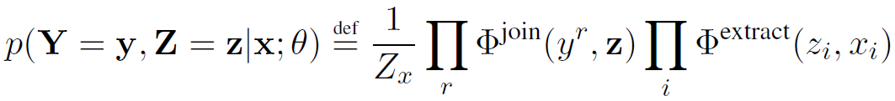
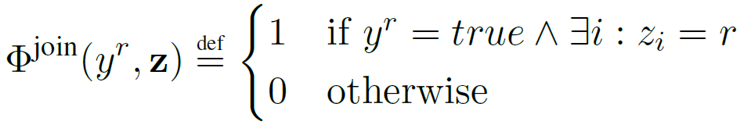
Model
Steve Jobs, Apple:
Y ^{bornIn}
Y ^{founder}
Y ^{locatedIn}
Y ^{capitalOf}
0
1
0
0
{0, 1}
0
{0, 1}
1
{0, 1}
0
{0, 1}
0
...
...
{bornIn,…}
{bornIn,…}
{bornIn,…}
CEO-of
founder
CEO-of
founder
founder
founder
Z₁
Z₂
Z₃
Steve Jobs was founder
of Apple.
Steve Jobs, Steve Wozniak and
Ronald Wayne founded Apple.
Steve Jobs is CEO of
Apple.
...
All features at sentence-level
(join factors are deterministic ORs)

Slide 16
Model
Y ^{bornIn}
Y ^{founder}
Y ^{locatedIn}
Y ^{capitalOf}
{0, 1}
0
{0, 1}
1
{0, 1}
0
{0, 1}
0
...
...
{bornIn,…}
founder
{bornIn,…}
founder
{bornIn,…}
CEO-of
Z₁
Z₂
Z₃
Steve Jobs was founder
of Apple.
Steve Jobs, Steve Wozniak and
Ronald Wayne founded Apple.
Steve Jobs is CEO of
Apple.
...
Extraction almost entirely driven by sentence-level reasoning
Tying of facts Y_{r} and sentence-level extractions Z_{i} still allows us to model weak supervision for training

Slide 17


Inference
Need:
Most likely sentence labels:
Most likely sentence labels given facts:
Y ^{bornIn}
Y ^{founder}
Y ^{locatedIn}
Y ^{capitalOf}
?
?
?
?
...
...
Easy
Z₁
?
?
?
Z₂
Z₃
Y ^{bornIn}
Y ^{founder}
Y ^{locatedIn}
Y ^{capitalOf}
0
1
0
1
...
...
Challenging
Z₁
?
?
?
Z₂
Z₃

Slide 18
Inference
Computing :
Y ^{bornIn}
Y ^{founder}
Y ^{locatedIn}
Y ^{capitalOf}
{0, 1}
0
{0, 1}
1
{0, 1}
0
{0, 1}
1
...
...
?
?
?
Z₁
Z₂
Z₃
bornIn
.5
bornIn
8
bornIn
7
founder
16
founder
11
founder
8
capitalOf
9
capitalOf
7
capitalOf
8
Steve Jobs was founder
of Apple.
Steve Jobs, Steve Wozniak and
Ronald Wayne founded Apple.
Steve Jobs is CEO of
Apple.
...

Slide 19
Inference
Variant of the weighted, edge-cover problem:
Y ^{bornIn}
Y ^{founder}
Y ^{locatedIn}
Y ^{capitalOf}
0
0
...
16
11
8
9
7
8
...
Z₁
Z₂
Z₃
bornIn
.5
bornIn
8
bornIn
7
founder
16
founder
11
founder
8
capitalOf
9
capitalOf
7
capitalOf
8
Steve Jobs was founder
of Apple.
Steve Jobs, Steve Wozniak and
Ronald Wayne founded Apple.
Steve Jobs is CEO of
Apple.
...

Slide 20



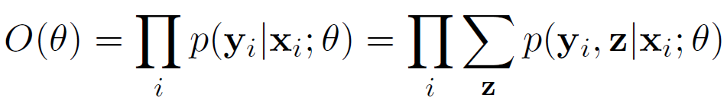
Learning
Training set , where
  corresponds to a particular entity pair
  contains all sentences with mentions of pair
  bit vector of facts about pair from database
Maximize Likelihood

Slide 21

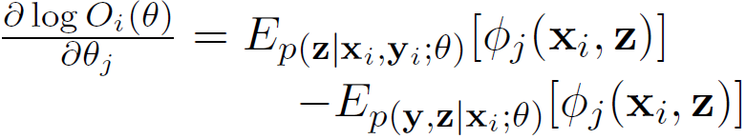
Learning
Scalability: Perceptron-style additive updates
Requires two approximations:
  Online learning
  For example i (entity pair), define
  Use gradient of local log likelihood for example i:
  Replace expectations with maximizations

Slide 22
Learning: Hidden-Variable Perceptron
passes over dataset
for each
entity pair i
most likely sentence labels
and inferred facts
(ignoring DB facts)
most likely
sentence labels given DB facts

Slide 23
Outline
Motivation
Our Approach
Related Work
Experiments
Conclusions

Slide 24
Sentential vs. Aggregate Extraction
Sentential
Aggregate
Input: one sentence
1
Steve Jobs is
CEO of Apple, …
E
2
CEO-of(1,2)
Steve Jobs was founder
of Apple.
Input: one entity pair
<Steve Jobs,
Apple>
E
Steve Jobs, Steve Wozniak and
Ronald Wayne founded Apple.
CEO-of(1,2)
Steve Jobs is CEO of
Apple.
...

Slide 25
Related Work
Mintz, Bills, Snow, Jurafsky 09:
  Extraction at aggregate level
  Features: conjunctions of lexical, syntactic, and entity type info along dependency path
Riedel, Yao, McCallum 10:
  Extraction at aggregate level
  Latent variable on sentence (should we extract?)
Bunescu, Mooney 07:
  Multi-instance learning for relation extraction
  Kernel-based approach

Slide 26
Outline
Motivation
Previous Approaches
Our Approach
Experiments
Conclusions

Slide 27
Experimental Setup
Data as in Riedel et al. 10:
  LDC NYT corpus, 2005-06 (training), 2007 (testing)
  Data first tagged with Stanford NER system
  Entities matched to Freebase, ~ top 50 relations
  Mention-level features as in Mintz et al. 09
Systems:
  MultiR: proposed approach
  SoloR: re-implementation of Riedel et al. 2010

Slide 28
Aggregate Extraction
How does set of predicted facts match to facts in Freebase?
Metric
For each entity pair compare inferred facts to facts in Freebase
Automated, but underestimates precision

Slide 29
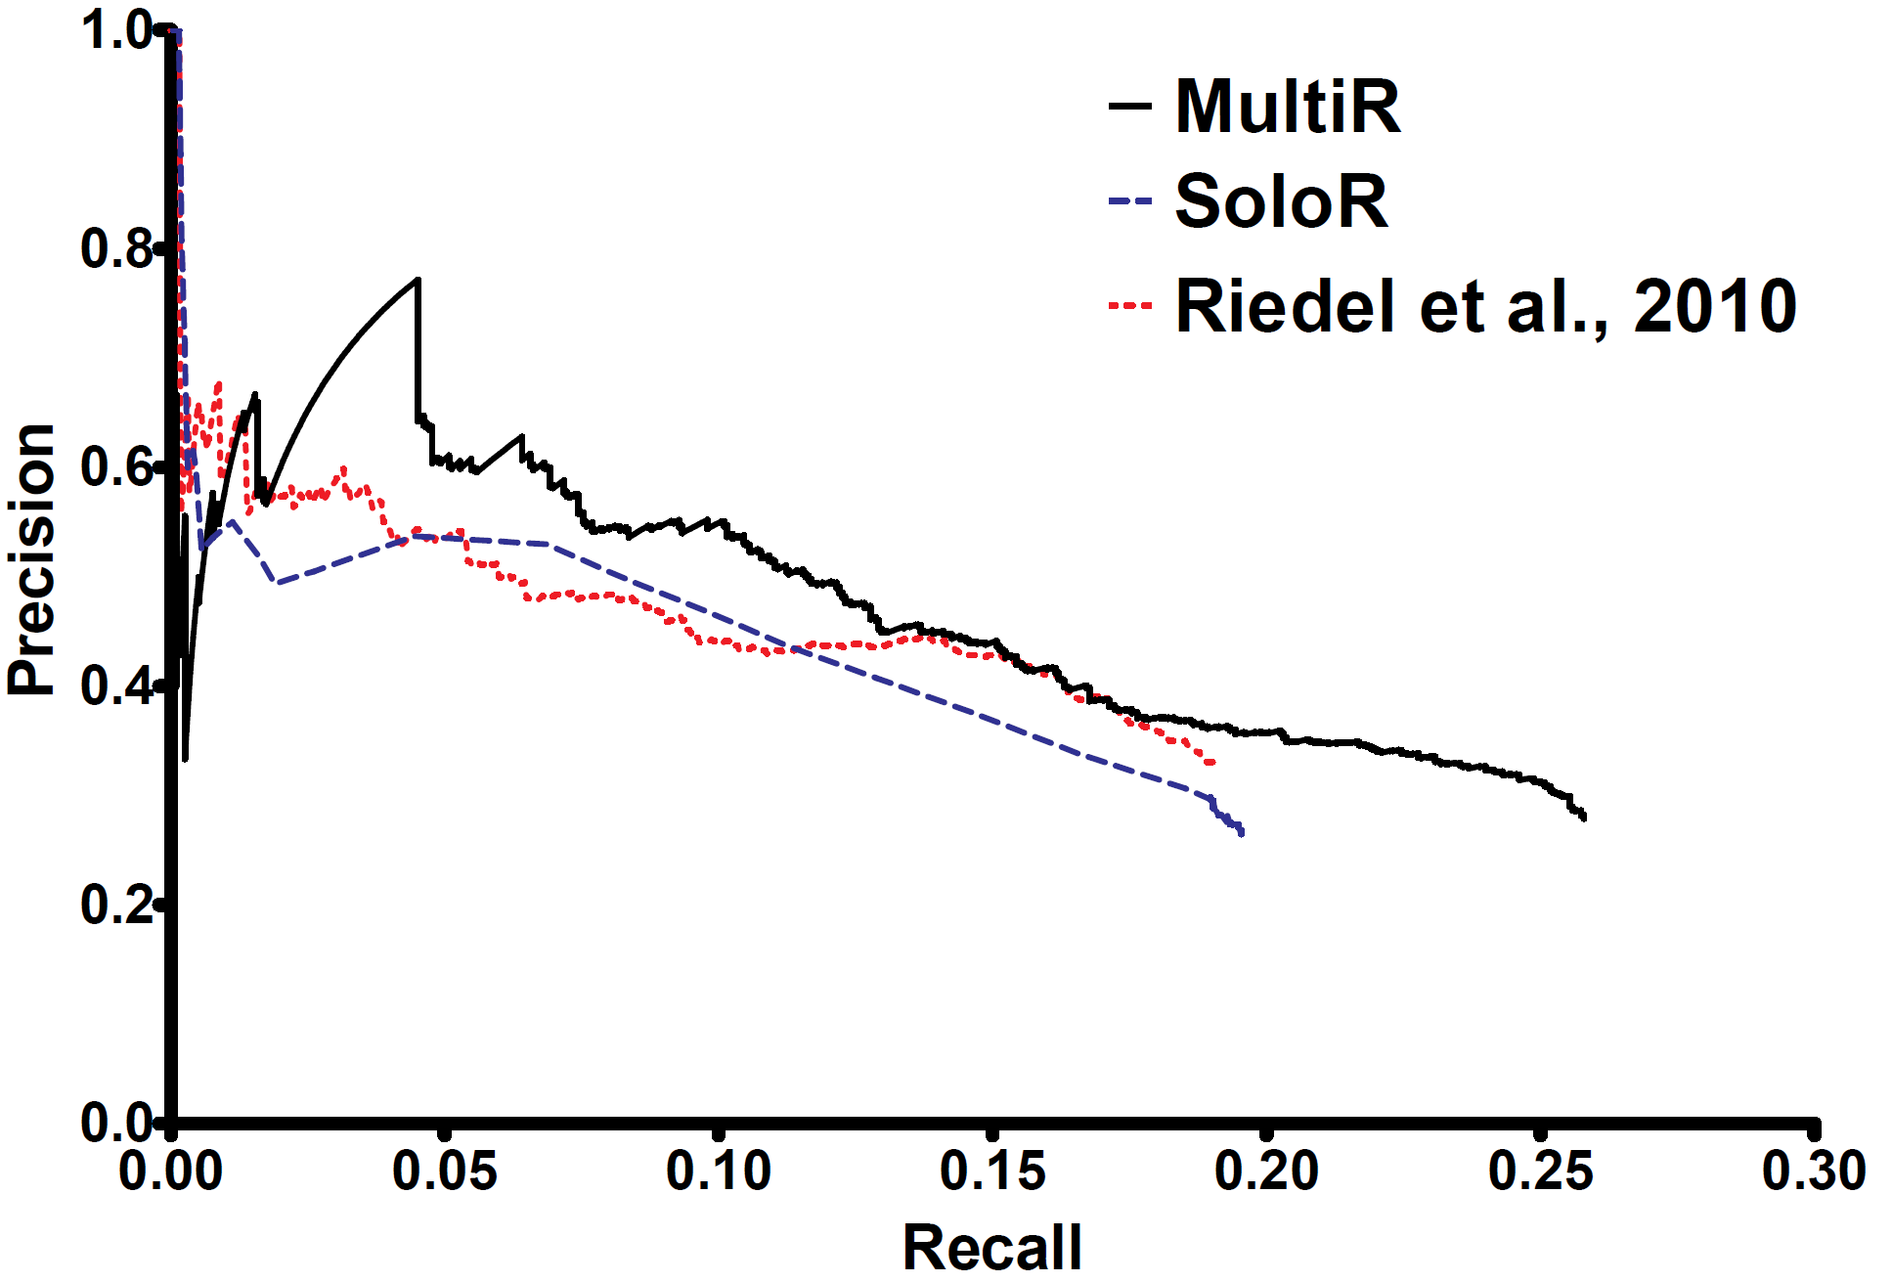
Aggregate Extraction
MultiR: proposed approach
SoloR: re-implementation of
Riedel et al. 2010
Riedel et al. 2010 (paper)
Dip: manual check finds that 23 out of the top 25 extractions were true facts, missing from Freebase
Notes:
Despite sentence-level

Slide 30
Sentential Extraction
How accurate is extraction from a given sentence?
Metric
Sample 1000 sentences from test set
Manual evaluation of precision and recall

Slide 31
Sentential Extraction

Slide 32
Relation-specific Performance
What is the quality of the matches for different relations?
How does our approach perform for different relations?
Metric:
Select 10 relations with highest #matches
Sample 100 sentences for each relation
Manually evaluate precision and recall

Slide 33
Quality of the Matching
Relation | Freebase Matches |  | MultiR
 | #sents | % true | precision | recall
/business/person/company | 302 | 89.0 | 100.0 | 25.8
/people/person/place_lived | 450 | 60.0 | 80.0 | 6.7
/location/location/contains | 2793 | 51.0 | 100.0 | 56.0
/business/company/founders | 95 | 48.4 | 71.4 | 10.9
/people/person/nationality | 723 | 41.0 | 85.7 | 15.0
/location/neighborhood/neighborhood_of | 68 | 39.7 | 100.0 | 11.1
/people/person/children | 30 | 80.0 | 100.0 | 8.3
/people/deceased_person/place_of_death | 68 | 22.1 | 100.0 | 20.0
/people/person/place_of_birth | 162 | 12.0 | 100.0 | 33.0
/location/country/administrative_divisions | 424 | 0.2 | N/A | 0.0

Slide 34
Quality of the Matching
Relation | Freebase Matches |  | MultiR
 | #sents | % true | precision | recall
/business/person/company | 302 | 89.0 | 100.0 | 25.8
/people/person/place_lived | 450 | 60.0 | 80.0 | 6.7
/location/location/contains | 2793 | 51.0 | 100.0 | 56.0
/business/company/founders | 95 | 48.4 | 71.4 | 10.9
/people/person/nationality | 723 | 41.0 | 85.7 | 15.0
/location/neighborhood/neighborhood_of | 68 | 39.7 | 100.0 | 11.1
/people/person/children | 30 | 80.0 | 100.0 | 8.3
/people/deceased_person/place_of_death | 68 | 22.1 | 100.0 | 20.0
/people/person/place_of_birth | 162 | 12.0 | 100.0 | 33.0
/location/country/administrative_divisions | 424 | 0.2 | N/A | 0.0

Slide 35
Performance of MultiR
Relation | Freebase Matches |  | MultiR
 | #sents | % true | precision | recall
/business/person/company | 302 | 89.0 | 100.0 | 25.8
/people/person/place_lived | 450 | 60.0 | 80.0 | 6.7
/location/location/contains | 2793 | 51.0 | 100.0 | 56.0
/business/company/founders | 95 | 48.4 | 71.4 | 10.9
/people/person/nationality | 723 | 41.0 | 85.7 | 15.0
/location/neighborhood/neighborhood_of | 68 | 39.7 | 100.0 | 11.1
/people/person/children | 30 | 80.0 | 100.0 | 8.3
/people/deceased_person/place_of_death | 68 | 22.1 | 100.0 | 20.0
/people/person/place_of_birth | 162 | 12.0 | 100.0 | 33.0
/location/country/administrative_divisions | 424 | 0.2 | N/A | 0.0
Notes:
Only 12% express relationship
Recover from noisy matches

Slide 36
Overlapping Relations
Relation | Freebase Matches |  | MultiR
 | #sents | % true | precision | recall
/business/person/company | 302 | 89.0 | 100.0 | 25.8
/people/person/place_lived | 450 | 60.0 | 80.0 | 6.7
/location/location/contains | 2793 | 51.0 | 100.0 | 56.0
/business/company/founders | 95 | 48.4 | 71.4 | 10.9
/people/person/nationality | 723 | 41.0 | 85.7 | 15.0
/location/neighborhood/neighborhood_of | 68 | 39.7 | 100.0 | 11.1
/people/person/children | 30 | 80.0 | 100.0 | 8.3
/people/deceased_person/place_of_death | 68 | 22.1 | 100.0 | 20.0
/people/person/place_of_birth | 162 | 12.0 | 100.0 | 33.0
/location/country/administrative_divisions | 424 | 0.2 | N/A | 0.0

Slide 37
Impact of Overlapping Relations
Ablation: for each training example at most one relation is labeled (create multiple training examples if there are overlaps)
Precision
Recall
F1 score
+12%
60.5%
MultiR
-26%
-20%
40.3%

Slide 38
Running Time
MultiR
  Training: 1 minute
  Testing: 1 second
SoloR
  Training: 6 hours
  Testing: 4 hours
Sentence-level extractions are efficient
Joint reasoning across sentences is computationally expensive

Slide 39
Conclusions
Propose a perceptron-style approach for knowledge-based weak supervision
  Scales to large amounts of data
  Driven by sentence-level reasoning
  Handles noise through multi-instance learning
  Handles overlapping relations

Slide 40
Future Work
Constraints on model expectations
  Observation: multi-instance learning assumption often does not hold (i.e. no true match for entity pair)
  Constrain model to expectations of true match probabilities
Linguistic background knowledge
  Observation: missing relevant features for some relations
  Develop new features which use linguistic resources

Slide 41
Thank You!
Download the source code at
http://www.cs.washington.edu/homes/raphaelh
Knowledge-Based Weak Supervision for Information Extraction of Overlapping Relations
Raphael Hoffmann, Congle Zhang, Xiao Ling, Luke Zettlemoyer, Daniel S. Weld
This material is based upon work supported by a WRF/TJ Cable Professorship, a gift from Google and by the Air Force Research Laboratory (AFRL) under prime contract no. FA8750-09-C-0181. Any opinions, findings, and conclusions or recommendations expressed in this material are those of the author(s) and do not necessarily reflect the view of the Air Force Research Laboratory (AFRL).

