Slide 1
Edge Detection
ECE P 596
Linda Shapiro

Slide 2
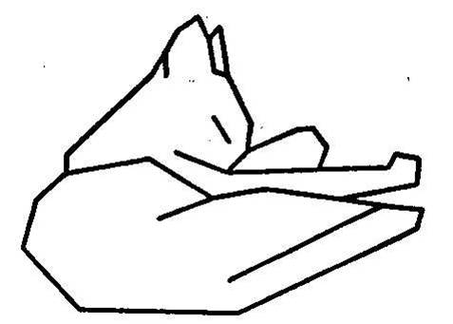
Edge
Attneave's Cat (1954)

Slide 3

Origin of edges
surface normal discontinuity
depth discontinuity
surface color discontinuity
illumination discontinuity
Edges are caused by a variety of factors.

Slide 4

Characterizing edges
An edge is a place of rapid change in the image intensity function
intensity function
(along horizontal scanline)
image
first derivative
edges correspond to
extrema of derivative

Slide 5
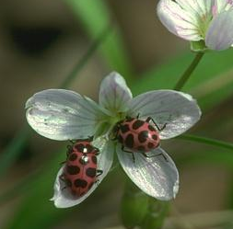
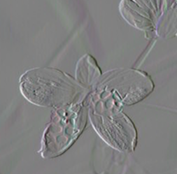
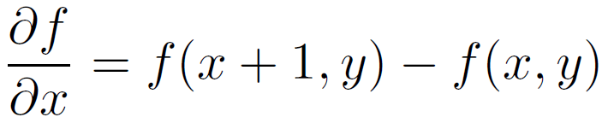


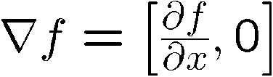
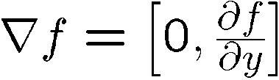
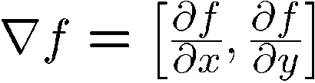
Image gradient
The gradient of an image:
The gradient points in the direction of most rapid change in intensity

Slide 6
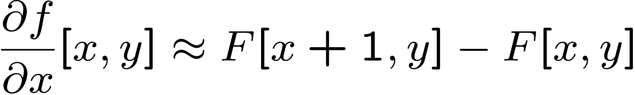
The discrete gradient
How can we differentiate a digital image F[x,y]?
  Option 1: reconstruct a continuous image, then take gradient
  Option 2: take discrete derivative (“finite difference”)

Slide 7

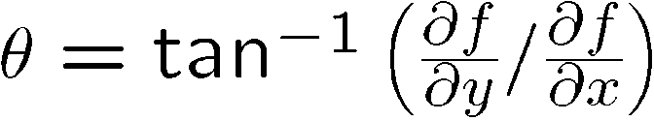
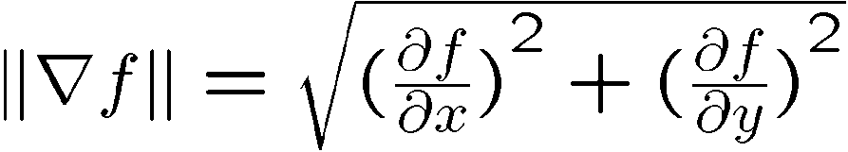
Simple image gradient
How would you implement this as a filter?
0 -1 1
The gradient direction is given by:
  How does this relate to the direction of the edge?
The edge strength is given by the gradient magnitude
perpendicular
or various
simplifications

Slide 8


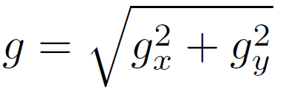
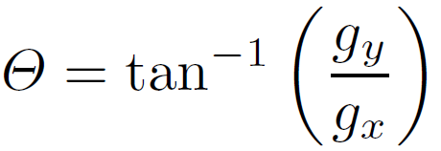
Sobel operator
Who was Sobel?
In practice, it is common to use:
-1 | 0 | 1
-2 | 0 | 2
-1 | 0 | 1
-1 | -2 | -1
0 | 0 | 0
1 | 2 | 1
Magnitude:
Orientation:
What’s the C/C++ function?
Use atan2

Slide 9
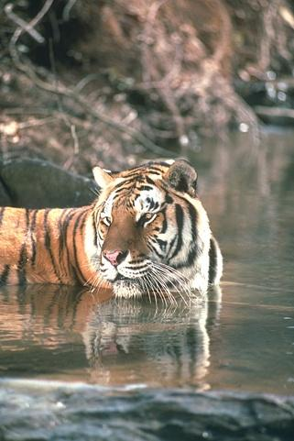
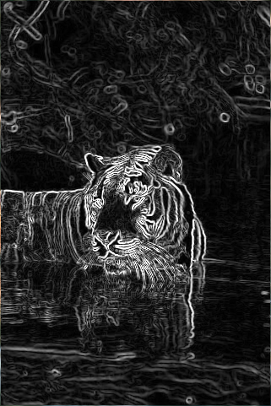
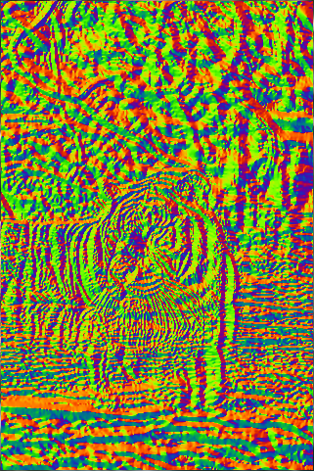
Sobel operator
Original
Magnitude
Orientation

Slide 10




Effects of noise
Consider a single row or column of the image
  Plotting intensity as a function of position gives a signal
Where is the edge?

Slide 11
Effects of noise
Difference filters respond strongly to noise
  Image noise results in pixels that look very different from their neighbors
  Generally, the larger the noise the stronger the response
What can we do about it?
Source: D. Forsyth

Slide 12



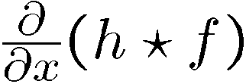

Solution: smooth first
Where is the edge?
Look for peaks in

Slide 13

Derivative theorem of convolution
Differentiation is convolution, and convolution is associative:
This saves us one operation:
f
We don’t
do that.
How can we find (local) maxima of a function?
Source: S. Seitz

Slide 14


Remember:
Derivative of Gaussian filter
x-direction
y-direction

Slide 15




Laplacian of Gaussian
Consider
Laplacian of Gaussian
operator
Where is the edge?
Zero-crossings of bottom graph

Slide 16








2D edge detection filters
Laplacian of Gaussian
Gaussian
derivative of Gaussian
is the Laplacian operator:
Notes:
How many 2nd derivative filters are there? There are four 2nd partial derivative filters.
In practice, it’s handy to define a single 2nd derivative filter—the Laplacian

Slide 17

Edge detection by subtraction
Note:
I hate the
Lena images.
original

Slide 18

Edge detection by subtraction
smoothed (5x5 Gaussian)

Slide 19
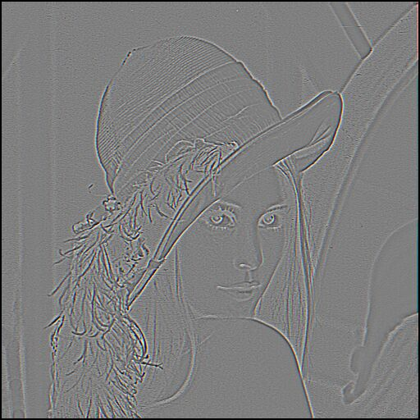
Edge detection by subtraction
smoothed – original
(scaled by 4, offset +128)

Slide 20
Using the LoG Function
(Laplacian of Gaussian)
The LoG function will be
  Zero far away from the edge
  Positive on one side
  Negative on the other side
  Zero just at the edge
It has simple digital mask implementation(s)
So it can be used as an edge operator
BUT, THERE’S SOMETHING BETTER

Slide 21
Canny edge detector
This is probably the most widely used edge detector in computer vision
J. Canny, A Computational Approach To Edge Detection, IEEE Trans. Pattern Analysis and Machine Intelligence, 8:679-714, 1986.
Source: L. Fei-Fei

Slide 22

The Canny edge detector
Note:
I continue
To hate the
Lena images.
original image (Lena)

Slide 23
Overview
The Canny edge detection algorithm is composed of 5 steps:
1. Noise reduction;
2. Gradient calculation;
3. Non-maximum suppression;
4. Double threshold;
5. Edge Tracking by Hysteresis.

Slide 24
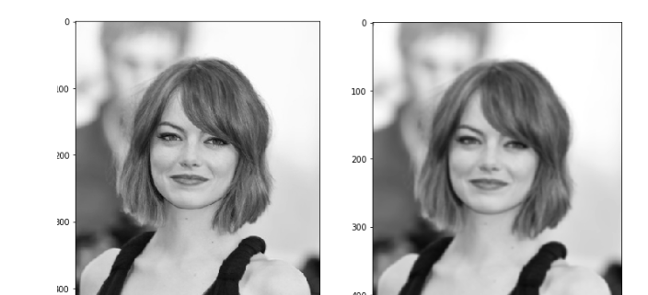
Gaussian Blur
Original Blurred

Slide 25
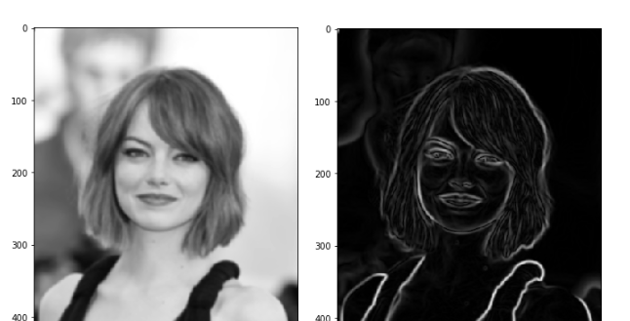
Sobel Edge Detection
Blurred Image Gradient Magnitude

Slide 26
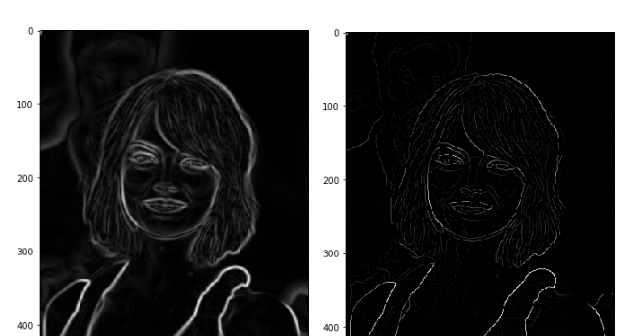
Nonmaximum Supression
Gradient Max Supressed

Slide 27

And on Lena
thinning
(non-maximum suppression)

Slide 28

Non-maximum suppression
Check if pixel is local maximum along gradient direction
Picture from Prem K Kalra

Slide 29
Double Threshold
High threshold is used to identify the strong pixels (intensity higher than the high threshold)
Low threshold is used to identify the non-relevant pixels (intensity lower than the low threshold)
All pixels having intensity between both thresholds are flagged as weak and the Hysteresis mechanism (next step) will help us identify the ones that could be considered as strong and the ones that are considered as non-relevant.

Slide 30
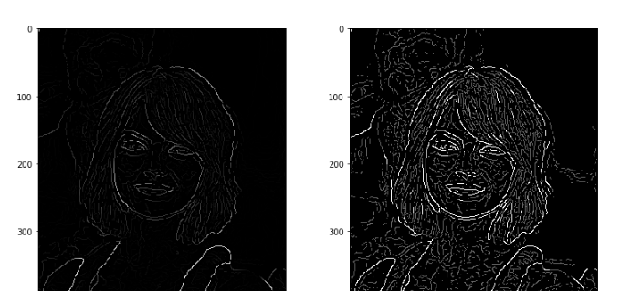
Double Threshold
Non-maximal suppression white pixels strong; gray weak

Slide 31
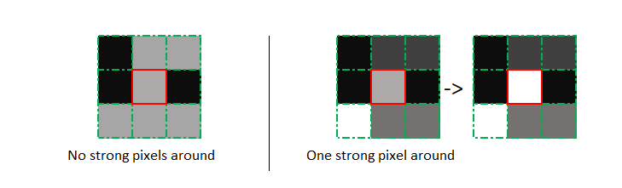
Edge Tracking by Hysteresis
Based on the threshold results, the hysteresis consists of transforming weak pixels into strong ones, if and only if at least one of the pixels around the one being processed is a strong one, as described below:

Slide 32
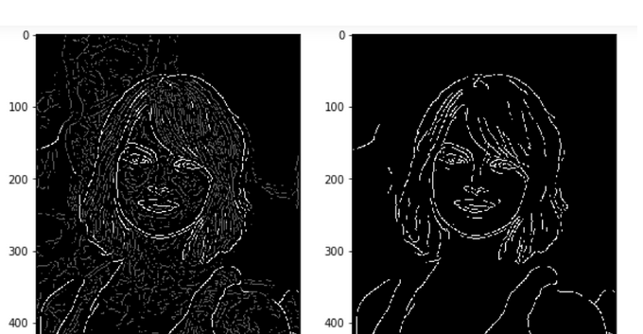
Results of Hysteresis

Slide 33
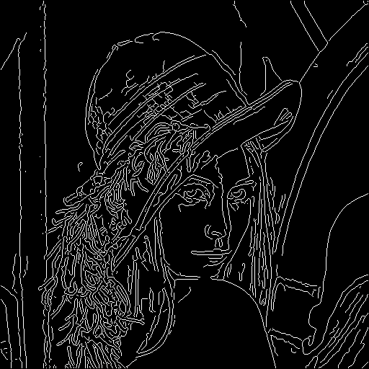
Canny Edges on Lena

Slide 34
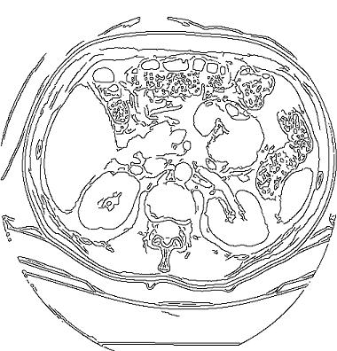
Canny Edges on Kidney

Slide 35
Canny Characteristics
The Canny operator gives single-pixel-wide images with good continuation between adjacent pixels
It is the most widely used edge operator today; no one has done better since it came out in the late 80s. Many implementations are available.
It is very sensitive to its parameters, which need to be adjusted for different application domains.

Slide 36






Effect of σ (Gaussian kernel spread/size)
original
Canny with
Canny with
The choice of depends on desired behavior
  large detects large scale edges
  small detects fine features

Slide 37
An edge is not a line...
How can we detect lines ?

Slide 38
Finding lines in an image
Option 1:
  Search for the line at every possible position/orientation
  What is the cost of this operation?
Option 2:
  Use a voting scheme: Hough transform

Slide 39

Finding lines in an image
y
b
b₀
x
m₀
m
image space
Hough space
Connection between image (x,y) and Hough (m,b) spaces
  A line in the image corresponds to a point in Hough space
  To go from image space to Hough space:
    given a set of points (x,y), find all (m,b) such that y = mx + b

Slide 40

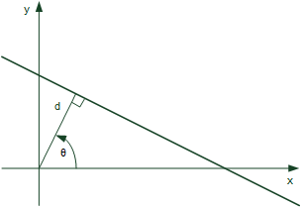
Hough transform algorithm
Typically use a different parameterization
  d is the perpendicular distance from the line to the origin
  θ is the angle of this perpendicular with the horizontal.

Slide 41
Hough transform algorithm
Array H
Basic Hough transform algorithm
  Initialize H[d, θ]=0
  for each edge point I[x,y] in the image
    for θ = 0 to 180
      H[d, θ] += 1
  Find the value(s) of (d, θ) where H[d, θ] is maximum
  The detected line in the image is given by
What’s the running time (measured in # votes)?
d
θ
How big is the array H?
Do we need to try all θ?

Slide 42
Example
gray-tone image
DQ
THETAQ
0 0 0 100 100
0 0 0 100 100
0 0 0 100 100
100 100 100 100 100
100 100 100 100 100
- - 3 3 -
- - 3 3 -
3 3 3 3 -
3 3 3 3 -
- - - - -
- - 0 0 -
- - 0 0 -
90 90 40 20 -
90 90 90 40 -
- - - - -
Accumulator H
PTLIST
360
.
6
3
0
- - - - - - -
- - - - - - -
- - - - - - -
4 - 1 - 2 - 5
- - - - - - -
360
.
6
3
0
- - - - - - -
- - - - - - -
- - - - - - -
* - * - * - *
- - - - - - -
(3,1)
(3,2)
(4,1)
(4,2)
(4,3)
distance
angle
0 10 20 30 40 …90
(1,3)(1,4)(2,3)(2,4)

Slide 43
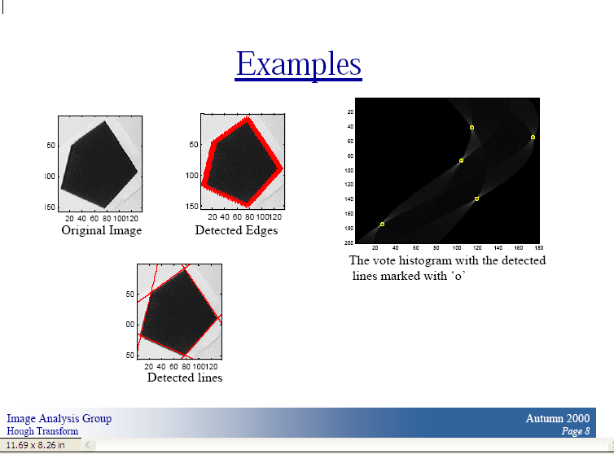
Chalmers University
of Technology

Slide 44
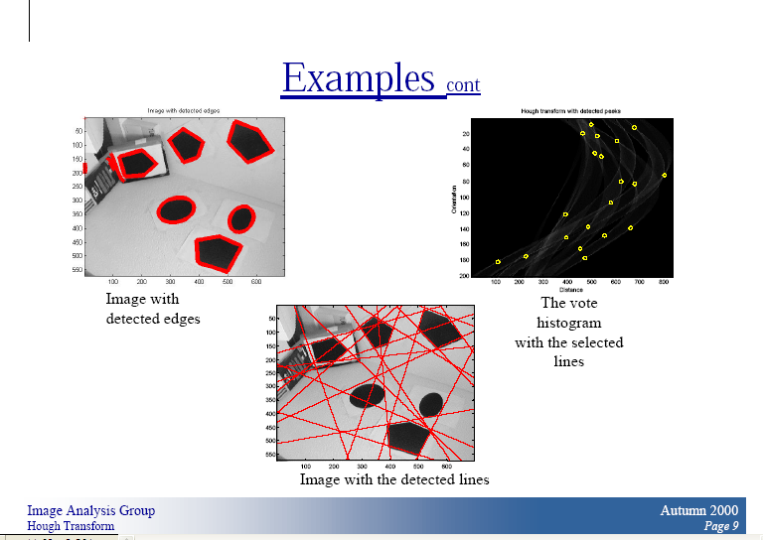
Chalmers University
of Technology

Slide 45
How do you extract the line segments from the accumulators?
pick the bin of H with highest value V
while V > value_threshold {
order the corresponding pointlist from PTLIST
merge in high gradient neighbors within 10 degrees
create line segment from final point list
zero out that bin of H
pick the bin of H with highest value V }

Slide 46
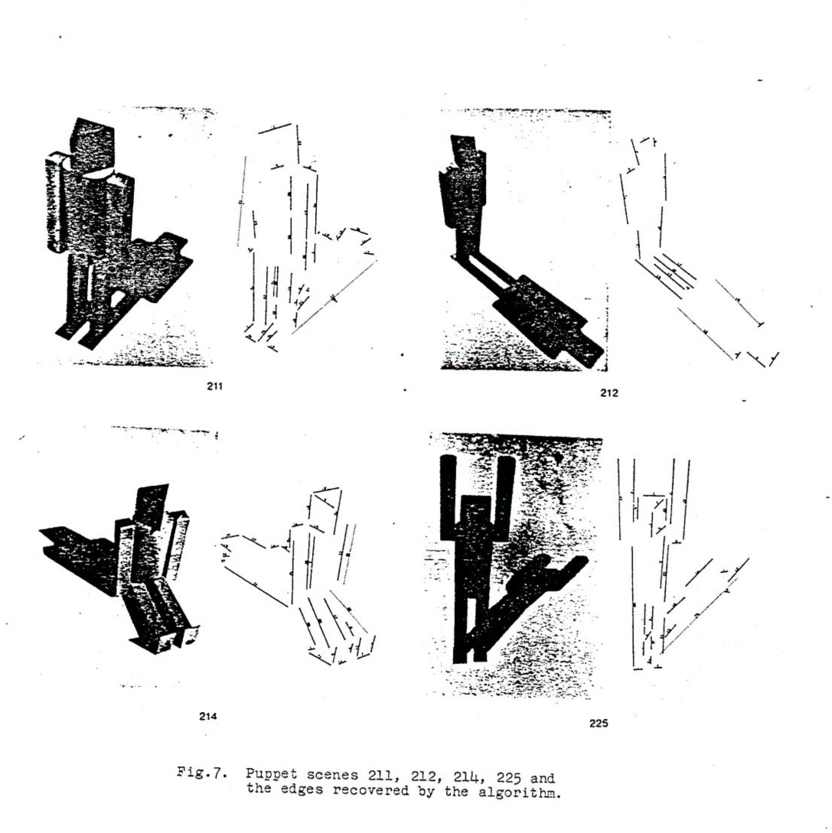
Line segments from Hough Transform

Slide 47
Extensions
Extension 1: Use the image gradient
  same
  for each edge point I[x,y] in the image
    compute unique (d, θ) based on image gradient at (x,y)
      H[d, θ] += 1
  same
  same
What’s the running time measured in votes?
Extension 2
  give more votes for stronger edges
Extension 3
  change the sampling of (d, θ) to give more/less resolution
Extension 4
  The same procedure can be used with circles, squares, or any other shape, How?
Extension 5; the Burns procedure. Uses only angle, two different quantifications, and connected components with votes for larger one.
Notes:
Ask: what are the axes for a circle Hough space? What does a point in the image map to in the Hough space?

Slide 48
A Nice Hough Variant
The Burns Line Finder
3
2
45
3
4
2
+22.5
4
1
0
5
1
5
8
6
7
6
7
8
-22.5
1. Compute gradient magnitude and direction at each pixel.
2. For high gradient magnitude points, assign direction labels
to two symbolic images for two different quantizations.
3. Find connected components of each symbolic image.
Each pixel belongs to 2 components, one for each symbolic image.
Each pixel votes for its longer component.
Each component receives a count of pixels who voted for it.
The components that receive majority support are selected.

Slide 49
Example
3
2
4
3
2
4
1
+22.5
0
5
1
5
8
6
7
6
7
8
-22.5
Quantization 1 Quantization 2
Quantization 1 leads to 2 yellow components and 2 green.
Quantization 2 leads to 1 BIG red component.
All the pixels on the line vote for their Quantization 2
component. It becomes the basis for the line.

Slide 50
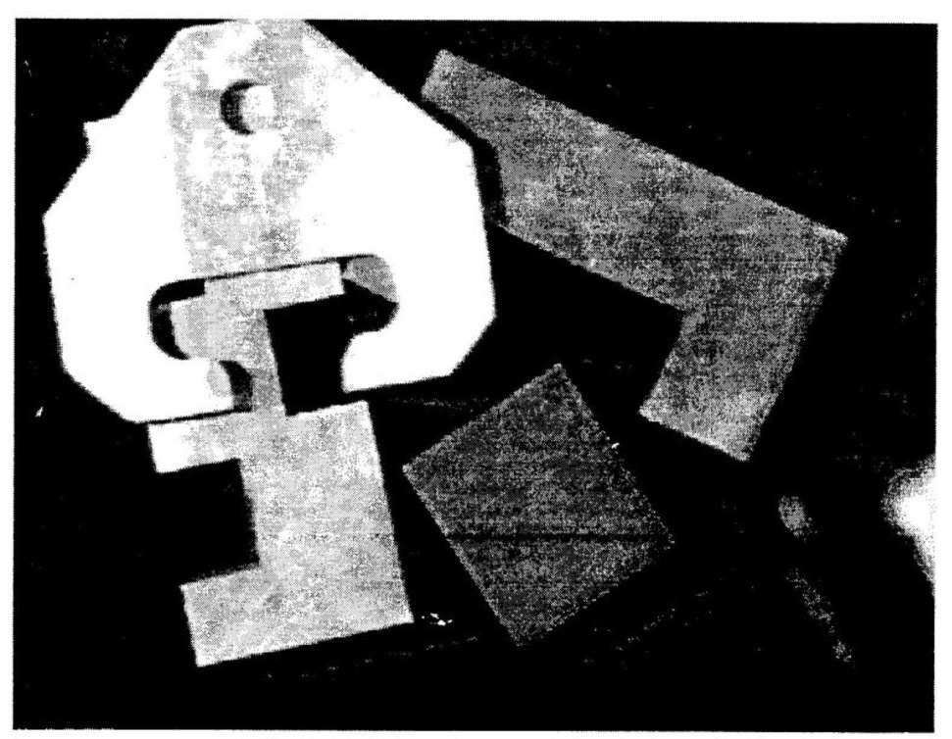
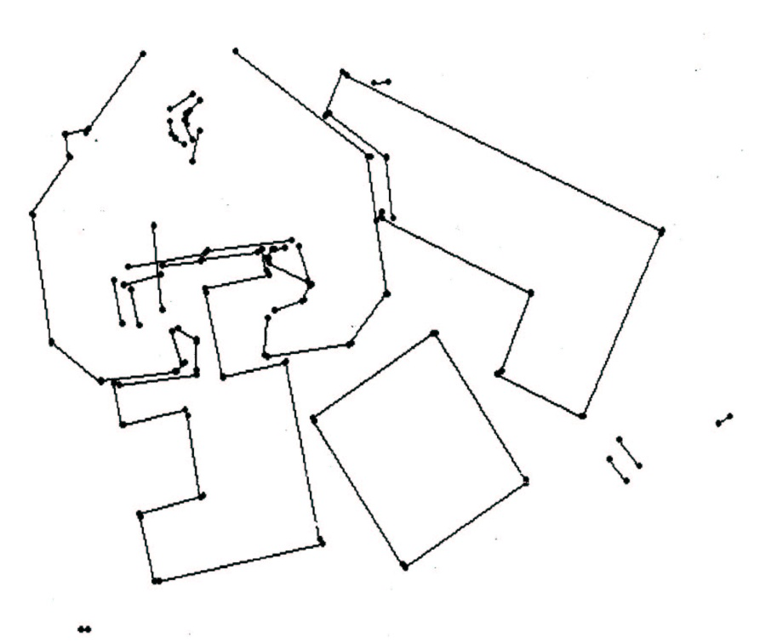
Burns Example 1

Slide 51
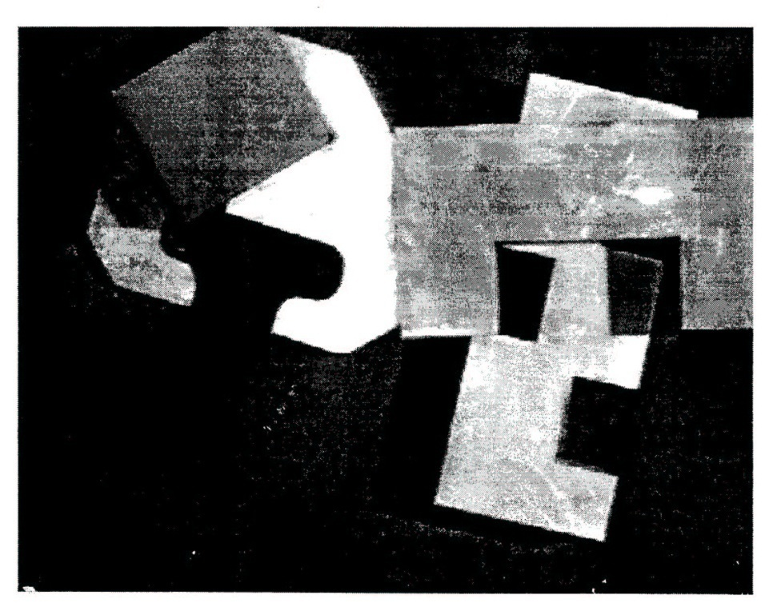
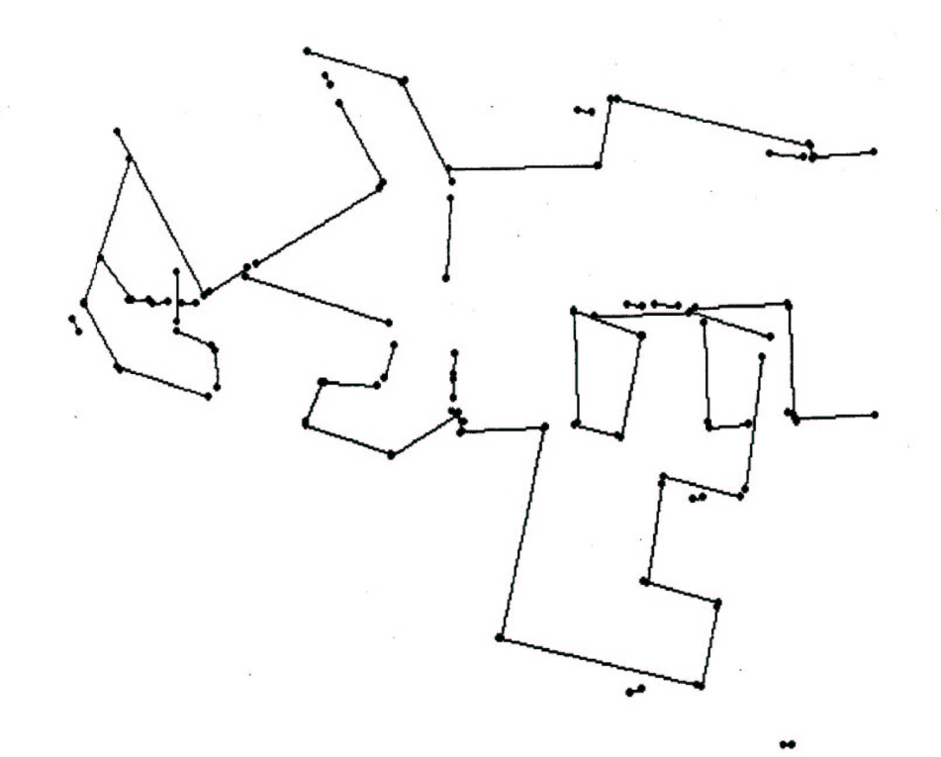
Burns Example 2

Slide 52
Hough Transform for Finding Circles
r = r0 + d sin θ
c = c0 - d cos θ
r, c, d are parameters
Equations:
Main idea: The gradient vector at an edge pixel points
to the center of the circle.
d
*(r,c)

Slide 53
Why it works
Filled Circle:
Outer points of circle have gradient
direction pointing to center.
Circular Ring:
Outer points gradient towards center.
Inner points gradient away from center.
The points in the away direction don’t
accumulate in one bin!

Slide 54
Procedure to Accumulate Circles
Set accumulator array A to all zero.
Set point list array PTLIST to all NIL.
For each pixel (R,C) in the image {
For each possible value of D {
- compute gradient magnitude GMAG
- if GMAG > gradient_threshold {
. Compute THETA(R,C,D)
. R0 := R - D*sin(THETA)
. C0 := C + D*cos(THETA)
. increment A(R0,C0,D)
. update PTLIST(R0,C0,D) }}

Slide 55
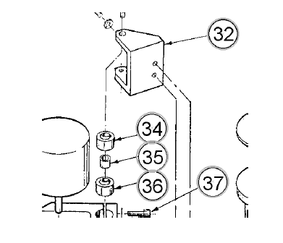

Slide 56
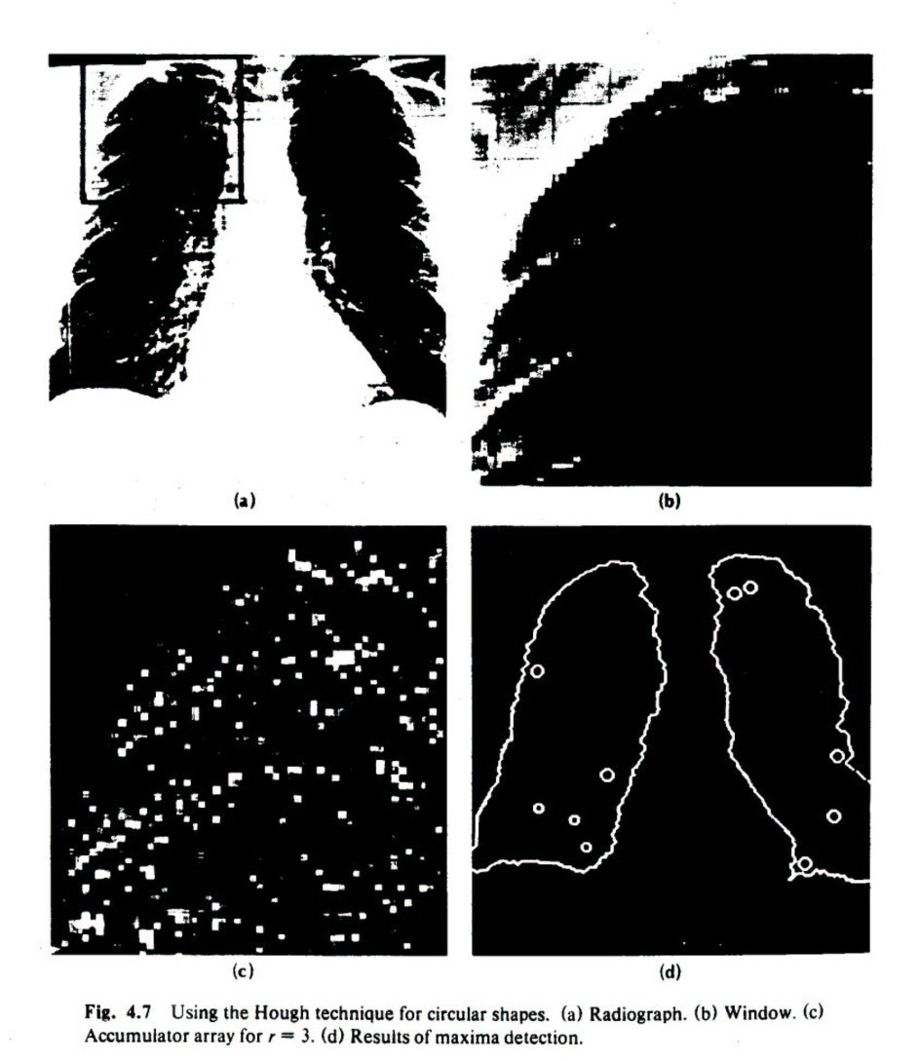
Finding lung nodules (Kimme & Ballard)

Slide 57
Finale
Edge operators are based on estimating derivatives.
While first derivatives show approximately where the edges are, zero crossings of second derivatives were shown to be better.
Ignoring that entirely, Canny developed his own edge detector that everyone uses now.
After finding good edges, we have to group them into lines, circles, curves, etc. to use further.
The Hough transform for circles works well, but for lines the performance can be poor. The Burns operator or some tracking operators (old ORT pkg) work better.

