Slide 1
Patch Descriptors -2
ECE P 596
Linda Shapiro

Slide 2
Bag-of-words models
Orderless document representation: frequencies of words from a dictionary Salton & McGill (1983)
Retrieve documents based on matching words in a query to frequencies of words in the document
Computer vision people grabbed this idea and invented the idea of visual words: little subimages that were representative of an image
So an image can be retrieved by the frequency of its important subimages

Slide 3
Example in Video:
Sivic’s “Video Google” work to retrieve frames
from videos
Two types of viewpoint covariant regions computed for each frame
Shape Adapted (SA) Mikolajczyk & Schmid
Maximally Stable (MSER) Matas et al.
Detect different kinds of image areas
Provide complimentary representations of frame
Computed at twice originally detected region size to be more discriminating

Slide 4
Examples of Harris-Affine Operator
(Shape Adapted Regions)

Slide 5
Examples of Maximally Stable Regions

Slide 6
Feature Descriptor
Each region represented by 128 dimensional vector using SIFT descriptor

Slide 7
Noise Removal
Tracking region over 70 frames (must track over at least 3)

Slide 8
Visual Vocabulary for Sivic’s Work
Implementation: K-Means clustering
Regions tracked through contiguous frames and average description computed
10% of tracks with highest variance eliminated, leaving about 1000 regions per frame
Subset of 48 shots (~10%) selected for clustering
Distance function: Mahalanobis
6000 SA clusters and 10000 MS clusters

Slide 9
Visual Vocabulary
Shape-Adapted
Maximally Stable

Slide 10
Sivic’s Experiments on Video Shot Retrieval
Goal: match scene locations within closed world of shots
Data:164 frames from 48 shots taken at 19 different 3D locations; 4-9 frames from each location

Slide 11
Experiments - Results
Precision = # relevant images/total # of frames retrieved
Recall = # correctly retrieved frames/ # relevant frames

Slide 12
More Pictorial Results

Slide 13
Clustering and vector quantization
Clustering is a common method for learning a visual vocabulary or codebook
Each cluster center produced by k-means becomes a codevector
Codebook can be learned on separate training set
The codebook is used for quantizing features
A vector quantizer takes a feature vector and maps it to the index of the nearest code vector in a codebook
Codebook = visual vocabulary
Code vector = visual word
1
2
3
N
code vector 1
code vector 2
code vector 3
code vector N
feature
vector

Slide 14
Another example visual vocabulary
Fei-Fei et al. 2005

Slide 15
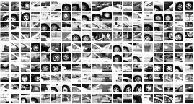
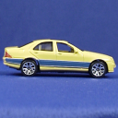
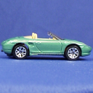
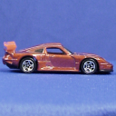
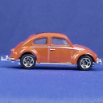
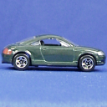
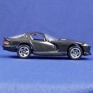
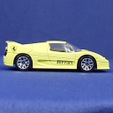
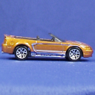
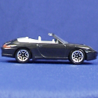
Example codebook
…
Appearance codebook
Source: B. Leibe

Slide 16
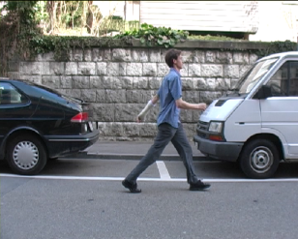
Another codebook
…
…
…
…
…
Appearance codebook
Source: B. Leibe

Slide 17
Image representation: histogram of codewords
frequency
…..
codewords

Slide 18
Image classification (later in course)
Given the bag-of-features representations of images from different classes, learn a classifier using machine learning

Slide 19
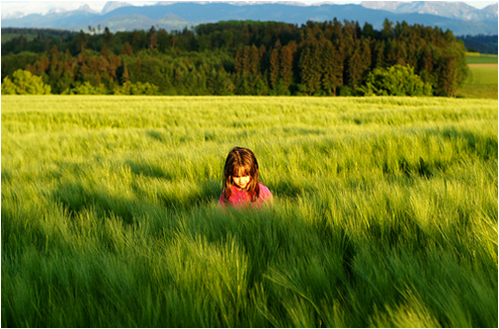
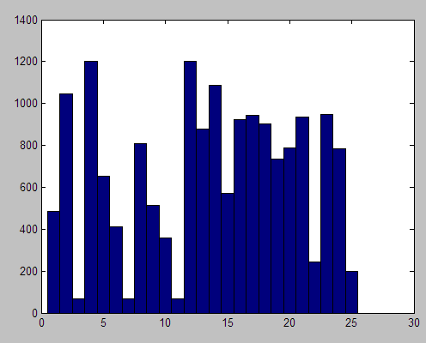
But what about layout?
All of these images have the same color histogram

Slide 20
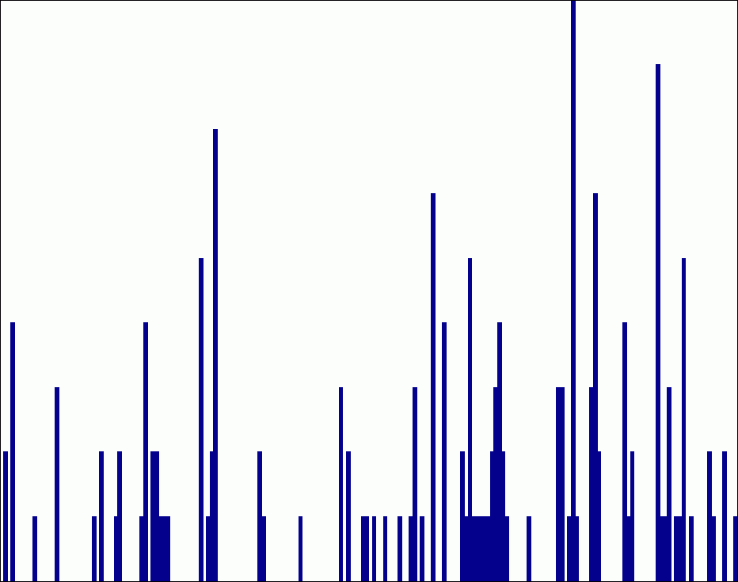
Spatial pyramid representation
Extension of a bag of features
Locally orderless representation at several levels of resolution
level 0
Lazebnik, Schmid & Ponce (CVPR 2006)

Slide 21
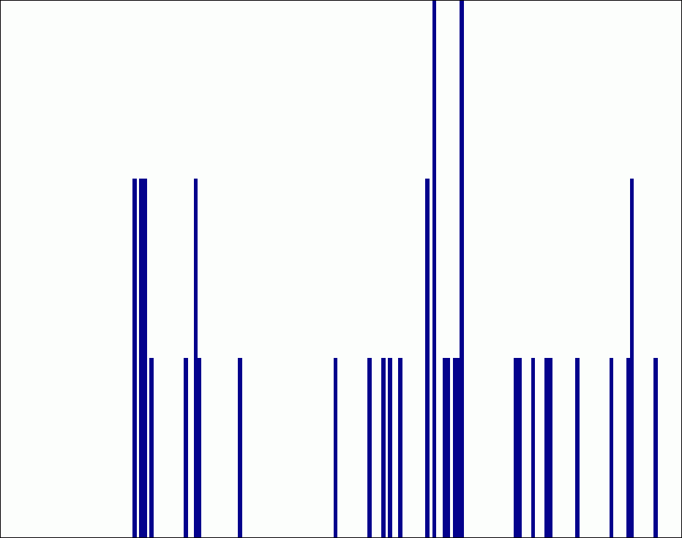
Spatial pyramid representation
Extension of a bag of features
Locally orderless representation at several levels of resolution
level 0
level 1
Lazebnik, Schmid & Ponce (CVPR 2006)

Slide 22
Spatial pyramid representation
Extension of a bag of features
Locally orderless representation at several levels of resolution
level 0
level 1
level 2
Lazebnik, Schmid & Ponce (CVPR 2006)

Slide 23
Finale
Describing images or image patches is very important for matching and recognition
Texture descriptors are also useful.
Bag-of-words is a handy technique borrowed from text retrieval. Lots of people use it to compare images or regions.
Sivic developed a video frame retrieval system using this method, called it Video Google.
The spatial pyramid allows us to describe an image as a whole and over its parts at multiple levels.

