Slide 1
Image Stitching II
Linda Shapiro
ECE P 596

Slide 2
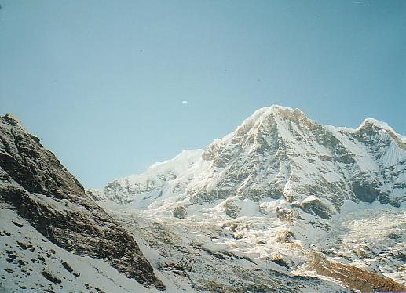
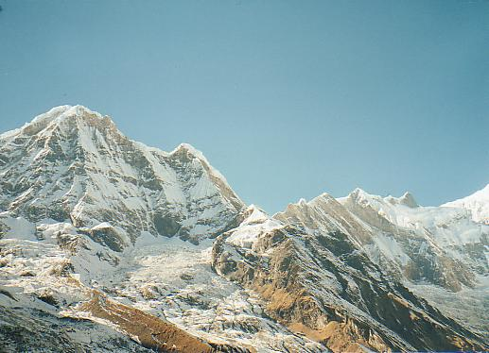
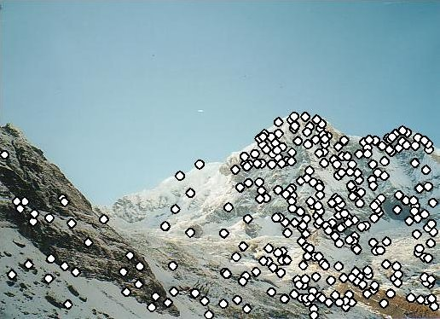
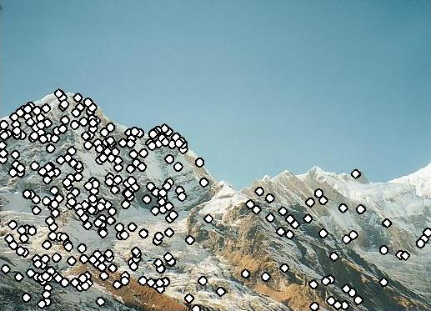
RANSAC for Homography
Initial Matched Points

Slide 3
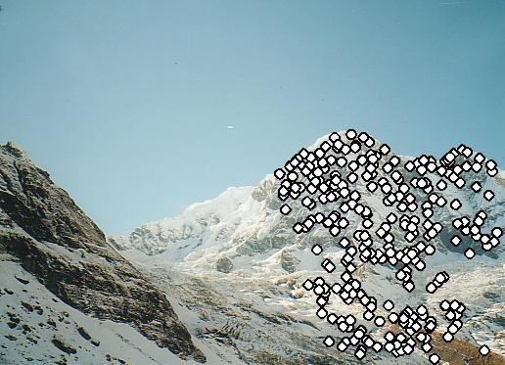
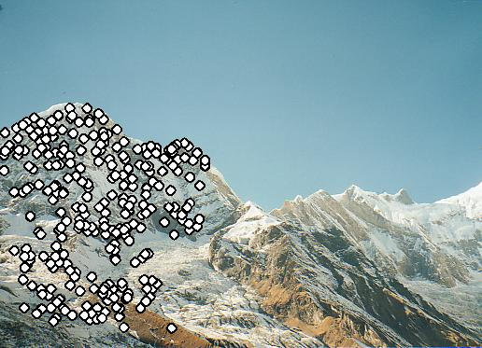
RANSAC for Homography
Final Matched Points

Slide 4
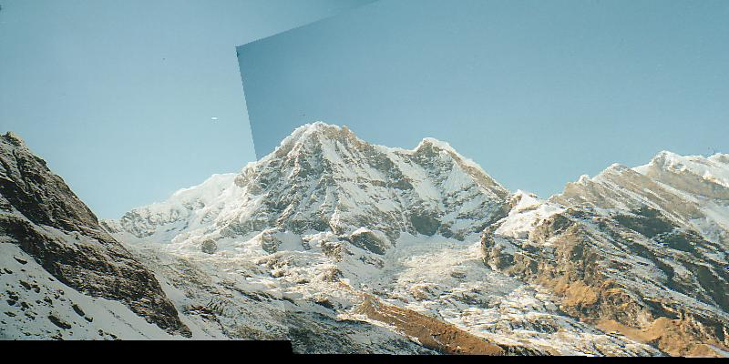
RANSAC for Homography

Slide 5
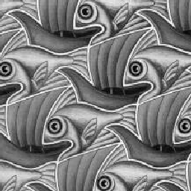
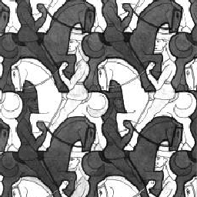
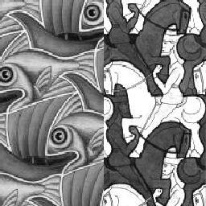
Image Blending
What’s wrong?

Slide 6
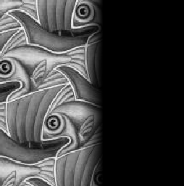
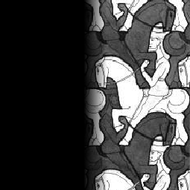
Feathering
+
1
1
0
ramp
0
=

Slide 7
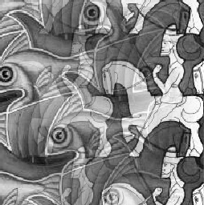
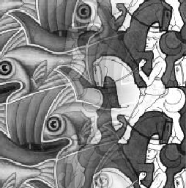
Effect of window (ramp-width) size
1
left
1
right
0
0

Slide 8
Effect of window size
1
1
0
0

Slide 9
Good window size
1
What can we do
instead?
0
“Optimal” window: smooth but not ghosted
Doesn’t always work...

Slide 10
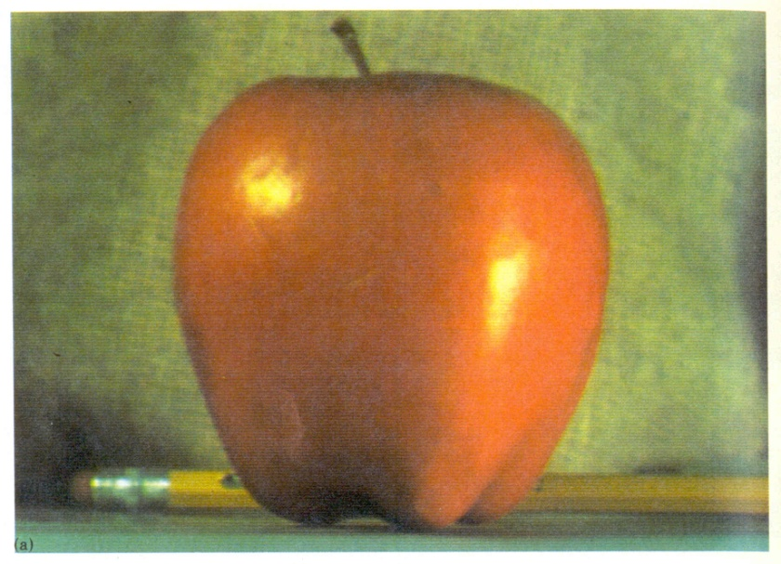
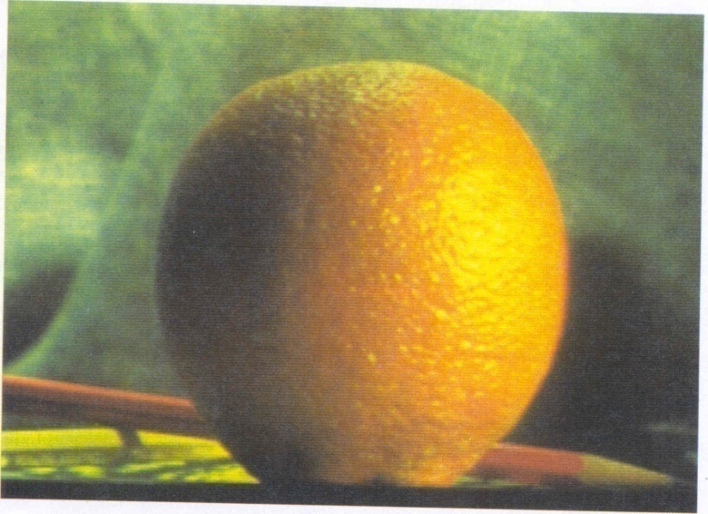
Pyramid blending
apple
orange
Create a Laplacian pyramid, blend each level
Burt, P. J. and Adelson, E. H., A Multiresolution Spline with Application to Image Mosaics, ACM Transactions on Graphics, 42(4), October 1983, 217-236. http://persci.mit.edu/pub_pdfs/spline83.pdf

Slide 11
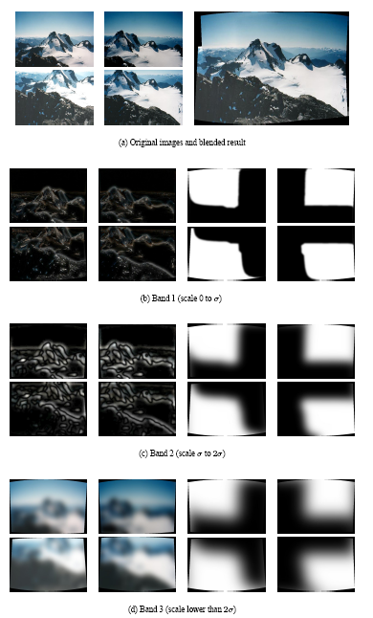
Multiband blending (IJCV 2007)
Laplacian pyramids
Compute Laplacian pyramid of images and mask
Create blended image at each level of pyramid
Reconstruct complete image
Notes:
3 different frequency levels of blending; mask is blurred in lower levels

Slide 12
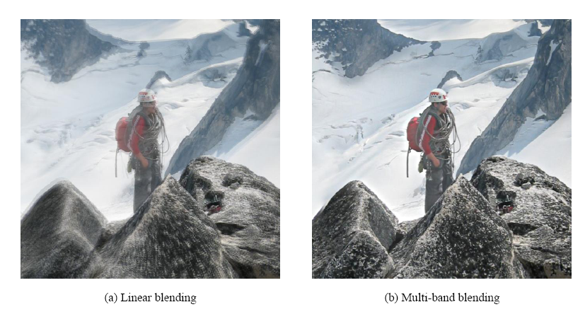
Blending comparison (IJCV 2007)

Slide 13
Alpha Blending
I₃
p
I₁
Optional: see Blinn (CGA, 1994) for details:
http://ieeexplore.ieee.org/iel1/38/7531/00310740.pdf?isNumber=7531&prod=JNL&arnumber=310740&arSt=83&ared=87&arAuthor=Blinn%2C+J.F.
I₂
Encoding blend weights: I(x,y) = (αR, αG, αB, α )
color at p =
Implement this in two steps:
1. accumulate: add up the (α premultiplied) RGB values at each pixel
2. normalize: divide each pixel’s accumulated RGB by its α value
Notes:
A: render as black

Slide 14
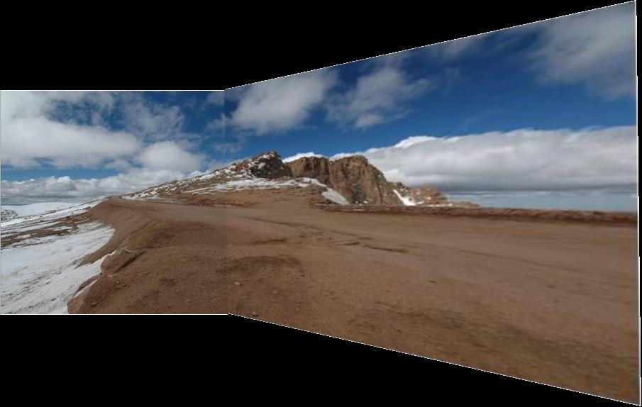
Gain Compensation: Getting rid of artifacts
Simple gain adjustment
Compute average RGB intensity of each image in overlapping region
Normalize intensities by ratio of averages

Slide 15
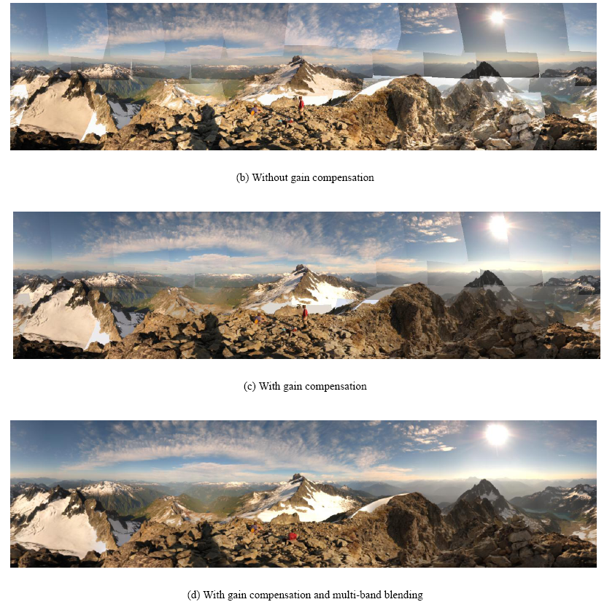
Blending Comparison

Slide 16
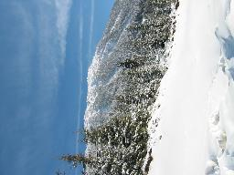
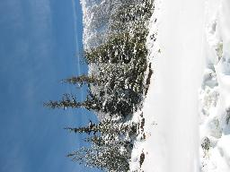
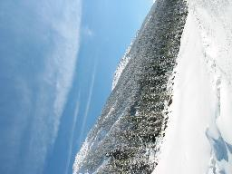
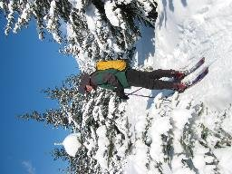
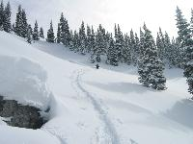
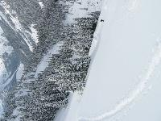
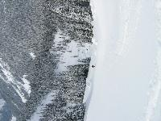
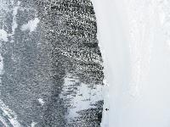
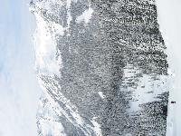
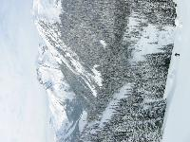
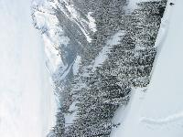
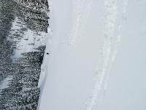
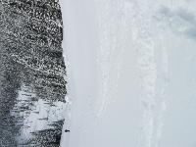
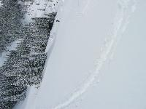
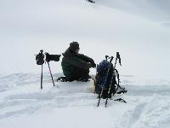
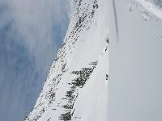
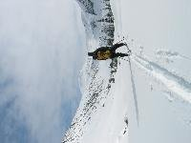
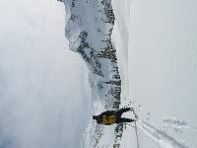
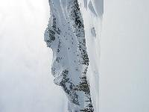
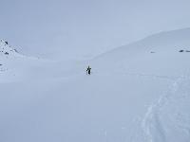
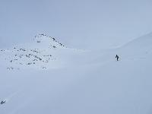
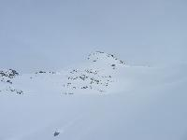
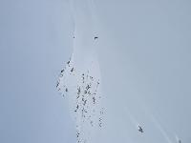
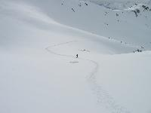
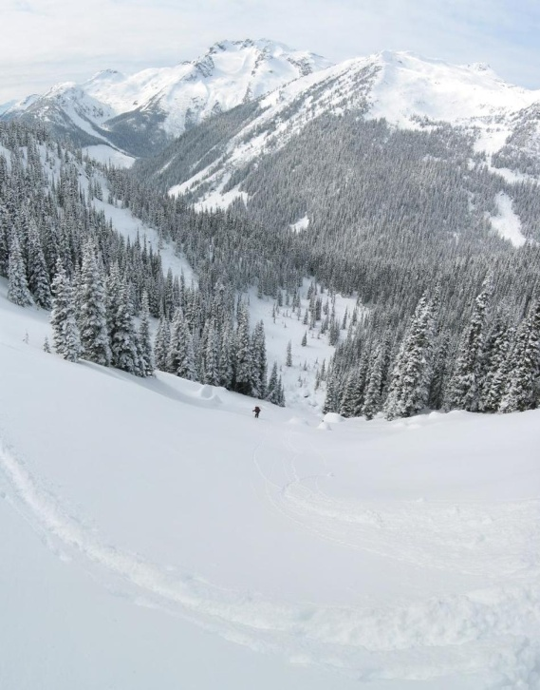
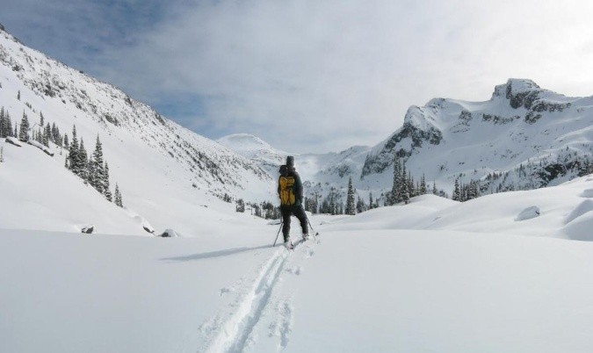
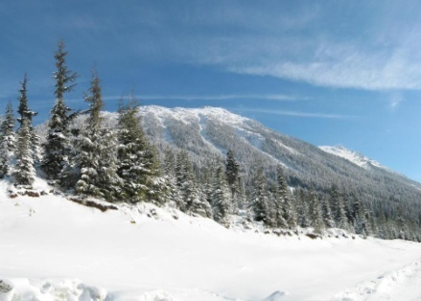
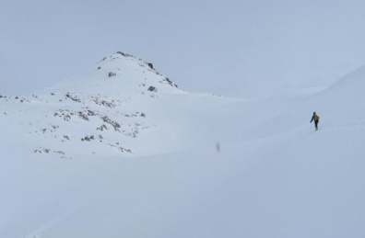
Recognizing Panoramas
Some of following material from Brown and Lowe 2003 talk
Brown and Lowe 2003, 2007

Slide 17
Recognizing Panoramas
Input: N images
Extract SIFT points, descriptors from all images
Find K-nearest neighbors for each point (K=4)
(from the OTHER images)
3. For each image
Select M candidate matching images by counting matched keypoints in other images (m=6)
Solve homography H_{ij} for each matched image

Slide 18
What else matches?

Slide 19
Recognizing Panoramas
Input: N images
Extract SIFT points, descriptors from all images
Find K-nearest neighbors for each point (K=4)
For each image
Select M candidate matching images by counting matched keypoints (m=6)
Solve homography H_{ij} for each matched image
Decide if match is valid (n_{i} > 8 + 0.3 n_{f} )
# inliers
# keypoints in overlapping area

Slide 20
Recognizing Panoramas (cont.)
(now we have matched pairs of images)
Make a graph of matched pairs
Find connected components of the graph

Slide 21
Finding the panoramas

Slide 22
Finding the panoramas

Slide 23
Recognizing Panoramas (cont.)
(now we have matched pairs of images)
Find connected components
For each connected component
Solve for rotation and f
Project to a surface (plane, cylinder, or sphere)
Render with multiband blending

Slide 24
Finding the panoramas

