Slide 1
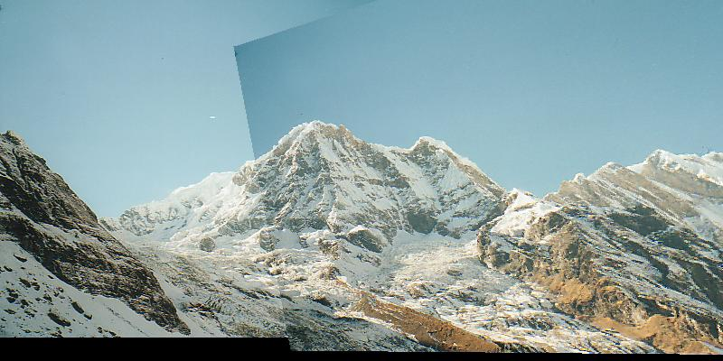
Assignment 3
Creating Panoramas

Slide 2
Step 1: (10 pts) Implement the Harris corner detector.
void HarrisCornerDetector(QImage image, double sigma, double thres,
CIntPt **cornerPts, int &numCornerPts, QImage &imageDisplay)
image is the input image
sigma is the standard deviation for the Gaussian
thres is the threshold for detection corners
cornerPts is an array that will contain the returned corner points
numCornerPts is the number of points returned
imageDisplay – image returned to display for debugging

Slide 3
Step 1: (10 pts) Implement the Harris corner detector.
Part b. void HarrisCornerDetector(QImage image, double sigma, double thres,
CIntPt **cornerPts, int &numCornerPts, QImage &imageDisplay)
To do:
i. Compute x and y derivatives of the image, use them to produce 3 images
(I_x^2, I_y^2, and I_x*I_y) and smooth each of them with the Gaussian.
ii. Compute the Harris matrix H for each pixel.
iii. Compute corner response function R = Det(H)/Tr(H), and threshold R.
Try threshold 50 on the UI.
iv. Find local maxima of the response function using nonmaximum suppression.
Note: We provide Convolution and GaussianBlurImage functions for you to use.
You can index a pixel (c,r) by image[r*w + c]
1
.
i
.
n
cornerPts[i].m_X, cornerPts[i].m_Y . . .

Slide 4
Step 2: (10 pts) Implement MatchCornerPoints.
void MatchCornerPoints(Qimage image1, Cintpt *cornerPts1, int numCornerPts1,
Qimage image2, Cintpt *cornerPts2, int numCornerPts2, CMatches **matches,
int &numMatches, Qimage &image1Display, Qimage &image2Display)
image1 is the first input image
image 2 is the second (match from image 1 to image 2)
cornerPts1 is a vector of interest points found in image1
cornerPts2 is a vector of interest points found in image 2
numCornerPts1 is the number of interest points in image1
numCornerPts2 is the number of interest points in Image 2
matches is a vector of matches; each match has X and Y coordinates from each image
1
.
i
.
n
matches[i].m_X1, matches[i].m_Y1, matches[i].m_X2, matches[i].m_Y2

Slide 5
Step 2: (10 pts) Implement MatchCornerPoints.
void MatchCornerPoints(Qimage image1, Cintpt *cornerPts1, int numCornerPts1,
Qimage image2, Cintpt *cornerPts2, int numCornerPts2, CMatches **matches,
int &numMatches, Qimage &image1Display, Qimage &image2Display)
To do this you'll need to follow these steps:
Compute the descriptors for each interest point.
This code has already been written for you.
b. For each corner point in image 1, find its best match in image 2.
The best match is defined as the closest distance (L1-norm distance. )
c. Add the pair of matching points to "matches".
d. Display the matches using DrawMatches (code is already written. )
Just pass it the required parameters.
You should see many correct and incorrect matches.

Slide 6
Step 3: (8 pts) Compute the homography between the images using RANSAC
void RANSAC (Cmatches *matches , int numMatches, int numIterations,
double inlierThreshold, double hom[3][3], double homInv[3][3],
Qimage &image1Display, Qimage &image2Display)
matches is a set of numMatches matches
numIterations is the number of times to iterate
inlierThreshold is a real number so that the distance from a projected point to the match
is less than its square
hom is the homography and homInv its inverse
Image1Display and Image2Display hold the matches to display
We provide Project and ComputeInlierCount functions for you to use

Slide 7
c. void RANSAC (Cmatches *matches , int numMatches, int numIterations,
double inlierThreshold, double hom[3][3], double homInv[3][3],
Qimage &image1Display, Qimage &image2Display)
a. Iteratively do the following for "numIterations" times:
i. Randomly select 4 pairs of potentially matching points from "matches".
ii. Compute the homography relating the four selected matches with the function
“Project. "
iii. Using the computed homography, compute the number of inliers using
"ComputeInlierCount".
iv. If this homography produces the highest number of inliers, store it as the best
homography.
b. i. Given the highest scoring homography, once again find all the inliers.
ii. Compute a new refined homography using all of the inliers (not just using four points
as you did previously. )
iii. Compute an inverse homography as well (the fourth term of
the function ComputeHomography should be false), and return their values
in "hom” and "homInv".
c. Display the inlier matches using "DrawMatches".

Slide 8
Step 4: (2 pts) Stitch the images together by calling the function directly following Step3.

