Slide 1
ECE 596
HW 4 Notes

Slide 2
Overview
Final Project (link)
Time: roughly 4 weeks
Type: group work (1-3 people)
Topic: four topics for you to choice from
(1) content based image retrieval
(2) object recognition
(3) tracking moving object
(4) propose your own project idea
Eval: Oral and Written Report. (& source code)
Points: 50 total points (+ extra credit)

Slide 3
Project Topic:
(1) content based image retrieval
(2) object recognition
(3) tracking moving object
(4) propose your own project

Slide 4
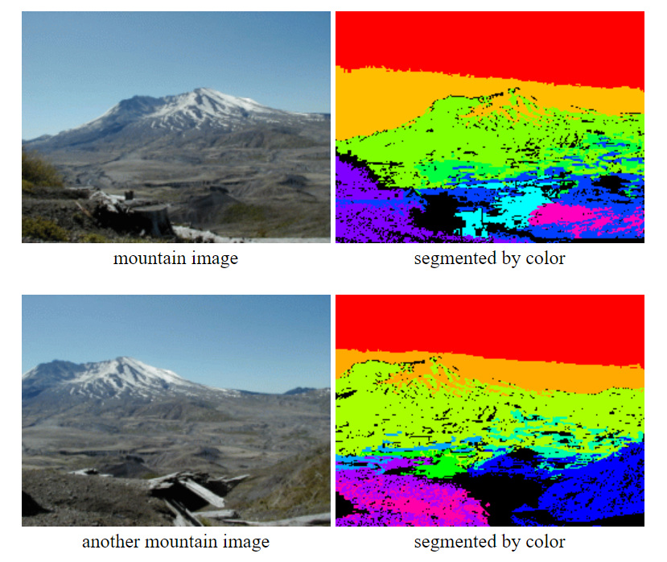
Project Topic:
(1) content based image retrieval
Step 1: color clustering
Step 2: connected component
morphology - get rid of noise
Step 3: attributes of a region
size, color, texture, centroid, bounding box
Step 4: region adjacency graph (RAG)
inside, above_adjacency, below_adjacency,
left_adjacency, right_adjacency, other
Step 5: store step 3, step 4 results of image I
in a data structure DS(I) that you designed.
Step 6: a distance measure RELDIST(I1,I2)
find best region correspondence & error
Step 7: a query system
input image I, output RELDIST(I, other Is)
as a sorted list. (UI not required)
Notes:
3 – traits
4 – triples
6- missing / extra regions
Use our image set → we have suggestions

Slide 5
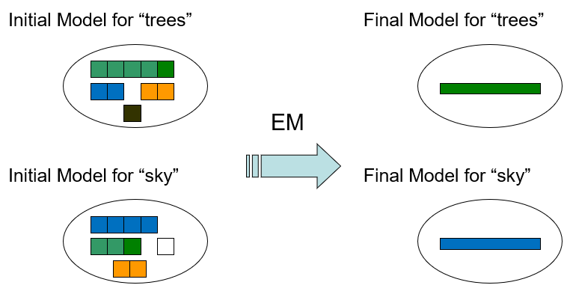
Project Topic:
(2) object recognition
Develop an object recognition system that uses "parts" from interest operators to recognize classes of objects. (ref: Yi’s work)
Step 1: code for detectors and descriptors
e.g. color/texture/line detectors and SIFT descriptors.
Step 2: EM algorithm used for clustering the parts (link)
to find out which attributes correlate well with the object of interest.
Step 3: discriminative classifier (link)
the WEKA package for ideas and code.

Slide 6
Project Topic:
(3) tracking moving object
The system should be able to detect and track multiple objects in a video, even if the background also moves.
Result should show a colored box around each tracked object with its designated identification number.
Sample Method I
Step 1: compute optical flow
Step 2: cluster the flow vectors
Step 3: find and remove the background region
Sample Method II
Step 1: interest operators (detectors and descriptors)
Step 2: incorporate temporal information
Notes:
Temporal information. (ID)
Stack of images

Slide 7
Project Topic:
(4) propose your own project
Anything computer vision related that interests you!
Roughly of 4-week effort
Define project objectives in report/email.

Slide 8
Timeline
Friday
11/15/2019
Confirm Project
11/25/2019
Progress Report
12/03/2019
Oral Presentation
12/07/2019
Final Report Due
1. Sign up your group on Canvas. (link)
2. Send Linda (shapiro@cs.washington.edu) an email:
group member/project choice/changes

Slide 9
Timeline
Friday
11/15/2019
Confirm Project
11/25/2019
Progress Report
12/03/2019
Oral Presentation
12/07/2019
Final Report Due
1. Sign up your group on Canvas.
2. Send Linda (shapiro@cs.washington.edu) an email:
group member/project choice/changes
Monday
3. Send Yun-Hsuan (yhsu83@uw.edu) an
email: with progress report about
current project progress. (template)

Slide 10
Timeline
Friday
11/15/2019
Confirm Project
11/25/2019
Progress Report
12/03/2019
Oral Presentation
12/07/2019
Final Report Due
1. Sign up your group on Canvas.
2. Send Linda (shapiro@cs.washington.edu) an email:
group member/project choice/changes
Monday
3. Send Yun-Hsuan (yhsu83@uw.edu) an
email: with progress report about
current project progress. (template)
Tuesday
4. Send Linda (shapiro@cs.washington.edu)
your power point slides by 12/02/2019.
5. Group presentation: demo + talk
(TBA mins)

Slide 11
Timeline
Friday
11/15/2019
Confirm Project
11/25/2019
Progress Report
12/03/2019
Oral Presentation
12/07/2019
Final Report Due
1. Sign up your group on Canvas.
2. Send Linda (shapiro@cs.washington.edu) an email:
group member/project choice/changes
Monday
3. Send Yun-Hsuan (yhsu83@uw.edu) an
email: with progress report about
current project progress. (template)
Tuesday
4. Send Linda (shapiro@cs.washington.edu)
your power point slides by 12/02/2019.
5. Group presentation: demo + talk
(TBA mins)
Saturday
6. Submit code and final report on Canvas.
(template)
Late submission till 12/10/2019
(With 10% penalty per day)

