Slide 1
Cameras and Stereo
ECE P 596
Linda Shapiro

Slide 2

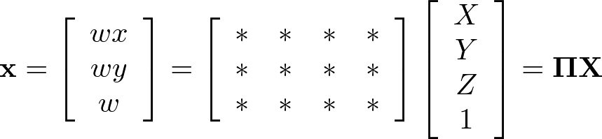




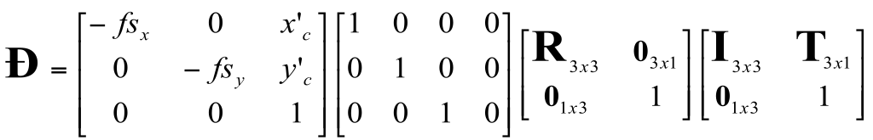
Camera parameters
A camera is described by several parameters
Translation T of the optical center from the origin of world coords
Rotation R of the image plane
focal length f, principal point (x’_{c}, y’_{c}), pixel size (s_{x}, s_{y})
blue parameters are called “extrinsics,” red are “intrinsics”
Projection equation
The projection matrix models the cumulative effect of all parameters
Useful to decompose into a series of operations
identity matrix
[tx, ty, tz]^{T}
intrinsics
projection
rotation
translation
The definitions of these parameters are not completely standardized
especially intrinsics—varies from one book to another

Slide 3
Where does all this lead?
We need it to understand stereo
And 3D reconstruction
It also leads into camera calibration, which is usually done in factory settings to solve for the camera parameters before performing an industrial task.
The extrinsic parameters must be determined.
Some of the intrinsic are given, some are solved for, some are improved.

Slide 4
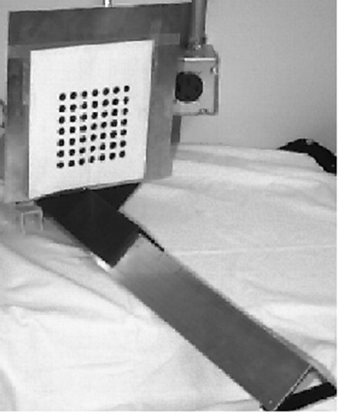
Camera Calibration
The idea is to snap
images at different
depths and get a
lot of 2D-3D point
correspondences.
x1, y1, z1, u1, v1
x2, y2, z1, u2, v2
.
.
xn, yn, zn, un, vn
Then solve a system
of equations to get
camera parameters.

Slide 5
Stereo

Slide 7
Amount of horizontal movement is …
…inversely proportional to the distance from the camera

Slide 8
Depth from Stereo
Goal: recover depth by finding image coordinate x’ that corresponds to x
X
X
x
z
x
x’
x'
f
f
C
Baseline
B
C’

Slide 9
Depth from disparity
X
z
x
x’
f
f
O
Baseline
B
O’
Disparity is inversely proportional to depth.

Slide 10
Depth from Stereo
Goal: recover depth by finding image coordinate x’ that corresponds to x
Sub-Problems
  Calibration: How do we recover the relation of the cameras (if not already known)?
  Correspondence: How do we search for the matching point x’?
X
x
x'

Slide 11


Correspondence Problem
x
?
We have two images taken from cameras with different intrinsic and extrinsic parameters
How do we match a point in the first image to a point in the second? How can we constrain our search?

Slide 12

Key idea: Epipolar constraint
X
X
X
x
x’
x’
x’
Potential matches for x have to lie on the corresponding line l’.
Potential matches for x’ have to lie on the corresponding line l.

Slide 13

Epipolar geometry: notation
X
x
x’
Baseline – line connecting the two camera centers
Epipoles
= intersections of baseline with image planes
= projections of the other camera center
Epipolar Plane – plane containing baseline (1D family)

Slide 14
Epipolar geometry: notation
X
x
x’
Baseline – line connecting the two camera centers
Epipoles
= intersections of baseline with image planes
= projections of the other camera center
Epipolar Plane – plane containing baseline (1D family)
Epipolar Lines - intersections of epipolar plane with image
planes (always come in corresponding pairs)

Slide 15



Example: Converging cameras

Slide 16



Example: Motion parallel to image plane

Slide 17
Epipolar constraint
X
x
x’
If we observe a point x in one image, where can the corresponding point x’ be in the other image?

Slide 18
Epipolar constraint
X
X
X
x
x’
x’
x’
Potential matches for x have to lie on the corresponding
epipolar line l’.
Potential matches for x’ have to lie on the corresponding
epipolar line l.

Slide 19
Epipolar constraint example

Slide 20
Epipolar constraint: Calibrated case
X
x
x’
Assume that the intrinsic and extrinsic parameters of the cameras are known
We can multiply the projection matrix of each camera (and the image points) by the inverse of the calibration matrix to get normalized image coordinates
We can also set the global coordinate system to the coordinate system of the first camera. Then the projection matrices of the two cameras can be written as [I | 0] and [R | t]

Slide 21
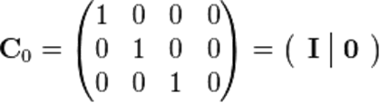

Simplified Matrices for the 2 Cameras
= (R | T)

Slide 22
Epipolar constraint: Calibrated case
X
= (x,1)^{T}
x
x’ = Rx+t
t
R
The vectors Rx, t, and x’ are coplanar
Notes:
X’ is X in the second camera’s coordinate system
We can identify the non-homogeneous 3D vectors X and X’ with the homogeneous coordinate vectors x and x’ of the projections of the two points into the two respective images

Slide 23
Epipolar constraint: Calibrated case
X
x
x’
Essential Matrix E
(Longuet-Higgins, 1981)
The vectors Rx, t, and x’ are coplanar

Slide 24
Epipolar constraint: Calibrated case
X
x
x’
E x is the epipolar line associated with x (l' = E x)
E^{T}x' is the epipolar line associated with x' (l = E^{T}x')
E e = 0 and E^{T}e' = 0
E is singular (rank two)
E has five degrees of freedom

Slide 25
Epipolar constraint: Uncalibrated case
X
x
x’
Fundamental Matrix
(Faugeras and Luong, 1992)

Slide 26

Comparison of estimation algorithms
 | 8-point | Normalized 8-point | Nonlinear least squares
Av. Dist. 1 | 2.33 pixels | 0.92 pixel | 0.86 pixel
Av. Dist. 2 | 2.18 pixels | 0.85 pixel | 0.80 pixel

Slide 27

Basic stereo matching algorithm
If necessary, rectify the two stereo images to transform epipolar lines into scanlines
For each pixel x in the first image
  Find corresponding epipolar scanline in the right image
  Search the scanline and pick the best match x’
  Compute disparity x-x’ and set depth(x) = fB/(x-x’)

Slide 28
Basic stereo matching algorithm
For each pixel in the first image
  Find corresponding epipolar line in the right image
  Search along epipolar line and pick the best match
  Triangulate the matches to get depth information
Simplest case: epipolar lines are scanlines
  When does this happen?

Slide 29
Stereo image rectification

Slide 30
Stereo image rectification
Reproject image planes onto a common plane parallel to the line between camera centers
Pixel motion is horizontal after this transformation
Two homographies (3x3 transform), one for each input image reprojection
C. Loop and Z. Zhang. Computing Rectifying Homographies for Stereo Vision. IEEE Conf. Computer Vision and Pattern Recognition, 1999.

Slide 31
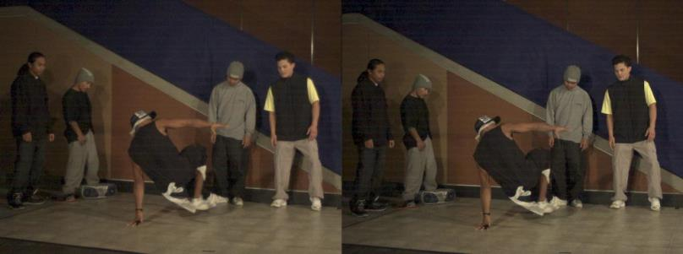
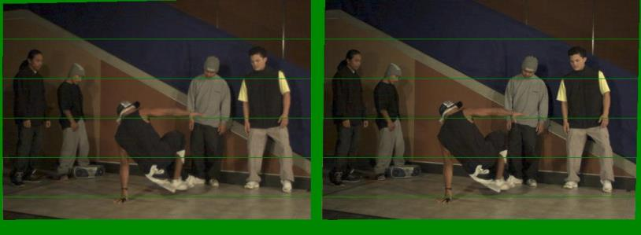
Example
Unrectified
Rectified

Slide 32


Left
Right
scanline
Matching cost
disparity
Slide a window along the right scanline and compare contents of that window with the reference window in the left image
Matching cost: SSD, SAD, or normalized correlation

Slide 33
Correspondence search
Left
Right
scanline
SSD

Slide 34
Correspondence search
Left
Right
scanline
Norm. corr

Slide 35


Failures of correspondence search
Textureless surfaces
Occlusions, repetition
Non-Lambertian surfaces, specularities

Slide 36



Results with window search
Data
Window-based matching
Ground truth

Slide 37
Priors and constraints
Uniqueness
  For any point in one image, there should be at most one matching point in the other image
Ordering
  Corresponding points should be in the same order in both views
Smoothness
  We expect disparity values to change slowly (for the most part)

Slide 38
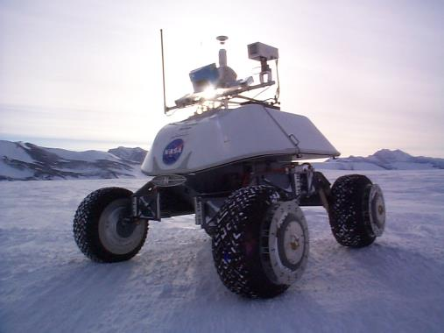
Real-time stereo
Nomad robot searches for meteorites in Antartica
  http://www.frc.ri.cmu.edu/projects/meteorobot/index.html
Used for robot navigation (and other tasks)
  Several software-based real-time stereo techniques have been developed (most based on simple discrete search)

Slide 39
Stereo reconstruction pipeline
Steps
  Calibrate cameras
  Rectify images
  Compute disparity
  Estimate depth
What will cause errors?
  Camera calibration errors
  Poor image resolution
  Occlusions
  Violations of brightness constancy (specular reflections)
  Large motions
  Low-contrast image regions

Slide 40
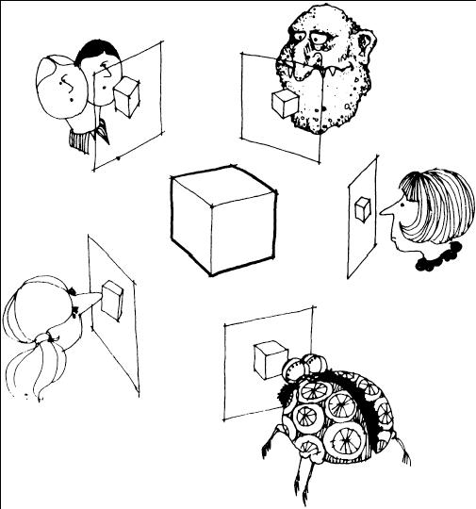
Multi-view stereo ?

Slide 41

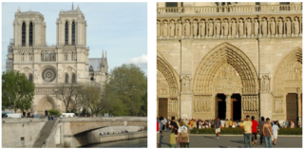
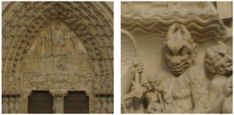
Using more than two images
Multi-View Stereo for Community Photo Collections
M. Goesele, N. Snavely, B. Curless, H. Hoppe, S. Seitz
Proceedings of ICCV 2007,

