Slide 1
Review
ECE P 596
Linda Shapiro

Slide 2


Second Moment Matrix or Harris Matrix
H
2 x 2 matrix of image derivatives smoothed by Gaussian weights.
Notation:
Notes:
2

Slide 3
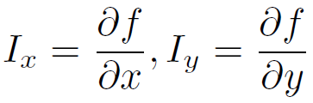
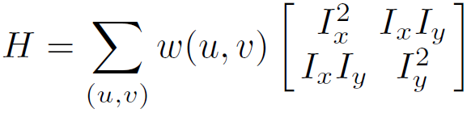
The math
To compute the eigenvalues:
Compute the Harris matrix over a window.
What does this equation mean in practice?
Σsmoothed I_{x}² Σsmoothed I_{x}I_{y}
Σsmoothed I_{x}I_{y} Σsmoothed I_{y}²
2. Compute response from that.
This is how people write it for
technical papers
Typically Gaussian weights
This is how you DO it.
You just smooth with
Gaussian as you add
up the derivatives.

Slide 4
Corner Response Function
Computing eigenvalues are expensive
Harris corner detector used the following alternative
Reminder:

Slide 5
Harris detector: Steps (modified to simplify)
Compute derivatives I_{x}², I_{y}² and I_{x}I_{y} at each pixel and smooth them with a Gaussian as you sum them to
Compute the Harris matrix H in a window around each pixel
Compute corner response function R
Threshold R
Find local maxima of response function (nonmaximum suppression)
C.Harris and M.Stephens. Proceedings of the 4th Alvey Vision Conference: pages 147—151, 1988.
Notes:
5

Slide 6
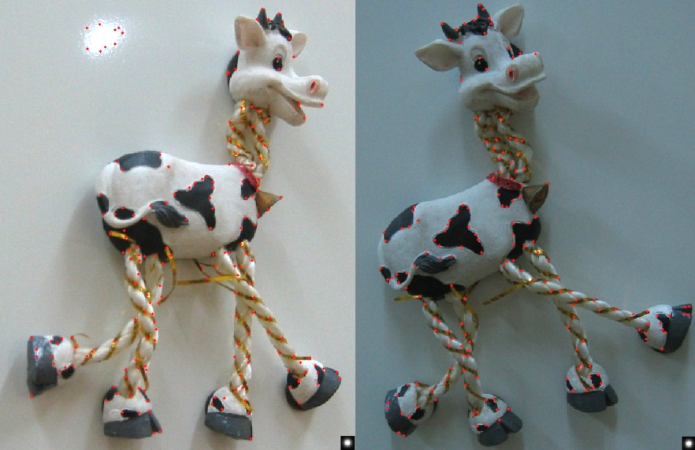
Harris Detector: Results
Notes:
6

Slide 7
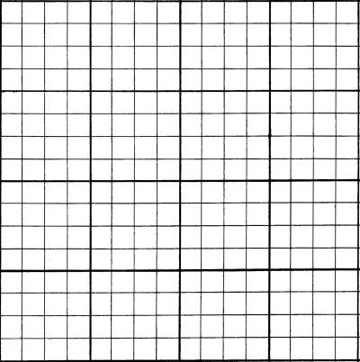
SIFT descriptor
Full version
  Divide the 16x16 window into a 4x4 grid of cells
  Compute an orientation histogram for each cell
  16 cells * 8 orientations = 128 dimensional descriptor
8 8 . . . 8

Slide 8
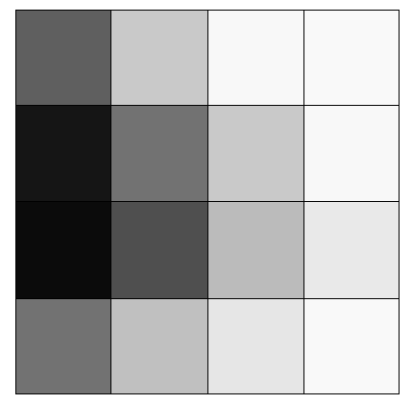
The orientations all
ended up in two bins:
11 in one bin, 5 in the
other. (rough count)
Orientations in each of
the 16 pixels of the cell
5 11 0 0 0 0 0 0

Slide 9
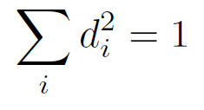

SIFT descriptor
Full version
  Start with a 16x16 window (256 pixels)
  Divide the 16x16 window into a 4x4 grid of cells (16 cells)
  Compute an orientation histogram for each cell
  16 cells * 8 orientations = 128 dimensional descriptor
  Threshold normalize the descriptor:
such that:
0.2
Adapted from slide by David Lowe

Slide 10

Matching with Features
Detect feature points in both images
Find corresponding pairs
Use these matching pairs to align images - the required mapping is called a homography.

