Slide 1
Machine Learning for Cancer Diagnosis
Linda G. Shapiro, Ph.D.
Joann G. Elmore, MD.

Slide 2
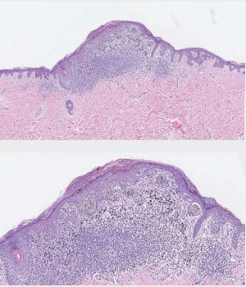
Example Skin Biopsy Case
(Moderately dysplastic per Expert Consensus)
36 Pathologists’ Interpretations
I. Benign (Mildly dysplastic) | 7
II. Moderately dysplastic | 10
III. Melanoma in situ | 14
IV. Invasive Melanoma (thin) | 4
V. Invasive Melanoma (thicker) | 1

Slide 3
I. We are users of Sedeen for R01- CA200690 on Melanoma Biopsy Analysis and Diagnosis
As collaborators to the PIIP project, we use Sedeen for our own cancer diagnosis work.
We use it to draw boundaries around regions on biopsy images and label the tissue types.
Sedeen made this extremely difficult task possible.

Slide 4
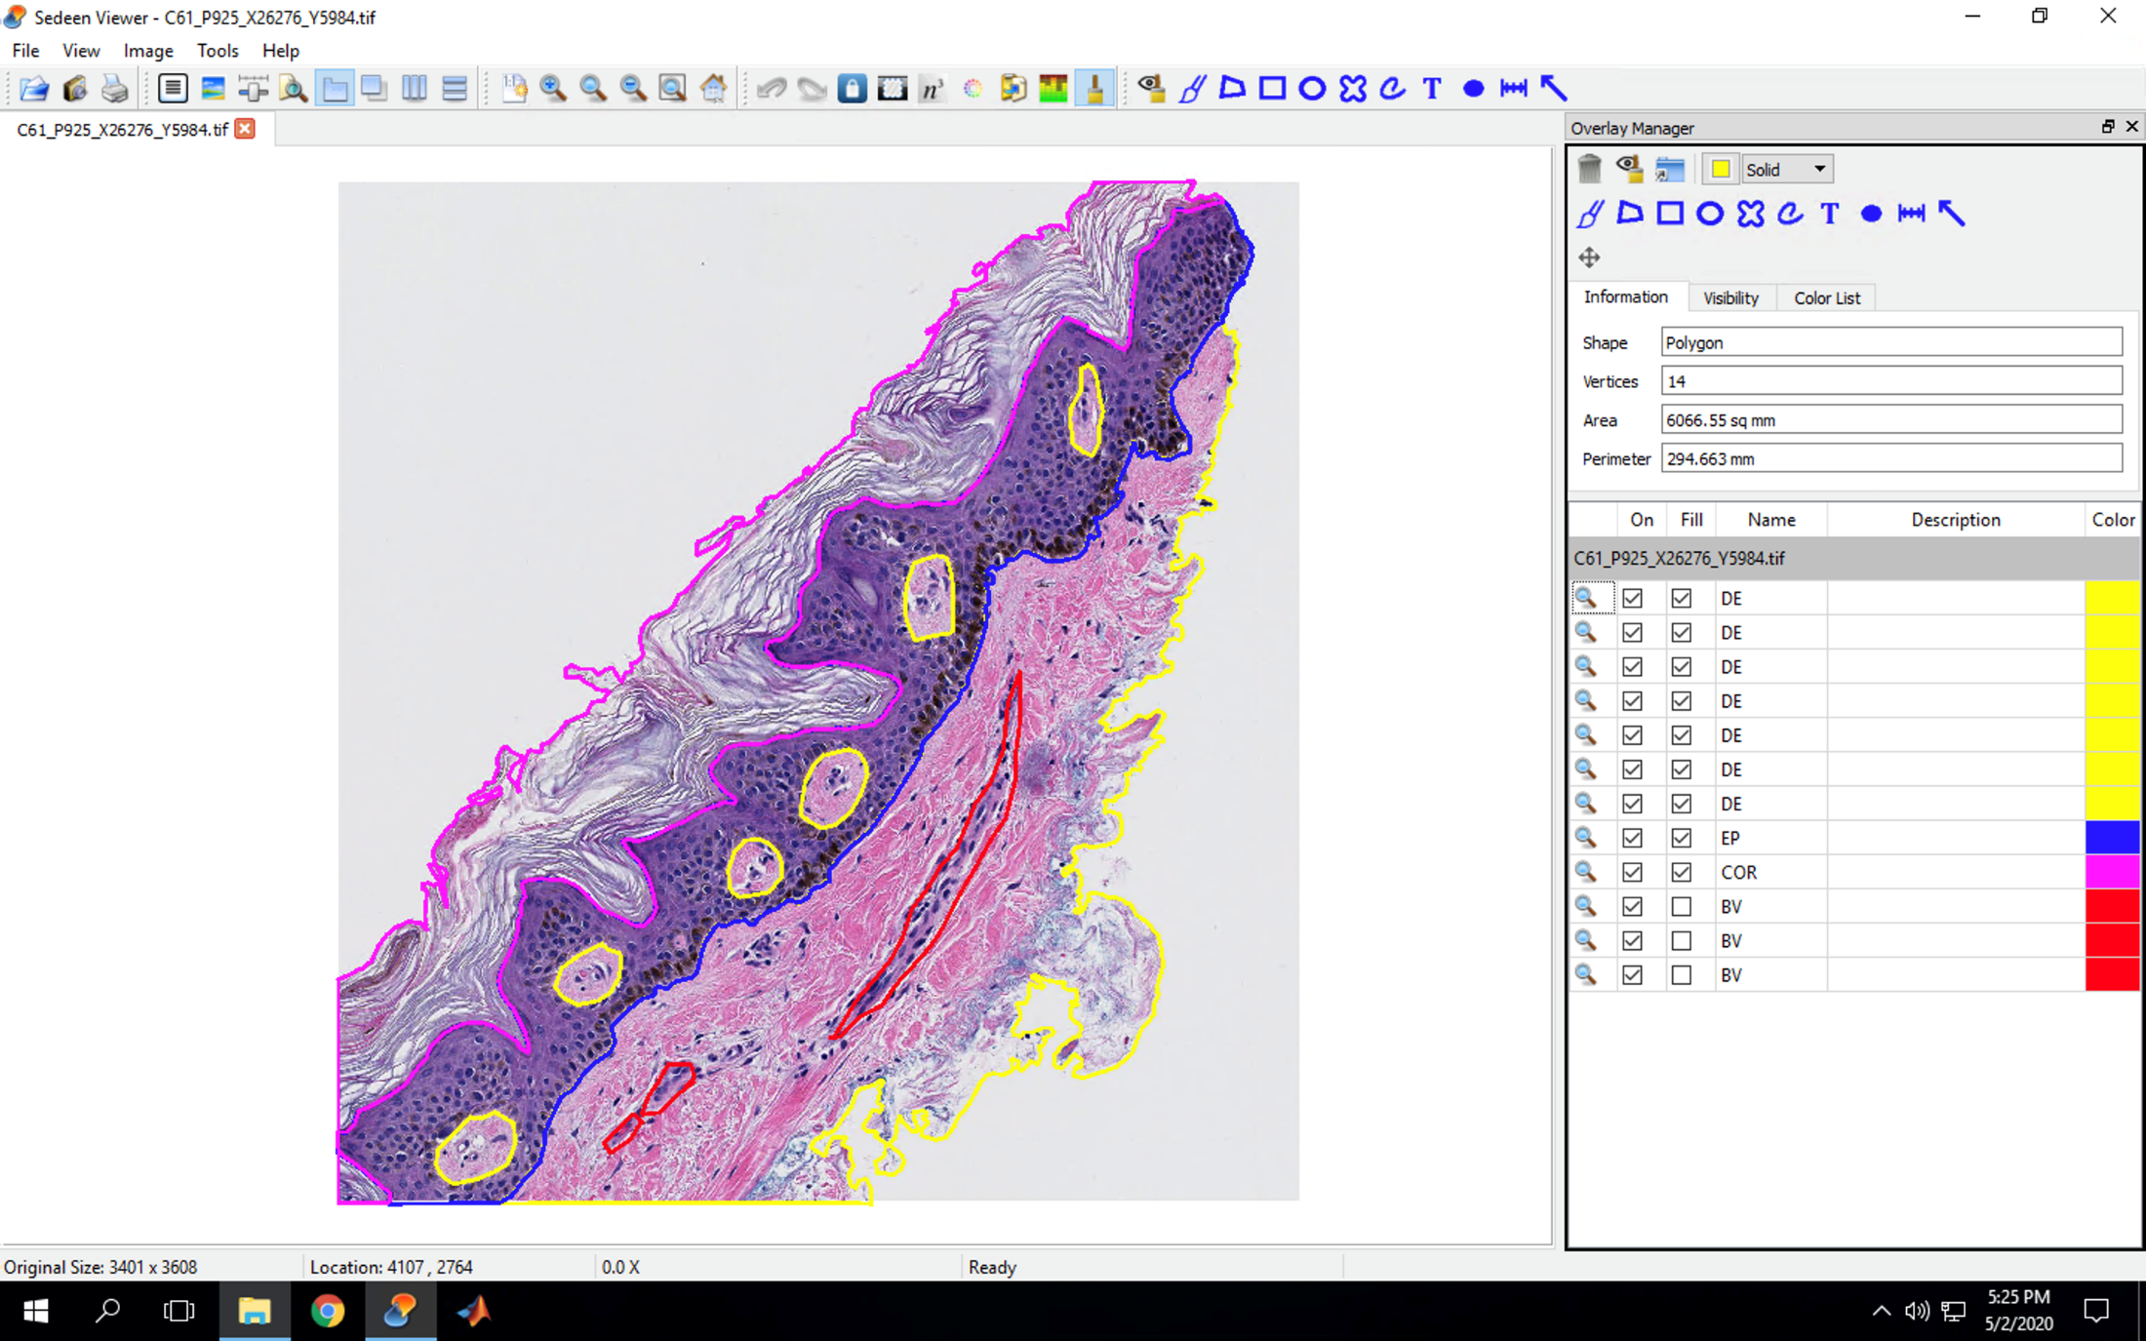
Benign

Slide 5
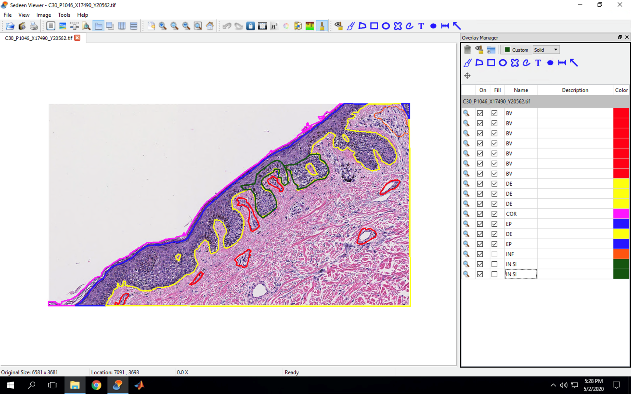
Melanoma In Situ

Slide 6
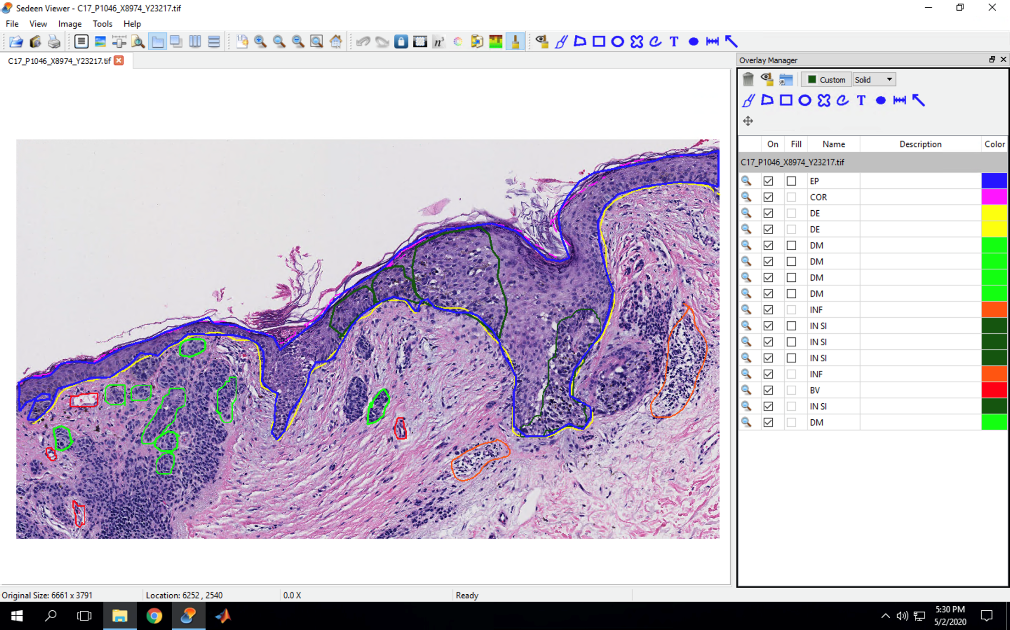
Invasive Cancer Class IA

Slide 7
Our ITCR Project: Machine Learning for Cancer Diagnosis
The idea was to convert algorithms developed for breast cancer whole slide biopsy image analysis under R01- CA172343 to usable software modules for use in breast cancer research and potentially usable for other cancers with additional training.
Aim 1: Finding regions of interest.
Aim 2: Analyzing them and producing a diagnosis.
Aim 3: Dissemination as a software package.

Slide 8
Our ITCR Project Update
Three main modules: Region-of-Interest Detection, Tissue Segmentation, and Diagnosis
background
benign epithelium
normal stroma
secretion
necrosis
malignant epithelium
desmoplastic stroma
blood
Atypical
Whole slide
Biopsy image
Region-of-Interest
Detection
Tissue
Segmentation
Diagnosis
Classification
suggested
diagnosis
selection

Slide 9
Semantic Segmentation of Tissue Classes

Slide 10
Features of the whole ROI: Frequency and Co-occurrence of tissue labels

Slide 11
Concentration of areas around and inside of ducts for breast cancer analysis

Slide 12
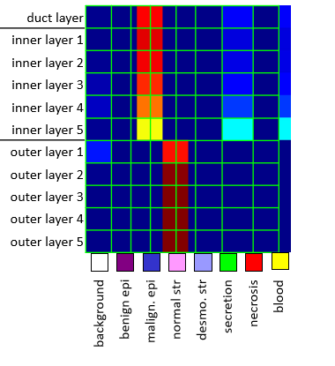
The Structure Feature

Slide 13
ROI Detection Examples (Published accuracy 75%)
Correct
Ground Truth ROIs
Predicted ROIs
Ground Truth ROIs
Predicted ROIs
Ground Truth ROIs
Predicted ROIs
Ground Truth ROIs
Predicted ROIs

Slide 14
ROI Detection Examples
Incorrect
Ground Truth ROIs
Predicted ROIs
Ground Truth ROIs
Predicted ROIs

Slide 15
ROI Segmentation and Diagnosis Examples
(Published segmentation F1-score .588 and diagnostic accuracy 62.5%)

Slide 16
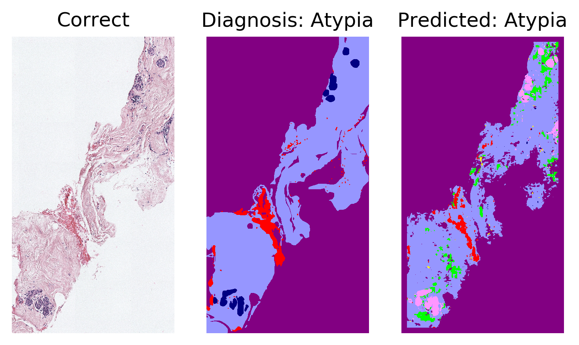

Slide 17
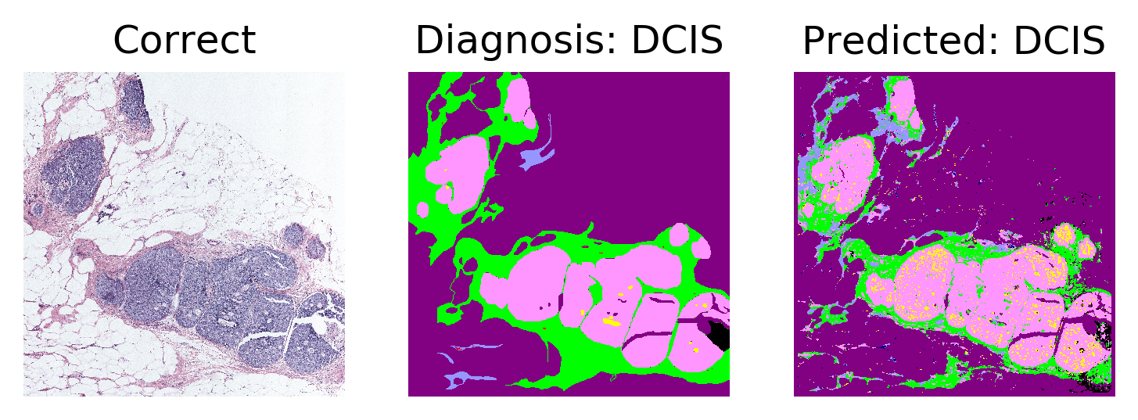
ROI Segmentation and Diagnosis Examples

Slide 18
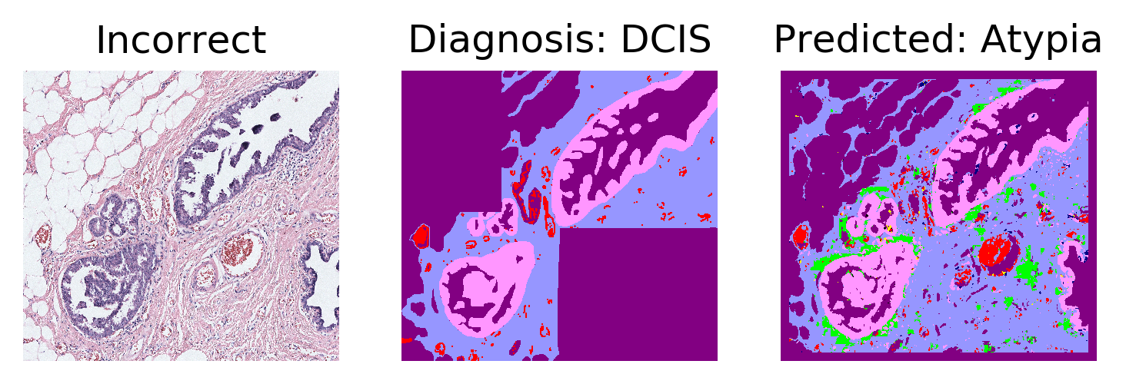
Segmentation is okay
Diagnosis is wrong

Slide 19
Segmentation is wrong
Diagnosis is also wrong

Slide 20
Our Webpage Tutorial: http://cancertech.cs.washington.edu/tutorial.html

