Slide 1

Automated Diagnosis of Breast Cancer and Pre-invasive Lesions on
Digital Whole Slide Images
Ezgi Mercan¹, Sachin Mehta²,
Jamen Bartlett³, Donald L. Weaver³,
Joann G. Elmore⁴, Linda G. Shapiro¹
1 Paul G. Allen School of Computer Science and Engineering, University of Washington
2 Department of Electrical Engineering, University of Washington
3 Department of Pathology, University of Vermont
4 Department of Medicine, University of Washington

Slide 2
Our Aim
Semantic segmentation of digital whole slide images of breast cancer biopsies into medically meaningful categories
Diagnostic classification of the images into four categories: benign, atypia, ductal carcinoma in situ, and invasive cancer.

Slide 3
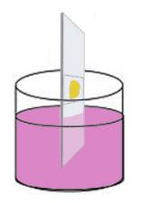

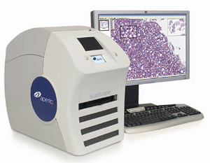
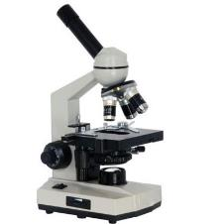
Medical Diagnosis of Cancer
tissue specimen
H&E staining
glass slide
light microscope
whole slide imaging

Slide 4
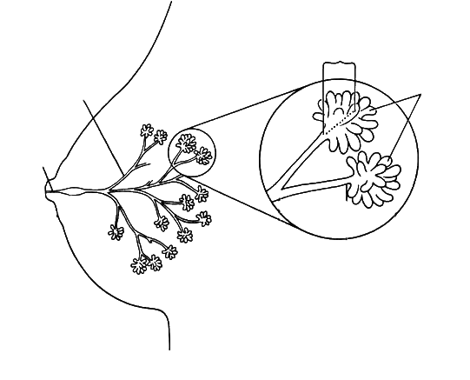
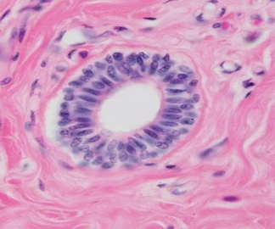
Breast Histopathology
terminal ducts
segmental ducts
ductules
duct
(epithelium)
stroma
(connective tissue)
female breast
a duct
lumen

Slide 5
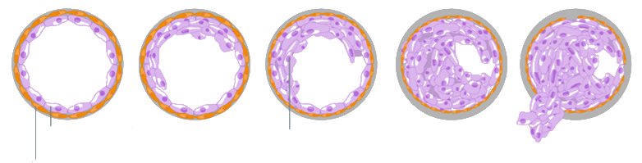
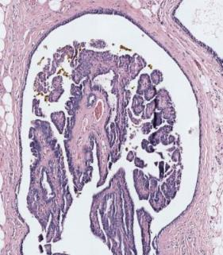
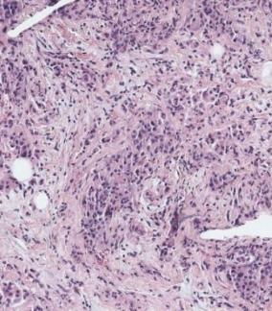
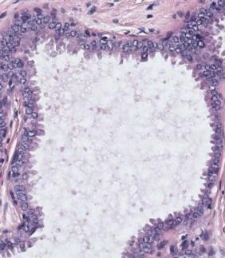
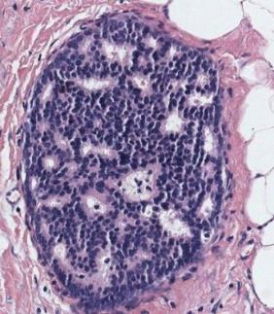
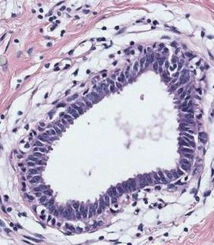
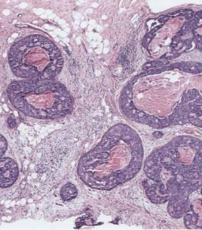
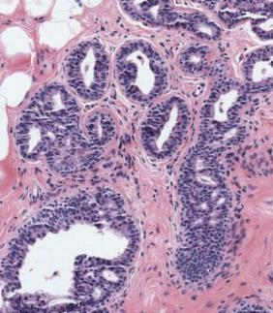
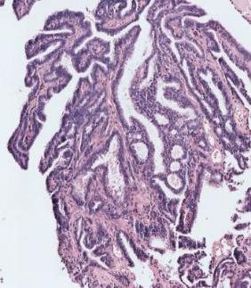
Diagnostic Categories
normal duct
benign
atypia
ductal carcinoma in situ (DCIS)
invasive
normal epithelial cells
cancer cells
atypical ductal hyperplasia
flat epithelial atypia
papilloma w/atypia
invasive carcinoma
columnar cell change
usual ductal hyperplasia
intraductal papilloma
ductal carcinoma in situ (DCIS)

Slide 6

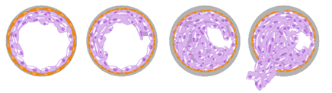
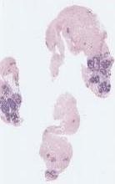
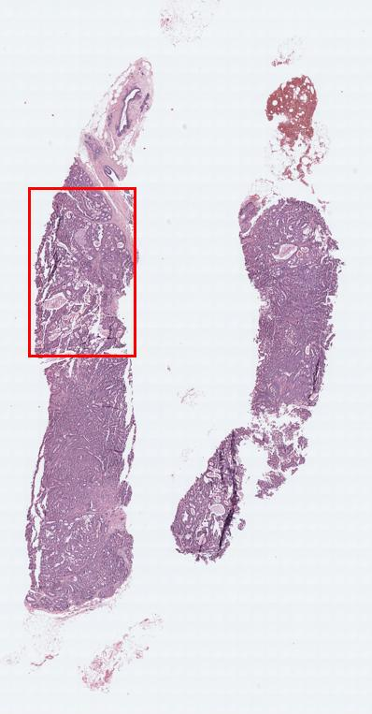
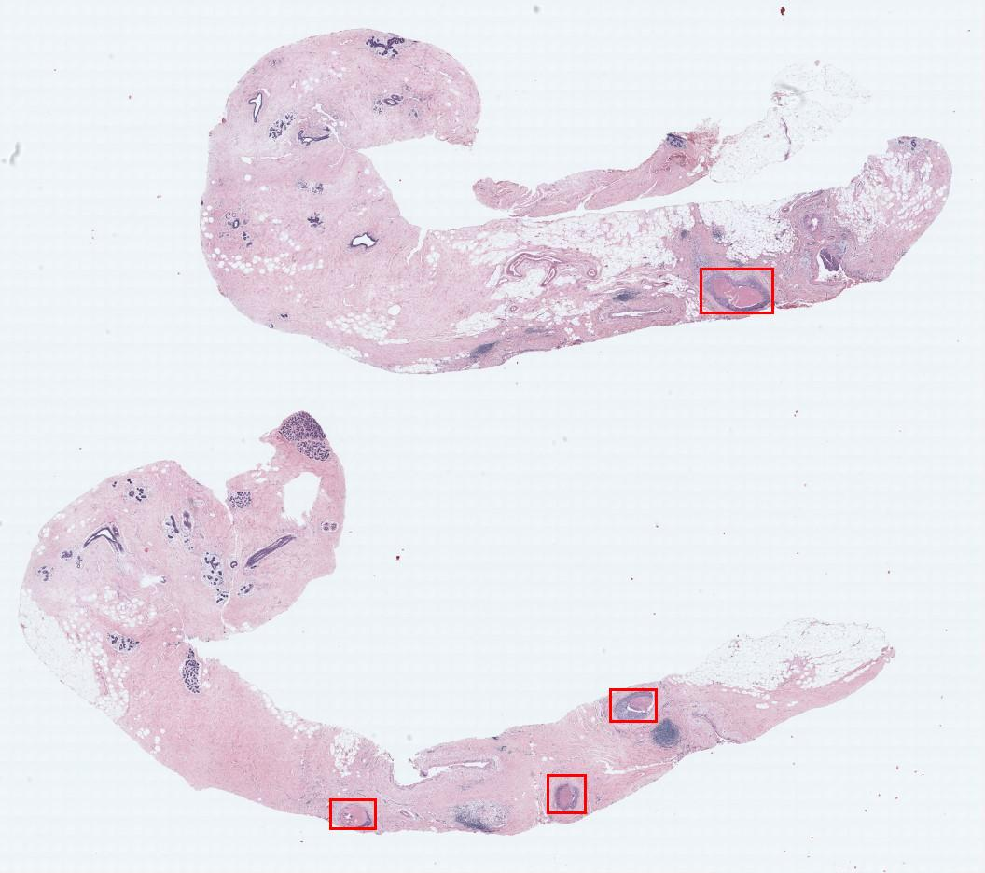
Expert Consensus Data Collection
digital
WSI
Consensus
Diagnosis
benign
atypia
(DCIS)
invasive
# Cases
60
80
78
22
Consensus
ROIs
102
128
162
36
3 world experts

Slide 7
Tissue Label Segmentation
For an automated diagnosis system, we need to describe the structural changes that lead to cancer.
Segmentation is a powerful tool that provides information about the distribution and arrangement of different tissue types.
S. Mehta, E. Mercan, et al., British Machine Vision Conference, 2017 (submitted).

Slide 8
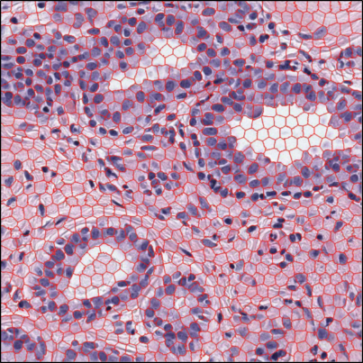








































Superpixel Clustering
empty space
k-means
clustering
blood cells
color (L*a*b) and
texture (LBP)
histograms
loose stroma
dense stroma
superpixel segmentation of an ROI
normal nuclei
Each superpixel cluster can be identified as a biologically meaningful building block of the tissue.
abnormal nuclei
superpixel clusters

Slide 9
Superpixel Clustering
benign
atypia
DCIS
Patterns emerge when we label the superpixels in an unsupervised manner.
This led us to a supervised labeling approach.

Slide 10

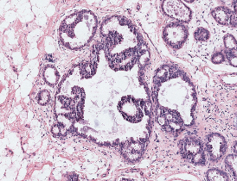
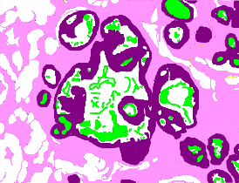
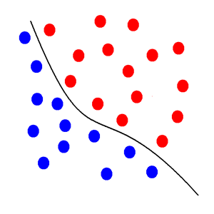
Supervised Tissue Label Segmentation
ground truth
label image
classifier
original image
We tested two models using a subset of ROIs (N=58):
Support Vector Machines (SVM) with color/texture features
Convolutional Neural Nets (CNN)

Slide 11
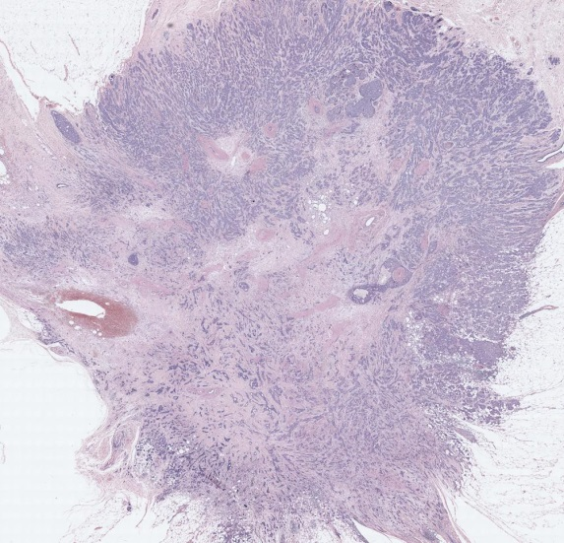
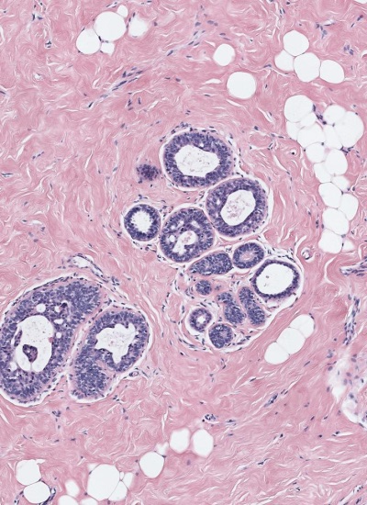
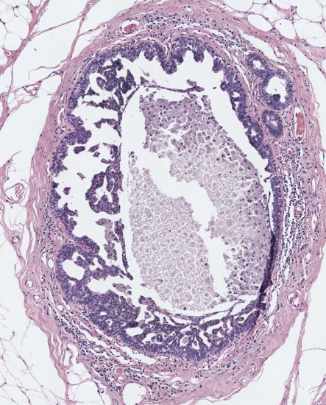
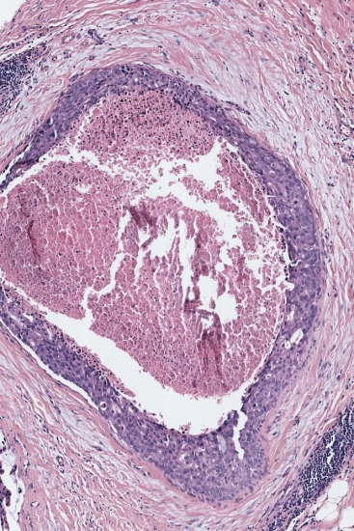
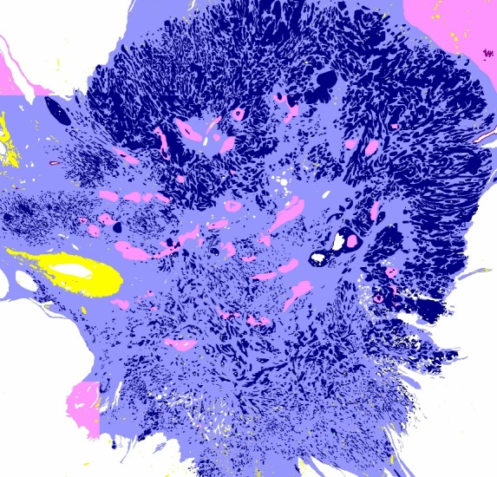
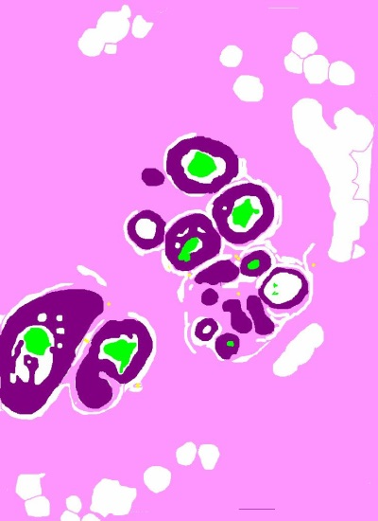
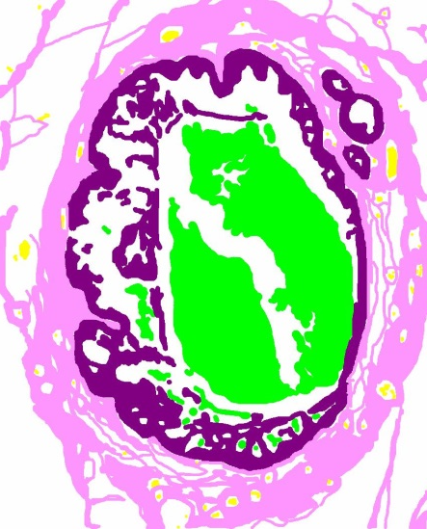
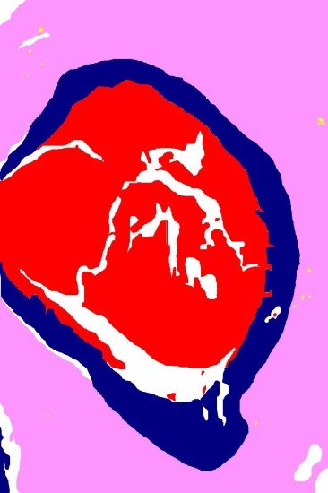
Training Labels
background
benign epithelium
normal stroma
secretion
necrosis
malignant epithelium
desmoplastic stroma
blood

Slide 12
Meaning of Labels
Benign Epithelium: epithelial cells from the benign and atypia categories
Malignant Epithelium: epithelial cells from DCIS and invasive cancer
Normal Stroma: normal connective tissue
Desmoplastic Stroma: stroma associated with a tumor
Secretion: benign substance filling the ducts
Necrosis: dead cells at the center of the ducts in DCIS and invasive cases
Blood: blood cells
Background: empty areas inside ducts

Slide 13
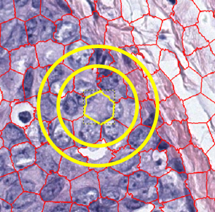
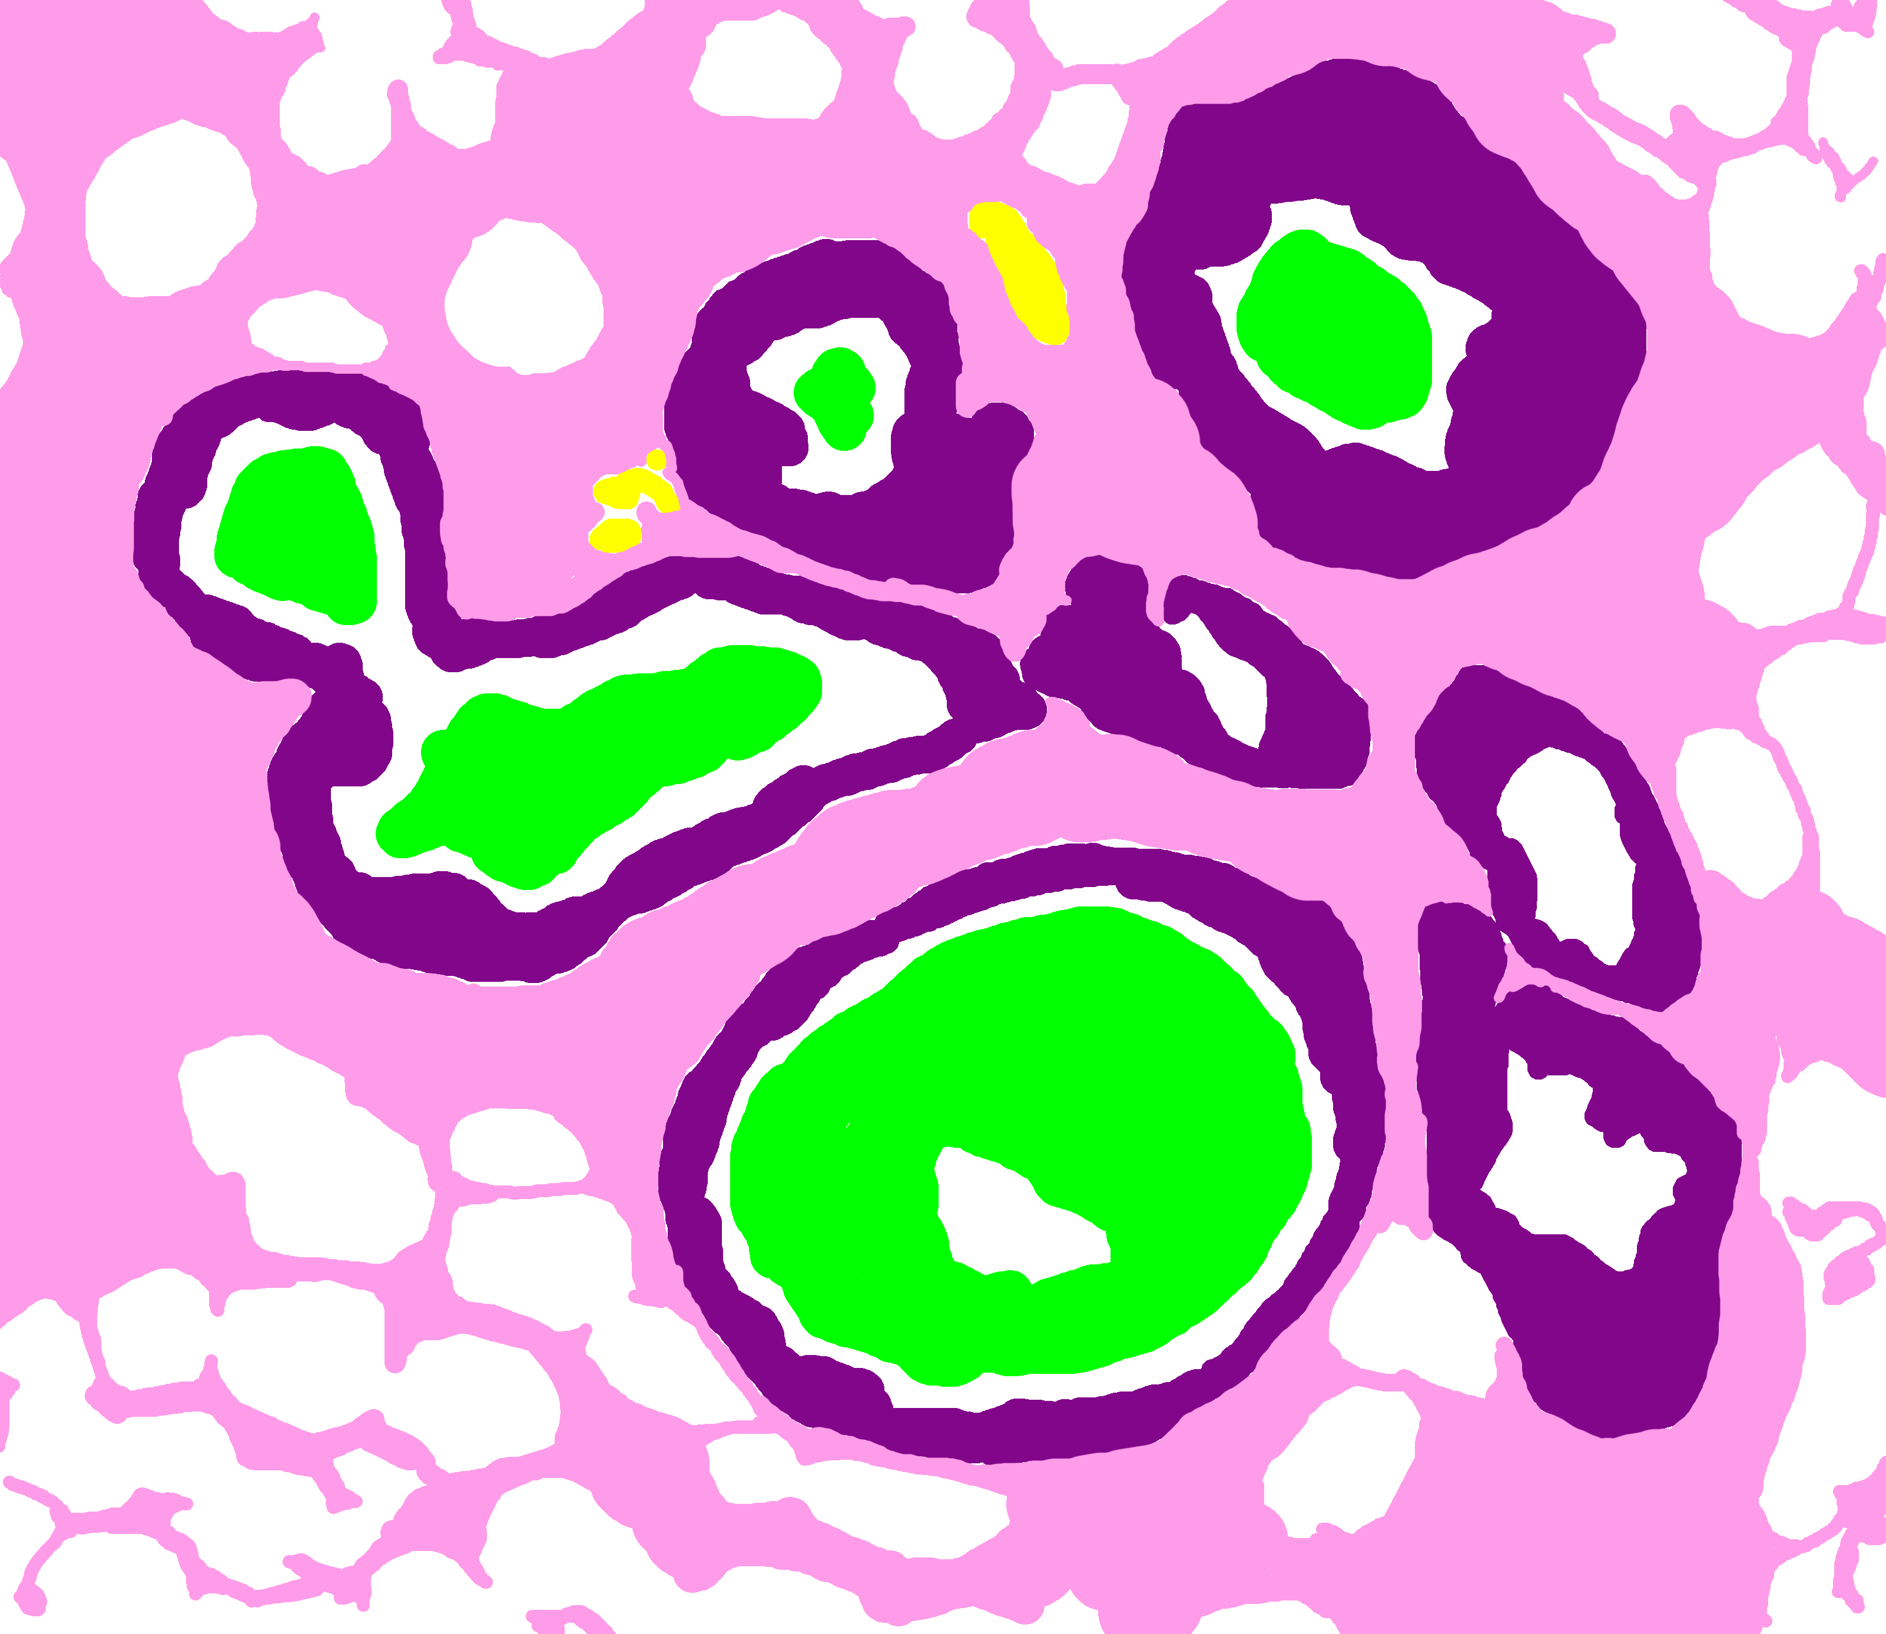
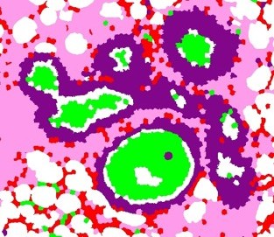
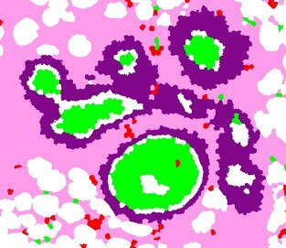


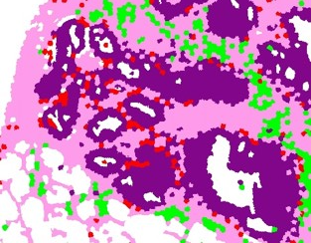
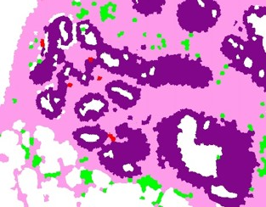
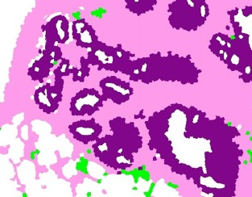
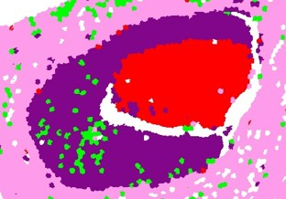
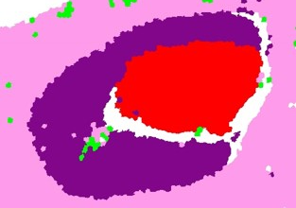

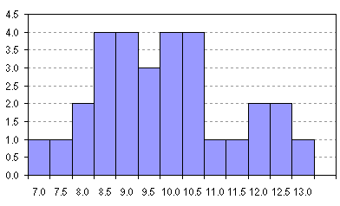

Superpixel + SVM-based Segmentation
Ground Truth
no neighborhood
1 neighborhood
2 neighborhoods
color and texture
histograms
background
benign epithelium
normal stroma
secretion
necrosis
malignant epithelium
desmoplastic stroma
blood

Slide 14
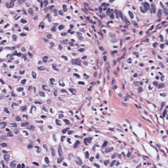
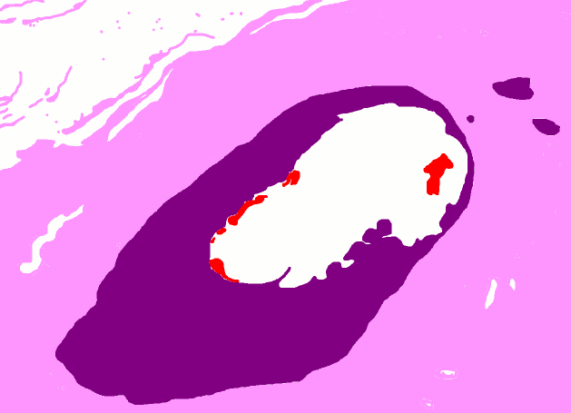
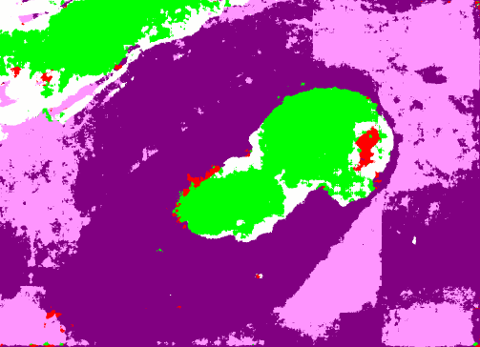

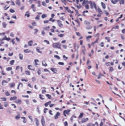

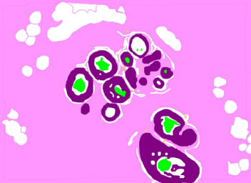
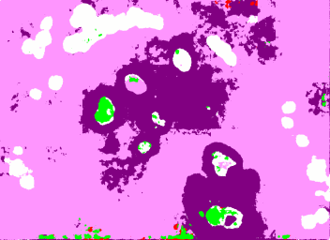
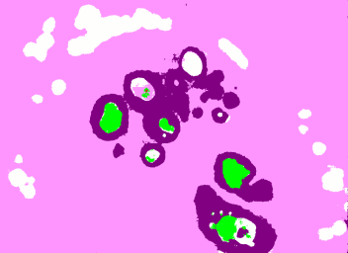

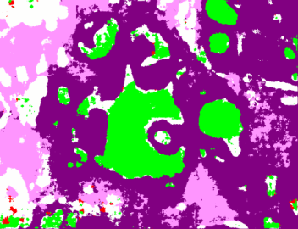
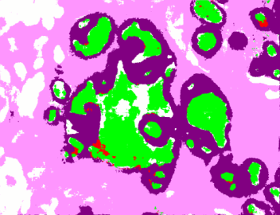




CNN-based Segmentation
Input Image
$$384×384$$
Ground Truth
Plain
Multi-Resolution
$$256×256$$
Encoder-Decoder
Encoder-Decoder
background
benign epithelium
normal stroma
secretion
necrosis
malignant epithelium
desmoplastic stroma
blood
Segmentation
$256×$256

Slide 15
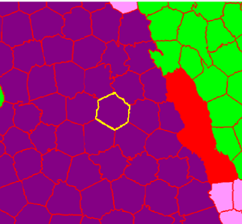


Supervised Tissue Label Segmentation
Superpixel + SVM
CNN
Each superpixel is assigned a class label.
Context: Two circular neighborhoods
Relatively simple model
Faster to train (~3 hours)
Each pixel is assigned a class label.
Context: 256x256 and 384x384 pixel patches
More complex model
~1 week to train on special hardware

Slide 16
Results
Mean F₁-score
SP+SVM | 0.40
CNN | 0.50

Slide 17



Confusion Matrices
Superpixels + SVM
CNN

Slide 18








Segmentation Results
RGB
Ground Truth Labels
SVM Predictions
CNN Predictions
background
benign epi
normal stroma
secretion
necrosis
malignant epi
desmoplastic stroma
blood

Slide 19
Segmentation Summary
Tissue-label segmentation is a useful abstraction.
We developed a set of 8 tissue labels and collected pixel-label data from a pathologist on 58 ROIs.
We trained two models: SVM and CNN
CNNs performed significantly better than SVMs both quantitatively and qualitatively.

Slide 20
Automated Diagnosis of ROIs
Diagnostic errors are alarmingly high for pre-invasive lesions of the breast.
In the digiPATH study, the agreement between pathologists and experts for the atypia cases is only 48%.
Novel image features for diagnosis can help
  develop computer aided diagnosis systems, and
  study the reasons for diagnostic errors.

Slide 21

Superpixel Label
Frequency and Co-occurrence Histograms
Frequency Histogram
Co-occurrence Histogram
stroma
necrosis
bg-bg
epi-bg
nec-bg
nec-str
secretion
epi-epi
secr-bg
secr-epi
secr-str
nec-epi
nec-nec
epithelium
secr-secr
nec-secr
background
stroma-bg
stroma-epi
stroma-stroma

Slide 22




Diagnostic Classification
Benign
Atypia
DCIS
Invasive
N=428
Invasive
DCIS
Atypia
Benign
N=36
N=162
N=128
N=102
4-class classification

Slide 23
Diagnostic Classification
Benign
Atypia
DCIS
Invasive
N=428
Invasive
Benign
Atypia
DCIS
N=392
N=36
Atypia
DCIS
Benign
N=290
N=102
1-diagnosis-at-a-time
mimicking pathologists
DCIS
Atypia
N=162
N=128

Slide 24
Experiments
We subsampled the training data for a uniform distribution of all classes.
We trained SVMs with different features.
We also trained CNNs.
We ran 10-fold cross-validation experiments for the 4 classification tasks:
All
All
All
All
Benign
Invasive
Invasive
Non-invasive
Invasive
Non-invasive
Invasive
Non-invasive
Atypia
DCIS
Atypia or DCIS
Benign
Atypia or DCIS
Benign
Atypia or DCIS
Benign
DCIS
Atypia
DCIS
Atypia
DCIS
Atypia

Slide 25
Results: 4-Class Diagnosis
All
Benign
Invasive
Atypia
DCIS
 | Accuracy
Our system SVM no background | 0.39
Our system CNN all labels | 0.46
Pathologists | 0.61

Slide 26
Results: Invasive vs. Non-invasive
All
Invasive
Non-invasive
Atypia or DCIS
Benign
DCIS
Atypia
 | Accuracy | Sensitivity | Specificity
Our system SVM no background | 0.62 | 0.15 | 0.97
Our system CNN no background | 0.94 | 0.70 | 0.95
Pathologists | 0.98 | 0.84 | 0.99

Slide 27
Results: Atypia-DCIS vs. Benign
All
Invasive
Non-invasive
Atypia or DCIS
Benign
DCIS
Atypia
 | Accuracy | Sensitivity | Specificity
Our system CNN nb ns | 0.60 | 0.94 | 0.39
Our system SVM all labels | 0.70 | 0.79 | 0.41
Pathologists | 0.81 | 0.72 | 0.62

Slide 28
Results: DCIS vs. Atypia
All
Invasive
Non-invasive
Atypia or DCIS
Benign
DCIS
Atypia
 | Accuracy | Sensitivity | Specificity
Our system SVM nb ns | 0.72 | 0.70 | 0.76
Our system CNN nb ns | 0.83 | 0.88 | 0.78
Pathologists | 0.80 | 0.70 | 0.82

Slide 29
Diagnostic Summary
Image features to describe the diagnostically important visual characteristics:
  superpixel label frequency and co-occurrence histograms
Comparable performance to pathologists
  Accuracies 0.94 for invasive, 0.70 for Atypia-DCIS vs. Benign and 0.83 for DCIS vs atypia.

Slide 30
Conclusions and Future Work
We have developed a system that performs semantic segmentation and diagnosis of whole slide breast biopsy images.
The initial system obtains of 0.94 for invasive, 0.70 for Atypia-DCIS vs. Benign and 0.83 for DCIS vs atypia.
We have also designed a new Structure Feature to be published soon that can increase the DCIS vs. atypia accuracy.
We are also experimenting with simultaneous segmentation and diagnostic classification to improve both levels.

