Slide 1
Efficient and Accurate Mitosis Detection: A Lightweight RCNN Approach
Yuguang Li², Ezgi Mercan¹
Stevan Knezevitch³,
Joann G. Elmore⁴, Linda G. Shapiro¹
1 Paul G. Allen School of Computer Science and Engineering, University of Washington 2 Department of Electrical Engineering, University of Washington 3 Pathology Associates 4 Department of Medicine, University of Washington

Slide 2
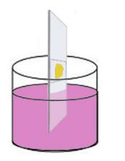
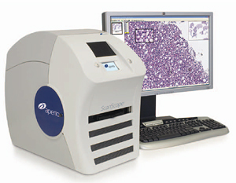
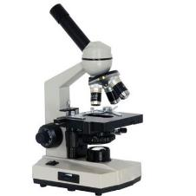
Medical Diagnosis of Cancer
tissue specimen
H&E staining
glass slide
light microscope
whole slide imaging

Slide 3
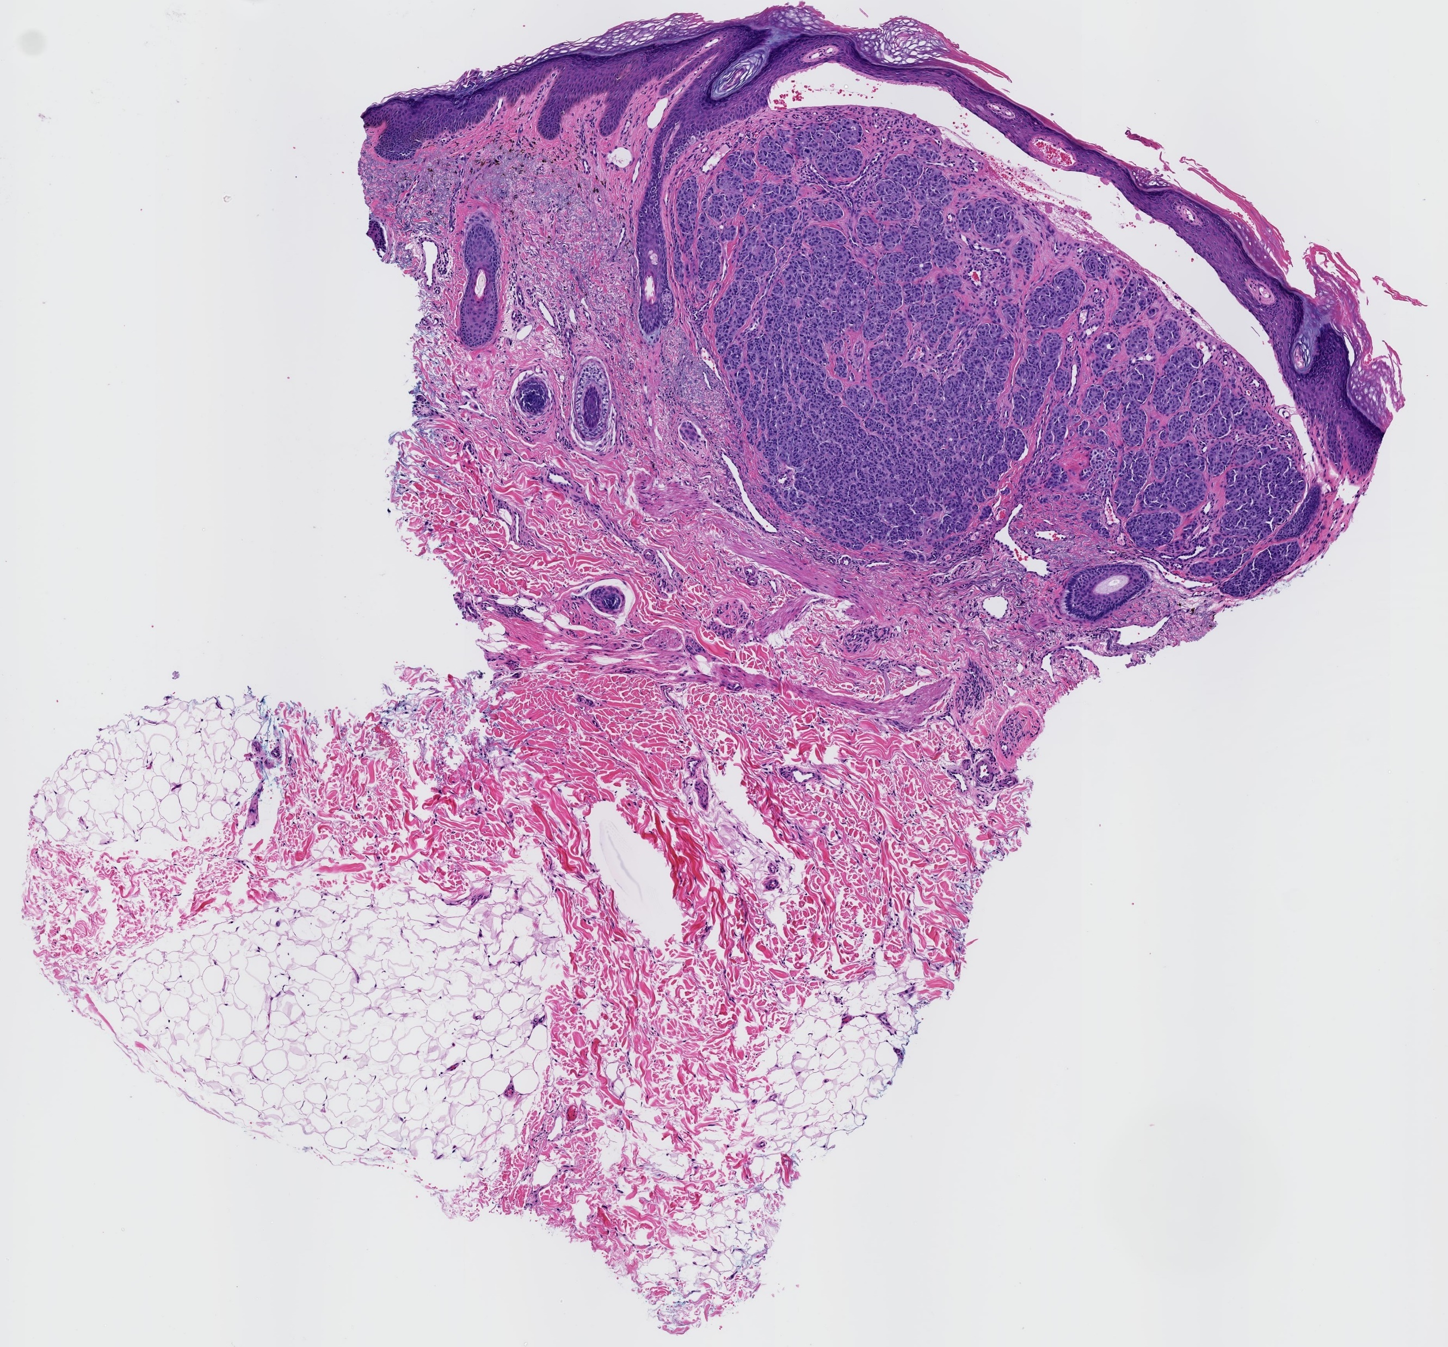
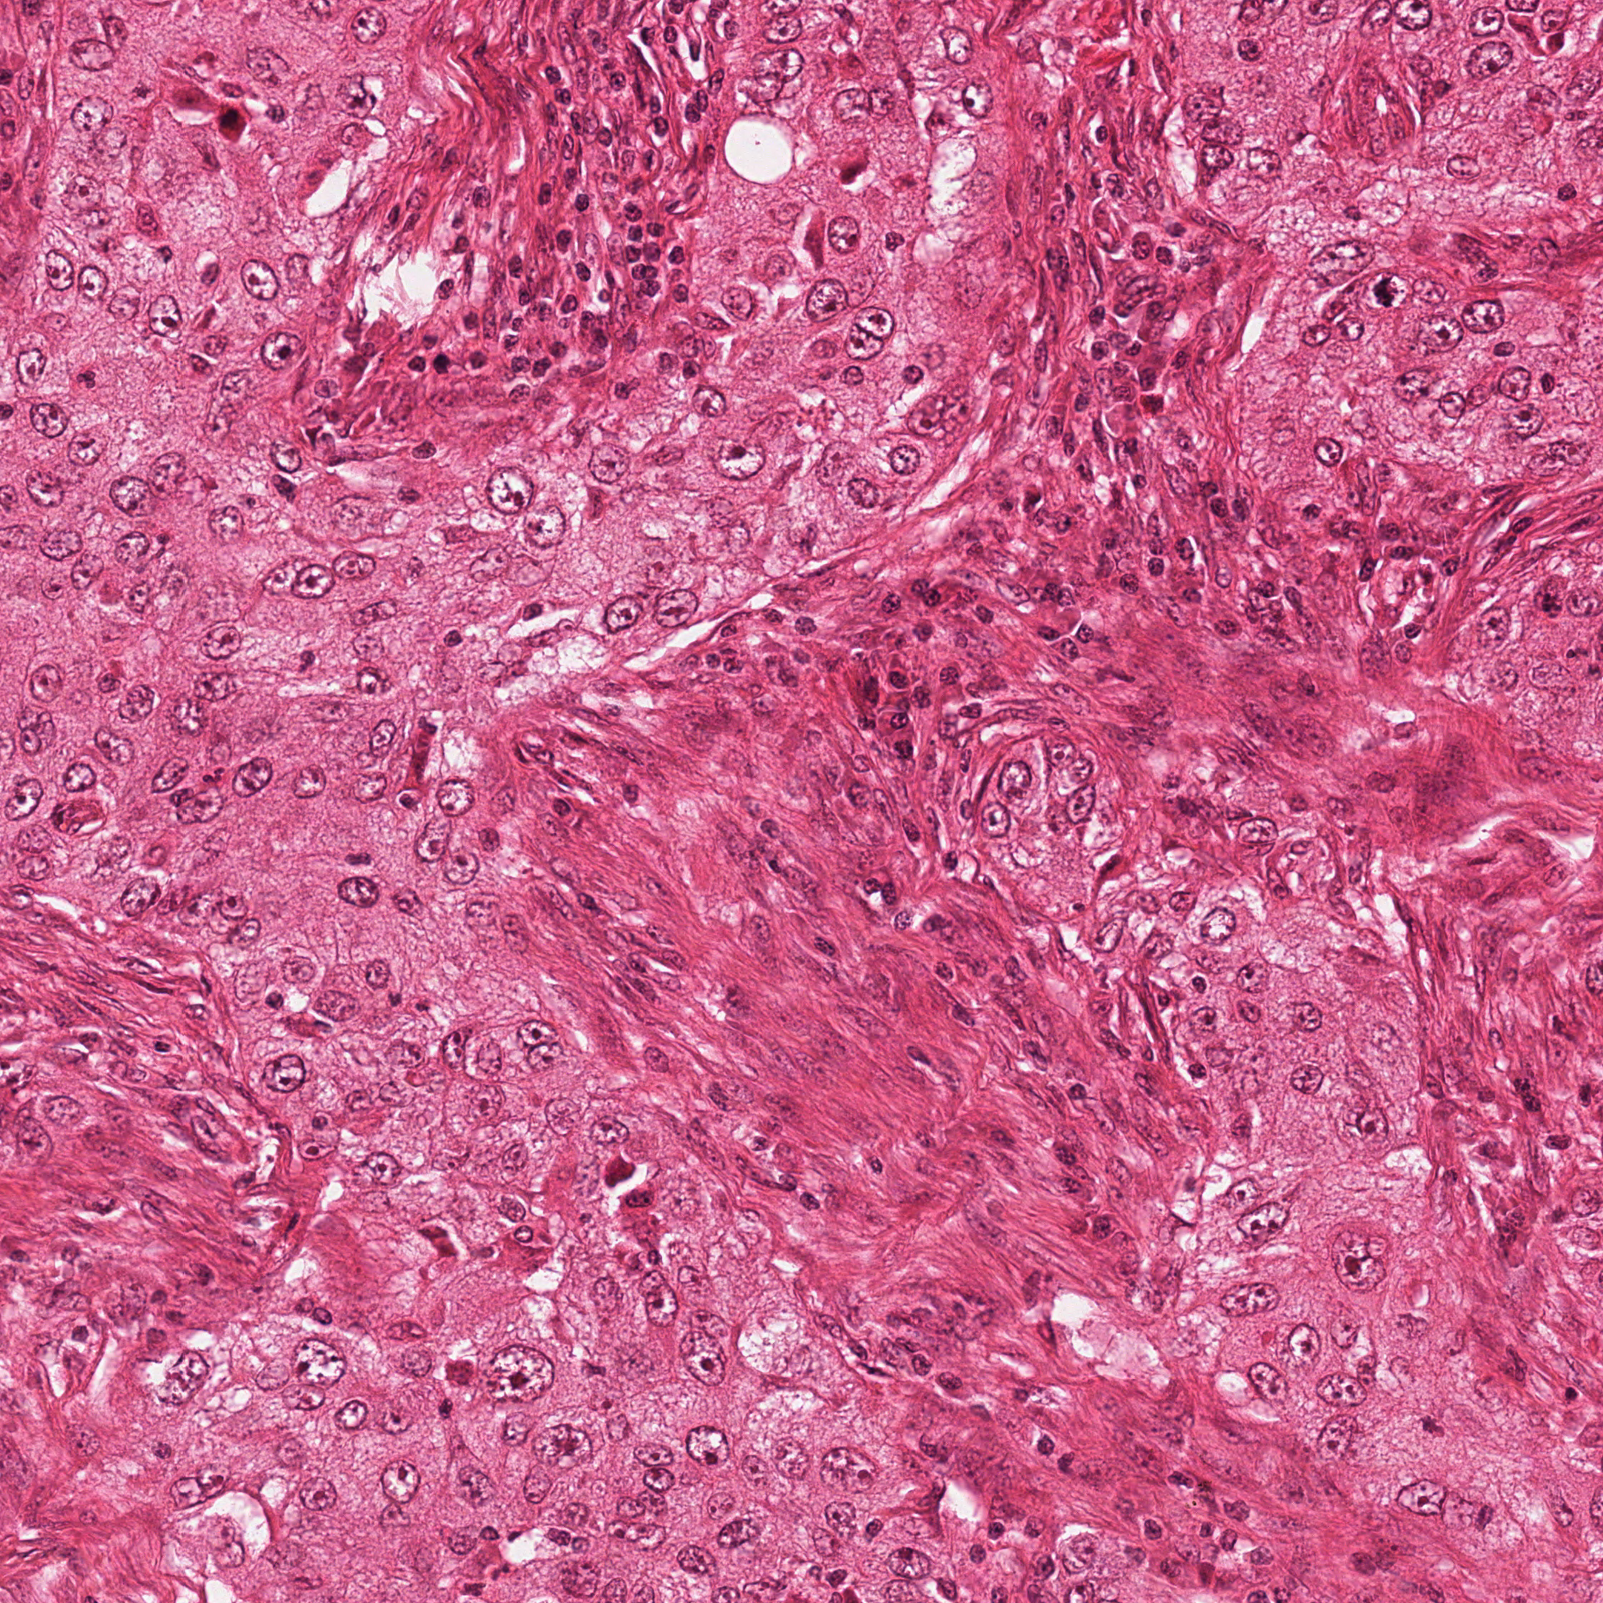
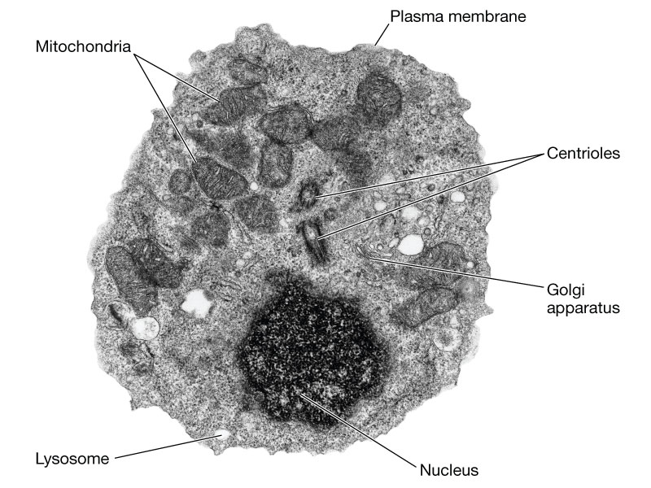
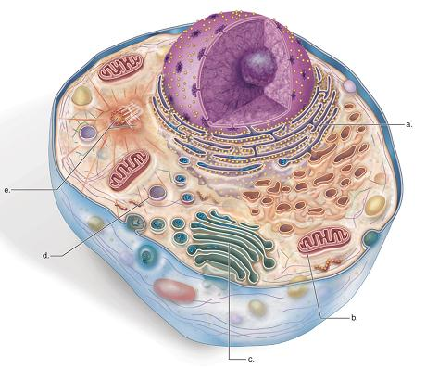
Mitotic Figures
Terminology:
Histopathological Images
Whole Slide
Tissue Staining
Scale x10
Whole Image Slides
Scale x40
Region of Tumor
Region of Interest
Cell
Mitosis

Slide 4
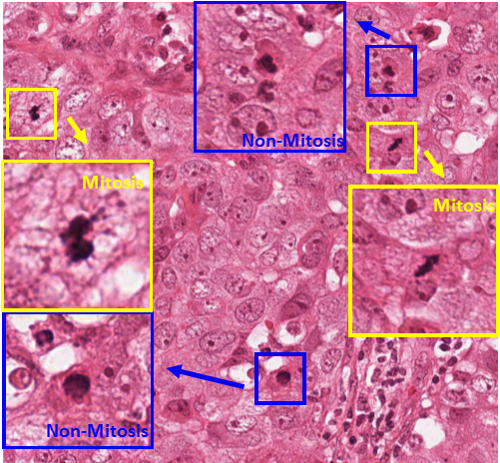
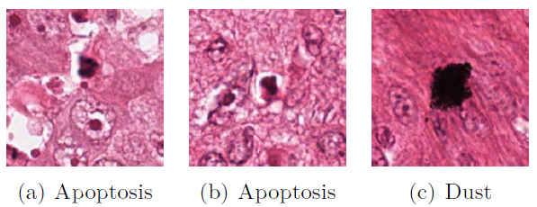
Objective: Counting Mitotic Figures
Challenges:
Small objects with a large variety of shape configurations & texture variation
Low frequency
Similarity with other types of nuclei
Mitosis
Non-Mitosis

Slide 5
Datasets
ICPR 2012
Training: 15 images & 100 mitoses
Test: 35 images & 200 mitoses
Image size is 2084 x 2084 pixel
ICPR 2014
Training 1200 images
Test: 496 images
Image size is 1539 x 1539 pixel
Probabilistic mitotic figure labels
Images from a large number of different biopsies

Slide 6
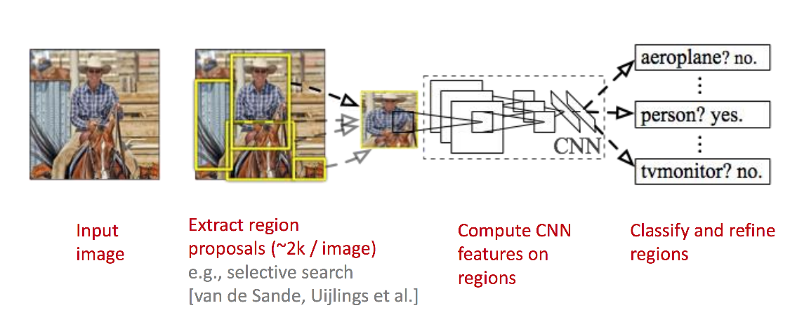
Region-based Convolutional Neural Network

Slide 7
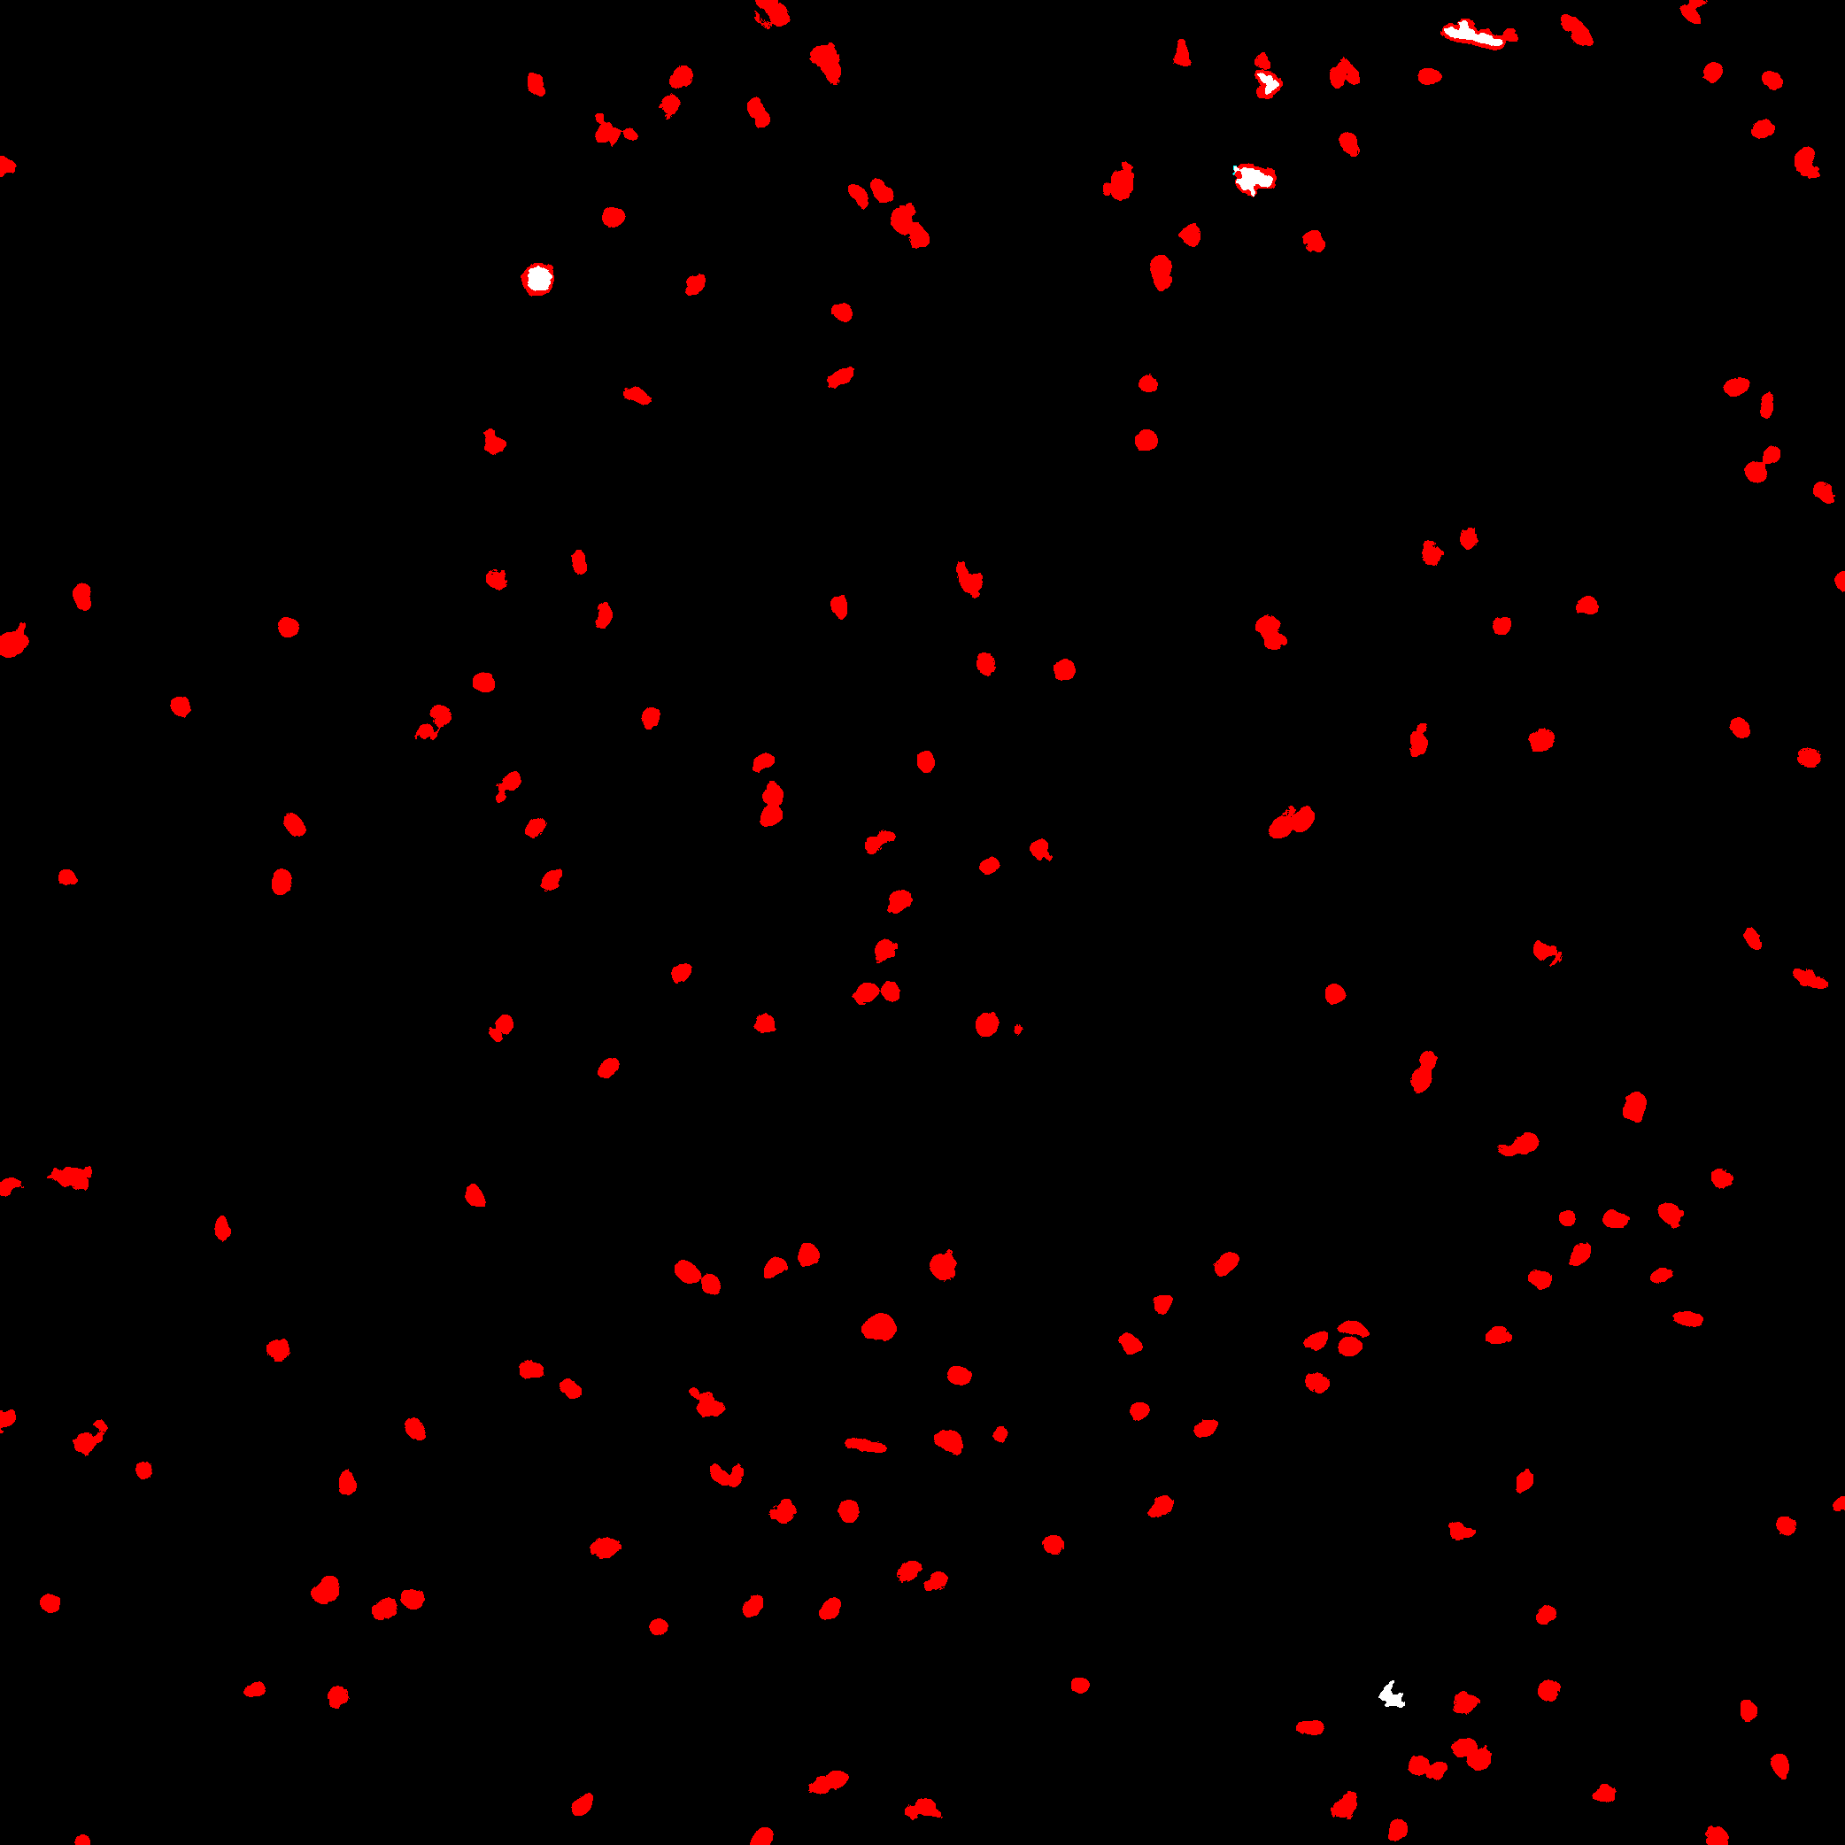
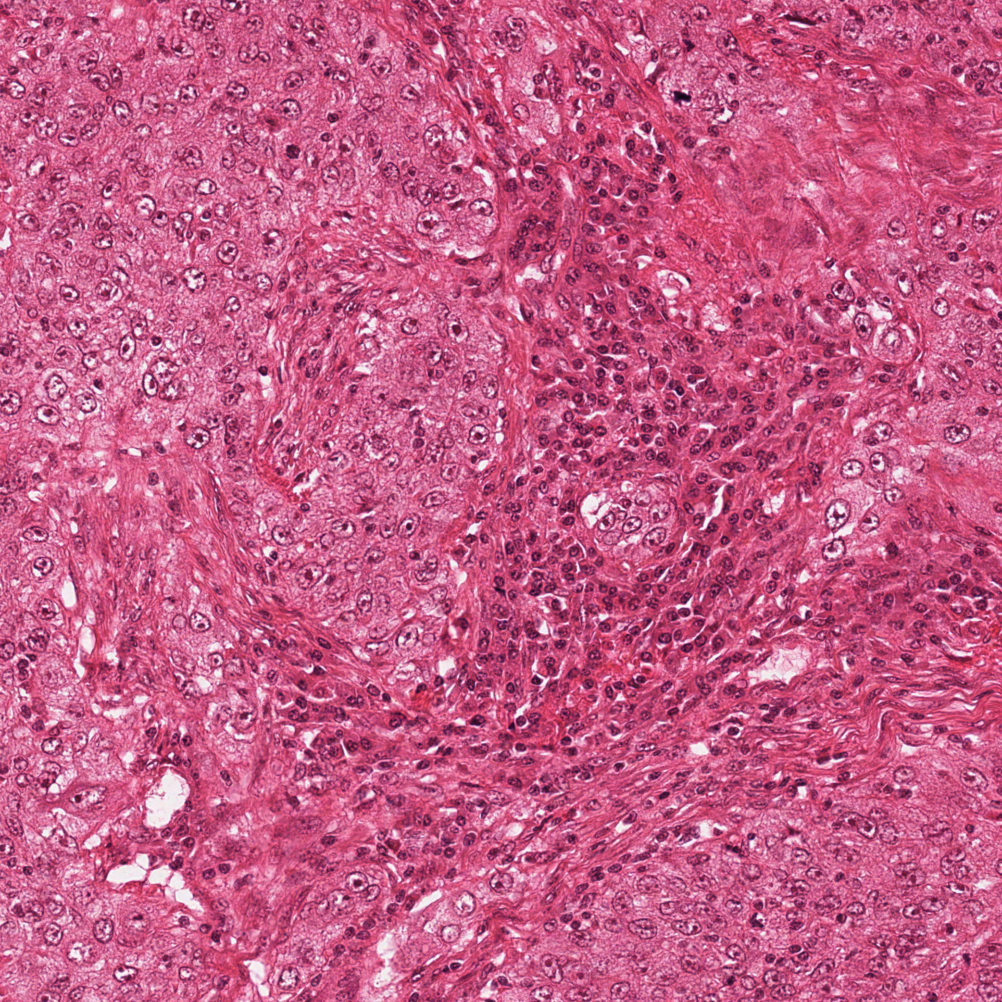
Motivation for the RCNN Work
Training Efficiency
Testing Efficiency
CNN (Caffe library)
CNN(5-pixel scanning interval)
 | ICPR12 Initial Set | ICPR12 Augmented Set
 | NVIDIA K40 | NVIDIA K40 | CPU
10-layer CNN | 40 min. | 8 hrs. | 20hrs
12-layer CNN | 2 hrs. | 12 hrs. | 45hrs
Image tested with 8 rotations:
24min per image with CPU
Lots of unnecessary scans!!!
CNN + feature-based Method
Random forest classifier is trained in less than 1 minute with extracted features on a CPU machine.

Slide 8
Mitosis Detection Pipeline
Stage 1: The CCE extracts
pixel-wise features at
different scales and
classifies each pixel as
possibly mitosis or not
Stage 3: The FMP uses
the same CNN to check
multiple pixels and also
multiple rotations.
Stage 2: The FCE uses a
CNN to check a fixed size
region centered at each
positive pixel to decide if
it is a possible mitosis.

Slide 9
Stage 1: Coarse Candidate Extractor
37 multi-scale features
Color (pixel values in Gaussian-smoothed color images)
Edge (Gaussian Gradient Magnitude, Gaussian Gradient Magnitude, Laplacian of Gaussian and Difference of Gaussian)
Texture (Structure Tensor Eigenvalues and Hessian of Gaussian Eigenvalues)
Feature selection to reduce 37 to 10.
Random forest classifier with six trees uses the 10 features to label pixels as mitotic candidate or not.

Slide 10
Selected 10 Features

Slide 11
Stage 2: Fine Candidate Extractor
Uses a CNN model trained using the ground truth training data provided by the organizers of the ICPR12 and ICPR 14 contests.
We color normalized it according to a color transfer method described in Reinhard et al. 2001.
Each pixel of each training image is labeled a mitosis if it is a pixel of a mitotic region and within 8 µm of the centroid.
For ICPR14 data, which is probabilistic, only mitotic regions with probability > 0.6 were used.
The two stage sampling techniques from Ciresan et al 2013 were used to build the final training image sample set.

Slide 12
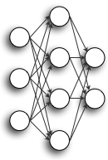
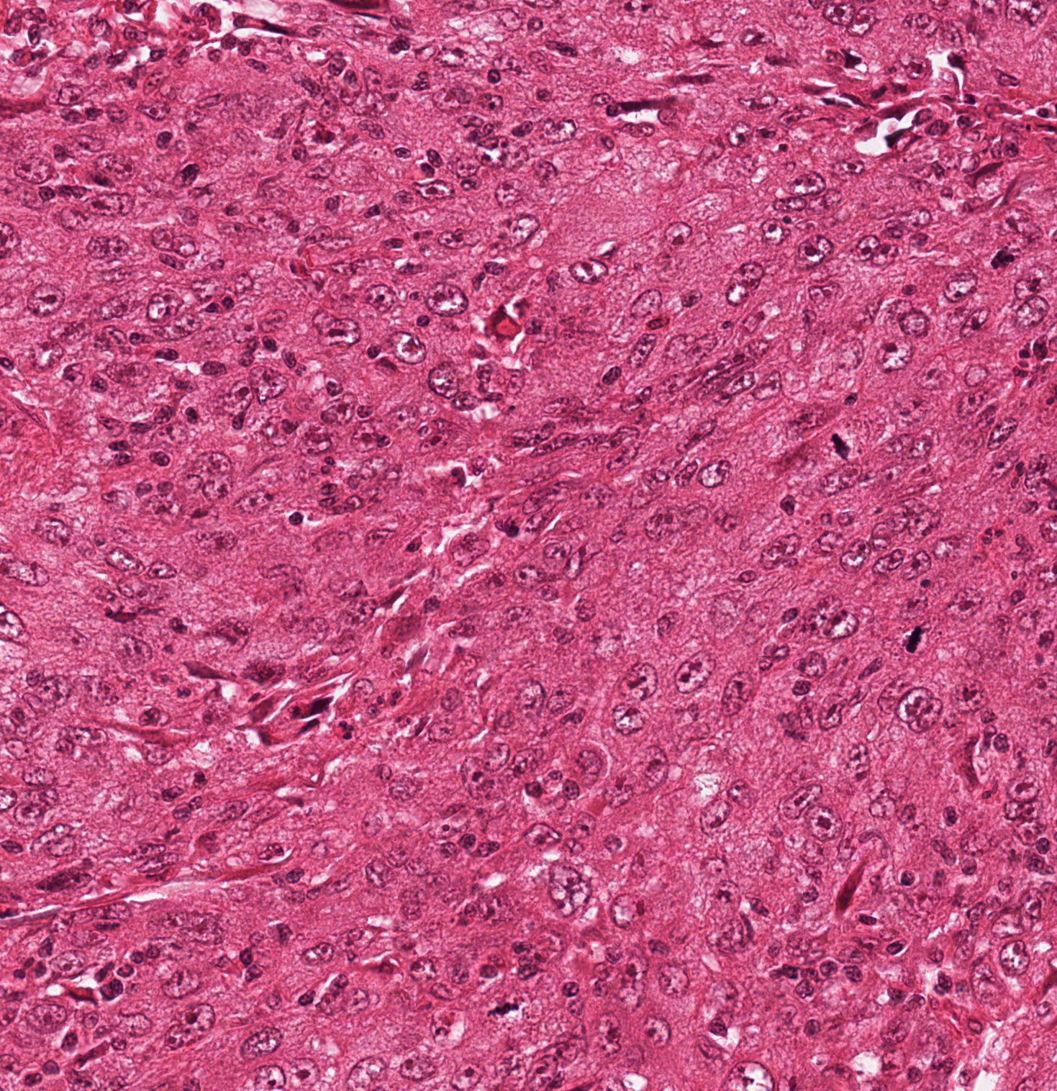
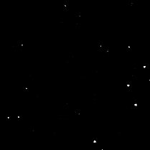
CNN Structure
12-layer CNN Model
Layer | Type | Neurons | Filter Size
0 | Input | 3M x 101 x 101 | --
1 | Conv | 16M x 100 x 100 | 2 x 2
2 | MaxPool | 16M x 50 x 50 | 2 x 2
3 | Conv | 16M x 48 x 48 | 3 x 3
4 | MaxPool | 16M x 24 x 24 | 2 x 2
5 | Conv | 16M x 22 x 22 | 3 x 3
6 | MaxPool | 16M x 11 x 11 | 2 x 2
7 | Conv | 16M x 10 x 10 | 2 x 2
8 | MaxPool | 16M x 5 x 5 | 2 x 2
9 | Conv | 16M x 4 x 4 | 2 x 2
10 | MaxPool | 16M x 2 x 2 | 2 x 2
11 | FullyConn | 100 | 1 x 1
12 | FullyConn | 2 | 1 x 1
RGB Patch Input
CNN Classifier
Probability
Testing method: Sliding Window
Original Image
Probability Map

Slide 13
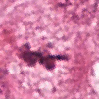
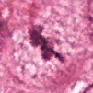
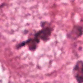
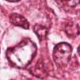
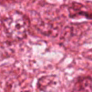
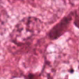
Training the CNN
Objective: Train a classifier to detect the mitosis at the center of a patch.
Challenges:
Very few positive samples: Only 200 mitoses in training set.
Trained classifier needs to be rotational and shift invariant.
Solutions:
We used random rotation, shift and mirroring to augmented the positive training samples.
In the first stage, we are using 66000 mitosis and 66000 non-mitosis patches in training samples.
Non-mitosis samples are randomly selected from the non-mitosis areas.
Augmented Training Samples:
Test samples:

Slide 14
Training the CNN
Sampling Probability Map
Step 1: Initial training set
66000 Mitosis
66000 Non-mitosis
Positive Samples: Apply rotations and shifts on 200 mitosis.
Negative Samples: Randomly sampled from the non-mitosis pixels.
Have the classifier learn difficult samples.
Step 2: Augmented training set
66000 Mitosis
1million Non-mitosis
Positive Samples: Same samples as above
Negative Samples: Use the probability of false positive samples from last step as sampling probabilities to create a lot more difficult samples.

Slide 15
Testing process
Accuracy from CNN Model with/ without 8 direction Average
Original Input Image
 | Precision | Recall | F-Score
Single Direction | 0.78 | 0.74 | 0.76
8-direction Average | 0.78 | 0.79 | 0.78
Ciresan et al | 0.88 | 0.70 | 0.78
Rotate 90° with/ without mirroring (8 images)
Accuracy from CNN Model with different thresholds
8 CNN predictions
Threshold Values | Precision | Recall | F-Score
0.5 | 0.69 | 0.86 | 0.77
0.6 | 0.73 | 0.84 | 0.77
0.7 | 0.78 | 0.79 | 0.78
0.8 | 0.84 | 0.73 | 0.78
0.9 | 0.87 | 0.70 | 0.78
Average Probability
Final Label from thresholding

Slide 16
Stage 3: Final Mitosis Predictor
Inputs the binary image produced by the FCE and uses the same trained CNN, but in a sequence of scans of multiple different pixels of the input image.
Each pixel that passes Stage 2 leads to a detailed search of a region around it for evidence of a mitotic figure.
A spiral scan path carries out this detailed search.
Pixels that pass Stage 2 become the centers for the first scan in Stage 3 at an intermediate threshold.
If a pixel in the first scan passes, the system goes into a finer scanning mode at a final threshold.

Slide 17
Scan path of final mitosis classifier

Slide 18
Results on ICPR 2012 and 2014 Datasets: Accuracy

Slide 19
Results on ICPR 2012 and 2014 Datasets: Efficiency
Performance comparison between Stages 2 and 3 of our pipeline and the fine discrimination model of Chen’s pipeline (Chen et al., 2016) for inference on 4Mpixels HPF images from the ICPR12 dataset.

Slide 20
Conclusions
We proposed a hybrid mitosis detection pipeline which combine efficient handcrafted feature-based pixel classifiers and CNNs in multi-stage pipelines.
Compared to the state-of-the-art methods, our approach reduced the computation amounts and hardware requirements, which makes it more practical in clinical applications.

