Slide 1
File Systems

Slide 2
Main Points
File layout
Directory layout

Slide 3
File System Design Constraints
For small files:
Small blocks for storage efficiency
Files used together should be stored together
For large files:
Contiguous allocation for sequential access
Efficient lookup for random access
May not know at file creation
Whether file will become small or large

Slide 4
File System Design
Data structures
Directories: file name -> file metadata
Store directories as files
File metadata: how to find file data blocks
Free map: list of free disk blocks
How do we organize these data structures?
Device has non-uniform performance

Slide 5
Design Challenges
Index structure
How do we locate the blocks of a file?
Index granularity
What block size do we use?
Free space
How do we find unused blocks on disk?
Locality
How do we preserve spatial locality?
Reliability
What if machine crashes in middle of a file system op?

Slide 6
File System Design Options
 | FAT | FFS | NTFS
Index structure | Linked list | Tree (fixed, assym) | Tree (dynamic)
granularity | block | block | extent
free space allocation | FAT array | Bitmap (fixed location) | Bitmap (file)
Locality | defragmentation | Block groups + reserve space | Extents Best fit defrag

Slide 7
Named Data in a File System

Slide 8
Microsoft File Allocation Table (FAT)
Linked list index structure
Simple, easy to implement
Still widely used (e.g., thumb drives)
File table:
Linear map of all blocks on disk
Each file a linked list of blocks

Slide 9
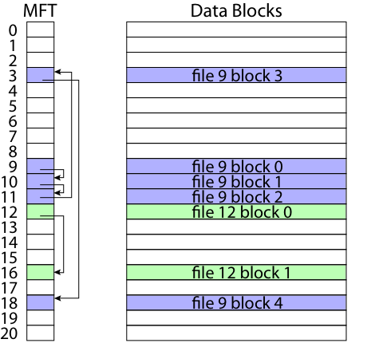
FAT

Slide 10
FAT
Pros:
Easy to find free block
Easy to append to a file
Easy to delete a file
Cons:
Small file access is slow
Random access is very slow
Fragmentation
File blocks for a given file may be scattered
Files in the same directory may be scattered
Problem becomes worse as disk fills

Slide 11
Berkeley UNIX FFS (Fast File System)
inode table
Analogous to FAT table
inode
Metadata
File owner, access permissions, access times, …
Set of 12 data pointers
With 4KB blocks => max size of 48KB files

Slide 12
FFS inode
Metadata
File owner, access permissions, access times, …
Set of 12 data pointers
With 4KB blocks => max size of 48KB files
Indirect block pointer
pointer to disk block of data pointers
Indirect block: 1K data blocks => 4MB (+48KB)

Slide 13
FFS inode
Metadata
File owner, access permissions, access times, …
Set of 12 data pointers
With 4KB blocks => max size of 48KB
Indirect block pointer
pointer to disk block of data pointers
4KB block size => 1K data blocks => 4MB
Doubly indirect block pointer
Doubly indirect block => 1K indirect blocks
4GB (+ 4MB + 48KB)

Slide 14
FFS inode
Metadata
File owner, access permissions, access times, …
Set of 12 data pointers
With 4KB blocks => max size of 48KB
Indirect block pointer
pointer to disk block of data pointers
4KB block size => 1K data blocks => 4MB
Doubly indirect block pointer
Doubly indirect block => 1K indirect blocks
4GB (+ 4MB + 48KB)
Triply indirect block pointer
Triply indirect block => 1K doubly indirect blocks
4TB (+ 4GB + 4MB + 48KB)

Slide 15
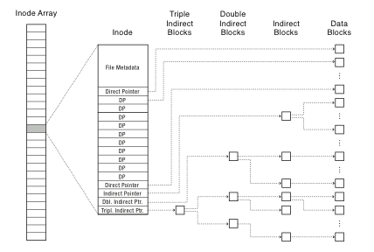

Slide 16
FFS Asymmetric Tree
Small files: shallow tree
Efficient storage for small files
Large files: deep tree
Efficient lookup for random access in large files
Sparse files: only fill pointers if needed

Slide 17
FFS Locality
Block group allocation
Block group is a set of nearby cylinders
Files in same directory located in same group
Subdirectories located in different block groups
inode table spread throughout disk
inodes, bitmap near file blocks
First fit allocation
Small files fragmented, large files contiguous

Slide 18
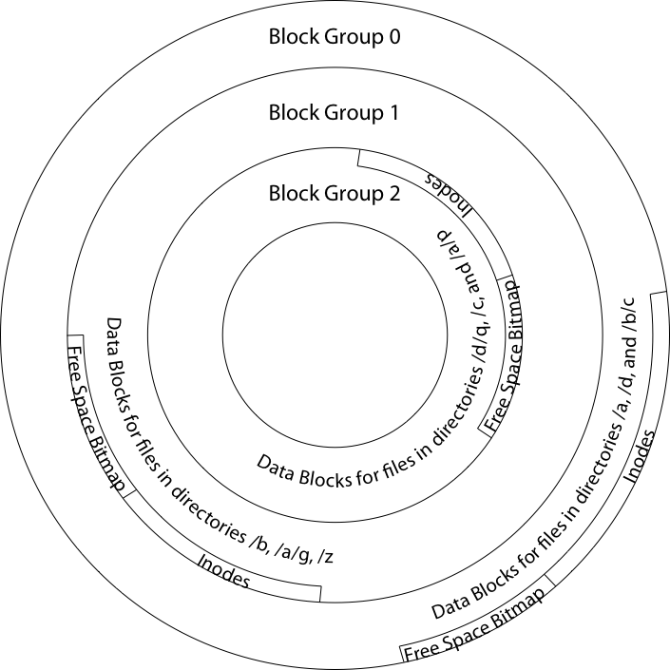

Slide 19
FFS First Fit Block Allocation

Slide 20
FFS First Fit Block Allocation

Slide 21
FFS First Fit Block Allocation

Slide 22
FFS
Pros
Efficient storage for both small and large files
Locality for both small and large files
Locality for metadata and data
Cons
Inefficient for tiny files (a 1 byte file requires both an inode and a data block)
Inefficient encoding when file is mostly contiguous on disk (no equivalent to superpages)
Need to reserve 10-20% of free space to prevent fragmentation

Slide 23
NTFS
Master File Table
Flexible 1KB storage for metadata and data
Extents
Block pointers cover runs of blocks
Similar approach in linux (ext4)
File create can provide hint as to size of file
Journalling for reliability
Next chapter

Slide 24
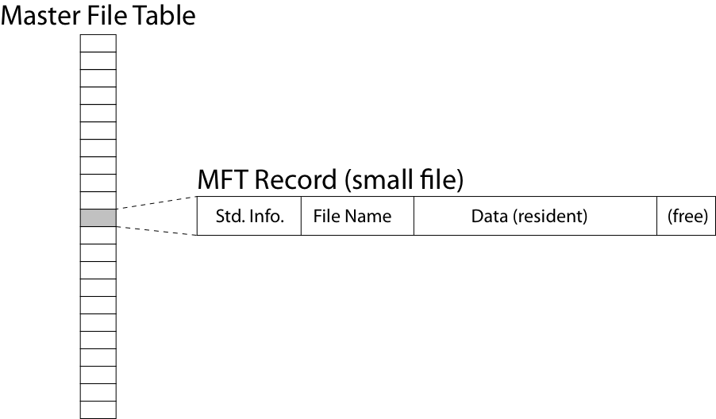
NTFS Small File

Slide 25
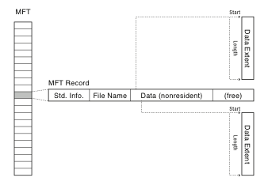
NTFS Medium-Sized File

Slide 26
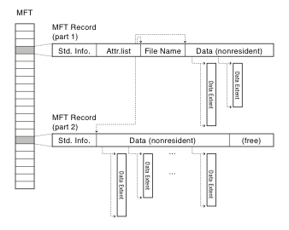
NTFS Indirect Block

Slide 27
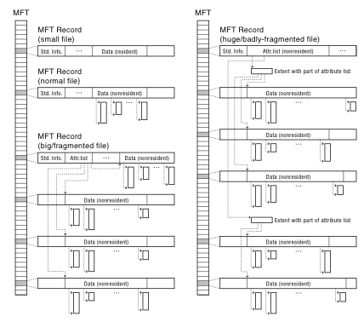

Slide 28
Named Data in a File System

Slide 29
Directories Are Files

Slide 30
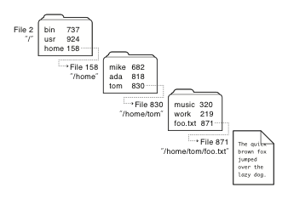
Recursive Filename Lookup

Slide 31
Directory Layout
Directory stored as a file
Linear search to find filename (small directories)

Slide 32
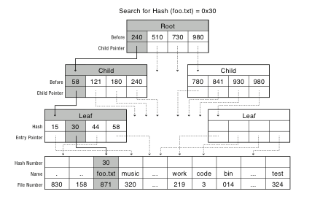
Large Directories: B Trees

Slide 33
Large Directories: Layout

