Slide 1
Ready-For-Use: 3 Weeks of Parallelism and Concurrency in a Required 2nd-Year Data-Structures Course
Dan Grossman
University of Washington
2010 Workshop on Curricula for Concurrency and Parallelism

Slide 2
Executive Summary
2.5 week unit introducing threads + shared memory
As of 2010, in our required core: this really exists!
Key ideas
Natural fit in 2nd-year data-structures course
Instructors need not be experts
Parallelism first, concurrency second
High-level view: Java, lightweight threads
Full materials available
Reading notes, slides, homeworks, etc.
Coherent approach on what is [not] introduced
http://www.cs.washington.edu/homes/djg/teachingMaterials/

Slide 3
Outline
Why 3 weeks and why 2nd-year data structures
Complements senior-level courses
Guiding principles
Quick tour of some topics
Status and materials available

Slide 4
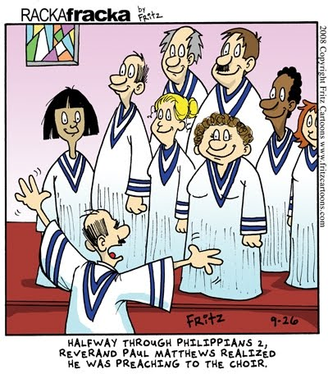
Preaching to the choir
Dear Choir,
Let’s teach tons of
parallelism/concurrency
Including your pet paradigms,
examples, and complications
No need to discuss how this fits into the curriculum or what we
should remove to make room
Amen

Slide 5
A broader view
Curriculum design [for 2nd-year courses]
Coordinate broad, brilliant colleagues
“Least common denominator” isn’t perjorative
Very different from creating a great course in your area
Nothing wrong with great courses too
But still the choir pleads…
Multicore must be the thing that deserves more coverage

Slide 6
Trade-offs
Do I believe every computer-science undergraduate needs to be prepared for the multicore era?
Absolutely. But what about:
Web-client programming
Cloud computing
Software security
Software process
UI design and HCI
Machine learning
Embedded systems
Technical writing
Business
Co-op experience(s)
Foreign language
Shakespeare, Freud, Darwin, …
And of course everything
we already require

Slide 7
Curriculum overview
CS1
“300-level”
CS2
“400-level”
Pertinent detail:
Quarter system =
10-week courses
3 terms / year
capstone
design

Slide 8
Why not intro?
CS1
CS1:
Variables, conditionals, loops, arrays, methods, I/O, …
2000 students / year
12% become majors
Also taught at community colleges
CS2

Slide 9
Why not intro?
CS1
CS2:
Recursion, linked lists, binary search trees, OOP, …
900 students / year
25% become majors
Also taught at community colleges
CS2
Bottom line: At best hope to de-emphasize sequential thinking

Slide 10
Why not [only] 400-level?
CS1
“300-level”
“400-level”
Senior year:
Too late
Too specialized
Too redundant
Rely on concepts throughout
CS2
capstone
design

Slide 11
New 300-level
required
Software
Design
Data
Structures
Big
Data
CS required
CompE required
recommended
Discrete
Math ++
Prob/Stats
P vs. NP
Systems
Prog.
Hw/Sw
Interface
Hardware
Design
Prog.
Languages
(Note: reality slightly
more complex)
Bottom line: 3 weeks required is a lot

Slide 12
“Data Abstractions” [vacuous name]
Catalog description:
Abstract data types and structures including dictionaries, balanced trees, hash tables, priority queues, and graphs; sorting; asymptotic analysis; fundamental graph algorithms including graph search, shortest path, and minimum spanning trees; concurrency and synchronization; and parallelism

Slide 13
Old vs. New
Old and new: 20 lectures
Big-Oh, Algorithm Analysis
Binary Heaps (Priority Qs)
AVL Trees
B Trees
Hashing
Sorting
Graph Traversals
Topological Sort
Shortest Paths
Minimum Spanning Trees
Amortization

Slide 14
Old vs. New
Old and new: 20 lectures
Big-Oh, Algorithm Analysis
Binary Heaps (Priority Qs)
AVL Trees
B Trees
Hashing
Sorting
Graph Traversals
Topological Sort
Shortest Paths
Minimum Spanning Trees
Amortization
Removed: 8 lectures
D-heaps
Leftist heaps
Skew heaps
Binomial queues
Splay trees ☹
Disjoint sets ☹
Network flow
Hack job on NP (moves elsewhere)

Slide 15
Old vs. New
Old and new: 20 lectures
Big-Oh, Algorithm Analysis
Binary Heaps (Priority Qs)
AVL Trees
B Trees
Hashing
Sorting
Graph Traversals
Topological Sort
Shortest Paths
Minimum Spanning Trees
Amortization
Added: 8 lectures
Multithreading Basics (1)
Fork-Join Parallelism (3)
Reductions, Prefix, Sorting
Parallelism Analysis
Amdahl’s Law
Concurrency (4)
Races, deadlocks
Locks (mostly)
Condition variables (a bit)
Programming guidelines (!)

Slide 16
Outline
Why 3 weeks and why 2nd-year data structures
Complements senior-level courses
Guiding principles
Quick tour of some topics
Status and materials available

Slide 17
1. Stick with shared memory
1 model enough for 3 weeks
Fits best with rest of course (and Java)
Briefly say other models exist (message-passing, data parallelism)
Unshared:
locals and
control
pc=…
Shared:
objects and
static fields
…
pc=…
pc=…
…
…
…

Slide 18
2. Parallelism before concurrency
Parallelism:
Using extra computational resources to solve a problem faster
work
resources
Concurrency:
Correctly and efficiently managing access to shared resources
requests
resource

Slide 19
Why parallelism first
Structured parallelism is easier to reason about
Only synchronization is join
Race conditions just don’t show up
Focus on algorithms
After comfortable with threads, deal with mutual exclusion, interleavings, etc.
Focus on thread-safe APIs rather than algorithms
Yes, in reality parallelism and concurrency co-mingle
In a 2nd-year course, emphasize the difference
Many separate curriculum topics co-mingle in practice

Slide 20
3. Fork-Join Parallelism
Use “Cilk-style” fork-join parallelism
Tiny fraction of Java’s ForkJoin Framework
(Or C/C++ TBB or C# TPL)
Allows 10,000+ threads (lightweight tasks)
Elegant recursion and robust asymptotic guarantees
But:
Needs sequential cut-off (great in this course!)
A few beginner “gotchas” (see my notes)
Omits memory bandwidth and communication cost

Slide 21
4. Concurrency basics
Focus on:
The need for mutual exclusion
Locks
Programming guidelines for correctness (thread-safety)
Distinguish data races from higher-level races
Briefly touch on other essential topics

Slide 22
5. The client view
Focus entirely on how to use parallelism/concurrency
Not how to implement it
Many topics belong in appropriate 400-level courses (operating systems, architecture, parallel programming, …)
Implementing of (asymptotically optimal) fork-join parallelism
Implementing threads and locks
Scheduling (what, how)
…

Slide 23
Outline
Why 3 weeks and why 2nd-year data structures
Complements senior-level courses
Guiding principles
Quick tour of some topics
Status and materials available

Slide 24
Sum an array
Show then disparage obvious way to use 4 cores for a reduction
ans0 ans1 ans2 ans3
ans
Problems:
Forward-performance: What if there 8 cores?
Dynamic resources: What if O/S takes away a core?
Load imbalance: What if some 1/4 has more work to do?
Many more threads than cores fixes these problems…

Slide 25
Divide-and-conquer
+
+
+
+
+
+
+
+
+
+
+
+
+
+
+
Concepts already in the course:
Divide-and-conquer
Sequential cut-off to eliminate most recursion (constant factors)
Balanced trees have logarithmic height
Easy-ish to implement (“manually”) in ForkJoin Framework

Slide 26
The math, part 1
Already in the course:
DAGs to represent dependencies
Asymptotic complexity
Expected time
T_{P} is O (T₁ / P + T ∞)
(expected time)
divide
base cases
combine results

Slide 27
The math, part 2
Amdahl’s Law is just algebra:
Let S be the portion of the execution that can’t be parallelized
Let T₁ = S + (1-S) = 1
Let (1-S) be perfectly parallelizable
Then T₁ / T_{P} = 1 / (S + (1-S)/P) and T₁ / T∞ = 1 / S
But “feeling the pain” requires plotting curves (homework!)
100x speed-up with 256 cores requires <0.7% sequential

Slide 28
Fancier parallelism
Parallel reductions and maps are the workhorses
But they’re so easy, so show something surprising
Already in course: surprising algorithms like Dijkstra’s
Already in course: building algorithms on top of each other
Parallel prefix → Parallel pack → (Very) Parallel quicksort
input
6
4
16
10
16
14
2
8
output
6
10
26
36
52
66
68
76

Slide 29
Fancier parallelism
Parallel reductions and maps are the workhorses
But they’re so easy, so show something surprising
Already in course: surprising algorithms like Dijkstra’s
Already in course: building algorithms on top of each other
Parallel prefix → Parallel pack → (Very) Parallel quicksort
input
6
4
16
10
16
14
2
8
< 10 ?
output
6
4
2
8

Slide 30
Fancier parallelism
Parallel reductions and maps are the workhorses
But they’re so easy, so show something surprising
Already in course: surprising algorithms like Dijkstra’s
Already in course: building algorithms on top of each other
Parallel prefix → Parallel pack → (Very) Parallel quicksort
input
6
4
16
10
16
14
2
8
output
2
4
6
8
10
14
16
16

Slide 31
Concurrency basics
Switch mindset: loosely coordinated threads + shared objects
Why do this? (Responsiveness, mask latency, …)
Explaining locks:
Naïve attempts at mutual exclusion are wrong
A lock as an ADT with atomic “acquire” and “release”
Then segue to Java’s synchronized
All objects are locks
Implicit release, even with exceptions
Re-entrant
Not explained in terms of monitors

Slide 32
A key distinction
Data races are wrong.
Period. (Can mention volatile.)
Even when they look right – have to be told they’re wrong!
Example “thanks” to my TA:
boolean stop = false;
while(!stop){
// iterative output
}
sleep(10000);
stop = true;
“Data race” is not an illuminating term
Prefer “simultaneous access error”

Slide 33
A key distinction
Bad interleavings depend on the semantics of your interface
Already in course: correct behavior of classic ADTs
Students get good at finding bad interleavings
class Stack<E> {
… /* internal state */ …
synchronized void push(E x){…}
synchronized E pop(){…}
/* unsynchronized */
E peek(){
E ans = pop();
push(ans);
return ans;
}
}

Slide 34
A key distinction
Bad interleavings depend on the semantics of your interface
Students get good at finding bad interleavings
Thread 1 (peek)
Thread 2
E ans = pop();
push(ans);
return ans;
push(x)
push(y)
E e = pop()
Time

Slide 35
Programming idioms
Spend a lecture on basic “rules of thumb”:
Make most data unshared or immutable
Each shared object consistently guarded by some lock
Start with coarse-grained locking where sufficient
Make critical sections as small as possible but not smaller
Don’t roll your own: Use concurrent data structures from experts
Emphasize common idioms and trade-offs
Not prescriptive or religious on methodology
But just showing “locks exist” is not enough

Slide 36
Other topics
Reader/writer locks
Fit well with “rare-insertion” hashtables
Fit well with simultaneous read/read is not a data race
Deadlock
Condition variables
Or some easier-to-use form of passive waiting
Fit well with semantics of a queue

Slide 37
Outline
Why 3 weeks and why 2nd-year data structures
Complements senior-level courses
Guiding principles
Quick tour of some topics
Status and materials available

Slide 38
Status
Spring 2010: Taught by me
“Every educational experiment is doomed to succeed”
Summer 2010: Taught by the Spring 2010 TA
This great success is a very good sign
2010-2011 academic year: Instructors 3, 4, and 5
Data structures was already a very popular course
And students really like the parallelism and concurrency

Slide 39
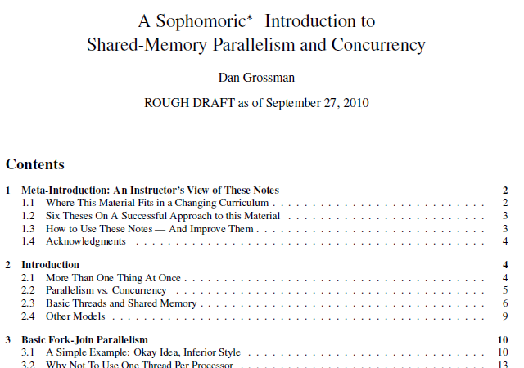
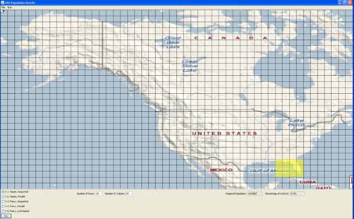
What I’ve got
60 pages of reading notes for students (and instructors!)
PowerPoint
Homework problems
Java ForkJoin for beginners
Programming project
Sample exam problems

Slide 40
Conclusions
3 weeks of material seems about right for sophomores
The choir can always add more
Data structures is the optimal place
Materials designed for adoption by non-experts
If you can teach Dijkstra’s algorithm and B Trees, you can teach parallelism and concurrency
Please provide constructive feedback
And help me advertise
http://www.cs.washington.edu/homes/djg/teachingMaterials/

