Slide 1


Dependent-Test-Aware
Regression Testing Techniques
Wing Lam August Shi Reed Oei
Sai Zhang Michael D. Ernst Tao Xie
{winglam2, awshi2, reedoei2}@illinois.edu
saizhang@google.com
mernst@cs.washington.edu
taoxie@pku.edu.cn
CNS-1564274
CNS-1646305
CNS-1740916
CCF-1763788
CCF-1816615
OAC-1839010
FA8750-12-2-0107
AFRL FA8750-15-C-0010
FA8750-16-2-0032

Slide 2
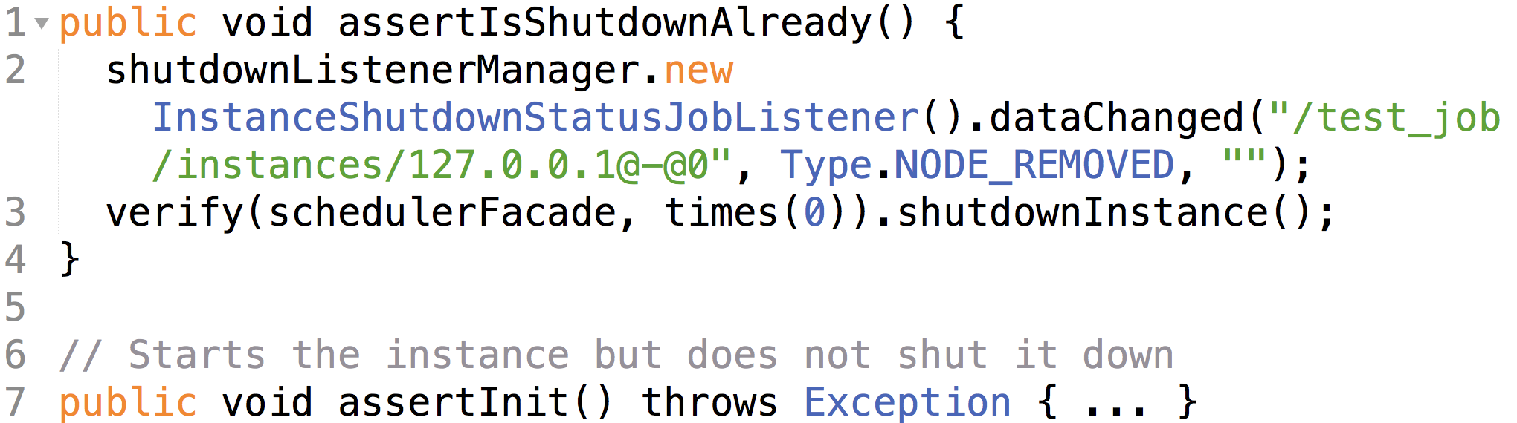
Order-dependent test – Example
A test is flaky if it passes and fails when run in the same test scenario
Order-dependent (OD) tests: flaky only due to the order in which tests run
Example OD test from Apache/ShardingSphere-ElasticJob-Lite (6.1k stars):

Slide 3
Order-dependent test – Example
Line 3 checks that an instance of a class variable is shut down.
But the instance can be started and not shutdown by other tests (Line 7)!
Example OD test from Apache/ShardingSphere-ElasticJob-Lite (6.1k stars):

Slide 4




Order-dependent test – Example
?
?
?
T1
T2
T2
T1
Example OD test from Apache/ShardingSphere-ElasticJob-Lite (6.1k stars):
T1
T2

Slide 5
Why should we care about OD tests?
Make test outcomes inconsistent -> may lead developers to manually debug nonexistent faults in their current changes and rerun tests
Affect regression testing algorithms
T1
T2
T3
Test prioritization
Test parallelization
T1
T2
Test selection
CPU 1:
T2
T1
T3
T3
T3
CPU 2:

Slide 6

Conventional wisdom:
OD tests are not a substantial issue
Our previous work [Zhang et al. ISSTA’14] found that many assumes that there are no OD tests
  Test prioritization
  Test selection
  Test parallelization
  Test generation
  …
Papers in
ICSE, FSE, ISSTA, ASE,
ICST, TSE, and TOSEM

Slide 7
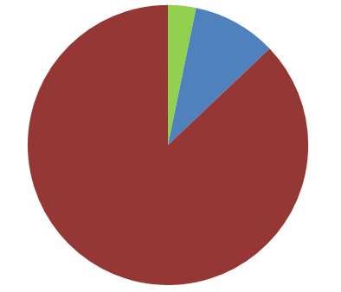
Conventional wisdom:
OD tests are not a substantial issue
Our previous work [Zhang et al. ISSTA’14] found that many assumes that there are no OD tests
  Test prioritization
  Test selection
  Test parallelization
  Test generation
  …
Consider OD tests
As a threat
to validity
3%
10%
31 papers in
ICSE, FSE, ISSTA, ASE,
ICST, TSE, and TOSEM
(2000 – 2013)
87%
Assume no OD test
without justification

Slide 8
Our contributions
Goal: understand the impact of OD tests on regression testing algorithms and how one can make them dependent-test-aware
Study – on how OD tests affect regression testing algorithms (test prioritization, test selection, and test parallelization)
Approach [1] – to enhance regression testing algorithms to be dependent-test-aware
Evaluation – of 12 enhanced regression testing algorithms
  Orders of enhanced algorithms can have 80% fewer OD-test failures, while being only 1% slower
[1] https://sites.google.com/view/flakytestdataset

Slide 9


Methodology
Selected subjects from our previous work [Lam et al. ICST’19] that created dataset of flaky tests
  Human-written test suites
    3,372 tests
  Automatically-generated test suites
    use Randoop [Pacheco et al. ICSE’07]
    18,637 tests
111 (3%) OD tests
11 modules from
8 real-world projects
28 (<1%) OD tests
# of OD tests are small but their impact can be substantial!

Slide 10



Test prioritization
…
…
A test execution order
A new test execution order
Developer’s expectation:
Each test should yield the same result!
Achieve coverage faster
Improve fault detection rate
…
Four test prioritization algorithms [Elbaum et al. ISSTA’00]
Prioritize on # statements covered by tests
Prioritize on # statements not yet covered by tests
Prioritize on # methods covered by tests
Prioritize on # methods not yet covered by tests
Run prioritized order and original order
Record number of OD tests yielding different results

Slide 11
Evaluating test prioritization algorithms
Test prioritization algorithms | # tests that yield different results
Prioritize on # statements covered by tests | 6 (5%)
Prioritize on # statements not yet covered by tests | 22 (20%)
Prioritize on # methods covered by tests | 5 (5%)
Prioritize on # methods not yet covered by tests | 28 (25%)
Union of all algorithms | 26 (23%)
Out of 111 human-written OD tests
Not yet covered algorithms have more OD tests than other ones. Our investigation reveals
Many OD tests fail if one particular test (dependee test) is run before them
In Not yet covered orders, dependee test is inbetween OD tests
In other orders, dependee test always runs after OD tests

Slide 12
Evaluating test prioritization algorithms
Test prioritization algorithms | # tests that yield different results
Prioritize on # statements covered by tests | 6 (5%)
Prioritize on # statements not yet covered by tests | 22 (20%)
Prioritize on # methods covered by tests | 5 (5%)
Prioritize on # methods not yet covered by tests | 28 (25%)
Union of all algorithms | 26 (23%)
Out of 111 human-written OD tests
Modest chance for OD tests to affect test prioritization, human-written tests

Slide 13
Evaluating test prioritization algorithms
Test prioritization algorithms | # tests that yield different results
Prioritize on # statements covered by tests | 20 (71%)
Prioritize on # statements not yet covered by tests | 7 (25%)
Prioritize on # methods covered by tests | 10 (36%)
Prioritize on # methods not yet covered by tests | 12 (43%)
Union of all algorithms | 15 (54%)
Out of 28 automatically-
generated OD tests
High chance for OD tests to affect test prioritization, automatically-generated tests

Slide 14
Test selection
…
…
A test execution order
A subset of the test execution order
Runs faster
…
Six test selection algorithms
[Harrold et al. OOPSLA’01]
Elements | Ordered by
Statement | Test id (no re-ordering)
Statement | # elements covered by tests
Statement | # elements not yet covered by tests
Method | Test id (no re-ordering)
Method | # elements covered by tests
Method | # elements not yet covered by tests
Developer’s expectation:
Each test should yield the same result!
Run selected order and original order
Record number of OD tests yielding different results

Slide 15
Evaluating test selection algorithms
Elements | Ordered by | # tests that yield different results
Statement | Test id (no re-ordering) | 4 (3%)
Statement | # elements covered by tests | 6 (5%)
Statement | # elements not yet covered by tests | 10 (9%)
Method | Test id (no re-ordering) | 1 (1%)
Method | # elements covered by tests | 29 (26%)
Method | # elements not yet covered by tests | 36 (32%)
Combined |  | 27 (24%)
Out of 111 human-written OD tests
Ordering algorithms tend to have more OD tests than no re-ordering ones!

Slide 16
Evaluating test selection algorithms
Elements | Ordered by | # tests that yield different results
Statement | Test id (no re-ordering) | 4 (3%)
Statement | # elements covered by tests | 6 (5%)
Statement | # elements not yet covered by tests | 10 (9%)
Method | Test id (no re-ordering) | 1 (1%)
Method | # elements covered by tests | 29 (26%)
Method | # elements not yet covered by tests | 36 (32%)
Combined |  | 27 (24%)
Out of 111 human-written OD tests
Modest chance for OD tests to affect test selection, human-written tests

Slide 17
Evaluating test selection algorithms
Elements | Ordered by | # tests that yield different results
Statement | Test id (no re-ordering) | 1 (4%)
Statement | # elements covered by tests | 1 (4%)
Statement | # elements not yet covered by tests | 1 (4%)
Method | Test id (no re-ordering) | 1 (4%)
Method | # elements covered by tests | 1 (4%)
Method | # elements not yet covered by tests | 1 (4%)
Combined |  | 1 (4%)
Out of 28 automatically-generated OD tests
Low chance for OD tests to affect test selection, automatically-generated tests

Slide 18
Test parallelization
CPU 1
…
CPU 2
…
A test execution order
Schedule the test execution order across multiple CPUs
Developer’s expectation:
Each test should yield the same result!
Reduce test latency
…
Test parallelization algorithms [1]
Parallelize on test id
Parallelize on test execution time
Run parallelized orders and original order
Record number of OD tests yielding different results
[1] Run tests in parallel using the Visual Studio Test task. https://docs.microsoft.com/en-us/azure/devops/pipelines/test/parallel-testing-vstest.

Slide 19
Evaluating test parallelization algorithms
Parallelize on test id |  | Parallelize on test execution time
#CPUs = 2 | #CPUs = 16 | #CPUs = 2 | #CPUs = 16
0 (0%) | 1 (1%) | 2 (2%) | 1 (1%)
Combined |  |  | 6 (5%)
#CPUs = 4 and 8 were evaluated but omitted for space reasons
Out of 111 human-written OD tests
Low chance for OD tests to affect test parallelization, human-written tests

Slide 20
Evaluating test parallelization algorithms
Parallelize on test id |  | Parallelize on test execution time
#CPUs = 2 | #CPUs = 16 | #CPUs = 2 | #CPUs = 16
1 (4%) | 6 (21%) | 8 (29%) | 12 (43%)
Combined |  |  | 10 (36%)
#CPUs = 4 and 8 were evaluated but omitted for space reasons
Out of 28 automatically-generated OD tests
Modest chance for OD test to affect test parallelization, automatically-generated tests

Slide 21
Impact of test dependence
Algorithms | Test suite type | Union of all algorithms | Chance of impact by OD tests
Prioritization | Human-written | 23% | Modest
Prioritization | Automatically-generated | 54% | High
Selection | Human-written | 24% | Modest
Selection | Automatically-generated | 4% | Low
Parallelization | Human-written | 5% | Low
Parallelization | Automatically-generated | 36% | Moderate
OD tests did affect ALL regression testing algorithms in 1+ modules from the subjects under study
Chance | Average % of OD test
Low | 0-20%
Modest | 20-40%
High | +40%

Slide 22
Our contributions
Goal: understand the impact of OD tests on regression testing algorithms and how one can make them dependent-test-aware
Study – on how OD tests affect regression testing algorithms (test prioritization, test selection, and test parallelization)
Approach [1] – to enhance regression testing algorithms to be dependent-test-aware
Evaluation – of 12 enhanced regression testing algorithms
  Orders of enhanced algorithms can have 80% fewer OD-test failures, while being only 1% slower
[1] https://sites.google.com/view/flakytestdataset

Slide 23
Dependent-test-aware regression testing
OD tests do affect regression testing algorithms
However, OD tests do benefit developers by running their tests faster
  Annotations @FixMethodOrder and @TestMethodOrder, and attributes dependsOnMethods and dependsOnGroups appear in over 197k files on OSS
Various tools exist to automatically find test dependencies
  E.g., iDFlakies [Lam et al. ICST’19], PRADET [Gambi et al. ICST’18], DTDetector [Zhang et al. ISSTA’14]
How can one enhance traditional regression testing algorithms with known test dependencies so that they are dependent-test-aware?

Slide 24
Our approach to enhance regression testing
Two main steps:
  Generate unenhanced regression testing order
  Reorder/add tests to existing order to output an order that respects all provided dependencies
Inputs:
  metadata for algorithms (e.g., coverage information for test prioritization)
  original order in which tests are run by default
  set of test dependencies (e.g., test 𝑡2 should be run only after running test 𝑡1)
Output: Enhanced regression testing order that respects all input test dependencies

Slide 25
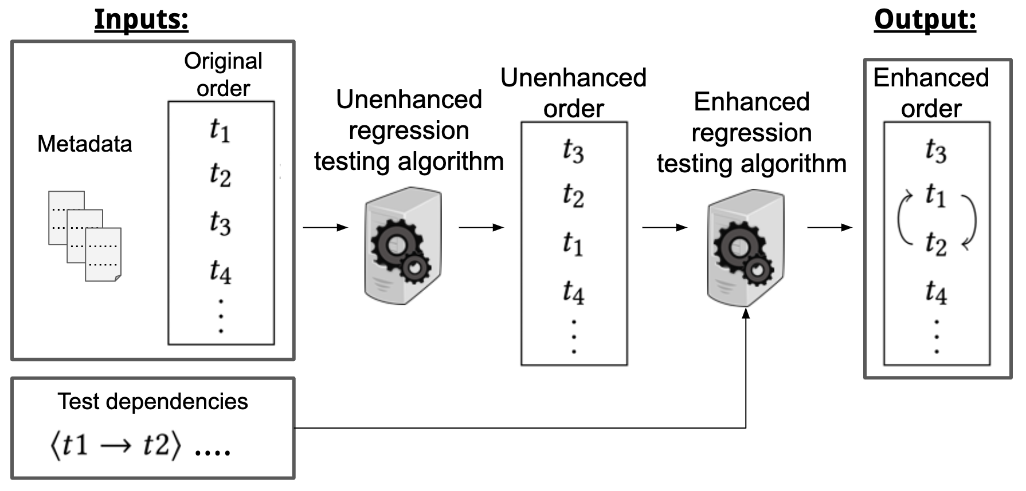
Our general approach – Inputs
Inputs: metadata for the algorithms, original order to run tests, and set of test dependencies (e.g., test 𝑡2 should be run only after running test 𝑡1)

Slide 26
Our general approach – Step 1
Generate unenhanced regression testing order with traditional regression testing algorithms

Slide 27
Our general approach – Step 2
Reorder and add tests to the unenhanced order as necessary to output an order that respects all the input test dependencies

Slide 28
Our general approach – Output
Inputs: metadata for the algorithms, original order to run tests, and set of test dependencies (e.g., test 𝑡2 should be run only after running test 𝑡1)
Output: Enhanced regression testing order that respects all input test dependencies

Slide 29
Our contributions
Goal: understand the impact of OD tests on regression testing algorithms and how one can make them dependent-test-aware
Study – on how OD tests affect regression testing algorithms (test prioritization, test selection, and test parallelization)
Approach [1] – to enhance regression testing algorithms to be dependent-test-aware
Evaluation – of 12 enhanced regression testing algorithms
  Orders of enhanced algorithms can have 80% fewer OD-test failures, while being only 1% slower
[1] https://sites.google.com/view/flakytestdataset

Slide 30
Experimental setup
Older
vers.
Newer
vers.
…
Project versions
Evaluation metrics:
  Effectiveness of reducing OD-test failures
  Efficiency of unenhanced vs. enhanced orders
All versions must pass in original order and have code changes

Slide 31
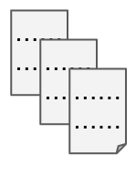
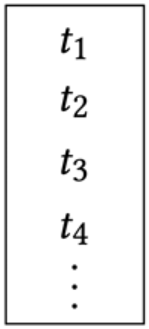

Experimental setup
Original order
Metadata
Test dependencies
…
Older
vers.
Newer
vers.
…
firstVers
Project versions
Compute inputs on firstVers, which includes
  Metadata: coverage and time of each test
  Original order: order in which tests are run by default
  Test dependencies: dependencies computed using automated tools. See paper for details

Slide 32
Experimental setup
Original order
Metadata
Test dependencies
…
Older
vers.
Newer
vers.
…
firstVers
secondVers
subSeqVers
subSeqVers
subSeqVers
subSeqVers
Project versions
Inputs are used on secondVers/subSeqVers to compute unenhanced and enhanced regression testing orders
  Test prioritization and parallelization uses secondVers

Slide 33
Experimental setup
Original order
Metadata
Test dependencies
…
Older
vers.
Newer
vers.
…
firstVers
secondVers
subSeqVers
subSeqVers
subSeqVers
subSeqVers
Project versions
Inputs are used on secondVers/subSeqVers to compute unenhanced and enhanced regression testing orders
  Test prioritization and parallelization uses secondVers
  Test selection uses all subseqVers

Slide 34
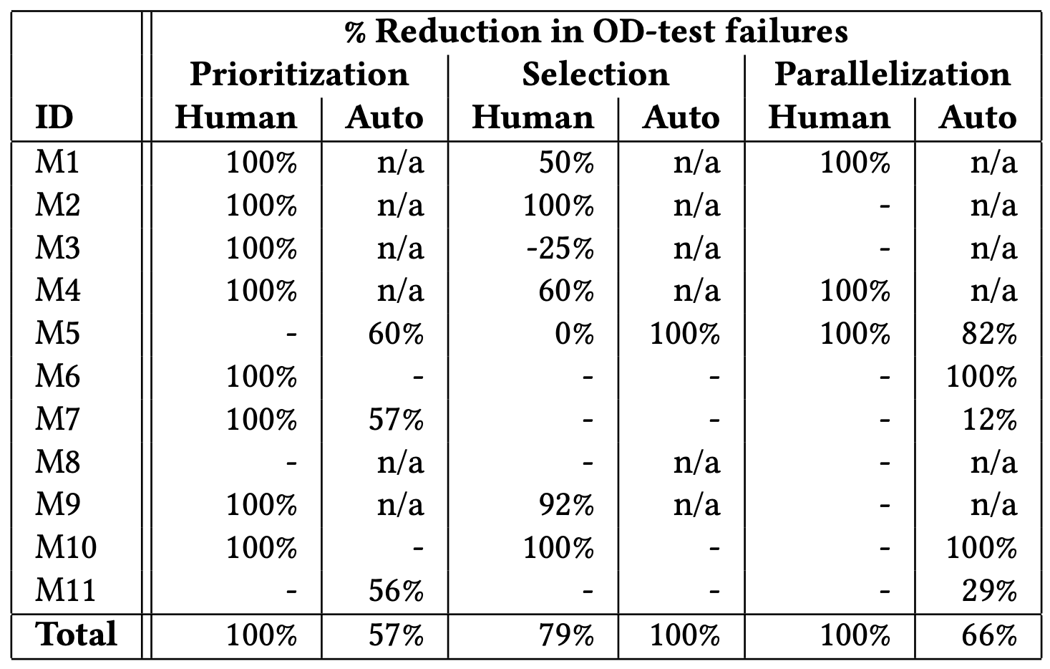
Effectiveness of reducing OD-test failures
High % indicates enhanced orders have fewer OD-test failures
Cases with no OD tests are marked “n/a”
Cases where unenhanced orders do not have OD-test failures are marked “-”
For 16 / 26 (62%) of enhanced orders completely eliminates all OD-test failures!
Combining all types of tests and modules, enhanced algorithms can reduce # of OD-test failures by 80%!

Slide 35
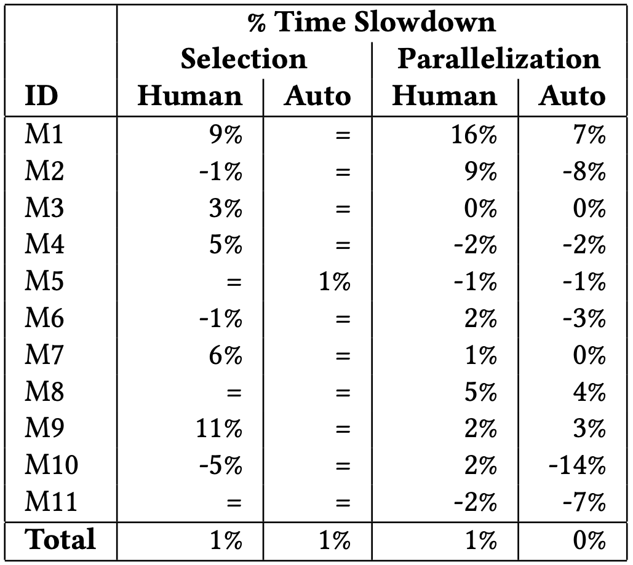
Efficiency of orders
High % indicates enhanced orders are slower
Projects with same orders for enhanced and unenhanced are marked “=”
Parallelization compares runtime of longest running subsuite
% = (sum of enhanced order runtimes - sum of unenhanced order runtimes) / sum of unenhanced order runtimes
For some cases, enhanced orders are faster (e.g., M10), because OD-test failures can slow down test runtime!
Runtime slowdown of enhanced compared to unenhanced orders is 1% across all types of tests for all modules!

Slide 36
Conclusion
Motivation:
Most existing regression testing work do not account for test dependencies
Developers are writing dependencies and can obtain them automatically with tools
To help understand the impact of order-dependent (OD) tests on regression testing algorithms and how one can make them dependent-test-aware
Study – on how OD tests affect regression testing algorithms
Approach [1] – to make regression testing algorithms dependent-test-aware
Evaluation – showing that orders of enhanced algorithms can have 80% fewer OD-test failures, while being only 1% slower
[1] https://sites.google.com/view/flakytestdataset
Email: winglam2@Illinois.edu

