Slide 1








Development History Granularity Transformations
Kıvanç Muşlu Luke Swart Yuriy Brun Michael D. Ernst
Microsoft, Tools for Software Engineers
University of Washington, Computer Science & Engineering
HaxGeo, Civic Software Development
University of Massachusetts Amherst, Information and Computer Science
Notes:
Hi everyone, I am Kivanc from Microsoft. I currently work in the Tools for Software Engineers team, on code review process and code review tools. However, today, I am going to talk about part of my PhD work I did at the University of Washington: Development history granularity transformations. This is joint work with Luke Swart, Yuriy Brun, and Michael Ernst.

Slide 2
Development histories simplify tasks
Development histories are used to:
localize bugs
rollback mistakes
understanding software evolution
predicting failures
…
Notes:
Development histories are useful to simplify many development tasks: developers use these histories to localize bugs, rollback histories, …

Slide 3
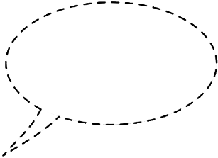

Different tasks require different granularities
Why does my test fail?
binary search history
How can I retrieve discarded code?
custom
compilable code
raw history
(thin) slice history
keystroke
How did a feature evolve?
Notes:
In other words, development histories are great! However, we have a problem: different development tasks require different history granularities. Let me show you this problem through an example: here, we have a developer trying to answer three questions: She first wonders why her test is failing, how she can retrieve a code she has discarded, and understand how a particular feature has evolved in time. All of these questions can be answered through the development history, but they require the developer accessing the history in different ways. For example, for the test failure, the developer can bisect the history; a binary search through the commits to find the diff between the last succeeding and first failing versions. Bisection works the best; pinpoints the bug, if we have the history in compliable code granularity: e.g., have access to all compiling versions. Similarly, if the developer wants to retrieve discarded code, then he can access the raw history. However, the raw history would be most useful if it recorded each keystroke since otherwise we might have lost the discarded information. Finally, to better understand the history of a feature, the developer can slice the history. To have the best visualization, we would need a custom granularity of the history that only captures the changes on the feature

Slide 4
Problem: development histories are inflexible
public static void
m
a
i
n
public static void main
automatically-managed histories [YoonM11, Mahoney12, NegaraCDJ14]
Fine-grained: extracting relevant information requires post processing
manually-managed histories
Incomplete: might miss information
Course-grained: information might be intermingled with irrelevant one
Notes:
Different tasks require different granularities. However, our current way to record and use development histories are inflexible. Before I tell you why this is the case, let me remind you what a development history looks like:

Slide 5
Solution: multi-grained development histories
Our contribution:
make recording granularity transparent
record a complete & fine-grained history
automatically transform this history into more optimal granularities for the task at hand
Notes:
To solve the flexibility problem, we propose multi-grained development histories. Our contribution with this work is to make recording granularity of a history transparent. Our approach will still record a complete and fine-grained history (or use one of the previous techniques). But we will provide tools that automatically transform this history into more optimal granularities for the task at hand.

Slide 6
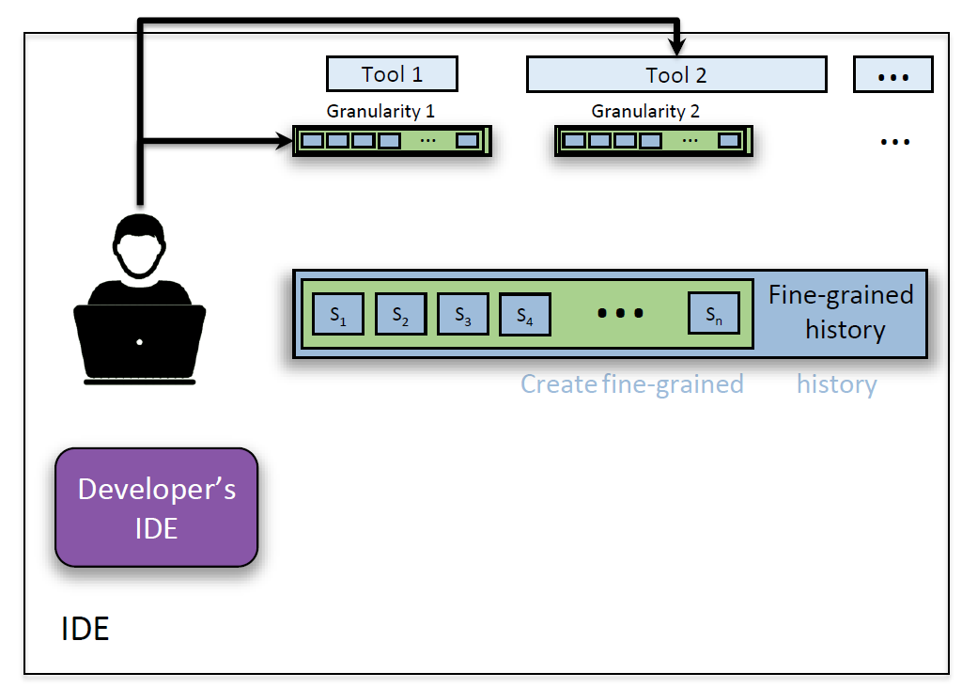
Solution: multi-grained development histories
?
?
?
?
?
?
Notes:
In other words, we have the following entities: the developer, interacting with custom granularities directly, or through other tools, we have a fine-grained development history, and the IDE. In the remaining part, we will figure out how to connect these pieces such that this picture is complete.

Slide 7

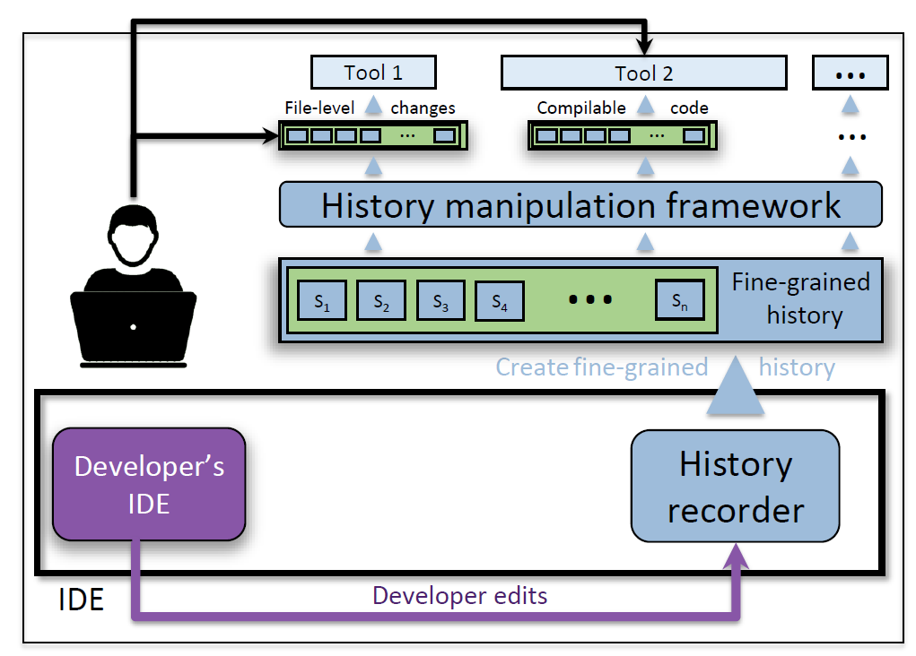
Outline
Transformations
Design
Notes:
I am done with the motivation part of the talk, in the remaining part, we will first talk about the granularity transformations; the theory behind multi-grained histories. Then, I will give you the gist of a potential design that we have implemented.

Slide 8
Transformations
granularity transformations
(group changes that satisfy … and reorder history such that …)
transformation operations
(intermediate operations)
transformation primitives
expand, collapse, group
Notes:
Let’s get started with the granularity transformations. In this section our goal is to define high-level granularity transformations: being able to say things like: group changes that satisfy some property and reorder the history such that something else is satisfied. And, we will get there, but to get there we first need intermediate transformation operations. And of course to have these intermediate operations, we will first define primitives.

Slide 9
Primitives: expand, collapse, and move
e₁
e₂
e₃
e₄
e₅
collapse(2, 4)
e₆
e₁
e₂
e₃
e₄
e₅
Notes:
So, let’s start with primitives: expand, collapse, and move. Assuming we have a history of 5 edits, collapse(2, 4) replaces edits from index 2 to 4 with one edit that is equivalent.

Slide 10
Primitives: expand, collapse, and move
e₁
e₂
e₃
e₄
e₅
collapse(2, 4)
e₁
e₂
e₃
e₄
e₅
Notes:
One very nice part of these granularity transformations is that they are completely reversible. So, in the current history, we can say:

Slide 11
Primitives: expand, collapse, and move
e₁
e₂
e₃
e₄
e₅
collapse(2, 4)
e₆
e₁
e₂
e₃
e₄
e₅
expand(2)
e₁
e₂
e₃
e₄
e₅
Notes:
expand(2) which reverses the collapse operations on the second edit and retrieves the original history.

Slide 12
Primitives: expand, collapse, and move
e₁
e₂
e₃
e₄
e₅
move(5,2)
e₁
e_{5'}
e_{2'}
e_{3'}
e_{4'}
Notes:
Move changes the location of an edit in the history. Move(5, 2) takes the edit in the fifth location and moves it to the second location in the history. This of course might change the edit being moved and all subsequent edits, according to dependencies.

Slide 13
Operation: group (move + collapse)
e₁
e₂
e₃
e₄
e₅
e₆
e₇
1
2
1
1
2
3
2
move(3,2) & move(4, 3)
move(7, 6)
e₁
e_{3'}
e_{4'}
e_{2'}
e₅
e_{7'}
e_{6'}
1
1
1
2
2
2
3
e₁
e_{3'}
e_{4'}
e_{2'}
e₅
e_{7'}
e_{6'}
collapse(1, 3)
collapse(2, 4)
e₈
e₉
e_{6'}
Notes:
Now that we have the primitives, let’s define an intermediate operation: group. Groups work like this: for each edit in the history, you assign a group name (or number). After this is done, group reorders the history such that all edits in the same group are next to each other. So, in our example, we will first move edit3 to the second location and edit4 to the third location. We don’t touch edit5 and continue by moving edit7 to the sixth location. Now that we have everything aligned, we collapse each group, to get a history of three edits, one representing each group.

Slide 14


Transformation: GroupCompilable (group)
1
2
3
3
3
4
4
e₁
e₂
e₃
e₄
e₅
e₆
e₇
e₁
e₂
e₃
e₄
e₅
e₆
e₇
e₁
e₂
e₈
e₉
Notes:
Group is quite powerful, let us define high-level transformations quite easily. For example, if we want to define GroupCompilable: a compilable view of the history, then we can first go over the edits and compute whether they compile or not. Once we have this information, then we assign group numbers such that whenever there is a compiling edit, we increment the group number by one. At the end, we have a history where each edit compiles and this is the finest granularity we can achieve this property.

Slide 15
All transformations
GroupCompilable: group(collapse)
GroupFiles: group(collapse + move)
for each modified file, creates a group containing all edits on this file
useful for manual inspection (e.g., VCS diff)
GroupCollocated: expand + group(collapse + move)
creates a group for each contiguous edit
useful for separating tangled changes
Notes:
I won’t go into the detail of all transformations due to time limitations. Here is a quick summary. We already talked about GroupCompilable. GroupFiles creates a group containing all edits on a file, for each modified file. GroupCollocated creates a group for each contiguous edit. I won’t go into the details, but it is useful for separating tangled changes.

Slide 16
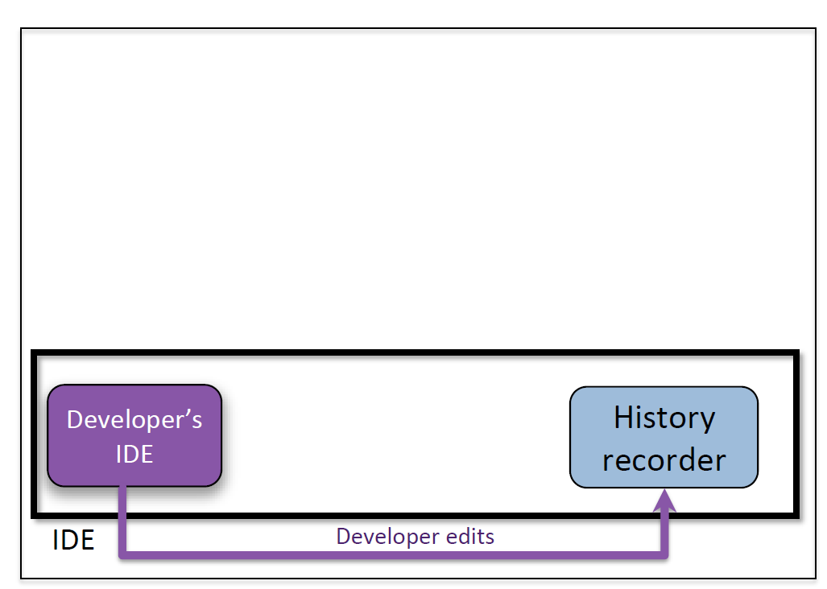
Codebase Manipulation: a design for multi-grained histories
Notes:
Now that we know the theory behind the transformations, let me talk about Codebase Manipulation, a design and implementation we did for realizing multi-grained histories. We start with the developer’s IDE. We have a history recorder that listens to each developer edit, each keystroke.

Slide 17
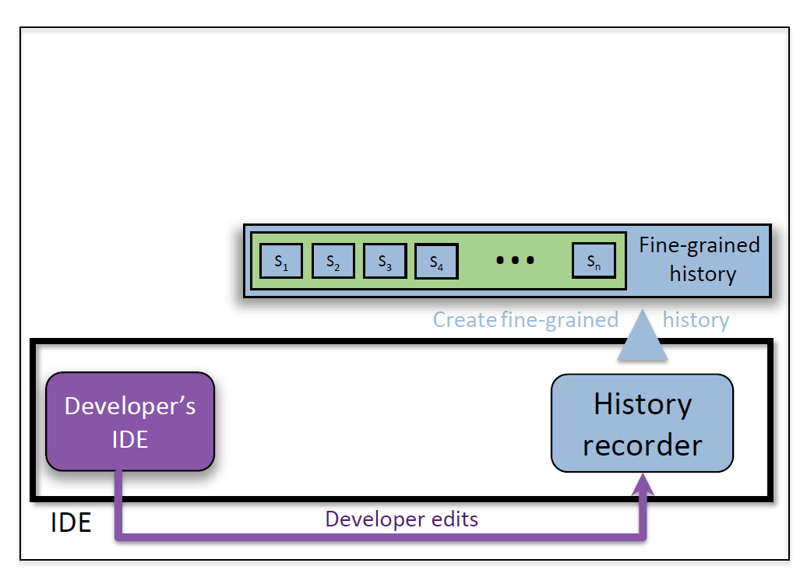
Codebase Manipulation: a design for multi-grained histories
Notes:
We create and maintain a fine-grained history by saving each edit as a snapshot.

Slide 18
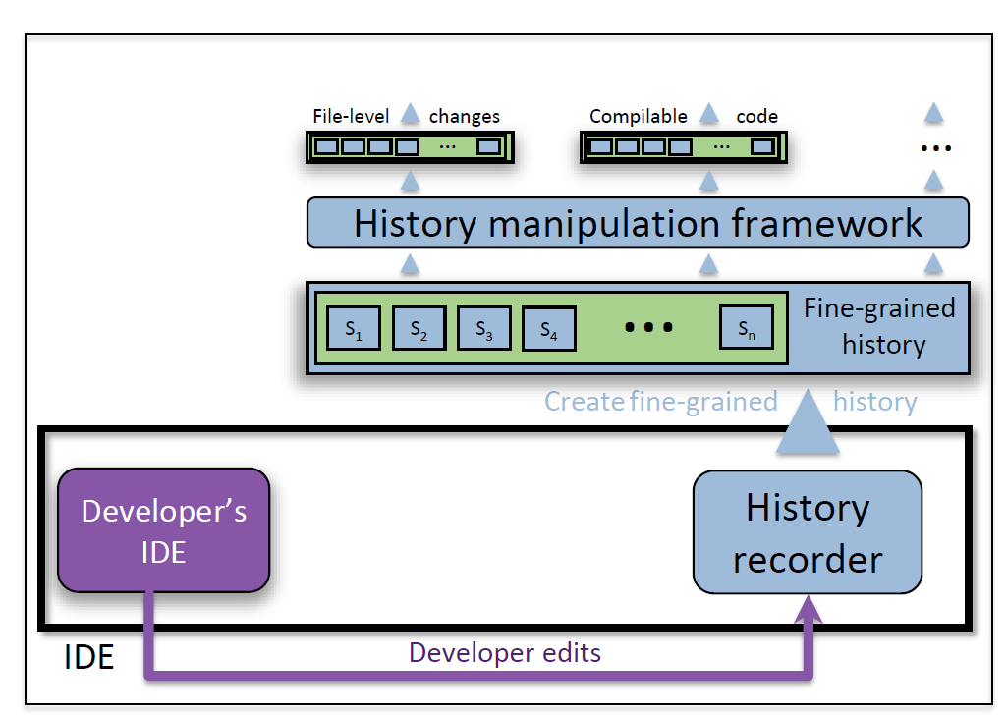
Codebase Manipulation: a design for multi-grained histories
Notes:
Building on top of this fine-grained history, we provide a history manipulation framework that provides the high-level granularity transformations that automatically transform the fine-grained development history into custom granularities. This way, we achieve a multi-grained development history.

Slide 19
Codebase Manipulation: a design for multi-grained histories
Notes:
Just to give you an idea how developer interacts with this design. We expect the developer to manually investigate some of the custom granularities herself, but we also expect the developer to interact with other tools that utilize more finer-granulartiies.

Slide 20
Contributions
identify inflexibility problem of the current development histories
propose multi-grained histories
Builds on three primitives: collapse, expand, move
History is automatically recorded
Developer uses the most optimal granularity for the current task
Codebase Manipulation: one design for multi-grained histories
Notes:
Let me conclude with contributions. With this work, we first identify the inflexibility problem of the current development histories. As a solution, we proposed multi-grained histories. Multi-grained histories build on three primitives: collapse, expand, and move. These operations are completely reversible. History is automatically recorded. Using multi-grained histories, the developers can access the history in the most optimal granularity suitable for the current task. Finally, I have shown you a design and implementation of Codebase Manipulation, one way to realize multi-grained histories.

