Slide 1


Proactive Detection of Inadequate Diagnostic Messages for Software Configuration Errors
Sai Zhang Michael D. Ernst
Google Research University of Washington

Slide 2








Goal: helping developers improve software error diagnostic messages
Input data
Software
Errors
Crashing
Silent failures
Users
Configuration
--port_num = 100.0
(should be an integer)
A bad diagnostic message:
“… unexpected system failure …”
Our technique: detecting such inadequate diagnostic messages caused by configuration errors

Slide 3


Goal: helping developers improve software error diagnostic messages
Software
Our technique:
ConfDiagDetector
Developers
Software
(with improved
diagnostic message)

Slide 4

Goal: helping developers improve software error diagnostic messages
Users
Configuration
--port_num = 100.0
(should be an integer)
Software
(with improved
diagnostic message)
A good diagnostic message:
“… wrong value in –port_num…”

Slide 5
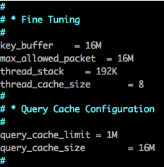
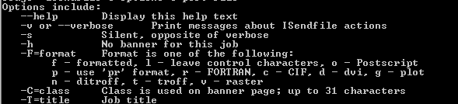
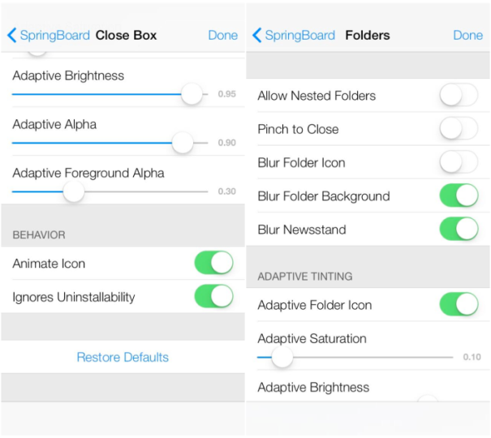
Why configuration errors?
Software systems often require configuration

Slide 6
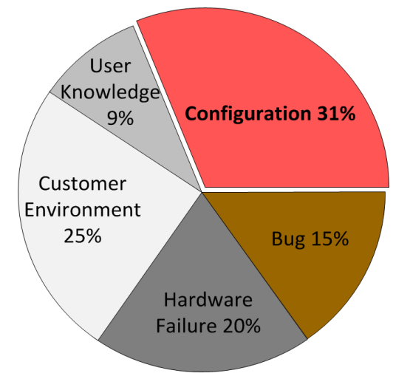
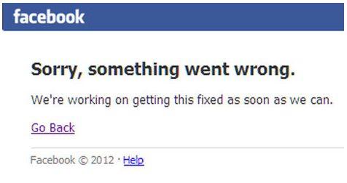


Why configuration errors?
Software systems often require configuration
Software configuration errors are common and severe
Configuration errors can have
disastrous impacts
(downtime costs 3.6% of revenue)
Root causes of high-severity issues in
a major storage company [Yin et al, SOSP’11]

Slide 7
Why diagnostic messages?
Often the sole data source available to understand an error
Many diagnostic messages in practice are inadequate
Missing
Ambiguous
Notes:
Mapping a message back to the
root-cause statement
Devising solutions based
on the message content

Slide 8
Why diagnostic messages?
Often the sole data source available to understand an error
Many diagnostic messages in practice are inadequate
Missing
Ambiguous
A misconfiguration in Apache JMeter
output_format = XYZ (an unsupported format)
No diagnostic message, but JMeter saves output in
the default “XML” format
Notes:
Mapping a message back to the
root-cause statement
Devising solutions based
on the message content

Slide 9
Why diagnostic messages?
Often the sole data source available to understand an error
Many diagnostic messages in practice are inadequate
Missing
Ambiguous
A misconfiguration in Apache Derby
derby.stream.error.method = hello
Diagnostic message:
IJ ERROR: Unable to establish connection
Notes:
Mapping a message back to the
root-cause statement
Devising solutions based
on the message content

Slide 10
Why diagnostic messages?
Often the sole data source available to understand an error
Many diagnostic messages in practice are inadequate
Missing
Ambiguous
Our technique: detecting those inadequate messages before they arise in the field.
Notes:
Mapping a message back to the
root-cause statement
Devising solutions based
on the message content

Slide 11
Outline
Motivation
The ConfDiagDetector technique
Evaluation
Related work
Contributions

Slide 12
Challenges of proactive detection of inadequate diagnostic messages
How to trigger a configuration error?
How to determine the inadequacy of a diagnostic message?

Slide 13



ConfDiagDetector’s solutions
How to trigger a configuration error?
How to determine the inadequacy of a diagnostic message?
Configuration mutation + checking system tests’ results
+
configuration
system tests
failed tests ≈ triggered errors
Use a NLP technique to check its semantic meaning
Similar semantic meanings?
Diagnostic messages
output by failed tests
Use manual

Slide 14
ConfDiagDetector workflow
An example configuration
System tests
All tests pass!
Software (binary)

Slide 15
ConfDiagDetector workflow
Configuration
mutation
…
An example configuration
Mutated configurations
Run tests under each
Mutated configuration
System tests
Software (binary)
Message
analysis
Use manual
Diagnostic messages
issued by failed tests
Inadequate
Diagnostic
messages

Slide 16
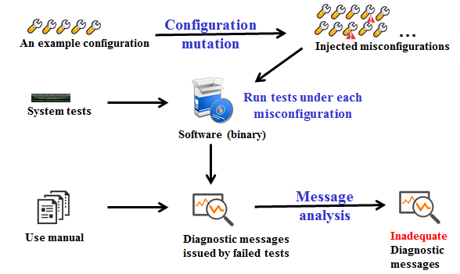


Configuration mutation
Randomly mutates option values
One mutated option in each mutated configuration
A configuration
…
Mutated configurations

Slide 17
Configuration mutation
Randomly mutates option values
One mutated option in each mutated configuration
Mutation rules for one configuration option
Delete existing value
format=xml → format=
Using a random value
format=xml → format= xyz
Injecting spelling mistakes
format=xml → format= xmk
Change the case of text
format=xml → format= XML

Slide 18

Running tests
Run the all tests under each mutated configuration
Parse each failed test’s log file or console to get the diagnostic message
+
System tests
…
…
Mutated configurations
Test results

Slide 19
Running tests
Run the all tests under each mutated configuration
Parse each failed test’s log file or console to get the diagnostic message
+
System tests
…
…
Mutated configurations
Test results
Failed tests
Diagnostic messages

Slide 20
Message analysis
A message is adequate, if it
contains the mutated option name or value
has a similar semantic meaning with the manual description
OR

Slide 21

Message analysis
A message is adequate, if it
contains the mutated option name or value
has a similar semantic meaning with the manual description
OR
Example:
Mutated option:
--percentage-split
Diagnostic message:
“the value of percentage-split should be > 0”

Slide 22
Message analysis
A message is adequate, if it
contains the mutated option name or value
has a similar semantic meaning with the manual description
OR
Example:
Mutated option:
--fnum
Diagnostic message:
“Number of folds must be greater than 1”
User manual description of --fnum:
“Sets number of folds for cross-validation”

Slide 23
Message analysis
A message is adequate, if it
contains the mutated option name or value
has a similar semantic meaning with the manual description
OR
A NLP technique [Mihalcea’06]

Slide 24
Key idea of the employed NLP technique
A message
Manual description
Has similar semantic meanings, if many words in them
have similar meanings
Example:
The program goes wrong
Remove all stop words
For each word in the diagnostic message,
tries to find the similar words in the manual
Two sentences are similar, if “many” words
are similar between them.
The software fails

Slide 25
Outline
Motivation
The ConfDiagDetector technique
Evaluation
Related work
Contributions

Slide 26
Research questions
ConfDiagDetector’s effectiveness
The detected inadequate messages
Time cost in inadequate message detection
Comparison with two existing techniques

Slide 27
4 mature configurable software systems
Subject | LOC | #Options | #System Tests
Weka | 274,448 | 125 | 16
JMeter | 91,979 | 212 | 5
Jetty | 123,028 | 23 | 7
Derby | 645,017 | 56 | 7
Converted from usage examples in the user manual.

Slide 28

Detected inadequate diagnostic messages
50 distinct
diagnostic messages
Notes:
For 4 errors, the results is not as good as others, but they are still better than a random guess
Combining messages with the tool

Slide 29
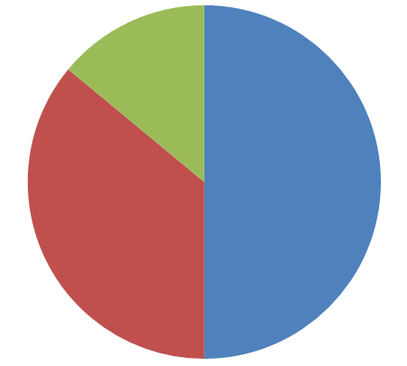
Detected inadequate diagnostic messages
7 adequate
messages
50 distinct
diagnostic messages
25 missing
messages
18 ambiguous
messages
Notes:
For 4 errors, the results is not as good as others, but they are still better than a random guess
Combining messages with the tool

Slide 30
Detected inadequate diagnostic messages
7 adequate
messages
50 distinct
diagnostic messages
25 missing
messages
Validating each message’s
Adequacy by user study
18 ambiguous
messages
Notes:
For 4 errors, the results is not as good as others, but they are still better than a random guess
Combining messages with the tool

Slide 31





User study
User manual
3 grad students
Adequate or not?
Diagnostic message
Each with 10 years
coding experience
Notes:
For 4 errors, the results is not as good as others, but they are still better than a random guess
Combining messages with the tool

Slide 32
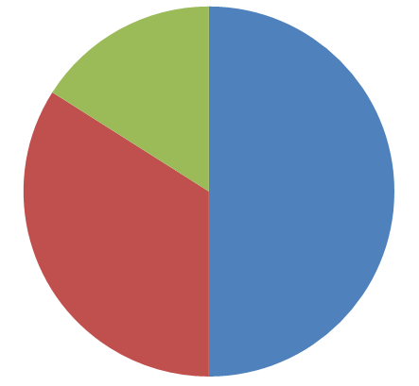
User study results
Differs only in 1 message
7 adequate
messages
8 adequate
messages
50 distinct
diagnostic messages
25 missing
messages
18 ambiguous
messages
17 ambiguous
messages
ConfDiagDetector’s results
User’s judgment
Zero false negative, and 2% false positive rate
Notes:
For 4 errors, the results is not as good as others, but they are still better than a random guess
Combining messages with the tool

Slide 33


Time cost
Manual effort
3.5 hours in total (4.2 minutes per message)
Converting usage examples into tests
Extract configuration option description from the user manual
ConfDiagDetector’s efficiency
3 minutes per message, on average

Slide 34
Comparison with two existing techniques
No Text Analysis
Implemented in ConfErr [Keller’08] and Spex-INJ [Yin’11]
A message is adequate if the misconfiguration option name or value appears in it
False positive rate: 16% (ConfDiagDetector’ rate: 2%)
Internet search
Search the diagnostic message in Google
A message is adequate if the misconfiguration option appears in the top 10 entries
False positive rate: 12% (ConfDiagDetector’ rate: 2%)

Slide 35
Outline
Motivation
The ConfDiagDetector technique
Evaluation
Related work
Contributions

Slide 36
Related work
Configuration error diagnosis techniques
Dynamic tainting [Attariyan’08], static tainting [Rabkin’11], Chronus [Whitaker’04]
Troubleshooting an exhibited error rather than detecting inadequate diagnostic messages
Software diagnosability improvement techniques
PeerPressure [Wang’04], RangeFixer [Xiong’12], ConfErr [Keller’08] and Spex-INJ [Yin’11], EnCore [Zhang’14]
Requires source code, usage history, or OS-level support

Slide 37
Outline
Motivation
The ConfDiagDetector technique
Evaluation
Related work
Contributions

Slide 38

Contributions
ConfDiagDetector
Software (binary)
Inadequate diagnostic messages
A technique to detect inadequate diagnostic messages
Combine configuration mutation and NLP techniques
Requires no source code and prior knowledge
Analyzes diagnostic messages in natural language
Requires no OS-level support
Accurate and fast
An evaluation on 4 mature, configurable systems
Identify 25 missing and 18 inadequate messages
No false negative, 2% false positive rate

