Slide 1
“Where should I comment my code?”
A dataset and model for predicting locations that need comments
Annie Louis (University of Edinburgh, now works at Google)
Co-authors: Santanu Kumar Dash (University of Surrey)
Earl T. Barr (University College London)
Michael D. Ernst (University of Washington)
Charles Sutton (Google Research)

Slide 2
How many comments and where in the code?
Too many comments → use more developer time / possible comment rot
Guide developers towards most useful locations
A new research problem: “Identify where to write comments”
A corpus of C/C++ code with comment locations
A machine learning solution to identify these locations
Identify only the location,
not the text of the comment!

Slide 3
Data for training a machine learning model
Need a source of good commenting practice
Android Open Source Project
601 files from 9 C/C++ libraries in the native substrate
Professionally developed

Slide 4
Idea of ‘Snippets’
code blocks delimited by empty lines
001
002 /* Find Huffman .. */
003 if (...)
004 ERREXIT1(...);
005 htbl =
006 isDC ? ... :
007
Snippet 1
Label=1 ‘comment here’
008 if (...)
009 cinfo(...) ;
010
Snippet 2
Label=0

Slide 5
Idea of ‘Snippets’
code blocks delimited by empty lines
001
002 /* Find Huffman .. */
003 if (...)
004 ERREXIT1(...);
005 htbl =
006 isDC ? ... :
007
Snippet 1
Label=1 ‘comment here’
008 if (...)
009 cinfo(...) ;
010
Snippet 2
Label=0
Comments are removed!

Slide 6
Idea of ‘Snippets’
code blocks delimited by empty lines
001
002 /* Find Huffman .. */
003 if (...)
004 ERREXIT1(...);
005 htbl =
006 isDC ? ... :
007
Snippet 1
Label=1 ‘comment here’
008 if (...)
009 cinfo(...) ;
010
Snippet 2
Label=0
Data = 41,506 snippets with binary labels

Slide 7
Best model: Hierarchical neural network

Slide 8
Best model: Hierarchical neural network
Snippet 1
Snippet 2
L3 L4 L5 L6 L8 L9

Slide 9
Best model: Hierarchical neural network
Snippet 1
Snippet 2
L3 L4 L5 L6 L8 L9
Recurrent neural network gets representations of lines of code based on prior lines
h_{i}
h_{i+1}
...
...
h_{k}
h_{k+1}

Slide 10
Best model: Hierarchical neural network
Snippet 1
Snippet 2
L3 L4 L5 L6 L8 L9
h_{i}
h_{i+1}
...
...
h_{k}
h_{k+1}
Represent the sequence of snippets in the file
j_{m}
j_{m+1}

Slide 11
Best model: Hierarchical neural network
Snippet 1
Snippet 2
L3 L4 L5 L6 L8 L9
h_{i}
h_{i+1}
...
...
h_{k}
h_{k+1}
j_{m}
j_{m+1}
Obtain predictions
1
0

Slide 12
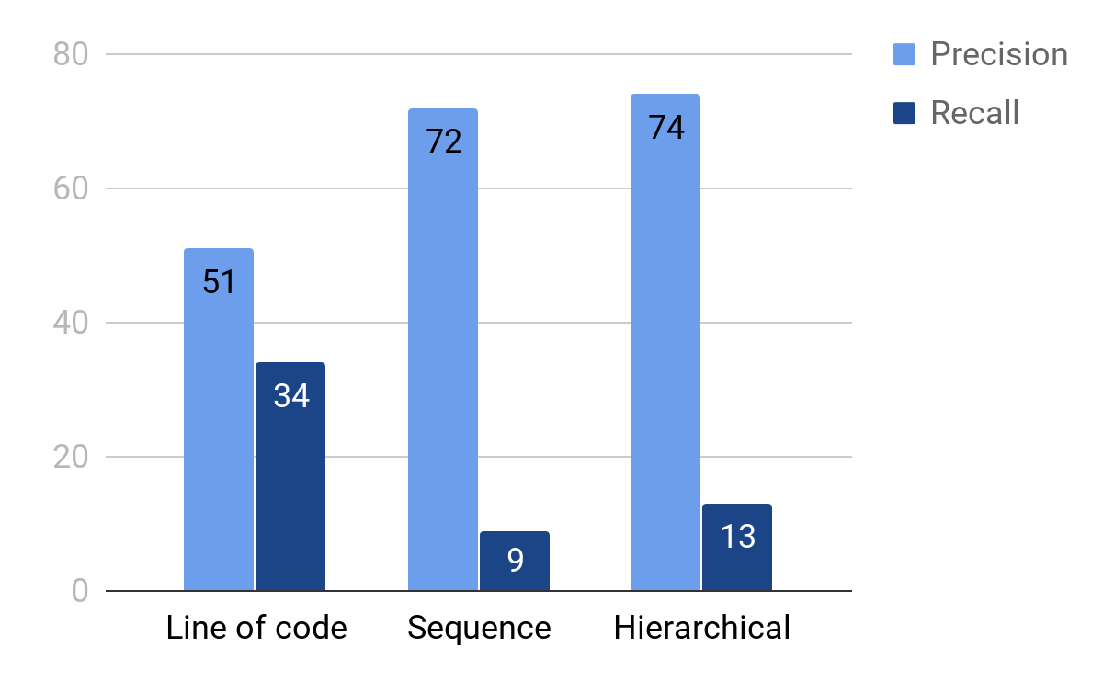
Performance on test data
High precision to avoid incorrect suggestions
Area for future work

Slide 13
Thank You
Our code and data is available at
http://groups.inf.ed.ac.uk/cup/comment-locator/

