Slide 1






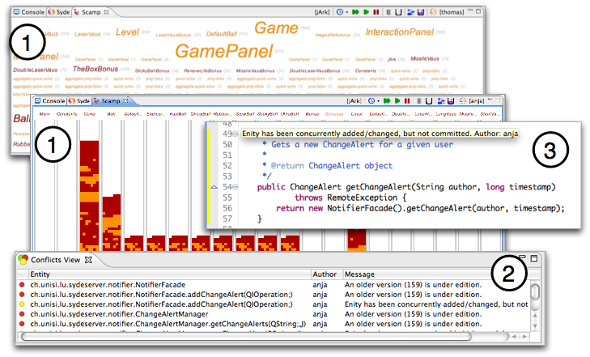
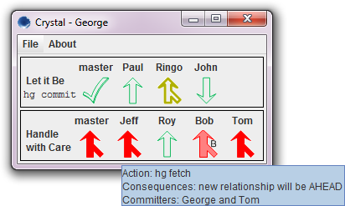
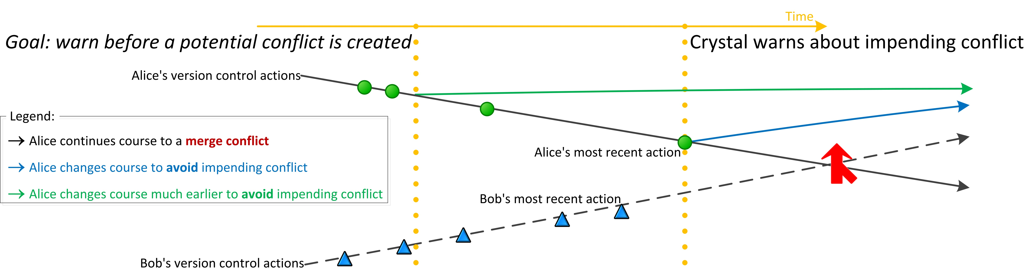
Predicting Development Trajectories to Prevent Collaboration Conflicts
Yuriy Brun, Kıvanç Muşlu, Reid Holmes, Michael D. Ernst, and David Notkin
University of Washington University of Waterloo
Problem: Collaboration Conflicts
    Version control helps developers work concurrently.
    Conflicts offset the benefits of concurrent work.
    Collaboration conflicts distract developers from their core tasks.
State-of-the-Practice: Detect on Merge
    Textual conflicts are discovered during merges.
    Compilation and testing conflicts are often discovered even later.
Shortcomings:
Version control isolates developers from others’ actions until they try to merge.
Merging is often painful.
The longer it takes to discover a merge conflict, the more difficult it to resolve.
Fear of conflicts often discourages concurrent work [4].
State-of-the-Art: Detect before Merge
      Awareness tools estimate when developers’ changes interact.
        FastDASH [1], Syde [5], CollabVS [3], Safe-commit [7], YooHoo [6].
      By computing future merges, Crystal [2] reports conflicts precisely,
      eliminating false positives and negatives.
        speculatively merges code in the background
        detects textual, compilation, and testing conflicts
        informs developers of conflicts as soon as they are created
      Syde
      Crystal
Our Vision: Predict before Creation
Today: Analyze actual changes to detect conflicts.
Tomorrow: Predict and analyze future changes.
References:
[1] J.T. Biehl, M. Czerwinsk, G. Smith, and G.G. Robertson, ”FASTDash: A visual dashboard for fostering awareness in software teams,” CHI, pp. 1313–1322, 2007.
[2] Y. Brun, R. Holmes, M.D. Ernst, and D. Notkin, “Proactive detection of collaboration conflicts,” ESEC/FSE, pp. 168–178 , 2011.
[3] P. Dewan, and R. Hegde, “Semi-synchronous conflict detection and resolution in asynchronous software development,” ECSCW, pp. 159–178, 2007.
[4] R. E. Grinter, “Using a configuration management tool to coordinate software development”, COCS, pp. 168–177, 1995.
[5] L. Hattori, and M. Lanza, “Syde: A tool for collaborative software development,” ICSE tool demo, pp. 235–238, 2010.
[6] R. Holmes, and R. J. Walker, “Customized awareness: Recommending relevant external change events,” ICSE, pp. 465–474, 2010.
[7] J. Wloka, B. Ryder, F. Tip, and X. Ren, “Safe-commit analysis to facilitate team software development”, ICSE, pp. 507–517, 2009.

