Slide 1
Unreproducible tests Successes, failures, and lessons in testing and verification
Michael D. Ernst
University of Washington
Presented at ICST
20 April 2012

Slide 2
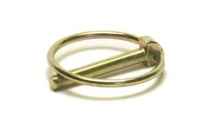
Reproducibility: The linchpin of verification
A test should behave deterministically
For detecting failures
For debugging
For providing confidence
A proof must be independently verifiable
Tool support: test frameworks, mocking, capture-replay, proof assistants, …
Notes:
Randomization/noise masks the signal

Slide 3
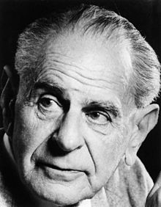
Reproducibility: The linchpin of research
Research:
A search for scientific truth
Should be testable (falsifiable) -Karl Popper
Example: evaluation of a tool or methodology
Bad news: Much research in testing and verification fails this scientific standard
Notes:
Scientific truths do not change depending on context
Science should enlighten, not mislead

Slide 4
Industrial practice is little better
“Variability and reproducibility in software engineering: A study of four companies that developed the same system”, Anda et al., 2008
Notes:
Neither is medicine, psychology, etc.

Slide 5
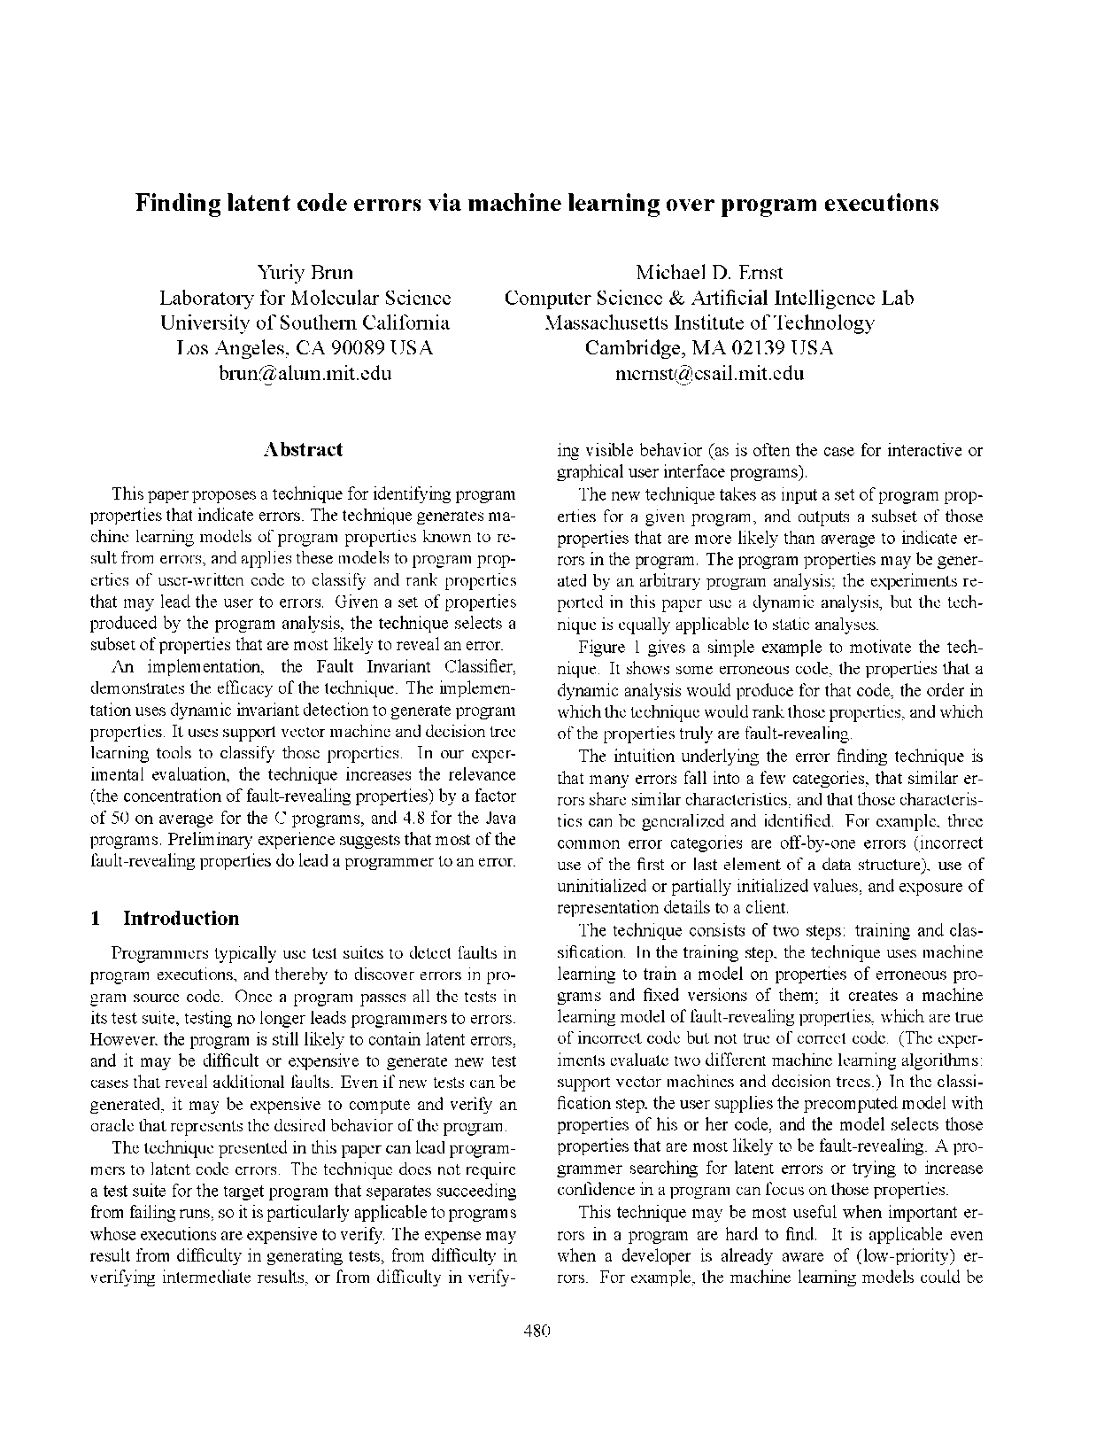
A personal embarrassment
“Finding Latent Code Errors via Machine Learning over Program Executions”, ICSE 2004
Indicates bug-prone code
Outperforms competitors; 50x better than random
Solves open problem
Innovative methods
>100 citations

Slide 6
What went wrong
Tried lots of machine learning techniques
Went with the one that worked
Output is actionable, but no explanatory power
Explanatory models were baffling
Unable to reproduce
Despite availability of source code & experiments
No malfeasance, but not enough care
How can we prevent such problems?

Slide 7
Outline
Examples of non-reproducibility
Causes of non-reproducibility
Is non-reproducibility a problem?
Achieving reproducibility

Slide 8
Random vs. systematic test generation
Random is worse
[Ferguson 1996, Csallner 2005, …]
Random is better
[Dickinson 2001, Pacheco 2009]
Mixed
[Hamlet 1990, D’Amorim 2006, Pacheco 2007, Qu 2008]
Notes:
Researchers love to implement a strawman random algorithm and show that their results are better.

Slide 9
Test coverage
Test-driven development improves outcomes [Franz 94, George 2004]
Unit testing ROI is 245%-1066% [IPL 2004]
Abandoned in practice [Robinson 2011]

Slide 10

Type systems
Static typing is better
[Gannon 1977, Morris 1978, Pretchelt 1998]
the Haskell crowd
Dynamic typing is better
[Hanenburg 2010]
the PHP/Python/JavaScript/Ruby crowd
Many attempts to combine them
Soft typing, inference
Gradual/hybrid typing
ICSE 2011

Slide 11

Programming styles
Introductory programming classes:
Objects first [Kolling 2001, Decker 2003, …]
Objects later [Reges 2006, …]
Makes no difference [Ehlert 2009, Schulte 2010, …]
Object-oriented programming
Functional languages
Yahoo! Store originally in Lisp
Facebook chat widget originally in Erlang
Notes:
When teaching a C++ class, I was criticized by a faculty member who preferred Scheme, complaining that I was doing too good a job and the students would come to enjoy C++.
ViaWeb attributed its success to the use of Lisp.

Slide 12
More examples
Formal methods from the beginning [Barnes 1997]
Extreme programming [Beck 1999]
Testing methodologies

Slide 13

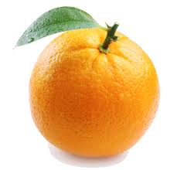
Causes of non-reproducibility
Some other factor dominates the experimental effect
Threats to validity
construct (correct measurements & statistics)
internal (alternative explanations & confounds)
external (generalize beyond subjects)
reliability (reproduce)

Slide 14
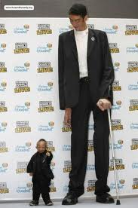
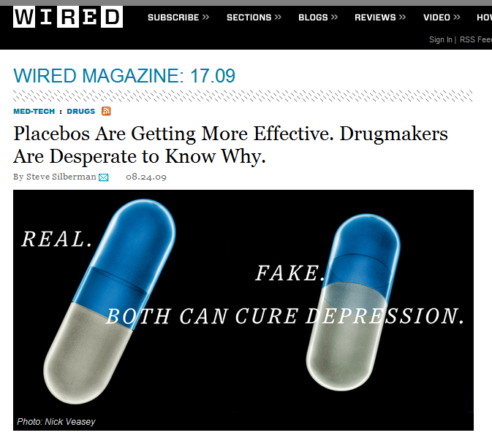
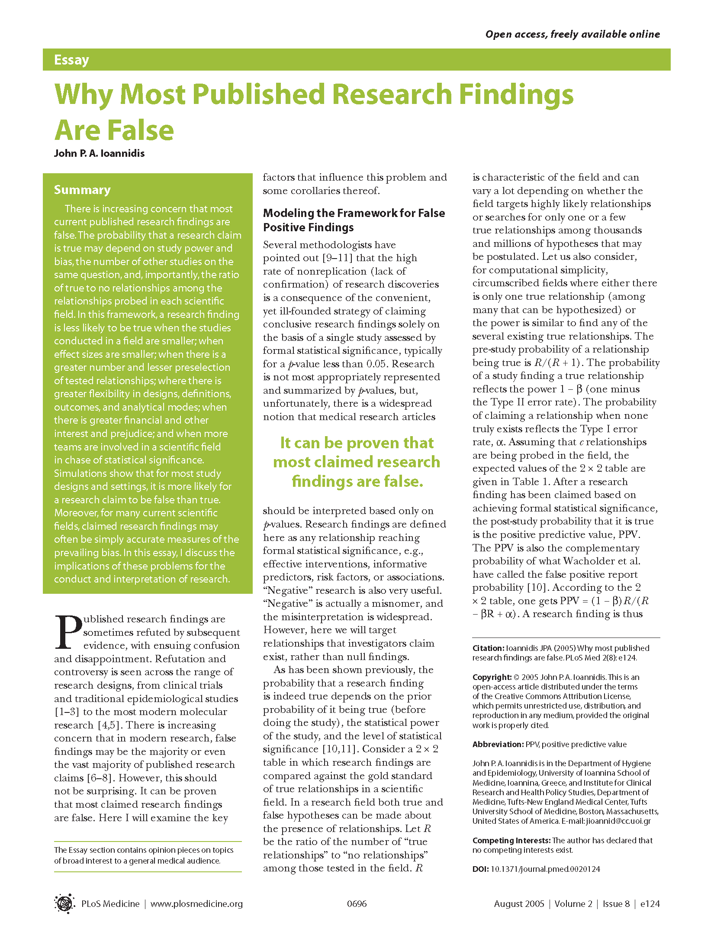
People
Abilities
Knowledge
Motivation
We can learn a lot even from studies of college students
Notes:
Medicine has it easy, because relatively speaking, there is only tiny variance in physical characteristics. But even they have problems.
Christopher Chabris:
Most Reported Genetic Associations with General Intelligence Are Probably False Positives
C. Glenn Begley attempted to replicate 53 cancer studies he deemed landmark publications. He could only replicate six.
By contrast, mental differences are much greater.
An argument for controlled experiments
What can we learn from studies of college students? Plenty. (See Per Bruneson and others on comparing students with professionals.)
Professional programmers aren’t exactly homogeneous, and there is some evidence that they perform similarly to professionals.
More generally, experimental subjects

Slide 15
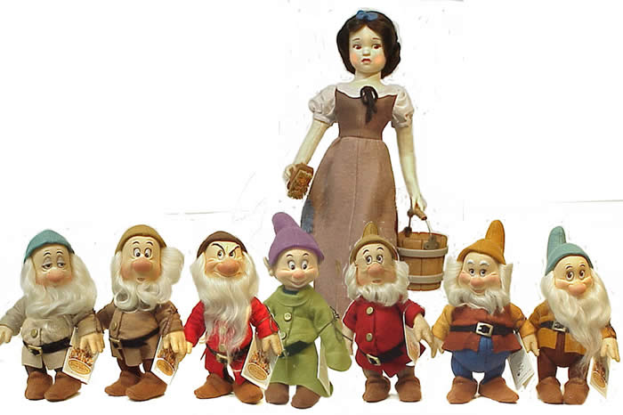
Other experimental subjects (besides people)
“Subsetting the SPEC CPU2006 benchmark suite” [Phansalkar 2007]
“Experiments with subsetting benchmark suites” [Vandierendonck 2005]
“The use and abuse of SPEC” [Hennessey 2003]
space program
Siemens suite
Notes:
Using space and the Siemens suite is just dopey

Slide 16
Implementation
Every evaluation is of an implementation
Tool, instantiation of a process such as XP or TDD, etc.
You hope it generalizes to a technique
Your tool
Tuned to specific problems or programs
Competing tool
Strawman implementation
Example: random testing
Tool is mismatched to the task
Example: clone detection [ICSE 2012]
Configuration/setup
Example: invariant detection
Notes:
Tools are hard to use; you need patience.
I will focus mostly on tools and mostly on testing.

Slide 17
Interpretation of results
Improper/missing statistical analysis
Statistical flukes
needs to have an explanation
tried too many things
Subjective bias
Notes:
Statistical flukes explains why placebos (and other drugs!) have been becoming less effective.

Slide 18
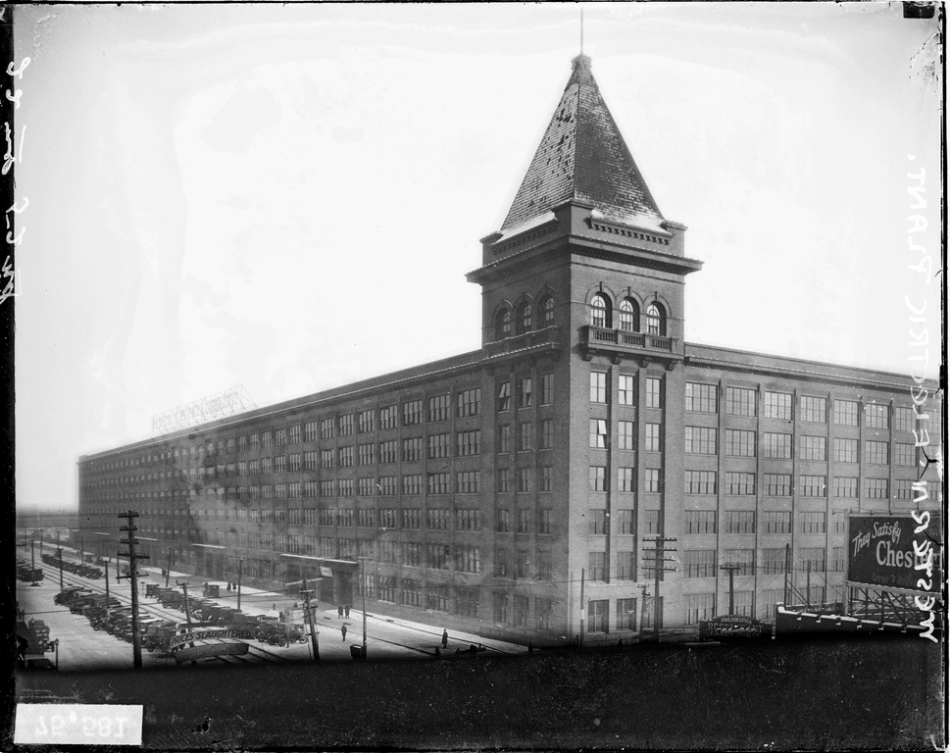
Biases
Hawthorne effect (observer effect)
Friendly users, underestimate effort
Sloppiness
Fraud
(Compare to sloppiness)
Notes:
Publication pressure is a cause
Sloppiness is related to babying your own tool

Slide 19


Reasons not to totemize reproducibility
Reproducibility is not always paramount

Slide 20
Reproducibility inhibits innovation
Reproducibility adds cost
Small increment for any project
Don’t over-engineer
If it’s not tested, it is not correct
Are your results important enough to be correct?
Expectation of reproducibility affects research
Reproducibility is a good way to get your paper accepted
Notes:
Each Stealth Bomber cost $1.5-2.1 billion to build
A paper is about a person-year of work
If less, you are lucky, extraordinary, or cutting corners
… Affects research is a way of saying, Affects which questions are asked

Slide 21
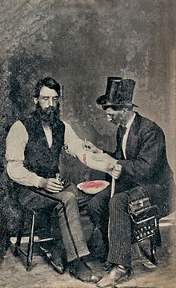
Our field is young
It takes decades to transition from research to practice
True but irrelevant
Lessons and generalizations will appear in time
How will they appear?
Do we want them to appear faster?
The field is still developing & learning
Statistics? Study design?
Notes:
We have a lot of people and a lot of experience to build upon

Slide 22
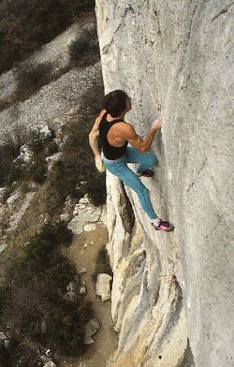

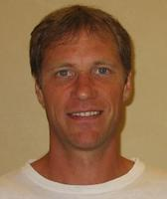
A novel idea is worthy of dissemination…
… without evaluation
… without artifacts
Possibly true, but irrelevant
“Results, not ideas.”
-Craig Chambers
Notes:
If it’s just an idea, then reproducibility is clarity of explanation
A proof of concept is worth doing carefully
Some people can free solo climb, but it’s not me (or you).
Some people can publish without regard to reproducibility, but it’s not me (or you).
One of these photos is Michael Reardon, a pioneering and inspirational free solo climber – until his untimely demise.

Slide 23
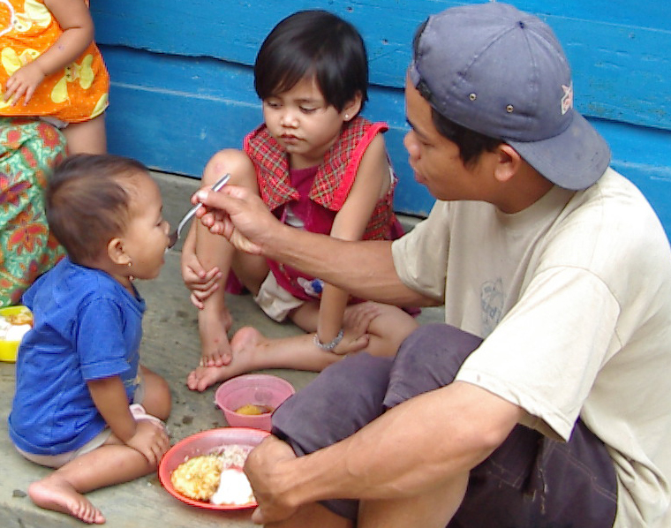
Positive deviance
A difference in outcomes indicates:
an important factor
a too-general question
Celebrate differences and seek lessons in them
Yes, but start understanding earlier
Notes:
Positive deviance is when you examine the outliers that are better than average, and you determine what is different about them in order to copy it.
Example: when I have an argument about who came up with an idea

Slide 24
How to achieve reproducibility

Slide 25
Definitions
Reproducible: an independent party can
follow the same steps, and
obtain similar results
Generalizable: similar results, in a different context
Credible: the audience believes the results
Notes:
Context = experimental subjects, etc.
independent party: a master's student
same result: up to measurement imprecision
It’s essential that another party can do what you did. Achieving the same results is highly desirable.

Slide 26
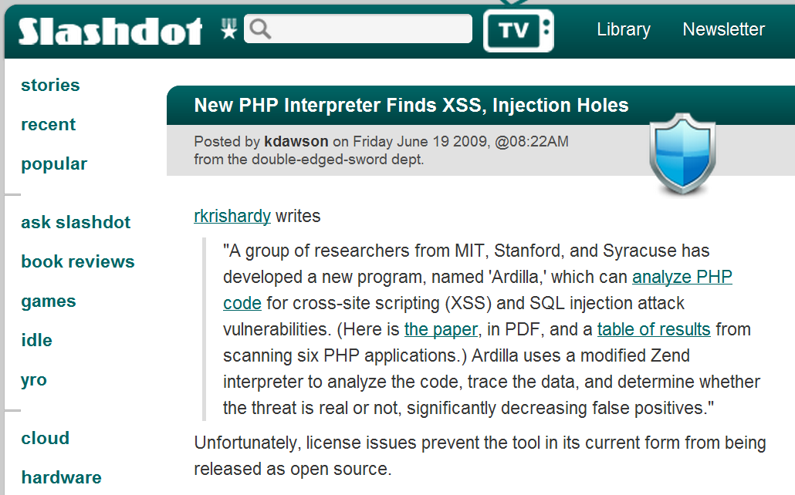
Give all the details
Goal: a master's student can reproduce the results
Open-source tools and data
Use the Web or a TR as appropriate
Takes extra work
Choice: science vs. extra publications vs. secrecy
Don’t suppress unfavorable data
Notes:
Suppressing unfavorable data is fraud

Slide 27
Admit non-generalizability
You cannot to control for every factor
What do you expect to generalize?
Why?
Did you try it?
Did you test your hypothesis?
Notes:
Can’t control every factor? That's OK! Be honest

Slide 28
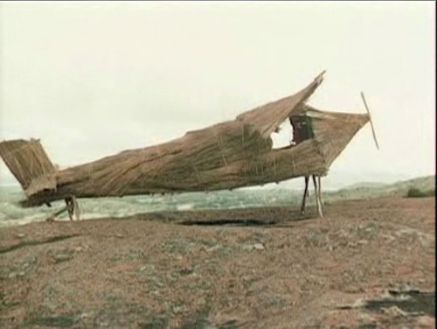
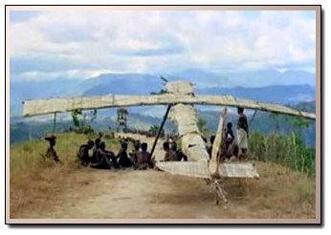
“Threats to validity” section considered dangerous
“Our experiments use a suite of 7 programs and may not generalize to other programs.”
Often omits the real threats – cargo-cult science
It's better to discuss as you go along
Summarize in conclusions
Notes:
Whether you have a TTV section is orthogonal to whether you discussed TTV.
Just like religion and morality are uncorrelated traits in a human being.

Slide 29
Explain yourself
No “I did it” research
Explain each result/effect
or admit you don’t know
What was hard or unexpected?
Why didn’t others do this before?
Make your conclusions actionable
Notes:
Don't leave it to the audience to figure this out
That is a cop-out, and you have not done your job
The goal of any writing is to move people to action. What is that action?

Slide 30
Research papers are software too
“If it isn’t tested, it’s probably broken.”
Have you tested your code?
Have you tested generalizability?
Act like your results matter
Notes:
A way te test generalizability: try one more experiment.
Accept no less in research than you do in software.
Research results matter: it’s not just a game about getting published.
Act like your results matter, and maybe they will matter.

Slide 31
Automate/script everything
There should be no manual steps (Excel, etc.)
Except during exploratory analysis
Prevents mistakes
Enables replication
Good if data changes
This costs no extra time in the long run
(Do you believe that? Why?)
Notes:
Computer scientists hate manual steps

Slide 32





Packaging a virtual machine
Reproducibility, but not generalizability
Hard to combine two such tools
Partial credit

Slide 33
Measure and compare
Actually measure
Compare to other work
Reuse data where possible
Report statistical results, not just averages
Explain differences
Look for measureable and repeatable effects
1% programmer productivity would matter!
It won't be visible

Slide 34
Focus
Don't bury the reader in details
Don't report irrelevant measures
Not every question needs to be answered
Not every question needs to be answered numerically

Slide 35
Usability
Is your setup only usable by the authors?
Do you want others to extend the work?
Pros and cons of realistic engineering
Engineering effort
Learning from users
Re-use (citations)
Notes:
Cost and time of “non-research” engineering effort.
You learn a lot from real use!
Others can stand on your shoulders.
Use real programmers? If you can find enough of them...
But this doesn't guarantee much except that you will spend a lot of money.

Slide 36
Reproducibility, not reproduction
Not every research result must be reproduced
All results should be reproducible
Your research answers some specific (small) question
Seek reproducibility in that context
Notes:
You never know which of your papers is going to be a home run
How controversial is it?
How important is it?

Slide 37
Blur the lines
Researchers should be practitioners
design, write, read, and test code!
and more besides, of course
Practitioners should be open to new ways of working
Settling for “best practices” is settling for mediocrity
Notes:
You will never get ahead of the pack if you just follow the herd
* don't settle for "best practices"; doing so is a trap
Best practices are only a starting point

Slide 38

We are doing a great job
Research in testing and verification:
Thriving research community
Influence beyond this community
Great ideas
Practical tools
Much good evaluation
Transformed industry
Helped society
We can do better

Slide 39

“If I have seen further it is by standing on the shoulders of giants.”
-Isaac Newton
Notes:
I am not perfect, but I am trying.
I invite you to join me in this effort.

