Slide 1
Identifying Research Problems
Michael D. Ernst
IMDEA Software Institute and University of Washington
Workshop at UPM

Slide 2
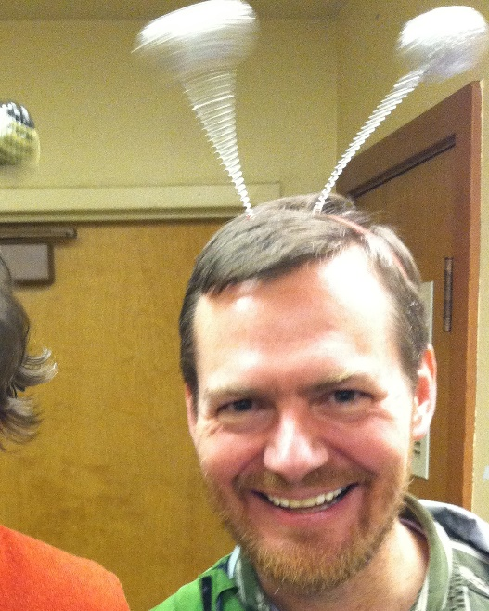
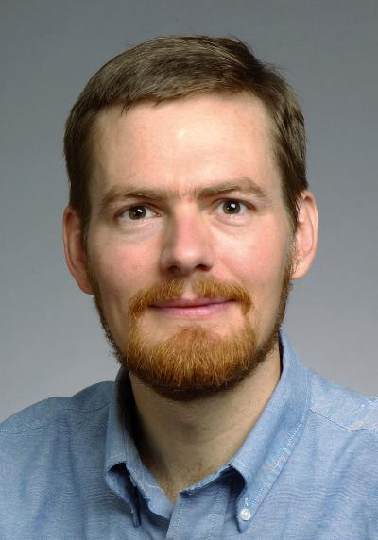
Introductions
I do research in programming langages, software engineering, security, and related fields
Professor at the U. of Washington
on sabbatical at IMDEA Software Institute
previously Associate Professor at MIT & researcher at Microsoft Research
maintain a webpage with advice: https://homes.cs.washington.edu/~mernst/advice/
Who are you?
(name, year, topic, research experience, why you are here, what you hope to learn)
Notes:
Sabbatical is supposed to be a break from teaching, but this is something I feel strongly about.
Get everyone to say something about themselves:

Slide 3
The hardest part of research: asking questions
If you are smart enough to get into graduate school, you are probably good at answering questions
That’s what college trained you to learn
Graduate school teaches you how to ask questions
Once you ask the right question, the answer is often obvious
The question you ask implies a framing of the problem

Slide 4
The characteristics of great research
Recall a good research paper/talk/result
What was remarkable about it?
Notes:
Exercise on the whiteboard

Slide 5
The characteristics of great research
Great research needs:
idea
execution
presentation
We will
⇦ today’s focus

Slide 6
Well-presented research convinces you:
The problem is interesting
effect on human welfare, corporate profits, defense
evidence: other people have worked on it
The problem is hard
other smart people have tried it
obvious approaches do not work
problem persists over time
The authors have solved the problem
technical details
evaluation, such as proofs or experiments
about
the
problem

Slide 7
Sources of research ideas
Always be working on something (even if it won’t be your thesis topic)
Think about problems, difficulties, or irritations
You might get sidetracked onto something more important
Learn about other research: attend talks, read papers, take classes
future work they identified
connections they did not make
assumptions
other criticisms
Your advisor
OK for starter projects, master's projects
not OK for PhD thesis topic

Slide 8
Think outside the box: A good research idea often “cheats”
If you take the same approach as other people, you are likely to be no more successful than they are
Cut the Gordian knot: take a different approach
Example:
Artificial intelligence vs. brute force (chess, speech, etc.)

Slide 9
Bad ideas are essential
Most ideas are bad ideas
If you have lots of ideas, some will be good
It’s better to have bad ideas than no ideas
I can teach people how to filter
It’s harder to teach courage and imagination
Filtering is initially your advisor’s role
You will get better with time, and spend less time evaluating and discarding bad ideas
Have faith in your own judgment, too
Your advisor is not infallible. Examples: Daikon, IGJ
Generate lots of ideas before filtering
Breadth-first, not depth-first, approach to the problem
Notes:
When you graduate, you will know more about your topic than your advisor does.

Slide 10
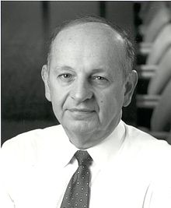
Heilmeier’s Catechism (questions to be asked about any research proposal)
What are you trying to do? Articulate your objectives using absolutely no jargon.
How is it done today, and what are the limits of current practice?
What's new in your approach and why do you think it will be successful?
Who cares?
If you're successful, what difference will it make?
What are the risks and the payoffs?
How much will it cost?
How long will it take?
What are the midterm and final "exams" to check for success?

Slide 11
Brainstorming strategies

Slide 12
Automation
Find a task that is currently done manually, or that is time-consuming or difficult
Thoughtfully examine the manual process
What reasoning does the person do?
Can you automate that process?

Slide 13
Contrarianism
Turn the conventional wisdom on its head
Do the opposite of what everyone else expects
You must do this thoughtfully: you have to justify why, and why it matters
Example: sequentializing parallel programs
Solves the same problem, and is better in some ways

Slide 14
Notice complementary approaches
Given two approaches to a problem: wherever one is used, try the other one
Example: static and dynamic analysis
Static: sound, conservative
Dynamic: precise, does not generalized
⇒ dynamic invariant detection
Example: semantic vs. syntactic analysis

Slide 15
Combine existing techniques
Apply one after the other
Create a hybrid analysis

Slide 16
Cross-fertilization
Take an approach from one domain, and apply it to another
Examples: Machine learning, statistics, biology, …

Slide 17
Fill in gaps
Review your previous research
Are there themes or commonalities?
Find ways to fill in the gaps
This is particularly useful for creating a PhD thesis out of a sequence of successful projects.

Slide 18
Goal vs. technique
A research project requires:
A goal or problem
A technical approach
Advantages of starting with a goal
More likely to find a technical approach
More likely to be novel and relevant
Advantages of starting with a technique
Quick to complete: you probably already have it implemented
Fits well with your other work

Slide 19
What is your secret weapon?
Use your unique set of skills and experiences
Why are you the right person to work on this?
You have taken a particular combination of classes
Example: Steve Jobs and calligraphy class
You have a friend with a tool/technique/knowledge
You thought of it first (new approach)
You are willing to work harder
Notes:
Example: Steve Jobs

Slide 20
Passion for your work
Your intellectual curiousity about a topic is necessary but not sufficient.
Necessary:
Your love for the topic will affect your motivation (and possibly ability)
It helps if the topic was your idea
Not sufficient:
It has to matter to other people as well

Slide 21
Generalizing
How does this generalize? What are the broader implications?

Slide 22
Brainstorming exercise
Think about problems that you encounter in day-to-day programming.

