Slide 1
Collaborating at the Hardware/Software Interface: A Programming-Languages Professor’s View
Dan Grossman
University of Washington
Spring 2011

Slide 2
Executive Summary
Working on many things, thanks to co-advising
Brief overview, then focus on a few
Chosen focus: Projects spanning hardware and software
Helping Luis Ceze advise the “SAMPA group”
Reinvigorate research across the HW/SW divide
HW/SW division sometimes a key research question
Apply PL principles even when not doing PL research
Four ongoing projects
DMP: Deterministic execution of multiple threads
OSHA: Code-centric thread-sharing partial specifications
EnerJ: Language support for low-power approximate computing
Concurrency Exceptions

Slide 3
Biography / group names
PLDI, ICFP, POPL “feel like home” 1997-
PhD for Cyclone: type system, compiler for memory-safe C dialect
UW faculty 2003-
30% ⇒ 80% focus on multithreading, 2005-
Lots of transactional memory, 2005-2008: meet HW people
Co-advising 3-4 students with architect+ Luis Ceze, 2007-
Two groups “for marketing purposes”
WASP wasp.cs.washington.edu
SAMPA sampa.cs.washington.edu

Slide 4
Other ongoing projects
Client-side third-party web extensions [with MSR]
Aspects for JavaScript (?!) [OOPSLA2010]
Modular memory-model semantics
And optimizations allowed by “data races illegal” [with HP]
TM semantics issues
Dynamic tracking of what can be used in transactions
Abstraction violation of “escape actions”
MapReduce progress estimation [SIGMOD2010]
Department + international work on undergraduate curriculum

Slide 5
Outline
DMP: Deterministic execution of multiple threads
OSHA: Code-centric thread-sharing partial specifications
EnerJ: Language support for low-power approximate computing
Concurrency Exceptions

Slide 6
Deterministic Execution – Why?
“Everybody knows” (shared-memory) multithreading
makes programming more difficult
Why? Many reasons with cumulative effect
One primary cause: non-determinism
Run each test many times
Hard to reproduce bug reports
Can’t keep replicas in sync
Timing-based security attacks
Can’t reason sequentially (much less modularly)

Slide 7
Two levels of non-determinism
Most languages are non-deterministic
Set of legal behaviors for a single program+input
Often exponential in program size
(Undefined evaluation order has an analogous problem)
Most language implementations are non-deterministic
Subject to whims of scheduler, hardware, temperature, …
(Undefined evaluation order not typically like this)
Our focus:
Implement non-deterministic languages deterministically:
“execution-level determinism”

Slide 8
Complementary advantages
Execution-Level Determinism
Works for today’s PLs for wider range of applications
No programmer effort
Solves (1)-(4), with caveats
Can leverage language non-determinism for performance
Language-Level Determinism
Sequential semantics eases reasoning/verification
More programmer control over run-time behavior
Solves (1)-(5), fewer caveats
Can leverage language restrictions for performance
Run each test many times
Hard to reproduce bug reports
Can’t keep replicas in sync
Timing-based security attacks
Can’t reason sequentially (much less modularly)

Slide 9
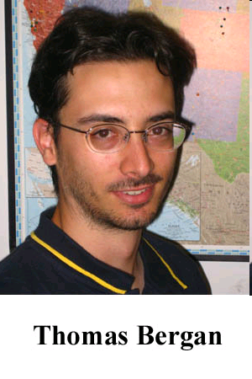
Work at UW to date
DMP: Special-purpose HW
[Devietti et al, ASPLOS’09]
Initial algorithms,
speculative or not
dOS: Page-based OS service
[Bergan, OSDI’10]
Deterministic process groups,
dealing with asynchronous inputs
CoreDet: Compiler + Run-Time
[Bergan et al, ASPLOS’10]
Static optimizations, parallel SW commit, non-speculative buffering
RCDC: HW/SW hybrid
[Devietti et al, ASPLOS’11]
HW only counts and buffers,
more scalable algorithms

Slide 10
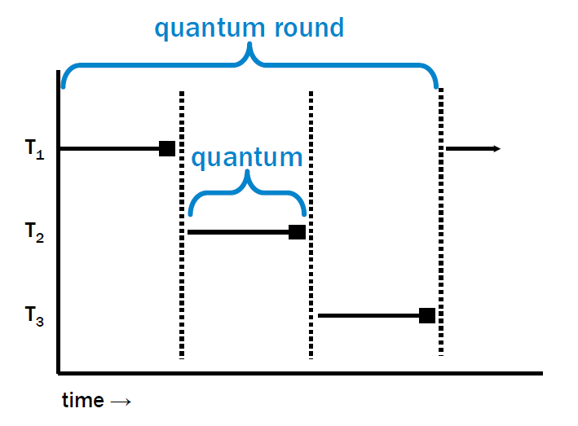
Determinism is easy…
Conceptual starting point: Deterministic serial execution
deterministic quantum size
(e.g., count instructions)
+
deterministic scheduling
=
determinism
… performance is hard

Slide 11
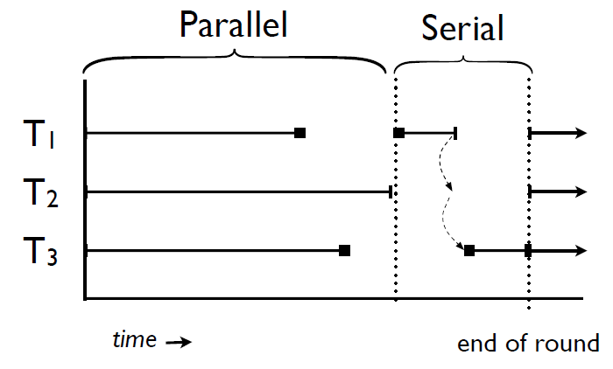
Can we do better?
No need to serialize non-communicating instructions
Ensure non-communication? Hold that thought
Split a quantum at first (dynamic) may-communicate instruction
“parallel mode” prefix and “serial mode” suffix

Slide 12
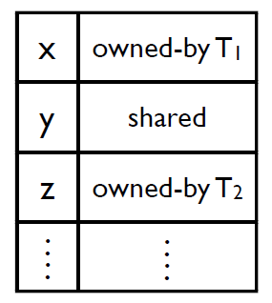
First approach: Ownership
For each object, track ownership: “owned by Ti” or “shared”
Any granularity of tracking is sound (cf. cache-line size)
In parallel mode, can read “owned by me” or “shared”
In parallel mode, can write “owned by me”
Therefore: no communication in parallel mode
So how should we initialize
and update ownership?

Slide 13
Ownership update
So how should we initialize
and update ownership?
Correctness vs. performance: Any deterministic policy is correct
Our policy, more or less:
In serial mode, read changes “owned by other” to “shared”
In serial mode, write changes anything to “owned by me”
(Cf. conventional multiprocessor cache, same locality reasons)

Slide 14
Performance needs
Need:
Short or non-existent serial mode
Coarse-grained communication → right ownership
Balanced quanta
Relatively short quanta, with rough instruction-cost model
No run-time timing allowed
Low overhead for quanta stopping, starting
Relatively long quanta (uh-oh, see above)
Low overhead for read/write barriers
Including static techniques to remove unnecessary barriers
Ensuring correctness was how I got involved…

Slide 15
An interesting optimization
Suppose reads R1 and R2:
Must alias (w.r.t. ownership tracking; can be different fields)
R2 must follow R1 in same quantum (e.g., same basic block)
Then R2 needs no instrumentation
Are you sure? ☺
Easy case: R1 and R2 both happen in parallel mode
Easy case: R1 and R2 both happen in serial mode
Hard case: R1 in parallel mode, R2 in serial mode…

Slide 16
Why is this okay?
Parallel Serial
T1: … … write(X)
T2: … read(X) … ... read(X)
X : shared
X : ???
time
After this round:
Without optimization, X : shared
With optimization, X : owned-by T1
Choice observably affects subsequent rounds
Where parallel mode ends affects order of writes
But it’s okay: Executable with or without optimization is deterministic
Different deterministic executables (key degree of freedom)

Slide 17
The limitation
So far: The ownership approach
Plus: Low-ish overhead
Check ownership and proceed
Minus: Unnecessary transfers to serial mode
Example: A lock acquire may “transfer” a whole data structure to Ti, but each quantum that first accesses a node has to serialize
A scalability problem: Worse with more cores (Amdahl)
So: The buffering approach
More overhead but better scalability
Standard trade-off in parallel systems

Slide 18
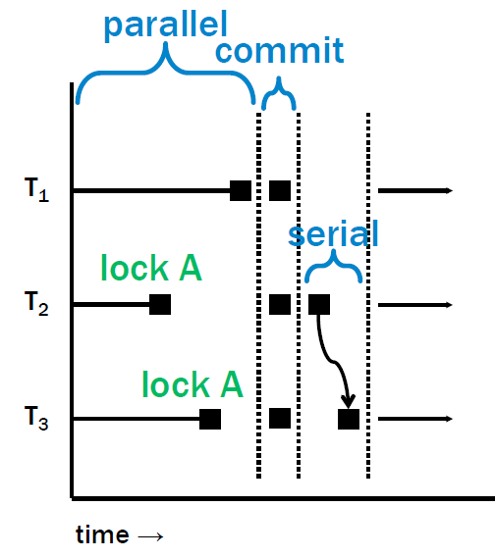
Buffering
Any thread can access any address in parallel mode
But:
All writes are buffered
All reads consult thread’s buffer (overhead!)
Only synchronization operations end parallel mode before quantum end

Slide 19
Buffering
After parallel mode, deterministically commit buffer
Semantically serial
But mostly in parallel
Cf. graphics z-buffers

Slide 20
Buffering
Short serial mode just for synchronization operations
The “fence” semantics of these operations forbids reordering with (buffered) writes
“Fixed” in our ASPLOS11 paper (but HW/SW hybrid)
Hopefully synchronization rare relative to quantum size

Slide 21
Buffering
Determinism:
Parallel modes isolated
And end deterministically
Commit is semantically serial
Serial is serial

Slide 22
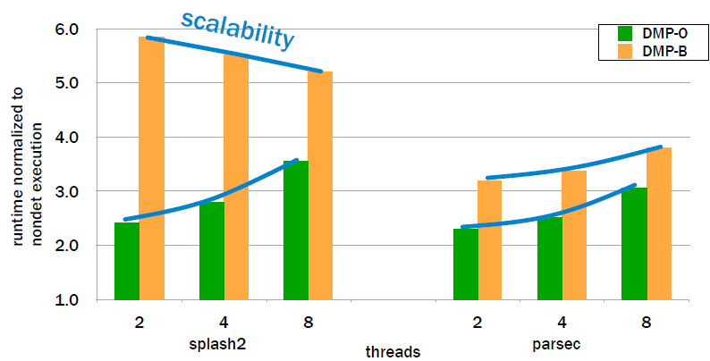
Results: the short version
Pure SW overhead is substantial
But if it scales, a great use of extra cores
Scalability depends on application (means can mislead)

Slide 23
Attacking overhead and scalability
After HW in ASPLOS09 and SW in ASPLOS10,
what are the general principles?
Overhead is a SW problem that HW-assist can solve
Count instructions, provide local buffers, expose via ISA
Scalability is an algorithm problem
Quantum balance requires careful tuning – okay
Buffering helps some applications, but fine-grained synchronization still suffers
So a new algorithm that avoids serial mode
Is ASPLOS11 just the 3rd of N years of more clever algorithms?
No…

Slide 24
Memory Models
Old HW lesson: Weaker memory-consistency models scale better
The reason for weak models
Ownership approach was sequentially consistent (SC)
Buffering was “total-store order” (TSO)
May as well relax to “happens-before” (HB)
The PL (cf. Java, C++) only gives you HB anyway
But the PL does give you HB, so can’t go weaker
ASPLOS11 results impressive: 5-70% overhead
But incomparable because assume HW/SW hybrid
For some applications, HB significantly outperforms TSO

Slide 25
Secret Sauce
Why does it matter that this has been a HW+SW project?
Same students can argue the semantics, hack the compiler, run architectural simulations
They don’t find it weird to go to PLDI and ISCA
Manage co-advisors with different skill sets
Complementary perspectives on what is efficient
Counting instructions vs. identifying thread-local data
Distinguish algorithmic technique from implementation
Can track ownership in HW, SW, or OS
It’s fun

Slide 26
Ongoing work
“The robustness problem”
Biggest caveat with respect to repeatability
Benefits to testing
Incorporating acceptable non-determinism
Application to distributed systems
Build on OS work

Slide 27
Related work
Determinism is a hot topic, so please pardon omissions
Deterministic languages:
DPJ [OOSPLA09, POPL11]
NESL, Jade, ORCS, …
Execution-level determinism
Kendo [ASPLOS09], good performance but assumes no data races
Grace [OOPSLA09]
System-level support: entire session at OSDI10
Record-and-replay: some of determinism’s benefits

Slide 28
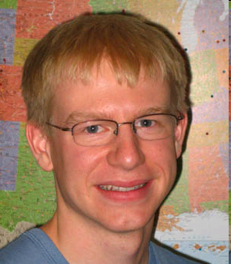
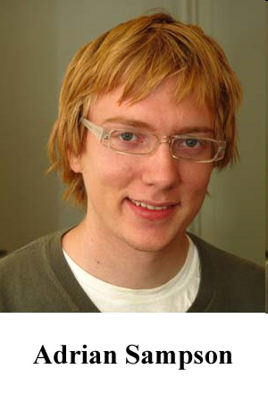
Outline
DMP: Deterministic execution of multiple threads
OSHA: Code-centric thread-sharing partial specifications [OOPSLA10]
EnerJ: Language support for low-power approximate computing
Concurrency Exceptions

Slide 29
Shared memory
For better or worse (probably worse), shared memory is one dominant paradigm for concurrent programming
At PL and HW levels, default is implicit sharing
But sharing/communication/interleaving should be rare
Rare sharing enables successful program-analysis tools
Data-centric: Race detectors, types for safe locking, sharing specs
Isolation-centric: Atomicity checkers, TM,
Code-centric: our work
Complementary: partially overlapping set of bugs
(Orthogonal to static vs. dynamic analysis, language vs. tool, etc.)

Slide 30
Code-centric
Consider shared-memory communication as between
code points executing in different threads
The writer and the subsequent reader
Partial specification: which directed pairs are allowed
enqueue
dequeue
Specification meaning:
At memory read, consider last write to same location
If write performed by different thread, then pair must be in spec
Code-centric: No mention of which memory, how much memory, synchronization protocol, etc.

Slide 31
Nice idea, but…
enqueue
dequeue
Basic idea doesn’t work without solving several problems
Helper functions
Many writes delegated to callee unaware of sharing
Multiple abstraction levels
Want to specify/check communication in terms of libraries and library clients (N levels deep, naturally)
Encapsulated sharing
Often callers should be unaware of some communication
Convenient specifications
App-specific properties require programmer annotations
Efficient enough checking to be more than documentation

Slide 32
Helper functions
enqueue
if(buffer full)
Util.resize(…)
dequeue
??
Util.resize
…
By our definition, Util.resize communicates to dequeue
But don’t want to specify that
Util.resize communicates on behalf of its caller
So specify it is conceptually inlined
Actually the default

Slide 33
Multiple abstraction levels
producer
consumer
enqueue
dequeue
array_put
array_get
Want to specify communication at each abstraction level separately
Want to check all the levels
So the dynamic check requires matching call stacks
Modulo inlining

Slide 34
Encapsulated Sharing
producer
consumer
??
enqueue
size++
dequeue
size--
array_put
array_get
Abstractions have internal communication that should not propagate
Extend specification language to describe interfaces
Dynamic checker stops stack processing after the (dequeue, enqueue) pair

Slide 35
Convenient specifications
Use groups of writers & readers to avoid quadratic blowup
Make inlining the default
Evaluation is empirical
Thankfully, in good software, communication is sparse
Caveat (feature?): “No annotations” is correct

Slide 36
A dynamic checker
Semantically:
On each write, store thread-id and call-stack with location
On each read, compare thread-ids and call-stacks
To get reasonable overhead for a debugging tool:
Check thread-ids first
Global memo-table of stack-pairs with full hash-consing
For hot reader-stacks, an inline cache for hot writer-stacks
Bottom line: These fast-paths work!
1 execution with over 6 billion reads needed 697 stack-walks
Unique communicating stack-pairs are rare

Slide 37
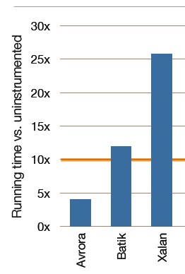
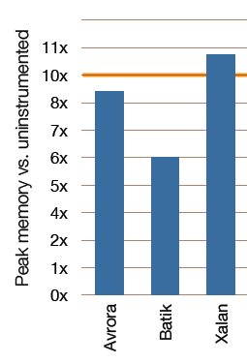
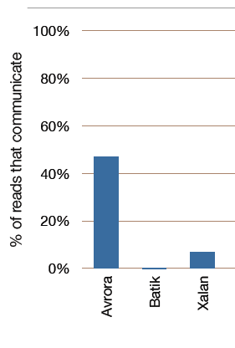
Debugging tool
Usable heavyweight debugging tool
# of different stacks matters more than amount of communication
Not fast, but useful for humans handling concurrency errors

Slide 38
The Hardware Connection
Turns out our OOPSLA10 paper has nothing to do with HW
But across the lab, a different code-centric technique using history of HW coherence events and machine learning for automatic bug diagnosis
[MICRO09]
Hmm… those ideas transfer/extend to software
So while I’m doing other things ☺, they write a PLDI11 paper:
Isolating and Understanding Concurrency Errors Using Reconstructed Execution Fragments

Slide 39
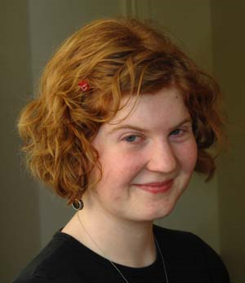
Outline
DMP: Deterministic execution of multiple threads
OSHA: Code-centric thread-sharing partial specifications
EnerJ: Language support for low-power approximate computing
[PLDI2011]
Concurrency Exceptions

Slide 40
Saving energy
Modern platforms expend a huge amount of energy
Largely to ensure you get the right answer
Often not the right trade-off!
Audio, Video
Clustering, classification, information retrieval
Monte Carlo simulation
Game AI
…

Slide 41
Many ways to save
Energy savings via approximation at various abstraction levels
Hardware
Lower voltage memory more likely to flip bits
Smaller functional units with less precision
Compiler
Data placement
Heuristically skip computations [Agarwal et al]
Application
Imprecise algorithm (e.g., smaller sample size)
Our work: Use PL to make existing techniques safer, easier to use

Slide 42
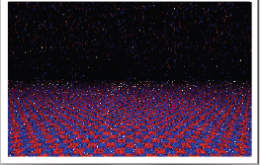
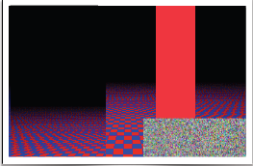
Idea #1
Higher levels must tell lower levels what is approximable
Ignoring how the lower level achieves approximation
Leave amount-of-approximation (QoS) to “best effort” for now

Slide 43
Idea #2
Different libraries have different ways to approximate
Clients should just indicate which uses are approximable
Examples:
Image data: okay to flip some bits (HW storage)
Average: okay to round floating-point (HW computation)
Average: okay to average a sample (alternate algorithm)

Slide 44
Idea #3
Programmer must indicate where approximate can influence precise
Catch bugs, control propagation of bad computations
“Just” an information-flow problem! (Good!)
Comfortable with
Very simple but sound information-flow tracking
Liberal use of explicit endorsement
Most code is precise (the default)
But hot computation often approximable

Slide 45
Putting it together
With these ideas, a very nice area-opening project:
Type qualifiers for precise, approx, and inherit-from-context
Approx bits can be stored in low-energy hardware, but array lengths, pointers, and type tags cannot
Overload methods with approximate versions
Client chooses when approximation is allowed
Run-time chooses when approximation is used
Information-flow type system
Keep it simple: No branches on approx data (endorse it)
Formal semantics to show non-interference

Slide 46
More on data storage [my little piece]
For memory safety, only (some) ints and floats can go in approximate storage
How can the hardware provide a usable memory hierarchy
How can the PL implementation use it
(Not carefully considered by prior work on approx caches)
Our answer (requiring knowledge of HW and SW)
Each cache line can have voltage scaled
Object layout just got interesting…

Slide 47
Example (32-byte cache lines)
class X {
@precise int a,b,c,d,e;
@approx int f,g;
}
class Y extends X {
@precise int h,i;
@approx int j,k;
}
unpadded
(bad for Y)
X
a
b
c
d
e
f
g
Y
a
b
c
d
e
f
g
h
i
j
k
padded
(bad for X)
X
a
b
c
d
e
--
--
Y
a
b
c
d
e
h
i
f
g
f
g
j
k
Note: Partial approx lines waste space & energy
Can’t start next object on approx line
Interesting, but in practice arrays matter the most
First few elements in precise line with length (less savings)

Slide 48
Evaluation
Annotate benchmark programs to identify legal approximation
Measure burden (it’s low, details omitted)
Using prior work, fake-but-realistic HW model to estimate savings / error probability curve
A simulator that injects faults probabilistically
Get details like cache-line granularity right (chose unpadded)
Measure energy savings and (application-defined) QoS

Slide 50
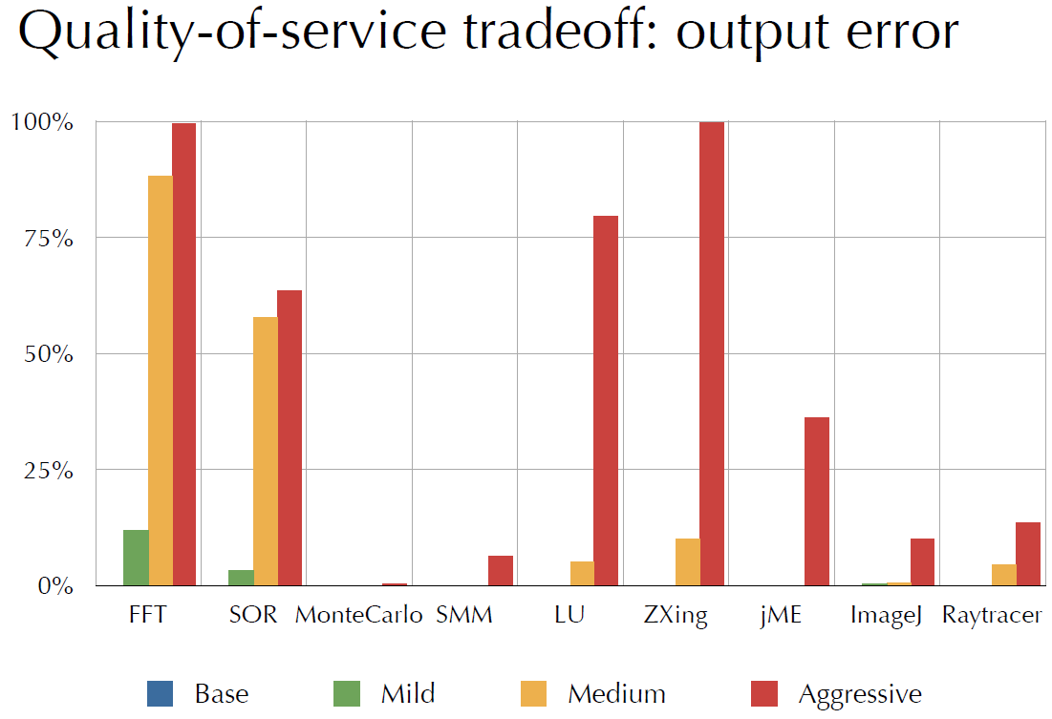

Slide 51
Future work
What if we didn’t assume novel hardware?
Distinguish low-probability bit-flip from guaranteed rounding?
Specifying more than “best effort”?
Is our information-flow system too strong or too weak?
…
A vision of controlled pay-as-you-go precision

Slide 52
Outline
DMP: Deterministic execution of multiple threads
OSHA: Code-centric thread-sharing partial specifications
EnerJ: Language support for low-power approximate computing
Concurrency Exceptions

Slide 53
Data-race exceptions
Data race: read/write or write/write of same location by different threads without intervening synchronization
What if the execution platform (e.g., HW) guaranteed
precise data-race detection at run-time (e.g., trap)?
Catch bugs
Drastically simplify defining and implementing memory-consistency models
Everyone agrees on “DRF implies SC”, i.e., interleaving semantics in the absence of data races
But the time between the two accesses in a data race isn’t bounded
Expensive to maintain all the metadata

Slide 54
Conflict exceptions [ISCA10]*
A slightly weaker guarantee that lets the platform bound checking:
(no data race) ⇒ (no exception) ∧ (sequential consistency)
(data race) ⇒ (exception)
Advantages
Still get some bug-checking, but allows missing “long races”
Still simplify language semantics!
*Lucia, Ceze, Strauss, Qadeer, Boehm [not me]
Closely related work: DRFx [PLDI10]
∨ (sequential consistency)

Slide 55
Ongoing work
Assuming
data-race exceptions
or, in contrast,
conflict exceptions
what else could a compiler + run-time system do with them?
Key idea: Data races may be really unlikely but not errors
Hint: Simpler read and write barriers (recover from trap)

Slide 56
Thanks!
DMP: Deterministic execution of multiple threads
OSHA: Code-centric thread-sharing partial specifications
EnerJ: Language support for low-power approximate computing
Concurrency Exceptions
Focus on technology trends: multicore and power
Let “HW or SW or both” be a question, but not the first question
And, by the way, 3 of the 4 projects have used formal semantics
http://sampa.cs.washington.edu

Slide 57
Owen
Anderson
Werner
Dietl
Kristi
Morton
Magdalena
Balazinska
Laura
Effinger-Dean
Jacob
Nelson
Tom
Bergan
Emily
Fortuna
Mark
Oskin
Luis
Ceze
Benjamin
Lerner
Adrian
Sampson
Joe
Devietti
Benjamin
Wood
Brandon
Lucia

