Slide 1
Region-Based Dynamic Separation in STM Haskell (And Related Perspective)
Dan Grossman
University of Washington
Transactional Memory
Workshop
April 30, 2010

Slide 2
Apology
From: Hank Levy (Department Chair)
Date: April 6, 2010
Subject: Upcoming faculty meetings
… Please reserve ** NOON TO 5:30 PM ** on THURSDAY APRIL 29th for a possible (marathon) faculty meeting…

Slide 3
Apology
From: Nicholas Kidd
Subject: Re: [TMW'10] A few announcements
Ugh indeed, this sounds terrible …
I hereby promise that coffee will be available
throughout TMW'10!

Slide 4
TM at Univ. Washington
I come at transactions from the programming-languages side
Formal semantics, language design, and efficient implementation for atomic blocks
Software-development benefits
Interaction with other sophisticated features of modern PLs
[ICFP05][MSPC06][PLDI07][OOPSLA07][SCHEME07][POPL08]
transfer(from,to,amt){
atomic {
deposit(to,amt);
withdraw(from,amt);
}
}
An easier-to-use and
harder-to-implement synchronization primitive

Slide 5
The goal
I want atomic blocks to:
Be easy to use in most cases
Interact well with rest of language design / implementation
Despite subtle semantic issues for PL experts
My favorite analogy [OOPSLA07] : garbage collection is a success story, for memory management rather than concurrency
People forget subtle semantic issues exist for GC
Finalization / resurrection
Space-explosion “optimizations” (like removing x=null)
…

Slide 6
Today
Review and perspective on transaction + non-transaction access
“How we got to where we are”
A healthy reminder, probably without (much) controversy
But not much new for this expert crowd
Not-yet-published work on specific issue of dynamic separation
Extension of STM Haskell
Emphasize need for “regions” and libraries reusable inside and outside transactions
Time permitting: Brief note on two other current projects

Slide 7
Are races allowed?
For performance and legacy reasons, many experts have decided not to allow code like the following
I can probably grudgingly live with this
Why penalize “good code” for questionable benefit
But:
For managed PLs, still struggle with “what can happen”
Does make it harder to maintain / evolve code
Thread 1
x = 2;
Thread 2
atomic {
x = 1;
y = 1;
assert(x==y);
}

Slide 8
Privatization
Alas, there are examples where it is awkward to consider the
program racy, but “basic” TM approaches can “create” a problem
Canonical “privatization” example:
initially ptr.f = = ptr.g
ptr
Thread 1
atomic {
r = ptr;
ptr = new C();
}
assert(r.f==r.g);
Thread 2
atomic {
++ptr.f;
++ptr.g;
}
f
g

Slide 9
The Problems
Eager update, lazy conflict detection:
assert may see one update from “doomed” Thread 2
Lazy update:
assert may see one update from “partially committed” Thread 2
initially ptr.f = = ptr.g
ptr
Thread 1
atomic {
r = ptr;
ptr = new C();
}
assert(r.f==r.g);
Thread 2
atomic {
++ptr.f;
++ptr.g;
}
f
g

Slide 10
Solution areas
To support atomic blocks that privatize (and related idioms):
Enrich underlying TM implementations to be privatization safe
I’m all for it if trade-offs are acceptable
Important but uncommon cases
Not today’s presentation
Disallow privatization
Either soundly prohibited by PL or programmer error
Allow privatization only if programmers do more explicit work
Our work, making this more convenient and flexible

Slide 11
Disallowing privatization
Prior work on static separation takes this approach
Same memory cannot be used inside a transaction and outside a transaction
Note read-only and thread-local are okay
Thread local
Immutable
See:
NAIT is provably enough for “weak” TM to implement “strong” atomic block
POPL08 * 2
STM Haskell
functional + monads
=> immutable or NAIT
Never
accessed in transaction

Slide 12
Dynamic separation
Dynamic separation allows objects to transition among
Only accessed inside transactions
Only accessed outside transactions
Read only
(Added by us: thread-local to thread tid)
Explicit language primitives to enact transitions
Example: protect obj transitions obj to “only inside”
Semantics and implementation for C# and AME
[Abadi et al, CC2009, CONCUR2008]

Slide 13
Uses of dynamic separation
Obvious use: Explicit privatization
Another: more efficient (re)-initialization of data structures than static separation would allow
Essentially a “publication”
Create a large tree in one thread without transactions and then protect it and make it thread-shared
Resize a hashtable without a long transaction (next slide)
But the (re)-initialization argument is much more compelling if we can transition an entire data structure in O(1) time/space
For example: If hash table uses linked lists

Slide 14
Hash table example
class HT {
T [] table;
boolean resizing = false;
…
void insert(T x){ atomic{ if(resizing) retry; … }}
T find(int key) { atomic{ if(resizing) retry; … }}
void resize() {
atomic{ if(resizing) return; resizing = true; }
unprotect(table);
…
protect(table);
atomic{ resizing = false; }
}
}

Slide 15
Today
Laura
Effinger-Dean
Review and perspective on transaction + non-transaction access
“How we got to where we are”
A healthy reminder, probably without (much) controversy
But not much new for this expert crowd
Not-yet-published work on specific issue of dynamic separation
Extension of STM Haskell
Emphasize need for “regions” and libraries reusable inside and outside transactions
Time permitting: Brief note on two other current projects

Slide 16
Why Haskell
In some sense, Haskell is a terrible choice for dynamic separation
The one language where static separation is natural
Monads already enforce static separation of many things
But this makes it an ideal setting for our research
Use dynamic separation only where static separation is unpalatable
Need a precise, workable semantics from the start, else it will be obvious we are “ruining Haskell”

Slide 17
Novelties
Region-based to support constant-time transition-change for collection of objects
Complement static separation (current default in Haskell)
Allow both approaches in same program (different data)
Use dynamic separation for composable libraries that can be used inside or outside transactions, without violating Haskell’s type system
Extend elegant formal semantics (including orelse)
Underlying implementation uses lazy update
Significant speed-up for some benchmarks by avoiding transactions that are necessary with static separation

Slide 18
STM Haskell basics
STM Haskell has static separation
Most data is read-only (purely functional language)
Non-transactional mutable locations called IORefs
Transactional mutable locations called TVars
Because the type system enforces static separation, you can’t “transactionalize” code using IORefs, by “slapping an atomic around it”
This is a general feature of Haskell’s monads
The STM monad and IO (top-level) monad are distinct
atomically primitive takes a transaction “object” and creates a top-level-action “object”
atomically :: STM a -> IO a

Slide 19
Adding DVars
From a language-design standpoint, it’s mostly straightforward to add a third kind of mutable location for dynamic separation
In “normal languages”, a DVar would be allowed by the type system to be accessed anywhere
A meta-data field would record “current protection state” and dynamically disallow transactions to use it when “unprotected”
This doesn’t work with monads: separation is the rule

Slide 20
DVars for Haskell
So we add a third monad, DSTM monad, for Dvars
Can turns a DSTM “object” into an STM “object” or a top-level-action “object”
atomically :: STM a -> IO a
protected :: DSTM a -> STM a
unprotected :: DSTM a -> IO a -- not atomic!
A DSTM “object” could be as little as a single read/write of a DVar
But sequences of actions can be packaged up so that the same library can be used inside or outside transactions
Trade-off between code reuse and protection-state checks
Not possible in previous approaches to sound separation

Slide 21
Regions
So far, we could just have the DSTM Monad include operations, including protection-state changes for DVars
newDRgn :: DSTM DRgn
a -> DRgn -> DSTM (DVar a)
newDVar :: a -> DSTM (DVar a)
readDVar :: DVar a -> DSTM a
writeDVar :: DVar a -> a -> DSTM a
protectDVar :: DVar a -> IO ()
unprotectDVar :: DVar a -> IO ()
protectDRgn :: DRgn -> IO ()
unprotectDRgn :: DRgn -> IO ()
Instead, we add a level of indirection for the protection state, so one state change can effect a collection of objects (could be 1)
Cost is one implicit word per DVar (avoidable if unneeded)

Slide 22
Novelties
Region-based to support constant-time transition-change for collection of objects
Complement static separation (current default in Haskell)
Allow both approaches in same program (different data)
Use dynamic separation for composable libraries that can be used inside or outside transactions, without violating Haskell’s type system
Extend elegant formal semantics (including orelse)
Underlying implementation uses lazy update
Significant speed-up for some benchmarks by avoiding transactions that are necessary with static separation

Slide 23
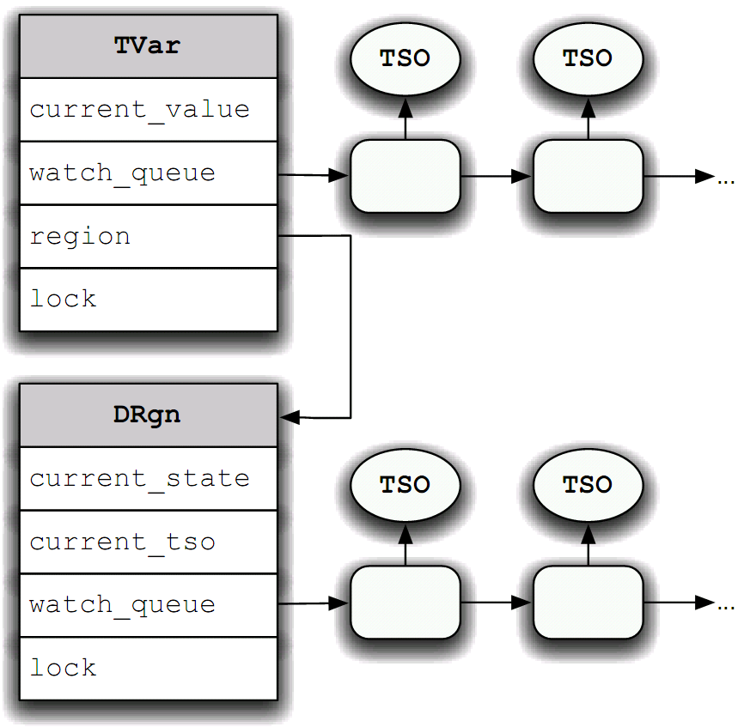
Implementation in one slide
DVar read/write also reads associated DRgn
Only txn’s first access of the DVar (easy with lazy update)
Protection-state change is a mini-transaction that writes to the DRgn
TM mechanism synchronizes with txns
There are, uhm, some other details ☺
DVar

Slide 24
Non-transactional accesses
Suppose DVar accesses outside of transactions do not check the DRgn protection-state
Any correct program w.r.t. dynamic separation runs correctly
Any incorrect program is still type safe, but may violate atomicity
Alternately, we can check all accesses
Have a safe caching mechanism to avoid unnecessary DRgn access in common cases

Slide 25
Preliminary Performance
Caveat: Comparing to STM Haskell baseline is not necessarily state-of-the-art
Approach 1: Take existing STM benchmarks, use all DVars instead of TVars, measure slowdown: 0-20%
Approach 2: Code up “killer uses” of dynamic separation, measure speedup: 2-8x for 4 threads (e.g., resizing hash table)
Approach 3: Find an STM Haskell program that would benefit from dynamic separation and rewrite it: TBD

Slide 26
Conclusion
Dynamic separation appears to be an elegant and viable alternative for implementing a PL over a TM that is not privatization-safe

