Slide 1
Building An Accessible Board Game
Carol Mertz
Senior Game Designer Exploding Kittens
Morgan Baker
Accessibility Specialist Independent (& EA)
Jesse Martinez
PhD Student University of Washington

Slide 2
What to Expect
Introduction
What is accessibility in the context of board games?
How do we approach and implement accessibility?
How do we get player feedback?
How do we provide continued support?

Slide 3
Hi!
Morgan Baker
Accessibility Specialist Independent (& EA)
Jesse Martinez
PhD Student University of Washington
Carol Mertz
Senior Game Designer Exploding Kittens

Slide 4
What is accessibility,
really though?
Notes:
I’ll be kicking off this section with a quick, “what is accessibility really, though?” where I’ll define some terms and share some broader strategies.

Slide 5
Let’s redefine “disability”
Morgan
Disability
Disability
When a “mismatch” occurs, we call this a barrier
Personal
Health
Condition
Mismatched
Human
Interactions
Source: World Health Organization
Notes:
First, let’s redefine “disability” for ourselves. Rachel mentioned this — there are tons of definitions and models out there that explain disability and accessibility. Very old definitions are grounded in the “medical model” Rachel shared, where disability is a personal health condition, “something is wrong with this person” and idk “they need to be treated or fixed” — which as Rachel discussed in depth — is limiting and tends to disregard personal identities and the “social model” at best, and can be rooted in ableism at worst. This definition more so does not always help us as table top creators. It’s making it a “your problem” and not an “our problem.”
Therefore, we lean into a newer and stronger definition that is grounded in the social model mentioned by Rachel - Disability is not just perhaps a personal health condition, but disability is a mismatched human interaction. Inaccessible environments and products create barriers that hinder the full and effective participation of people with disabilities.
We don’t say “this person can’t read our game instructions because they’re sight is bad” but instead challenge ourselves to say “this person can’t read our game instructions because we printed it on flat, glossy paper with teeny tiny font… What is this, text for ants?”
So… we don’t say it’s something wrong with the person, there is nothing “wrong” with anyone here, but instead something needs to be improved in our design, whether it be by adjusting the design itself fundamentally or providing some type of option to mitigate whatever mismatch is happening. For example, maybe don’t print instructions using tiny font. Or if you must, provide some alternative format, maybe written instructions online or even better; a video with some voiceover that explains how the game works.
We aim to identify the mismatch that is happening between the person and our product. When a mismatch occurs, we call this a barrier.

Slide 6
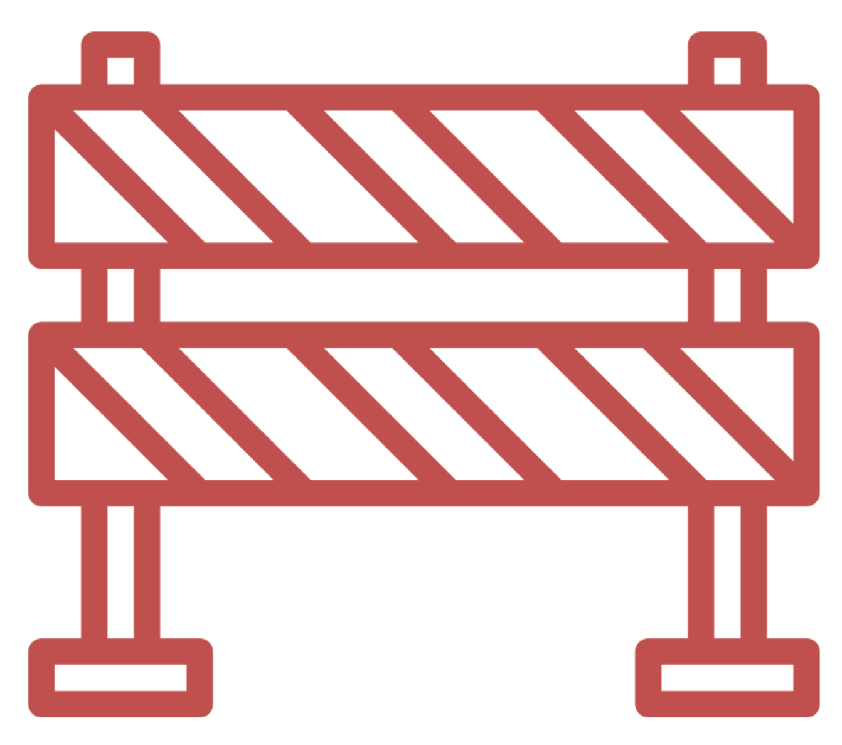
So how do we define accessibility?
Morgan
Disability = mismatch between a player and the product.
Accessible Design = reducing, facilitating, or removing the mismatch between a player and the game.
Player
Barrier
Game
Notes:
So how do we define accessibility? If disability is a mismatch between a player and the product, we jsay that accessible design is the practice of reducing, facilitating, or removing the mismatch between a player and the game.
On one side, we have a player who has their own individual needs, and on the other side we have our game. A barrier stands between the two when a player can’t fully access the intended player experience.
For example, maybe someone has a hearing condition like deafness, or being hard of hearing. Maybe someone has a vision condition, like colorblindness, low vision, or sightlessness. You can also consider physical aspects, maybe someone has gross motor conditions like walking, or fine motor conditions like handling small pieces on a board. You can consider the mind as well, including cognitive conditions that impact learning, thinking, processing speed, memory, and so on. Just ask yourself, how do players play my game?

Slide 7
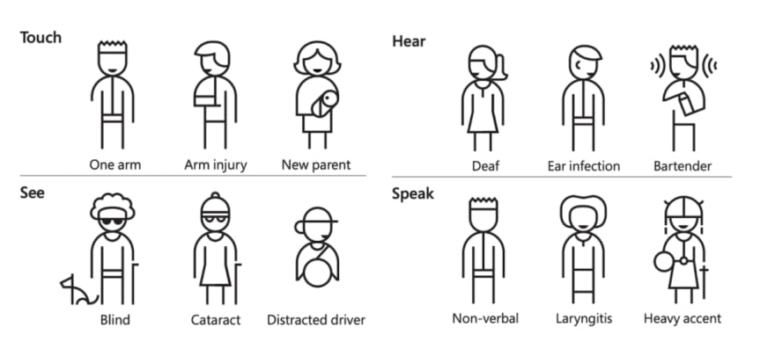
How does accessibility help?
Morgan
Further Reading: Inclusive Design Toolkit
Notes:
But here is the brilliance of accessibility and how it helps…
When we design for one, and we extend to many.
Everyone will experience barriers in their lives, regardless of their identities, abilities, and backgrounds. Conditions can be permanent, like someone who is deaf. Conditions can be temporary, like having ear infection and maybe you just got off a plane and your ears won’t pop. Or conditions can be situational-maybe you wanna play some settlers at a bar but can’t hear whether someone wants to trade you wheat or wood.
In fact, you’d be surprised by how much accessibility you use in your everyday life!
How many of you have turned on subtitles before when watching a movie or tv show?
> PAUSE
See, many of you! When we are designing for one — someone who is deaf — we are actually extending our design to many and genuinely improving the overall quality of our products. And that’s pretty neat.
But maybe you are sitting here thinking, “Morgan, this seems like a lot.” And yeah okay fine, that’s valid.
There is no silver bullet I can hand to you to make jenga more accessible to folks with dysgraphia or guess who? more accessible to someone who is colorblind.
The secret truth is, accessibility is a marathon, not a sprint. It’s about continuous learning, improvement, and growth—where we just keep pushing ourselves to do our best. Just like Hand-to-Hand Wombat, you won’t solve it all overnight, but you will make your game more accessible if you make it a part of your process. And then like everything else: you iterate and push yourself to do more.

Slide 8
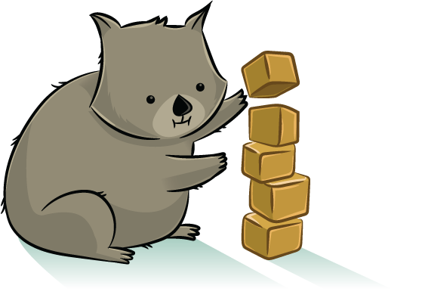
How do we identify problems (and solutions)?
Morgan
Learning from Expert Reviews
Learning from players
Learning from Guidelines & Other Resources
carol
Source: igda-gasig
Notes:
“That was visionary Morgan… where do I start?”
Use resources to identify and solve problems!
So when understanding the problem, there are three tools available to game creators. The first is learning from guidelines and other existing resources. No use in re-inventing the wheel when there are plenty of people willing to hand over blueprints. For example, there is the Xbox Accessibility Guidelines created by Microsoft. There is also the Game Accessibility Guidelines, which is a curated list of best practices that was created by game accessibility experts.
The second is learning from expert reviews. Accessibility is a rapidly growing topic with tons of information and knowledge. Accessibility Specialists and Designers, like myself, can serve as a resource to help you hone in on your game and help identify goals and quality targets for you to achieve more accessible experiences.
Lastly and most importantly, you can understand your problem by learning from your players. The disability community mantra is “Nothing About Us Without Us” – meaning, it’s difficult to make a product for disabled people if we do not listen to or involve them. Disabled gamers, and just anyone who benefits from accessibility, have always existed in our audiences—whether we realize it or not. User testing and player panels can help you a lot. You can delve through forums to see what players are doing, but you can also interact with them too – and this tends to have higher success rates. This transitions well into Jesse’s work, where he will being talking about game accessibility research.

Slide 9
Game Accessibility Research
Notes:
with this context in mind, we have the question: how do we actually apply these principles in the game design process?
And that’s where accessibility research comes in
The first step in this research process is one you all already know: playtesting

Slide 10
Accessibility Playtesting
Reasons this is important:
These players will have a fundamentally different experience with your game
Notes:
But specifically, let’s talk about playtesting with players with disabilities
At a surface level, we can understand that including disabled players in playtesting is good for “coverage”: these are players who will have a fundamentally different experience with your game, so their feedback likely won’t have come out in other playtests.
But when you include players with disabilities in playtests, you’re getting something special: you’re getting an EXPERT.
If you want your game to be more visually appealing, you’ll probably call in a graphic designer or some other expert on visual aesthetics: expertise is valuable!
With the same logic, when you want to know about your game’s accessibility, it’s crucial to consult actual people with disabilities! No one has a better understanding of what it’s like to navigate the world with a certain disability than a person who actually has that disability.
There’s a motto in the world of accessibility & disability justice: “nothing about us without us”-- we can’t expect to create games that actually meet the needs of disabled gamers without involving disabled gamers in the development process.
But in addition to giving feedback on sheer accessibility, disabled gamers also offer valuable insights on other facets of gameplay that might not come up in your average play session, such as feedback on pacing, physical design, and the like– as Morgan mentioned, we can design for one and extend to all.

Slide 11
Accessibility Playtesting
Reasons this is important:
These players will have a fundamentally different experience with your game
Disabled players are experts
Notes:
But specifically, let’s talk about playtesting with players with disabilities
At a surface level, we can understand that including disabled players in playtesting is good for “coverage”: these are players who will have a fundamentally different experience with your game, so their feedback likely won’t have come out in other playtests.
But when you include players with disabilities in playtests, you’re getting something special: you’re getting an EXPERT.
If you want your game to be more visually appealing, you’ll probably call in a graphic designer or some other expert on visual aesthetics: expertise is valuable!
With the same logic, when you want to know about your game’s accessibility, it’s crucial to consult actual people with disabilities! No one has a better understanding of what it’s like to navigate the world with a certain disability than a person who actually has that disability.
There’s a motto in the world of accessibility & disability justice: “nothing about us without us”-- we can’t expect to create games that actually meet the needs of disabled gamers without involving disabled gamers in the development process.
But in addition to giving feedback on sheer accessibility, disabled gamers also offer valuable insights on other facets of gameplay that might not come up in your average play session, such as feedback on pacing, physical design, and the like– and as Morgan mentioned, we can design for one and extend to all.

Slide 12
Accessibility Playtesting
Reasons this is important:
These players will have a fundamentally different experience with your game
Disabled players are experts
“Nothing about us, without us”
Notes:
But specifically, let’s talk about playtesting with players with disabilities
At a surface level, we can understand that including disabled players in playtesting is good for “coverage”: these are players who will have a fundamentally different experience with your game, so their feedback likely won’t have come out in other playtests.
But when you include players with disabilities in playtests, you’re getting something special: you’re getting an EXPERT.
If you want your game to be more visually appealing, you’ll probably call in a graphic designer or some other expert on visual aesthetics: expertise is valuable!
With the same logic, when you want to know about your game’s accessibility, it’s crucial to consult actual people with disabilities! No one has a better understanding of what it’s like to navigate the world with a certain disability than a person who actually has that disability.
There’s a motto in the world of accessibility & disability justice: “nothing about us without us”-- we can’t expect to create games that actually meet the needs of disabled gamers without involving disabled gamers in the development process.
But in addition to giving feedback on sheer accessibility, disabled gamers also offer valuable insights on other facets of gameplay that might not come up in your average play session, such as feedback on pacing, physical design, and the like– and as Morgan mentioned, we can design for one and extend to all.

Slide 13
“But Jesse, How do I find playtesters with disabilities??”
Notes:
Now you might be asking: “Jesse, how do I find playtesters with disabilities??”
And this is a good question to ask, because the answer isn’t just “recruit as usual and hope disabled playtesters show up”. Instead, you do need to seek out people with disabilities specifically, and make a targeted request for playtesters with disabilities.

Slide 14
Recruiting Playtesters with Disabilities
Local Resources
Community Organizations
University Student Groups
National/Global Resources:
Accessibility Consultants
Online Disabled Gaming Communities
Notes:
Now obviously the specific ways to reach out vary wildly, but some good places to start looking at could be local resources like community organizations, or if you’ve got a decent-sized university nearby, they probably have an organization for students with disabilities of some sort that you can reach out to. If you’re looking on a larger scale, there are some great accessibility consultants out there– although I’ll note there’s not a ton of consultants for tabletop games specifically (Meeple Like Us is a great one for tabletop gaming)-- so you can contact consultants about this, or, if you need or prefer to connect with people online, you can engage with online disabled gaming communities on Reddit, Twitter, Discord, Facebook– basically any social media platform has communities of gamers with disabilities which can be a great entry point for recruiting playtesters with disabilities

Slide 15
Ability Requirements Analysis (ARA)
“What am I asking my players to do?”
Notes:
In addition to playtesting, another core tool in the accessibility research process is something that doesn’t have a particularly formal name, but I call it Ability Requirements Analysis or A.R.A., which really boils down to this central question of “what am I asking my players to do?”
While I’m sure this is already a question most of you ask while designing a game, A.R.A. goes a step further to look at the really base level requirements associated with each task a player might need to perform while playing a game, from manipulating physical game components, to game strategy and techniques, to interacting with other players during the game

Slide 16
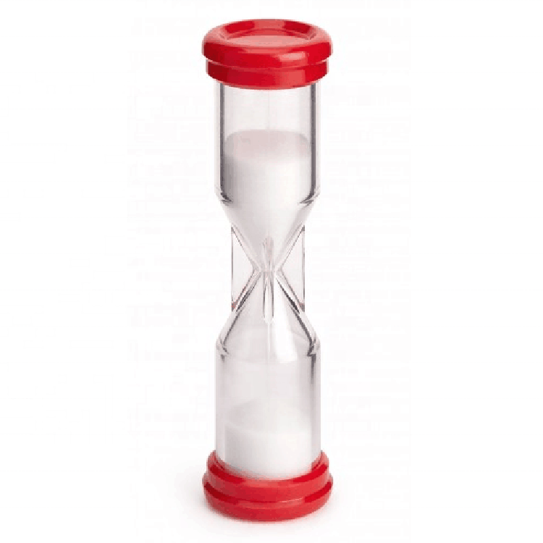
Ability Requirement Analysis (ARA)
Notes:
So, for an example, we can look at a sand timer as a common element in a tabletop game– some of us probably own dozens of these. But implicit in using this element are a number of implicit ability requirements:
Flipping the timer requires some fine motor skills
Checking the timer is a totally visual task
And needing to notice when the timer is done has some cognitive requirements, like forcing players to split their focus, which can be challenging
And there are plenty more aspects of a sand timer that can be bad for accessibility, like the inability to change the length of the timer or easily pause it
And so if we break down every fundamental task we ask players to perform, we can start to see places where we can add new accessible alternatives within our design

Slide 17
Ability Requirement Analysis (ARA)
Motor Req: Flipping the timer
Notes:
So, for an example, we can look at a sand timer as a common element in a tabletop game– some of us probably own dozens of these. But implicit in using this element are a number of implicit ability requirements:
Flipping the timer requires some fine motor skills
Checking the timer is a totally visual task
And needing to notice when the timer is done has some cognitive requirements, like forcing players to split their focus, which can be challenging
And there are plenty more aspects of a sand timer that can be bad for accessibility, like the inability to change the length of the timer or easily pause it
And so if we break down every fundamental task we ask players to perform, we can start to see places where we can add new accessible alternatives within our design

Slide 18
Ability Requirement Analysis (ARA)
Motor Req: Flipping the timer
Visual Req: Checking for time left
Notes:
So, for an example, we can look at a sand timer as a common element in a tabletop game– some of us probably own dozens of these. But implicit in using this element are a number of implicit ability requirements:
Flipping the timer requires some fine motor skills
Checking the timer is a totally visual task
And needing to notice when the timer is done has some cognitive requirements, like forcing players to split their focus, which can be challenging
And there are plenty more aspects of a sand timer that can be bad for accessibility, like the inability to change the length of the timer or easily pause it
And so if we break down every fundamental task we ask players to perform, we can start to see places where we can add new accessible alternatives within our design

Slide 19
Ability Requirement Analysis (ARA)
Motor Req: Flipping the timer
Visual Req: Checking for time left
Cognitive Req: Noticing when the timer is done
Notes:
So, for an example, we can look at a sand timer as a common element in a tabletop game– some of us probably own dozens of these. But implicit in using this element are a number of implicit ability requirements:
Flipping the timer requires some fine motor skills
Checking the timer is a totally visual task
And needing to notice when the timer is done has some cognitive requirements, like forcing players to split their focus, which can be challenging
And there are plenty more aspects of a sand timer that can be bad for accessibility, like the inability to change the length of the timer or easily pause it
And so if we break down every fundamental task we ask players to perform, we can start to see places where we can add new accessible alternatives within our design

Slide 20
Accessibility Testing
Accessibility Playtesting
Ability Requirements Analysis
Notes:
And so with a combination of Accessibility Playtesting and ARA, we can really begin to understand some of the access issues present in our games, and if done early enough in the design process, hopefully we can nip these issues in the bud before they become larger problems for players.
However, there’s still one more key question left: how do we actually apply this access research in the design of a game?

Slide 21
A
How do we turn Access Research into Design?
Notes:
However, there’s still one more key question left: how do we actually apply this access research in the design of a game?
And this is obviously a hard question– if it was easy, we wouldn’t be here– but I’ll start to answer it with a blunt statement:

Slide 22
Enabling Custom Gameplay Styles
FACT: No single game will be perfectly accessible to every player*
Notes:
“No single game will be perfectly accessible to every player”
And I do mean this: every game will have something built into it that someone can’t do– but the secret about all this is that every player doesn’t need to do every single thing in the game, or play the game in precisely one totally inflexible way
And so the trick to applying a lot of our research insights is working to design flexibly, and creating customizable gameplay styles for players, as opposed to just trying to reach some unachievable ‘perfectly accessible’ game

Slide 23
Enabling Custom Gameplay Styles
Lower the Barrier
Mitigation
Notes:
And so for a few examples of what I mean here, we can look at a few main strategies that (within my research, at least), I’ve seen players use to navigate access barriers in games
So the first is lowering the barrier: sometimes, we can get rid of the barrier altogether– maybe instead of having players roll dice to see who goes first, we just say the player with the closest birthday starts. If we can’t get rid of the barrier altogether, maybe we can make it a little easier to manage, like by simplifying the math players need to do to add up their final score at the end of the game.
The second is finding workarounds: maybe the barrier is still there, but can we give players a way around it? So for instance: maybe your game still relies on having a timer, but instead of requiring the use of a visually inaccessible sand timer, you give players the information on how to run their own timer on their phone
And then our third method is giving the players new ways to play, or really changing the rules and gameplay: maybe this is a set of recommendations on alternate time limits based on how hard players want the game to be, maybe it’s an alternate ruleset for co-op play that removes the pressure of the time limit.
We all have our various “house rules” that we develop as players to better suit what we want from a game– by doing that game design work for the players ahead of time, we enable customizable game experiences that can provide huge advantages for accessibility.

Slide 24
Enabling Custom Gameplay Styles
Lower the Barrier
Find Workarounds
Mitigation
Notes:
And so for a few examples of what I mean here, we can look at a few main strategies that (within my research, at least), I’ve seen players use to navigate access barriers in games
So the first is lowering the barrier: sometimes, we can get rid of the barrier altogether– maybe instead of having players roll dice to see who goes first, we just say the player with the closest birthday starts. If we can’t get rid of the barrier altogether, maybe we can make it a little easier to manage, like by simplifying the math players need to do to add up their final score at the end of the game.
The second is finding workarounds: maybe the barrier is still there, but can we give players a way around it? So for instance: maybe your game still relies on having a timer, but instead of requiring the use of a visually inaccessible sand timer, you give players the information on how to run their own timer on their phone
And then our third method is giving the players new ways to play, or really changing the rules and gameplay: maybe this is a set of recommendations on alternate time limits based on how hard players want the game to be, maybe it’s an alternate ruleset for co-op play that removes the pressure of the time limit.
We all have our various “house rules” that we develop as players to better suit what we want from a game– by doing that game design work for the players ahead of time, we enable customizable game experiences that can provide huge advantages for accessibility.

Slide 25
Enabling Custom Gameplay Styles
Lower the Barrier
Find Workarounds
Provide new ways to play
Mitigation
Notes:
And so for a few examples of what I mean here, we can look at a few main strategies that (within my research, at least), I’ve seen players use to navigate access barriers in games
So the first is lowering the barrier: sometimes, we can get rid of the barrier altogether– maybe instead of having players roll dice to see who goes first, we just say the player with the closest birthday starts. If we can’t get rid of the barrier altogether, maybe we can make it a little easier to manage, like by simplifying the math players need to do to add up their final score at the end of the game.
The second is finding workarounds: maybe the barrier is still there, but can we give players a way around it? So for instance: maybe your game still relies on having a timer, but instead of requiring the use of a visually inaccessible sand timer, you give players the information on how to run their own timer on their phone
And then our third method is giving the players new ways to play, or really changing the rules and gameplay: maybe this is a set of recommendations on alternate time limits based on how hard players want the game to be, maybe it’s an alternate ruleset for co-op play that removes the pressure of the time limit.
We all have our various “house rules” that we develop as players to better suit what we want from a game– by doing that game design work for the players ahead of time, we enable customizable game experiences that can provide huge advantages for accessibility.

Slide 26
A case study:
Hand-to-Hand Wombat

Slide 27
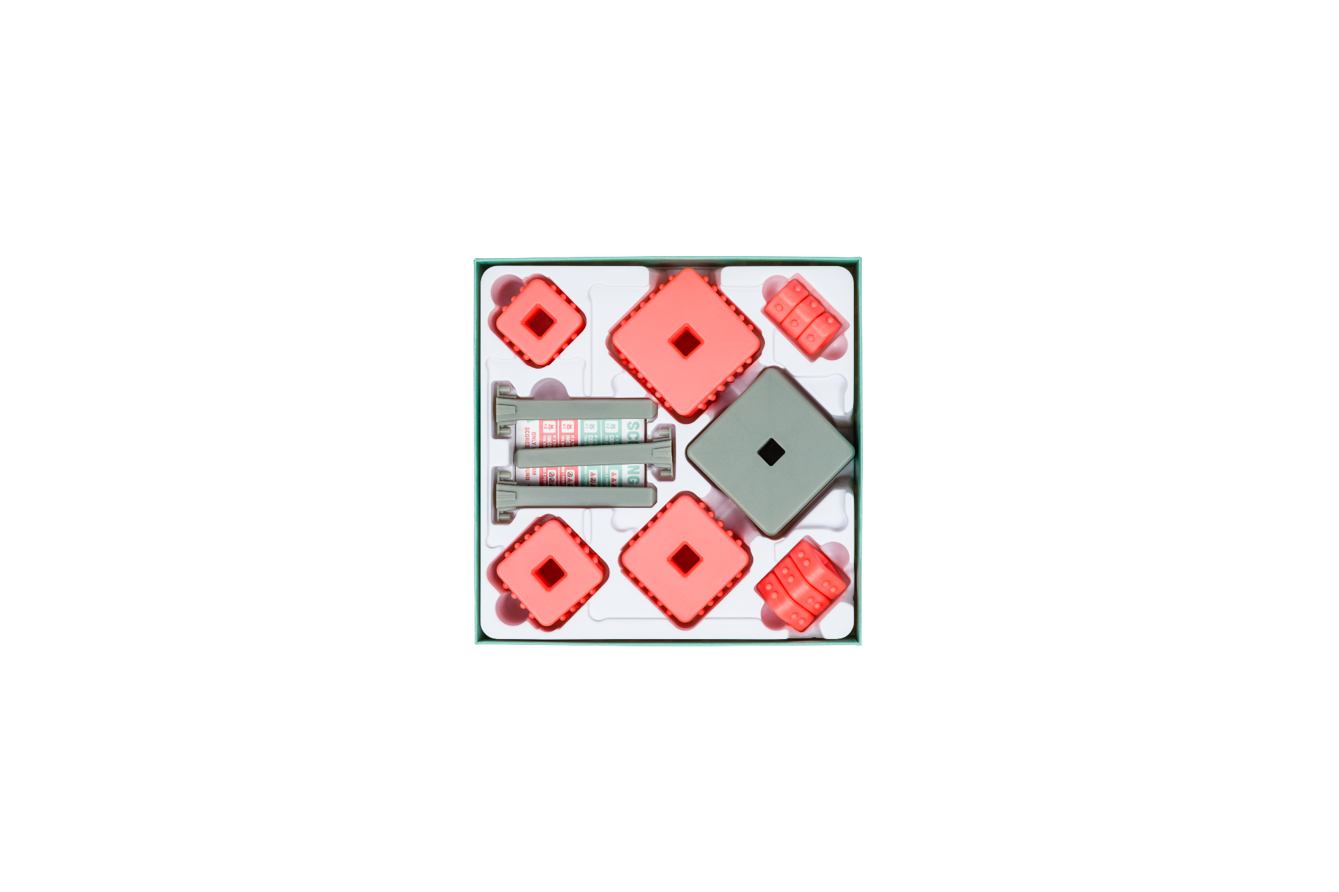
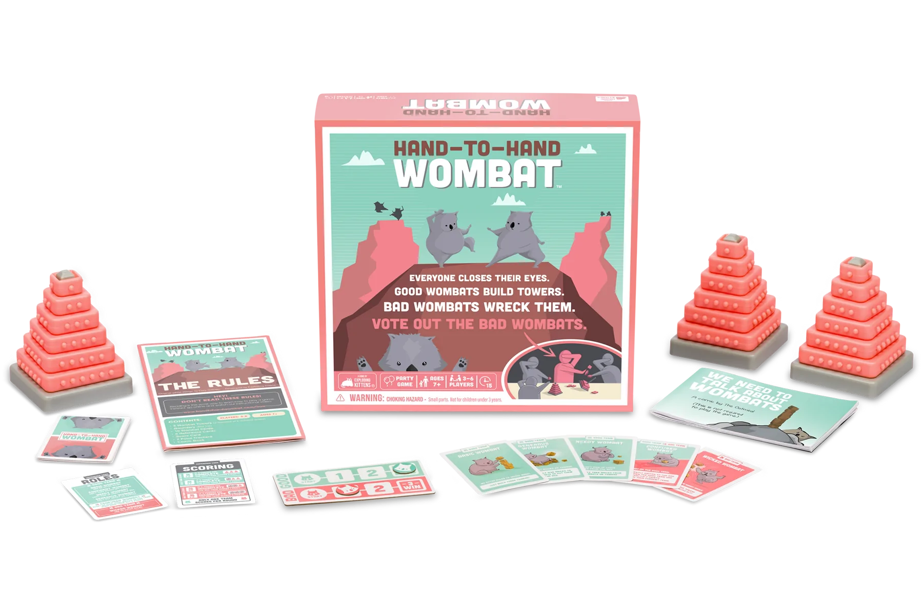
Case Study of Hand-to-Hand Wombat: Practical Accessibility Implementation at Exploding Kittens
Carol
Notes:
Working with Morgan opened my eyes to some of the ways Exploding Kittens wasn’t taking advantage of all available opportunities to truly support all of our players, so I was really excited to incorporate accessibility into our design process for Hand-to-Hand Wombat. For those unfamiliar with it, Hand-to-Hand Wombat is a tactile social deduction game where players close their eyes and collaborate to build towers in the right order while one or more players actively tries to sabotage those towers. Because of the nature of its eyes-closed gameplay, we realized early on that Hand-to-Hand Wombat was uniquely poised to be accessible to low-and-no-vision players. For that reason, designer Cory O’Brien and I approached gameplay and component design in a way that accommodates these players and others the best way we could, while also staying in budget for a mass market game.

Slide 28
Considerations During Design:
Carol
Learning
Staggered Difficulty Ramping
Component Tactility
Non-visual Cues
Opportunities for Player Modification

Slide 29
Learning
Carol
Notes:
Learning: All Exploding Kittens games aim to generally be 5 minutes to learn, 15 minutes to play, and our goal for Hand-to-Hand Wombat was no different. We refined the gameplay and instructions carefully to ensure that players of all experience levels and cognitive abilities could easily understand and play the game on their first time. Including a clear overview and examples was important, as well as a “tutorial” mode built into the first learning experience, to allow players to practice with the tactile aspects of the game before diving into a scored round. While this could be considered more in the “approachability” camp than “accessibility,” having simple instructions that allow players to quickly and easily learn the game supports a broad range of cognitive and social abilities, as well as varied attention spans.

Slide 30
Staggered Difficulty Ramping
Carol
Notes:
We also wanted the game to be approachable to mass market players, but also interesting to seasoned players. We built in a staggered learning mode, from an un-scored tutorial round, to an introductory mode without additional roles, to the “advanced” mode where players have additional constraints and challenges set against them. We discovered through testing that framing our desired complexity as “advanced” helped the game feel far more approachable to players who have difficulty learning new games, which can also translate to accessibility for players with disabilities related to learning and memory.

Slide 31
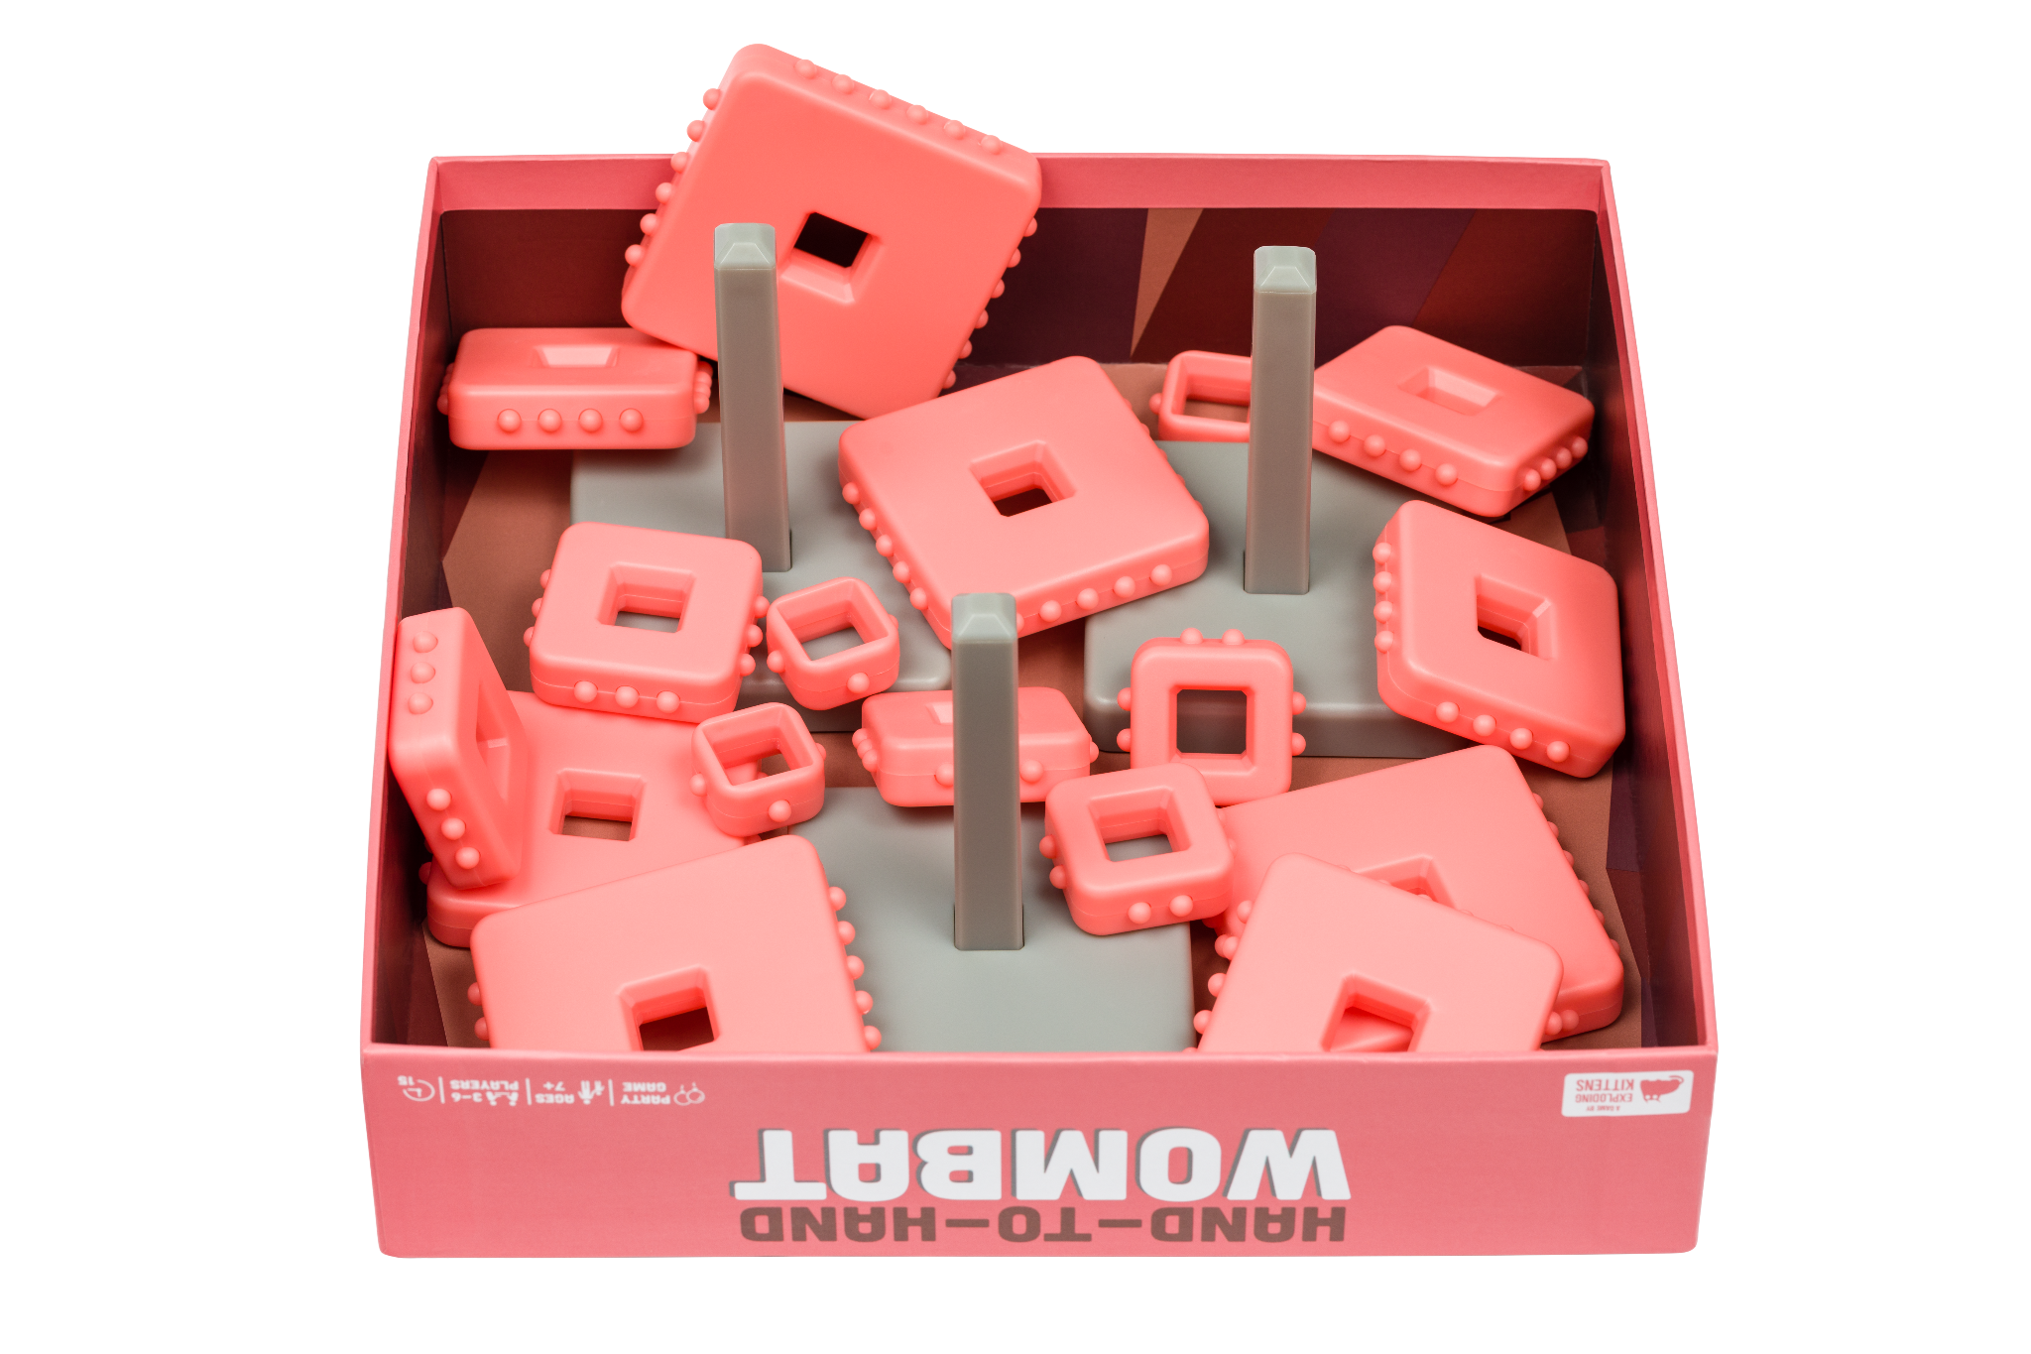
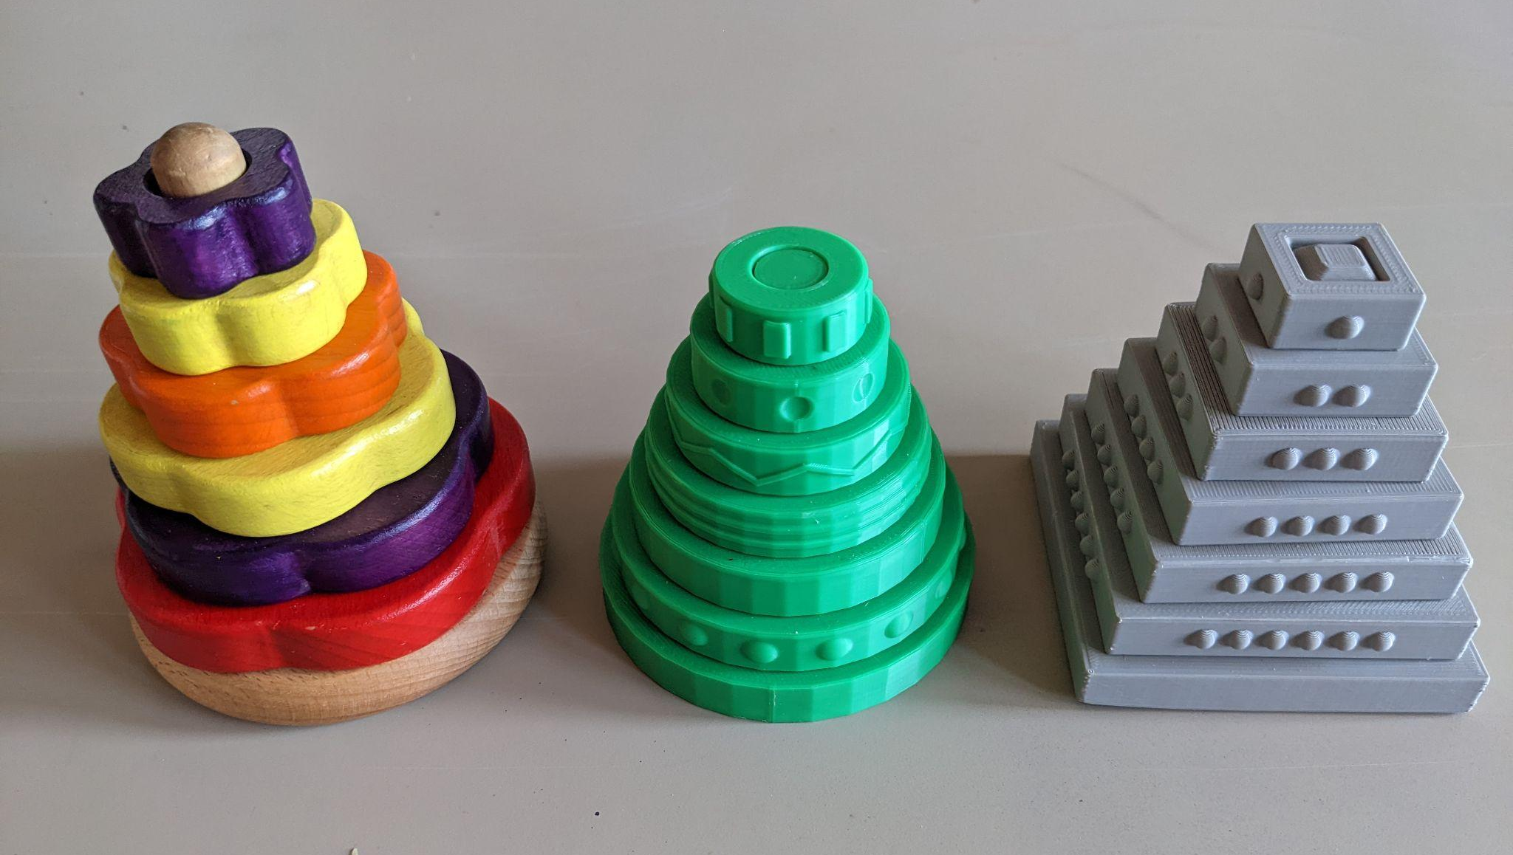
Tactility
Carol
Notes:
Tactility: As the name implies, Hand-to-Hand Wombat is an extremely hands-on game. We experimented with a number of different shapes and textures for our towers to ensure that we considered visual accessibility, tactile sensitivities, and motor abilities. We discovered that painted wooden pieces caused negative reactions with players with tactile and sensory sensitivities, as well as pieces that created loud or jarring noises when placing and removing from the towers. Because of these revelations, we aimed to create pieces that were smooth to the touch, and smooth to put on and remove from the towers. We also wanted to ensure that players could easily identify the size piece they were holding, so we added nubs to each of the bricks to denote the order in which pieces should sit on the towers. This is called dual-coding — creating multiple methods to obtain data, in this case, both size and the number of nubs. This modification helps all players, but especially players who have difficulty discerning size by touch alone. Even into production with the factory, we heavily tested and iterated materials, size of bricks, and size and depth of nubs. We also tested heavily to ensure that the towers were easy to assemble and disassemble without risk of breakage, getting stuck, or possibly hurting players. We also stress-tested the box, cards, and towers to ensure that they could withstand repeated and aggressive play.

Slide 32
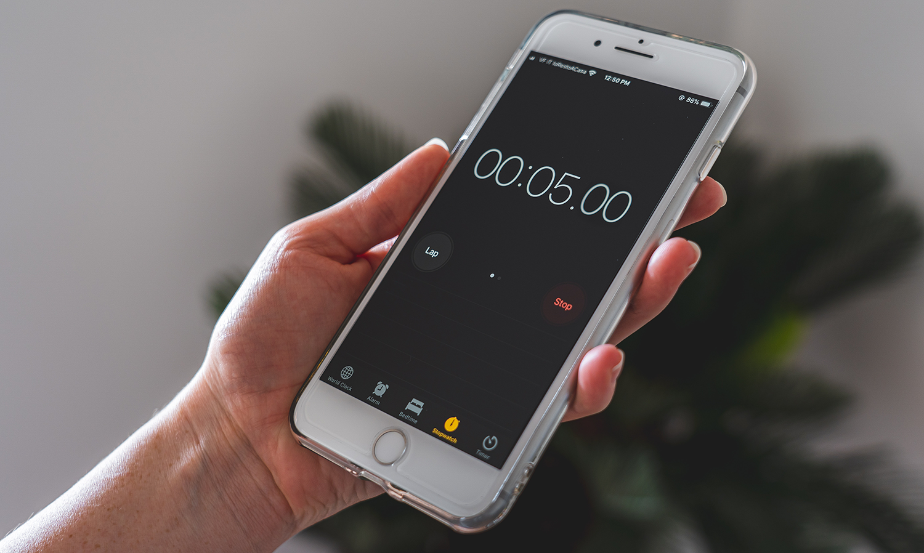
Non-visual Cues
Carol
Notes:
Nonvisual Cues: This is a case where we felt using players’ own phones would not only save on cost of goods, but also give players a chance to use the kind of alarm and alert that suited them best. We specify in the instructions to use an alarm that has both a heavy vibration and a loud sound, to help alert all players to the end of the game.

Slide 33
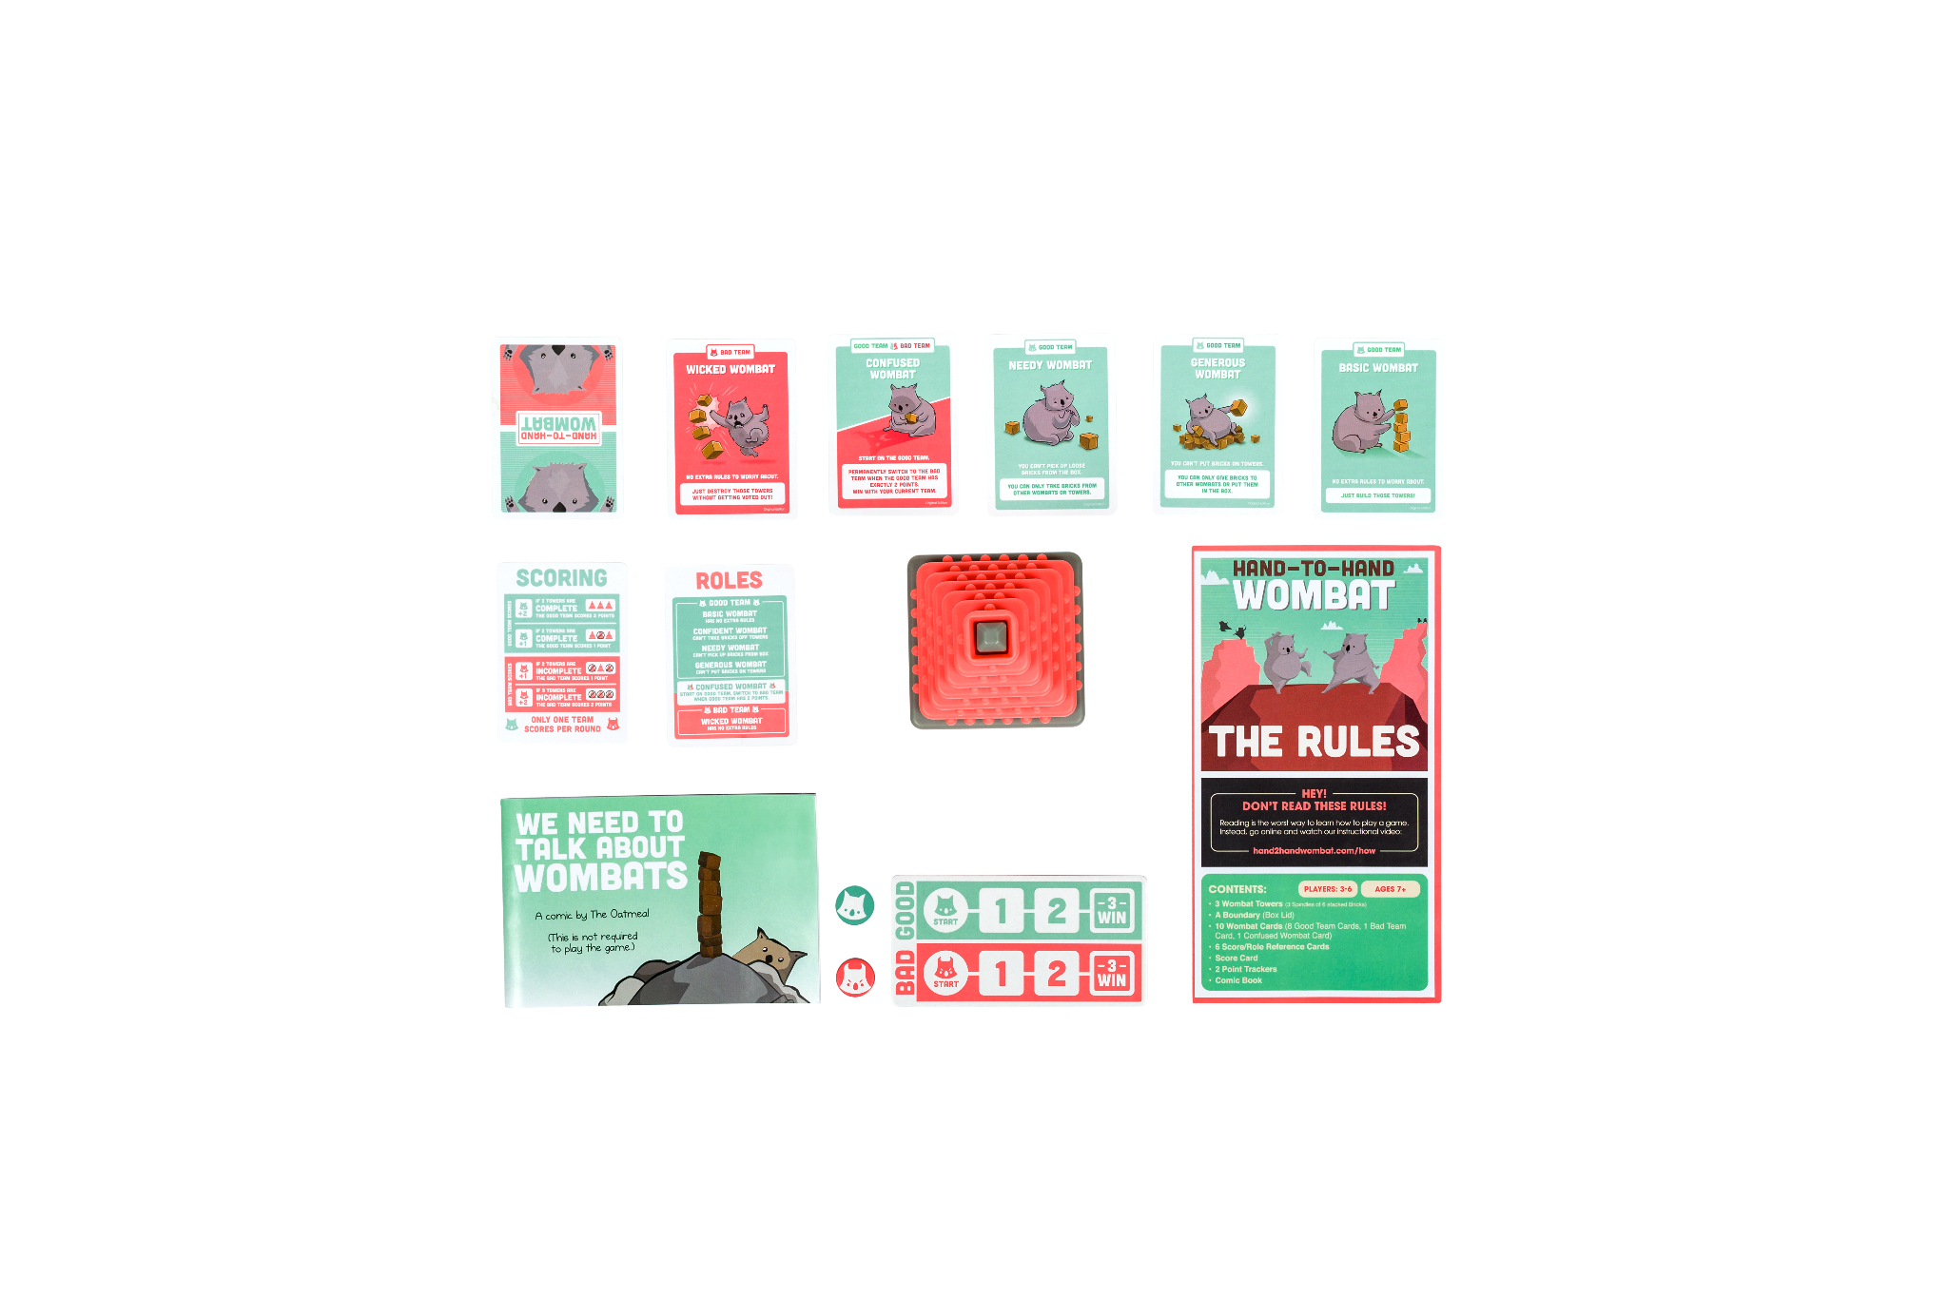
Visual and Physical Design
Carol
Notes:
We used another example of dual-coding by including unique illustrations for each of the roles and card types in addition to color to help express the behavior of the card — this helps to differentiate the card type to players whether or not they could easily discern the color of the card. We also chose brightly colored bricks against neutral spindles to help players differentiate bricks from spindles during setup, even though they wouldn’t see them during gameplay.
I do want to note that we did NOT implement braille or any sort of varied tactility on our cards, due to cost. We looked into it, as we knew that was the biggest thing preventing our game from being fully accessible to players with visual disabilities, but unfortunately it was not feasible for mass production. We were fortunate, however, to know that companies like 64 Ounce Games create quality accessibility kits, including a braille kit for Exploding Kittens, so we were hopeful that players who need card modifications would be able to develop solutions that work for them.

Slide 34
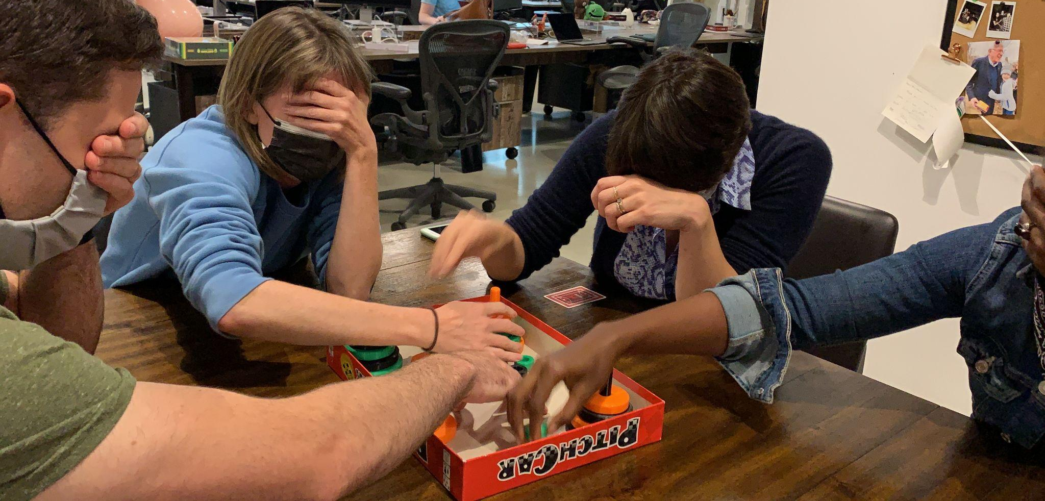
Opportunities for Modification
Carol
Notes:
While we generally try to avoid overwhelming players with too many “game types” or alternative game modes, we found a lot of value in different ways of playing Hand-to-Hand Wombat that extended to both player comfort and accessibility. We made sure to note successful modifications we experimented with during development, so that we could offer these options online to our players, giving them the freedom and flexibility to experiment with their own ways of playing.

Slide 35
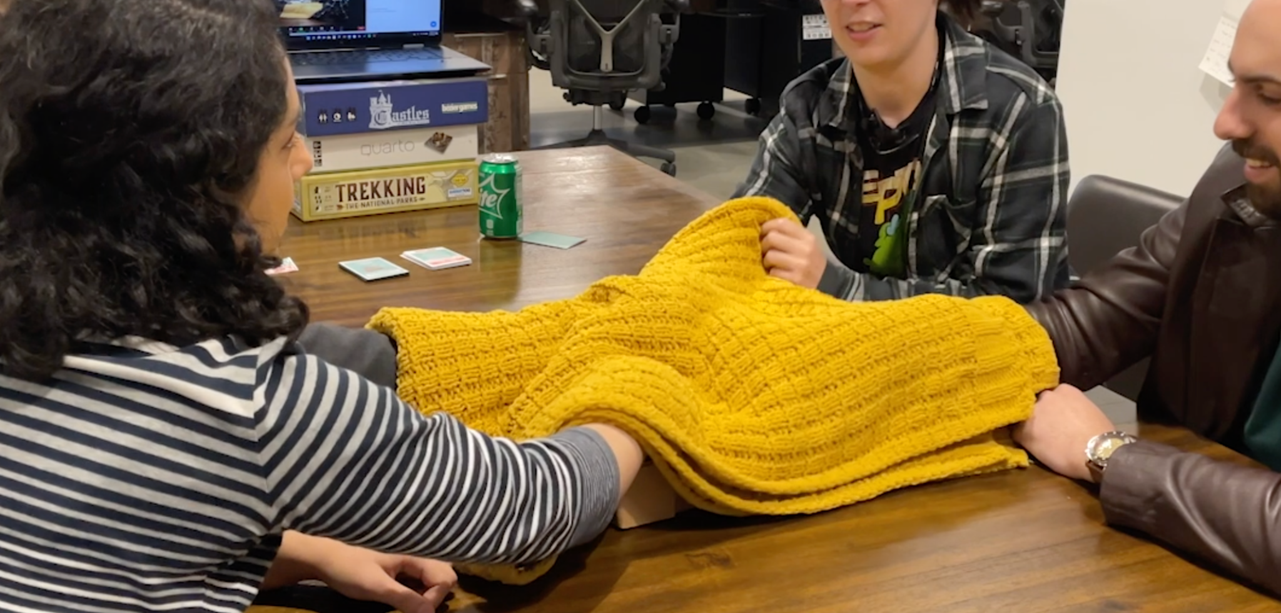
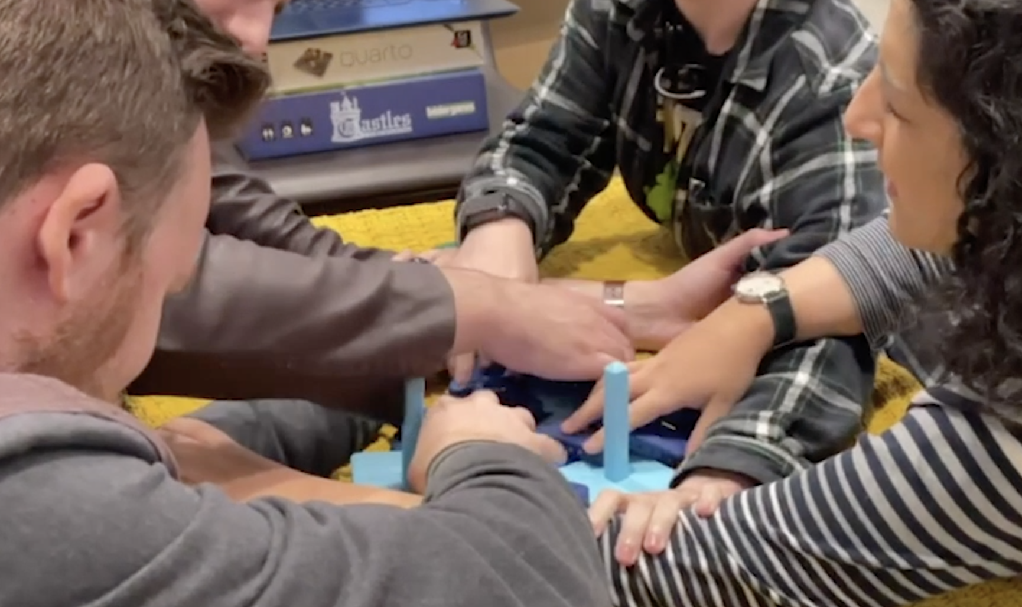
Continued Player Support
Notes:
We implemented Jesse’s findings to further support our players by offering accessible instructions and online guides to play depending on the unique needs of your group — we’d never seen anything like it done before by any other publishers, so we thought we’d help pave the way.
We worked hard to create, test, and implement accessible digital instructions, as well as alternative gameplay modes and digital accessibility recommendations categorized by player need.
These tools give the power to our players to make the gameplay decisions that are best for them.

Slide 36
Examples of Accessibility Recommendations
For Vision Accessibility:
Download the accessible PDF instructions.
Modify the Role Cards with stickers so that you can differentiate each one by feel.
When playing Advanced Mode, have someone read the description of each role aloud before assigning roles, to ensure that everyone is familiar with what each role does before beginning the game.
Designate a player to announce the score each round.
Spectate by feeling inside the box during gameplay (but not picking up or moving pieces), allowing you to still observe the game.

Slide 37
Examples of Accessibility Recommendations
For Hearing Accessibility:
We recommend playing a modified game mode, where you place a blanket over the play area and keep your eyes open while Building. This allows you to watch players’ mouths and facial expressions, and allows you to communicate with your free hand.
In this mode, you can implement a house rule for a shared signal to pause the game as-needed.
(NOTE: This can be used for players with speech and cognitive conditions as well.)

Slide 38
Examples of Accessibility Recommendations
For Motor Accessibility:
Consider adding more time on the clock for all players. We recommend starting at 2 minutes, and adjust as-needed depending on your group’s needs.
Add a house rule that all players can only hold one piece at a time.

Slide 39
Conclusion
Accessibility is an important part of the design, development, and production process to ensure that you’re supporting as many of your players as possible.
Integrating Player Research into your playtesting and development process ensures that you get feedback directly from players who have accessibility needs.
Not every game can be playable by every person straight out-of-the-box, but with user research and thoughtful implementation, we can make thoughtful recommendations for how more players can enjoy our games.

Slide 40
Thank you!
Morgan Baker
@momoxmia
Jesse Martinez
@JesseDoesHCI
Carol Mertz
@carolmertz

