Slide 1
designing languages for Data Visualization
Jeffrey Heer Stanford University

Slide 2
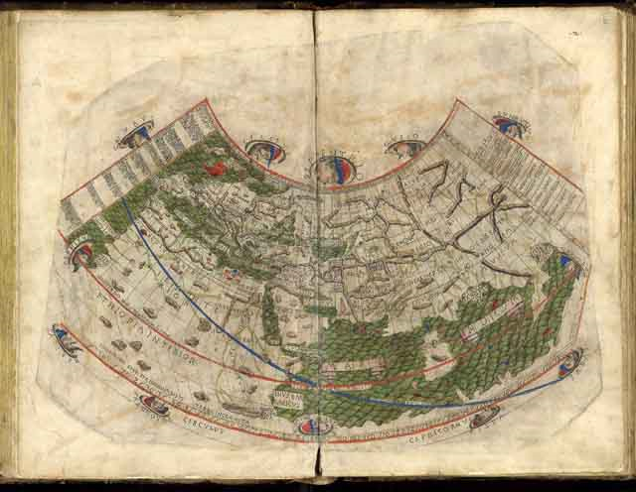
Notes:
http://www.math.yorku.ca/SCS/Gallery/milestone/sec2.html
c.150 AD
Map projections of a spherical earth and use of latitude and longitude to characterize position (first display of longitude)- Claudius Ptolemy (c. 85-c. 165), Alexandria, Egypt.
Ptolemy put all this information into a grand scheme. He assigned coordinates to all the places and geographic features he knew, in a grid that spanned the globe. Latitude was measured from the equator, as it is today, but Ptolemy preferred to express it as the length of the longest day rather than degrees of arc (the length of the midsummer day increases from 12h to 24h as you go from the equator to the polar circle). He put the meridian of 0 longitude at the most western land he knew, the Canary Islands.
The maps in surviving manuscripts of Ptolemy's Geographia, however, date only from about 1300, after the text was rediscovered by Maximus Planudes. It seems likely that the topographical tables in books 2-7 are cumulative texts - texts which were altered and added to as new knowledge became available in the centuries after Ptolemy (Bagrow 1945). This means that information contained in different parts of the Geography is likely to be of different date.
Woodcut of Ptolemy map by Johane Schnitzer(Ulm: Leinhart Holle, 1482)
Maps based on scientific principles had been made since the time of Eratosthenes (3rd century BC), but Ptolemy improved projections. It is known that a world map based on the Geographia was on display in Autun, France in late Roman times. In the 15th century Ptolemy's Geographia began to be printed with engraved maps; the earliest printed edition with engraved maps was produced in Bologna in 1477, followed quickly by a Roman edition in 1478 (Campbell, 1987). An edition printed at Ulm in 1482, including woodcut maps, was the first one printed north of the Alps. The maps look distorted as compared to modern maps, because Ptolemy's data were inaccurate

Slide 3
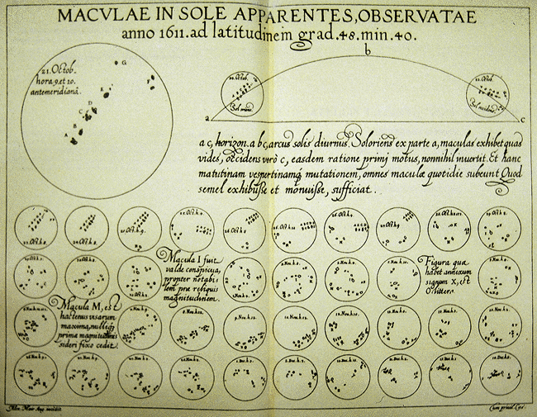
Notes:
1626
Visual representations used to chart the changes in sunspots over time. Also, the first known use of the idea of ``small multiples'' to show a series of images in a coherent display- Christoph Scheiner (1575-1650), Augsburg
-Viewed through telescope with colored lens

Slide 4
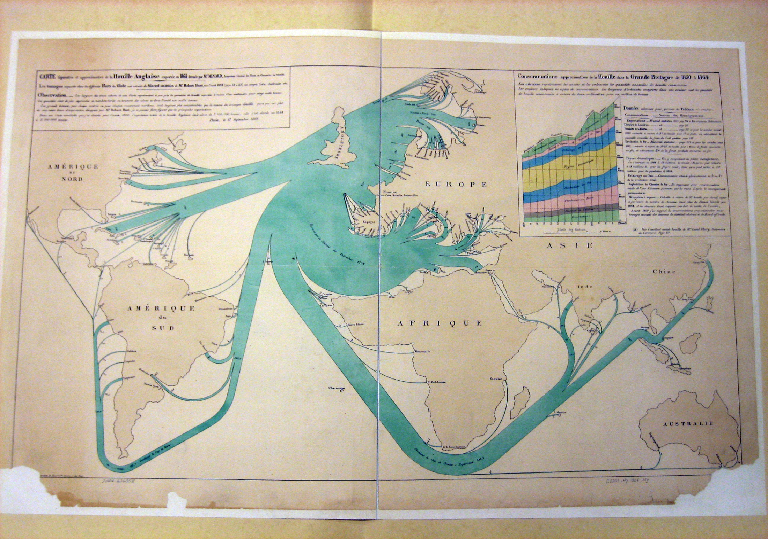
Notes:
http://cartographia.wordpress.com/2008/06/09/minards-map-of-british-coal-exports/
Britain was the world’s leading industrial power for most of the 1800s. 19th Century industrial production relied on coal–it powered factories, heated homes, and was essential for producing steel–and as an industrial power Britain relied on coal to make it great. Most British coal was used domestically, but some was exported to support burgeoning industrial needs in other parts of the world. Charles Joseph Minard, the well-regarded economic cartographer, produced this excellent map of British coal exports for the year 1864.
As with most of Minard’s works, this map relates the thickness of each export line to the amount of coal it represents. Here, each millimeter of thickness represents 20,000 tons of coal. The numbers written over or beside the lines represent the total number of tons of coal, in thousands. Click here or on the picture above to see the full map. Minard also included a fascinating graph of the eventual uses of all British-mined coal in the upper right. More on that graph later.
The map clearly demonstrates that the majority of British coal exports were destined for use in Western Europe–in Italy, France, the Netherlands, Belgium, the German states, and Scandinavia. A smaller but still significant amount was exported to Russia (via both the Baltic and Black Seas) and the Ottoman Empire.
The coal that was not shipped to Europe was distributed across the remaining five populated continents, but not evenly: Australia and Africa (with the exception of British-controlled Egypt) imported hardly any coal at all, whereas China and India imported much more. South America also imported a significant amount of British coal–much of it to Brazil, Chile, or Peru. Canada and the United States imported a relatively small amount–the former possibly due to its lower population, and the latter probably due to large domestic coal production.
The map show some interesting details about international trade during the mid 1860s. Malta, Singapore, and especially Cuba imported large amounts of coal given their relative size and levels of industrialization. Malta and Singapore, at least, were British colonies; but Cuba was a Spanish possession, showing how much the dwindling Spanish Empire had come to rely on foreign industry to sustain itself.
Though St. Petersburg was the Russian capital at the time, the majority of Russian coal imports from the Baltic Sea were instead destined for the city of Kronstadt, located on an island off the coast of St. Petersburg. Kronstadt was the headquarters of the Russian Baltic Fleet, and its steam-powered battlecruisers consumed coal at a tremendous rate.
Prussia’s growing power in Germany is shown by the amount of coal it imported from the Baltic, peeling off into multiple ports. But Minard also indicates that a rather large amount of coal was still being imported to the German North Sea ports and destined for the “Villes Anseatiques”–the cities of the old Hanseatic League, a Renaissance-era trading guild that had become defunct in all but name in the 1600s. Interestingly, however, the German cities of Lubeck, Hamburg, and Bremen maintained the pretenses of the League until 1862–only two years before the data for this map was gathered. It is unclear whether Minard refers to the imports of the last three cities, or of a collection of older member cities. At the very least, the use of this nomenclature shows the continuing decentralization of Germany, which would not change until German unification under Prussia at the beginning of the next decade.
Finally, the map also shows the continuing economic importance of the Caribbean islands. More coal was imported by those small specks of land than by the rest of North America combined.

Slide 5
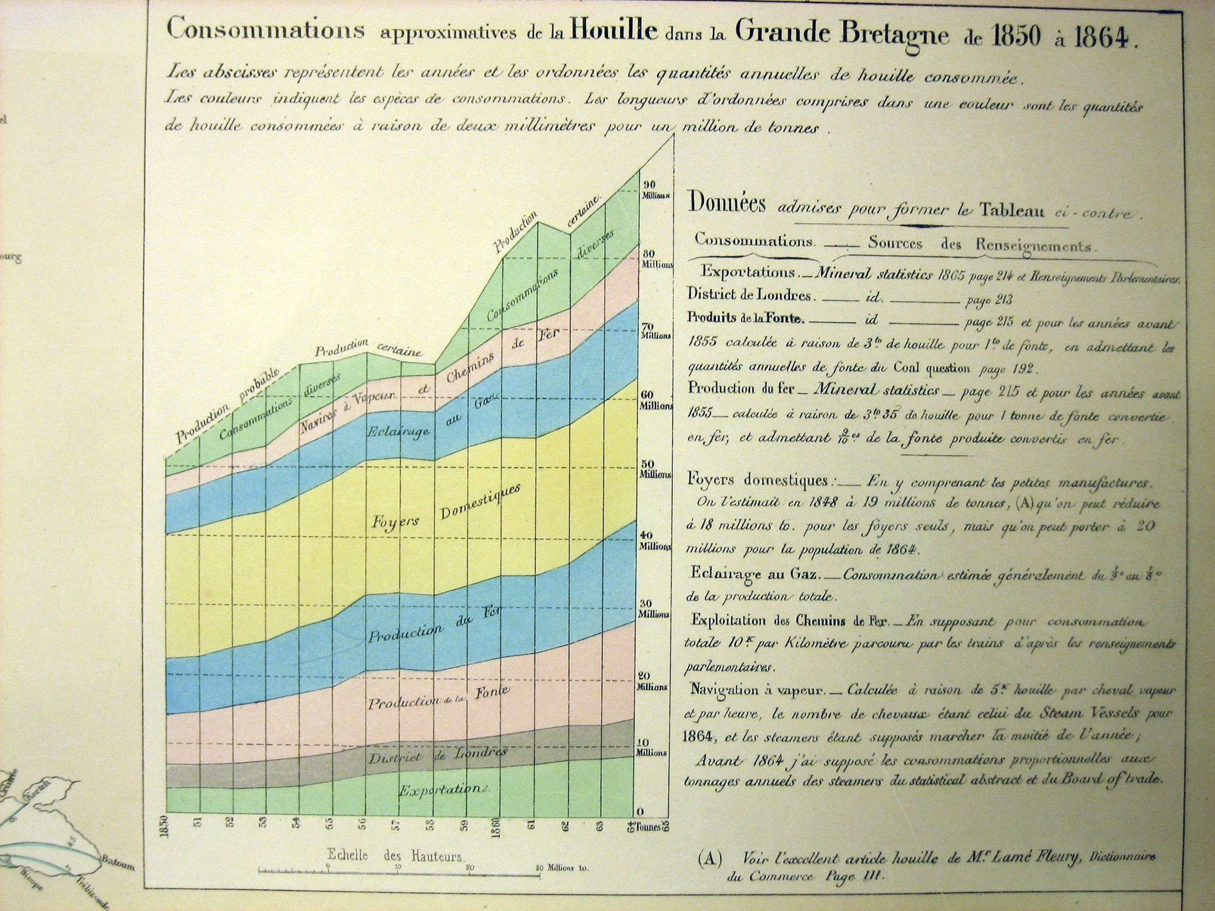
Notes:
http://cartographia.wordpress.com/2008/06/09/minards-map-of-british-coal-exports/
Minard also included an interesting chart in the upper right-hand corner of the map, showing the amount of British coal produced for each year between 1850 and 1864, and how it was used. The graph shows the tremendous changes in coal production over only a decade and a half–an increase of nearly 100% from just over 50 million to nearly 95 million tons. Of this, less than 10% was ever exported–meaning that the British domestic market was consuming nine times as much coal as is shown as exported in the main map.
The major uses of British coal, according to the chart, are: the production of iron (”Fer”) and cast iron (”Fonte”), gas lighting (”Eclairage au gas”), steam engines in ships and trains (”Navires a Vapeur et Chemins de Fer”), and domestic fireplaces (”Foyers Domestiques”). A large amount of this production was also specifically slated for use in London, showing how that city was the major center of British industry.

Slide 6
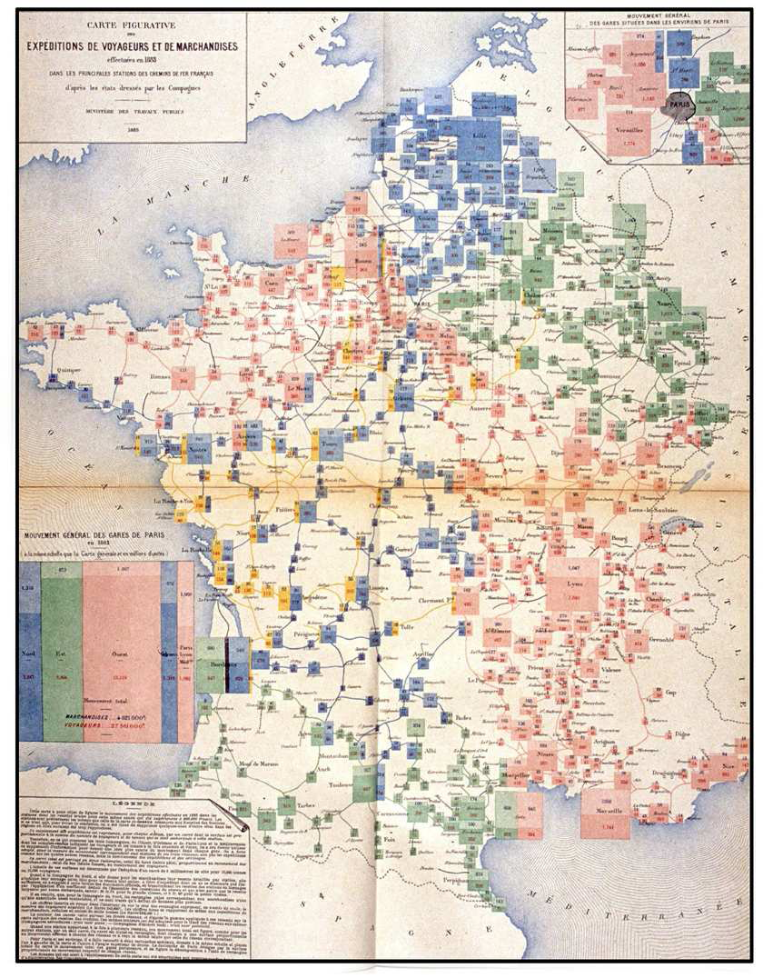
Notes:
Mouvement des voyageurs et des marchandises dans les principales stations de
chemins de fer en 1882. Scale: 2mm2 = 10,000 passengers or tons of freight. Source: Album,
1884, Plate 11 (author’s collection).
The pinnacle of this period of state-sponsored statistical albums is undoubtedly the Albums
de Statistique Graphique published annually by the French ministry of public works from 1879-
1897 under the direction of ´Emile Cheysson.19 They were published as large-format books
(about 11 x 17 in.), and many of the plates folded out to four- or six-times that size, all printed
in color and with great attention to layout and composition. We concur with Funkhouser (1937,
p.336) that “the Albums present the finest specimens of French graphic work in the century and
considerable pride was taken in them by the French people, statisticians and laymen alike.”
The subject matter of the albums largely concerned economic and financial data related to
the planning, development and administration of public works— transport of passengers and
freight, by rail, on inland waterways and through seaports, but also included such topics as
revenues in the major theaters of Paris, attendance at the universal expositions of 1867, 1878
and 1889, changes in populations of French departments over time, and so forth.
More significantly for this account the Albums can also be viewed as an exquisite sampler of
all the graphical methods known at the time, with significant adaptations to the problem at hand.
The majority of these graphs used and extended the flow map pioneered byMinard. Others used
polar forms— variants of pie and circle diagrams, star plots and rose diagrams, often overlaid
on a map and extended to show additional variables of interest. Still others used sub-divided
squares in the manner of modern mosaic displays (Friendly, 1994) to show the breakdown of
a total (passengers, freight) by several variables. It should be noted that in almost all cases
the graphical representation of the data was accompanied by numerical annotations or tables,
providing precise numerical values.
The Albums are discussed extensively by Palsky (1996), who includes seven representative
illustrations. It is hard to choose a single image here, but my favorites are surely the recursive,
multi-mosaic of rail transportation for the 1884–1886 volumes, the first of which is shown in
Figure 12. This cartogram uses one large mosaic (in the lower left) to show the numbers of
passengers and tons of freight shipped from Paris from the four principal train stations. Of the
total leaving Paris, the amounts going to each main city are shown by smaller mosaics, colored
according to railway lines; of those amounts, the distribution to smaller cities is similarly shown,
connected by lines along the rail routes.

Slide 7
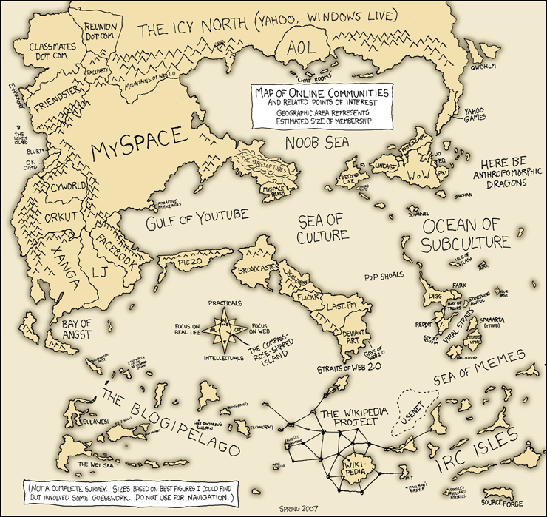

Slide 9
Notes:
No doubt some of you are familiar with this guy. Hans Rosling of the Gapminder foundation uses interactive visualizations to talk about globalization. His wildly popular talks at the TED conference have raised awareness of visualization technologies and their use in persuasive story telling.

Slide 10
Notes:
A notable Harvard alum has also shown that effectively communicating data with visualizations may help net you a Nobel prize.

Slide 11
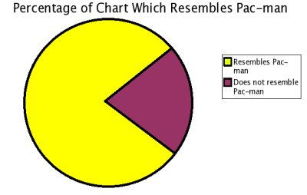
Pac-Man
Vernacular vis
http://www.boingboing.net/2006/11/02/hilarious-piechartvi.html
Notes:
Visualizations tailored to a domain
Visual expression rising
Poetic, Lyrical, Rhetorical, Authoritative, Comical
Visualization is going mainstream
Data warehouses – business intelligence
Homeland security – post 9/11 intelligence analysis
Availability of web-based data
New York Times, Stamen Design, Sep (Art)

Slide 12
The Rise of Graphical Literacy and Expression

Slide 13
Chart Typology

Slide 15
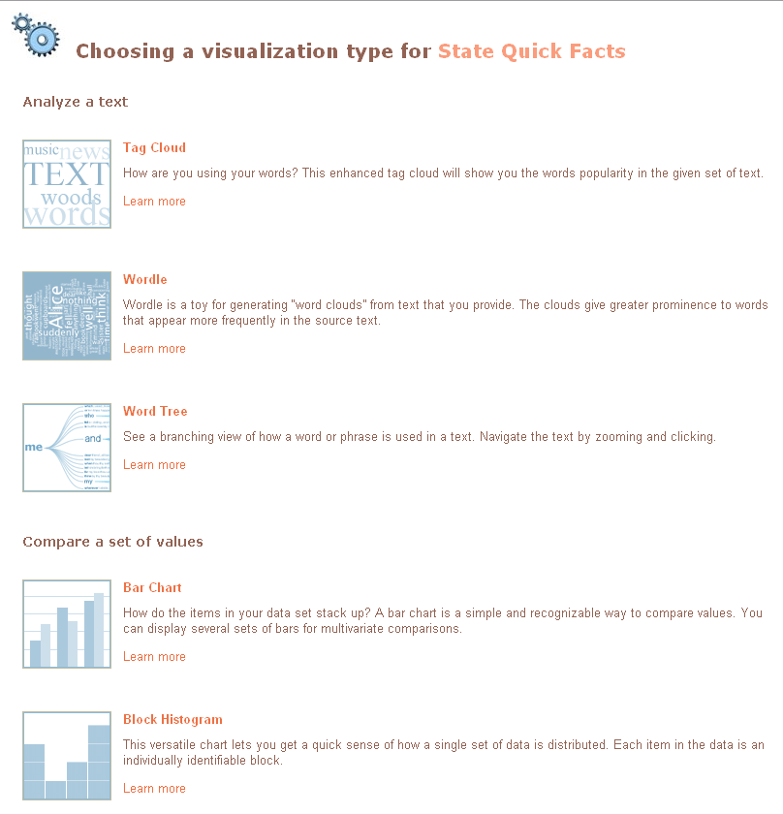

Slide 16
Notes:
Excel, Many-Eyes → Mad Libs

Slide 17
Notes:
“They give the user an impression of having explored data rather than the experience.”
- Leland Wilkinson

Slide 18
Data
Visual Form
Task
Raw Data
Data Tables
Visual Structures
Views
Data Transformations
Visual Encodings
View Transformations

Slide 19
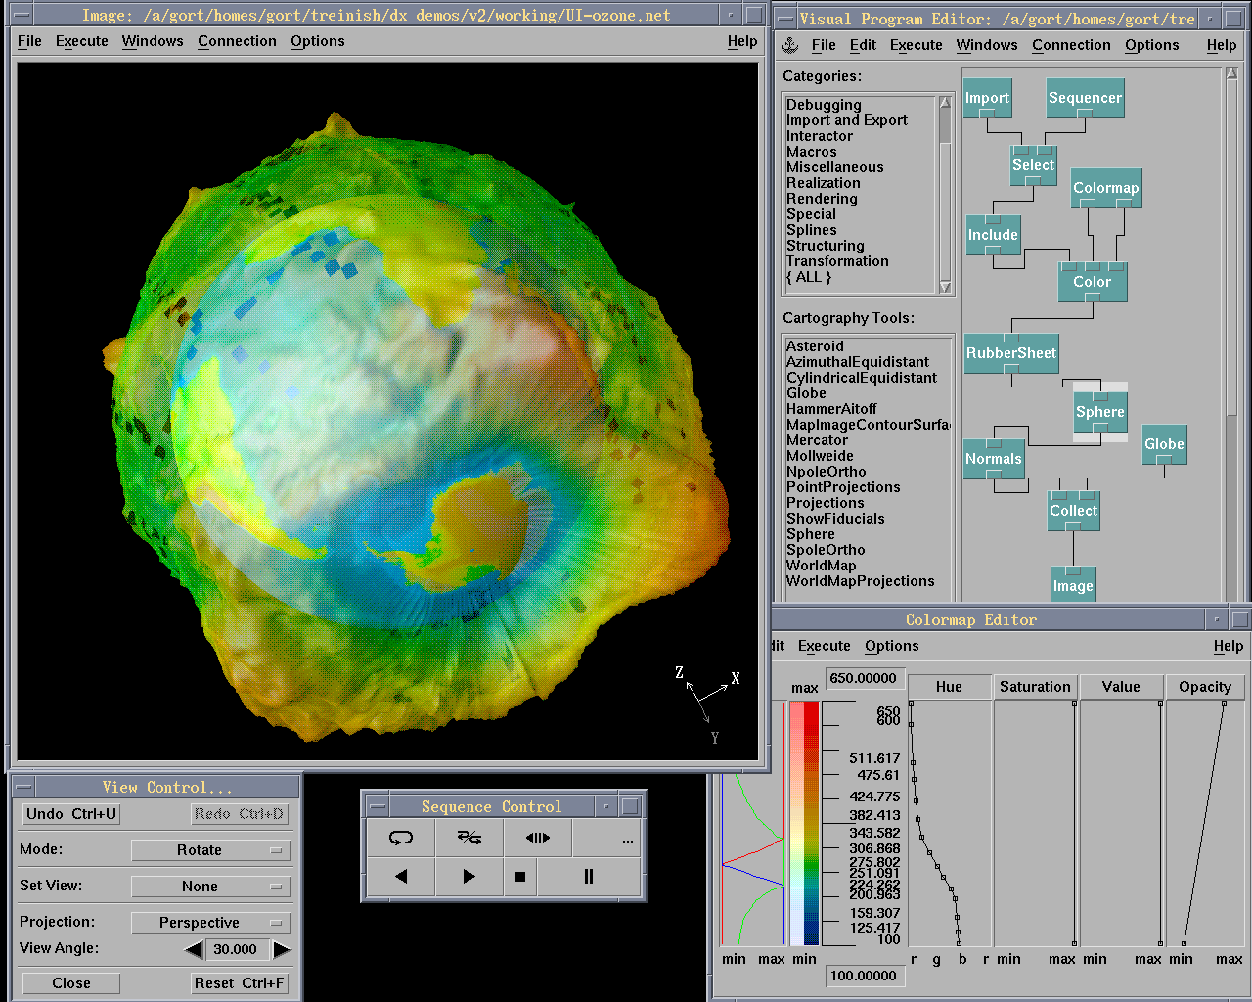

Slide 21
Today's first task is not to invent wholly new [graphical] techniques, though these are needed. Rather we need most vitally to recognize and reorganize the essential of old techniques, to make easy their assembly in new ways, and to modify their external appearances to fit the new opportunities.
J. W. Tukey, The Future of Data Analysis, 1962.

Slide 22
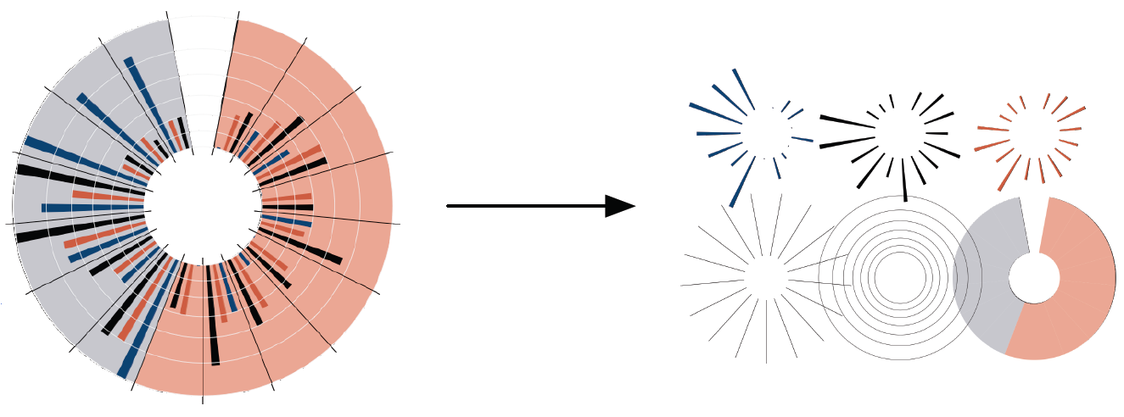
Protovis: A Declarative Language for Visualization
http://protovis.org/
A graphic is a composition of data-representative marks.

Slide 23
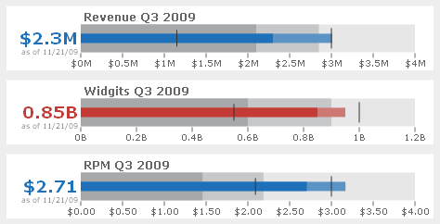
Bullet Charts | Clint Ivy

Slide 24
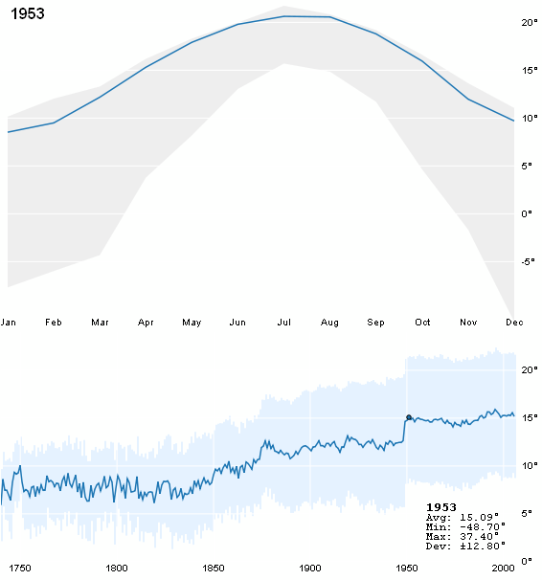
Climate Graph | Robert Kosara

Slide 25
Bach’s Prelude #1 in C Major | Jieun Oh

Slide 26
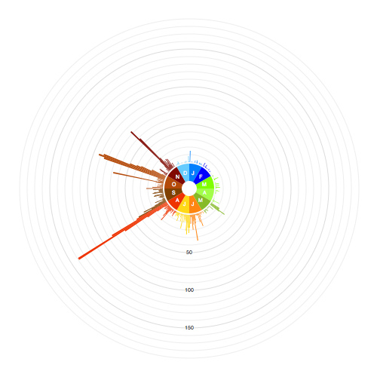
FlickrSeason | Ken-Ichi Ueda

Slide 27
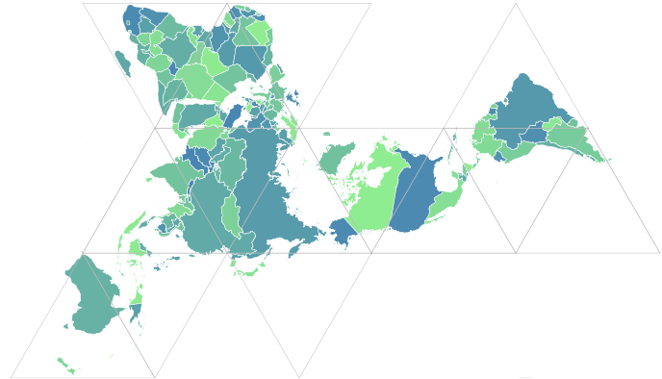
Dymaxion Maps | Vadim Ogievetsky

Slide 28
Acquisition
Cleaning
Integration
Visualization
Modeling
Presentation
Dissemination

Slide 29
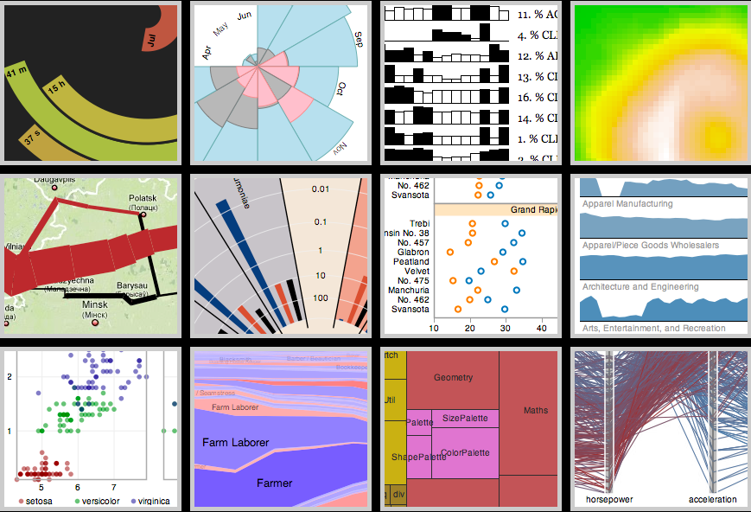
http://protovis.org Stanford University

