Slide 1
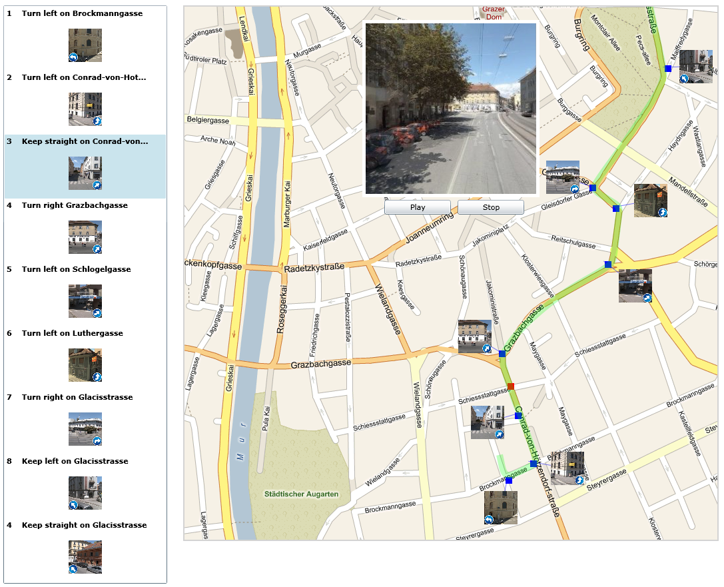
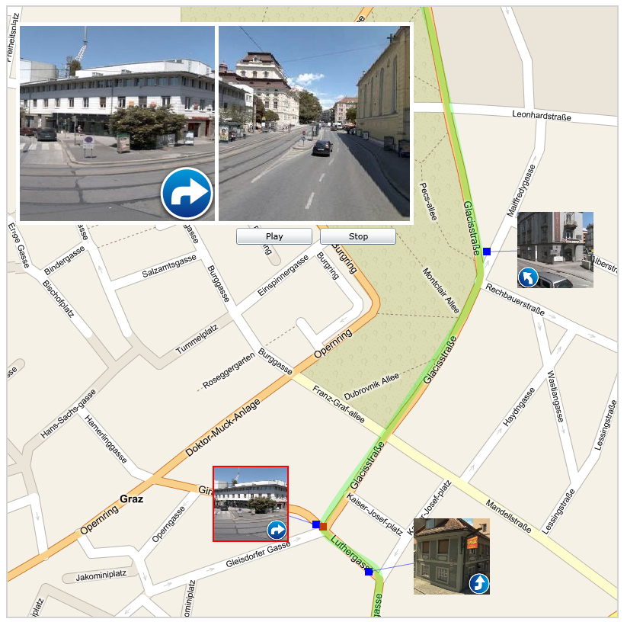
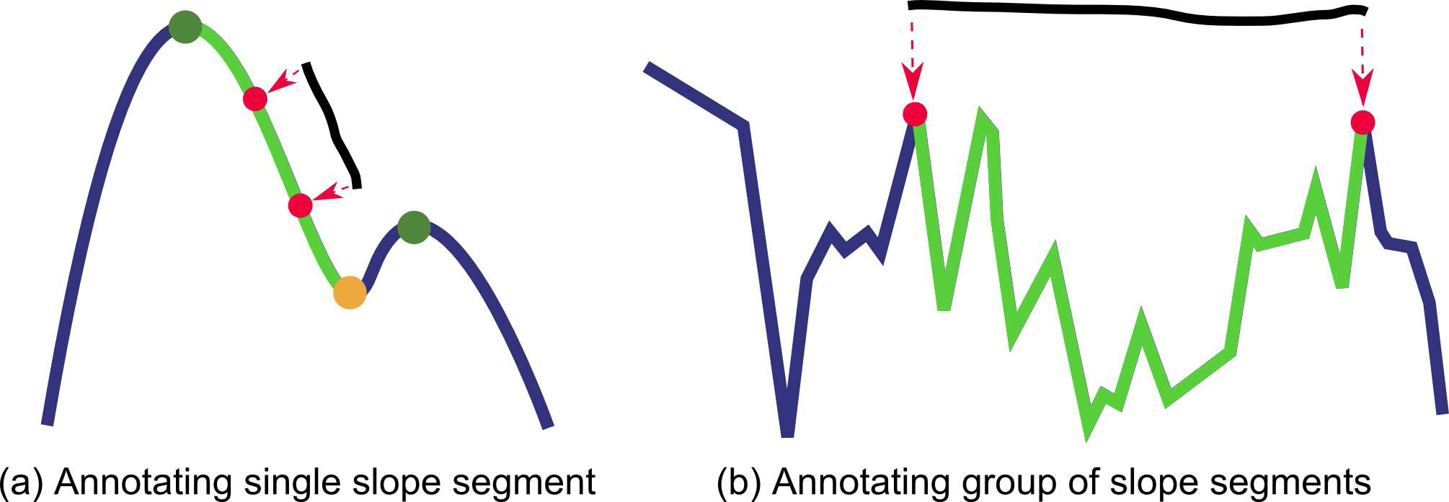
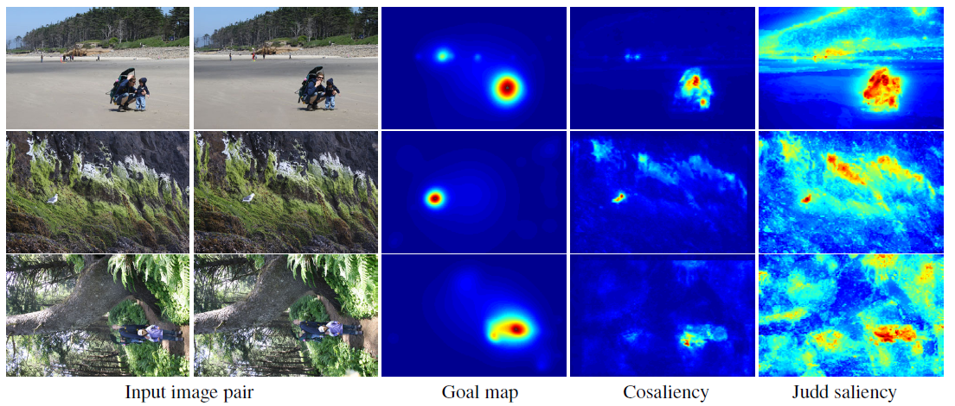
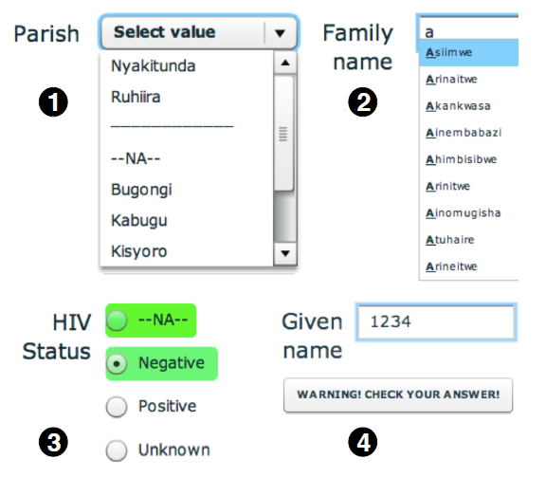
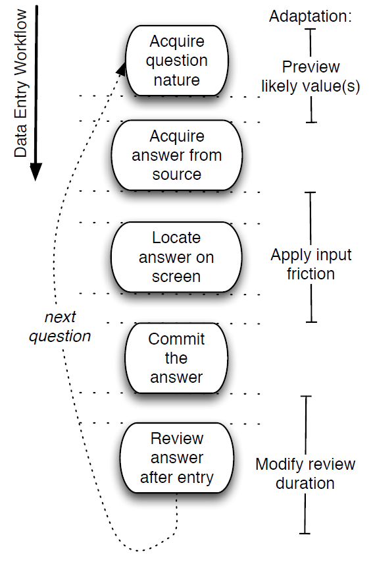
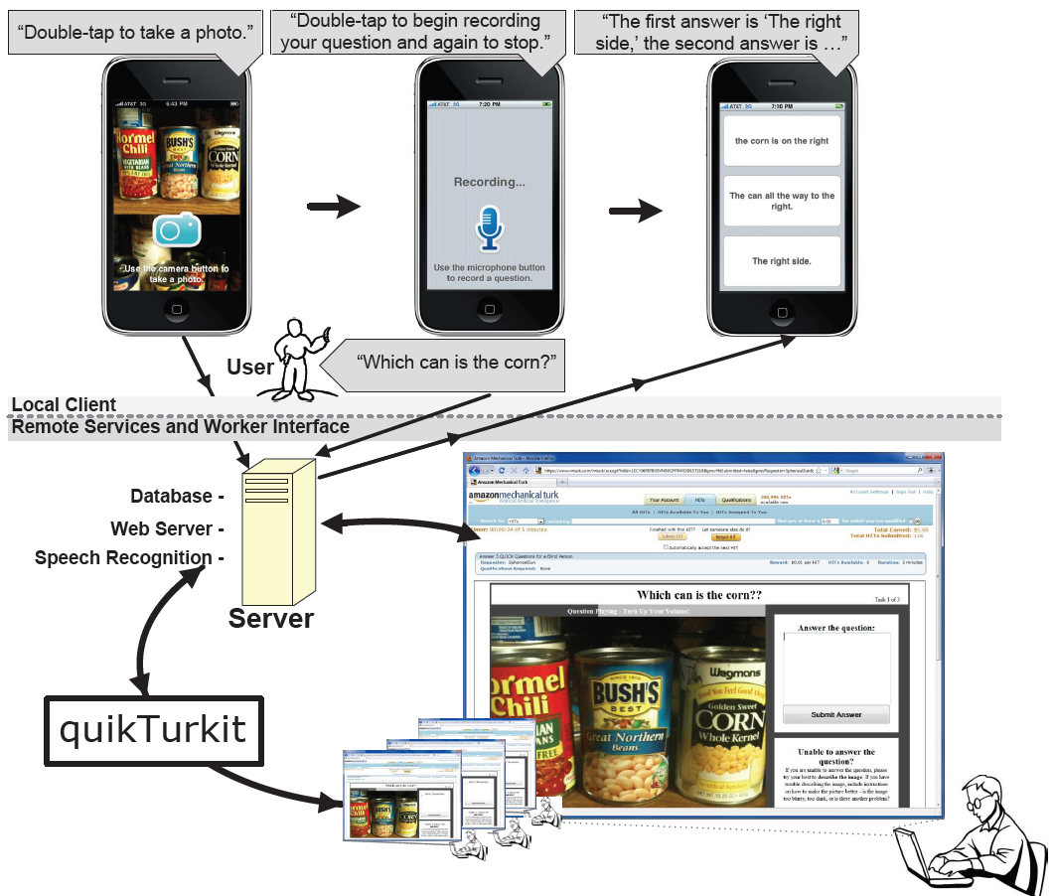
Visualization in Other Venues
UIST 2009 & 2010
UIST (ACM Symposium on User Interface Software and Technology) is the premier forum for innovations in the software and technology of human-computer interfaces. Sponsored by ACM's special interest groups on computer-human interaction (SIGCHI) and computer graphics (SIGGRAPH), UIST brings together researchers and practitioners from diverse areas that include traditional graphical web user interfaces, tangible ubiquitous computing, virtual augmented reality, multimedia, new input output devices, and CSCW.
Below you will find an overview of some recent UIST papers relevant to visualization and related themes.
UIST 2009
Relaxed Selection Techniques for Querying Time-Series Graphs
Perceptual Interpretation of Ink Annotations on Line Charts
Integrating Videos and Maps
for Driving Directions
Christian Holz & Steve Feiner Hasso Plattner Institute & Columbia University
Nicholas Kong & Maneesh Agrawala
University of California, Berkeley
B. Chen, B. Neubert, E. Ofek, O. Deussen & M. Cohen
Microsoft Research & University of Konstanz
WHAT:
Introduces relaxed selection techniques for time-series data. Users sketch over part of the graph, establishing the level of similarity through either spatial deviations from the graph, or the speed at which they sketch (temporal deviations).
WHY:
To more tightly integrate visual search and query specification, to support common tasks such as comparing
values at different points in time and searching for specified
patterns, either exact or approximate.
USER STUDY RESULTS:
Participants were significantly faster when using the
temporally relaxed selection technique than when using
traditional techniques. In addition, they achieved significantly
higher precision and recall with the spatially relaxed
selection technique compared to traditional techniques.
WHAT:
A technique for matching freeform ink annotations to perceptual features of line charts, such as peaks, valleys, and slopes. The system first applies a parts-based segmentation algorithm that identifies the visually salient parts in the chart. The system then analyzes the freeform annotations to infer the corresponding peaks, valleys, or sloping segments.
WHY:
Annotation is often used to aid collaborative discussion. The proposed technique is intended to reduce ambiguity of interpretation in asynchronous discussion and enable computational interpretation of referenced data segments.
WHAT:
Presents a system that integrates a map with a video automatically constructed from panoramic imagery captured at close intervals along the route. The routing information is used to create a variable speed video depicting the route. During playback of the video, the frame and field of view are dynamically modulated to highlight salient features along the
route and connect them back to the map.
WHY:
While navigation systems are gaining in importance, maps are still the medium of choice for way finding. However, even with a map, one is typically more comfortable navigating a route the second time due to one’s visual memory. The goal is to make the first time navigating a route feel more familiar.
UIST 2010
Cosaliency: Where People Look When Comparing Images
Designing Adaptive Forms for Improving Data Entry
VizWiz: Nearly Real-Time Answers to Visual Questions
David Jacobs, Dan Goldman & Eli Shechtman Stanford University & Adobe Systems, Inc.
Kuang Chen, Tapan Parikh & Joseph Hellerstein
University of California, Berkeley
Jeffrey Bigham plus 10 others
Univ. Rochester, Univ. Washington, MIT, UCF, Univ. Maryland
WHAT:
Explores the importance of local structure changes--e.g. human pose, appearance changes, object orientation, etc.--to photographic triage tasks. Conducts a user study in which subjects are asked to mark regions of image pairs most useful in making triage decisions. From this data, the authors train a model for image saliency in the context of other images, an approached called cosaliency. The model allows creation of collection-aware crops that can augment the information provided by existing thumbnailing techniques.
WHY:
Image triage is a common task in digital photography. Determining which photos are worth processing for sharing with friends and family and which should be deleted to make room for new ones can be a challenge, especially on a device with a small screen like a mobile phone or camera.
WHAT:
Usher is a tool for improved data entry. Based on prior data, Usher learns a probabilistic model of the dependencies between form questions and values and uses it to maximize information gain. By asking the most unpredictable questions first, Usher is better able to predict answers for the remaining questions. This paper introduces intelligent user interface adaptations that improve data entry accuracy and efficiency.
RESULTS:
Usher was evaluated with professional data entry clerks working with real patient data from six clinics in rural Uganda. The results show that adaptive forms can reduce error by up to 78%, with limited effect on entry time (varying between
-14% and +6%).
WHAT:
VizWiz is a speech application for mobile phones that offers a new alternative to answering visual questions in nearly real-time—asking multiple people on the web. The authors also introduce an approach for intelligently recruiting human workers in advance called quikTurkit. A field deployment with 11 blind participants illustrates that blind people can use VizWiz to quickly answer questions in their everyday lives, highlighting issues that automatic approaches will need to address to be useful.
assembled by Petra Isenberg (ack.: Danyel Fisher)

