Slide 1
Visualization Evaluation of the Masses, by the Masses, and for the Masses.
Jeffrey Heer Stanford University

Slide 2
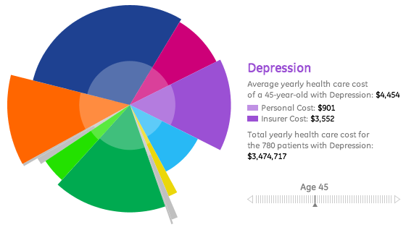
A sick chart?

Slide 3
For most visualizations today an unsettling question remains:
Is there a more effective design?
Notes:
I believe the visualization research community can do more to improve visualization evaluation not only in our research field, but in a manner that reaches the larger community of visualization designers. At the BELIV workshop I would like to have an open discussion on the topic.

Slide 4
Two Ideas…
An Analytic Framework for Visualization Criticism
Cost-Effective Evaluation Techniques: Crowdsourced Experimentation

Slide 5
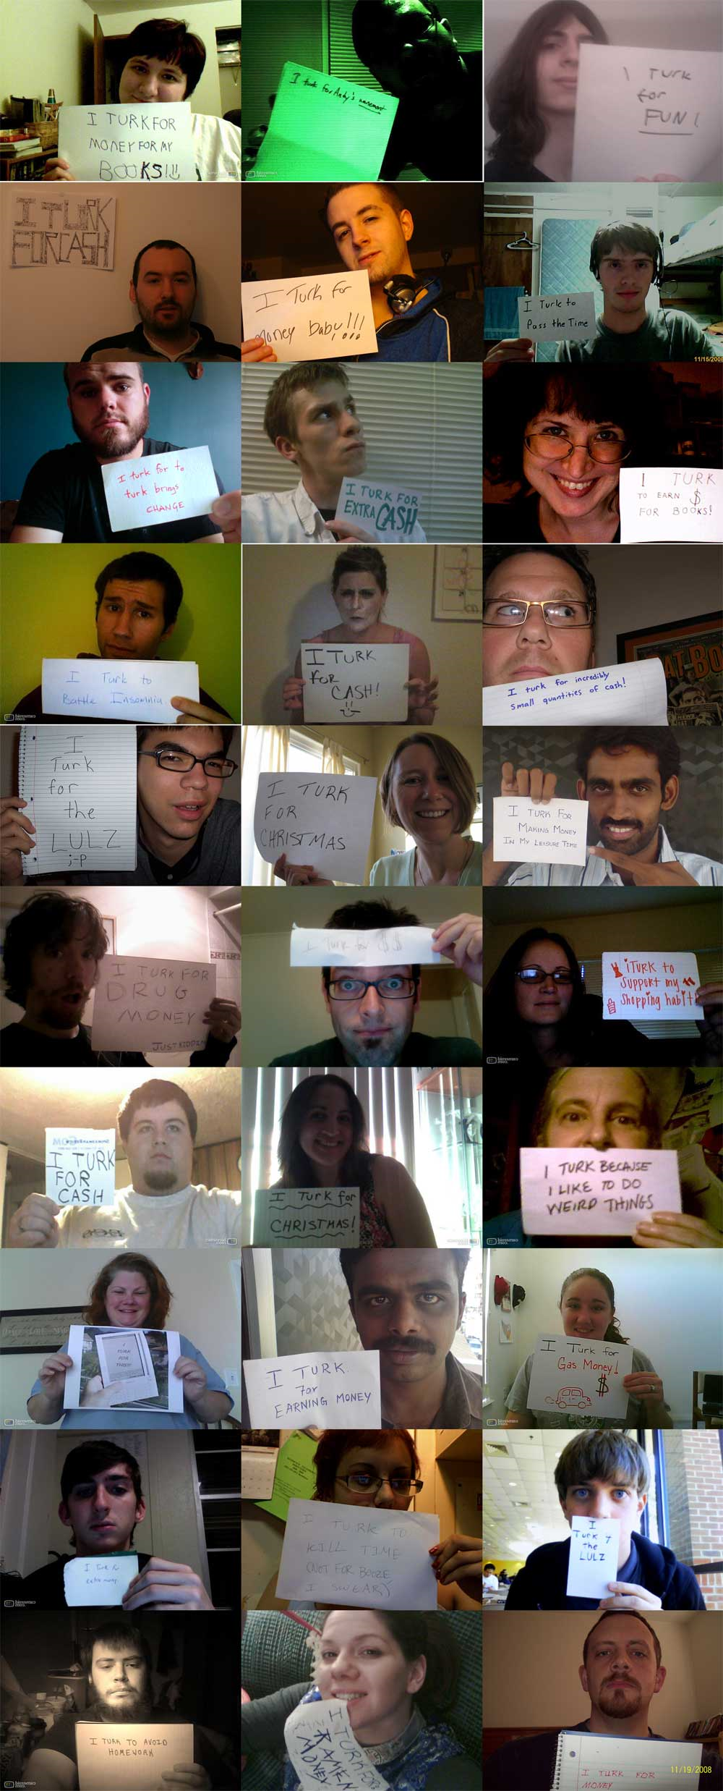
Andy Baio - Waxy.org
Notes:
http://waxy.org/2008/11/the_faces_of_mechanical_turk/

Slide 6
Andy Baio - Waxy.org

Slide 7
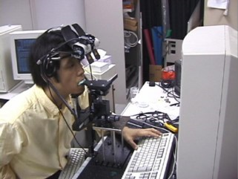
Notes:
hawaii.naist.jp/research/visual_e.html

Slide 8
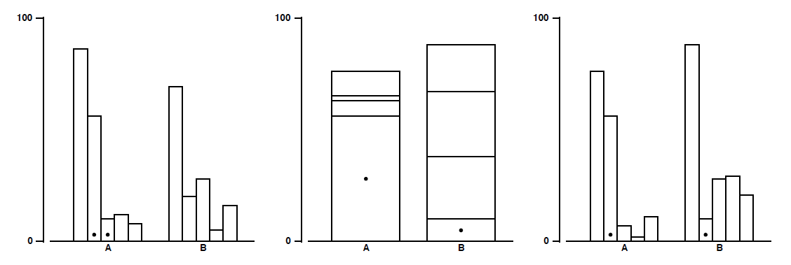
Cleveland & McGill, 1984
Stimuli for position encodings.
Task: estimate % smaller element is of the larger

Slide 9
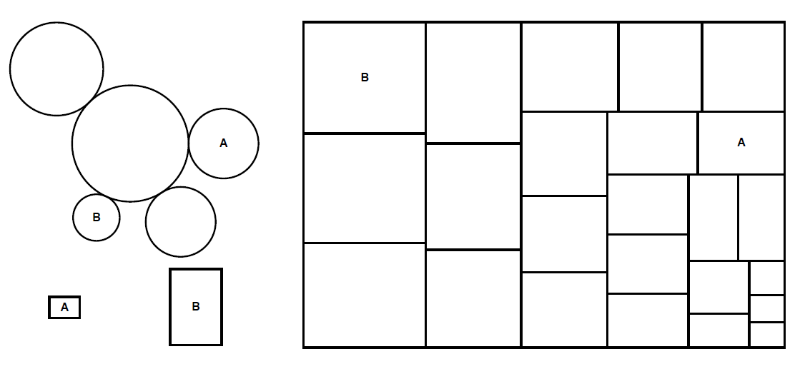
Area Judgment Stimuli
on encodings.
Task: estimate % smaller element is of the larger

Slide 10
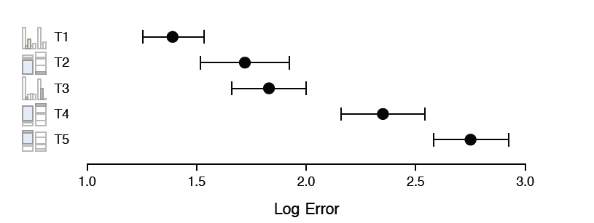
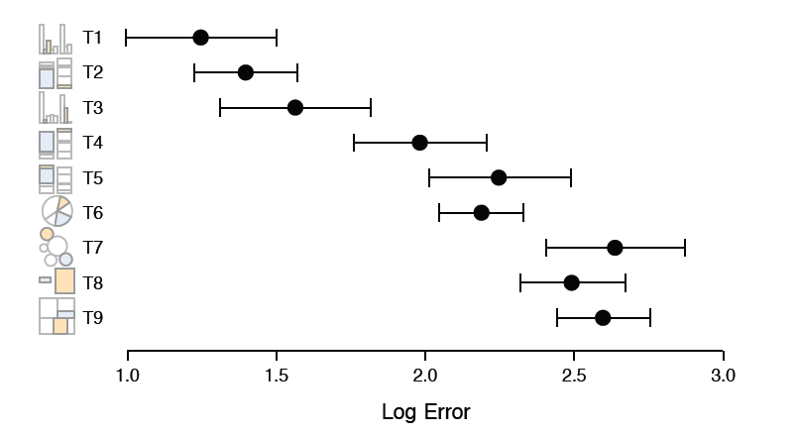
Cleveland & McGill, 1984 (Lab Study)
Heer & Bostock, 2010 (Crowdsourced Study)

