Slide 1
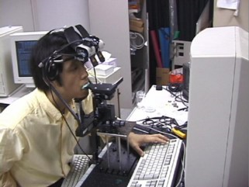
Notes:
hawaii.naist.jp/research/visual_e.html

Slide 2
VS.

Slide 3
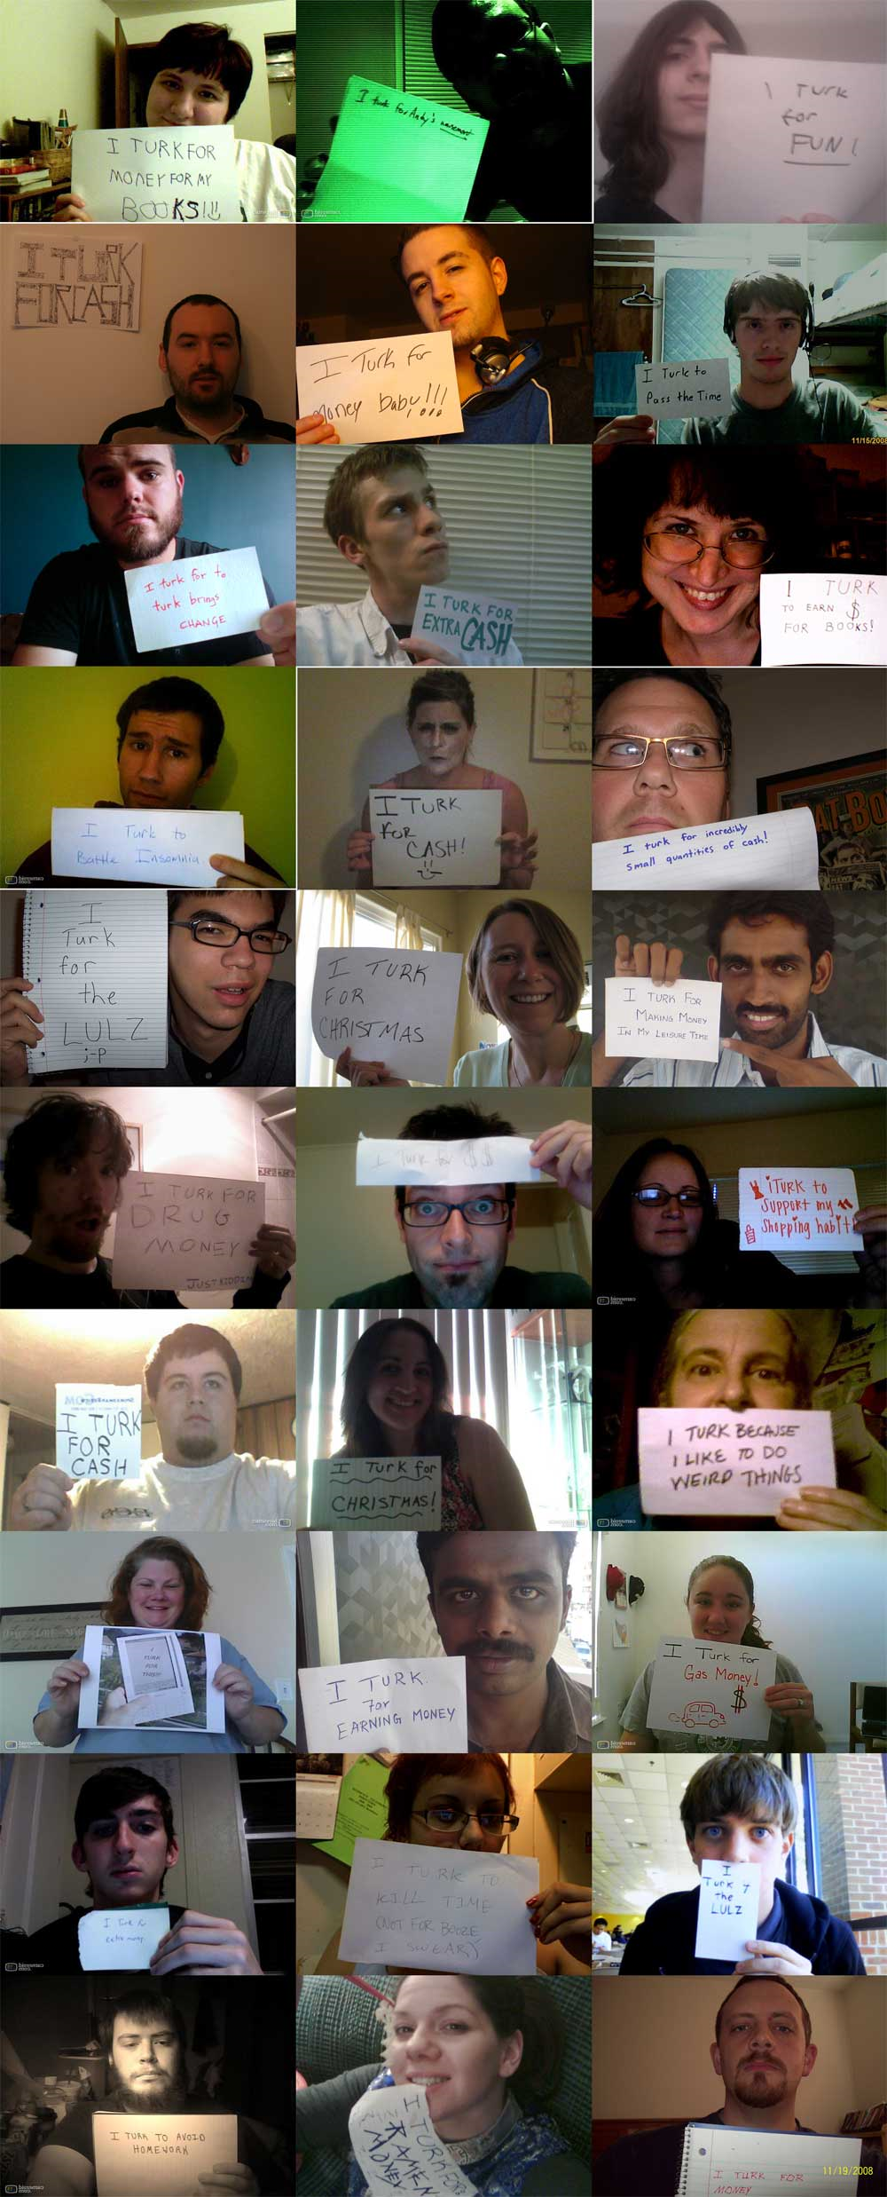
Andy Baio - Waxy.org
Notes:
http://waxy.org/2008/11/the_faces_of_mechanical_turk/

Slide 4
Andy Baio - Waxy.org

Slide 6
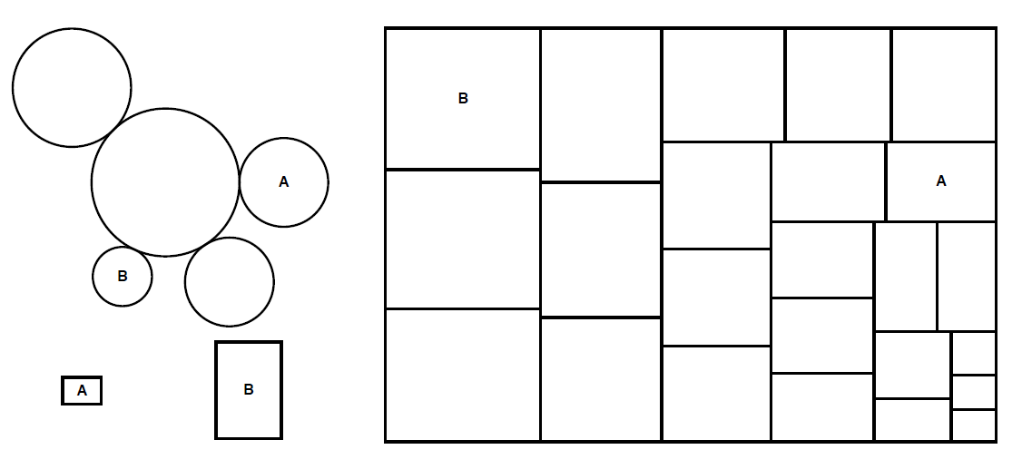
Crowdsourcing Graphical Perception Using Mechanical Turk to Assess Visualization Design
Jeff Heer, Mike Bostock Stanford University
TODAY at 11:30AM – Visualization Session!

