Slide 1
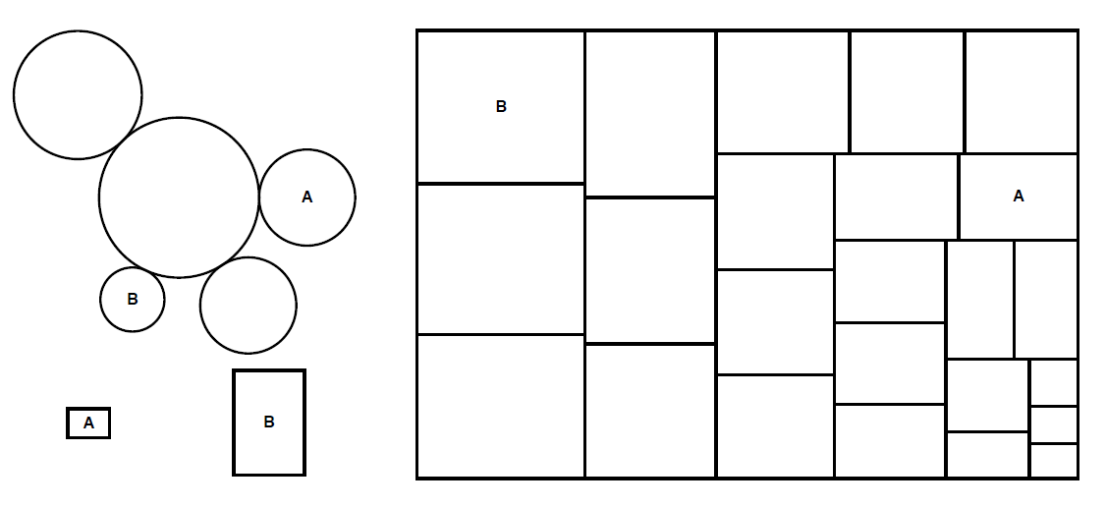
Crowdsourcing Graphical Perception Using Mechanical Turk to Assess Visualization Design
Jeffrey Heer & Michael Bostock
Stanford University
Notes:
Who am I? What do I do?
We don’t just build. We study things.

Slide 2
Set A
Set B
Set C
Set D
X | Y |  | X | Y |  | X | Y |  | X | Y
10 | 8.04 |  | 10 | 9.14 |  | 10 | 7.46 |  | 8 | 6.58
8 | 6.95 |  | 8 | 8.14 |  | 8 | 6.77 |  | 8 | 5.76
13 | 7.58 |  | 13 | 8.74 |  | 13 | 12.74 |  | 8 | 7.71
9 | 8.81 |  | 9 | 8.77 |  | 9 | 7.11 |  | 8 | 8.84
11 | 8.33 |  | 11 | 9.26 |  | 11 | 7.81 |  | 8 | 8.47
14 | 9.96 |  | 14 | 8.1 |  | 14 | 8.84 |  | 8 | 7.04
6 | 7.24 |  | 6 | 6.13 |  | 6 | 6.08 |  | 8 | 5.25
4 | 4.26 |  | 4 | 3.1 |  | 4 | 5.39 |  | 19 | 12.5
12 | 10.84 |  | 12 | 9.11 |  | 12 | 8.15 |  | 8 | 5.56
7 | 4.82 |  | 7 | 7.26 |  | 7 | 6.42 |  | 8 | 7.91
5 | 5.68 |  | 5 | 4.74 |  | 5 | 5.73 |  | 8 | 6.89
Summary Statistics Linear Regression
u_{X} = 9.0 σ_{X} = 3.317 Y² = 3 + 0.5 X
u_{Y} = 7.5 σ_{Y} = 2.03 R² = 0.67
[Anscombe 73]
Notes:
Imagine a colleague has been running a simulation and has asked us to help make sense of their output.
It’s always good practice to first inspect the raw data. Eyeballing the numbers, we can get a sense of the range of values, and might notice that set D has repeated values in the X column, but otherwise its not immediately clear if there are any patterns.
So we might next compute some basic statistics. In this case we find that across all sets, the data dimensions have the same means and standard deviations. Furthermore it turns out that if we try to fit the data to a line, we find that the same line describes each data set.
The intimate relationship between correlation and regression raises the question of whether it is possible for a regression analysis to be misleading in the same sense as the set of scatterplots all of which had a correlation coefficient of 0.70. In 1973, Frank Anscombe published a set of examples showing the answer is a definite yes (Anscombe FJ (1973), "Graphs in Statistical Analysis," The American Statistician, 27, 17-21). Anscombe's examples share not only the same correlation coefficient, but also the same value for any other summary statistic that is usually calculated.

Slide 3
Set A
Set B
Y
Set C
Set D
Y
X
X
Notes:
If we plot the data, however, we immediately see that each set has a unique pattern. The lesson is that through an appropriate visual encoding, we can exploit human visual processing to gain insight and start asking the right questions.
Of course, each of these data sets include only 10 tuples. Today, many real-world data sets consist of thousands or millions of data points and often contain more complicated structures.

Slide 4
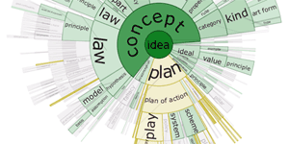
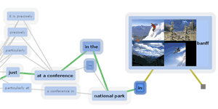
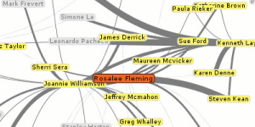
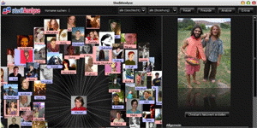
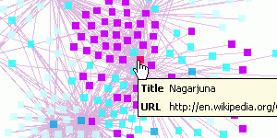
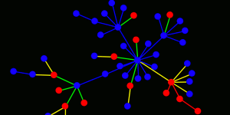
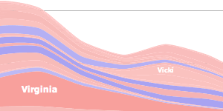
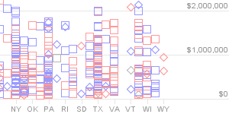
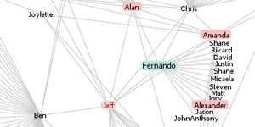
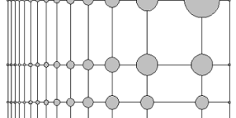
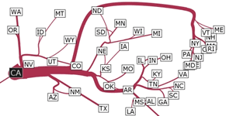
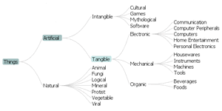
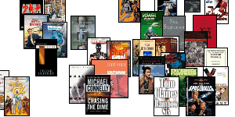
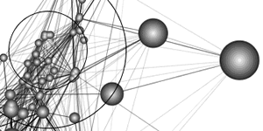
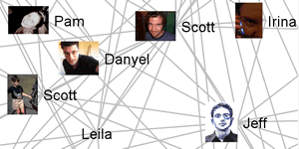
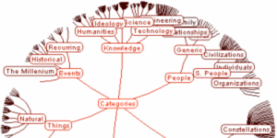
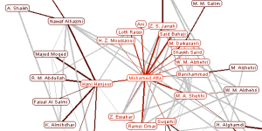
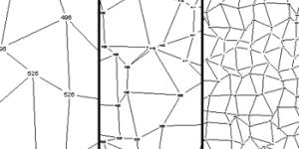
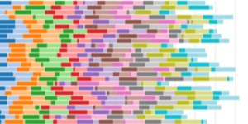
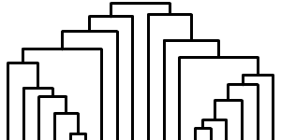
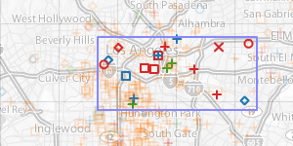
Panopoly of visualizations

Slide 5
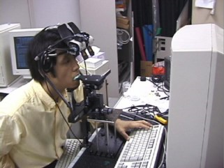
hawaii.naist.jp/research/visual_e.html
Notes:
In the current work, we are interested in using Mechanical Turk to conduct perception experiments for assessing visualization designs. Here we see what in many respects is the ideal perception experiment: we have complete control over the monitor, environmental lighting, and subjects head movement and distance to display. In contrast, we lack of control over subjects’ display configuration when crowdsourcing. Can we perhaps trade this control for improved ecological validity and still run reliable experiments?
hawaii.naist.jp/research/visual_e.html

Slide 6
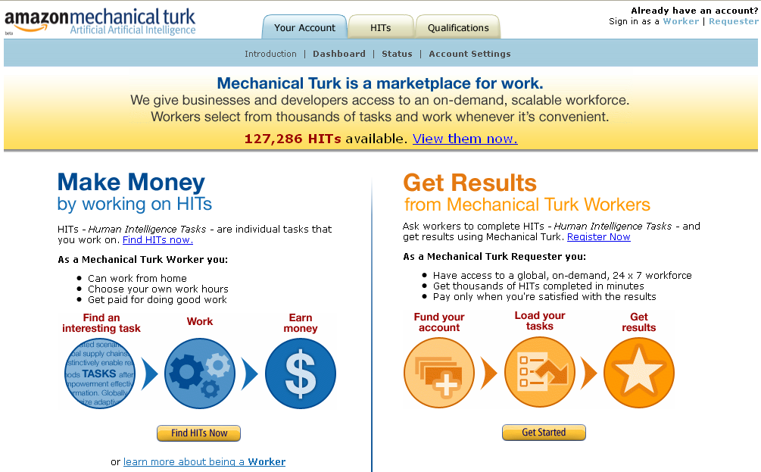
Notes:
Analogously, the modern-day Mechanical Turk is a site run by Amazon with the motto: “Artificial Artifical Intelligence”. It is a micro-task market place where so-called “Turkers” are paid small sums of money to perform online tasks, particularly those that are difficult to computationally automate.
Now, to help get a sense of your familiarity, how many of you have completed tasks on Mechanical Turk as a worker? And how many of you has submitted tasks as a requester?

Slide 7
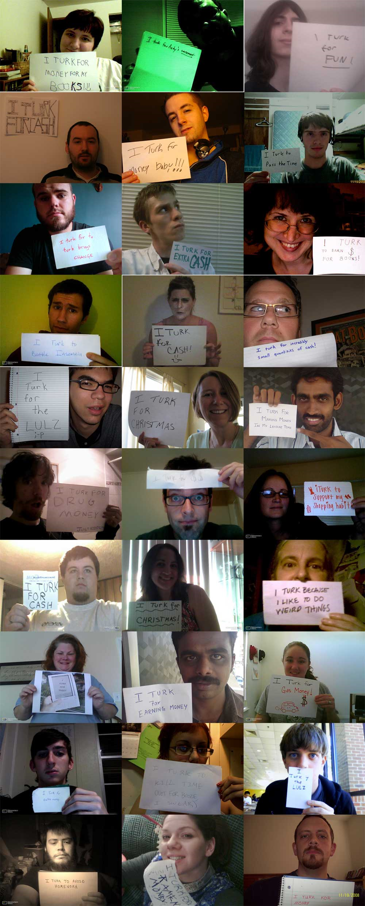
Andy Baio - Waxy.org
Notes:
http://waxy.org/2008/11/the_faces_of_mechanical_turk/
At this point, you may be wondering who these Turkers are. Here is a collage collected by Andy Baio of waxy.org. He posted a task to Mechanical Turk requesting that Turkers upload a portrait of themselves holding a piece of paper describing why they Turk. Turkers cite various motivations, including fun, interest, and money.

Slide 8
Using MTurk for Research
Machine Learning, Comp. Vision & Info. Retrieval
User-Generated Metadata, Labeling Data
Kittur, Chi & Suh: Wikipedia Article Quality
Use verifiable questions to reduce gaming
Make sincere responses as easy as insincere ones
Mason & Watts: Financial Incentives
Higher reward → faster completion, same quality
Notes:
Kittur et al. [14] used MTurk for collecting quality judgments of Wikipedia articles. Turker ratings correlated with those of Wikipedia administrators when the tasks included verifiable questions and were designed such that completing them meaningfully is as easy as not. Mason & Watts [23] studied the effect of compensation level for image sorting and word puzzle tasks. They found that raising the reward for each HIT increased the quantity of individual responses but not the quality (e.g., accuracy) of the work performed. The implication is that paying more results in faster, though not better, results.

Slide 9
an example: TimeNets for Genealogical Data

Slide 10
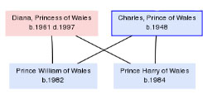
Visualizing Genealogical Graphs

Slide 11
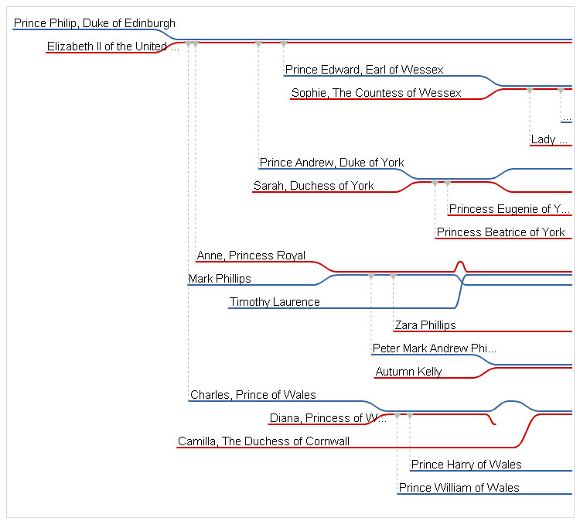

Slide 12
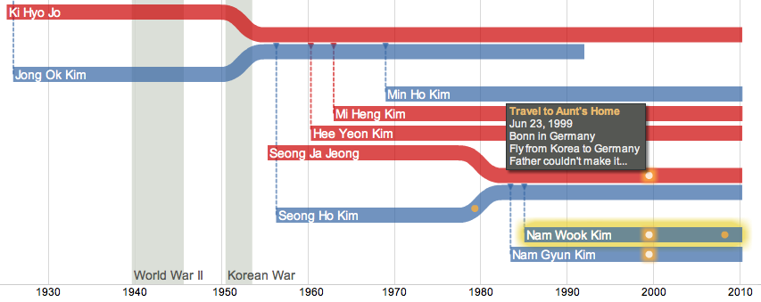
TimeNets = Time x Family Trees

Slide 13
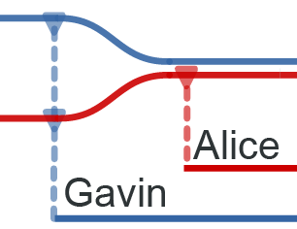
(Out-of-Wedlock Births)

Slide 14
Elizabeth Taylor (Remarriage)

Slide 15
Osama bin Laden (Polygamy)

Slide 16
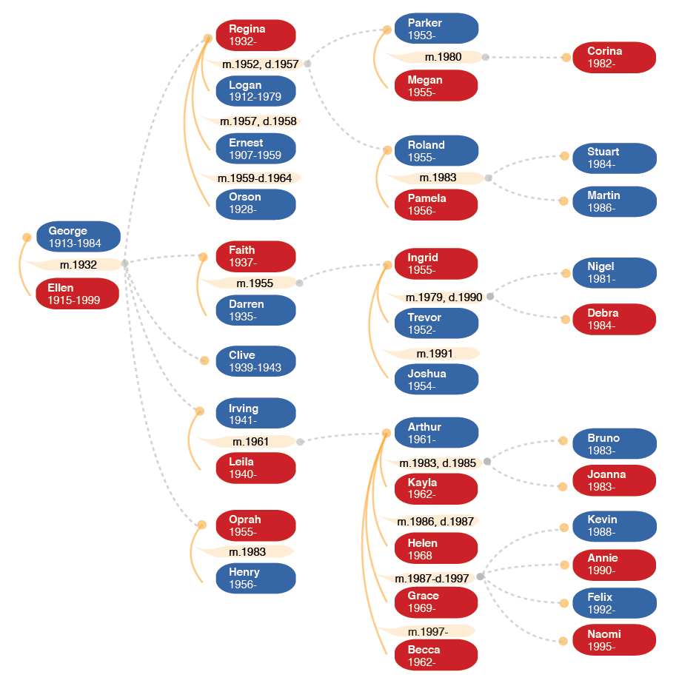
Family Tree

Slide 17
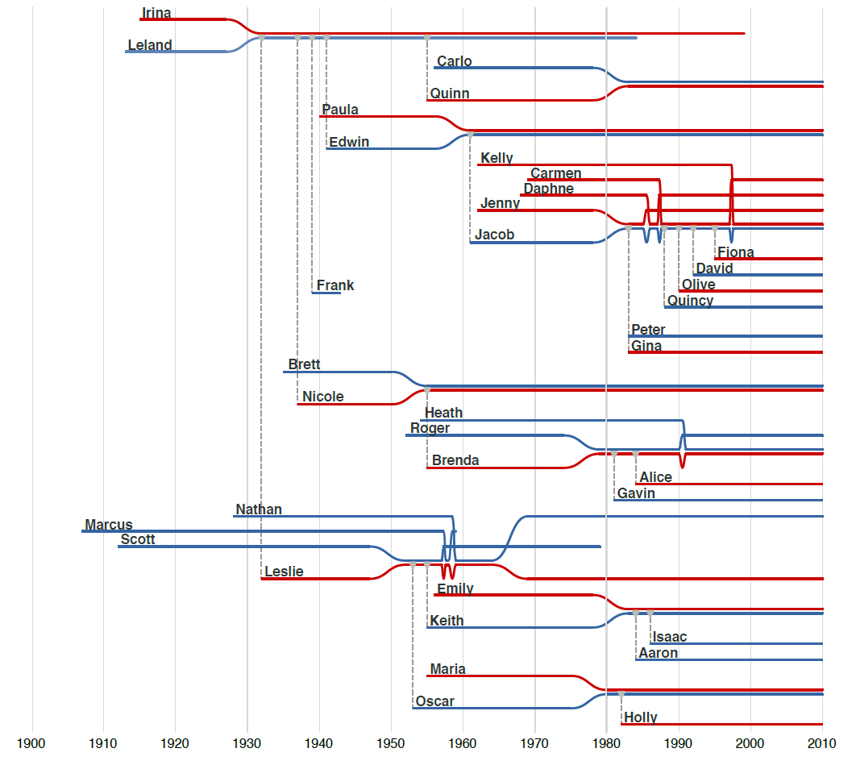
TimeNets

Slide 18
Family Tree
vs.
Asked structural, temporal & struct x temp tasks
No accuracy differences between visuals
TimeNets were significantly faster (~25%) for tasks with a temporal component

Slide 19
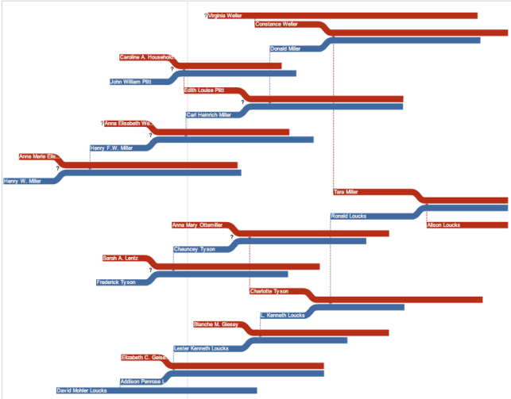
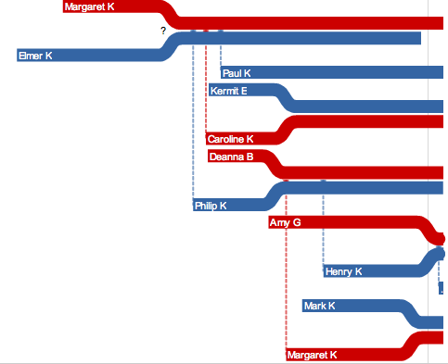
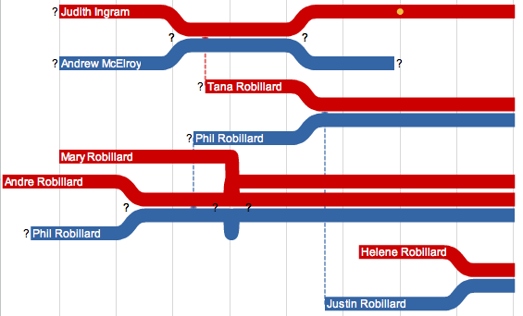
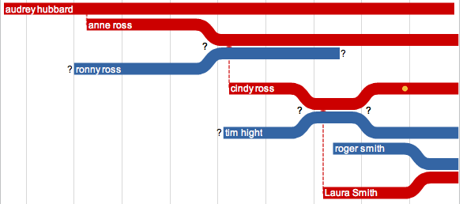
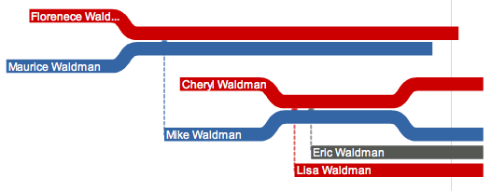
Notes:
Here are some of visualizations and feedbacks from mechanical turk users. Some of users really enjoyed Akinu. As I mentioned, however, the biggest harassment was the browser crash and many people complained about it.

Slide 20
hawaii.naist.jp/research/visual_e.html
Notes:
In the current work, we are interested in using Mechanical Turk to conduct perception experiments for assessing visualization designs. Here we see what in many respects is the ideal perception experiment: we have complete control over the monitor, environmental lighting, and subjects head movement and distance to display. In contrast, we lack of control over subjects’ display configuration when crowdsourcing. Can we perhaps trade this control for improved ecological validity and still run reliable experiments?
hawaii.naist.jp/research/visual_e.html

Slide 21
Research Goals
1. Assess the viability of crowdsourced perception experiments on Mechanical Turk.
2. Demonstrate the use of MTurk to gain novel insights for visualization design.
3. Analyze experimental data to characterize MTurk as an experimental platform.
Notes:
In the current research we had 3 primary goals.
To do this we replicated well-known laboratory studies on both spatial visual encodings and luminance contrast.
For this we ran novel experiments on rectangular area judgments (as found in visualizations such as treemaps and cartograms) and on chart size and gridline spacing.
(Read)
Next I will first describe a subset of our experimental results, saving any overarching concerns for a final discussion on our experiences using Mechanical Turk.

Slide 22
Experiment 1: Proportional Judgments of Spatial Data Encodings

Slide 23
Most accurate Position (common) scale
Position (non-aligned) scale
Length
Slope
Angle
Area
Volume
Least accurate Color hue-saturation-density
Cleveland & McGill ‘84
Notes:
One of the seminal results of graphical perception research are guidelines for the effective use of different visual encoding variables. Through a combination of psychophysical theory and human subjects experiments, the statistician William Cleveland and his contemporaries were able to establish a rank ordering of visual variables based on their effectiveness. This slide shows the resulting rank ordering of visual encodings for displaying quantitative data.
-----
Cleveland task: estimate the proportion of one element as a percentage of another element
Are these the same as the ranking for discriminating which of two quantities are larger?
The above ordering is based on the revised ranking in this paper (cites evidence that angle is not as good as slope)
Hollands, J. & Spence, I. (2001). The discrimination of graphical elements. Applied Cognitive Psychology, 15, 413-431.

Slide 24
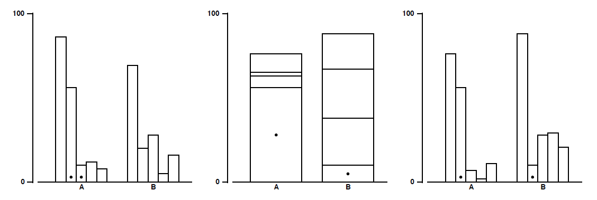
Cleveland & McGill, 1984
Stimuli for position encodings.
Task: estimate % smaller element is of the larger
Notes:
In Cleveland & McGill’s seminal experiment, they had subjects (Bell Labs employees) view a chart with two marked elements. They then asked subjects to identify which marked element was smaller, and then estimate what percentage the smaller was of the larger. This slide shows 3 different configurations using a position encoding.
As one of the most influential studies in statistical data graphics, this was a natural experiment to attempt to replicate via crowdsourcing.

Slide 25
Experiment 1A: Proportions
Goal: replicate Cleveland & McGill, 1984
5 original types: position (3) + length (2)
+ 2 new types: angle + circular area
x 10 proportional differences
N=50 assignments, $0.05 per HIT
Task: estimate % smaller element is of the larger
Error = log₂( | true% - estimated% | + 1/8)

Slide 26
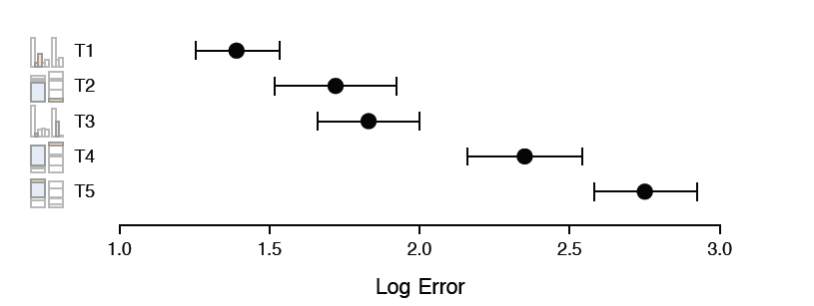
Cleveland & McGill, 1984 (Lab Study)
Our Crowdsourced Study

Slide 27
Cleveland & McGill, 1984 (Lab Study)
Our Crowdsourced Study

Slide 28
Experiment 2: Gridline Alpha Contrast
Notes:
https://www.mturk.com/mturk/findquals?requestable=false&earned=true

Slide 29
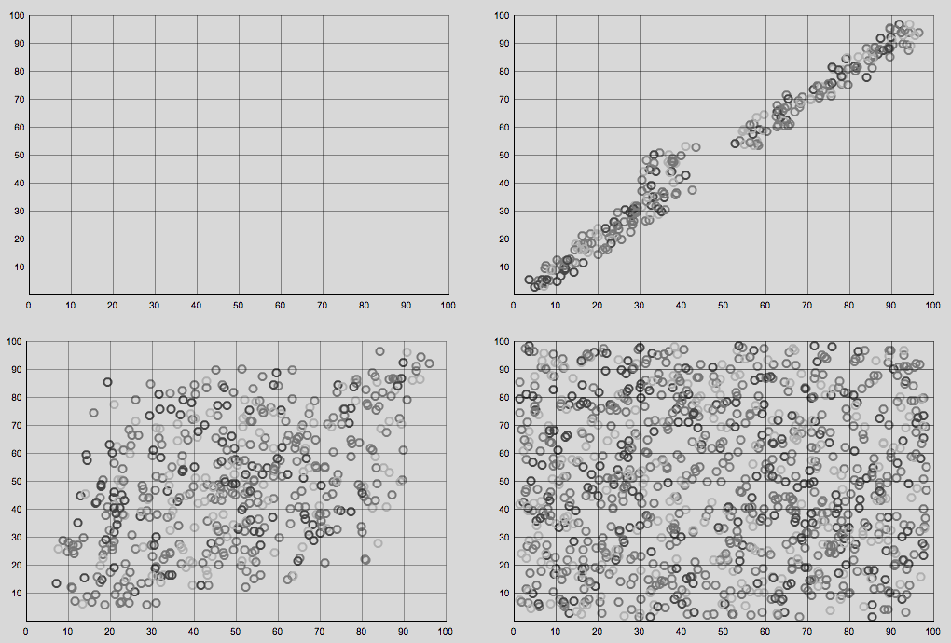
Notes:
Plot density conditions

Slide 30
Experiment 2 Tasks
2L: Adjust the grid so that it is as light as possible while still being usably perceptible.
2D: Adjust the grid strength to meet your best judgment of how obvious it can be before it becomes too intrusive and sits in front of the image; some users have called this a ‘fence’.

Slide 31
Experiment 2: Gridline Alpha
4 plot density: none, sparse, medium, dense
x 5 background: #f3, #d8, #be, #a5, #8e
x 3 replications
N=24 assignments, $0.02 per HIT
Record alpha value, User-Agent, JS “screen” info

Slide 32
Stone & Bartram, 2009 (Lab Study)
Our Crowdsourced Study

Slide 33
Inferred Display Configuration
Operating System (& gamma?) from User-Agent
MacOS < 10.6: γ = 1.8 vs. PC: γ = 2.2
Alpha x pixel resolution: r = 0.07, p < 0.01
Alpha x color depth: r = -0.18, p < 0.01
Notes:
We found a weak positive correlation (r(1431) = 0.07, p < 0.01) between alpha values and screen resolution (measured in total pixels; resolutions varied from 1024x768 to 1920x1200). Thus as the resolution increased, users tended to make the (likely thinner) gridlines slightly darker. Unsurprisingly, we also found a negative correlation (r(1431) = -0.176, p < 0.01) between alpha values and monitor color depth (one of 16, 24, or 32 bits): subjects tended to select lighter alphas on displays with greater color resolution, presumably due to better contrast.

Slide 34
Experiment 3: Chart Size & Gridline Spacing
Read our paper….

Slide 35
Mechanical Turk: Performance and Cost

Slide 36
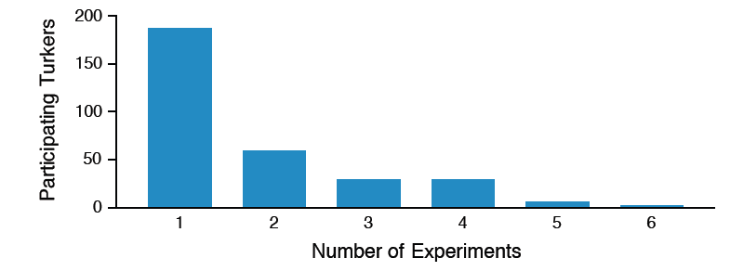
Turkers Overlap Across Studies
31% (51/186) Turkers participated in 2 or more
Only 7% (13) from Exp. 1A participated later

Slide 37
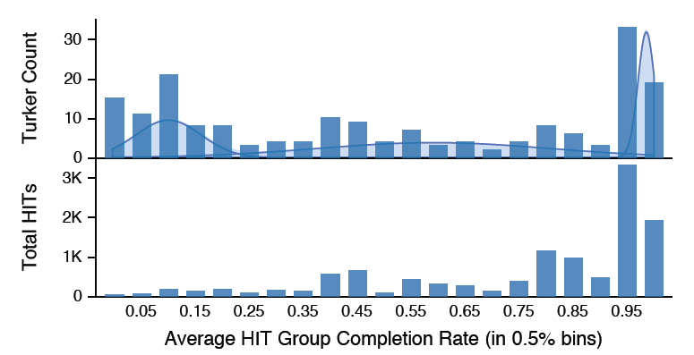
Samplers and Streakers

Slide 38
Quality with Qualification
High quality results: Only 0.75% of responses were rejected outliers.
Removing qualification tasks resulted in over 10% unusable responses.
Verifiable answers reduce gaming incentive and insincere responses.

Slide 39
Standard HITs Frustrate Timing
Expected time per HIT: 10s
Observed time per HIT: 42s (μ=54s, σ=41s)
→ Timing data is not reliable.
Strategies for Fine-Grained Timing
Macro-Task (batch of micro-tasks)
Ready-Set-Go HIT interface
→ Successful in subsequent studies.

Slide 40
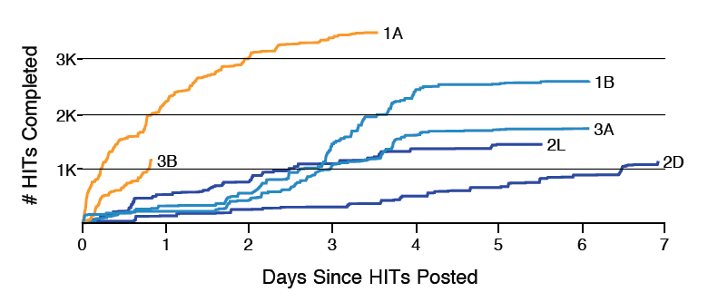
HIT Completion Rates
Orange ≥ 4¢ Blue = 2¢
Raise reward → faster results; ≅ quality

Slide 41
Crowdsourcing Reduces Costs
6x cost savings (vs. $15/subject lab rate)
9x savings possible (using $0.02 rewards)
Study time drops from 2 weeks to 1-3 days
→ Crowdsourcing provides up to an order of magnitude $$ and time savings
→ With constant cost, it enables more studies, more variables, more subjects

Slide 42
Future Work
Multiple methods studies: how to best balance the laboratory with online crowdsourcing?
Better tools for crowdsourced experimentation. Facilitate experimental control and adaptation.
Community resources for evaluation: share “market” data, share experimental designs, facilitate replication and meta-analysis.

Slide 43
Extend crowdsourcing methods to an even greater diversity
of experimental designs.

Slide 44
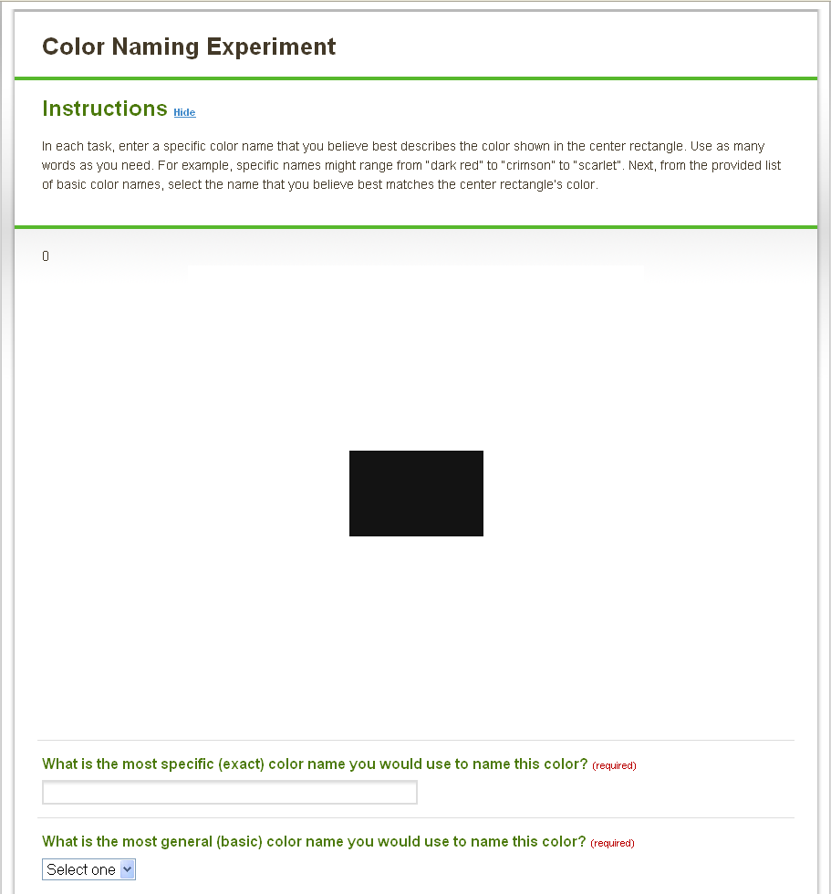

Slide 45
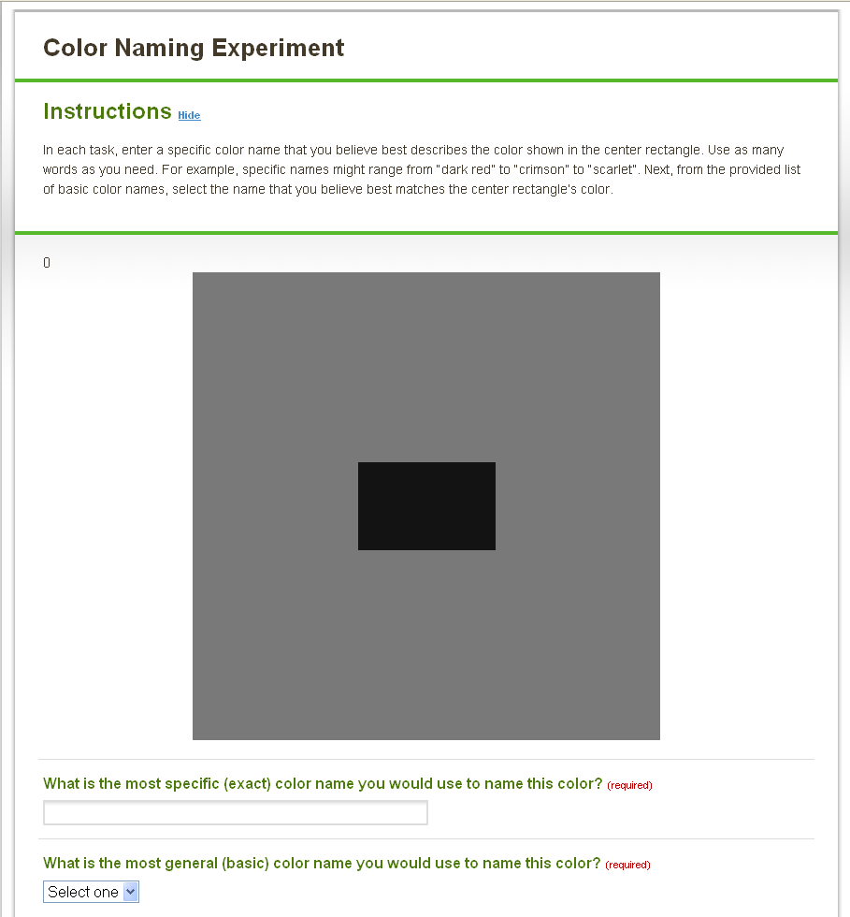

Slide 47
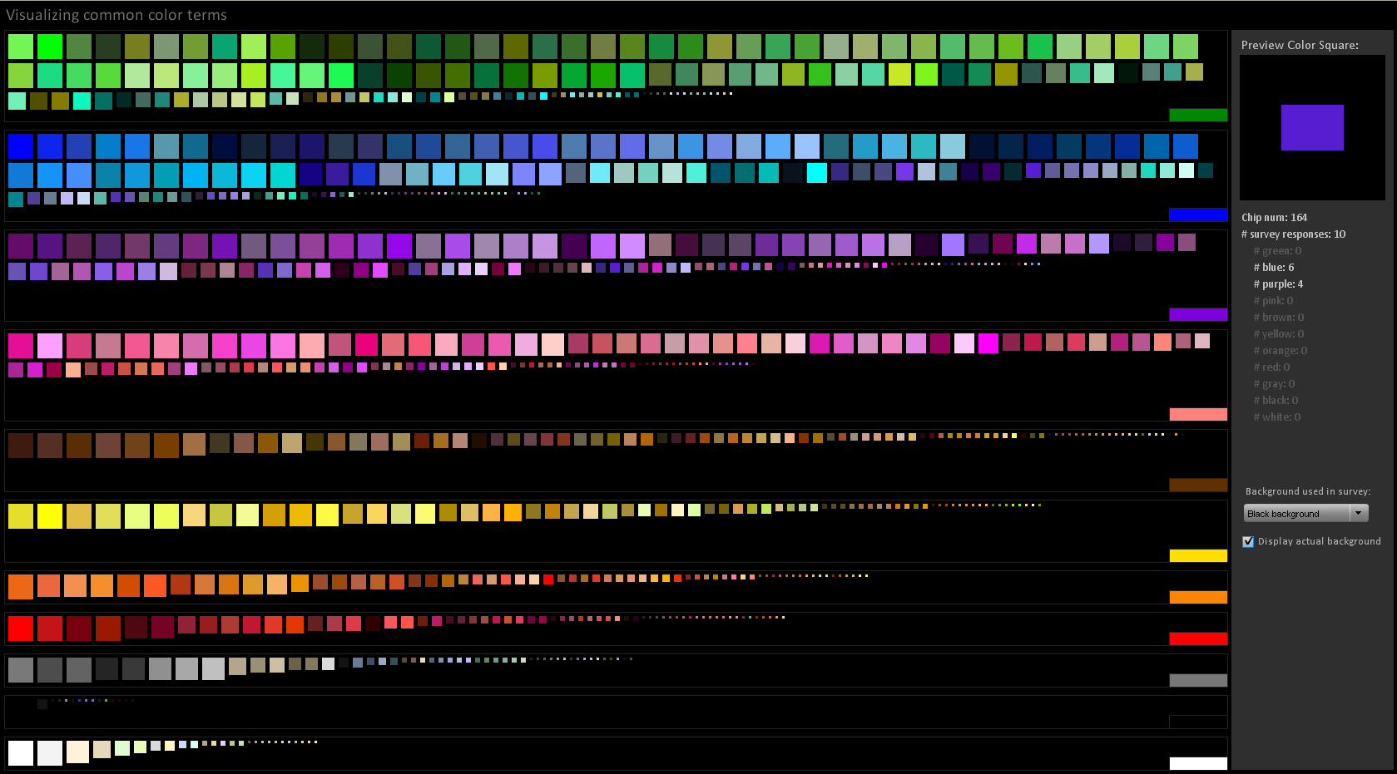

Slide 48
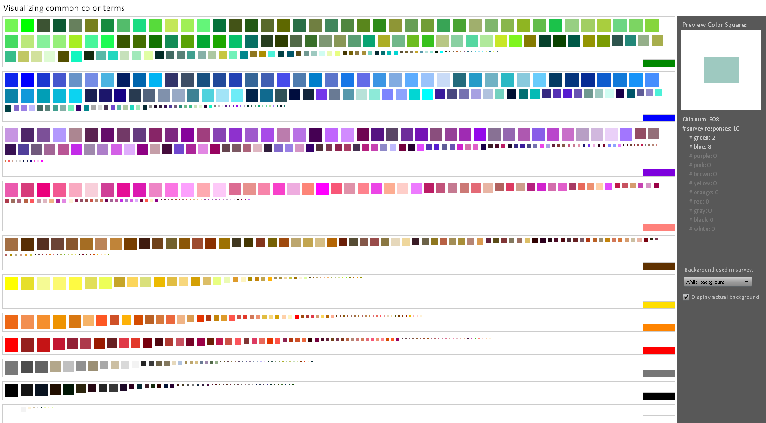

Slide 49
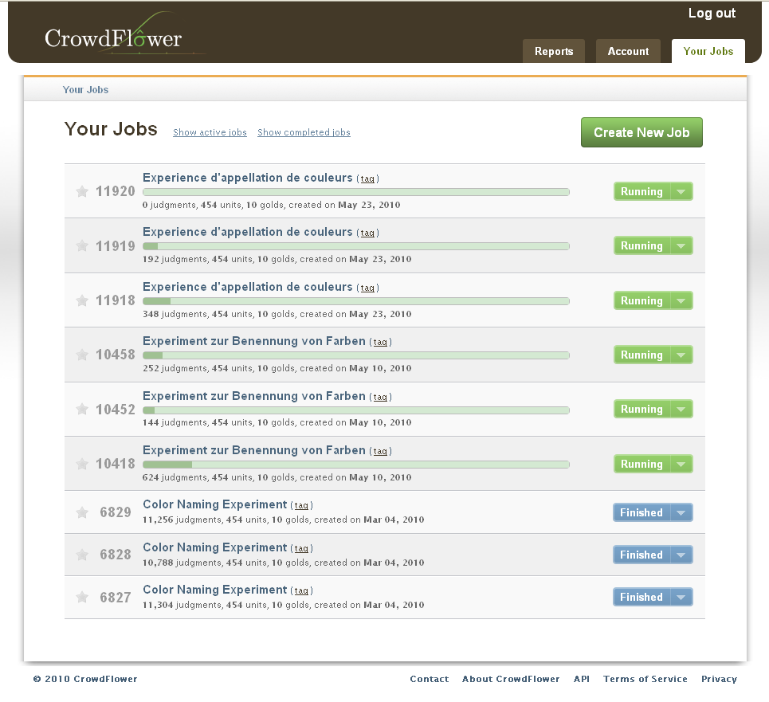

Slide 50
Crowdsourcing Graphical Perception Using Mechanical Turk to Assess Visualization Design
Jeffrey Heer & Michael Bostock
http://hci.stanford.edu/jheer

