Slide 1
(Awkward) Social Software
Most social software is arguably autistic…
Are you my friend? YES or NO.
Friend recommendation: your ex.
How might social services generate and utilize more nuanced models of communities and relations?
Applications to online sharing, access control, privacy management, and recommenders.
Notes:
Collaboration between HCI and PrPl.

Slide 2
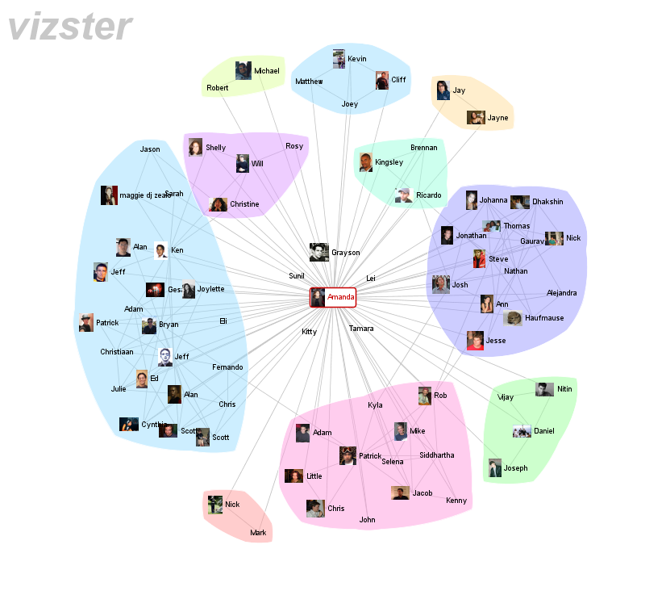
Notes:
This is what your social landscape looks like according to current community detection approaches based on network partitioning – note that each person is grouped into a single, homogenous community.

Slide 3
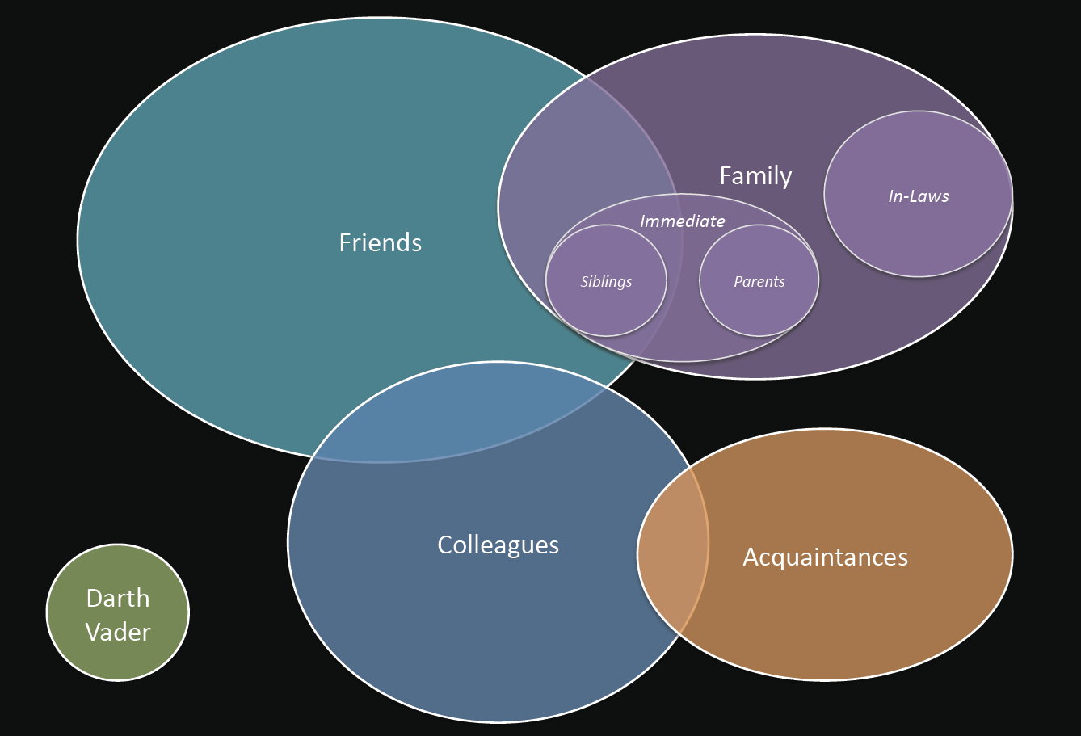
Notes:
However, in reality our social relations are more like this.
Communities overlap, often significantly. For example, work colleagues may also be hiking buddies, but communicate in very different contexts.
People have varying tie strengths. For example, you might have a core groups of close friends within your wider friendship circle.
It is not feasible to ask people to communicate these relationships by hand, as people may have hundreds or even thousands of contacts.

Slide 4
Real-world social groups are:
Overlapping
Nested
Highly Contextual
Notes:
However, in reality our social relations are more like this.
Communities overlap, often significantly. For example, work colleagues may also be hiking buddies, but communicate in very different contexts.
People have varying tie strengths. For example, you might have a core groups of close friends within your wider friendship circle.
We refer to these structures as “social topologies”.
It is not feasible to ask people to specify topologies by hand, as people may have hundreds or even thousands of contacts.

Slide 5
New Algorithm for Social Topologies
Analyze co-occurrence in communication.
1. Identify and infer repeated recipient groups
2. Prune groups according to a sharing error
3. Infer macro-structure via group unions
4. Organize results into a hierarchy
Developed and evaluated on e-mail archives, but generally applicable to social co-occurrence.
Notes:
So we have created a new algorithm for inferring these social topologies from co-occurrence of individuals within social media. In particular, we have focused on mining topologies from e-mail, as it provides a rich source of social interaction data often involving a variety of social contexts. Moreover, e-mail requires some investment of effort on the part of the writer, thus providing a better cue of tie strength than a one time friend request.
I’d like to now give a sketch of how our algorithm works. We start by…
While we have initially focused on email data, I should note that in principle our approach is applicable to any data source involving social co-occurrence in which the frequency of interaction is a meaningful indicator of connection strength.

Slide 6
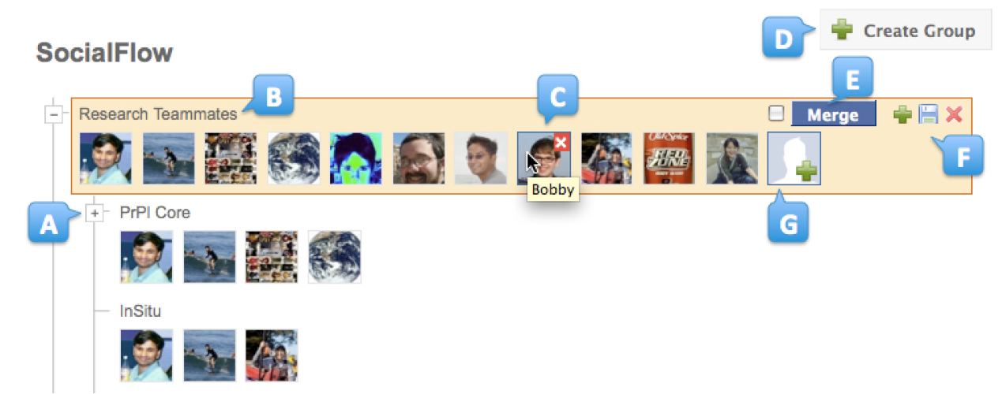
SocialFlows Topology Browser
User study found SocialFlows significantly faster and more useful than the Gmail contact management UI
In addition, 6 out of 19 users found the Gmail intolerable and quit the task!
Notes:
To enable users to view and refine their social topologies, we built a browser interface call SocialFlows. Using this interface, users can drill down from large communities into smaller groups, label and organize those groups, and also edit group memberships.
We then ran a user study comparing the use of Social Flows and a state-of-the-art contacts management UI—in this case the Gmail contacts manager—to create social topologies in response to a variety of sharing scenarios. We found that users were able to quickly make sense of their social topology with our UI and make a number of small refinements. This resulted in significantly faster topology construction for those who completed tasks in both conditions. However, 6 out of 19 subjects found the Gmail interface intolerable and refused to complete the task with that interface. Moreover, users rated the social models made with our algorithm and interface as more accurate and useful.

Slide 8
Collaboration via POMI
Collaborative research between POMI team and the Stanford Visualization and HCI groups.
Diverse, multi-disciplinary faculty and students.
Multiple publications and demos (KDD, UIST).
Applications to social sharing, access control, visualization, and social media analysis.

Slide 9
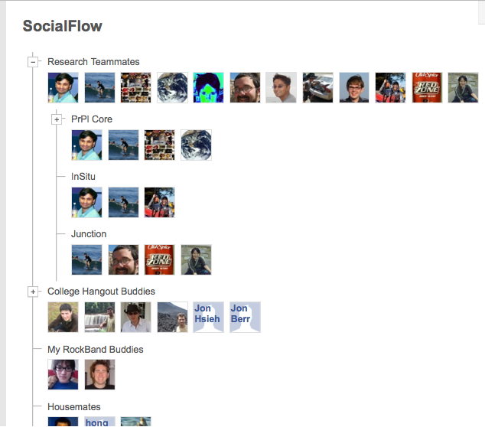
Social Topology
Derive our social topology naturally from our email communication
Can keep up to date continuously
Novel algorithm: finds overlapping / nested groups
UI: allows users to drill down
Comparison with Gmail mailing list UI
6 out of 19 found Gmail inferior and quit

