Slide 1
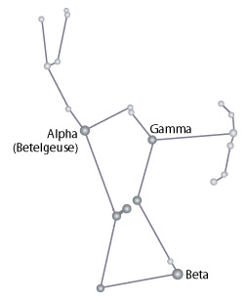
A user logs in to Orion, ready to analyze.
ORION
Query, Analysis, and Visualization of Networks
Database movies@localhost
Login user.name
Password ********
(or alternatively, uses a form for data upload: GraphML, CSV tables, etc…)

Slide 2
Meanwhile, in the database lie a set of tables…
ACTORS
actor_id | actor_name
1 | Jack
2 | Meryl
3 | Audrey
4 | Fred
AWARDS
award_id | award_type
1 | Oscar
2 | Emmy
ACTORS_MOVIES
actor_id | movie_id
1 | 1
1 | 3
2 | 2
2 | 3
3 | 1
3 | 2
4 | 2
MOVIES
movie_id | movie_name | director | year
1 | One Hot Winter | Qubrick | 1969
2 | Electric Blanket | van Shant | 1977
3 | Home for Halloween | van Shant | 1981
ACTORS_AWARDS
actor_id | award_id | year
1 | 2 | 1969
2 | 1 | 1977

Slide 3
ORION Entity Builder
☺ user.name | Settings | Logout
database movies@localhost
SCHEMA
actors
(&) actor_id
(T) actor_name
movies
(&) movie_id
(T) movie_name
(T) director
(#) year
awards
(&) award_id
(T) award_type
actors_movies
(→) actor_id
(→) movie_id
actors_awards
(→) actor_id
(→) award_id
(#) year
ENTITIES
Name Identifier Match By Size
actors actors/actor_id equal v 4
movies movies/movie_id equal v 3
awards awards/award_id equal v 2
directors movies/director edit_dist v 2
The user uses the Entity Builder to define “node” types. By default, the list is populated with table primary keys.
The name can be user-edited; the identifier field uses a uniquely identifying column value; match by determines how record equivalance is established; size (and potentially other fields) previews properties of the node set.

Slide 4
ORION Entity Builder
☺ user.name | Settings | Logout
database movies@localhost
SCHEMA
actors
(&) actor_id
(T) actor_name
movies
(&) movie_id
(T) movie_name
(T) director
(#) year
awards
(&) award_id
(T) award_type
actors_movies
(→) actor_id
(→) movie_id
actors_awards
(→) actor_id
(→) award_id
(#) year
ENTITIES
Name Identifier Match By Size
actors actors/actor_id equal v 4
movies movies/movie_id equal v 3
awards awards/award_id equal v 2
directors movies/director edit_dist v 2
director
Users can drag-and-drop a field to add or remove entity types.
Here, the film director is just a string variable. We can infer a node type from this column. Underneath the hood, we could even extract the values, build a new table, and assign new keys. In the future, we might expose this type of data cleaning and transformation.

Slide 5
ORION Entity Builder
☺ user.name | Settings | Logout
database movies@localhost
SCHEMA
actors
(&) actor_id
(T) actor_name
movies
(&) movie_id
(T) movie_name
(T) director
(#) year
awards
(&) award_id
(T) award_type
actors_movies
(→) actor_id
(→) movie_id
actors_awards
(→) actor_id
(→) award_id
(#) year
ENTITIES
Name Identifier Match By Size
actors actors/actor_id equal v 4
movies movies/movie_id equal v 3
awards awards/award_id equal v 2
directors movies/director edit_dist v 2

Slide 6
ORION Graph Builder
☺ user.name | Settings | Logout
database movies@localhost
ENTITIES
Actors
Movies
Awards
Directors
GRAPH BUILDER
Query [Drop Entities Here]
[x]
In the Graph Builder, users drag-and-drop entities to specify a network to analyze.

Slide 7
ORION Graph Builder
☺ user.name | Settings | Logout
database movies@localhost
ENTITIES
Actors
Movies
Awards
Directors
GRAPH BUILDER
Query (Actors)
[x]
(Actors)
Here, a user requests a social network of actors; the query specifies links from actors to actors.

Slide 8
ORION Graph Builder
☺ user.name | Settings | Logout
database movies@localhost
ENTITIES
Actors
Movies
Awards
Directors
GRAPH BUILDER
Query (Actors) → (Actors)
[x] Path Value Weight
[x] actors_movies × actors_movies -- 1.0
[x] actors_awards × actors_awards -- 1.0
Function ∪ UNION v
∩ INTERSECT
⊕ ADD
⊗ MULTIPLY
Based on the entity connections requested, the Orion backend determines the possible linking relations and presents them back to the user. Multiple edge sets can (optionally) be weighted and then combined using a mixing function.

Slide 9
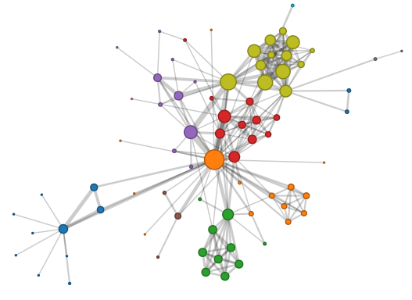
ORION Actors → Actors
☺ user.name | Settings | Logout
Graph Builder | Entity Builder
Now the user can visualize the network and start exploring…
NODES
Actors
(@) actor_id
(T) actor_name
(#) commCluster
(#) btwCentrality
EDGES
(#) linkDegree
(#) inDegree
(#) outDegree
(#) btwCentrality
NODES X: Y:
Label …. Color … Size …

