Slide 1
From Profiling to Analysis
designing visualization tools for purpose
Jeffrey Heer
Trifacta / U. Washington
Jock Mackinlay
Tableau Software

Slide 2
By Way of Introduction…
Berkeley
Stanford
PARC
Tableau
JOCK
JEFF
PARC
Tableau
Trifacta
Berkeley
Berkeley
Stanford
UW
A combined ~50 years of experience designing visualization tools!
Notes:
Red lines indicate collaborations…
(Could add additional annotations here for interesting milestones like APT & D3.js, etc)

Slide 3
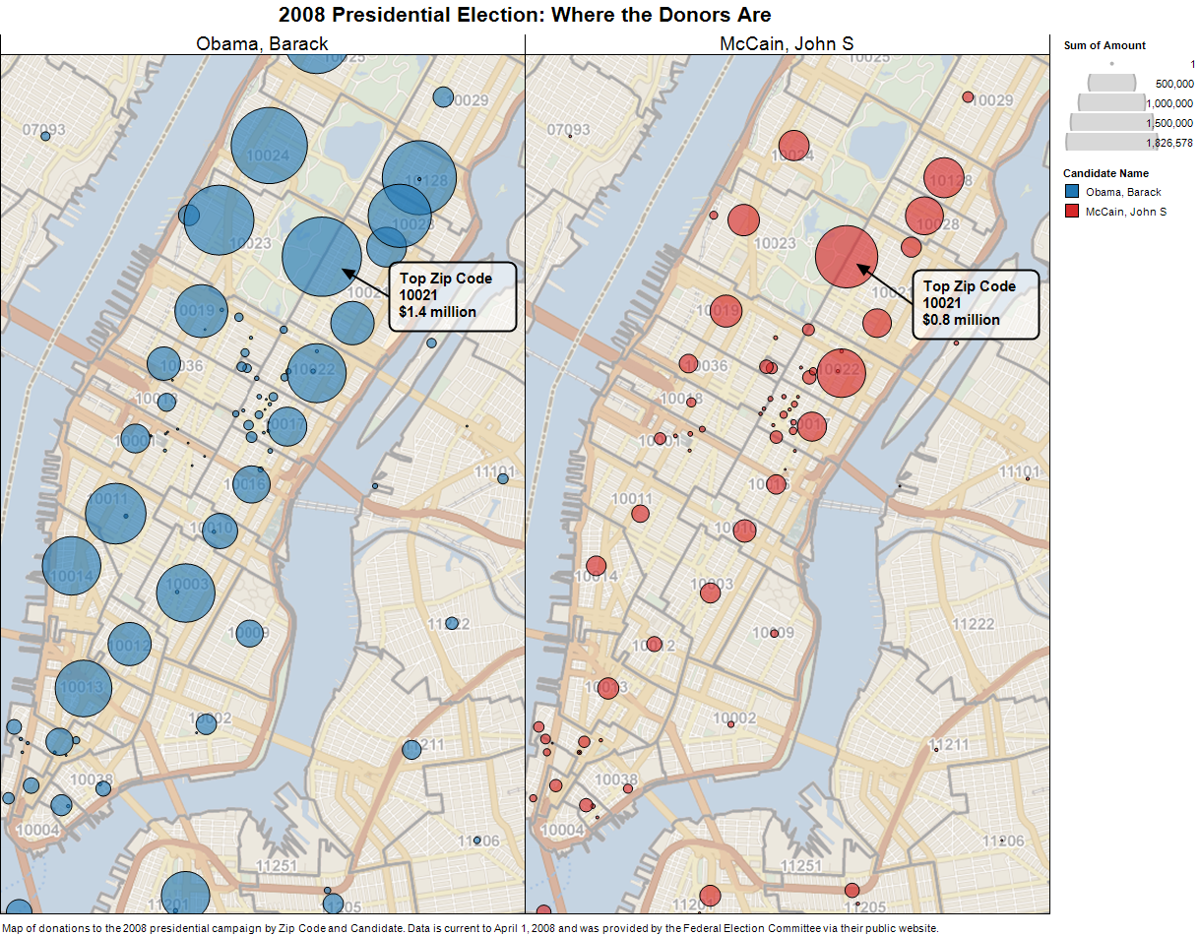
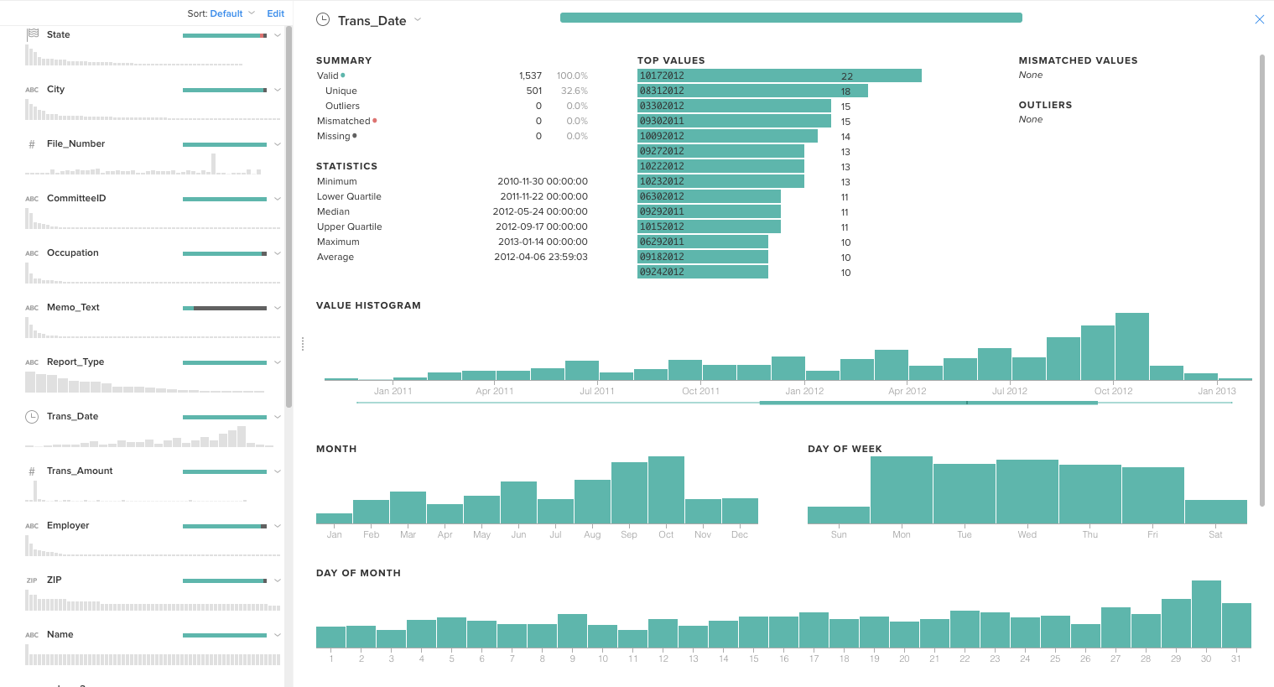
Designing for Purpose
Visual analysis is central to both Tableau & Trifacta.
Each tool focuses on different complementary tasks, sometimes leading to divergent decisions for visualization and interaction design.
Here, we will examine how each tool uses visualization to help people make sense of data.
What lessons we can draw for the design of future visual analysis systems?

Slide 4
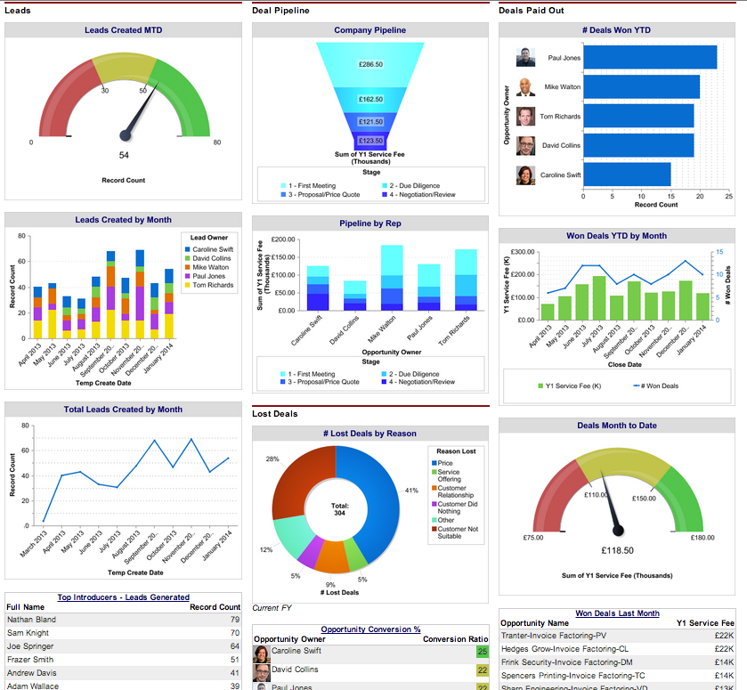
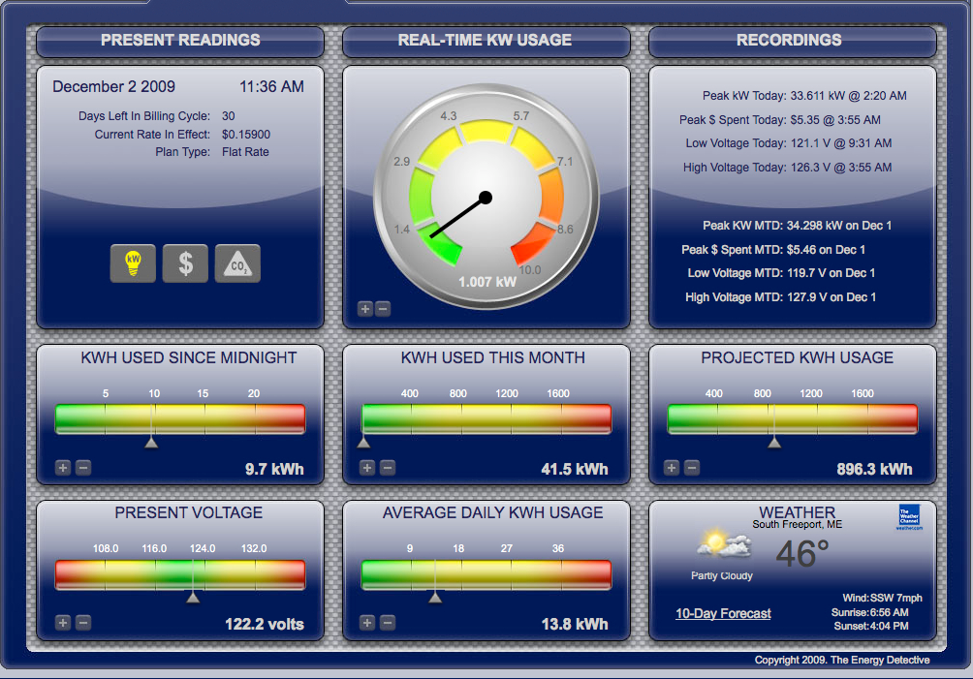
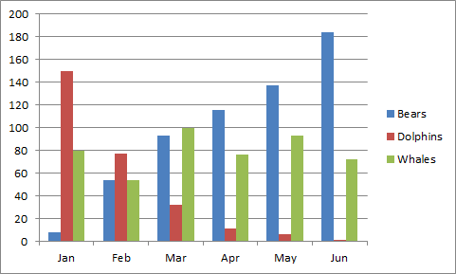
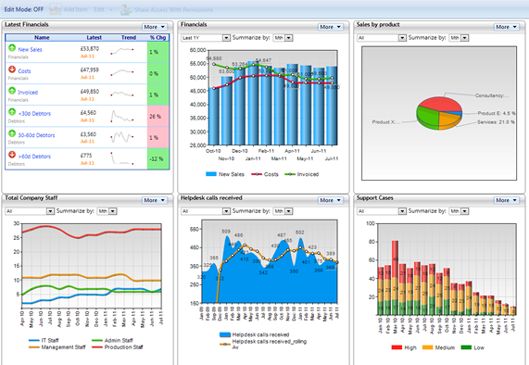
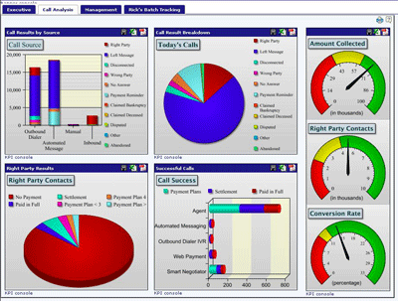
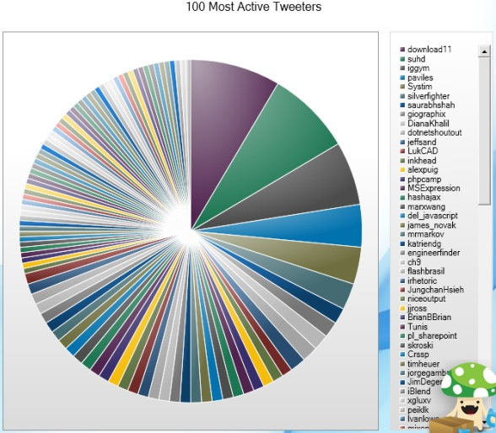
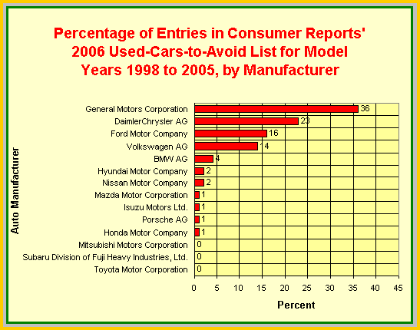
Notes:
The vast majority of the world’s visualizations are produced using end-user software, often looking something like this… (click)
…or this. (click)
Data visualization tools are often created by folks, who, while well-intentioned, unfortunately lack familiarity with effective visualization design and how to better support analysis.

Slide 5
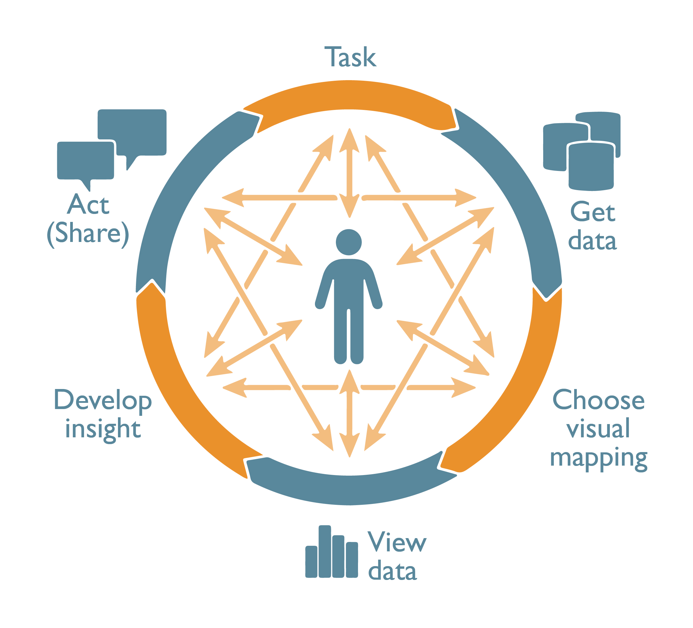

Slide 8
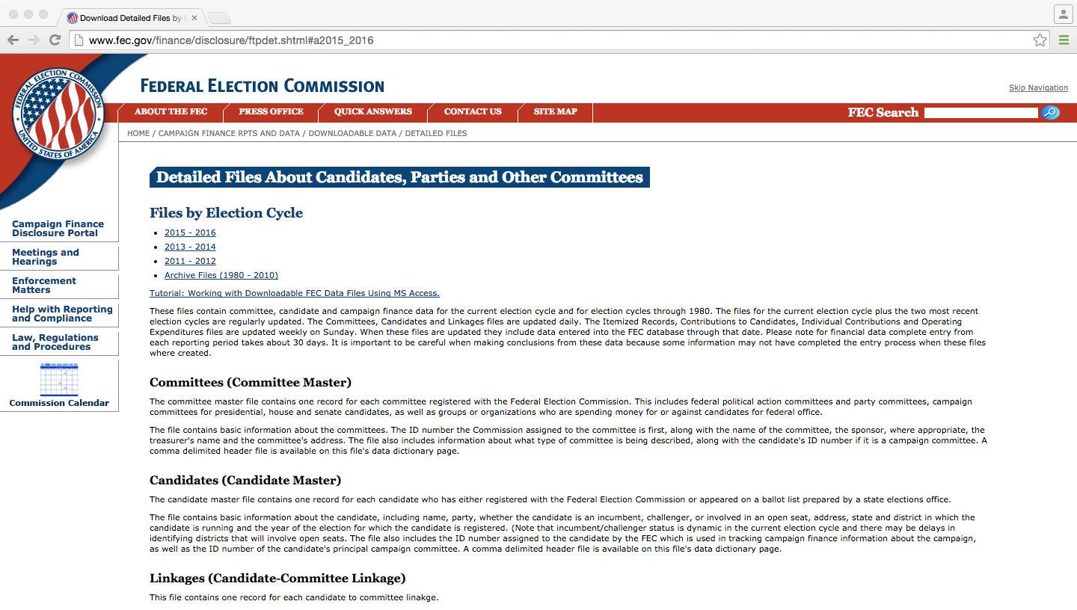

Slide 9
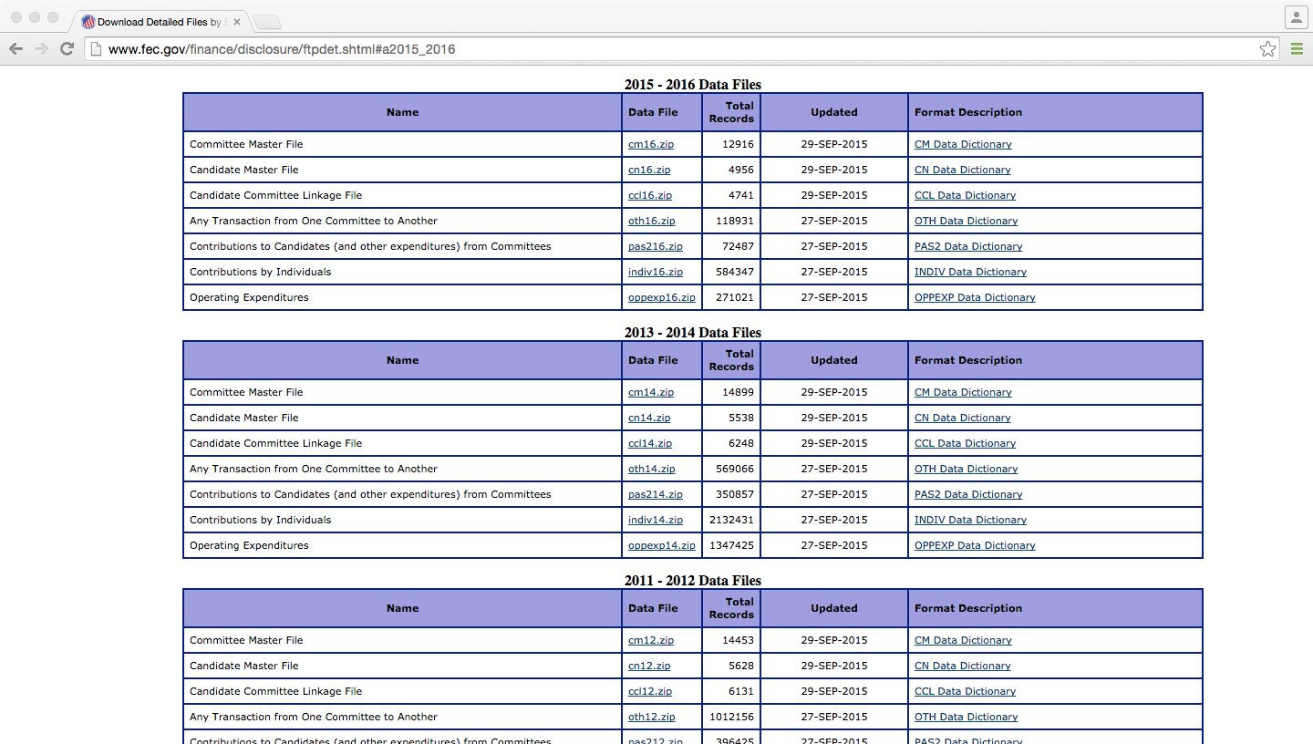

Slide 10
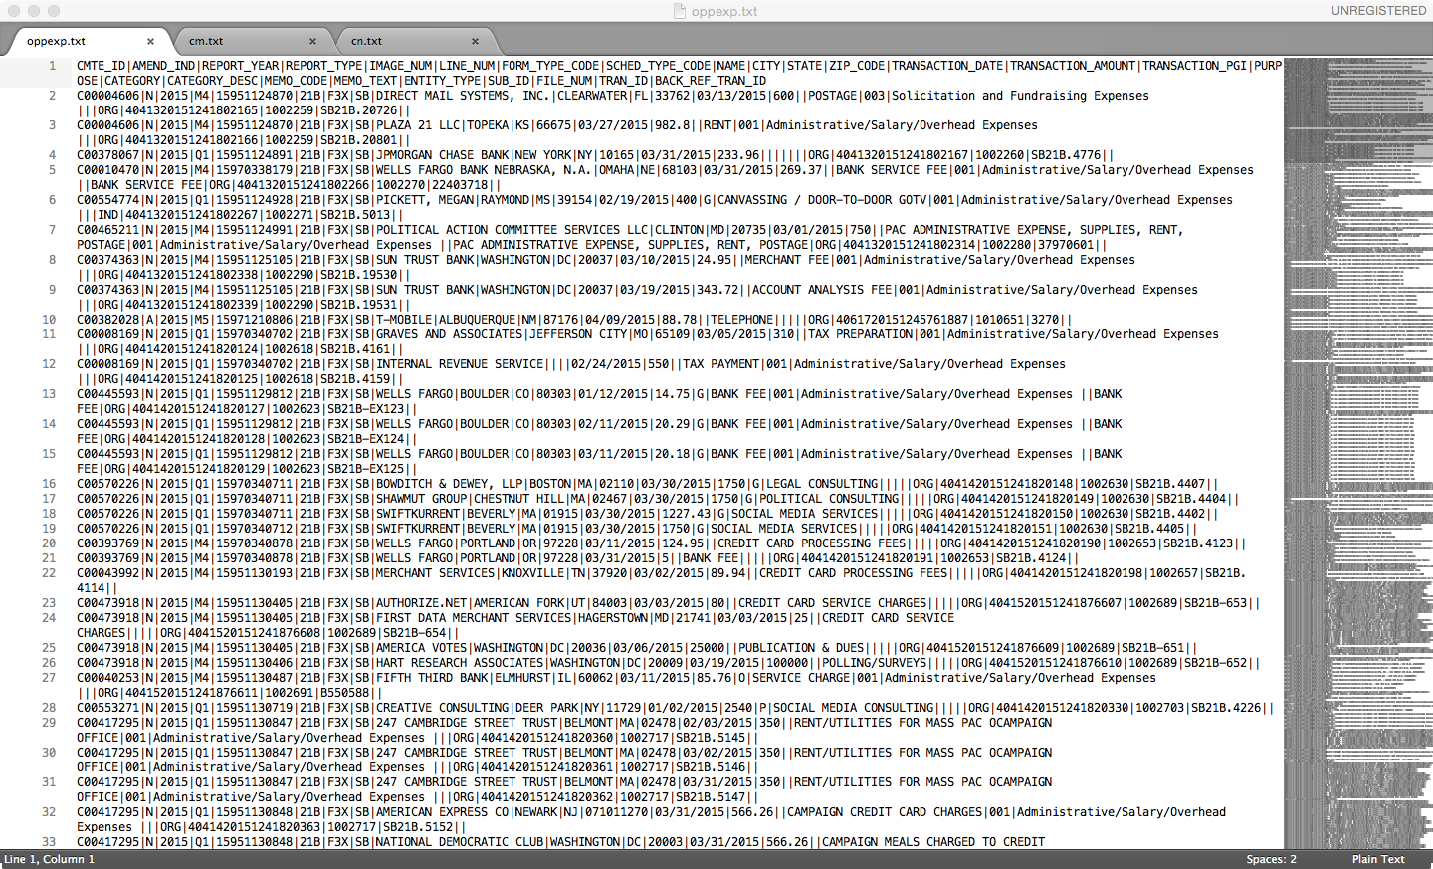

Slide 11
TRIFACTA
Task: Data Wrangling
Notes:
Launch into Trifacta demo!

Slide 12
Automatic
Effective
Scalable
Actionable

Slide 13
Automatic

Slide 14
Notes:
> Automatic presentation: expose shape and structure of data
> Encourage consideration of all variables
> Focus on data cleaning and transformation

Slide 15
Overview
Notes:
We automatically present overview visualizations for each dimension in the data set…

Slide 16
Details
Notes:
…and enable drill-down into more detailed summaries.
Here we see when political contributions are made. The charts reveal when contributions are more likely to occur. In this case, contributions increase closer to the election date and are more likely on week days and at the end of a month.
Each of these plots was chosen dynamically, in a data-driven fashion. As the data does not include variation at the level of hours, minutes or seconds, the system excludes those views to avoid unnecessary distractions.

Slide 17
Effective

Slide 18
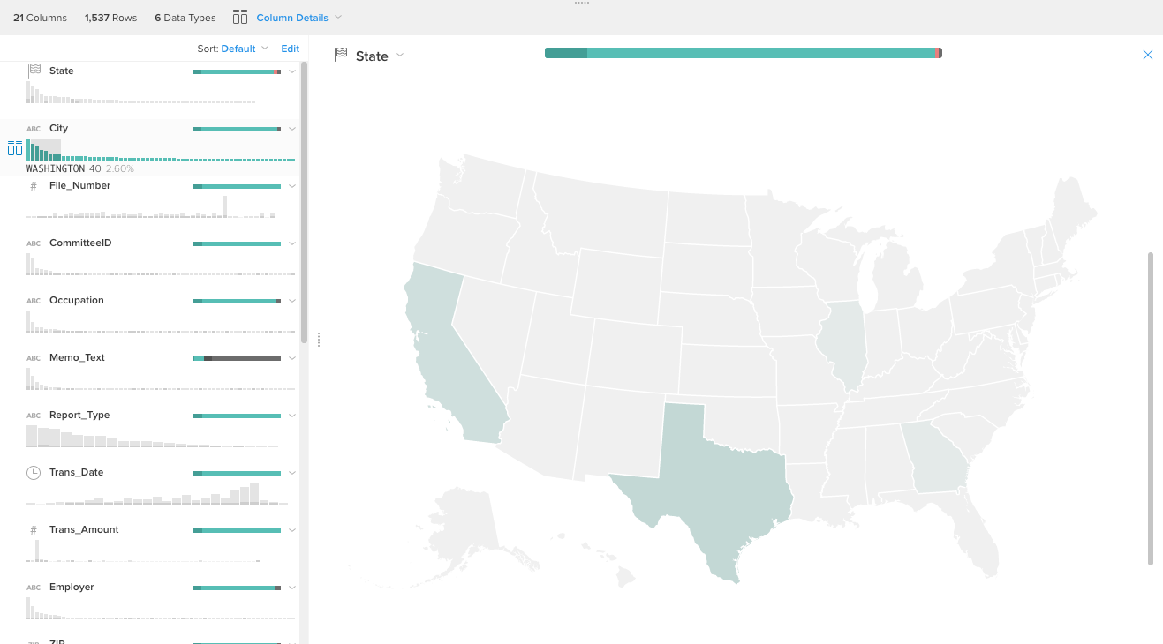
Notes:
Here, we automatically recognize a geographic data field and can present a map visualization, in this case showing where political contributions come from.
But do you see a problem? Using color to encode quantities is much less accurate than other encodings.
But the even bigger problem is what you don’t see!
Due to our choice of encoding we miss the large number of donations coming from Washington D.C.
What other encodings might we consider?

Slide 19
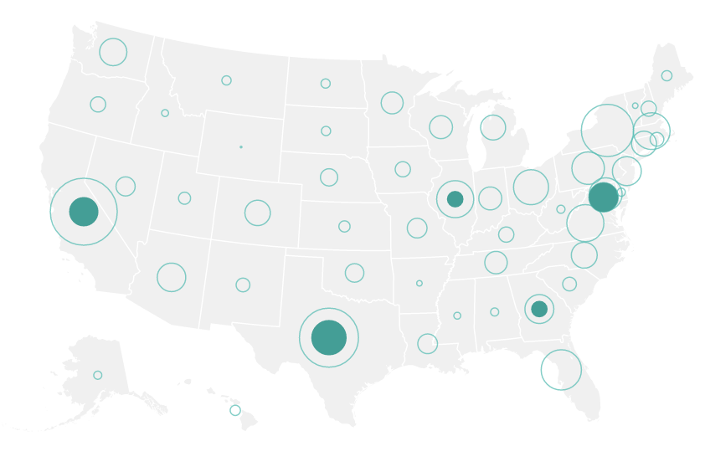
Notes:
We would also like to leverage the familiar spatial context of the map, so we switch the encoding from color to area.
Position encodings lead to the most accurate comparisons, so we also include sorted bar charts in the left panel, and provide interactive linking between displays.
This configuration allows us to see more and make better comparisons.

Slide 20
Scalable

Slide 21
Summarize Random Sample
Notes:
Map circles vs. choropleth

Slide 23
Summarize Full Data Set
Notes:
Map circles vs. choropleth

Slide 24
Immediate Brushing & Linking
Notes:
Map circles vs. choropleth

Slide 25
Immediate Brushing & Linking
Notes:
Map circles vs. choropleth

Slide 26
Immediate Brushing & Linking
Notes:
Map circles vs. choropleth

Slide 27
Immediate Brushing & Linking
Notes:
Map circles vs. choropleth

Slide 28
Actionable

Slide 29
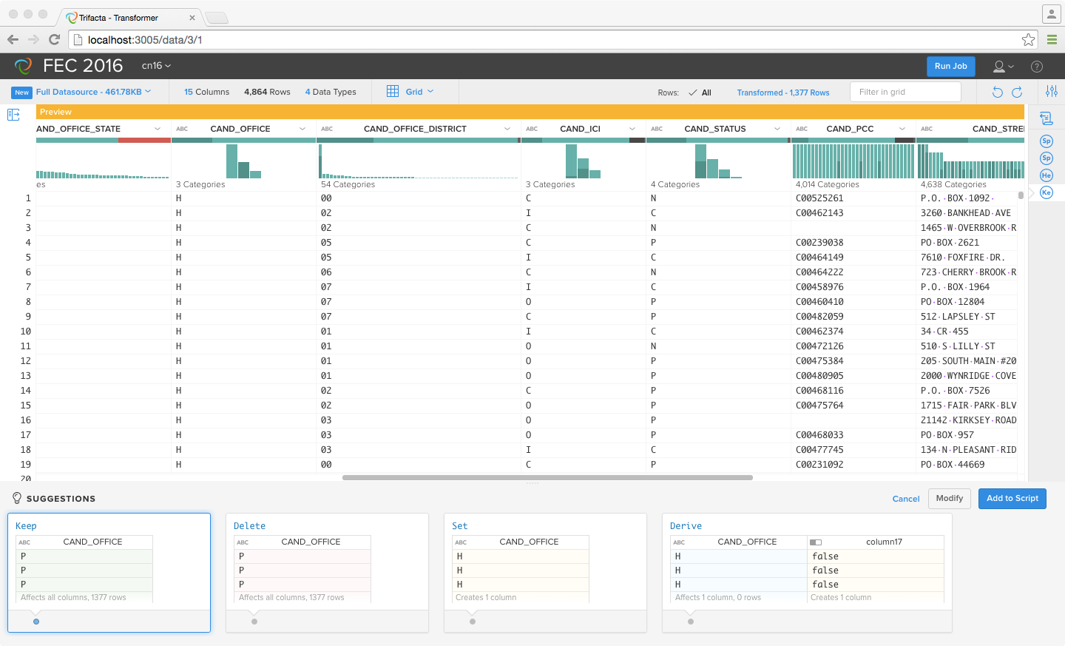
Linked Selection
Transform Previews
Notes:
Select a data value, immediately see related values across columns, and receive transformation previews.

Slide 30
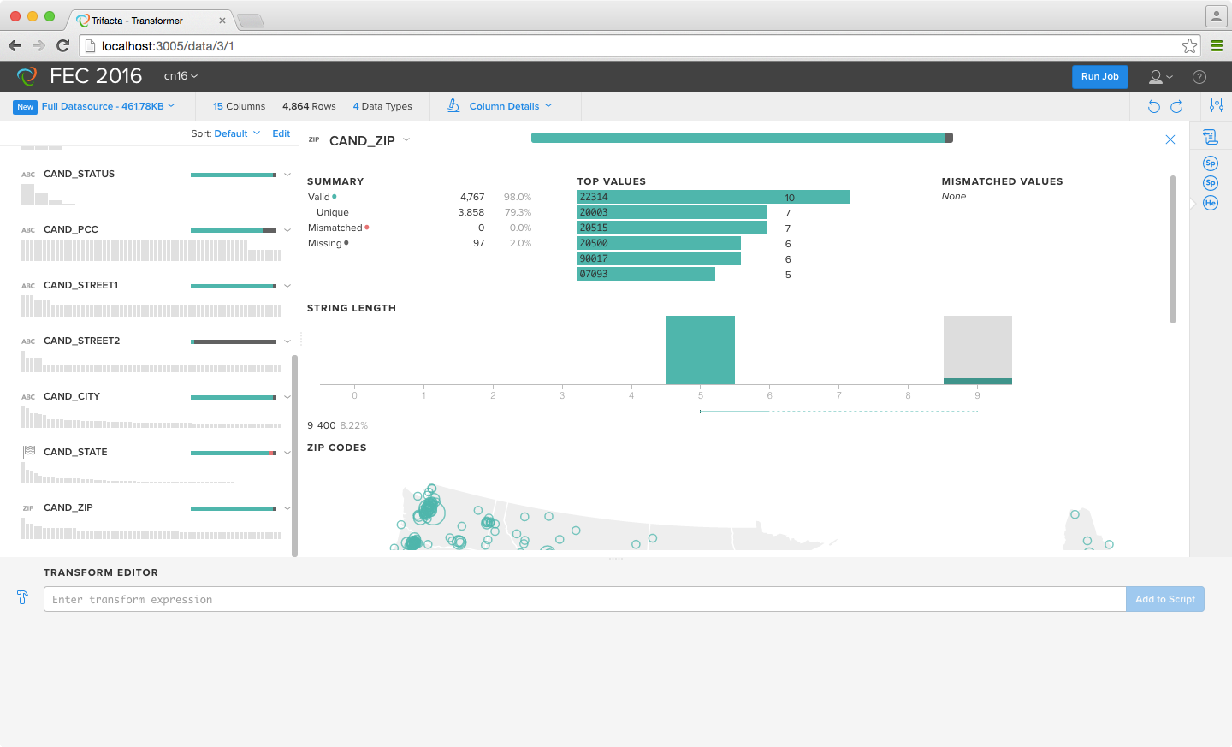
Notes:
Select 9 digit zip codes

Slide 31
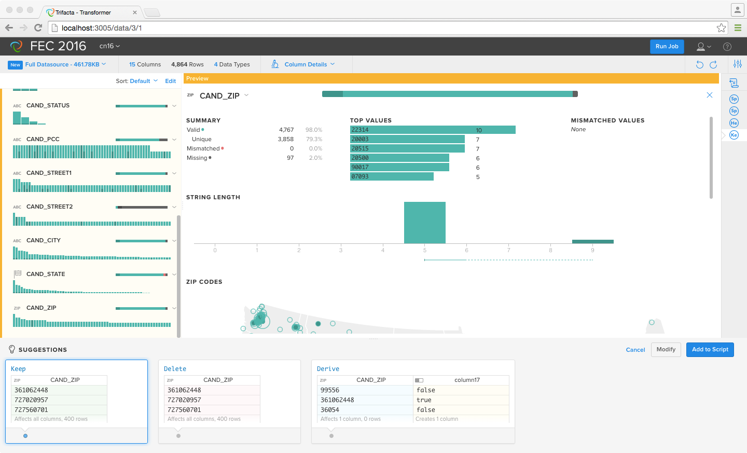
Notes:
Receive transformation suggestions

Slide 32
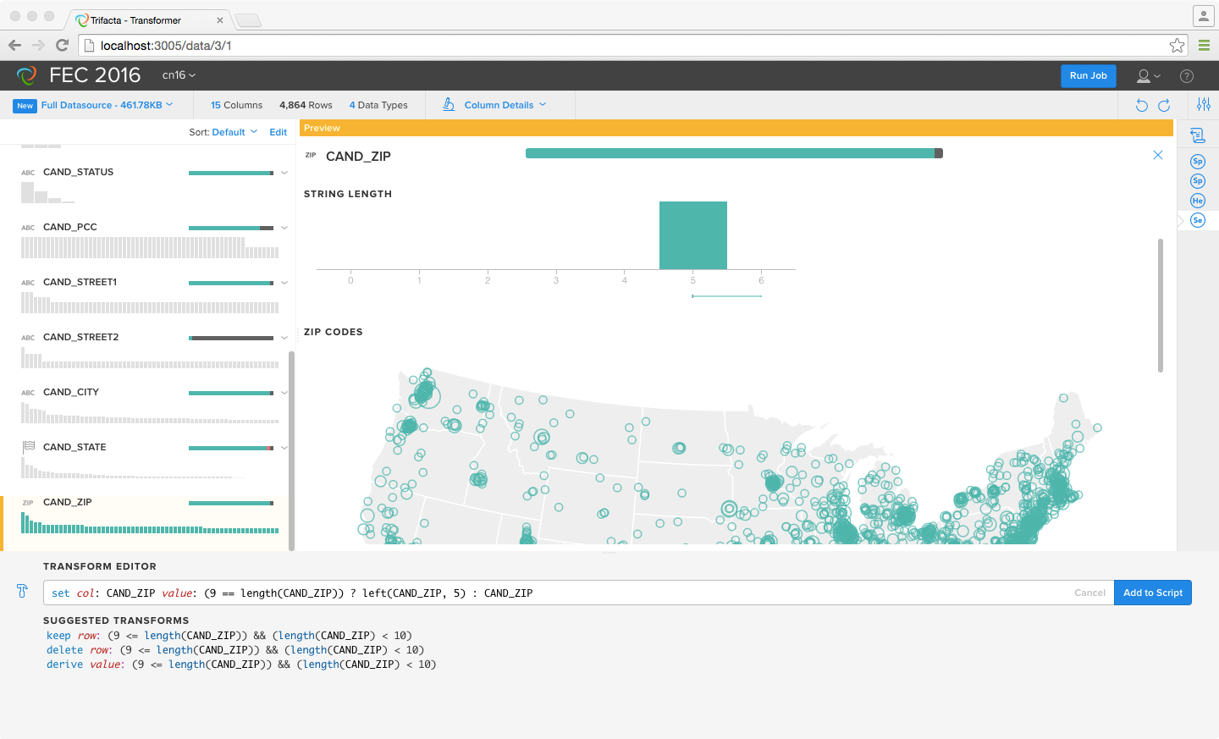
Notes:
Write custom transformation formula

Slide 33
TABLEAU
Task: Exploratory Analysis
Notes:
Launch into Tableau demo here!

Slide 34
Notes:
Not just Aha! Power is not in speeding to an astounding conclusion… It’s about the speed of data and moving through it.
We do this through how we support the Cycle of Visual Analysis

Slide 36
Incremental
Expressive
Unified
Direct
Notes:
How does this play out in practice?

Slide 37
Incremental

Slide 38
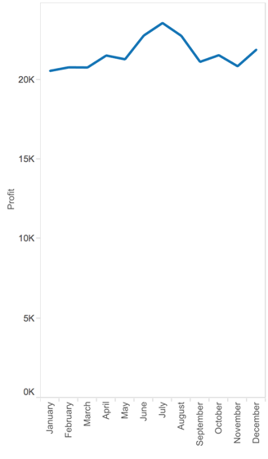
Notes:
Supporting the “Cycle of Visual Analysis”: Incremental
Start SIMPLE, add detail, develop the story over time

Slide 39
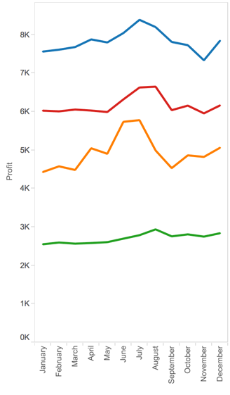
Notes:
Supporting the “Cycle of Visual Analysis”: Incremental
Start SIMPLE, add detail, develop the story over time

Slide 40
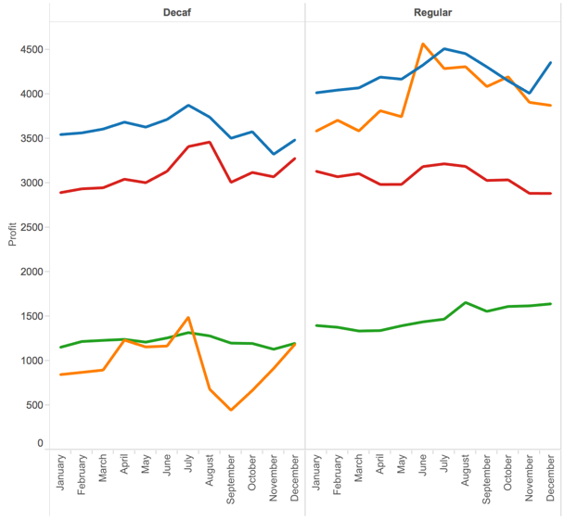
Notes:
Supporting the “Cycle of Visual Analysis”: Incremental
Start SIMPLE, add detail, develop the story over time

Slide 41
Expressive

Slide 42
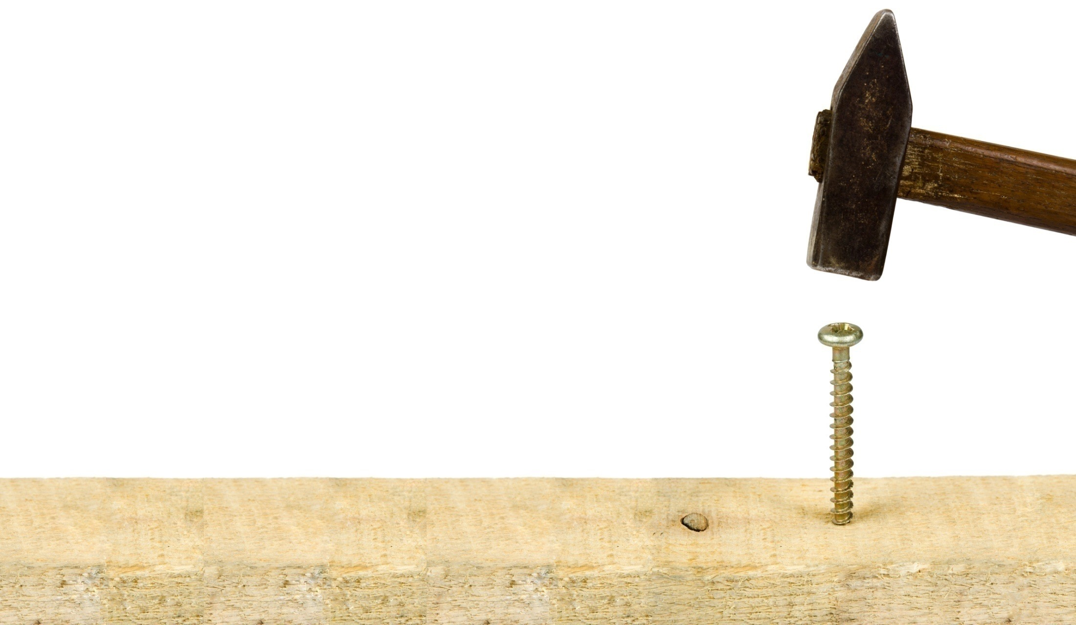
There is no single view for all tasks and all data

Slide 43
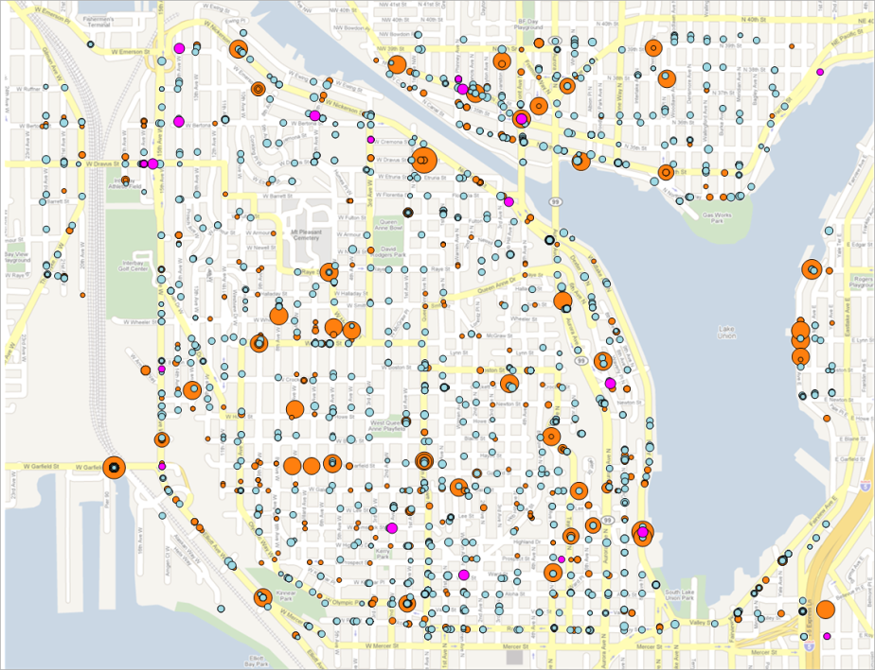
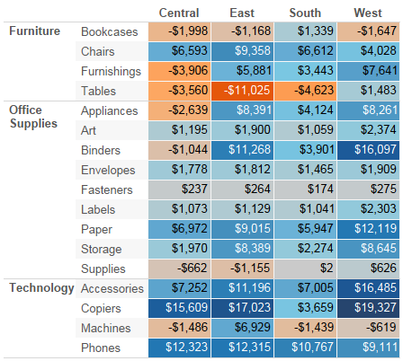
Notes:
Supporting the “Cycle of Visual Analysis”: Expressive
There is no single view for all tasks and all data
Lines for trends over time, multiples for comparing, Maps are good for data with a geographic bent, heatmaps for finding outliers across categories
Multiple columns show distribution and individual marks over time
Fundamentally REVERSING traditional thinking. START with the data.

Slide 44
Unified

Slide 45
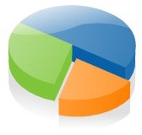
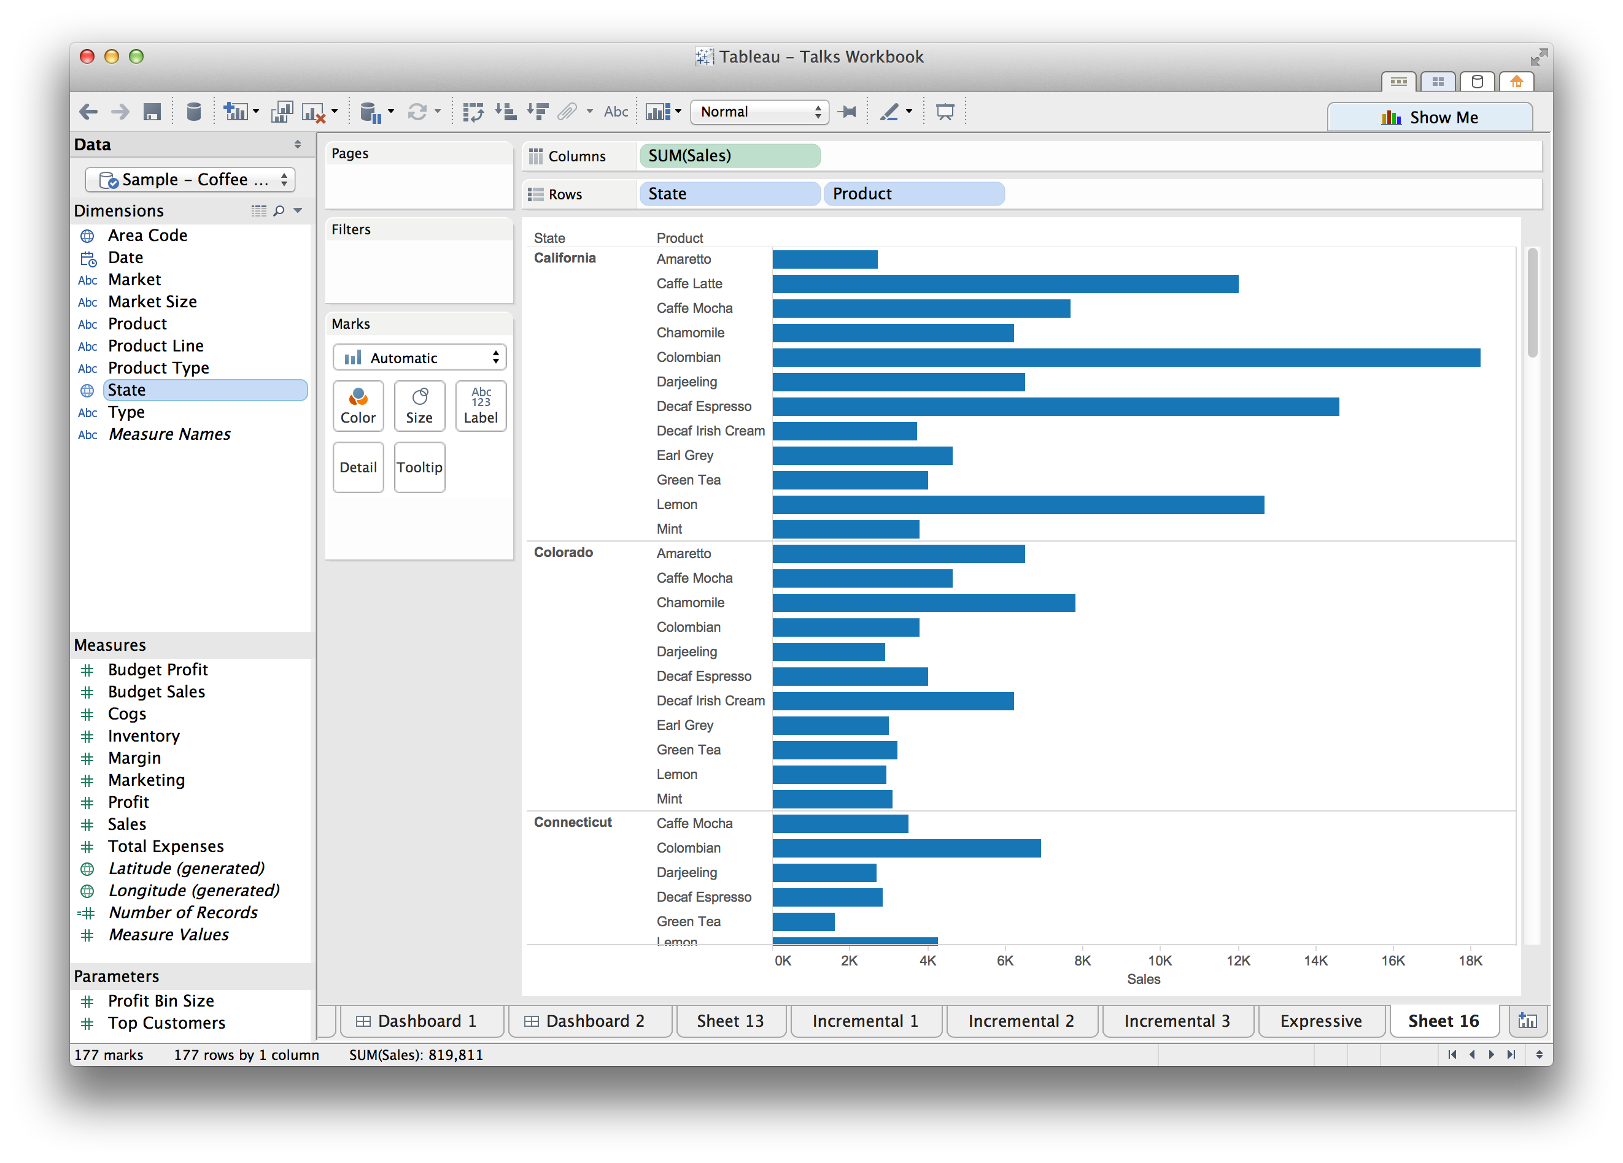
Traditional Reporting Tools
versus
Tableau
Traditional Visualization Tools
Notes:
Supporting the “Cycle of Visual Analysis”: Unification with the database

Slide 46
Notes:
Supporting the “Cycle of Visual Analysis”: Unification with the database
Leverage the revolutionary changes in database technology: connect to a huge diversity of data types, from text files to traditional SQL databases to new advances like NoSQL and Hadoop

Slide 47
Direct
Notes:
Direct interaction creates highly interactive interfaces

Slide 48
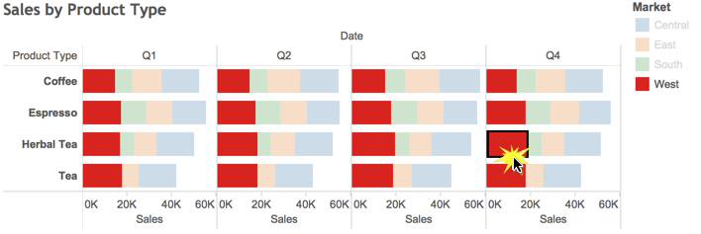
Notes:
Supporting the “Cycle of Visual Analysis”: Direct Interaction
Make the tool disappear and allow the user to directly interact with the data.

Slide 49
Designing for Purpose

Slide 50
Tableau
Incremental
Expressive
Unified
Direct
Trifacta
Automatic
Effective
Scalable
Actionable

Slide 51
Trifacta
Breadth-First
Analysis Strategy

Slide 52
Tableau
Depth-First
Analysis Strategy

Slide 53
How might we combine and extend these analysis strategies?

Slide 54
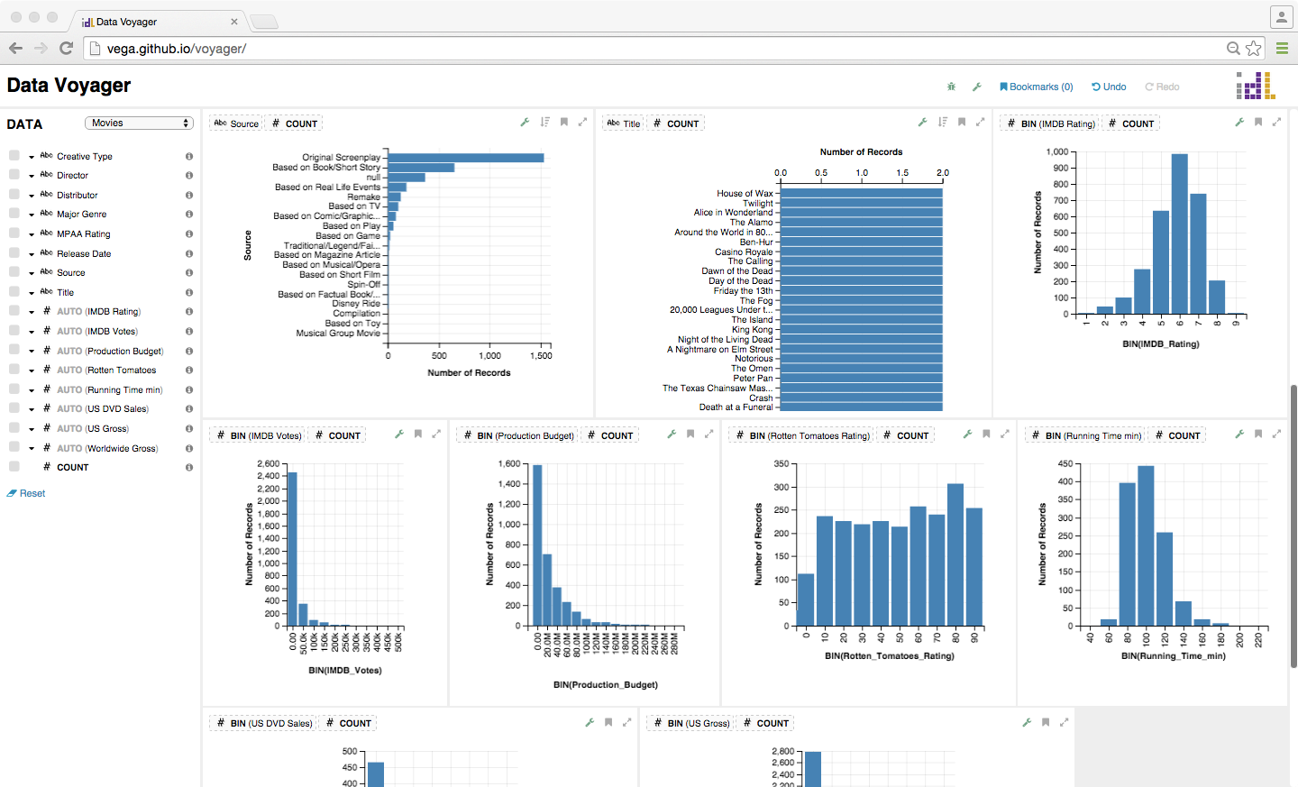
Notes:
In collaborative work between the University of Washington and Tableau, we are researching new methods for end-user data exploration. Our Data Voyager system generates thousands of charts in parallel, ranks them using both statistical and perceptual measures, and presents the top-ranked examples as recommended views.

Slide 55
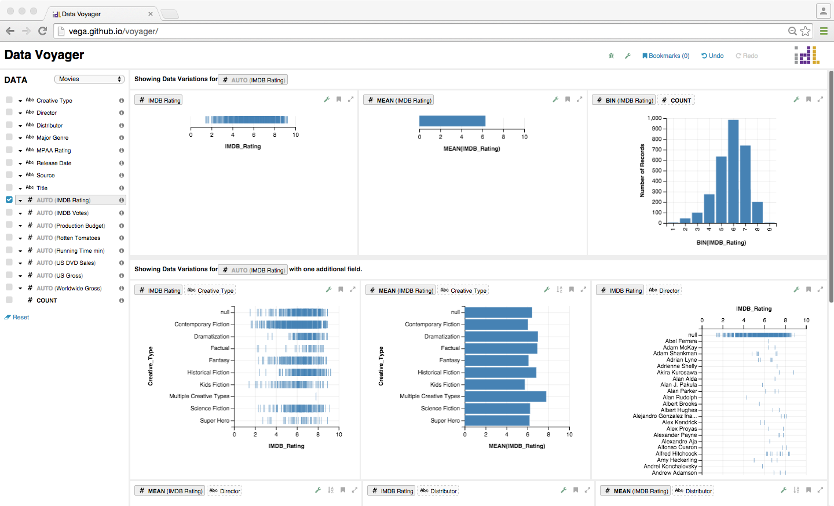
Notes:
Users can steer these suggestions by simply indicating data fields of interest.

Slide 56
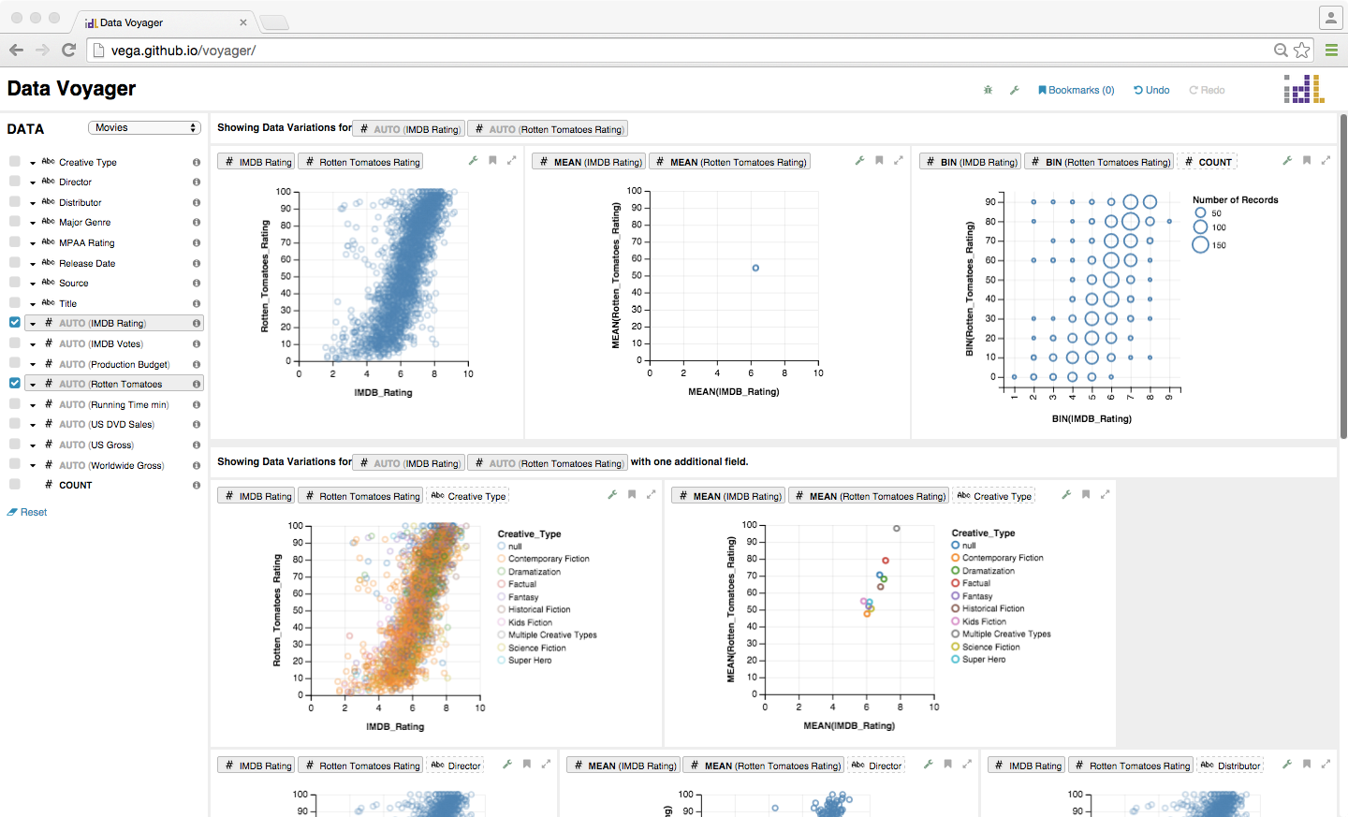

Slide 57
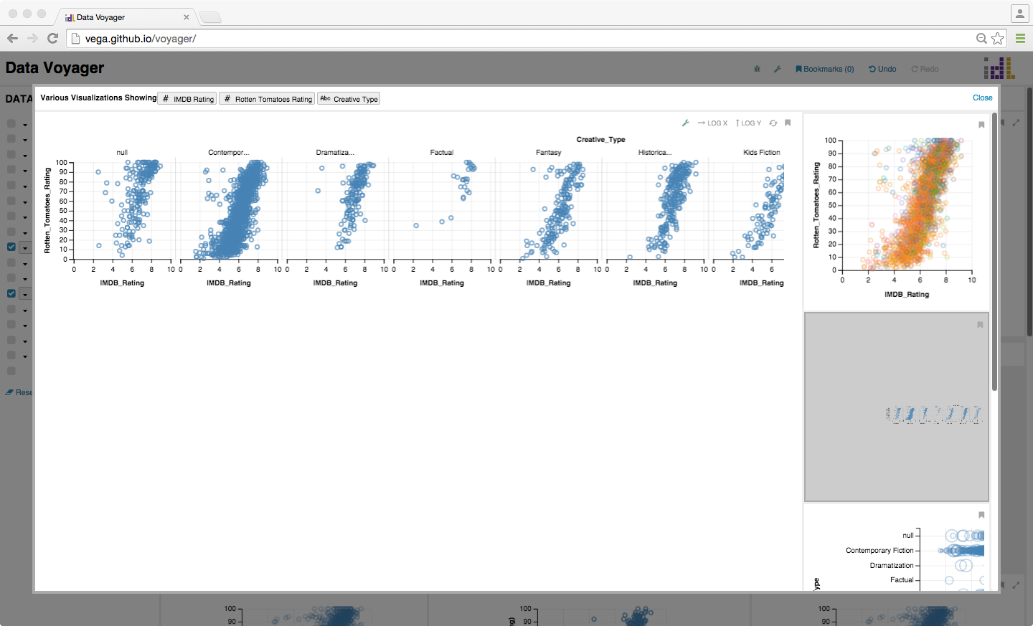

Slide 58
User

Slide 59
Data Set
Voyager Visualization Browser
User

Slide 60
Compass
Recommendation Engine
Data Schema
& Statistics
Voyager Visualization Browser
User

Slide 61
Select data variables
Apply transformations
Pick visual encodings
Compass
Recommendation Engine
Data Schema
& Statistics
Voyager Visualization Browser
User

Slide 62
Constrain & rank choices
by data type, statistics &
perceptual principles.
Compass
Recommendation Engine
Data Schema
& Statistics
Voyager Visualization Browser
User

Slide 65
Compass
Recommendation Engine
Data Schema
& Statistics
Ranked and Clustered
Vega-lite Specifications
Voyager Visualization Browser
User

Slide 66
Compass
Recommendation Engine
Data Schema
& Statistics
Ranked and Clustered
Vega-lite Specifications
Voyager Visualization Browser
User
Vega-lite
Specifications
Vega-lite
Compiler

Slide 67
Compass
Recommendation Engine
Data Schema
& Statistics
Ranked and Clustered
Vega-lite Specifications
Voyager Visualization Browser
User
Vega-lite
Specifications
Vega
Renderer
Vega-lite
Compiler
Vega Specifications

Slide 68
Compass
Recommendation Engine
Data Schema
& Statistics
Ranked and Clustered
Vega-lite Specifications
Voyager Visualization Browser
User
Vega-lite
Specifications
Interactive
Visualizations
Vega
Renderer
Vega-lite
Compiler
Vega Specifications

Slide 69
Compass
Recommendation Engine
Data Schema
& Statistics
Ranked and Clustered
Vega-lite Specifications
Voyager Visualization Browser
Interactive
Visualizations
User
Vega-lite
Specifications
Interactive
Visualizations
Vega
Renderer
Vega-lite
Compiler
Vega Specifications

Slide 70
Compass
Recommendation Engine
User Selection,
Data Schema
& Statistics
Ranked and Clustered
Vega-lite Specifications
User Selection
Voyager Visualization Browser
Interactive
Visualizations
User
Vega-lite
Specifications
Interactive
Visualizations
Vega
Renderer
Vega-lite
Compiler
Vega Specifications

Slide 71
Improves data coverage!
+3x variable sets shown
+1.5x more interacted with
Compass
Recommendation Engine
User Selection,
Data Schema
& Statistics
Ranked and Clustered
Vega-lite Specifications
User Selection
Voyager Visualization Browser
Interactive
Visualizations
User
Vega-lite
Specifications
Interactive
Visualizations
Vega
Renderer
Vega-lite
Compiler
Vega Specifications

Slide 72
User Feedback
Data Voyager: Movies
“Voyager gave me a lot of options I wouldn’t have thought about on my own, it encouraged me to look more deeply at data, even data I didn’t know a lot about.”
Voyager “prompted me to explore new questions in a way that didn’t derail me from answering follow-up questions.“
“I would start with Voyager but want to go and switch to [Tableau] to dive into my question. Once that question was answered, I would like to switch back to Voyager.”
Data Voyager: Movies

Slide 73
Different iterations of the cycle
may require different strategies.
Keep the analyst in
control of the process!
Notes:
Different stages of the cycle of visual analysis may require different analysis strategies.
Keep the user in the center of this process!

Slide 74
From Profiling to Analysis
designing visualization tools for purpose
Jeffrey Heer
Trifacta / U. Washington
Jock Mackinlay
Tableau Software

