Slide 1
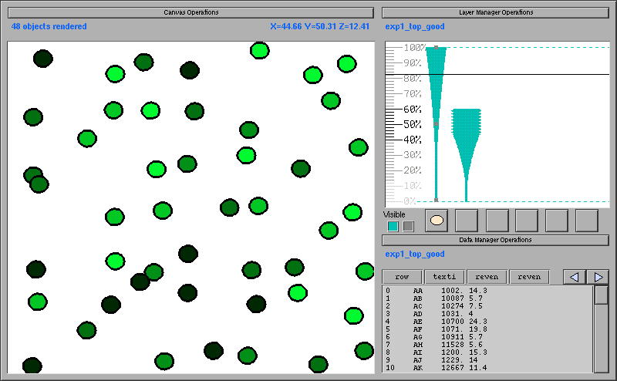
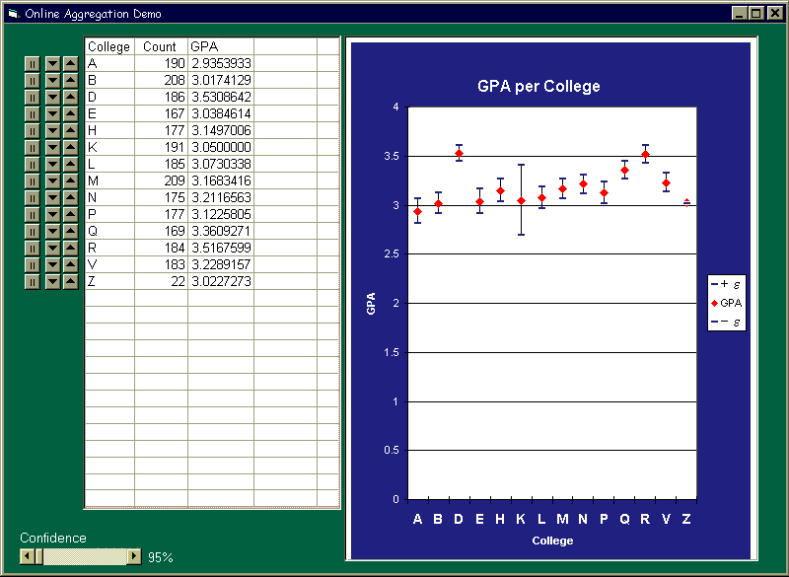
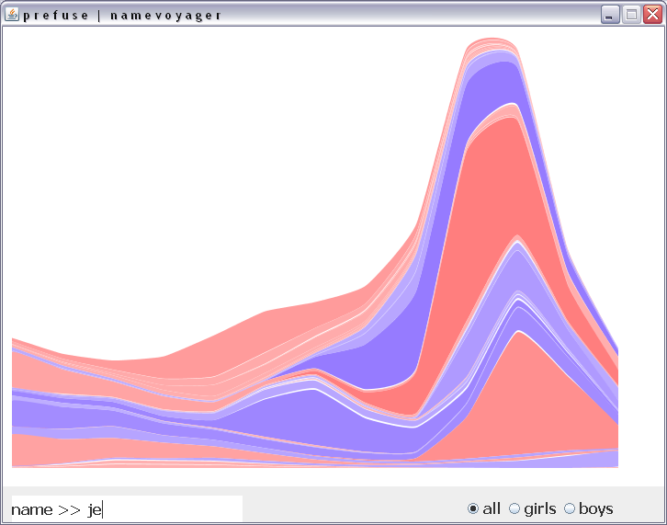
Scalable Data Visualization and Social Data Analysis
Jeffrey Heer Stanford University
Joe Hellerstein UC Berkeley
TexPoint fonts used in EMF.
Read the TexPoint manual before you delete this box.: AAA

Slide 2
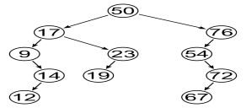
Visualization Reference Model
1010101….
Task
Raw Data
Data Tables
Visual Structures
Views
Data Transformations
Visual Encodings
View Transformations

Slide 3
Interactivity and Scale
Visualization as query specification
  Leave Big Data in the database
  2 DB research tools: Datasplash and DEVise

Slide 4
Visualization Reference Model
1010101….
Task
Raw Data
Data Tables
Visual Structures
Views
Data Transformations
Visual Encodings
View Transformations

Slide 5
Interactivity and Scale
Visualization as query specification
  Leave Big Data in the database
  2 DB research tools: Datasplash and DEVise
Interactivity via precomputation
  OLAP
  Sketches, synopses

Slide 6

Visualization Reference Model
1010101….
Task
Raw Data
Data Tables
Visual Structures
Views
Data Transformations
Visual Encodings
View Transformations

Slide 7
Interactivity and Scale
Visualization as query specification
  Leave Big Data in the database
  Peek at 2 research tools: Datasplash and DEVise
Interactivity via precomputation
  OLAP
  Sketches, synopses
Interactivity via online methods
  CONTROL: Online Aggregation and more
  integration of vis, DB and stat!

Slide 8
Visualization Reference Model
1010101….
Raw Data
Data Tables
Visual Structures
Views
Data Transformations
Visual Encodings
View Transformations

Slide 9
Interactivity and Scale
Visualization as query specification
  Leave Big Data in the database
  Peek at 2 research tools: Datasplash and DEVise
Interactivity via precomputation
  OLAP
  Sketches, synopses
Interactivity via online methods
  CONTROL: Online Aggregation and more
  integration of vis, DB and stat!

Slide 10
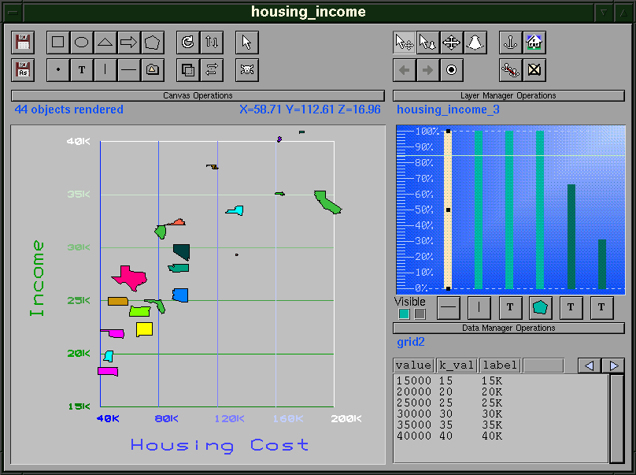
Datasplash
Woodruff, Olston, et al. J. Vis Lang & Comp 2001
2 Query builders:
  Tioga box-and-arrow relational+UDF
  VIQING direct-manipulation interface
  for composite visualizations
Visual mappings: one “mark” per row of output
  Row attributes → mark attributes via “paint” interface
    x, y, height, width, color, rotation, picture, etc.
Pan in x/y space, semantic zoom in z
  Layer manager for overlays generalizes drill-down/roll-up
  Aids for designer to maintain Constant Information Density
Variety of links/navigation between visualizations
  See Olston/Woodruff InfoVis2000, Baldonado, etal. AVI2000
Influenced commercial products at Illustra/Informix

Slide 11
Datasplash: Semantic Zoom
datasplash.cs.berkeley.edu

Slide 12
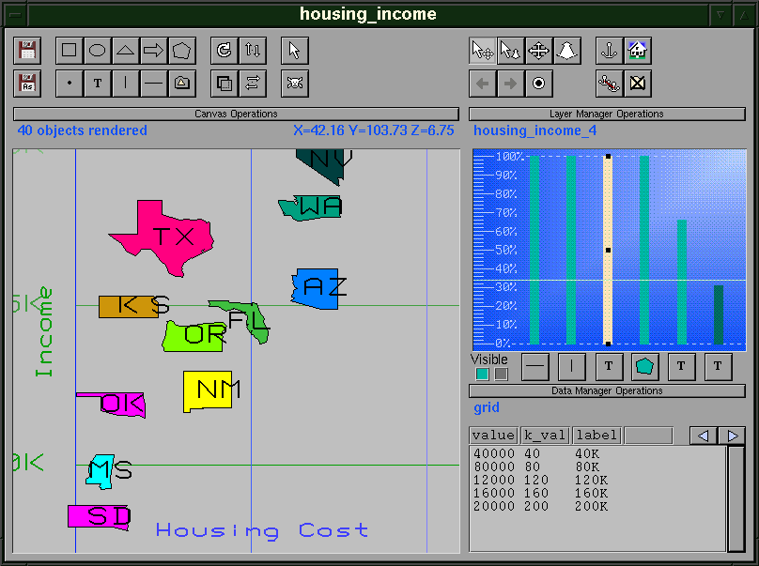
Datasplash: Semantic Zoom
datasplash.cs.berkeley.edu

Slide 13
Datasplash: Information Density
datasplash.cs.berkeley.edu

Slide 14
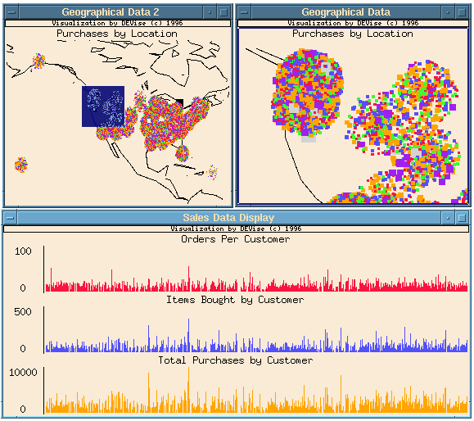
DEVise
Livny, Ramakrishnan, Bayer, et al. SIGMOD‘97
Visual relational query builder
Mapping: one “mark” per row of output
  Row attributes → mark attributes
    x, y, height, width, color, rotation, picture, etc.
Visual filters map back to relational input query
Focus on multiple linked visualizations
  Various linking models
Proposed collaboration facilities (!!)
  Active Reports: a vis definition and relevant data
  Collaborate by shipping visual specs between multiple Active Reports
Distributed queries & optimization
Still in use by Wisconsin BioMagResBank

Slide 15
Typical DEVise Presentation
Multiple
windows
Multiple
views
pages.cs.wisc.edu/~devise

Slide 16
courtesy Raghu Ramakrishnan
ranking
vs. document
documents with same
category and year
documents with same
category source
selected
Ranking
vs
year
Ranking
vs
source
selected document
category vs.
year
category vs.
source

Slide 17
Common Themes
Visual query specification
  Variety of ideas, convergence only on basics
Ship query to DB, ship (small) results to UI
Visualization defined by row → mark map
  Scales with visual density
Browser selections push down into query
Multiple views and linked navigation

Slide 18
Scaling Data Visualization
Visualization as query specification
  Leave Big Data in the database
  Peek at 2 research tools: Datasplash and DEVise
Interactivity via precomputation
  OLAP
  Sketches, synopses
Interactivity via online methods
  CONTROL: Online Aggregation and more
  integration of vis, DB and stat

Slide 19
Precomputation: OLAP
Specifically, Multidimensional OLAP (MOLAP)
Complete results for sub-cubes
Much work on which sub-cubes to precompute
Little documentation on interface decisions
  Significant design theme here:
    Provide UI affordances only for the fast stuff
    Also manifest in desktop tools like Excel

Slide 20
Precomputation: Sketching
Also known as synopsis data structures
Extensive family of algorithmic work
  Not a visual metaphor
  Bell Labs AQUA project
  See Garofalakis tutorials
A few system integrations
  E.g. Reiss’ Data Triage in Telegraph [ICDE 2006]
Essentially no interface discussions

Slide 21
Scaling Data Visualization
Visualization as query specification
  Leave Big Data in the database
  Peek at 2 research tools: Datasplash and DEVise
Interactivity via precomputation
  OLAP
  Sketches, synopses
Interactivity via online methods
  CONTROL: Online Aggregation and more
  integration of vis, DB and stat!

Slide 22
Interactivity and Big Data
Background
CONTROL examples
  Online aggregation
  Density plots for Datasplash (Clouds)
  Potter’s Wheel spreadsheet for data cleaning
Basic query processing support
  Sampling
  Online reordering

Slide 23
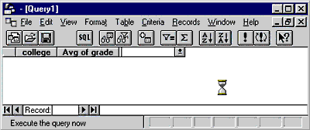
High Tech Batch Interfaces I
Microsoft Query

Slide 24
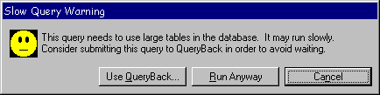
High Tech Batch Interfaces II
Informix Metacube

Slide 25
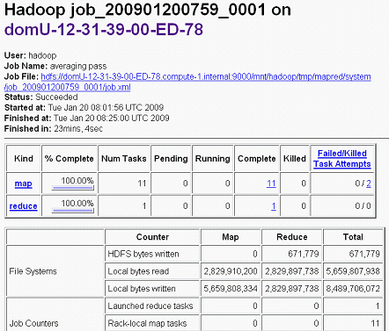
High Tech Batch Interfaces III
Hadoop

Slide 26
Typical Approaches
Only final, exact answers made available
“HCI solution”: interactivity trumps scale
  E.g. MS Excel, Multidimensional OLAP
“Systems solution”: scale trumps interactivity
  E.g. Hadoop
Can’t we all just get along?

Slide 27

CONTROL
Continuous Output, Navigation and
Transformation with Refinement On-Line
Hellerstein, Avnur, Chou et al. IEEE Computer 1999
“Of all men's miseries, the bitterest is this:
to know so much and have control over nothing”
  -- Herodotus
Requirements for CONTROL systems
  Early answers
  Refinement over time
  Interaction and ad-hoc control
“Crystal Ball” vs. Black Box
  vs. “Lucite Watch”

Slide 28
Goals for Online Processing
“Greedy” performance regime
  Maximize 1st derivative of the “mirth index”
    Or batch at some suitable “animation rate”
  Mirth defined on-the-fly
  Therefore need FEEDBACK and CONTROL
100%
Online
☺
Traditional
Time

Slide 29
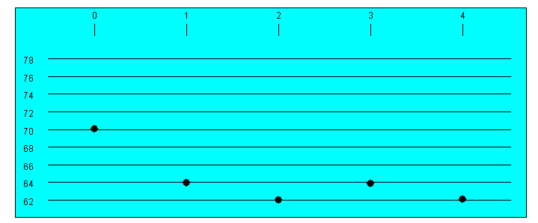
Online Aggregation
SELECT AVG(temp) FROM t GROUP BY site
330K rows in table (synthetic data)
the exact answer:
Courtesy Peter Haas, IBM

Slide 30
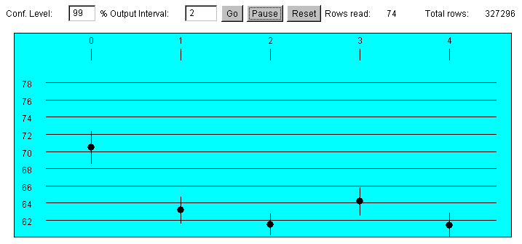
Online Aggregation, cont’d
A simple online aggregation interface (after 74 rows)
Courtesy Peter Haas, IBM

Slide 31
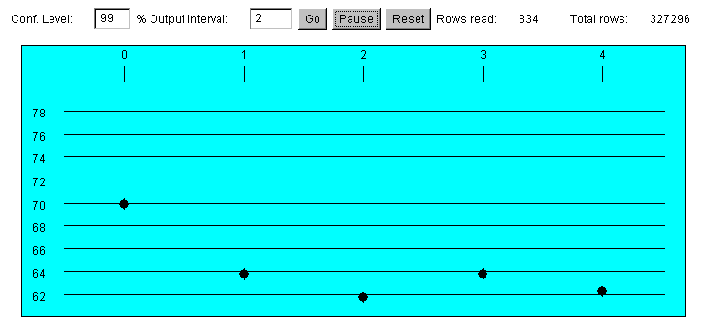
Online Aggregation, cont’d
After 834 rows:
Courtesy Peter Haas, IBM

Slide 32
Example: Online Aggregation
Controls
per Group:
Speed up
Slow down
Terminate

Slide 33
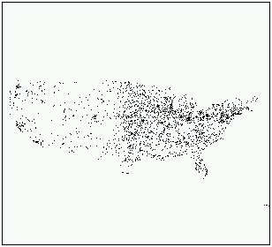
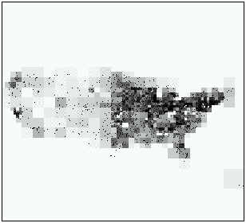
Online Visual Aggregation
CLOUDS [Chris Olston, undergraduate]

Slide 34
Potter’s Wheel [Raman/Hellerstein VLDB 2001]
Scalable spreadsheet
  A fraction of data is materialized in GUI widget
  Scrolling = preference for delivering quantiles to widget
  Easy visual query modification
Interactive data cleaning
  Visual transformation algebra
  Transformation by example
Online structure and discrepancy detection
  Minimum Description Length methods meet ADTs

Slide 35
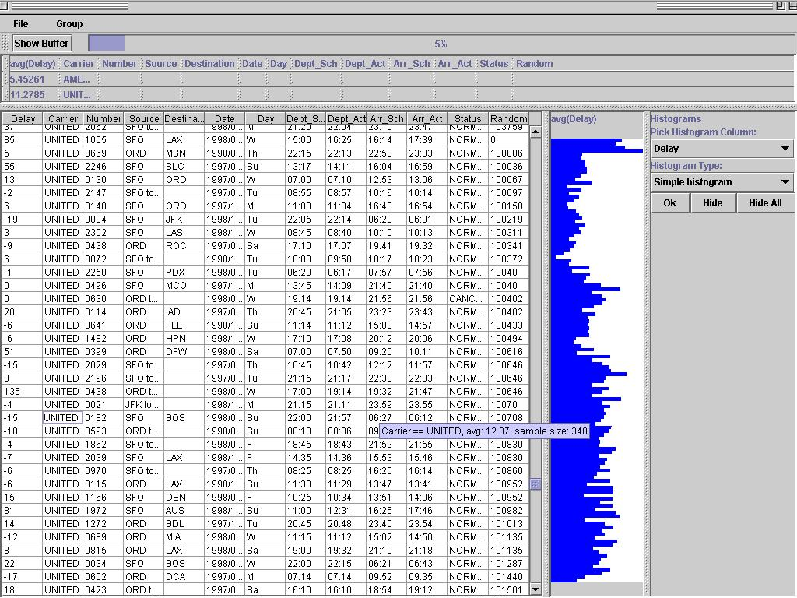
Scalable Spreadsheets

Slide 36
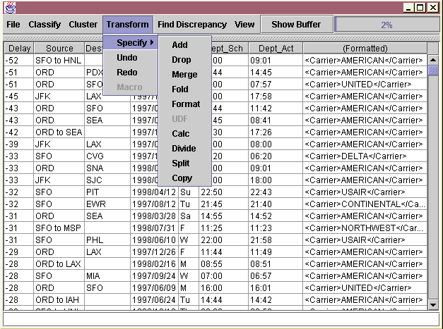
Visual Transformation Shot

Slide 38
Some Building Blocks
Focus on some generally useful tools
  Data access, data delivery
Much more in the literature
  Join algorithms
  Aggregate estimators
  Subqueries
  Query processing frameworks
  (Citations below)

Slide 39
Sampling w/o Replacement
We want i.i.d. samples w/o replacement
  At any time, the input to the query is a sample
  Input grows over time
Can pre-sort tables randomly
  Re-randomize incrementally in the background
  See [Jermaine, TKDE 2007] and [Joshi/Jermaine, TKDE 2008]
Techniques for random sampling in DBs well studied
  Both from files and from indexes
  Some tricks here
  Olken’s Ph.D. thesis

Slide 40
Preferential Data Delivery
Why needed
  Speedup/slowdown arrows
  Spreadsheet scrollbars
  Pipeline quasi-sort
Online Reordering [Raman²/Hellerstein, VLDB ‘99]
  Excellent in most cases, general purpose
  We’ll focus on this, but…
If index pre-exists, can play other games
  Index stride [Hellerstein/Haas/Wang, SIGMOD ‘97]
  High I/O costs, good for frequency outliers
  Can “mix and match” techniques adaptively! [Raman/Hellerstein, ICDE ‘03]

Slide 41
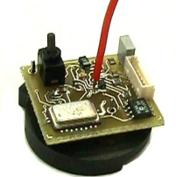
Online Reordering
[Raman²/Hellerstein, VLDB ‘99]
join
disk
transmit
produce
process
consume
Deliver “interesting” items first
  “Interesting” determined on the fly
Exploit rate gap between produce and process/consume

Slide 42
Online Reordering
join
disk
transmit
produce
reorder
process
consume
Deliver “interesting” items first
  “Interesting” determined on the fly
Exploit rate gap between produce and process/consume

Slide 43
Mechanism
process/consume
getNext
buffer
prefetch
enrich
spool
Two threads
  prefetch from input
  spool/enrich from auxiliary side disk
Juggle data between buffer and side disk
  keep buffer full of “interesting” items
  getNext chooses best item currently on buffer
getNext, enrich/spool decisions -- based on reordering policy
Side disk management
  hash index, populated in a way that postpones random I/O
  play both sides of sort/hash duality
side disk
produce

Slide 44
Policies
☺
QOF
“good” permutation of items t₁ … t_{n} to t_{Π1}…t_{Πn}
quality of feedback for a prefix t_{Π1}t_{Π2}…t_{Πk}
QOF(UP(t_{Π1}), UP(t_{Π2}), … UP(t_{Πk} )), UP = user preference
  determined by application
goodness of reordering: dQOF/dt
implication for juggle mechanism
  process gets item from buffer that maximizes dQOF/dt
  juggle tries to maintain buffer with such items
Notes:
we will see a number of applications

Slide 45
Example: Online Aggregation
Metric: avg weighted confidence interval
Preference acts as weight on confidence interval
  QOF = −∑ UP_{i} / (n_{i})^{1/2}
  n_{i} = number of tuples processed from group
process pulls items from group with max UP_{i} / n_{i}^{3/2}
  desired ratio of group i in buffer = UP_{i}^{2/3}/∑_{j} UP_{j}^{2/3}
  juggle tries to maintain this by enrich/spool
Similar derivations for other preferences
  e.g. explicit rates, explicit ranking, etc.
Notes:
I’m no

Slide 46
More Online Query Processing
Joins & Estimators
  Ripple Joins [Haas/Hellerstein SIGMOD ‘99]
  DBO’s “one-level step” [Jermaine, et al. SIGMOD ’07]
Correlated Subqueries
  [Joshi/Jermaine VLDBJ ‘09]
Distributed Online Aggregation
  [Wu, et al. VLDB ‘09]

