Slide 1
“Liberating” Data

Slide 2
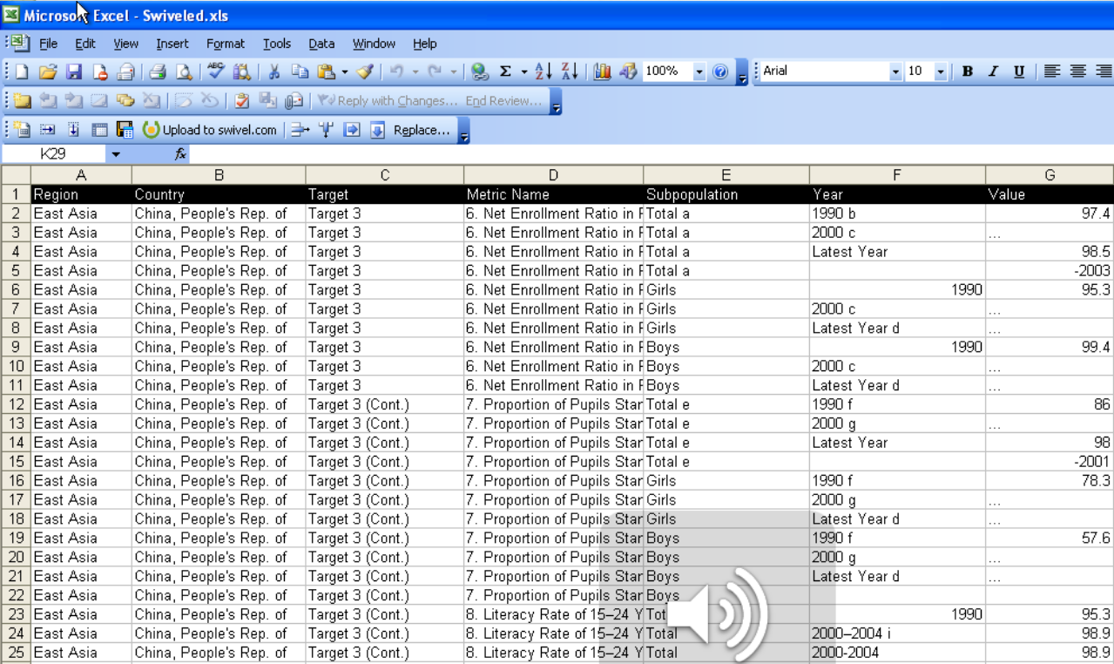
Liberating Data: Structure

Slide 3
Liberating Data: Challenges
A simple structural algebra
Accomodating extra-relational operators
Visually intuitive
Affordances encouraging (recognizing) “good” formats
Transparency of Cause and Effect
Role of Automation?

Slide 4
Content Challenges
Data formatting
Structure at the cell level
Data cleaning
Entity resolution
Outlier detection

Slide 5
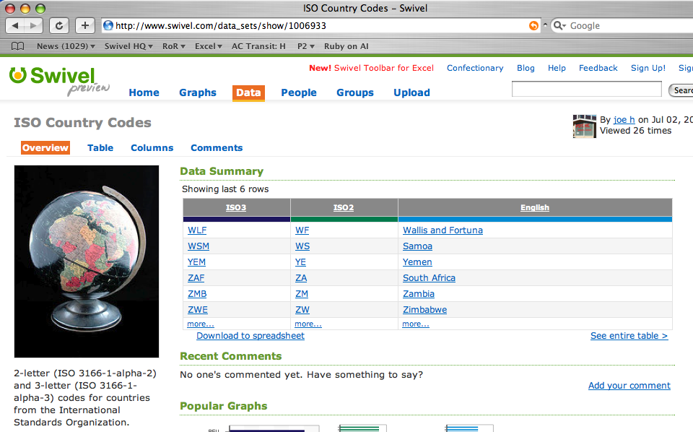
Types: A Piece of the Puzzle
column type induction
community code books

Slide 6
MDL Type Induction
Best type = Best compression
Balances against overfitting
Works for opaque types
Dictionaries, RegEx, black box functions
Challenges
Non-categorical types
Composite types
Lots and lots of mappings

Slide 7
Power to the People
Yes, community can help with data integration!
Mapping tables a nice start
Generally: join paths
Incentives for creation, curation, customization
Challenges even here
Join/mapping “paths”
Hybridization/prioritization
http://www.flickr.com/photos/wadey/400836753/

Slide 8
Ramp? Tipping Point?
Getting close to powerful social data analysis?
Tipping points in public data, social engagement
Wikipedia, Dbpedia
Tipping points in data integration
WebTables: lots of metadata+data, simple algorithms
Moving upramp in usability
Esp. in full data lifecycle
Scripting data transformations
Crafting visualizations
Social dialog models

