Slide 1
Beyond Classical Search
Chapter 3 covered problems that considered the whole search space and produced a sequence of actions leading to a goal.
Chapter 4 covers techniques (some developed outside of AI) that don’t try to cover the whole space and only the goal state, not the steps, are important.
The techniques of Chapter 4 tend to use much less memory and are not guaranteed to find an optimal solution.

Slide 2
More Search Methods
Local Search
  Hill Climbing
  Simulated Annealing
  Beam Search
  Genetic Search
Local Search in Continuous Spaces
Searching with Nondeterministic Actions
Online Search (agent is executing actions)

Slide 3
Local Search Algorithms and Optimization Problems
Complete state formulation
  For example, for the 8 queens problem, all 8 queens are on the board and need to be moved around to get to a goal state
Equivalent to optimization problems often found in science and engineering
Start somewhere and try to get to the solution from there
Local search around the current state to decide where to go next

Slide 4
Pose Estimation Example
Given a geometric model of a 3D object and a 2D image of the object.
Determine the position and orientation of the object wrt the camera that snapped the image.
image 3D object
State (x, y, z, θx, θy, θz)

Slide 5
Hill Climbing
“Gradient ascent”
solution
Note: solutions shown
here as max not min.
Often used for numerical optimization problems.
How does it work?
In continuous space, the gradient tells you the
direction in which to move uphill.

Slide 6
AI Hill Climbing
Steepest-Ascent Hill Climbing
current ← start node
loop do
  neighbor ← a highest-valued successor of current
  if neighbor.Value <= current.Value then return current.State
  current ← neighbor
end loop
At each step, the current node is replaced by
the best (highest-valued) neighbor.
This is sometimes called greedy local search.

Slide 7
Hill Climbing Search
current
6
4
10
3
2
8
What if current had a value of 12?

Slide 8
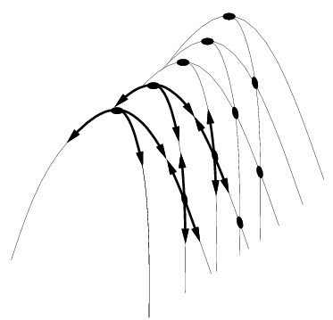
Hill Climbing Problems
  Local maxima
  Plateaus
  Diagonal ridges
What is it sensitive to?
Does it have any advantages?

Slide 9
Solving the Problems
Allow backtracking (What happens to complexity?)
Stochastic hill climbing: choose at random from uphill moves, using steepness for a probability
Random restarts: “If at first you don’t succeed, try, try again.”
Several moves in each of several directions, then test
Jump to a different part of the search space

Slide 10
Simulated Annealing
Variant of hill climbing (so up is good)
Tries to explore enough of the search space early on, so that the final solution is less sensitive to the start state
May make some downhill moves before finding a good way to move uphill.

Slide 11
Simulated Annealing
Comes from the physical process of annealing in which substances are raised to high energy levels (melted) and then cooled to solid state.
The probability of moving to a higher energy state, instead of lower is
p = e^(-ΔE/kT)
where ΔE is the positive change in energy level, T is the temperature, and k is Bolzmann’s constant.
heat cool

Slide 12
Simulated Annealing
At the beginning, the temperature is high.
As the temperature becomes lower
  kT becomes lower
  ΔE/kT gets bigger
  (-ΔE/kT) gets smaller
  e^(-ΔE/kT) gets smaller
As the process continues, the probability of a downhill move gets smaller and smaller.

Slide 13
For Simulated Annealing
ΔE represents the change in the value of the objective function.
Since the physical relationships no longer apply, drop k. So p = e^(-ΔE/T)
We need an annealing schedule, which is a sequence of values of T: T₀, T₁, T₂, ...

Slide 14
Simulated Annealing Algorithm
current ← start node;
for each T on the schedule /* need a schedule */
  next ← randomly selected successor of current
  evaluate next; it it’s a goal, return it
  ΔE ← next.Value – current.Value /* already negated */
  if ΔE > 0
    then current ← next /* better than current */
    else current ← next with probability e^(ΔE/T)
How would you do this probabilistic selection?

Slide 15
Probabilistic Selection
Select next with probability p
Generate a random number
If it’s <= p, select next
p
0 1
random
number

Slide 16
Simulated Annealing Properties
At a fixed “temperature” T, state occupation probability reaches the Boltzman distribution
If T is decreased slowly enough (very slowly), the procedure will reach the best state.
Slowly enough has proven too slow for some researchers who have developed alternate schedules.
p(x) = αe^(E(x)/kT)

Slide 17
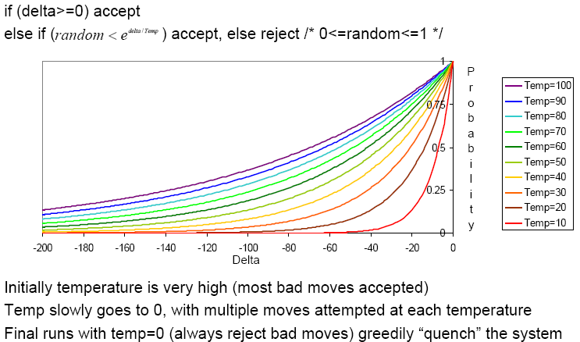
Simulated Annealing Schedules
Acceptance criterion and cooling schedule

Slide 18
Simulated Annealing Applications
Basic Problems
  Traveling salesman
  Graph partitioning
  Matching problems
  Graph coloring
  Scheduling
Engineering
  VLSI design
    Placement
    Routing
    Array logic minimization
    Layout
  Facilities layout
  Image processing
  Code design in information theory

Slide 19
Local Beam Search
Keeps more previous states in memory
  Simulated annealing just kept one previous state in memory.
  This search keeps k states in memory.
    - randomly generate k initial states
    - if any state is a goal, terminate
    - else, generate all successors and select best k
    - repeat

Slide 20

Local Beam Search

Slide 22
Genetic Algorithms
Start with random population of states
  Representation serialized (ie. strings of characters or bits)
  States are ranked with “fitness function”
Produce new generation
  Select random pair(s) using probability:
    probability ~ fitness
  Randomly choose “crossover point”
    Offspring mix halves
  Randomly mutate bits
Crossover Mutation
174629844710
174611094281
164611094281
→
→
776511094281
776529844710
776029844210

Slide 23
Genetic Algorithm
Given: population P and fitness-function f
repeat
  newP ← empty set
  for i = 1 to size(P)
    x ← RandomSelection(P,f)
    y ← RandomSelection(P,f)
    child ← Reproduce(x,y)
    if (small random probability) then child ← Mutate(child)
    add child to newP
  P ← newP
until some individual is fit enough or enough time has elapsed
return the best individual in P according to f

Slide 24
Using Genetic Algorithms
2 important aspects to using them
  1. How to encode your real-life problem
  2. Choice of fitness function
Research Example
  I have N variables V1, V2, ... VN
  I want to produce a single number from them that best satisfies my fitness function F
  I tried linear combinations, but that didn’t work
  A guy named Stan I met at a workshop in Italy told me to try Genetic Programming

Slide 25
Genetic Programming
Like genetic algorithm, but instead of finding the best character string, we want to find the best arithmetic expression tree
The leaves will be the variables and the non-terminals will be arithmetic operators
It uses the same ideas of crossover and mutation to produce the arithmetic expression tree that maximizes the fitness function.

Slide 26
Example: Classification and Quantification of Facial Abnormalities
Input is 3D meshes of faces
Disease is 22q11.2 Deletion Syndrome.
Multiple different facial abnormalities
We’d like to assign severity scores to the different abnormalities, so need a single number to represent our analysis of a portion of the face.

Slide 27
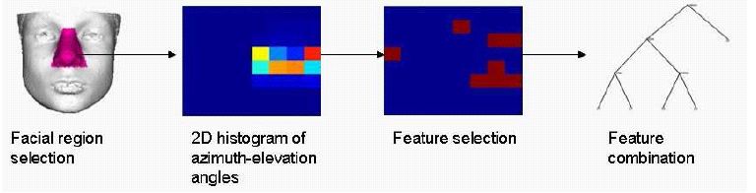
Learning 3D Shape Quantification
Analyze 22q11.2DS and 9 associated facial features
Goal: quantify different shape variations in different facial abnormalities
Notes:
For this part, we will focus the analysis on 22q11,2DS and its associated facial features
The goal of the work for this part is to quantify or produce a numeric representation of the different shape variation that manifests in the different facial abnormalities in individuals with 22q11.2DS
This figures shows the overview of the learning quantification framework
The framework begins with the selection of the facial region that is most pertinent to a given facial abnormality. Features in the form of a 2D histogram of azimuth elevation angles of surface normals are extracted from the selected facial region. The framework continues by selecting features from the selected facial region using Adaboost. Genetic programming is then used to combine the selected features and produce the quantification of a given facial abnormality

Slide 28
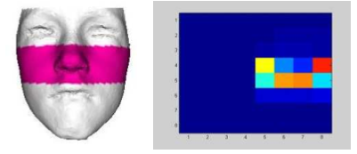
Learning 3D Shape Quantification -
2D Histogram Azimuth Elevation
Using azimuth and elevation angles of surface normal vectors of points in selected region
elevation
azimuth
Notes:
Once the facial region pertinent to a given facial abnormality has been selected, features are extracted from the selected region
The various 3D facial shape variations in the selected region are represented using a 2D histogram of azimuth elevation angles of surface normal vectors of the 3D points in the selected region, which is our second signature that we previously saw
We can always treat the vector of histogram bin values as feature vector and directly use those for classification
However, rather than a linear combination of the histogram bins we determine the bins that are most important and most discriminative in classifying the different facial abnormalities. We then use genetic programming to find the best way to combine the discriminative histogram bin values to generate quantification for the different facial abnormalities

Slide 29
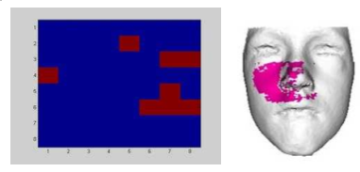
Learning 3D Shape Quantification -
Feature Selection
Determine most discriminative bins
Use Adaboost learning
Obtain positional information of important region on face
Notes:
To ndetermine the histogram bins that are most discriminative in classifying and quantifying given facial abnormalities,
Adaboost learning is used to select the bins that optimize the classification performance
This figure shows the selected bin values of the 2D histogram for classiying midface hypoplasia
Positional information about which points in the selected region contribute to the selected bins can be projected back onto the face
Shows correlation between features

Slide 30
Learning 3D Shape Quantification -
Feature Combination
Use Genetic Programming (GP) to evolve mathematical expression
Start with random population
  Individuals are evaluated with fitness measure
  Best individuals reproduce to form new population
Notes:
We did some preliminary experiments where we combined the selected discriminative bin values using weighted linear methods, however the results were less than satisfactory and highlighted the fact that the best combination is possibly non-linear
Genetic programming methodology is used to combine the values of the selected discriminative histogram bins to produce mathematical expressions that quantify the shape variation of the different facial abnormalities
Instead of thinking it in terms of genes or DNA string, you think of it in terms of programs
Follow theory of evolution by evolving individual computer programs following the survival of fittest approach
Uses genetic operators such as mutation and cross over to generate new individual to form a population
Starting with a random population, every individual in the population is evaluated
Individuals that perform best according to a given fitness measure reproduce with one another to produce a new population
After a number of iterations, the best individual from all the populations is selected as the final solution

Slide 31
Learning 3D Shape Quantification -
Genetic Programming
Individual:
  Tree structure
  Terminals e.g variables eg. 3, 5, x, y, …
  Function set e.g +, -, *, …
  Fitness measure e.g sum of square …
*
5
+
x
y
5*(x+y)
Notes:
A quick summary of GP:
Fundamental elements of an individual are its genes which form a code
Individual program is a tree-like structure where there are two types of genes: functions and terminals
Terminals are the leaves of the tree while functions are the nodes with children
Function’s children provide arguments for the function

Slide 32
Learning 3D Shape Quantification - Feature Combination
22q11.2DS dataset
  Assessed by craniofacial experts
  Groundtruth is union of expert scores
Goal: classify individual according to given facial abnormality
Notes:
Our analysis is focus on the 22q dataset
Experiments were performed on the balanced 22q11.2DS consisting of 86 individuals each of which were assessed by three craniofacial experts who assigned scores to their facial features.
The groundtruth for each individuals was set to be a binary label 0 and 1 and was computed to be the union of the expert scores

Slide 33

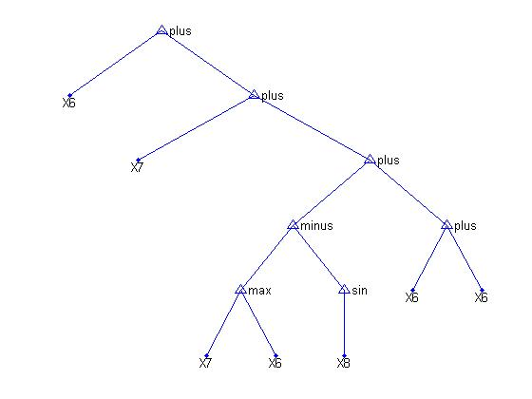
Learning 3D Shape Quantification -
Feature Combination
Individual
  Terminal: selected histogram bins
  Function set: +,-,*,min,max,sqrt,log,2x,5x,10x
  Fitness measure: F1-measure
precision = TP/(TP + FP)
recall = TP/all positives
X6 + X7 + (max(X7,X6)-sin(X8) + (X6+X6))
Notes:
Fitness function to Measure of performance of an individual using F-measure that gives a good balance between precision and recall
The best individual in the population is the individual with maximum F-measure value
The approach produces the tree structure of the best individual, which can then be translated into a mathematical expression

Slide 34
Learning 3D Shape Quantification - Experiment 1
Objective: investigate function sets
  Combo1 = {+,-,*,min,max}
  Combo2 = {+,-,*,min,max,sqrt,log2,log10}
  Combo3 = {+,-,*,min,max,
  2x,5x,10x,20x,50x,100x}
  Combo4 = {+,-,*,min,max,sqrt,log2,log10,
  2x,5x,10x,20x,50x,100x}
Notes:
The objective of the first experimental set is to analyze the classification performance of the GP quantification method using different function sets.
In this experiment, four different combinations of functions are compared
The last two function sets were chosen to introduce weighting to the mathematical experessions
Each GP function set combination was run a total of 10 times

Slide 35
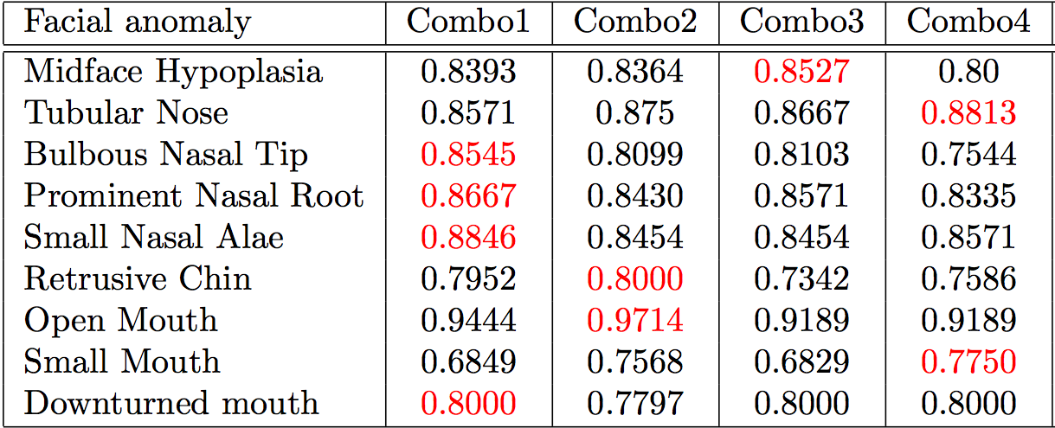
Learning 3D Shape Quantification - Experiment 1
Best F-measure out of 10 runs
Notes:
This result shows the best F-measure out of the 10 iterations for each of the different GP function set combinations
The best performing GP function set for each of the facial abnormalities is highlighted in bold
Results show that for most of the facial abnormality the simpler function sets, Combo1 and Combo2 that do not include the weighted operations perform better than the weighted GP function set

Slide 36
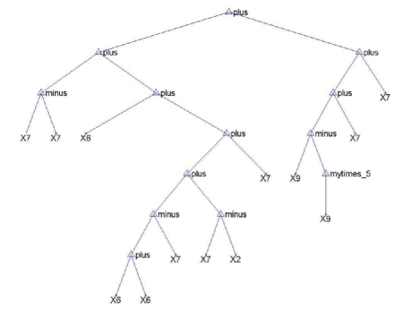

Tree structure for quantifying midface hypoplasia
Xi are the selected histogram bins from an azimuth-
elevation histogram of the surface normals of the face.
Notes:
Tree structure of the best performing GP mathematical expression for quantifying midface hypoplasia
The variables are the selected histogram bins

Slide 37
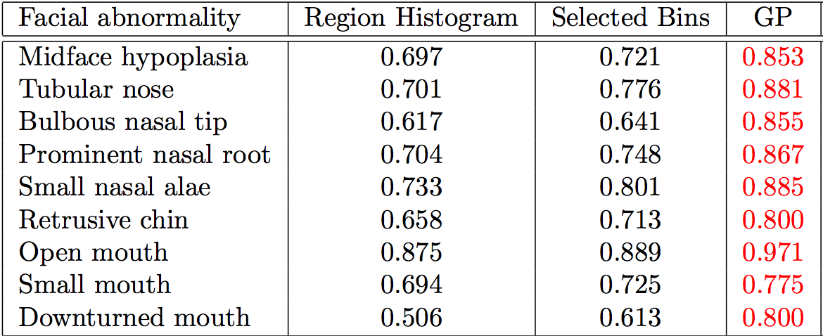
Learning 3D Shape Quantification - Experiment 2
Objective: compare local facial shape descriptors
Notes:
The second experiment compares three different facial shape descriptors: (1) 2D histogram of azimuth elevation angles of points in the selected region (2) selected 2D histogram bin values as a feature vector, (3) genetic programming quantification results
Results show that for all facial abnormalities, using the GP approach to quantify and classify the facial abnormalities performs the best
Using the selected 2D histogram bin values performs worse than GP but better than using the full 2D histogram of all points in the selected facial region

Slide 38
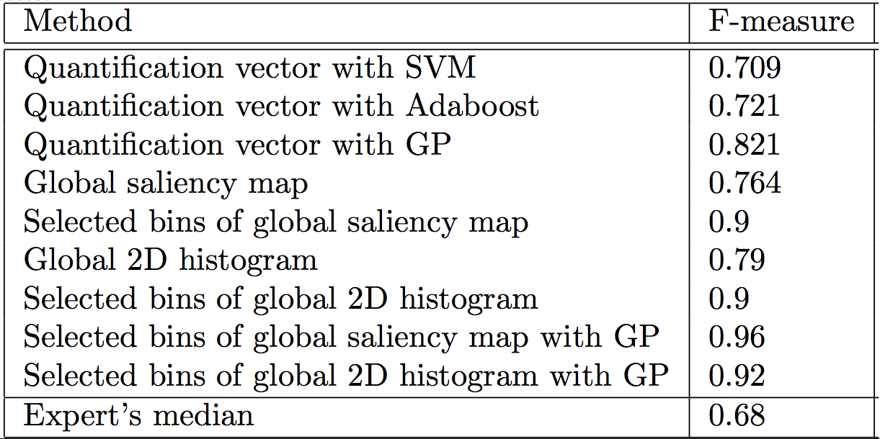
Learning 3D Shape Quantification - Experiment 3
Objective: predict 22q11.2DS
Notes:
This experiment analyzes how the learned GP quantification performed in predicting 22q11.2DS for individuals in the dataset.
The best performing mathematical expression obtained by the GP approach for each of the nine facial abnormalities are evaluated and the resulting values is concatenated into a feature vector of dimension nine
The resulting feature vector is then used to classify each individual in the dataset

Slide 40
Local Search in Continuous Spaces
Given a continuous state space
S = {(x₁,x₂,…,x_{N}) | x_{i} ε R}
Given a continuous objective function f(x₁,x₂,…,x_{N})
The gradient of the objective function is a vector ∇f = (∂f/∂x₁,∂f/∂x₂,…,∂f/∂x_{N})
The gradient gives the magnitude and direction of the steepest slope at a point.

Slide 41
Local Search in Continuous Spaces
To find a maximum, the basic idea is to set ∇f =0
Then updating of the current state becomes
x ← x + α∇f(x)
where α is a small constant.
Theory behind this is taught in numerical methods classes.
Your book suggests the Newton-Raphson method. Luckily there are packages…..

Slide 42
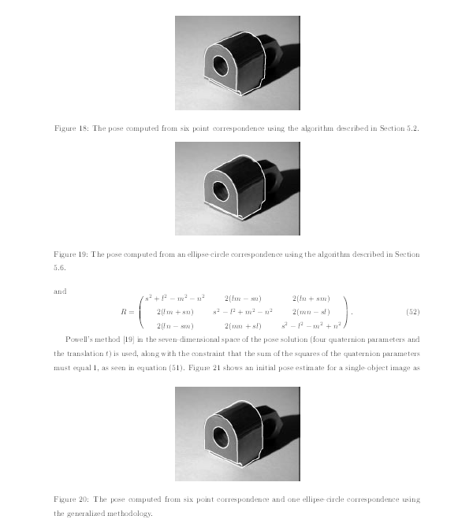
Computer Vision Pose Estimation Example
I have a
3D model
of an object
and an image
of that object.
I want to find
the pose: the
position and
orientation
of the camera.
pose from
6 point
correspondences
pose from ellipse-
circle
correspondence
pose from both
6 points and
ellipse-circle
correspondences

Slide 43
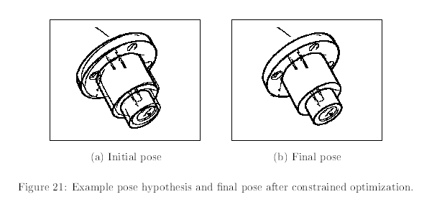
Computer Vision Pose Estimation Example
Initial pose from points/ellipses and
final pose after optimization.
The optimization was searching a 6D space:
(x,y,z,θx,θy,θz)
The fitness function was how well the projection
of the 3D object lined up with the edges on
the image.

Slide 45
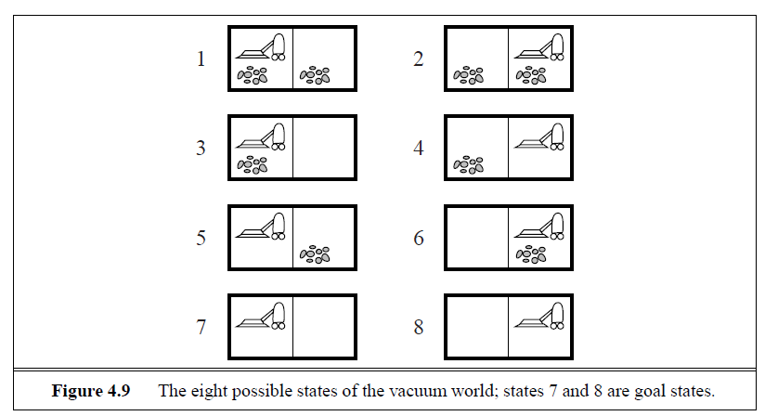
Searching with Nondeterministic Actions
Please read it in the text.
Vacuum World (actions = {left, right, suck})

Slide 46
Searching with Partial Observations
The agent does not always know its state!
Instead, it maintains a belief state: a set of possible states it might be in.
Example: a robot can be used to build a map of a hostile environment. It will have sensors that allow it to “see” the world.

Slide 47
Online Search Problems
Active agent
  executes actions
  acquires percepts from sensors
  deterministic and fully observable
  has to perform an action to know the outcome
Examples
  Web search
  Autonomous vehicle

