Slide 1
Neural Networks
Nov 2022
Beibin Li

Slide 2
Summary
CNN
Image Classification
Segmentation, Detection, Generation
RNN
Transformer
RL
PyTorch

Slide 3
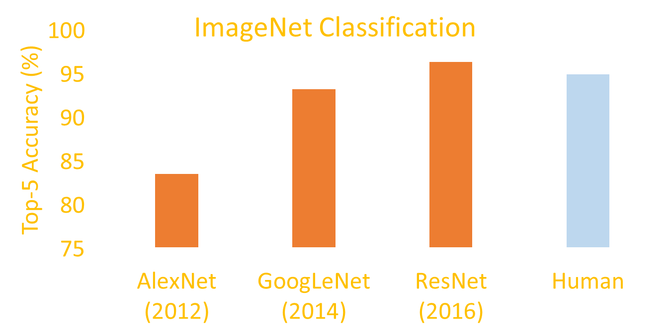
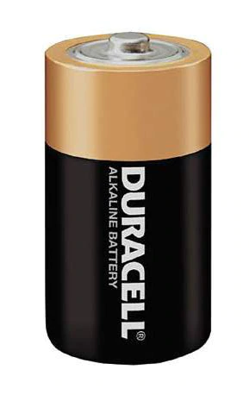
Introduction
Accuracy improves
Speed reduces
Energy consumption increases
8 Layers
22 Layers
151 Layers
Network Depth
Notes:
In last few years, deep neural networks have attained human-level performance across several tasks. However, these deep networks are slow and power hungry.

Slide 4
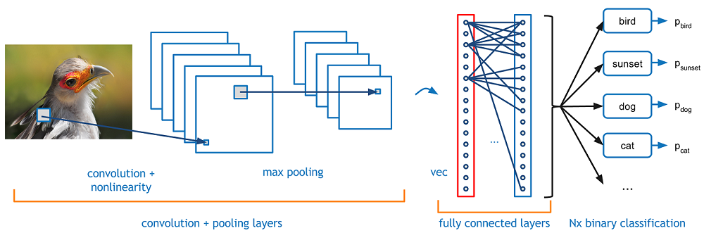
CNN

Slide 5
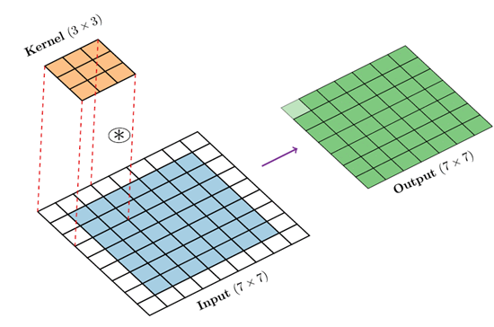
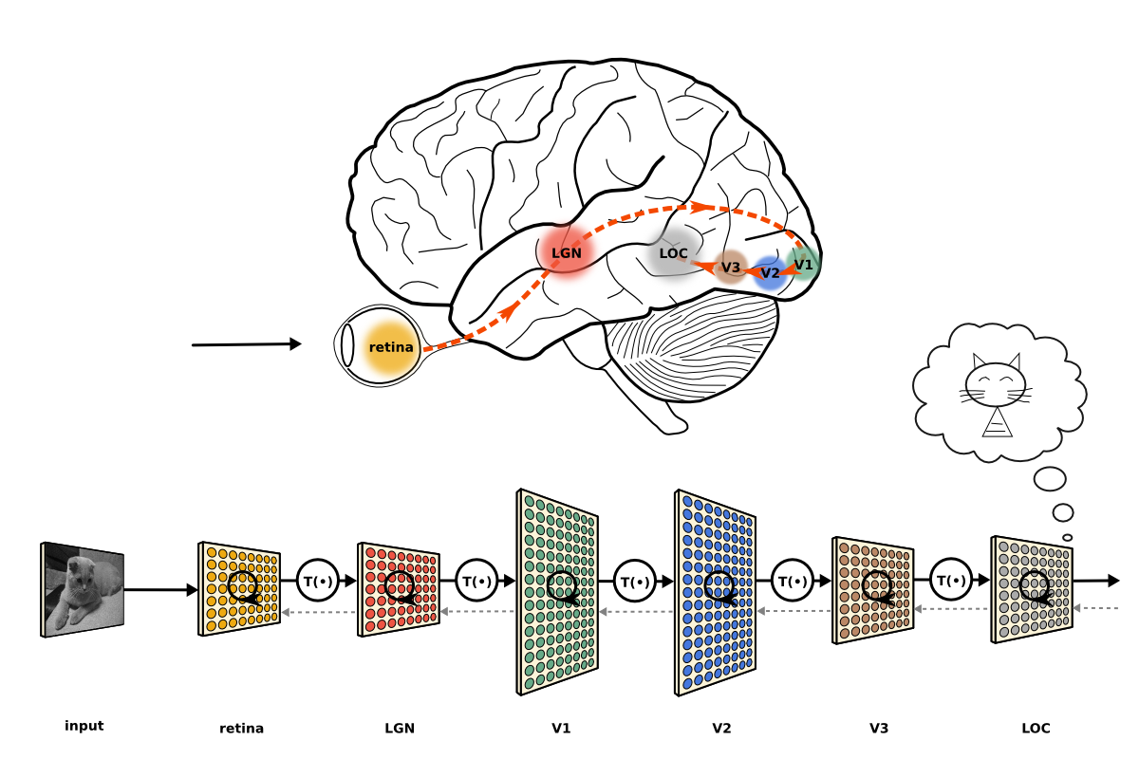
Convolution Operation
Nowadays, we learn kernels from the data.

Slide 6
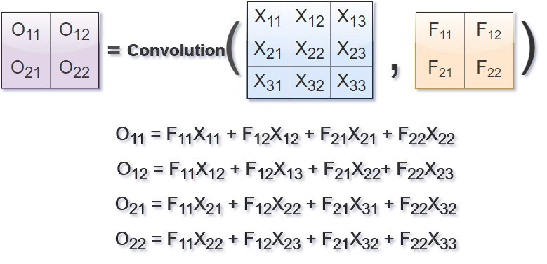
Learning
Details:
https://www.slideshare.net/EdwinEfranJimnezLepe/example-feedforward-backpropagation
https://medium.com/@2017csm1006/forward-and-backpropagation-in-convolutional-neural-network-4dfa96d7b37e

Slide 7
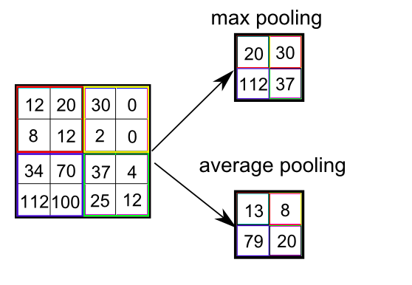
Pooling
e.g. kernel size = 2, stride = 2 for both width and height.

Slide 8
CNN Structures
Image Classification

Slide 9
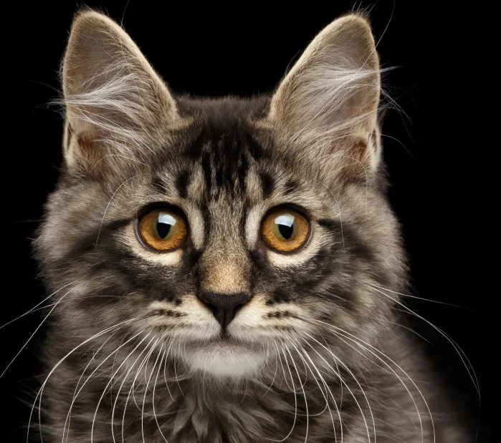
Image Classification
CU
Convolutional
Unit
FC
Fully-connected
Or Linear Layer
DU
Down-sampling
Unit
GAP
Global Avg.
Pooling
CU
DU
CU
DU
CU
GAP
FC
Cat
28 x 28
= [28]²
[28]²
[14]²
[14]²
[7]²
[7]²
[1]²

Slide 10
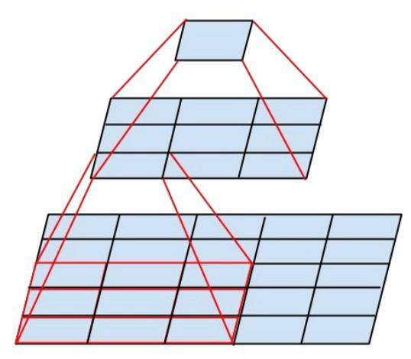
Convolutional Unit (CU) - VGG
3x3 Conv Layer
3x3 Conv Layer
Image Source (Inception): Szegedy, Christian, et al. "Rethinking the inception architecture for computer vision." CVPR. 2016.

Slide 11
Basic Block in ResNet
ResNet: He, Kaiming, et al. "Deep residual learning for image recognition." CVPR. 2016.
3x3 Conv Layer
Residual Connection
Element-wise addition of input and output
Improves gradient flow and accuracy
In ResNet-18 and ResNet-34
Still computationally expensive
Hard to train very deep networks (> 100 layers)
3x3 Conv Layer

Slide 12
Bottleneck in ResNet
1x1 Conv Layer
Used in ResNet-50, ResNet-101, ResNet-152, etc...
Computationally Efficient
Influence:
Bottleneck unit with Depth-wise convs
MobileNetv2
ShuffleNetv2
MobileNetv2: Sandler, Mark, et al. "Mobilenetv2: Inverted residuals and linear bottlenecks." CVPR, 2018.
ShuffleNetv2: Ma, Ningning, et al. "Shufflenet v2: Practical guidelines for efficient cnn architecture design." ECCV, 2018.
3x3 Depth-Conv Layer
1x1 Conv Layer

Slide 13
CNN Structures
Segmentation, Detection, Generation

Slide 14
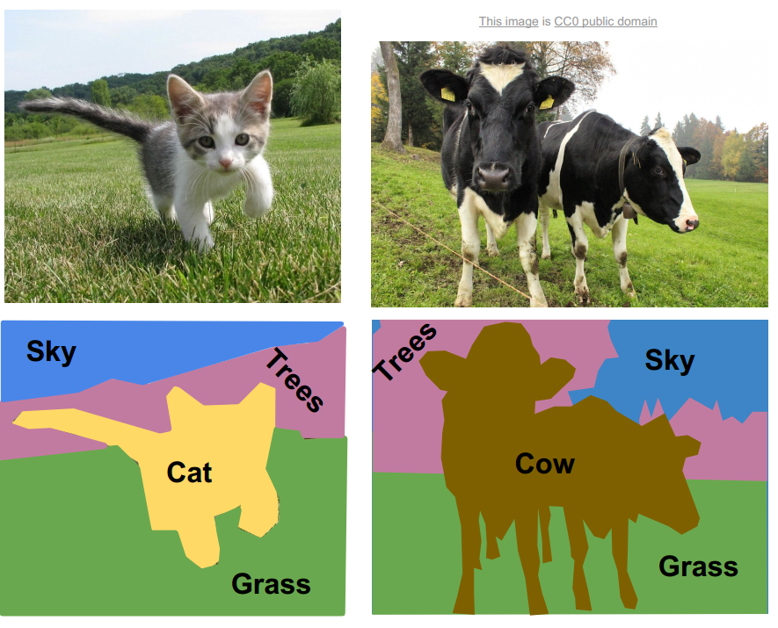

Slide 15
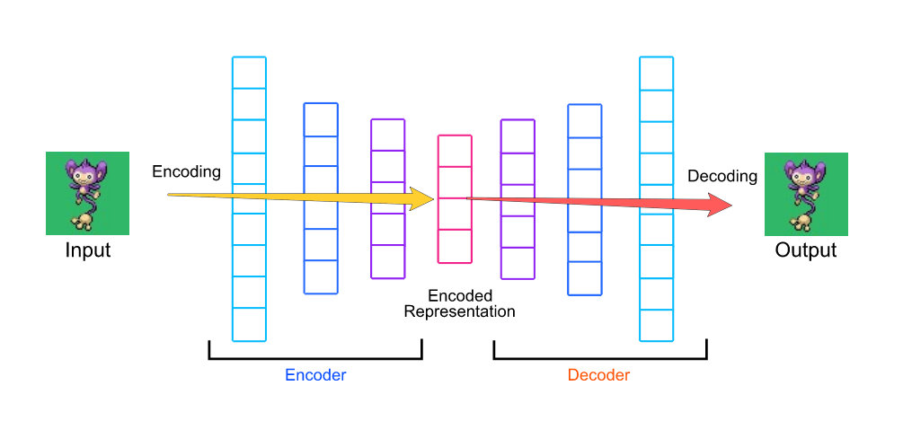
Encoder-Decoder

Slide 16
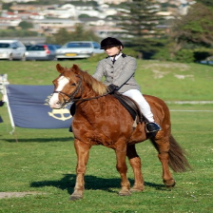
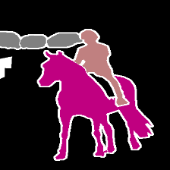
Encoder-Decoder in Semantic Segmentation
CU
DU
CU
DU
CU
CU
UU
CU
UU
UU
Up-sampling
Unit
CU
Convolutional
Unit
FC
Fully-connected
Or Linear Layer
DU
Down-sampling
Unit
GAP
Global Avg.
Pooling

Slide 17
U-Net
CU
DU
CU
DU
CU
CU
UU
CU
UU
UU
Up-sampling
Unit
CU
Convolutional
Unit
FC
Fully-connected
Or Linear Layer
DU
Down-sampling
Unit
GAP
Global Avg.
Pooling

Slide 18
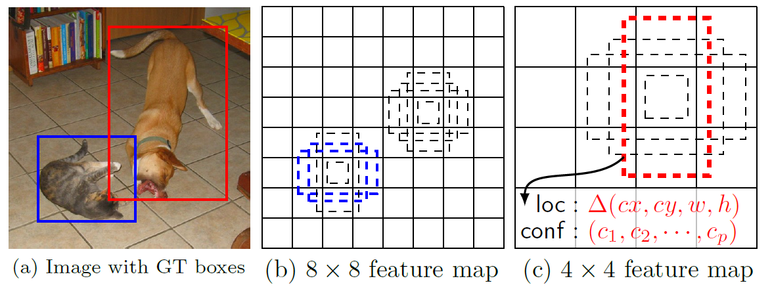
Faster R-CNN
Notes:
https://www.mathworks.com/help/vision/ug/getting-started-with-r-cnn-fast-r-cnn-and-faster-r-cnn.html
https://towardsdatascience.com/review-ssd-single-shot-detector-object-detection-851a94607d11

Slide 19
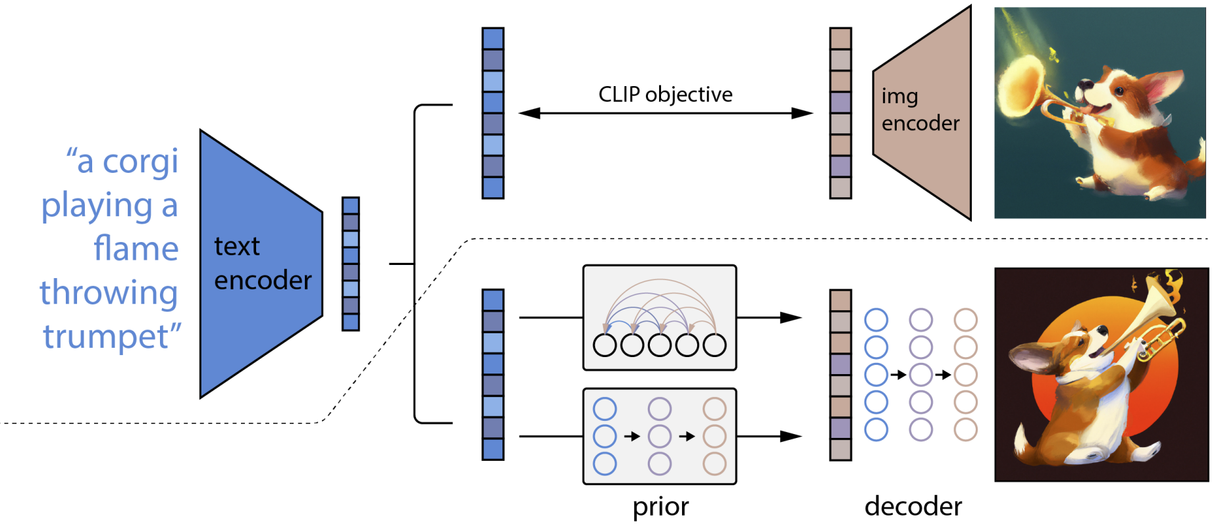
Diffusion (DALL·E 2)

Slide 20
RNN Structures

Slide 21
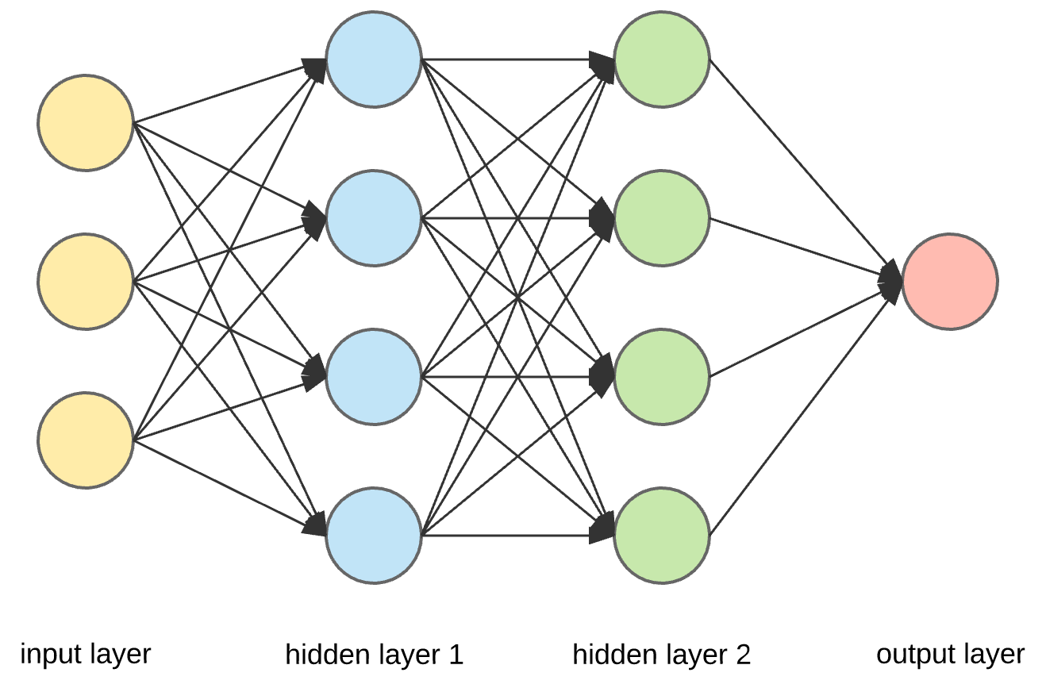
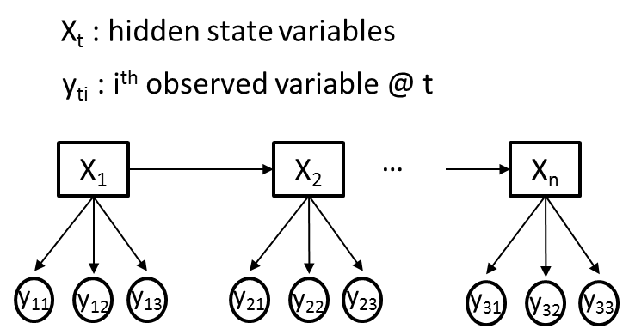
Challenges for time-series signals
Different signal length
Online inference for new timepoint
(Vanilla) Neural Network
1940s - 1980s
Hidden Markov Model
Andrew Viterbi, 1967
Lawrence Rabiner, 1989

Slide 22
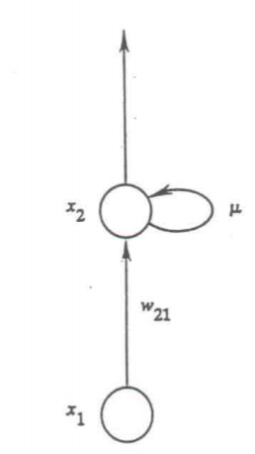
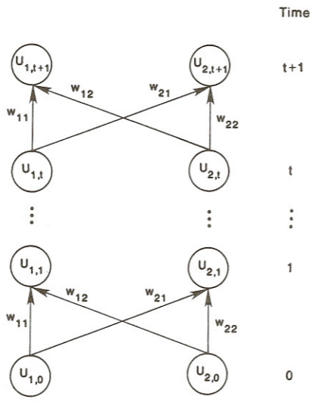
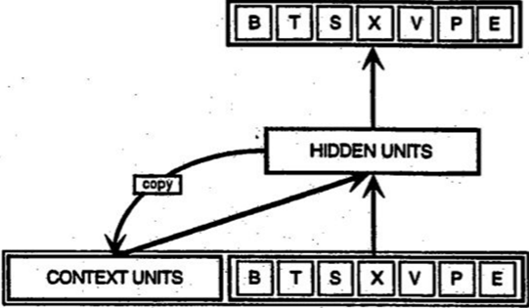
Learning internal representations by error propagation
Rumelhart, Hinton, and Williams (1985)
A parallel distributed processing approach
Jordan (1986)
Graded state machines
Servan-Schreiber, Cleeremans, and McClelland (1991)

Slide 23
Recurrent Neural Network

Slide 24
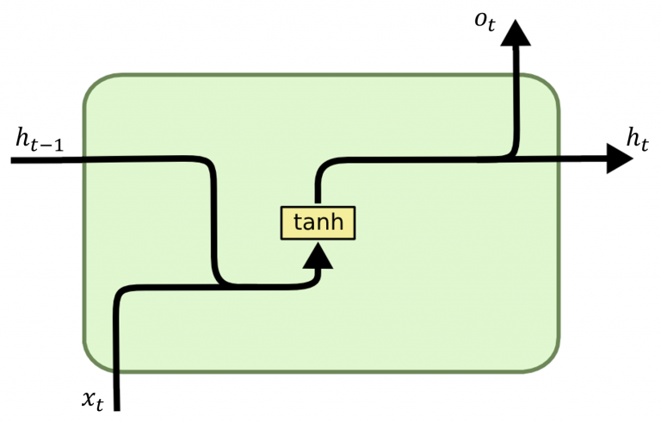
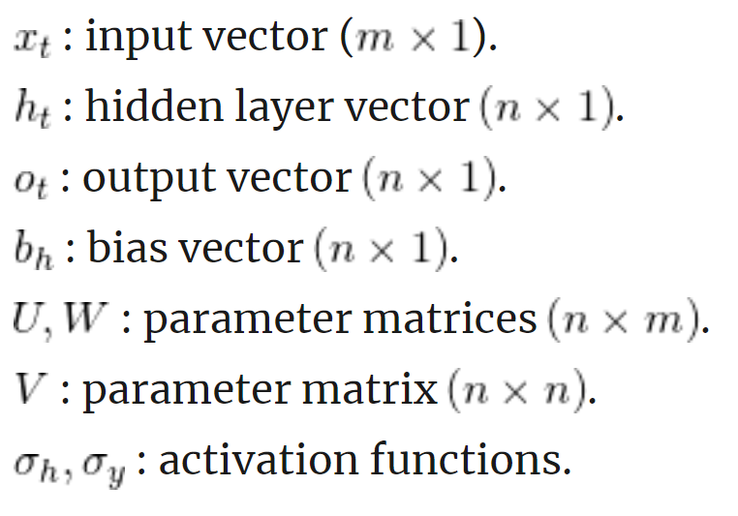
Parameters in Recurrent Neural Network

Slide 25
LSTM and GRU: Memory for RNNs
http://dprogrammer.org/rnn-lstm-gru
https://towardsdatascience.com/grus-and-lstm-s-741709a9b9b1

Slide 26
Seq-2-Seq
Encoder maps a variable-length source sequence (input) to a fixed-length vector
Decoder maps the vector representation back to a variable-length target sequence (output)
Two RNNs are trained jointly to maximize the conditional probability of the target sequence given a source sequence

Slide 27
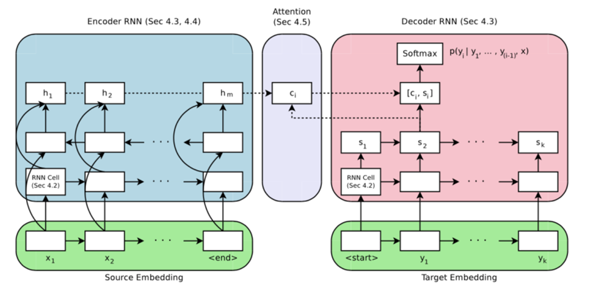
Seq-2-Seq with Attention

Slide 28
Transformer

Slide 29
Limitations of CNN and RNN
“Locality” of the convolution operation
Reduce dimension (compared to fully-connected layers) while maintaining useful local information
It could NOT see two pixels that are far away
“Recurrentness” of recurrent neural network
It can take an input with arbitrary size (length)
“Vanishing of gradient” problem when sequence length is too long (during backpropagation)

Slide 30
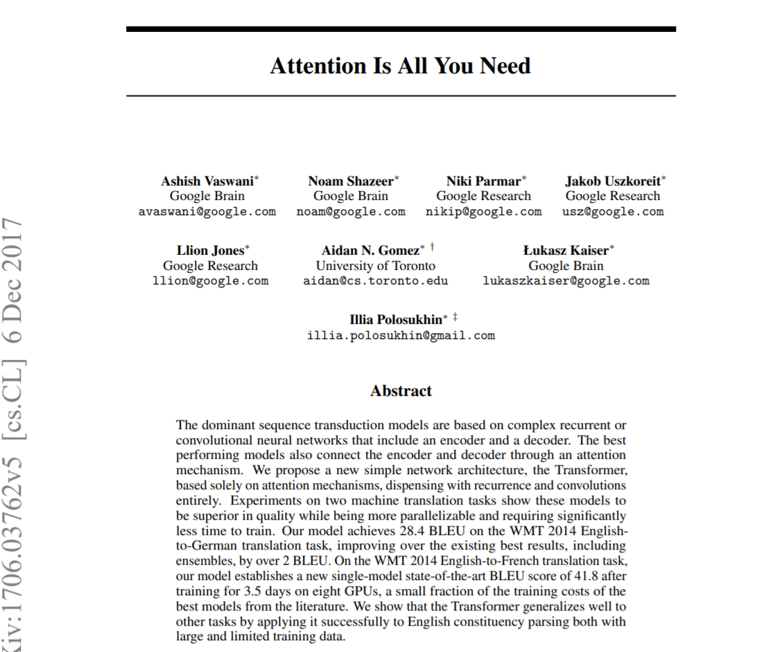
Well, forget about convolution and recurrent
IS ALL YOU NEED

Slide 31
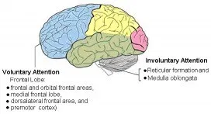
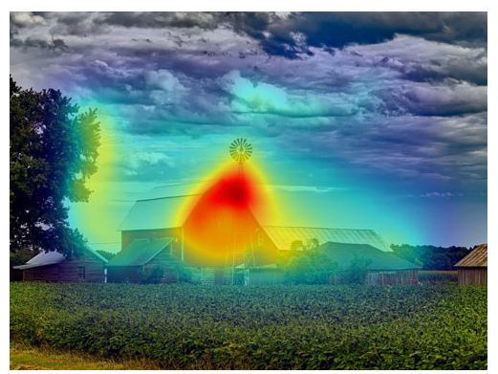
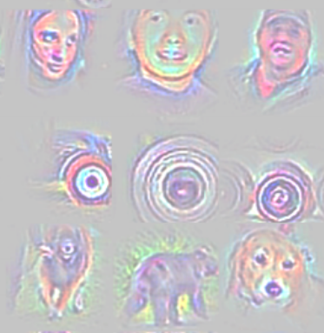
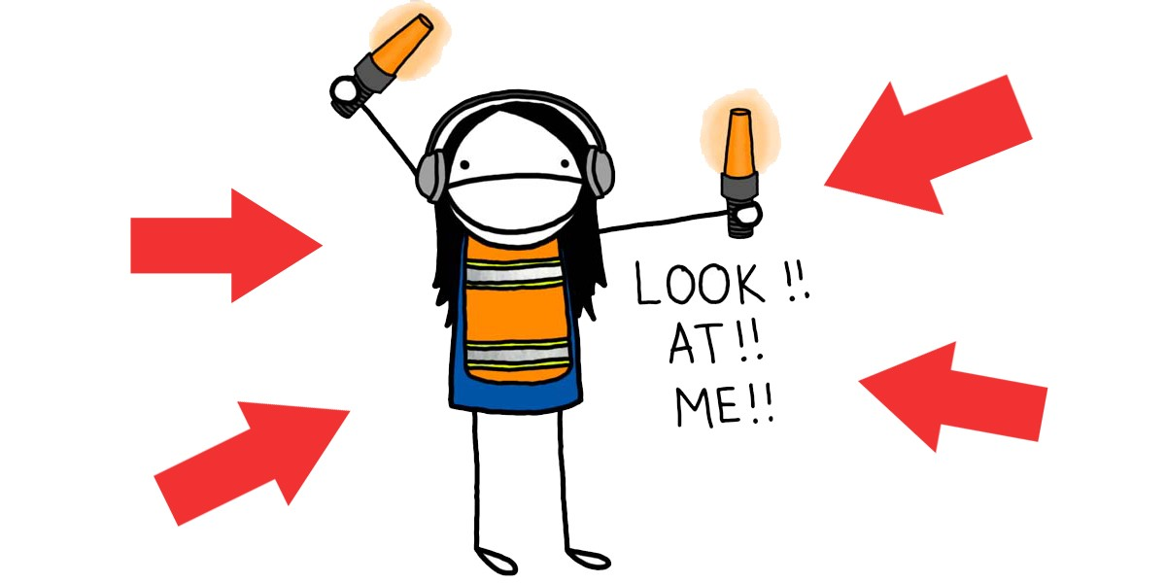
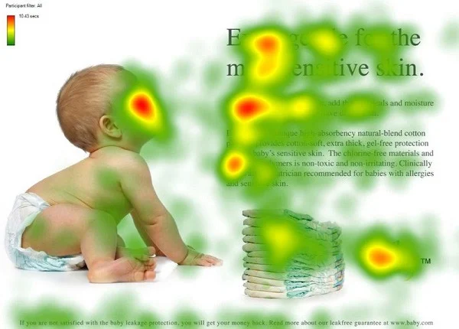
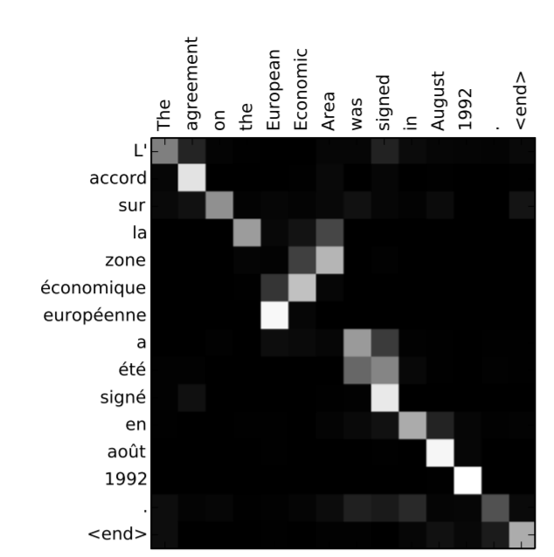
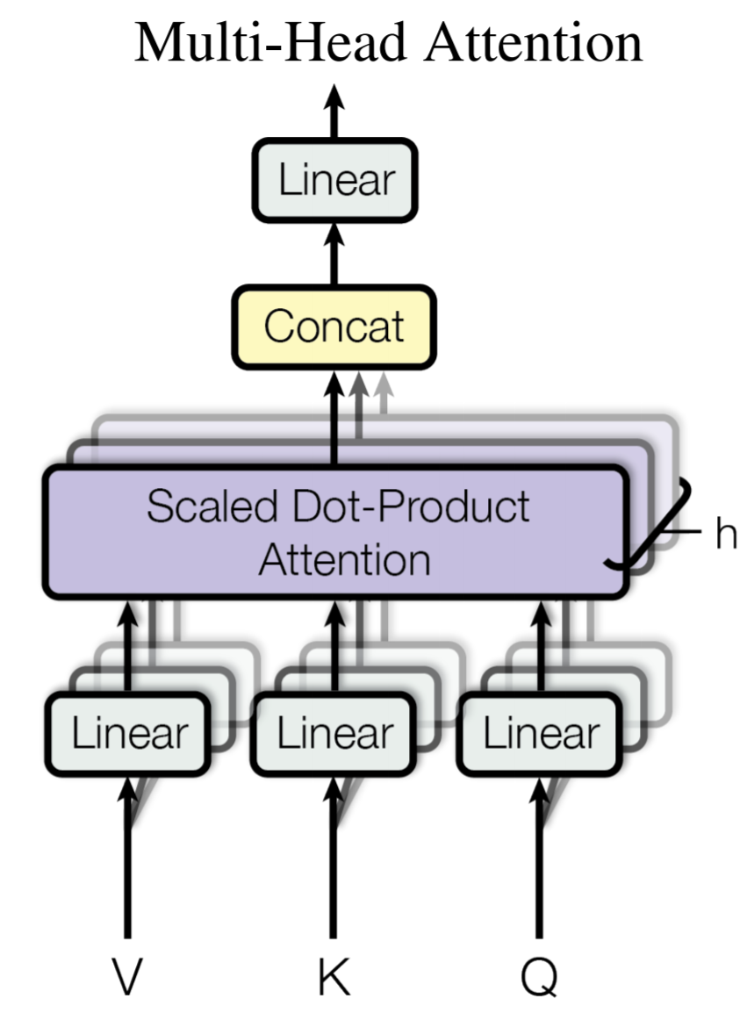
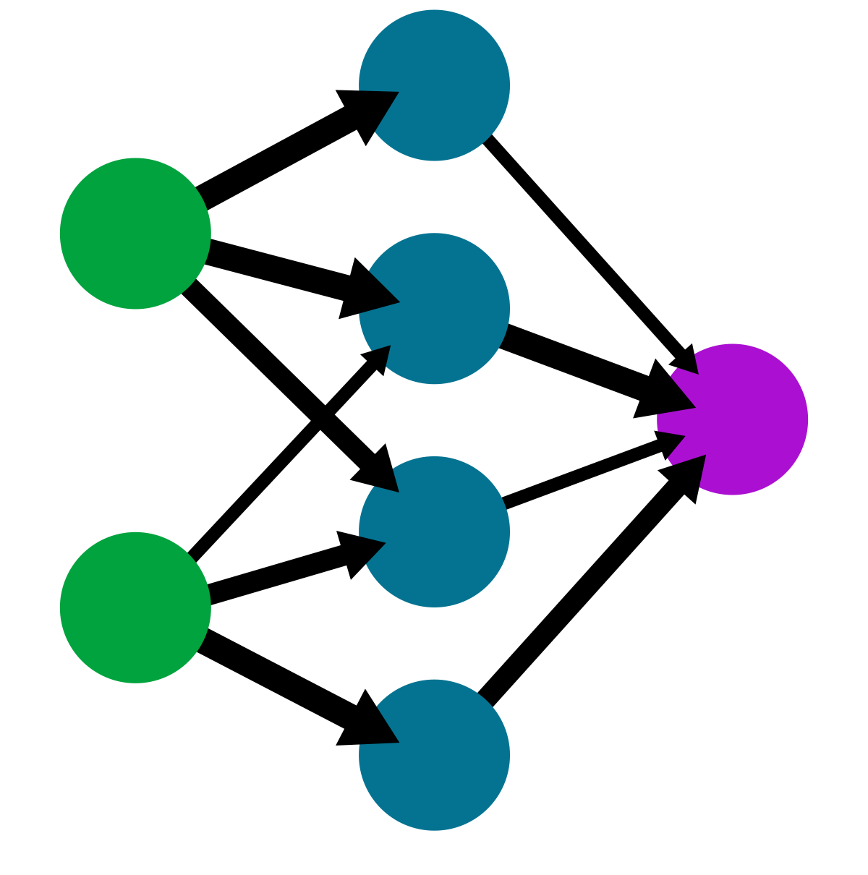
What is attention?
Computer Vision
(Saliency Map)
Computer Vision
(Backpropagation)
Psychology
Eye-tracking
Value, Key, Query
Neural Network
(weights)
Transformer
NLP (align)
Bahdanau, Cho, Bengio, 2015, ICLR

Slide 32
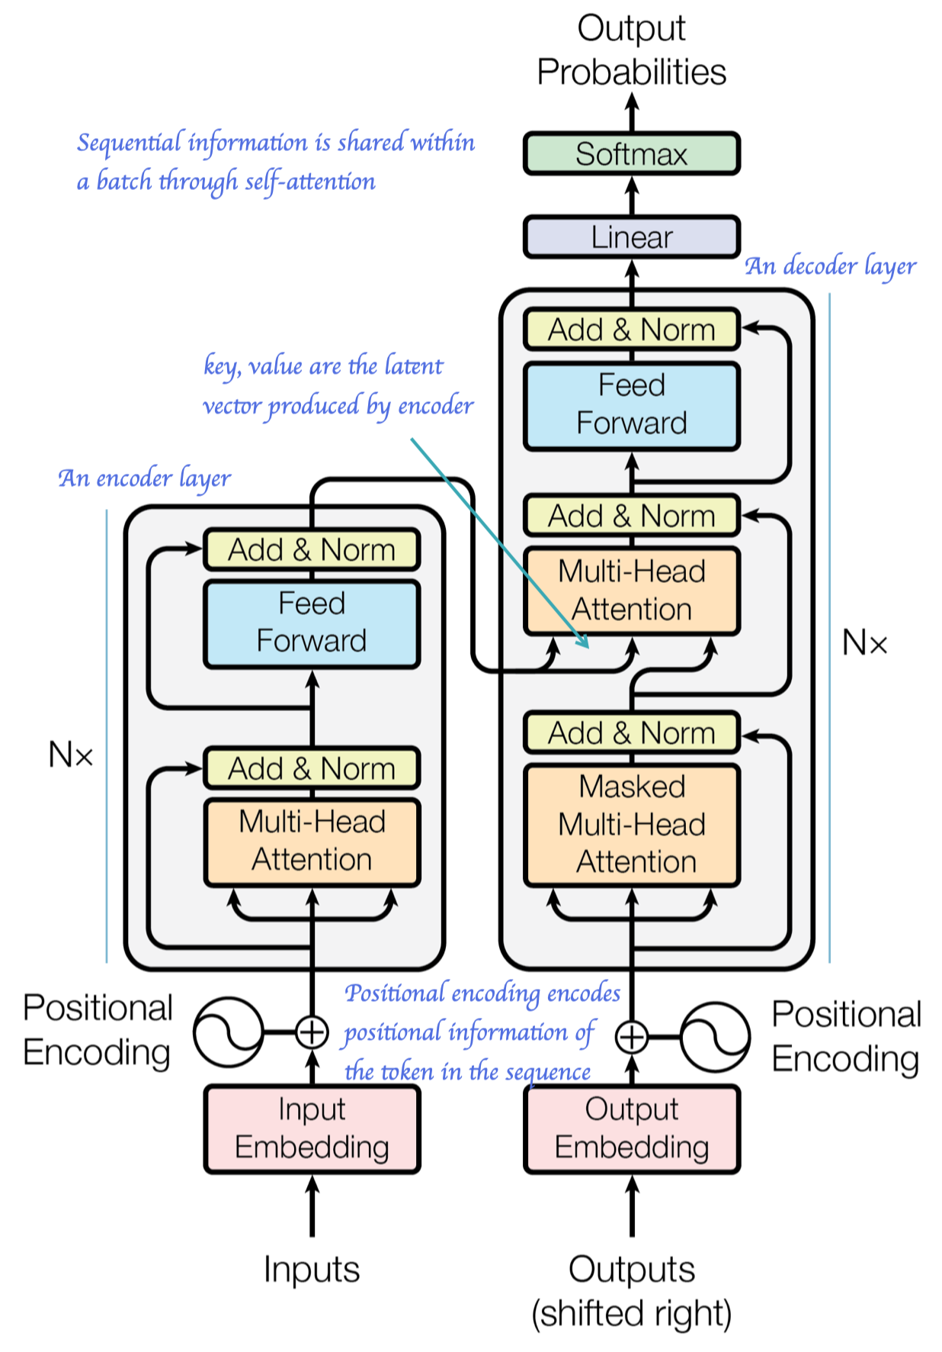
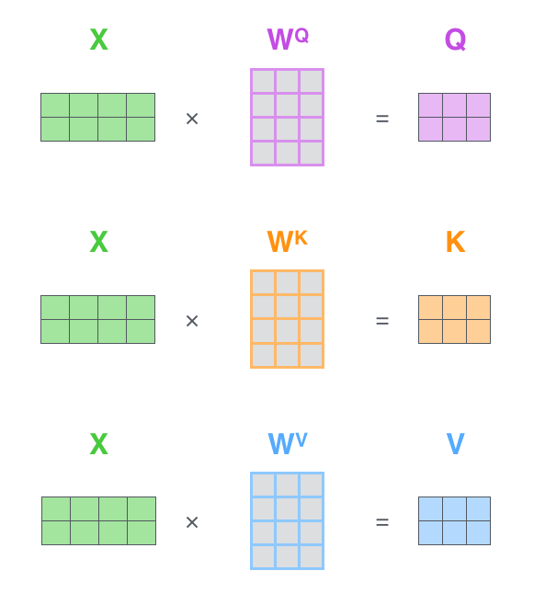
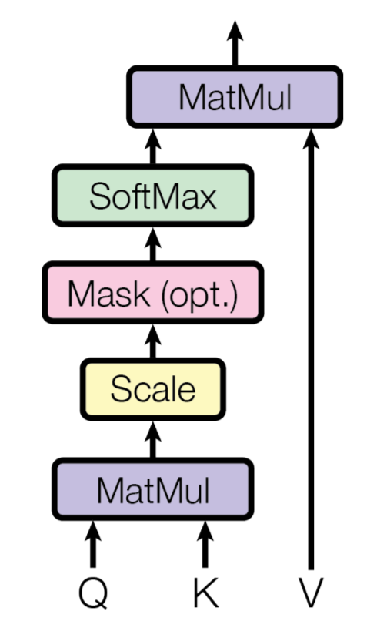
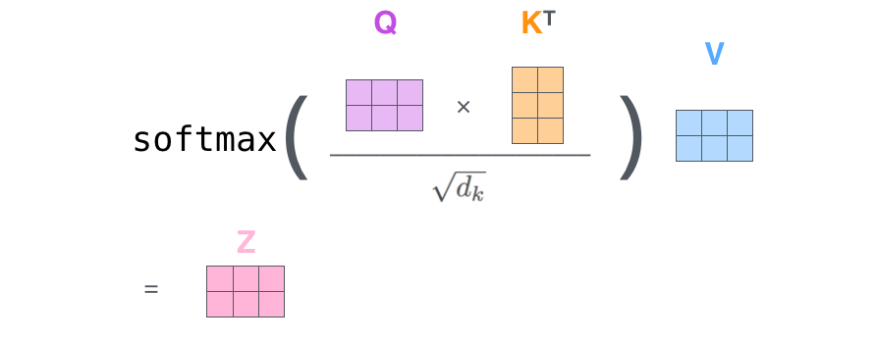
http://jalammar.github.io/illustrated-transformer/

Slide 33
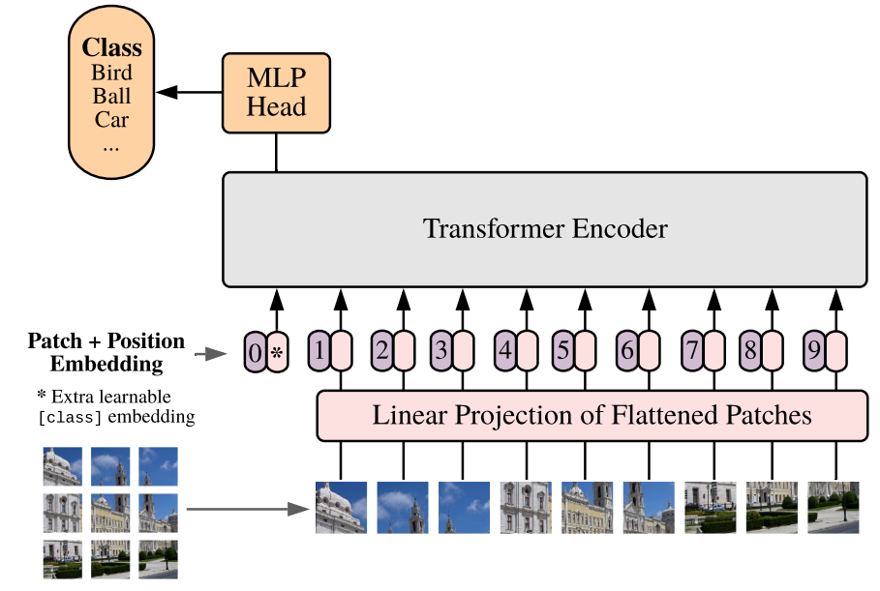
Vision Transformer

Slide 34
Limitations of Transformer
It cannot learn hierarchical features efficiently (while CNN can)
It cannot model periodic finite-state language (while RNN can)
It requires lots for computer memory
Solution: efficient transformers, e.g., BigBird, Longformer, etc.
It requires more training data than CNN/RNN
Not a big problem for natural images
Solution: smarter architecture design and learning paradigms for low-resource datasets
Solution: self-supervised learning, transfer learning, etc.

Slide 35
NN for RL

Slide 36
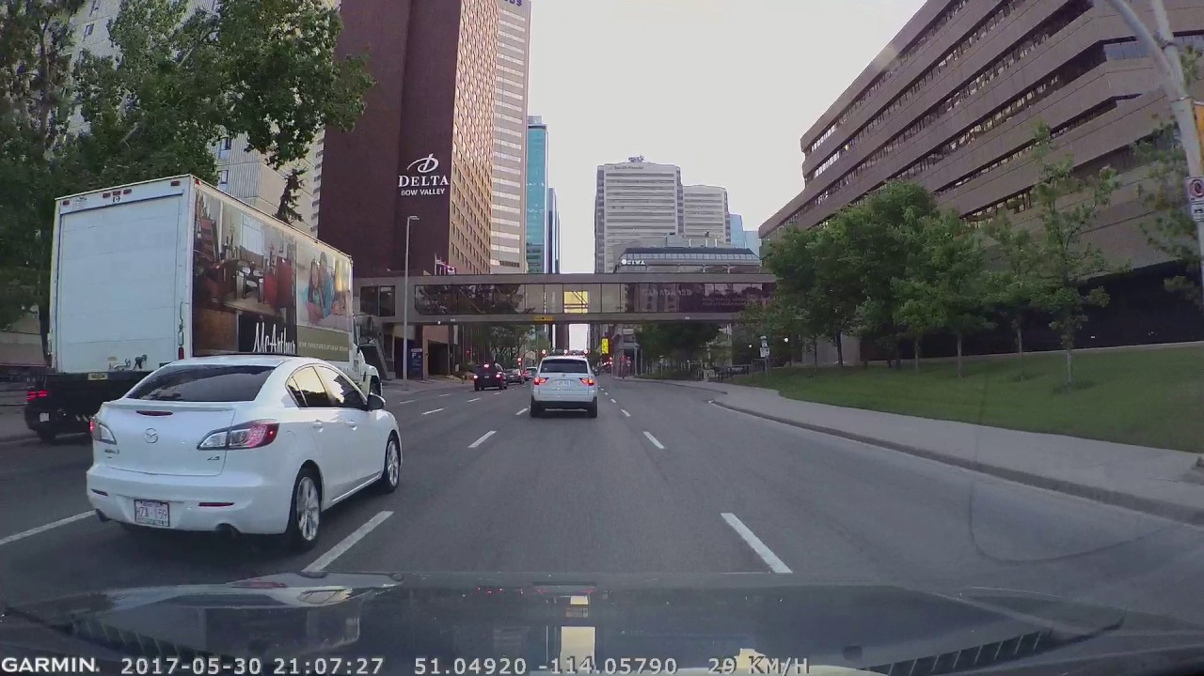
Which Direction
Regression:
Angle = [ -540°, 540°]
Classification:
Turn left
Turn right
Stay Still

Slide 37
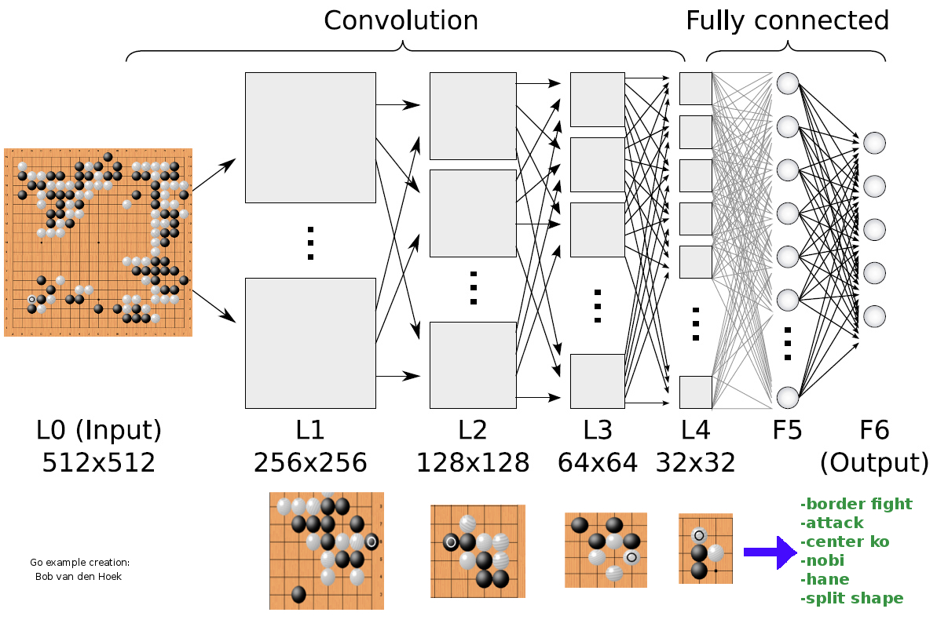
Which Move

Slide 38
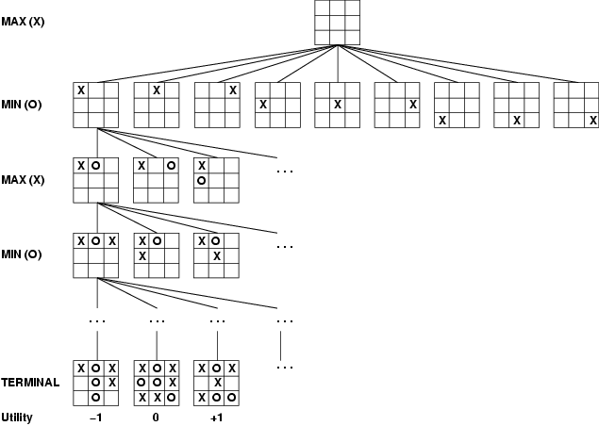
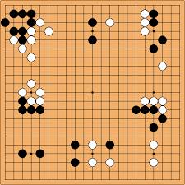
Design Utility Function
We can train a CNN to replace the manual utility function
Utility = CNN( )

Slide 39
AlphaZero
ResNet backbone
Policy Network
Value Network

Slide 40
Monte Carlo Tree Search
Active Learning to balance Exploration v.s. Exploitation

Slide 41
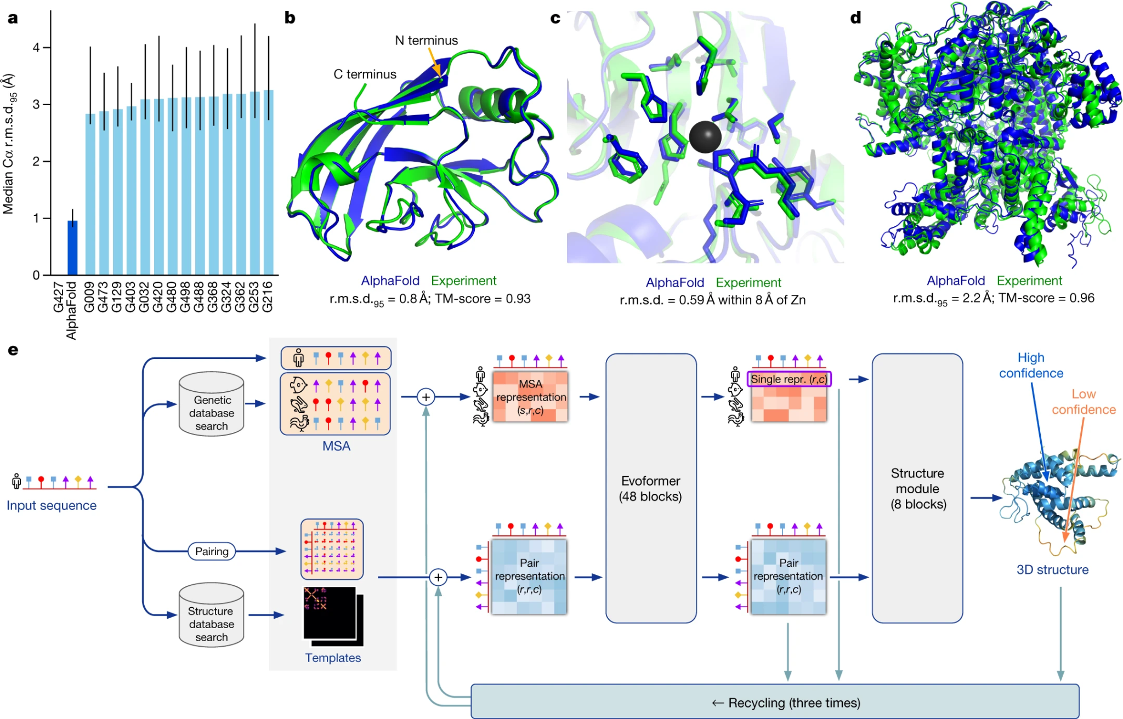
Alpha Fold

Slide 42
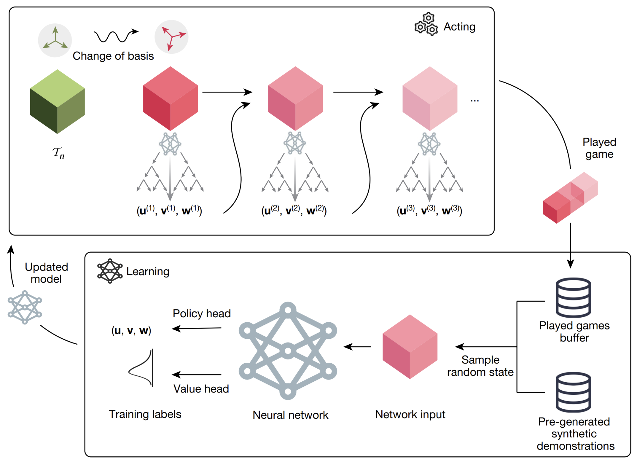
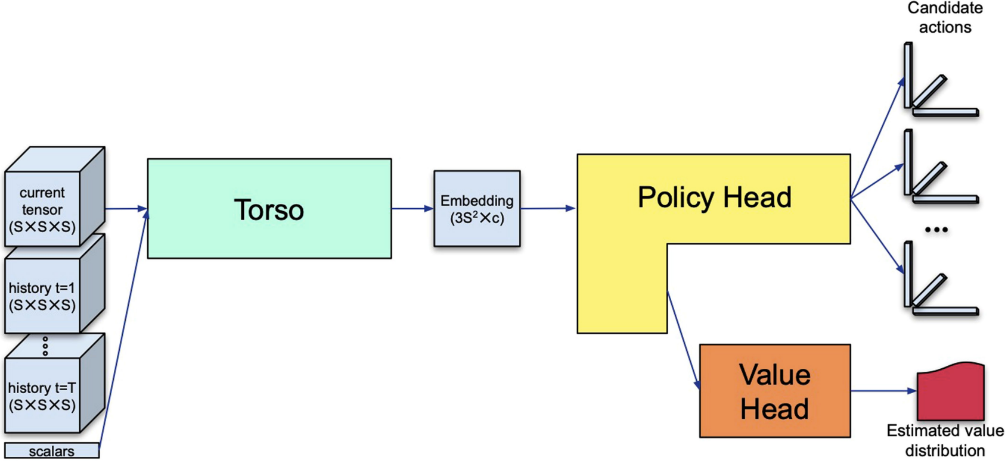
RL Applications: Alpha Tensor

Slide 43
Intro to PyTorch

Slide 44
Deep Learning Libraries

Slide 45
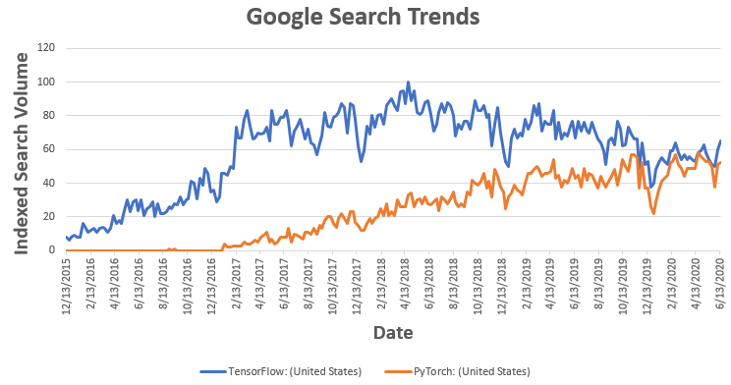
Deep Learning Frameworks
Before 2012: custom C++, MatLab, R, Lua, … code.
Only limited libraries/functions
You need to do most things yourself
MXNet (2015)
TensorFlow (2015)
Caffee (2015)
Torch (2002): Lua
PyTorch (2016)

Slide 46
Why PyTorch
Autograd
Dynamic computational graph
Debugging is easier!
Data Parallelism (multiple GPU)
Pythonic-syntax (Python)
Multiple language support: Python, C++, Java
Many more!

Slide 47
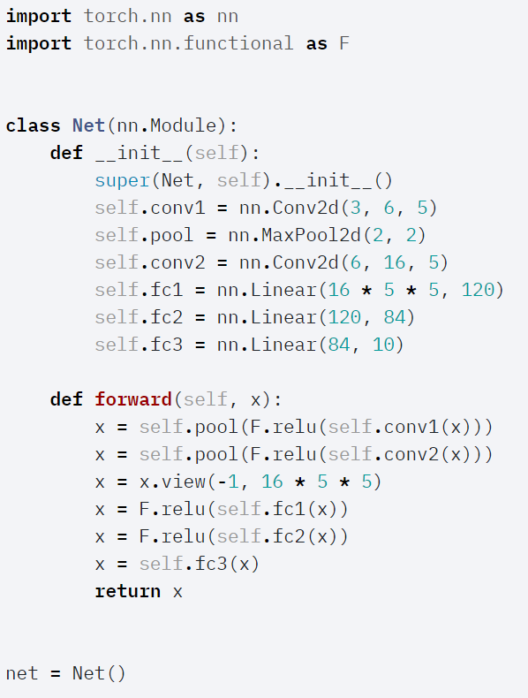
Model Definition

Slide 48
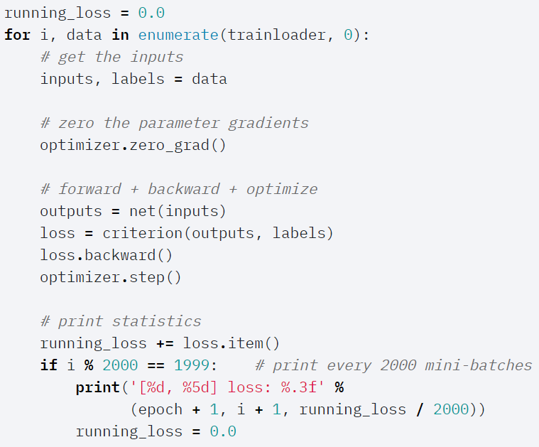
Training a model

Slide 49
Homework 4
Convolutional Neural Networks
In PyTorch

Slide 50
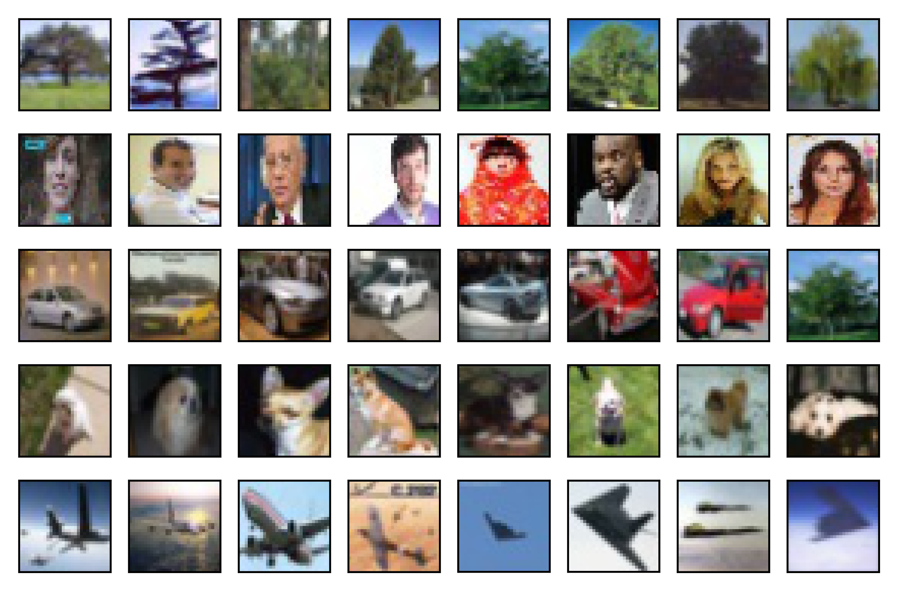
Which Object?
Image Classification:
Tree
Face
Car
Dog
Plane
Training set: 90 images per cls
Testing set: 10 images per cls

Slide 51
Neural Network (Q1)

Slide 52
Convolutional Neural Network (Q2)
Conv
Pool
FC
Cross Entropy

Slide 53
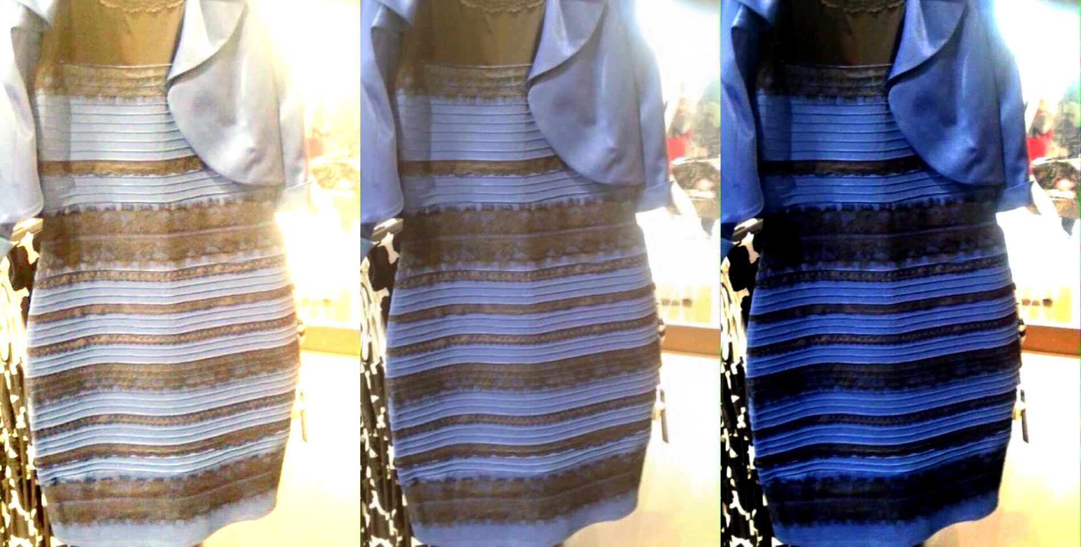
Color Normalization (Q3)

Slide 54
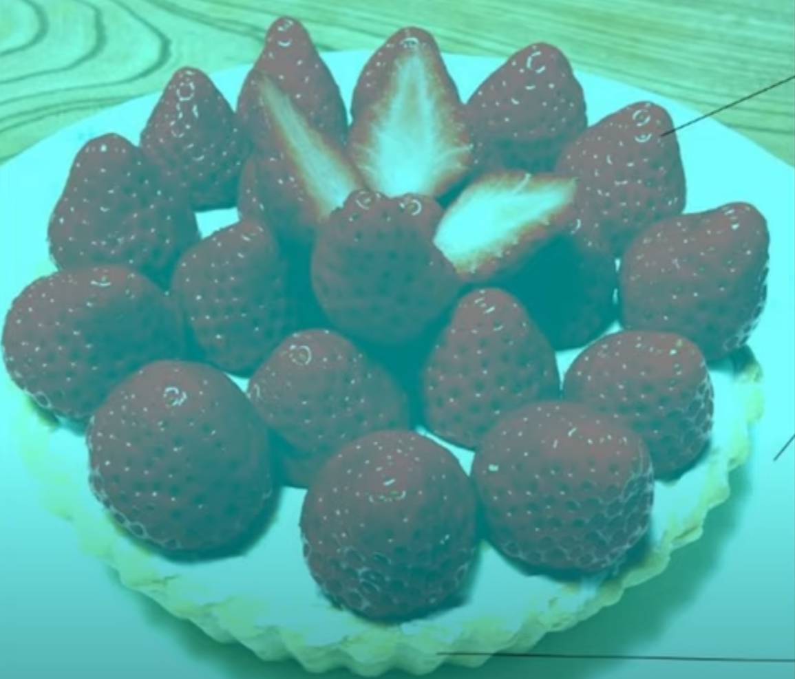
What’s the Color of the Strawberry

Slide 55
Deep Convolutional Neural Network (Q4)

Slide 56
Make the Design More Flexible
Input:
[8, 16, 32, "pool"]

Slide 57
Data Augmentation (Q5)
Random Affine Transformation

